Slide 1
Cryptography
Lecture 1
Arpita Patra

Slide 2
Welcome to the second Half of the Course ☺
Course Homepage: http://drona.csa.iisc.ernet.in/~arpita/Cryptography15.html
Katz & Lindell: Introduction to Modern Cryptography, 2nd Edition, CRC Press.
Buy one, a great book.

Slide 3
Evaluation Policy (2nd Half)
Use it for a better cause than grading:
Enhance our learning process
Nurture qualities of a good cryptographer
Four Pillars of Evaluation
Depth
Breadth
Presentation- Oral
Presentation- Written
Class Attentiveness
Scribe (5%) | Chalk & Talk (10%) | Assignments (20%) | Final Exam (15%)
✔
✔
✔
✔
✔
✔
✔
✔
✔
✔
2 students / lecture
2 sessions / week: Friday 8-9:30 am
1 evaluation / three weeks
1 evaluation

Slide 4
Let’s start the exciting Journey of Cryptography
Well, you have already started.
Let’s see where we stand so far and where we are heading to

Slide 5

Why Cryptography?
Tool to control access to information; tool to enforce policies who can learn/influence information
Ethical Cryptographer: Protect Good from Bad

Slide 6
Crypto: Past and Present
Until 1970s
After 1970s and Until Now
Message Communication
Authenticated Message Communication
E-cash
Cryptography: Study of mathematical techniques for securing digital information, systems and distributed computation against adversarial attacks
E-election, E-auction
Activism with Safety
Secure Storage, Disk encryption
Secure Information Retrieval
Secure outsourcing to Cloud
……….and the list goes on
All these fall under the purview of Cryptography

Slide 7
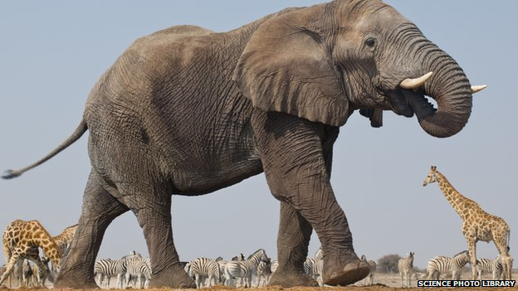
Crypto Zoo
Real life Applications: Including previous ones
Homomorphic Encryption
Primitives:
Functional Encryption
Deniable Encryption
Multiparty Computation
Stream Cipher
PRP
Symmetric Key Encryption
Leakage Resilient Crypto
Commitment Schemes
SPRP
Oblivious Transfer
PRG
Secret Sharing
Key Agreement
Key Derivation
SPRP
Zero Knowledge Proofs
Public Key Encryption
PRF
Blind Signature
Obfuscation
Key Agreement
Block Cipher
One way Function
Digital Signature
Authenticated Encryption
One way permutation
Hash Functions
MAC
Assumptions: Number Theoretic/crude assumptions like AES/DES are secure PRF schemes, SHA 3 secure hash function etc.
Slide Idea courtesy: Manoj Prabhakaran
Notes:
Cryptomania & Minicrypt

Slide 8
Impagliazzo’s Crypto World: Crytomania & Minicrypt
Minicrypt assumes One way Function (OWF) exists and encompasses all that can be built from OWF: Symmetric Key Cryptography, Signatures, Commitments….
Cryptomania assumes Oblivious Transfer (OT) exists and encompasses all that can be built from OT: Almost everything that you can imagine in crypto
A big chunk of Cryptomania will be covered in my next course CSA E0 312 “Secure Computation” – Aug-Dec’15
Notes:
OWF lovers, you can’t a lot of things.

Slide 9
Three Key Principles of Modern Crypto
Perfect security
Principle 1:
Formulation of rigorous and precise definition of security capturing requirement. Just having intuition is not enough.
Principle 2:
Rely on well-studied assumption.
Principle 3:
Construct scheme with rigorous proof of security

Slide 10
Our lookout in this course
Secure Message Communication
Message Authentication/Integrity
Symmetric/Private/Shared Key Setting
Asymmetric/Public Key Setting
Hash Function – How to compress a message
Key Agreement – How to agree on a key
>> How to construct a formal definition
>> Various Formal Security Definitions
>> Constructions and Security Proof

Slide 11
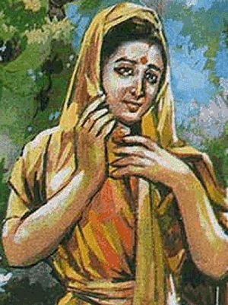



Secure Communication in Private Key Setting
m
m
c
m
Encryption
Decryption
k
??
k
Secret key k shared in advance (by “some” mechanism)
m is the plain-text
c is the cipher-text (scrambled message)
Symmetry: same key used for encryption and decryption

Slide 12
Syntax of SKE
Key-generation Algorithm (Gen()):
Outputs a key k chosen according to some probability distribution determined by the scheme;
MUST be a Randomized algorithm
2. Encryption Algorithm (Enc_{k}(m)); m from {0,1}*:
c ← Enc_{k}(m) when randomized and c:=Enc_{k}(m) when deterministic
Deterministic/Randomized algorithm
3. Decryption Algorithm (Dec_{k}(c)):
Outputs m:= Dec_{k}(c)
Usually deterministic
Notes:
Gen is not randomized. Kerchoffs Principle the security should hold when all algorithms are public. The adversary also knows which key will be output by the Gen. No Security can be obtained.

Slide 13

Syntax of SKE
Any cipher defines the following three space (sets):
Key space ( ):
Set of all possible keys output by algorithm Gen
Usually Gen selects a key k uniformly at random from
2. Plain-text (message) space ( ):
Set of all possible “legal” message (i.e. those supported by Enc)
3. Cipher-text space ( ):
Set of all cipher-texts output by algorithm Enc
The sets and together define the set
Any cipher is defined by specifying (Gen, Enc, Dec) and
Notes:
M is independent of the scheme so it should be a part of the description. Other sets are subsumed in the triple algorithms description.

Slide 14

Towards Defining Security of SKE
Two components of a security definition:
Threat:
>> Who is your threat?
>> Who do you want to protect from?
>> Cultivate your enemy a.k.a adversary in crypto language.
>> Look out in practical scenarios / be an adversary
>> Unless you know your adv, no hope of defeating him
Break:
>> What are you afraid of losing?
>> What do you want to protect?
>> If you don’t know what to protect then how to do you
when or if you are protecting it?
>> Means different for different task

Slide 15




Threat Model
How powerful
How powerful computationally?
What are his capabilities?
Unbounded Powerful
Computationally Bounded
Pr [M = m | C = c] = Pr [M = m] ∀ m, c
Guarantee: “The SKE cannot be broken with probability better than 2⁻⁸⁰ in 200 yrs with the fastest supercomputer. (But can be broken in theory)
Two relaxations:
>> Bounded Adversary
>> Probability of sucess
Perfect/Shannon Security
Computational Security
Posteriori probability that m is encrypted in c
a priori probability that m will be sent
Key as large as the message
A small key will do
Fresh key for every encryption
Key reuse is permitted.
Notes:
Only nerds do Perfect/information theoretic security.

Slide 16
Computational Security of SKE
Computational security --- two relaxations to perfect-security
Bounded resource/ efficient adversaries
2. Adversaries can break the scheme with some very small probability, which is so small that we do not bother
Is it necessary to incorporate these two relaxations ?
YES Absolutely!
Will see towards the end of this class
Notes:
Computational Security is the de facto way of defining security in cryptography.

Slide 17
Making “Efficient” and “Very Small” Precise– Asymptotic Approach
>> Security parameter n --- publicly known (part of the scheme)
Our SKE cannot be broken with probability better than 2^{-n} by adversary with n¹⁰ running time.
Running time of the users
Running time of the attacker
Success probability of the attacker
Functions of a security parameter n
>> Typically it is the size of secret-key (ex: n = 128, 256, etc)
1. “Feasible” /“Efficient” / “Probabilistic Poly time (PPT)” means :
Ex: 2^{-n}
Recall the properties of negl functions
running time is O(n^{c}) for some constant c
2. “ Very Small” / “negligible” means those f(n) :
for every constant c, there exists some N, such that f(n) < n^{–c} , for all n > N
“eventually becomes 0”, “grows slower than any inverse poly”

Slide 18
Choosing n Carefully is Very Essential
A designer claims that an adversary running for n³ minutes can break his scheme with probability 2⁴⁰ 2^{-n}
2⁴⁰ 2^{-n} is negligible --- hence secure scheme
But what value of n to select while implementing ?
If n ≤ 40 then an adversary working for 40³ minutes (6 weeks) can break the scheme with probability 1
--- completely useless
: adversary working for 50³ minutes (3 months) succeed with probability 1/1000
n = 50 ?
--- may be unacceptable
n = 500: adversary working for 200 yrs can break the scheme with probability 2⁻⁴⁶⁰
--- definitely acceptable

Slide 19

n = Knob
User’s running time is also increasing ☹
Adv’s job becomes harder ☺
min
max
n

Slide 20
Concrete Approach
>> Set the value of n
>> Run users and adversary on specific machines
No adversary running for 5 yrs on 4GHz Machine can break the scheme with probability better than 2⁻⁶⁰
Concrete Statement 1
Concrete Statement 2
Asymptotic Statement
……
☑
Concrete Statement n
Asymptotic Approach
☒
Concrete Approach

Slide 21
Threat Model
How powerful
How powerful computationally?
What are his capabilities?
Unbounded Powerful
Computationally Bounded
Perfect/Shannon Security
Computational Security
Key as large as the message
A small key will do
Fresh key for every encryption
Key reuse is permitted.

Slide 22
Threat Model
Weakest: Ciphertext-only Attack
m
c
Enc
??
k
k
If you are thinking this is the best attack that can be mounted. Time for you to retire. Adversary is way more smarter ☺
Attacker has access to a cipher-text (cipher-texts)
Goal: to determine the underlying plain-text(s)
Passive/Eavesdropper in nature
Easy to mount
Notes:
We will progress in baby steps. But learn to defeat a weaker adversary then will think about defeating stronger adversary.

Slide 23
Threat Model
>> Bounded Computing Power; Negligible error probability
>> Ciphertext-only Attack
>> Randomized Adversary
Randomness is absolute necessity in Crypto; it is practical and Good guys use randomness often. Why not adversary?
Good to be liberal in terms of giving more power to adversary
Notes:
We are almost done. The more power you give to the adversary the stronger your definition is and the safer your scheme is.

Slide 24
What constitutes your “Break”?
Break:
>> What are you afraid of losing?
>> What do you want to protect?
>> If you don’t know what to protect then how to do you
when or if you are protecting it?
>> Means different for different crypto task
A1>> Secret key ?
Then Enc(m) = m is secure
A2>> Entire Message?
Then Enc(m) leaking msb is secure m is your salary
A3>> No additional info about the message irrespective of prior information?
Right Notion
Notes:
Recall what do we mean by break.

Slide 25
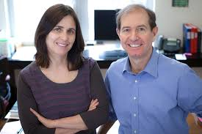
Semantic Security Notion for SKE
S. Goldwasser and S. Micali. Probabilistic Encryption. Journal of Computer and System Sciences, 28(2): 270-299, 1984
Captures the ciphertext does not give any additional information about the message to the adversary irrespective of prior knowledge about m.
h(m): external info about m; history function
f(m): additional partial information about m that adv wants to compute

Slide 26
Syntax of SKE
Key-generation Algorithm (Gen(1^{n})):
MUST be a Randomized algorithm
Outputs a key k chosen according to some probability distribution determined by the scheme; |k| >= n
2. Encryption Algorithm (Enc_{k}(m)); m from {0,1}*:
Deterministic/Randomized algorithm
c ← Enc_{k}(m) when randomized and c:=Enc_{k}(m) when deterministic
3. Decryption Algorithm (Dec_{k}(c)):
Usually deterministic
Outputs m:= Dec_{k}(c)
If (Gen, Enc, Dec) is defined over message space {0,1}^{l(n)} then fixed-length SKE
For message of length l(n)

Slide 27

Semantic Security
Two worlds: In one adv gets ciphertext and in another it does not. If the difference between probabilities of guessing f(x) in the both worlds are negligibly apart, then semantic security is achieved.
m
c ← Enc_{k}(m)
h(m)
|m|
h(m)
Enc
A
A’
Gen(1^{n})
k
Computational version of Shannon’s definition of perfect-security
guess about f(m)
guess about f(m)
Π = (Gen, Enc, Dec) is semantically-secure in the presence of a eavesdropper if for every PPT A there exists a A’ such that for any Samp and PPT functions f and h:
|
Pr [ A(1^{n},c,h(m) =f(m)]
-
Pr [ A’(1^{n},|m|,h(m) =f(m)]
|
≤ negl(n)
Probability taken over
>> uniform k,
>> m output by Samp(1^{n}),
>> the randomness of A and
>> the randomness of Enc
Probability taken over
>> m output by Samp(1^{n}) and
>> the randomness of A’

Slide 28



Indistinguishability Based Definition
Common Feature: Experiment- a game between a challenger and an adversary
co
PrivK (n)
Eavesdropping indistinguishability experiment
Π = (Gen, Enc, Dec),
A, Π
Attacker A
Challenger
m₀, m₁∈ , |m₀|=|m₁|
b ← {0, 1}
(freedom to choose any pair)
c ← Enc_{k}(m_{b})
I can break Π
b’ ∈ {0, 1}
k
Let me verify
Run time: Poly(n)
(Attacker’s guess about encrypted message)
Gen(1^{n})
b = b’
co
PrivK (n)
b ≠ b’
A, Π
0 --- attacker lost
1 --- attacker won
All Security Definitions will be in Ind style
SEMANTIC Security ≈ IND Security
(First Chalk & Talk Topic)
Π has indistinguishable encryptions in the presence of an eavesdropper or is co-secure if for every PPT attacker A, there is a negligible function negl(n) such that
co
Probability is taken over the randomness used by A and the challenger
Pr
PrivK (n)
½ + negl(n)
= 1
≤
A, Π
Notes:
Published in the same paper. It captures the fact that the adversary gets just a single ciphertext. Even though the adversary knows that the ciphertext corresponds to one two message m0 and m1, it cannot tell apart which message the ciphertext corresponds to. Very strong.

Slide 29
Equivalent Formulation of Ind Definition
Attacker A
Π = (Gen, Enc, Dec), , n
Challenger
b ← {0, 1}
m₀, m₁∈ , |m₀| = |m₁|
(freedom to choose any pair)
c ← Enc_{k}(m_{b})
I can break Π
b’ ∈ {0, 1}
k
Let me verify
Run time: Poly(n)
(Attacker’s guess about encrypted message)
Gen(1^{n})
b = b’
Game Output
b ≠ b’
1 --- attacker won
0 --- attacker lost
co
Pr
PrivK (n)
½ + negl(n)
= 1
≤
A, Π
Intuition behind the definition ?
>> Attacker should behave in the same way irrespective of of m₀ or m₁
>> What does same behavior mean ? --- Attacker just outputs a bit
>> Same behavior means that attacker outputs 1 with al most the same probability in each case (irrespective of whether it sees an encryption of m₀ or m₁)

Slide 30
Equivalent Formulation
co
PrivK (n, b) : the eavesdropping experiment with m_{b} selected by challenger
A, Π
co
co
Output(PrivK (n, b)) : output bit of the attacker during
PrivK (n, b))
A, Π
A, Π
>> How to formalize that attacker’s strategy gives the same output in each case
Π = (Gen, Enc, Dec) is CO-secure if for every PPT adversary A, there is a negligible function negl, such that :
|
co
co
|
Pr[Output(PrivK (n, 0)) = 1]
-
Pr[Output(PrivK (n, 1)) = 1]
≤ negl(n)
A, Π
A, Π
Π = (Gen, Enc, Dec) is co-secure if for every PPT adversary A, there is a negligible function negl, such that :
co
Pr
PrivK (n)
½ + negl(n)
= 1
≤
A, Π

Slide 31
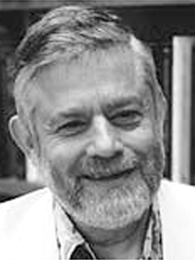
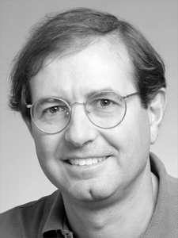
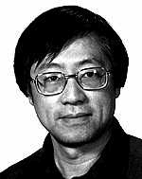
Ingredient for co-secure SKEs
OTP ? But key as large as message
Need Better solution- Shorter key for big message
Which symmetric-key primitive would serve our purpose?
Pseudorandom Generators (PRGs)
M. Blum, S. Micali. How to Generate Cryptographically strong sequences of pseudo-random bits. SIAM Journal of Computing, 13(4), 850-864, 1984
A. C.-C. Yao. Theory and Applications of Trapdoor Functions. FOCS, 80-91, 1982.

Slide 32
Random Strings/Pseudorandom Strings
Pseudorandom string looks like a uniformly distributed string
“looking entity” runs in polynomial time
0100010101010100010101010
“pseudorandom” or “random” ?
Randomness/Pseudorandomness is a property of a distributions on strings
Random Generator / Pseudorandomgenerator is a property of a process/algorithm that generates strings according to the respective distributions.

Slide 33
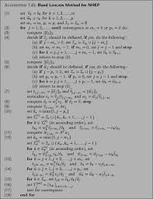
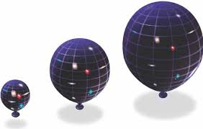
Pseudorandom Generators (PRGs)
A deterministic algorithm that “expands” a truly random short string into a long pseudorandom string (that looks like a random string for a PPT Distinguishaer)
Algorithm G
s ∈_{R} {0,1}^{n}
G(s) ∈ {0,1}^{l(n)}
Seed / Secret Key
n : security parameter
l() : expansion factor of G
Deterministic
Requirements :
1. Expansion : for every n, l(n) > n
2. Pseudorandomness : G(s) “looks like” a truly random string
Mathematical formulation of pseudorandomness ?
--- Indistinguishability game

Slide 34


PRG Security
Oracle
U : uniform distribution over {0,1}^{l(n)}
PPT distinguisher D
Challenger
A random string of length l(n) plz
A string of length l(n) please
y∈_{R} {0,1}^{l(n)}
y
b= 0
How I selected it ?
b= 1
s ∈_{R} {0,1}^{n}
G: Probability distribution over {G(s): s ∈_{R} {0,1}^{n}}
y: = G(s)
G
G is a PRG if for every PPT D, there is a negligible function negl
|
-
|
≤ negl(n)
Pr [D(r) = 1]
Pr [D(G(s)) = 1]
r ∈_{R} {0,1}^{l(n)}
s ∈_{R} {0,1}^{n}
Probability taken over
>> Random Choice of r
>> the randomness of D
Probability taken over
>> Random Choice of s
>> the randomness of D

Slide 35
Is designing PRG easy?
s’ = s₁⊕s₂⊕…⊕s_{n}
s ∈_{R} {0,1}^{n}
G(s) = ss’
Expansion factor: n+1
Is G a PRG?
--- trivial to design a distinguisher D
D outputs 1
Yes
y generated by G
y∈{0,1}^{n+1}
Is the final bit of y XOR
random or generated by G ?
of the preceding bits ?
No
D outputs 0
D
y random
With how much probability D distinguishes a random and pseudorandom string ?
If y generated by G
If y is truly random
D outputs 1 with probability 1
D outputs 1 with probability ½
Pr [D(G(s)) = 1] = 1
s ∈_{R} {0,1}^{n}
Pr [D(r) = 1] = ½
r ∈_{R} {0,1}^{n+1}
|
-
|
= ½
Non-negligible
Pr [D(r) = 1]
Pr [D(G(s)) = 1]

Slide 36
Existence of PRG
Do PRG exists ?
OWF + hardcore bit → PRG
Provably secure
Several practical PRGs (Stream Ciphers)
Not provably secure (but no good distinguishers found till now)
High practical efficiency compared to provably-secure PRGs

Slide 37


Slide 38

Computational Security : Necessity of the Relaxations
Practical crypto : many messages encrypted using a single short key
Relaxation I : security only against efficient attackers
--- Why ?
Let | | < | |
Let the attacker launch a known-plaintext attack against the scheme
Attacker can try decrypting each cipher-text with all possible keys until it finds a matching key
k₁
k₁
k ?
k₂
k ?
k₂
k ?
k₃
k₃
---brute-force search
(m₁, c₁), (m₂, c₂), …, (m_{t}, c_{t}): c_{i} = Enc_{k}(m_{i})
? Dec_{k1}(c_{i}) = m_{i}, for all i
O(| |) time
? Dec_{k2}(c_{i}) = m_{i}, for all i
Need to bound the running time of the attacker to disallow it to carry brute-force search attack
Yes
? Dec_{k3}(c_{i}) = m_{i}, for all i
Hurray : I got the key

Slide 39
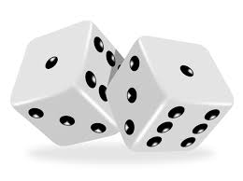
Computational Security : Necessity of the Relaxations
Practical crypto : many messages encrypted using a single short key
Relaxation II : Attacker allowed to break the scheme with some very small probability
--- Why ?
Let | | < | |
Attacker launches a known-plaintext attack
k₁
Attacker randomly guess a key k ∈ and checks whether it is the matching key
k ?
k₂
k ?
k₂
k ?
k₃
--- O(1) time
(m₁, c₁), (m₂, c₂), …, (m_{t}, c_{t}): c_{i} = Enc_{k}(m_{i})
? Dec_{k2}(c_{i}) = m_{i}, for all i
Yes
Need to allow a very small probability of success without considering it a break
Hurray : my guess was correct
Probability : 1 / | |

