Slide 1
Cryptography
Lecture 3
Arpita Patra

Slide 2
Quick Recall and Today’s Roadmap
>> Construction based on PRG
>> Overview of Proof by reduction
>> Proof of PRG-based SKE
>> Extension of CO-security to CO-MULT-security and the second is stronger than previous
>> Chosen Plaintext Attack (CPA), CPA Security, stronger than previous notions; minimum requirement for any SKE
>> Is it practical?
>> A construction for CPA-secure scheme
>> Proof of Security
>> Extension to CPA-MULT-security
>> Modes of Operations (very efficient construction used in practice)
Notes:
One reason why we did not construct a scheme secure with co-MULT-security, but moved to CPA security is: so far we don’t have scheme that is simple and is secure according to the first notion but insecure according to the second notion.

Slide 3
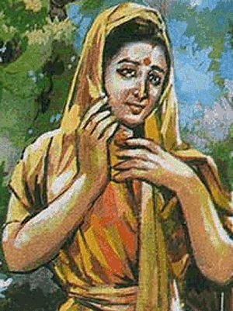



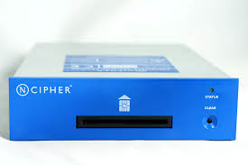
Chosen-Plaintext Attacks (CPA)
(Single-message Security)
m
c = Enc_{k}(m)
Enc
??
m₁
m₂
k
m_{t}
k
c₁
c₂
c_{t}
(m₁, c₁), (m₂, c₂), …, (m_{t}, c_{t}): c_{i} = Enc_{k}(m_{i})
Encryption Oracle
>> Adversary influences the honest parties to get encryption of plain-texts (using the same key) of its choice
>> Adv’s Goal: to determine the plain-text encrypted in a new cipher-text
Notes:
Don’t shout right away that this attack is unmountable, unrealistic, adversary cannot do it. It is very much doable.

Slide 4
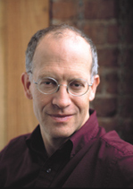


CPA
M. Luby: Pseudorandomness and Cryptographic Applications; Princeton University Press, 1996
Mihir Bellare, Anand Desai, E. Jokipii, Phillip Rogaway:
A Concrete Security Treatment of Symmetric Encryption. FOCS: 394-403, 1997

Slide 5
Is CPA Realistic ?
How can an attacker influence parties to encrypt messages of its choice (using the same key) ?
Consider a secure hardware with secret-key embedded
>> Often used in military applications
An insider may have access to the hardware (not the key)
>> Can choose messages of its choice and get their encryptions

Slide 6
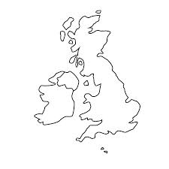

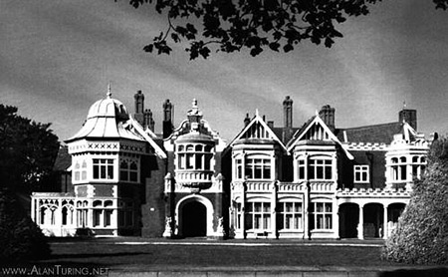
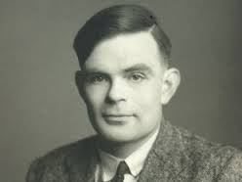

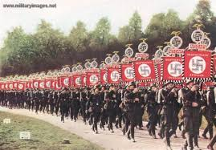
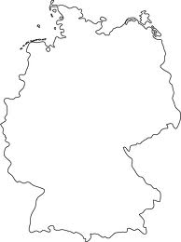
CPA shortened WWII by 2-3 Years
Breaking of German codes by British during WW II
Allied Power
Loc₃
Loc₁
Loc₂
At Bletchley Park
Axis Power
Enc_{k}(Loc₁)
Trivia: Who played a key role in this cryptanalysis process
Enc_{k}(Loc₂)
Enc_{k}(Loc₃)
Notes:
CPA has a great contribution to humankind. Bletchley park was the mecca of cryptanalysis + crypto during WWII.

Slide 7


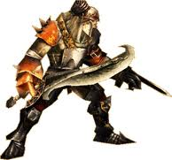
CPA Indistinguishability Experiment
cpa
PrivK (n)
Π = (Gen, Enc, Dec), , n
A, Π
Query: Plain-text
Response: Ciphertext
PPT Attacker A
k
Let me verify
Gen(1^{n})
I can break Π
Training Phase:
>> A is given oracle access to Enc_{k}()
>> A adaptively submits its query (free to submit m₀, m₁) and receives their encryption

Slide 8

CPA Indistinguishability Experiment
cpa
PrivK (n)
Π = (Gen, Enc, Dec), , n
A, Π
Training Phase
b ← {0, 1}
PPT Attacker A
m₀, m₁∈ , |m₀| = |m₁|
c ← Enc_{k}(m_{b})
k
Let me verify
Gen(1^{n})
I can break Π
Challenge Phase:
>> A submits two equal length challenge plaintexts
>> A is free to submit any message of its choice (including the ones already queried during the training phase)
>> One of the challenge plaintexts is randomly encrypted for A (using fresh randomness)

Slide 9
CPA Indistinguishability Experiment
cpa
PrivK (n)
Π = (Gen, Enc, Dec), , n
A, Π
Training Phase
b ← {0, 1}
PPT Attacker A
m₀, m₁∈ , |m₀| = |m₁|
c ← Enc_{k}(m_{b})
Query: Plain-text
k
Let me verify
Gen(1^{n})
I can break Π
Response: Ciphertext
Post-challenge Training Phase:
>> A is given oracle access to Enc_{k}()
>> A adaptively submits its query (possibly including m₀, m₁) and receives their encryption

Slide 10
CPA Indistinguishability Experiment
cpa
PrivK (n)
Π = (Gen, Enc, Dec), , n
A, Π
Training Phase
b ← {0, 1}
PPT Attacker A
m₀, m₁∈ , |m₀| = |m₁|
c ← Enc_{k}(m_{b})
k
Post-challenge Training
Let me verify
Gen(1^{n})
I can break Π
b’ ∈ {0, 1}
b = b’
Game Output
b ≠ b’
1 --- attacker won
0 --- attacker lost
Response Phase:
A finally submits its guess regarding encrypted challenge plain-text
A wins the experiment if its guess is correct

Slide 11
CPA Security
cpa
PrivK (n)
Π = (Gen, Enc, Dec), , n
A, Π
Training Phase
b ← {0, 1}
PPT Attacker A
m₀, m₁∈ , |m₀| = |m₁|
c ← Enc_{k}(m_{b})
k
Post-challenge Training
Let me verify
Gen(1^{n})
I can break Π
b’ ∈ {0, 1}
b = b’
Game Output
b ≠ b’
1 --- attacker won
0 --- attacker lost
Π is CPA-secure if for every PPT A, there is a negligible function negl, such that:
cpa
Pr
PrivK (n)
½ + negl(n)
= 1
≤
A, Π

Slide 12
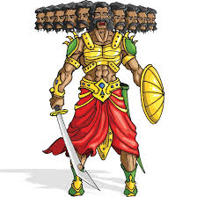
Search for Ingredients of CPA-Secure Scheme
Encryption procedure cannot be deterministic. Can u find an attack?
Encryption procedure MUST be randomized
>> Need “fresh” randomness for each run of Enc. Results different ciphertexts for the same message
>> At the same time want to use a “single key”.
m
c = (x_{i}, m⊕ y_{i})
Enc
??
x₁ = 00000…0
y₁ ∈_{R} {0,1}^{n}
x₁ = 00000…0
y₁ ∈_{R} {0,1}^{n}
x₂ = 00000…1
y₂ ∈_{R} {0,1}^{n}
y_{i}
x₂ = 00000…1
y₂ ∈_{R} {0,1}^{n}
…
…
…
…
x₂^{n} = 11111… 1
y₂^{n} ∈_{R} {0,1}^{n}
Pad y_{i} is truly random
x₂^{n} = 11111… 1
y₂^{n} ∈_{R} {0,1}^{n}
f: {0,1}^{n} → {0, 1}^{n}
>> Instances of OTP
f: {0,1}^{n} → {0, 1}^{n}
>> Problem with the above solution
--- size of f is n2^{n} bits

Slide 13
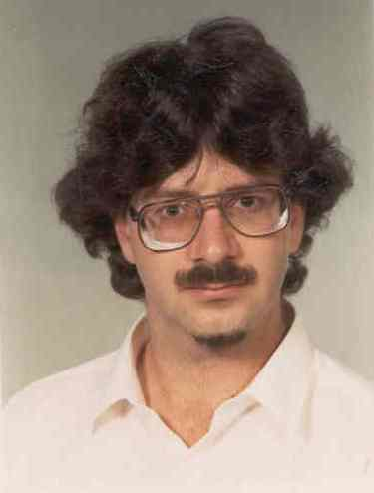
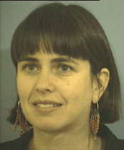
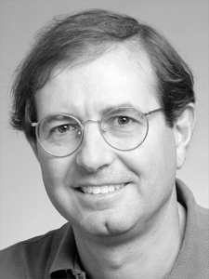
Ingredient for CPA-secure SKEs
Need a smarter tool. A short key.
Pseudorandom Function (PRF)
O. Goldreich, S. Goldwasser and S. Micali. How to Construct Random Functions. JACM, 33(4), 792-807, 1986

Slide 14
Pseudorandom Functions (PRF)
What is a truly random function (TRF) ?
>> Whose output behavior is completely unpredictable
>> Given an input, it randomly assigns one element from the co-domain as the output
>> Every element from the co-domain is a possible image with equal probability
What is a PRF ?
>> Intuitively a function whose output behavior “looks like” a TRF
>> As long as the “entity” who observes is computationally bounded
Given a function f: is it TRF or PRF ?
>> Randomness/Pseudorandomness tag of a function is meaningful when it is drawn from a distributions of functions.

Slide 15
TRF vs PRF
For simplicity, consider functions from {0,1}^{n} to {0,1}^{n}
Func_{n} = {f₁, f₂, …, f } --- family of all such functions
2^{n. 2n}
A function chosen uniformly at random from the above is a TRF
Func_{n} = {F_{k1}, …, F_{k} } –-- family of keyed functions with key length n
2^{n}
A function chosen uniformly at random from the above is a PRF
|Func_{n}| >>>>>>>>>>> |Func_{n}|
PRFs are keyed functions; given key and input, there is an efficient way of computing a PRF

Slide 16
A possible Definition of PRF in PRG style
Give F (table) either uniformly sampled from Func_{n} or from to PPT distinguisher D and ask if it is a TRF or PRF.
Func_{n}
>> Does it work?
>> No, since the description of the function is of exponential size
>> Instead we give D oracle access to either a TRF or a PRF and ask “tell us who are you interacting with?”
>> If D cannot tell apart the “behavior” of the function F_{k} (for a uniformly random k) from a truly random function f: {0,1}^{n} → {0,1}^{n}, then we say f is a PRF.

Slide 17


Indistinguishability Game for PRF
F: {0, 1}^{n} x {0, 1}^{n} → {0, 1}^{n}
Func_{n} = {f₁, f₂, …, f }
Oracle
2^{n. 2n}
x₁
Value of the function at x₁
y₁ = f(x₁)
f ∈_{R} Func_{n}
b= 0
PPT distinguisher D
Value of the function at x₁ is y₁
Func_{n}
= {F_{k1}, …, F_{k} }
b
2^{n}

Slide 18
Indistinguishability Game for PRF
F: {0, 1}^{n} x {0, 1}^{n} → {0, 1}^{n}
Func_{n} = {f₁, f₂, …, f }
Oracle
2^{n. 2n}
x_{t}
Value of the function at x_{t}
y_{t} = f(x_{t})
f ∈_{R} Func_{n}
b= 0
PPT distinguisher D
Value of the function at x_{t} is y_{t}
Func_{n}
= {F_{k1}, …, F_{k} }
b
2^{n}
D can adaptively asks its queries
D allowed to ask polynomial number of queries

Slide 19
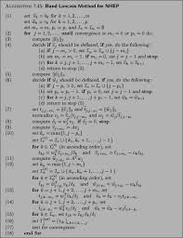
Indistinguishability Game for PRF
F: {0, 1}^{n} x {0, 1}^{n} → {0, 1}^{n}
Func_{n} = {f₁, f₂, …, f }
2^{n. 2n}
Value of the function at x₁
PPT distinguisher D
Value of the function at x₁ is y₁
b= 1
k ∈_{R} {0,1}^{n}
Func_{n}
= {F_{k1}, …, F_{k} }
b
2^{n}
x₁
y₁= F_{k}(x₁)
F_{k}

Slide 20
Indistinguishability Game for PRF
F: {0, 1}^{n} x {0, 1}^{n} → {0, 1}^{n}
Func_{n} = {f₁, f₂, …, f }
2^{n. 2n}
Value of the function at x_{t}
PPT distinguisher D
Value of the function at x_{t} is y_{t}
b= 1
k ∈_{R} {0,1}^{n}
Func_{n}
= {F_{k1}, …, F_{k} }
b
2^{n}
x_{t}
y_{t}= F_{k}(x_{t})
F_{k}
D can adaptively asks its queries
D allowed to ask polynomial number of queries

Slide 21

Modeling PRF as an Indistinguishability Game
F: {0, 1}^{n} x {0, 1}^{n} → {0, 1}^{n}
Func_{n} = {f₁, f₂, …, f }
2^{n. 2n}
?
?
PPT distinguisher D
(x₁, y₁), (x₂, y₂),…, (x_{k}, y_{k})
Func_{n}
= {F_{k1}, …, F_{k} }
2^{n}
F is a PRF if for every PPT D there is an negl(n)
|
F_{k}( )
-
f( )
|
Pr [D (1^{n}) = 1]
Pr [D (1^{n}) = 1]
≤ negl(n)
>> uniformly random k
>> D‘s randomness
>> uniform choice of f
>> D’s randomness
>> D not given k in the above game
--- otherwise D can distinguish with high probability

Slide 22
Existence of PRF
Do PRF exists ?
OWF → PRG → PRF (Tree Construction) (otheway is also possible; take as an HW)
>> NT based; Not used in practice
Several practical PRFs
>> Block Ciphers, AES, DES
>> No good distinguishers found till now; believed to be PRF
>> AES/DES are PRFs: this is an assumption
>> High practical efficiency compared to provably-secure PRFs

Slide 23
PRF-based CPA-Secure Scheme
Potential solution
Let us agree on a truly random function
(secret meeting / mechanism)
x₁ = 00000…0
y₁ ∈_{R} {0,1}^{n}
x₂ = 00000…1
y₂ ∈_{R} {0,1}^{n}
…
…
x₂^{n} = 11111… 1
y₂^{n} ∈_{R} {0,1}^{n}
Look-up table of a TRF f from {0,1}^{n} to {0, 1}^{n}

Slide 24
Fixed-length CPA-Secure Encryption from PRF
Let F be a length-preserving PRF (just for simplicity)
Fixed-length encryption
F: {0, 1}^{n} x {0, 1}^{n} → {0, 1}^{n}
Construct a CPA-secure encryption cipher for messages of length n
Enc_{k}(m)
>> r in {0, 1}^{n}
>> c = (r, m⊕ F_{k}(r))
m,k
c
c,k
Dec_{k}(c = (c0,c1))
>> m = c1 ⊕ F_{k}(c0)
Secret PRF-key k
(key-agreement)

Slide 25
Security Proof
Enc_{k}(m)
>> r in {0, 1}^{n}
>> c = (r, m⊕ F_{k}(r))
m,k
c
c,k
Dec_{k}(c = (c0,c1))
>> m = c1 ⊕ F_{k}(c0)
Secret PRF-key k
(key-agreement)
Theorem. If F_{k} is a PRF, then Π is a CPA-secure scheme.
Proof: On the board.

Slide 26
Recall Security Proof of PRG-based Scheme
m,k
Enc_{k}(m)
>> c = m⊕ G(k)
c
c,k
Dec_{k}(c)
>> m = c ⊕ G(k)
Secret PRG-key k
Theorem. If G is a PRG, then Π is a CO-secure scheme.
Proof: Assume Π is not secure
co
co
A, p(n):
Pr
PrivK (n)
½ + 1/p(n)
= 1
>
Pr
PrivK (n)
½
= 1
=
A, Π
A, Π
=
=
Pr [D(G(s)) = 1]
Pr [D(y) = 1]
co
Let us run
PRS or RS?
PrivK (n)
A, Π
y∈{0,1}^{l(n)}
D
m₀, m₁∈_{R} , |m₀| = |m₁|
A
c = m_{b} ⊕ y
1 if b = b’
0 otherwise
b’ ∈ {0, 1}
b

Slide 27
Pseudo Random Permutation (PRP)
F: {0, 1}^{n} x {0, 1}^{n} → {0, 1}^{n}
Perm_{n} = {f₁, f₂, …, f }
(2^{n})!
?
?
PPT distinguisher D
(x₁, y₁), (x₂, y₂),…, (x_{k}, y_{k})
Perm_{n}
= {F_{k1}, …, F_{k} }
Distinct pairs
2^{n}
F is a PRF if for every PPT D there is an negl(n)
|
F_{k}( )
-
f( )
|
Pr [D (1^{n}) = 1]
Pr [D (1^{n}) = 1]
≤ negl(n)
>> uniformly random k
>> D‘s randomness
>> uniform choice of f
>> D’s randomness

Slide 28
Strong PRP
F: {0, 1}^{n} x {0, 1}^{n} → {0, 1}^{n}
Perm_{n} = {f₁, f₂, …, f }
(2^{n})!
?
>> Any strong PRP is by default a PRP
?
>> What about the converse ?
PPT distinguisher D
Perm_{n}
= {F_{k1}, …, F_{k} }
(x₁, y₁), (x₂, y₂),…, (x_{k}, y_{k})
2^{n}
(y₁, x₁), (y₂, x₂),…, (y_{k}, x_{k})
F is a PRF if for every PPT D there is an negl(n)
|
F_{k}( )
, F_{k}⁻¹( )
-
f( )
, f⁻¹( )
|
Pr [D (1^{n}) = 1]
Pr [D (1^{n}) = 1]
≤ negl(n)
>> uniformly random k
>> D‘s randomness
>> uniform choice of f
>> D’s randomness

Slide 29
PRF/PRP/SPRP
Theoretical instantiation of CPA-secure SKE from any PRF/PRP/SPRP.
Practical instantiation of CPA-secure SKE from only PRP/Strong PRP
>> Ex: AES, DES; No distinguisher found so far
>> Blocks ciphers
>> Operates on block of message at a time --- hence the name

Slide 30
CPA Security for Multiple Encryptions
cpa-mult
PrivK (n)
Π = (Gen, Enc, Dec), , n
A, Π
Training Phase
b ← {0, 1}
→
→
PPT Attacker A
M₀ = (m_{0,1}, …, m_{0, t})
M₁ = (m_{1,1}, …, m_{1, t})
(freedom to choose any pair)
c₁ ← Enc_{k}(m_{b,1})
c_{t} ← Enc_{k}(m_{b, t})
,…,
k
Let me verify
Gen(1^{n})
I can break Π
Post-challenge Training
b’ ∈ {0, 1}
b = b’
Game Output
b ≠ b’
1 --- attacker won
0 --- attacker lost
Π is CPA-secure for multiple encryptions if for every PPT A, there is a negligible function negl, such that:
cpa-mult
Pr
PrivK (n)
½ + negl(n)
= 1
≤
A, Π

Slide 31


CPA Multiple-message vs Single-message Security
cpa
cpa-mult
Experiment is a special case of
PrivK (n)
PrivK (n)
A, Π
A, Π
→
→
Set |M₀| = |M₁| = 1
>> Converse was not true in the case of co-security
>> Ciphers with indistinguishable encryption for single message but no indistinguishable multiple encryptions
Any cipher that is CPA-secure for multiple encryptions is also CPA-secure (for single encryption)
What about the converse ?
Theorem: Any cipher that is CPA-secure is also CPA-secure for multiple encryptions
Sufficient to prove CPA-security for single encryption; rest is “for free”

Slide 32
CPA-security Guarantee in Practice
Ensures security against CPA even if multiple messages are encrypted using a single key and communicated
>> Even if the adversary knows that the encrypted messages belong to one of the two possible “classes”
>> Even if the adversary has seen encryptions of the messages in those classes in the past
Very good security guarantees
>> The least we should expect from a cipher
Notes:
We have overcome both the drawbacks perfectly-secure scheme: (a) key size as big as message (b) key cannot be reused

Slide 33
CPA-security for Arbitrary-length Messages (Theoretical Construction)
Let Π = (Gen, Enc, Dec) be a fixed-length CPA-secure based on PRP/SPRP/PRF. Supports message of length
n
n
n
m
m₁
m₂
m₃
Enc_{k}(m)
r in {0, 1}^{n}
c = (r, m⊕ F_{k}(r))
Enc_{k}(m)
r in {0, 1}^{n}
c = (r, m⊕ F_{k}(r))
Enc_{k}(m)
r in {0, 1}^{n}
c = (r, m⊕ F_{k}(r))
c₁
c₃
c₆
Gen
k
c₁c₂…c₆ ← Enc_{k}(m)
Notes:
Without compromising CPA security. Nice blend of Practice and Theory

Slide 34
How Good it is?
Assume Message Blocks: k; |m| = k n
Theoretical Construction
n / Block = kn
2n / Block = 2kn
Yes
No
PRF
Yes
Finally
n / Overall = n
k n + n
Yes
Yes
PRF
Yes
Randomness Usage
Ciphertext Expansion
Ciphertext Computation Parallelizable
Randomness Reusability
Minimal Assumption (PRF/PRP/SPRP)
CPA Security

Slide 35
Block-cipher Modes of Operations
Given
A length-preserving block cipher F (may be a PRF/PRP/SPRP) with block length n
k ∈_{R} {0, 1}^{n}
F_{k}(x) = F(k, x) ∈ {0, 1}^{n}
x ∈ {0, 1}^{n}
Keyed Algorithm F
Goal
To encrypt a message m = m₁m₂ … m_{k} using F with ciphertext length as small as possible and with randomness as less as possible.
Without loss of generality --- each m_{i} ∈ {0,1}^{n}
{0,1}^{n}
{0,1}^{n}
{0,1}^{n}
{0,1}^{n}
{0,1}^{n}
{0,1}^{n}
m
m₁
m₂
m₃
m₄
…
m_{k}

Slide 36
Electronic Code Book (ECB) Mode
m
m₁
m₂
m₃
k
Gen
F
F
F
c₁ = F_{k}(m₁)
c₂ = F_{k}(m₂)
c₃ = F_{k}(m₃)
Encryption: compute c_{i} = F_{k}(m_{i}) – No randomness used at all !
|c| = |m|
Decryption: compute m_{i} = F_{k}⁻¹(c_{i})
>> Assumes F_{k} is SPRP.
Parallelizable!
CPA Security ?
>> Deterministic Encryption
>> No. not even CO security for multi message

Slide 37
Current Picture
Assume Message Blocks: k; |m| = k n
Theoretical Construction
n / Block = kn
2n / Block = 2kn
Yes
No
PRF
Yes
ECB Mode
No randomness
k n
Yes
---
SPRP
NO
Randomness Usage
Ciphertext Expansion
Ciphertext Computation Parallizable
Randomness Reusability
Minimal Assumption (PRF/PRP/SPRP)
CPA Security

Slide 38
Cipher Block Chaining (CBC) Mode
m
m₁
m₂
m₃
IV
⊕
⊕
⊕
k
Gen
F
F
F
c₀
c₁ = F_{k}(m₁⊕c₀)
c₂ = F_{k}(m₂⊕c₁)
c₃ = F_{k}(m₃⊕c₂)
Encryption
c_{i} = F_{k}(m_{i}⊕c_{i-1}), for i = 1, …, k
Enc_{k}(m₁ m₂ … m_{l}) = (c₀ c₁… c_{l})
Decryption:
m_{i} = F_{k}⁻¹(c_{i}) ⊕c_{i-1}, for i = 1, …, l
>> Assumes F_{k} is SPRP.
Blockwise Parallel Computation ?
>> NO
CPA Security ?
>> Randomized Encryption. Provides CPA security. HW
Security ? --- looks like yes as F_{k} is a PRF/PRP/SPRP

Slide 39
Current Picture
Assume Message Blocks: k; |m| = k n
Theoretical Construction
n / Block = kn
2n / Block = 2kn
Yes
No
PRF
Yes
ECB Mode
No randomness
k n
Yes
---
SPRP
NO
CBC Mode
n
k n + n
NO
---
SPRP
YES
Randomness Usage
Ciphertext Expansion
Ciphertext Computation Parallizable
Randomness Reusability
Minimal Assumption (PRF/PRP/SPRP)
CPA Security

Slide 40
IV Misuse in CBC Mode
m
m₁
m₂
m₃
IV
⊕
⊕
⊕
k
Gen
F
F
F
c₀
c₁ = F_{k}(m₁⊕c₀)
c₂ = F_{k}(m₂⊕c₁)
c₃ = F_{k}(m₃⊕c₂)
Choosing distinct IV enough ? Can save randomness
Unfortunately this version of CBC mode is not cpa-secure-- Assignment

Slide 41
IV misuse in CBC Mode
m
m₁
m₂
m₃
IV
⊕
⊕
⊕
k
Gen
F
F
F
c₀
c₁ = F_{k}(m₁⊕c₀)
c₂ = F_{k}(m₂⊕c₁)
c₃ = F_{k}(m₃⊕c₂)
Can the last ciphertext of previous block act as the IV for next encryption ?
Bandwidth and randomness saving

Slide 42
IV misuse in CBC Mode
M₁
m₁
m₂
m₃
M₂
m₄
m₅
m₆
IV₁
⊕
⊕
⊕
IV₂
⊕
⊕
⊕
k
k
Gen
F
F
F
F
F
F
c₀
c₁
c₂
c₃
c₄
c₅
c₆
c₇
Ideal way of encrypting two messages via CBC mode
Can the last ciphertext of previous block act as the IV for next encryption ?
Bandwidth and randomness saving

Slide 43

IV misuse in CBC Mode- Chained CBC
M₁
m₁
m₂
m₃
M₂
m₄
m₅
m₆
IV₁
⊕
⊕
⊕
⊕
⊕
⊕
k
k
Gen
F
F
F
F
F
F
c₀
c₁
c₂
c₃
c₄
c₅
c₆
Chained CBC mode
Can the last ciphertext of previous block act as the IV for next encryption ?
BEAST attack on SSL/TSL
>> Bandwidth and randomness saving
No modifications to crypto schemes even if the modifications look benign
Chained CBC mode --- used in SSL 3.0 and TLS 1.0
>> Stateful variant of CBC
CPA security?
>> It is “equivalent” to encrypting a single large message M = M₁ || M₂ via CBC mode
>> Yet Not CPA-secure

Slide 44
Output Feedback (OFB) Mode
IV
k
Gen
F
F
F
y₀
y₁ = F_{k}(y₀)
y₂ = F_{k}(y₁)
y₃ = F_{k}(y₂)
⊕
⊕
⊕
m
m₁
m₂
m₃
c₀
c₁ = y₁⊕m₁
c₂ = y₂⊕m₂
c₃ = y₃⊕m₃
Encryption: Enc_{k}(m₁ m₂ … m_{l}) = (c₀ c₁… c_{l})
First generate a pseudorandom stream of pad (independent of m)
Use the pseudorandom stream for masking m

Slide 45
Output Feedback (OFB) Mode
IV
k
Gen
F
F
F
y₀
y₁ = F_{k}(y₀)
y₂ = F_{k}(y₁)
y₃ = F_{k}(y₂)
⊕
⊕
⊕
m
m₁
m₂
m₃
c₀
c₁ = y₁⊕m₁
c₂ = y₂⊕m₂
c₃ = y₃⊕m₃
Encryption: Enc_{k}(m₁ m₂ … m_{l}) = (c₀ c₁… c_{l})
Decryption: m_{i} = F(y_{i-1}) ⊕ c_{i}
PRF Enough !
Not parallalizable but pre-computable
CPA-secure! The chained version too!

Slide 46
Current Picture
Assume Message Blocks: k; |m| = k n
Theoretical Construction
n / Block = kn
2n / Block = 2kn
Yes
No
PRF
Yes
ECB Mode
No randomness
k n
Yes
---
SPRP
NO
CBC Mode
n
k n + n
NO
---
SPRP
YES
OFB Mode
n
k n + n
NO (But pre-computable)
YES
PRF
YES
Randomness Usage
Ciphertext Expansion
Ciphertext Computation Parallizable
Randomness Reusability
Minimal Assumption (PRF/PRP/SPRP)
CPA Security

Slide 47
Counter (CTR) Mode
CTR +1
CTR +2
CTR +3
CTR ∈ {0, 1}^{n}
k
mod 2^{n}
Gen
F
F
F
y₁
y₂
y₃
⊕
⊕
⊕
Pseudorandom stream
m
m₁
m₂
m₃
c₀
c₁ = y₁⊕m₁
c₂ = y₂⊕m₂
c₃ = y₃⊕m₃
Encryption: Enc_{k}(m₁ m₂ … m_{l}) = (c₀ c₁… c_{l})
Same idea as in OFB modes : pseudorandom stream followed by masking
However everything can be now parallelized

Slide 48
Counter (CTR) Mode
CTR +1
CTR +2
CTR +3
CTR ∈ {0, 1}^{n}
k
mod 2^{n}
Gen
F
F
F
y₁
y₂
y₃
⊕
⊕
⊕
Pseudorandom stream
m
m₁
m₂
m₃
c₀
c₁ = y₁⊕m₁
c₂ = y₂⊕m₂
c₃ = y₃⊕m₃
Encryption: Enc_{k}(m₁ m₂ … m_{l}) = (c₀ c₁… c_{l}); Decryption: Easy; PRF enough!
Chalk &Talk Session 2 Topic:
CPA-security of CTR Mode
Highly attractive features
Encryption / decryption can be parallelized
Can decrypt a specific ciphertext block by just one invocation of F
Chained/Statefull variant is CPA-secure

Slide 49
Current Picture
Assume Message Blocks: k; |m| = k n
Theoretical Construction
n / Block = kn
2n / Block = 2kn
Yes
No
PRF
Yes
ECB Mode
No randomness
k n
Yes
---
SPRP
NO
CBC Mode
n
k n + n
NO
---
SPRP
YES
OFB Mode
n
k n + n
NO (But pre-computable)
YES
PRF
YES
CTR Mode
n
k n + n
YES
YES
PRF
YES
Randomness Usage
Ciphertext Expansion
Ciphertext Computation Parallizable
Randomness Reusability
Minimal Assumption (PRF/PRP/SPRP)
CPA Security

Slide 50
Some Practical Issues
Block length in practice
CBC, OFB, CTR mode uses a random IV as the starting point
For randomizing the encryption process
Ensures that each invocation of F is on a “fresh” input (w.h.p)
If two invocations of F are on the same input --- security issues
Ideal size of IV ? --- depends on block length supported by F
Say the block length supported by F is l
Birthday paradox
In CTR mode, IV will be a uniform string of l bits
After 2^{l/2} encryptions, IV will repeat with a constant probability
If l is too short, then impractical security (even if F is a SPRP)
DES with l = 64 --- IV repetition after 2³² ≈ 4, 300, 000, 000 encryptions
Approximately 32 GB of plaintexts --- may not be too large for all applications

Slide 51
Some Practical Issues
IV misuse
Assumption made: a uniform IV selected as the starting point
What if the assumption goes wrong (say due to poor randomness generation, incorrect implementation, etc) ?
Problems if IV is repeated
In the CTR and OFB modes, the same pseudorandom stream will be generated
Two messages XORed with the same stream --- serious security breach
In the CBC mode, the effect is not that serious
After few blocks, inputs to F will “diverge” (blocks of m are also part of the input)
Solution against IV misuse
Use CBC mode
Or stateful OFB / CTR mode

Slide 52
Conclusion
We discussed the notion of CPA
A very important class of (passive) attack
Minimum requirement from any cipher : CPA-security
CPA-secure cipher requires stronger primitive than PRG
Solution: pseudorandom function (PRF)
Fixed-length CPA-secure cipher using PRF
Arbitrary length CPA-secure encryption: divide into blocks and encrypt each block by fixed-length encryption --- theoretical (inefficient)
Practical solution (modes of operation of block ciphers)

Slide 53


Slide 54
Distribution for a TRF
For simplicity, consider functions from {0,1}^{n} to {0,1}^{n}
>> How many such functions ?
--- 2^{n. 2n}
>> Func_{n} = {f₁, f₂, …, f } --- family of all such functions
2^{n. 2n}
f is a TRF {0,1}^{n} to {0,1}^{n} if picked uniformly at random from Func_{n}
>> Picking a f from Func_{n} ≈
>> Each row of the look-up table of f randomly selected from {0,1}^{n}
x₁ = 00000…0
y₁ ∈_{R} {0,1}^{n}
x₂ = 00000…1
y₂ ∈_{R} {0,1}^{n}
…
…
x₂^{n} = 11111… 1
y₂^{n} ∈_{R} {0,1}^{n}
½
½
½
x
>> Prob. that a random look-up table is of f =
n
n
x
…
x
n

Slide 55
Distributions for a PRF
Func_{n} = {f₁, f₂, …, f }
2^{n. 2n}
Func_{n} = {F_{k1}, …, F_{k} }
2^{n}
|Func_{n}| >>>>>>>>>>> |Func_{n}|
Each function corresponds to a n-length key uniformly distributed over {0,1}^{n}
>> The key facilitates efficient evaluation of the function
PRFs are keyed functions

Slide 56
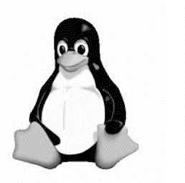
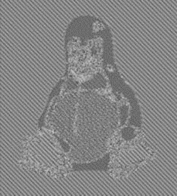

Insecurity of ECB Mode: A practical Example
Think of some practical situation where encrypting using ECB mode is indeed dangerous
Suppose you want to encrypt a black and white image using ECB mode
Say a group of pixels in the image corresponds to one block of F
ECB mode
Secure mode
Image to be encrypted
Encrypted image
Encrypted image (via a secure mode)
Source: Wikipedia with imaged derived from Larry Ewing using GIMP

Slide 57
Block-cipher Modes of Operations : Some Practical Issues
Message transmission errors (non-adversarial)
Dropped packets, changed bits, etc
Different modes of operations have different effect
Standard solutions --- error-correction, re-transmission
Message transmission errors (adversarial)
What if the adversary “changes” ciphertext contents ?
Issue of message integrity / authentication
Will be discussed in detail later

