Slide 1
Cryptography
Lecture 13
Arpita Patra

Slide 2
Recall
One-way Functions (OWF) & One-way Permutations (OWP)
Definition
Do they exist?
Candidate OWFs
Hard-core Predicates of OWF/OWP
Definition
Non-triviality of finding it.
Hard-core predicates from OWF/OWP (Goldreich-Levin Theorem) – partial proof
Roadmap of constructing PRG for poly expansion factor from OWF + Hard-core predicate

Slide 3



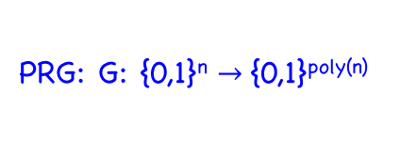
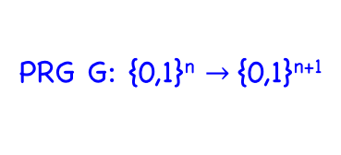
Roadmap
PRF
PRG: G: {0,1}^{n} $→${0,1}^{poly(n)}
PRG G: {0,1}^{n} $→${0,1}^{n+1}
OWF/P g, hc
OWF/P f

Slide 4
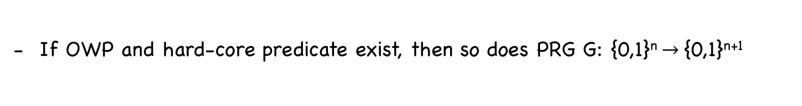
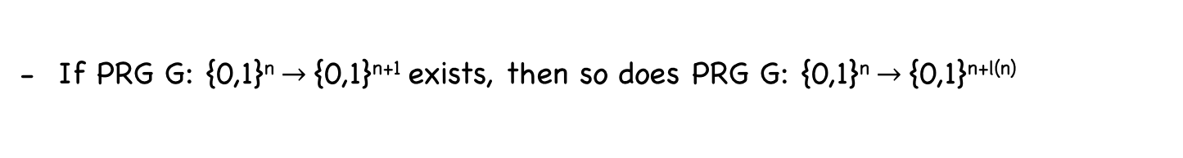
Today’s Goal
If OWP and hard-core predicate exist, then so does PRG G: {0,1}^{n} $→${0,1}^{n+1}
Construction
Proof
If PRG G: {0,1}^{n} $→${0,1}^{n+1} exists, then so does PRG G: {0,1}^{n} $→${0,1}^{n+l(n)}
Construction
Proof

Slide 5


PRG with Minimal Expansion from OWP and HCP
Theorem: Let f be a OWP with hard-core predicate hc. Then the algorithm G(s) = f(s)||hc(s) is a PRG with expansion factor n+1
f: {0, 1}^{n} → {0, 1}^{n} (bijection)
{0, 1}^{n}
{0, 1}^{n}
- s uniform random → f(s) uniformly random
- Given f(s), the value hc(s) is close to random
r₁….r_{n}
r_{n+1}
f(s)
hc(s)
r $∈$ {0,1}^{n+1}
f(s)||hc(s) $∈$ {0,1}^{n+1}
- First n bits have same dist. (purely random)
- Last bit is random in r but ”close to” random in the latter

Slide 6



PRG with Minimal Expansion from OWP and HCP
Theorem: Let f be a OWP with hard-core predicate hc. Then the algorithm G(s) = f(s)||hc(s) is a PRG with expansion factor l(n) = n+1
Hard-core Breaker A
Distinguisher D
f(s)
hc(s)
Pr[D(r) = 1 ] - Pr[D(G(s)) = 1])
= Pr[D(f(s) || r’) = 1 ]
-
Pr[D(f(s) || hc(s)) = 1]
r ← {0, 1}^{n+1}
s ← {0, 1}^{n}
s ← {0,1}^{n} r’ ← {0,1}
s ← {0, 1}^{n}
= ½ Pr[D(f(s) || hc(s)) = 1]
+ ½ Pr[D(f(s) || hc’(s)) = 1]
-
Pr[D(f(s) || hc(s)) = 1]
s ← {0,1}^{n}
s ← {0,1}^{n}
s ← {0, 1}^{n}
= ½ (Pr[D(f(s) || hc’(s)) = 1]
- Pr[D(f(s) || hc(s)) = 1])
$≥$ 1/p(n)
s ← {0,1}^{n}
s ← {0,1}^{n}

Slide 7

PRG with Minimal Expansion from OWP and HCP
Theorem: Let f be a OWP with hard-core predicate hc. Then the algorithm G(s) = f(s)||hc(s) is a PRG with expansion factor l(n) = n+1
Hard-core Breaker A
Distinguisher D
f(s)
f(s)||r
_{b}
Pick a random r
If b =0, return r
Else return r’
Pr[A(f(s)) = hc(s)]
= Pr[A(f(s)) = hc(s) $∧$ r = hc(s)] + Pr[A(f(s)) = hc(s) $∧$ r $≠$ hc(s)]
s ← {0, 1}^{n}
s ← {0, 1}^{n}
s ← {0, 1}^{n}
= ½ ( Pr[A(f(s)) = hc(s) $|$ r = hc(s)] + Pr[A(f(s)) = hc(s) $|$ r $≠$ hc(s)] )
s ← {0, 1}^{n}
s ← {0, 1}^{n}
= ½ ( Pr[D(f(s) || hc(s)) =0 ] + Pr[D(f(s) || hc’(s)) =1] )
s ← {0, 1}^{n}
s ← {0, 1}^{n}
= ½ + ½ ( Pr[D(f(s) || hc’(s)) =1 ] - Pr[D(f(s) || hc(s)) =1] )
$≥$½ + 1/p(n)
s ← {0, 1}^{n}
s ← {0, 1}^{n}

Slide 8

PRG with poly Expansion Factor
Theorem: If there is a PRG with expansion factor l(n) = n+1, then for any poly(n), there exists a PRG G’ with expansion factor poly(n).
$→$
PRG G: {0, 1}^{n} → {0, 1}^{n+1}
PRG G’: {0, 1}^{n} → {0, 1}^{poly(n)}
s: seed of G
s: seed of G’
n bits 1 bit
G(s)
G_{n} : {0, 1}^{n} → {0, 1}^{n}
G_{n+1} : {0, 1}^{n} → {0, 1}
G_{n}(s) = First n bits of G(s)
G_{n+1}(s) = (n+1)th bit of G(s)

Slide 9

PRG with poly Expansion Factor
$→$
PRG G: {0, 1}^{n} → {0, 1}^{n+1}
PRG G’: {0, 1}^{n} → {0, 1}^{n+p(n)}
s: seed of G
s: seed of G’
n bits 1 bit
G(s)
G_{n}(s) = First n bits of G(s)
G_{n+1}(s) = (n+1)th bit of G(k)
s
G_{n}(s)
G_{n+1}(s)
Proof via hybrid arguments ☺
G_{n}(G_{n}(s))
G_{n+1}(G_{n}(s))
G_{n+1}(s)
p(n)
G_{n}(G_{n} ……G_{n}(s)))
……
G_{n+1}(G_{n}(s))
G_{n+1}(s)
n + p(n)

Slide 10
Proof
H₀ : Distribution on leaves when the root (0th level node) is a random string
H₀ : Uniform Distribution on all strings of length (n+p(n)) generated by G’
- Can you think of a reduction to the distinguisher that distinguishes a RS from a PSR of length (n+1)?
- Hybrids??
H_{n+p(n)} : Distributions on leaves when the leaves (p(n)th level nodes) are random strings
H_{n+p(n)} : Uniform Distribution on ALL strings of length (n+p(n))

Slide 11
Proof
H₀ : Distribution on the leaves when the 0th level is a random string
-
<
Pr [D (G’(s)) = 1]
Pr [D(r₁) = 1]
negl(n)
+
H_{i-1} : Distributions on the leaves when the (i-1)th level is a random string
-
<
Pr [D(r_{i-1}) = 1]
Pr [D(r_{i}) = 1]
negl(n)
H_{i} : Distributions on the leaves when the ith level is a random string
+
-
<
Pr [D(r_{n’-1}) = 1]
Pr [D(r) = 1]
negl(n)
H_{n’} : Distributions on the leaves when the nth level is a random string

Slide 12
Proof via Hybrid Argument
-
<
Pr [D(G’(s)) = 1]
Pr [D(r) = 1]
n’. negl(n)

Slide 13
Proof
H_{i-1} : Distributions on the leaves when the (i-1)th level is a random string
Lemma: If G: {0, 1}^{n} → {0, 1}^{n+1} is a PRG
|
-
|
Pr [A(r) = 1]
Pr [D(G(s)) = 1]
≤ negl(n)
s∈_{R} {0,1}^{n}
r ∈_{R} {0,1}^{n+1}
then
-
<
Pr [D(G’(s)) = 1]
Pr [D(r) = 1]
negl(n)
s∈_{R} {0,1}^{n}
r ∈_{R} {0,1}^{n’}
H_{i} : Distributions on the leaves when the ith level is a random string

Slide 14

Proof
H_{i-1} : Distributions on the leaves when the (i-1)th level is a random string
z: PRS
Pr [D(z) = 1]
Pr [D’(r_{i-1}) = 1]
PPT Distinguisher for G
PPT Distinguisher for G’
RS or PRS?
y
z∈ {0,1}^{n+1}
b
b
- Flip i-1 random coins z_{n+2},…z_{n+i}
Complete tree and let y be the output
z: RS
Pr [D(z) = 1]
Pr [D’(r_{i} ) = 1]
H_{i} : Distributions on the leaves when the ith level is a random string

Slide 15


