Slide 1
Cryptography
Lecture 14
Arpita Patra

Slide 2
Today’s Goal
OWP (from RSA assumption) from Number Theory
- A specific Group $ℤ_{N}^{∗}$ : N is product of two equal length primes
Modular Arithmetic
Groups & Finite Groups & Some Properties

Slide 3


Modular Arithmetic
$ℤ$ - set of integers
Let a, N ∈ $ℤ$, with N > 1. Then
[a mod N] = remainder when a is divided by N
Proposition: Given a and N, there always exist integers q and r such that:
a = q N + r, where 0 ≤ r < N
Notation: r is denoted as [a mod N]
There exists a unique mapping from a to [a mod N]; f: $ℤ$ → {0,….,N-1}
Definition (Reduction modulo N): The process of mapping an integer a to [a mod N] is called reduction modulo N

Slide 4
Easy way of Modular Reduction
To do reduction modulo N, always imagine a clock with marks 0, 1, …, N-1
Find [a mod N] in the clock notation as follows:
If a is positive: start counting from 0 in the clock in a clock-wise direction and stop after counting a times --- the final mark represents [a mod N]
If a is negative: start counting from 0 in the clock in an anti clock-wise direction and stop after counting a times --- the final mark represents [a mod N]
Ex: N = 4
[5 mod 4] = 1
[-7 mod 4] = 1
0
0
0
3
1
3
1
3
1
2
2
2

Slide 5
Congruence Modulo N
Definition (Congruence Modulo N): If [a mod N] = [b mod N], then a is said to be congruent to b modulo N
a and b are mapped to the same r
Notation: a = b mod N;
Note that a = [b mod N] is different; modulo reduction done on b ONLY 36 = 21 mod 15, but 36 =/= 6
a = b mod N ⇔ N divides (a - b)
Proposition: Congruence modulo N is an equivalence relation: Reflexive, symmetric & transitive

Slide 6
Standard Rules of Arithmetic for Congruence mod N
Yes, trivially for Addition. Subtraction and Multiplication
If a = a’ mod N and b = b’ mod N then a + b = a’ + b’ mod N
Reduce and then add/subtract/multiply
If a = a’ mod N and b = b’ mod N then a – b = a’ - b’ mod N
Instead of add/subtract/multiply and then reduce
If a = a’ mod N and b = b’ mod N then a * b = a’ * b’ mod N
Example: Compute [1093028 * 190301 mod 100]
Option I : first compute 1093028 * 190301 and then reduce mod 100
Option II : first reduce 1093028 and 190301 mod 100 and get 28 and 1 respectively. Then compute 28* 1 and reduce mod 100
Definitely option II is far better than option I

Slide 7
Division for Modular Arithmetic
If b is invertible modulo N (i.e. b⁻¹ exists) then division by b modulo N is defined as:
def
[a/b mod N] = [ab⁻¹ mod N]
If ab = cb mod N and if b is invertible then a = c mod N
“Dividing” each side by b (which actually means multiplying both sides by b⁻¹)
Which integers b are invertible modulo a given modulus N ?
Proposition: Given integers b and N, with b ≥ 1 and N > 1, then b is invertible modulo N if and only if gcd(b, N) = 1 (i.e. b & N are relatively prime).
Proof (<=): Inverse finding algorithm (if the number is invertible) --- Extended Euclid (GCD) algorithm
Given any b, N, the Extended Euclid algorithm outputs X and Y such that
bX + NY = gcd(b, N)
If gcd(b, N) = 1 then above equation implies that bX + NY = 1
Taking mod N both sides gives bX = 1 mod N → b⁻¹ = [X mod N]

Slide 8
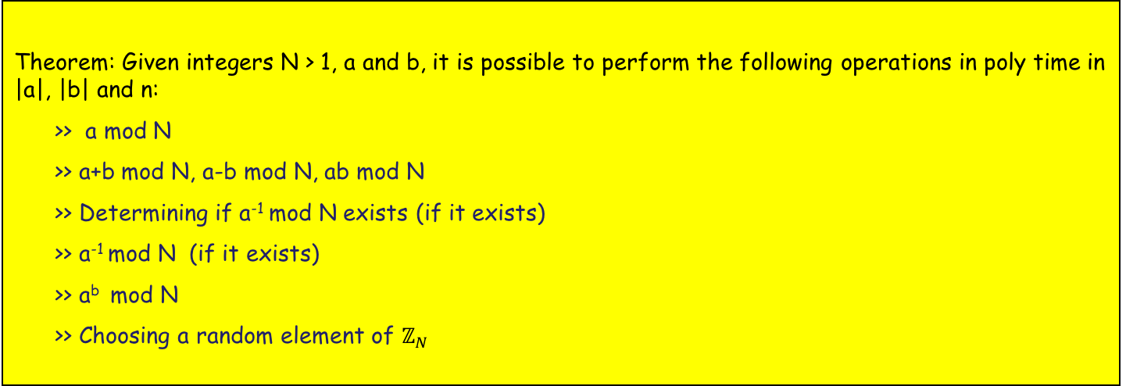
Algorithms for Modular Arithmetic
$ℤ_{N}$ - set of integers modulo N: {0, 1, …, N - 1}
Let |N| = n --- number of bits to represent N : n = Θ(log N)
Let a, b ∈ $ℤ_{N}$ - each represented by at most n bits
Theorem: Given integers N > 1, a and b, it is possible to perform the following operations in poly time in |a|, |b| and n:
>> a mod N
>> a+b mod N, a-b mod N, ab mod N
>> Determining if a⁻¹ mod N exists (if it exists)
>> a⁻¹ mod N (if it exists)
>> a^{b} mod N
>> Choosing a random element of $ℤ_{N}$

Slide 9
Group
Definition(Group): A group is a set G along with a binary operation o satisfying the following axioms :
Closure : for every g, h ∈ G, the value g o h ∈ G
Associativity: for every g₁, g₂, g₃ ∈ G, (g₁ o g₂) o g₃ = g₁ o (g₂ o g₃)
Existence of Identity Element: there exists an identity element e ∈ G, such that for all g ∈ G
(e o g) = g = (g o e)
Existence of Inverse: for every g ∈ G, there exists an element h ∈ G, such that
(g o h) = e = (h o g)
Definition (Order of a Group:) If G has finite number of elements, then |G| denotes the number of elements in G and is called the order of G
Definition(Abelian Group:) If G satisfies the following additional property then it is called a commutative (Abelien) group: For every g, h ∈ G, (g o h) = (h o g)
Proposition: There exists only one identity element in a group. Every element in a group has a unique inverse

Slide 10
Group Theory
The set of integers $ℤ$is an abelian group with respect to the addition operation (+)
Closure and associativity holds
The integer 0 is the identity element --- for every integer x, 0 + x = x = x + 0
For every integer x, there exists an integer –x, such that x + (-x) = 0 = (-x) + x
For any two integers x, y, we have x + y = y + x --- commutativity
We are interested only in Finite groups

Slide 11
Finite Groups
Define $ℤ$_{N} = {0, 1, …, N-1} and the operation + in $ℤ$_{N} as
a + b = (a + b) mod N, for every a, b ∈ $ℤ$_{N}
The set $ℤ$_{N} = {0, 1, …, N-1} is a group with respect to addition modulo N
- Closure, commutative and associativity holds --- trivial to verify
- 0 ∈ $ℤ$_{N} is the identity element --- for every a ∈ $ℤ$_{N}, (a + 0) mod N = (0 + a) mod N = a
- Element (N - a) is additive inverse of a modulo N
Define operation * in $ℤ$_{N} as a * b = (ab) mod N, for every a, b ∈ $ℤ$_{N}
- The identity element is 1 as for every a ∈ $ℤ$_{N}, we have (a . 1) = (1 . a) = (a mod N) = a
- Will every element have an inverse ?
Element 0 will have no inverse --- a ∈ $ℤ$_{N} such that (a0 mod N) = 1
Element a will have an inverse if and only if gcd(a, N) = 1
- So $ℤ$_{N} is NOT a group with respect to multiplication modulo N
- Can we construct a set from $ℤ$_{N} which will be a group with respect to multiplication modulo N ?

Slide 12
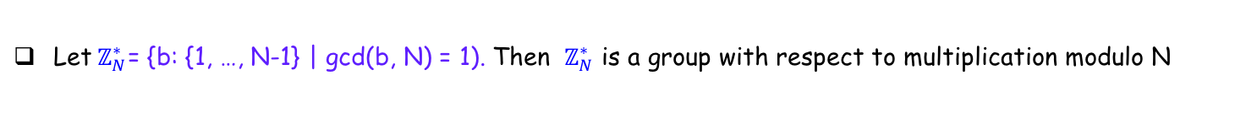

Finite Groups
Let${ ℤ}_{N}^{∗}$= {b: {1, …, N-1} | gcd(b, N) = 1). Then $ℤ_{N}^{∗}$ is a group with respect to multiplication modulo N
The set$ℤ_{N}^{∗}$ is the set of integers relatively prime to N
Element 1 is the identity element. Every element is invertible. Associativity holds.
- given a, b ∈ $ℤ_{N}^{∗}$, will [ab mod N] ∈ $ℤ_{N}^{∗}$
Is $ℤ_{N}^{∗}$ closed with respect to multiplication mod N ?
Claim: gcd(N, [ab mod N]) = 1
--- element [ab mod N] has multiplicative inverse [b⁻¹a⁻¹ mod N]

Slide 13
Group Order and Identity Element
Theorem: Let (G, o) be a group of order m, with identity element e. Then for every element g ∈ G:
g o g o … o g = e
m times
I.e. Any group element composed with itself m times results in the identity element
Proof: Let G = {g₁, …, g_{m}} --- for simplicity assume G to be an Abelian group
Let g be an arbitrary element of G
Claim: elements (g o g₁), (g o g₂), …, (g o g_{m}) are all distinct
On contrary if for distinct g_{i}, g_{j}, we have (g o g_{i}) = (g o g_{j}) → (g⁻¹ o g o g_{i}) = (g⁻¹ o g o g_{j}) → g_{i} = g_{j}
Thus {(g o g₁), (g o g₂), …, (g o g_{m})} = G
So g₁ o g₂ o … o g_{m} = (g o g₁) o (g o g₂) o … o (g o g_{m}) -- (both side we have all the elements of G)
= (g o g o … o g) o (g₁ o g₂ o … o g_{m}) –- (by associative and commutative property)
e = (g o g o … o g) o e -- (multiply by (g₁ o g₂ o … o g_{m})⁻¹ both sides)
e = (g o g o … o g) -- (a o e = a)

Slide 14
Order of $ℤ_{N}^{∗}$
$ℤ_{N}^{∗}$ = {b: {1, …, N-1} | gcd(b, N) = 1). It is a group with respect to multiplication modulo N
ϕ(N) = order of the above group
N is a prime number, say p
$ℤ_{p}^{∗}$ = {1, 2, …, p-1} --- every number from 1 to p-1 is relatively prime to p
N = p.q, where p and q are primes
$ℤ_{N}^{∗}$ = (p-1)(q-1) --- follows from the principle of mutual inclusion-exclusion
Which numbers in {1, 2, …, N-1} are not relatively prime to N ?
Numbers which are divisible by p --- q-1 such numbers
Numbers which are divisible by q --- p-1 such numbers
Numbers which are divisible by both p and q --- 0 such number
How many numbers in {1, 2, …, N-1} are not relatively prime to N ? --- p + q - 2
How many numbers in {1, 2, …, N-1} are relatively prime to N ? --- N -1 - p – q + 2 = (p-1)(q-1)

Slide 15
Relation of Group Order and Identity Element in ${ ℤ}_{N}^{∗}$
Theorem: Let (G, o) be a group of order m, with identity element e. Then for every element g ∈ G:
g o g o … o g = e
m times
I.e. Any group element composed with itself m times results in the identity element
- Take any arbitrary N > 1 and any a ∈ $ℤ_{N}^{∗}$. Then:
[[[[[a . a mod N] . a mod N] . a mod N] . a mod N] . … . a mod N] = [a^{ϕ(N)} mod N] = 1
ϕ(N) times
- If N is a prime number, say p, then for any a ∈ {1, 2, …, p-1}, we have :
[a^{p-1} mod p] = 1
If N is a composite number, p.q, then for any a we have :
[a^{(p-1)(q-1)} mod N] = 1

Slide 16
Permutation in a Group ($ℤ_{N}^{∗}$)
Theorem: Let (G, o) be a group of order m. Let e be an integer and define the function f_{e} : G $⟼$ G by f_{e} (g) = g^{e}. If gcd(e.m) =1, then f_{e} is a permutation. If d=e⁻¹ mod m, then f_{d} is the inverse of f_{e.}
f_{d} (f_{e} (g)) = f_{d} (g^{e}) = g^{ed} = g^{[ed mod m]} =g¹ = g
Theorem: Fix N. For integer e > 0 define f_{e} : $ℤ_{N}^{∗}$ $⟼$ $ℤ_{N}^{∗}$ by f_{e} (x) = x^{e} mod N. If gcd(e, ϕ(N)) =1, then f_{e} is a permutation. Moreover, if d=e⁻¹ mod ϕ(N), then f_{d} is the inverse of f_{e}.
RSA OWF: f(N,e,x) = (N, e, x^{e} mod N)

Slide 17



RSA Assumption
GenRSA (1^{n}): N; product of two n-bit primes
e; gcd(e, ϕ(N)) = 1
Experiment RSA-inv (n)
- Run GenRSA to obtain N, e
A, GenRSA
- x ∈_{R} $ℤ_{N}^{∗}$
PPT A(1^{n})
y = x^{e} mod N
x
I can break RSA
Let me verify
x^{e} = y
Game Output
x^{e} ≠ y
1 --- A won
0 --- A lost
The RSA problem is hard relative to GenRSA, if for every PPT algorithm A, there is a negligible function negl() :
Pr
RSA-inv (n)
= 1
≤
negl(n)
RSA assumption: the above is true!!
A, GenRSA

Slide 18
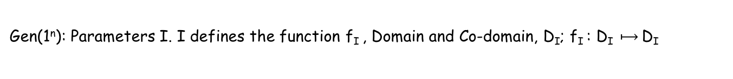

Family of One-Way Permutations- $Π$ = (Gen, Samp, f)
Gen(1^{n}): Parameters I. I defines the function f_{I} , Domain and Co-domain, D_{I}; f_{I} : D_{I} $⟼$ D_{I}
Samp(1^{n}, I): Uniform element from D_{I}
f(1^{n}, I, x): y
- All the above algorithms must be easy (PPT)
- Pr
Invert (n)
= 1
≤
negl(n)
A, $Π$
Gen(1^{n}): Run GenRSA to get N, e. Set I = (N,e) and D_{I} = $ℤ_{N}^{∗}$
Samp(1^{n}, I): Uniform element from $ℤ_{N}^{∗}$
f(1^{n}, I, x): x^{e} mod N

Slide 19


Slide 20
Group Exponentiation in Groups
Exponentiation: applying same operation on the same element a number of times in a group (G, o)
Using Multiplication Notation:
def
g^{m} = g o g o … o g (m times)
def
g^{-m} = (g⁻¹ o g⁻¹ o … o g⁻¹) (m times)
def
g⁰ = e, the group identity element
Using Addition Notation:
def
mg = g o g o … o g (m times)
def
-mg = (-g + -g + … + -g) (m times)
def
0g = e, the group identity element

