Slide 1
Cryptography
Lecture 12
Arpita Patra

Slide 2
Recall
If PRG exists, then so does PRF
Construction of PRF using PRG
Introduction to Hybrid Proof Technique
Proof

Slide 3
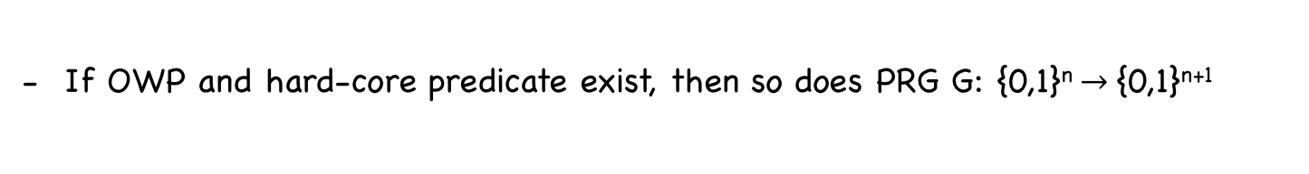
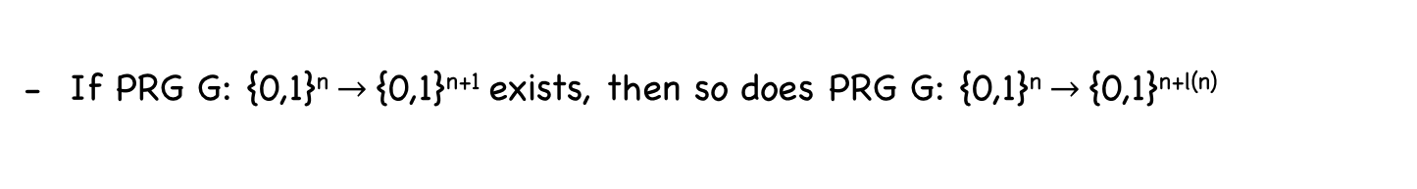
Today’s Goal
One-way Functions (OWF) & One-way Permutations (OWP)
Definition
Do they exist?
Candidate OWF
Hard-core Predicates of OWF/OWP
Definition
Non-triviality of finding it.
- Hard-core predicates from OWF/OWP (Goldreich-Levin Theorem) – partial proof
If OWP and hard-core predicate exist, then so does PRG G: {0,1}^{n} $→${0,1}^{n+1}
Construction
Proof
If PRG G: {0,1}^{n} $→${0,1}^{n+1} exists, then so does PRG G: {0,1}^{n} $→${0,1}^{n+l(n)}
Construction
Proof

Slide 4



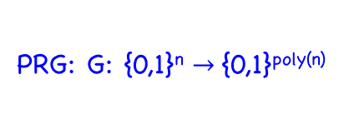
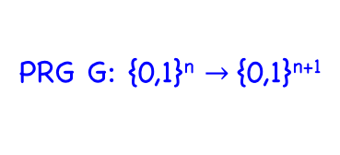
Roadmap
PRF
PRG: G: {0,1}^{n} $→${0,1}^{poly(n)}
PRG G: {0,1}^{n} $→${0,1}^{n+1}
OWF/P g, hc
OWF/P f

Slide 5
One-Way Functions (OWF)
Functions that are easy to compute but “difficult” to invert (almost-always)
f: {0, 1}* → {0, 1}*
{0, 1}*
{0, 1}*

Slide 6

One-Way Functions (OWF)
y = f(x)
x ∈ {0, 1}*
{0, 1}*
Easy task: Polynomial in |input|
{0, 1}*

Slide 7

One-Way Functions (OWF)
x = f⁻¹(y)
y ∈ {0, 1}*
{0, 1}*
Difficult task
{0, 1}*

Slide 8


The Inverting Experiment
Experiment Invert (n)
A, f
f: {0, 1}* → {0, 1}*
x ∈_{R} {0, 1}^{n}
PPT A(1^{n})
y = f(x)
x’
I can invert f on any input
A’s guess about pre-image of y
Let me verify
f(x’) = y
Game Output
f(x’) ≠ y
1 --- A won
0 --- A lost
- A need not have to find the original x to win the game --- sufficient to find one pre-image

Slide 9
OWF: Mathematical Formulation
f: {0, 1}* → {0, 1}*
{0, 1}*
{0, 1}*
Function f is a OWF if the following two conditions hold :
- Easy to compute: for every x ∈ {0, 1}*, f(x) can be computed in poly(|x|) times
- Hard to Invert: For every PPT algorithm A, there is a negligible function negl() :
Pr
Invert (n)
= 1
≤
negl(n)
≈
Pr [ A(f(x), 1^{n}) ∈ f⁻¹(f(x))] ≤ negl(n)
A, f
x ← {0, 1}^{n}
OWF does not exist in the realm of unbounded powerful adversary.
- Any function is invertible in principle given enough time/computational power.
- The assumption of existence of OWF is about computational hardness.

Slide 10

Functions that are not one-way (non-OWFs)
Pr
Invert (n)
= 1
≤
negl(n)
≈
Pr [ A(f(x), 1^{n}) ∈ f⁻¹(f(x))] ≤ negl(n)
A, f
x ← {0, 1}^{n}
For a function to be non-OWF, there should exist an A, p(n) s.t
Pr [ A(f(x), 1^{n}) ∈ f⁻¹(f(x))] $≥$ 1/p(n) for infinite many n’s
x ← {0, 1}^{n}
Example I: Consider f s.t.
f is not one-way
Pr [ A(f(x), 1^{n}) ∈ f⁻¹(f(x))]
> 1/n¹⁰ when n is even
x ← {0, 1}^{n}
≤ negl(n) when n is odd
Example II: f(x, y) = x. y, where x, y ∈ N
f is not one-way
≥ 3/4
Pr [ A(f(x, y), 1^{n}) ∈ f⁻¹(f(x, y))]
x, y ← {0,1}^{n/2}
xy: even $→$ (2, xy/2) is a pre-image)
Example III: f(x) = x₁x₂……x_{n-1}, where x ∈ {0,1}^{n}
f is not one-way
Pr [ A(f(x), 1^{n}) ∈ f⁻¹(f(x))] = 1/2
x ← {0, 1}^{n}

Slide 11

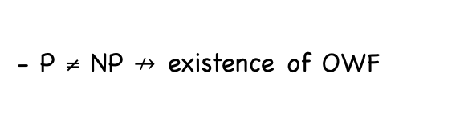
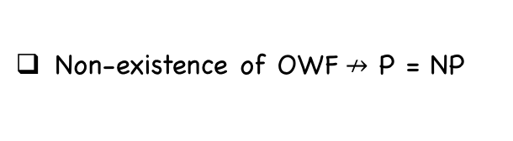

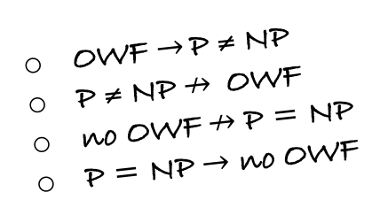
Do OWFs Exist?
No unconditional proof of their existence yet.
- Proof is hard because
existence of OWF $→$ P ≠ NP
OWF $→$ P ≠ NP
P ≠ NP $↛$OWF
no OWF$↛$ P = NP
P = NP $→$ no OWF
- Finding a proof will lead to solving the million dollar question in CS whether P = NP or not
Whole world believes that they do and so existence of OWF is an assumption/conjecture
- Several noteworthy computational problems (int. factorization) received intensive attention since ages (even before crypto was born) but no poly time algo is found.
- P ≠ NP $↛$existence of OWF
> The former suggests every PPT algo must fail to solve at least for one input
> The latter suggests every PPT algo must fail to solve ALMOST ALWAYS (for any random input)
- Being NP-complete is not enough to be a candidate OWF
- Belief that OWF exists is much more than believing P ≠ NP
Non-existence of OWF$↛$ P = NP
But, P = NP $→$ non-existence of OWF

Slide 12
Candidate OWFs
Subset Sum Problem:
f(x₁,…..,x_{n}, J) = (x₁,…..,x_{n}, $∑_{j∈J}$ x_{j} mod 2^{n} ) : each x_{i} is a n-bit string, J is a n-bit string
Integer Factorization:
f(x, y) = xy : x and y are equal length primes.

Slide 13
One-Way Permutation (OWP)
f: {0, 1}* → {0, 1}*
{0, 1}*
{0, 1}*
Function f is length-preserving if |f(x)| = |x| for all x
Size of the image and pre-image are the same
Function f is a OWP if it is a OWF and
Length-preserving
One-to-one mapping
If f is a OWP then every y has a unique pre-image x
Still finding x should be hard in polynomial time

Slide 14
Hard-Core Predicates
Let f: {0, 1}* → {0, 1}* be a OWF
- Given y = f(x) for a random x, computing the entire x is hard
- Does this mean nothing about x can be determined from f(x) ?
Given f, define g as follows:
- g(x₁, x₂) = (x₁, f(x₂)), where |x₁| = |x₂|
- g too is OWF (otherwise inverter of g can be used to invert f) !!
- but it leaks half of its input !!
In general, f(x) does NOT hide everything about x.
But, f(x) must hide something about x (otherwise computing x would have been easy)
- “something” that remains hidden about x even given f(x) is captured by hard-core predicates
- They are one bit of info about x that is hard to guess given f(x).
- Modelled as a Boolean function: hc: {0, 1}* → {0, 1}

Slide 15
Hard-Core Predicates
- Let f: {0, 1}* → {0, 1}* be ANY function (need not be a OWF)
- Let hc: {0, 1}* → {0, 1} be a Boolean function
Function hc is a hard-core predicate for the function f if the following holds:
- Given x, the value hc(x) can be computed in polynomial (in input size) time
- Pr [ A(f(x), 1^{n}) = hc(x)] ≤ ½ + negl(n)
x ← {0, 1}^{n}
Hard-core Predicate may exist even for functions that are NOT one-way
- Non-OWF: f(x₁, …, x_{n}) = (x₁, …, x_{n-1})
- hc(x₁, …, x_{n}) = x_{n}
- For a RANDOM x, given f(x₁, …, x_{n}), hc(x₁, …, x_{n}) can be guessed with prob. ½
We are NOT interested in hard-core predicates of functions that are NOT one-way.

Slide 16
Hard-Core Predicates for Permutations
- Let f: {0, 1}* → {0, 1}* be a permutation
- Let hc: {0, 1}* → {0, 1} be a Boolean function
Function hc is a hard-core predicate for the permutation f if the following holds:
- Given x, the value hc(x) can be computed in polynomial (in input size) time
- Pr [ A(f(x), 1^{n}) = hc(x)] ≤ ½ + negl(n)
x ← {0, 1}^{n}
Does hardcore predicates exist for permutations that are not one-way
- Not possible
CT 16 (one): If a one-to-one function has hard-core predicate then it must be one-way.

Slide 17

Finding HCPs for OWF/OWP is not Simple
Let f: {0, 1}* → {0, 1}* be a OWF
- Given f(x₁, …, x_{n}) for a random x = x₁, …, x_{n}, at least one of the bits of x must be hidden --- as f is a OWF
- So computing x₁ ⊕ … ⊕ x_{n} from f(x₁, …, x_{n}) must be hard
- So hc(x₁, …, x_{n}) = x₁ ⊕ … ⊕ x_{n} is a hard-core predicate for f
Consider g constructed using f
- g(x₁, …, x_{n}) = (f(x₁, …, x_{n}), x₁ ⊕ … ⊕ x_{n})
- g is a OWF (else f is not a OWF; proof by reduction)
- hc(x) = x₁ ⊕ … ⊕ x_{n} is not a HCP for g
For a given fixed Boolean function hc(x), there always exist a OWF f such that hc is not a hard-core predicate for the function f

Slide 18
Does HCP exist for any OWF?
No proof yet.
Given a OWF f, we can construct a OWF g and its HCP.
Weaker yet sufficient for our purpose
Theorem (Goldreich-Levin): Assume OWF (OWP) exists, then there exists a OWF (OWP) g and a hard-core predicate hc for g.
- Let f be a OWF/OWP
- g(x, r) = (f(x), r), where x = x₁, …, x_{n} and r = r₁, …, r_{n}.
- hc(x, r) = r₁x₁ ⊕ … ⊕ r_{n}x_{n} is a hard-core predicate for the function g
Theorem (Goldreich-Levin): Let f be a OWF/OWP and define g by g(x, r) = (f(x), r), where x = x₁, …, x_{n} and r = r₁, …, r_{n}. Then the Boolean function hc(x, r) = r₁x₁ ⊕ … ⊕ r_{n}x_{n} is a hard-core predicate for the function g

Slide 19






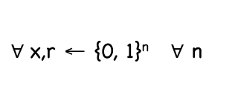
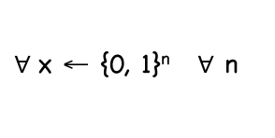
Goldreich Levin Theorem
Theorem (Goldreich-Levin): Let f be a OWP and define g by g(x, r) = (f(x), r), where x = x₁, …, x_{n} and r = r₁, …, r_{n}. Then the Boolean function hc(x,r) = r₁x₁ ⊕ … ⊕ r_{n}x_{n} is a hard-core predicate for the function g
Proof:
A’
A
Difficulty Level
Pr[A’(f(x), 1^{n}) = x))] $≥$ 1/p’(n)
*****
Pr[A(f(x),r) = hc(x,r)] $≥$ ½ + 1/p(n)
x ← {0, 1}^{n}
x,r ← {0, 1}^{n}
Pr[A’(f(x), 1^{n}) = x))] $≥$ 1/4p(n)
***
Pr[A(f(x),r) = hc(x,r)] $≥$ ¾ + 1/p(n)
x ← {0, 1}^{n}
x,r ← {0, 1}^{n}
Pr[A’(f(x)) = x))] = 1
*
Pr[A(f(x),r) = hc(x,r)] = 1
$∀$x ← {0, 1}^{n} $∀$ n
$∀$x,r ← {0, 1}^{n} $∀$ n

Slide 20

GL Theorem: The Most Simple Case (*)
- g(x, r) = (f(x), r), x = x₁, …, x_{n} and r = r₁, …, r_{n}.
- hc(x, r) = r₁x₁ ⊕ … ⊕ r_{n}x_{n}
Pr[A’(f(x)) = x))] = 1
Pr[A(f(x),r) = hc(x,r)] = 1
$∀$x ← {0, 1}^{n} $∀$ n
$∀$x,r ← {0, 1}^{n} $∀$ n
A’
A
f(x₁, …, x_{n})
f(x₁, …, x_{n}), (1, 0, …, 0)
x₁ ⊕ 0 … ⊕ 0
Aha! x₁
f(x₁, …, x_{n}), (0, 1, …, 0)
Aha! x₂
0 ⊕ x₂ … ⊕ 0
f(x₁, …, x_{n}), (0, 0, …, 1)
x₁, …, x_{n}
Aha! x_{n}
0 ⊕ 0… ⊕ x_{n}

Slide 21



GL Theorem: The Most Simple Case (*)
- g(x, r) = (f(x), r), x = x₁, …, x_{n} and r = r₁, …, r_{n}.
- hc(x, r) = r₁x₁ ⊕ … ⊕ r_{n}x_{n}
Why 1:
Does not guarantee the hcs are correct for sure; may be it always fails for r= (1,0,…,0,0)
Pr[A’(f(x)) = x))] $≥$ 1/4p(n)
Pr[A(f(x),r) = hc(x,r)] $≥$ ¾ + 1/p(n)
x ← {0, 1}^{n}
x,r ← {0, 1}^{n}
A’
Why 2:
A
Adv’s power can retrieved when queried on random r (here r’s are not random)
f(x₁, …, x_{n})
f(x₁, …, x_{n}), (1, 0, …, 0)
x₁ ⊕ 0 … ⊕ 0
Aha! x₁
f(x₁, …, x_{n}), (0, 1, …, 0)
Aha! x₂
0 ⊕ x₂ … ⊕ 0
f(x₁, …, x_{n}), (0, 0, …, 1)
x₁, …, x_{n}
Aha! x_{n}
0 ⊕ 0… ⊕ x_{n}

Slide 22
Roadmap
PRF
PRG: G: {0,1}^{n} $→${0,1}^{poly(n)}
PRG G: {0,1}^{n} $→${0,1}^{n+1}
OWF/P g, hc
OWF/P f

Slide 23

PRG with Minimal Expansion from OWP and HCP
Theorem: Let f be a OWP with hard-core predicate hc. Then the algorithm G(s) = f(s)||hc(s) is a PRG with expansion factor n+1
f: {0, 1}^{n} → {0, 1}^{n} (bijection)
{0, 1}^{n}
{0, 1}^{n}
- s uniform random → f(s) uniformly random
- Given f(s), the value hc(s) is close to random
r₁….r_{n}
r_{n+1}
f(s)
hc(s)
r $∈$ {0,1}^{n+1}
f(s)||hc(s) $∈$ {0,1}^{n+1}
- First n bits have same dist. (purely random)
- Last bit is random in r but ”close to” random in the latter

Slide 24

PRG with Minimal Expansion from OWP and HCP
Theorem: Let f be a OWP with hard-core predicate hc. Then the algorithm G(s) = f(s)||hc(s) is a PRG with expansion factor l(n) = n+1
Hard-core Breaker A
Distinguisher D
f(s)
hc(s)
Pr[D(r) = 1 ] - Pr[D(G(s)) = 1])
= Pr[D(f(s) || r’) = 1 ]
-
Pr[D(f(s) || hc(s)) = 1]
r ← {0, 1}^{n+1}
s ← {0, 1}^{n}
s ← {0,1}^{n} r’ ← {0,1}
s ← {0, 1}^{n}
= ½ Pr[D(f(s) || hc(s)) = 1]
+ ½ Pr[D(f(s) || hc’(s)) = 1]
-
Pr[D(f(s) || hc(s)) = 1]
s ← {0,1}^{n}
s ← {0,1}^{n}
s ← {0, 1}^{n}
= ½ (Pr[D(f(s) || hc’(s)) = 1]
- Pr[D(f(s) || hc(s)) = 1])
$≥$ 1/p(n)
s ← {0,1}^{n}
s ← {0,1}^{n}

Slide 25
PRG with Minimal Expansion from OWP and HCP
Theorem: Let f be a OWP with hard-core predicate hc. Then the algorithm G(s) = f(s)||hc(s) is a PRG with expansion factor l(n) = n+1
Hard-core Breaker A
Distinguisher D
f(s)
f(s)||r
_{b}
Pick a random r
If b =0, return r
Else return r’
Pr[A(f(s)) = hc(s)]
= Pr[A(f(s)) = hc(s) $∧$ r = hc(s)] + Pr[A(f(s)) = hc(s) $∧$ r $≠$ hc(s)]
s ← {0, 1}^{n}
s ← {0, 1}^{n}
s ← {0, 1}^{n}
= ½ ( Pr[A(f(s)) = hc(s) $|$ r = hc(s)] + Pr[A(f(s)) = hc(s) $|$ r $≠$ hc(s)] )
s ← {0, 1}^{n}
s ← {0, 1}^{n}
= ½ ( Pr[D(f(s) || hc(s)) =0 ] + Pr[D(f(s) || hc’(s)) =1] )
s ← {0, 1}^{n}
s ← {0, 1}^{n}
= ½ + ½ ( Pr[D(f(s) || hc’(s)) =1 ] - Pr[D(f(s) || hc(s)) =1] )
$≥$½ + 1/p(n)
s ← {0, 1}^{n}
s ← {0, 1}^{n}

Slide 26
Roadmap
PRF
PRG: G: {0,1}^{n} $→${0,1}^{poly(n)}
PRG G: {0,1}^{n} $→${0,1}^{n+1}
OWF/P g, hc
OWF/P f

Slide 27
PRG with poly Expansion Factor
Theorem: If there is a PRG with expansion factor l(n) = n+1, then for any poly(n), there exists a PRG G’ with expansion factor poly(n).
$→$
PRG G: {0, 1}^{n} → {0, 1}^{n+1}
PRG G’: {0, 1}^{n} → {0, 1}^{poly(n)}
s: seed of G
s: seed of G’
n bits 1 bit
G(s)
G_{n} : {0, 1}^{n} → {0, 1}^{n}
G_{n+1} : {0, 1}^{n} → {0, 1}
G_{n}(s) = First n bits of G(s)
G_{n+1}(s) = (n+1)th bit of G(s)

Slide 28
PRG with poly Expansion Factor
$→$
PRG G: {0, 1}^{n} → {0, 1}^{n+1}
PRG G’: {0, 1}^{n} → {0, 1}^{n+p(n)}
s: seed of G
s: seed of G’
n bits 1 bit
G(s)
G_{n}(s) = First n bits of G(s)
G_{n+1}(s) = (n+1)th bit of G(k)
s
G_{n}(s)
G_{n+1}(s)
Proof via hybrid arguments ☺
G_{n}(G_{n}(s))
G_{n+1}(G_{n}(s))
G_{n+1}(s)
p(n)
G_{n}(G_{n} ……G_{n}(s)))
……
G_{n+1}(G_{n}(s))
G_{n+1}(s)
n + p(n)

Slide 29
Proof
H₀ : Distribution on leaves when the root (0th level node) is a random string
H₀ : Uniform Distribution on all strings of length (n+p(n)) generated by G’
- Can you think of a reduction to the distinguisher that distinguishes a RS from a PSR of length (n+1)?
- Hybrids??
H_{n+p(n)} : Distributions on leaves when the leaves (p(n)th level nodes) are random strings
H_{n+p(n)} : Uniform Distribution on ALL strings of length (n+p(n))

Slide 30
Proof
H₀ : Distribution on the leaves when the 0th level is a random string
-
<
Pr [D (G’(s)) = 1]
Pr [D(r₁) = 1]
negl(n)
+
H_{i-1} : Distributions on the leaves when the (i-1)th level is a random string
-
<
Pr [D(r_{i-1}) = 1]
Pr [D(r_{i}) = 1]
negl(n)
H_{i} : Distributions on the leaves when the ith level is a random string
+
-
<
Pr [D(r_{n’-1}) = 1]
Pr [D(r) = 1]
negl(n)
H_{n’} : Distributions on the leaves when the nth level is a random string

Slide 31
Proof via Hybrid Argument
-
<
Pr [D(G’(s)) = 1]
Pr [D(r) = 1]
n’. negl(n)

Slide 32
Proof
H_{i-1} : Distributions on the leaves when the (i-1)th level is a random string
Lemma: If G: {0, 1}^{n} → {0, 1}^{n+1} is a PRG
|
-
|
Pr [A(r) = 1]
Pr [D(G(s)) = 1]
≤ negl(n)
s∈_{R} {0,1}^{n}
r ∈_{R} {0,1}^{n+1}
then
-
<
Pr [D(G’(s)) = 1]
Pr [D(r) = 1]
negl(n)
s∈_{R} {0,1}^{n}
r ∈_{R} {0,1}^{n’}
H_{i} : Distributions on the leaves when the ith level is a random string

Slide 33

Proof
H_{i-1} : Distributions on the leaves when the (i-1)th level is a random string
z: PRS
Pr [D(z) = 1]
Pr [D’(r_{i-1}) = 1]
PPT Distinguisher for G
PPT Distinguisher for G’
RS or PRS?
y
z∈ {0,1}^{n+1}
b
b
- Flip i-1 random coins z_{n+2},…z_{n+i}
Complete tree and let y be the output
z: RS
Pr [D(z) = 1]
Pr [D’(r_{i} ) = 1]
H_{i} : Distributions on the leaves when the ith level is a random string

Slide 34
Roadmap
PRF
PRG: G: {0,1}^{n} $→${0,1}^{poly(n)}
PRG G: {0,1}^{n} $→${0,1}^{n+1}
OWF/P g, hc
OWF/P f

Slide 35


