Slide 1
Cryptography
Lecture 11
Arpita Patra

Slide 2
Recall
>> cpa-security to cca-security
Padding Oracle Attack on CBC mode
Attack on cpa-secure scheme from PRF
>> MAC
Definitions- cma, scma, cmva, scmva

Slide 3
Today’s Goal
Recall of security definitions of MAC
Construction from PRF
Domain Extension: How to find a tag for long message
CBC-MAC
Authenticated Encryption (AE)- message privacy + integrity
Definition
Any AE is cca-secure. Stronger than cca-security. Nontrivial proof
Construction of AE from- cpa-secure SKE + cma-secure MAC

Slide 4
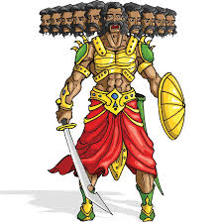

Security for MAC
Randomized
PPT
Chosen Message Attack (CMA)
It is not possible to come up with (m,t) if no tag on m is not seen before
It is not possible to come up with (m,t) if (m,t) is not seen before
Randomized
PPT
Chosen Message and Verification Attack (CMVA)
It is not possible to come up with (m,t) if (m,t) has not been seen before.
It is not possible to come up with (m,t) if (m,t) is not seen before

Slide 5

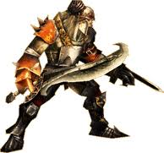
CMA Security for MAC
cma
Experiment Mac-forge (n)
Π = (Gen, Mac, Vrfy), n
A, Π
Attacker A
Training Phase
(m, t)
k
I can break Π
Let me verify
Forged tag generated by A
Gen(1^{n})
Run time: Poly(n)
Q = {(m₁, …,m_{l} }
game output
1 (A succeeds) if Vrfy_{k}(m, t) = 1 and m ∉ Q
0 (A fails) otherwise
Π is CMA- secure if for every A, there is a negl(n) such that
cma
Pr [Mac-forge (n) = 1] ≤ negl(n)
A, Π

Slide 6
Strong CMA Security for MAC
cma
Experiment Mac-sforge (n)
Π = (Gen, Mac, Vrfy), n
A, Π
Attacker A
Training Phase
(m, t)
k
I can break Π
Let me verify
Forged tag generated by A
Gen(1^{n})
Run time: Poly(n)
Q = {(m₁, t₁), …,(m_{l} , t_{l})}
game output
1 (A succeeds) if Vrfy_{k}(m, t) = 1 and (m, t) ∉ Q
0 (A fails) otherwise
Π is strong CMA-secure if for every A, there is a negl(n) such that
cma
Pr [Mac-sforge (n) = 1] ≤ negl(n)
A, Π

Slide 7
CMA and strong CMA Security
- It is NOT true that you need randomized MAC to satisfy scma-security
- Any MAC that has canonical verification and cma-secure is also scma-secure.
- Every deterministic MAC has canonical verification
- For deterministic MAC, enough to prove cma-security as scma security is ‘free’
- PRF-based scheme is scma-secure (because it is deterministic and provably cma-secure).

Slide 8
What is not Captured in MAC Security Definition
If A returns (m,t) for a already queried message, we don’t consider that as the break.
>> What it captures in real scenario? if (m,t) is a valid pair generated by the sender, then there is no harm if the receiver accepts it even though adv forwards it (may be at a later point of time)
>> Is it problematic?
>> Let a bank user X sends the following instruction to the bank:
“transfer ₹ 1000 from account #X to account #Y“
>> What if an attacker simply sends 10 copies of the original (message, tag) pair --Bank will consider each request genuine --- disaster for X
>> The above attack is called replay attack
Why Replay Attack is not taken care in MAC Definition
>> Whether this attack is of concern depends on actual application scenario
>> So it is better to deal with this in the outer protocol (that used MAC for authentication)
>> Additional techniques like (synchronized) counters, timestamp, etc are used

Slide 9
Fixed-length MAC from PRF
Let F:{0, 1}^{n} x {0, 1}^{n} → {0, 1}^{n} be a PRF
Then Π = (Gen, Mac, Vrfy) is a fixed-length MAC for n-bit strings where :
k
k
1^{n}
k∈_{R} {0, 1}^{n}
m∈{0, 1}^{n}
t:= F_{k}(m)
m,t
0, if t ≠ F_{k}(m)
Gen
Mac
Vrfy
1, if t = F_{k}(m)
(Deterministic Mac)
Theorem: If F is a PRF then Π is a cma-secure MAC.
Show that if Π is not cma-secure then F is not a PRF by designing a distinguisher for F
If instead a TRF f was used to compute tag then an attacker can guess f(m) for a “new” m with probability at most 2^{-n}
The same should hold even if a PRF is used (as key is unknown)

Slide 10


Security Proof
Theorem. If F_{k} is a PRF, then Π is a CMA-secure scheme.
Proof: Assume Π is NOT secure
cma
cma
A, p(n):
Pr
forge (n)
= 1
>
Pr
1/p(n)
forge (n)
= 1
= 2^{-n}
A, Π
A, Π
=
F_{k}
=
f
Pr [D () = 1]
Pr [D () = 1]
D
A
m₁
m₁
y₁
(m₁, y₁)
F_{k}(PRF)
f (TRF)
Repeat
Repeat
Q = {m₁, …,m_{l} }
m
(m,t)
y
1 if y = t & m ∉ Q
0 otherwise

Slide 11
Domain Extension
Given a scheme that handles fixed-length message.
How to handle arbitrary-length messages
SKE
MAC
Break the message into blocks and encrypt each block using fixed-length scheme (minimum security notion CPA-security)
The same does not work here– Additional tricks necessary
Want efficiency?– Go for Mode of operations
Want efficiency?– CBC-MAC, C-MAC, Hash-and-MAC, HMAC

Slide 12


Domain Extension
Warning!! Simple ideas do not work !!
Attempt I
Divide the message into blocks and authenticate each separately via fixed-length MAC
n
n
n
m
m₁
m₂
m₃
k
Mac
Mac
Mac
Mac_{k}(m) = t = t₁ || t₂ || t₃
t₁ = Mac_{k}(m₁)
t₂ = Mac_{k}(m₂)
t₃ = Mac_{k}(m₃)
Block re-ordering attack :
Given (m, t), where m = m₁ || m₂ || m₃ and t = t₁ || t₂ || t₃
Then (m’, t’) is a valid pair, where m’ = m₂ || m₁ || m₃ and t’ = t₂ || t₁ || t₃
Notes:
CPA secure Encryption scheme it was easy…just encrypt for individual blocks..similar idea does not work..this shows that MAC is a completely different ball game.

Slide 13
Domain Extension for MAC
Warning!! Simple ideas do not work !!
Attempt II
Prevent the previous attack by authenticating block index along with each block
n
n
n
m
1
m₁
2
m₂
3
m₃
k
Mac
Mac
Mac
Mac_{k}(m) = t = t₁ || t₂ || t₃
t₁ = Mac_{k}(1 || m₁)
t₂ = Mac_{k}(2 || m₂)
t₃ = Mac_{k}(3 || m₃)
Truncation attack :
A valid (msg, tag) pair can be generated by dropping (msg, tag) blocks from the end
(m₁ || m₂, t₁ || t₂) is a valid new (msg, tag) pair generated from (m₁ || m₂ || m₃, t₁ || t₂ || t₃)

Slide 14
Domain Extension for MAC
Warning!! Simple ideas do not work !!
Attempt III
Prevent the previous attack by additionally authenticating message length with each block
l = 3n
m
l
1
m₁
l
2
m₂
l
3
m₃
k
Mac
Mac
Mac
Mac_{k}(m) = t = t₁ || t₂ || t₃
t₁ = Mac_{k}(l || 1 || m₁)
t₂ = Mac_{k}(l || 2 || m₂)
t₃ = Mac_{k}(l || 3 || m₃)
Mix-and-match attack :
Suppose attacker learns (m₁ || m₂ || m₃, t₁ || t₂ || t₃) and (m’₁ || m’₂ || m’₃, t’₁ || t’₂ || t’₃) where | m₁ || m₂ || m₃ | = | m’₁ || m’₂ || m’₃ |
Then (m₁ || m’₂ || m₃, t₁ || t’₂ || t₃) is a valid, new (message, tag) pair

Slide 15
Domain Extension for MAC
Warning!! Simple ideas do not work !!
Ahhhh Finally!
Attempt IV
Prevent the previous attack by additionally authenticating a random identifier with each block; a fresh random identifier for each message
l
m
r
l
1
m₁
r
l
2
m₂
r
l
3
m₃
k
Mac
Mac
Mac
Mac_{k}(m) = t = t₁ || t₂ || t₃
t₁ = Mac_{k}(r || l || 1 || m₁)
t₂ = Mac_{k}(r || l || 2 || m₂)
t₃ = Mac_{k}(r || l || 3 || m₃)
Is this construction secure ? --- yes (it is in fact a randomized MAC)
Is Randomization necessary for domain extension?-- NO
But this is highly inefficient --- each invocation of Mac is now invoked only on n/4 bits of m
So if |m| = dn bits, then it requires 4d invocations of Mac algorithm and tag size is 4dn bits
Notes:
There are lots of applications out there for authentication where resource constrained devices are involved. RFID chips in identity cards. Randomization is a bane for such devices..need to go for determinism..

Slide 16
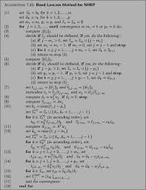
CBC-MAC for Arbitrary-length Messages
Let F: {0, 1}^{n} x {0, 1}^{n} → {0, 1}^{n} be a PRF, whose key k is agreed between S and R
Let S has a message m with |m| = dn, where d is some polynomial in n
CBC-Mac:
m
m₁
m₂
m₃
|m|
⊕
⊕
⊕
k
F
F
F
F
t = Mac_{k}(m)
Length of m (i.e. |m|) need to be prepended, not appended --- otherwise insecure
4dn bits
4d invocations of PRF
The tag consists of only n bits
Highly efficient
Only d invocations of PRF

Slide 17
Information-theoretic MAC
RA13: Definition (restriction on key usage/one-time)
Construction from Universal Function
Proof of security
RA14: Limitations of i.t MAC

Slide 18

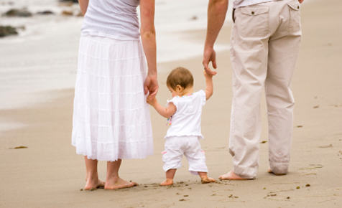
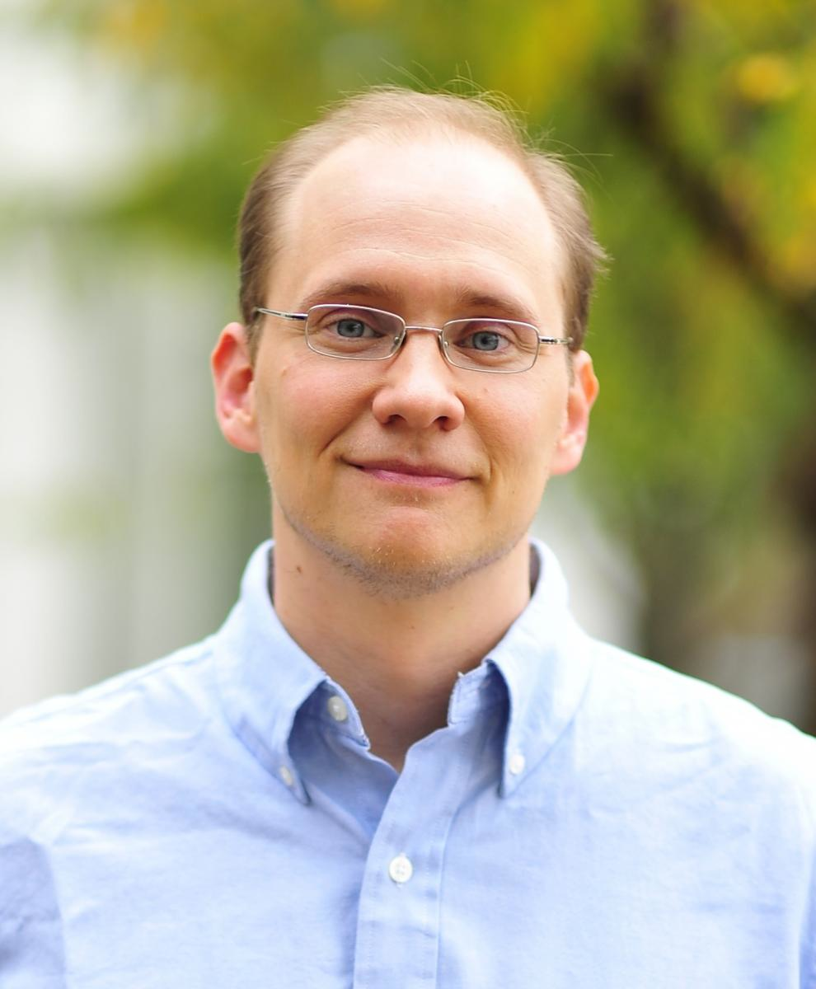


The Picture Till Now
SKE
MAC
Privacy
Integrity & Authentication
Not necessarily provide integrity and authentication;
>> easy to come of with a valid ciphertext
>> easy to manipulate known ciphertext
Not necessarily provide privacy;
>> Easy to distinguish tags of two different messages
Authenticated Encryption
Mihir Bellare, Chanathip Namprempre:
Authenticated Encryption: Relations among Notions and Analysis of the Generic Composition Paradigm. ASIACRYPT 2000: 531-545
Jonathan Katz, Moti Yung:
Unforgeable Encryption and Chosen Ciphertext Secure Modes of Operation. FSE 2000: 284-299
Notes:
They complement each other so nicely. What do you think about them as a couple. Let’s marry them off. Think of their child. Wonderful features. Privacy and authetication together! But w are not the ones to note it first and foresee the qualities of their child.

Slide 19
Authenticated Encryption
AE
Open channel
Secure & Authenticated channel
But how do we define such security of such a primitive ?
Way out: try to capture secrecy and authenticity/integrity separately in the definition
Π is an authenticated encryption scheme if no PPT attacker is able to non-negligibly win the CPA-experiment and CiIn experiment with respect to Π
Let Π = (Gen, Enc, Dec) be a SKE. Intuitively we demand the following secrecy and integrity property to be satisfied by Π to qualify it as an AE scheme :
For secrecy, we demand CPA security: no PPT attacker should be able to non-negligibly distinguish between encryption of two messages of its choice, even if it has access to encryption oracle service
>> Ci-In is similar in spirit of Mac-sforge
>> We need to introduce new game and definition since MAC and SKE has different sintax
For integrity/authentication, we demand something similar to strong cma-security for MAC. No PPT attacker can come up with a valid ciphertext for ANY message). Implies if receiver has received a valid ciphertext that it is THE ciphertext sent by the sender.
Modeled via a new experiment which exactly captures the above --- CiIn
Notes:
Needs new style of security definitions: real world/ ideal world, can captures a lot more scenarios that occur in practice which cannot be captured via game based definitions.. Will be taught in my next course..

Slide 20
Authenticated Encryption
Π = (Gen, Enc, Dec) is an authenticated encryption if
- Π = (Gen, Enc, Dec) is cpa-secure AND
- Π = (Gen, Enc, Dec) has ciphertext integrity (hard to come up with a ciphertext that has valid decryption even after sufficient training )

Slide 21
Ciphertext Integrity Experiment
Experiment CiIn (n)
Π = (Gen, Enc, Dec)
A, Π
PPT Attacker A
Encryption Oracle
message
k
Encryption
I can forge Π
Let me verify
Gen(1^{n})
Ciphertext c
Q = {c₁, …, c_{t}}
game output
Dec_{k}(c) = m ≠ ⊥
Dec_{k}(c) = m = ⊥
and
or
c ∉ Q
c ∈ Q
1
0
Π Has ciphertext intigrity if for every PPT A:
Pr
CiIn (n)
≤
negl(n)
A, Π

Slide 22
Ingredients for Authenticated Encryption
>> cpa-secure SKE
>> scma-secure MAC
>> How to combine them– crux of AE

Slide 23
Attempt I (Encrypt-and-Authenticate)
Let Π_{E} = (Enc, Dec) be a cpa-secure SKE and Π_{M} = (Mac, Vrfy) be a scma-secure MAC
Algorithm Gen in both Π_{E} and Π_{M} selects a random key from the respectively domain
k_{E}
Encryption
k_{E}
Decryption
c
m
Enc
c
Dec
m
(c, t)
(c, t)
m
t
t
1
k_{M}
Mac
k_{M}
Vrfy
k_{E} and k_{M} are independent keys for Π_{E} and Π_{M}

Slide 24
Attempt I (Encrypt-and-Authenticate)
Let Π_{E} = (Enc, Dec) be a cpa-secure SKE and Π_{M} = (Mac, Vrfy) be a scma-secure MAC
Algorithm Gen in both Π_{E} and Π_{M} selects a random key from the respectively domain
k_{E}
Encryption
k_{E}
Decryption
c
m
Enc
c
Dec
m
(c, t)
(c, t)
⊥
t
t
0
k_{M}
Mac
k_{M}
Vrfy
k_{E} and k_{M} are independent keys for Π_{E} and Π_{M}
In general this approach is not recommended
This approach used in SSH --- does this guarantee authenticated encryption ?
Not necessarily --- a secure MAC not necessarily preserves the privacy of m
Ex: a MAC may always output the first two bits of m as the first two bits of MAC tag

Slide 25
Attempt II (Authenticate-then-Encrypt)
Let Π_{E} = (Enc, Dec) be a cpa-secure SKE and Π_{M} = (Mac, Vrfy) be a scma-secure MAC
Algorithm Gen in both Π_{E} and Π_{M} selects a random key from the respective domain
k_{M}
Encryption
k_{E}
Decryption
t
Dec
Mac
m || t
m
c
c
m
k_{M}
Vrfy
1
k_{E}
Enc

Slide 26
Attempt II (Authenticate-then-Encrypt)
Let Π_{E} = (Enc, Dec) be a cpa-secure SKE and Π_{M} = (Mac, Vrfy) be a scma-secure MAC
Algorithm Gen in both Π_{E} and Π_{M} selects a random key from the respectively domain
k_{M}
Encryption
k_{E}
Decryption
t
Dec
Mac
m || t
m
c
c
⊥
k_{M}
Vrfy
0
k_{E}
Enc
This approach used in SSL --- does this guarantee authenticated encryption ?
In general this approach is not recommended
Unfortunately the above approach does not always lead to an authenticated cipher
There exists an instantiation of Π_{E} which is cpa-secure and which when combined with any MAC using the above approach does not lead to an authenticated cipher
CBC-mode of encryption + MAC using above approach → authenticated encryption
Security of this approach depends upon the underlying instantiation of Π_{E}
Notes:
We have specific example where this approach leads to insecure protocol. So generically we can not build secure AE using this approach. With specific instantiation you have to prove separately which may be cumbersome..

Slide 27
Attempt III (Encrypt-then-Authenticate)
Let Π_{E} = (Enc, Dec) be a cpa-secure SKE and Π_{M} = (Mac, Vrfy) be a scma-secure MAC
Algorithm Gen in both Π_{E} and Π_{M} selects a random key from the respectively domain
k_{E}
Encryption
k_{E}
Decryption
c
c
Enc
c
Dec
m
(c, t)
m
t
t
1
k_{E}
Mac
c
Vrfy
k_{M}

Slide 28
Attempt III (Encrypt-then-Authenticate)
Let Let Π_{E} = (Enc, Dec) be a cpa-secure SKE and Π_{M} = (Mac, Vrfy) be a scma-secure MAC
Algorithm Gen in both Π_{E} and Π_{M} selects a random key from the respectively domain
k_{E}
Encryption
Decryption
c
c
Enc
m
(c, t)
⊥
t
t
0
k_{E}
Mac
c
Vrfy
k_{M}
This approach used in IPSec --- does this guarantee authenticated encryption ?
Fortunately this approach always lead to an AE, irrespective of how Π_{E} and Π_{M} are instantiated

Slide 29


