Slide 1
Cryptography
Lecture 8
Arpita Patra

Slide 2
Roadmap
Yao’s millionaire’s problem- triggered fundamental area of secure computation
Generic secure 2-party computation (2PC)
- Security goal
Yao’s 2PC
- Garbled circuit -- CPA secure SKE
- Oblivious Transfer
Tracing the journey of garbled circuits and some open questions

Slide 3
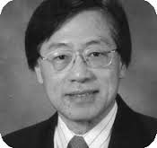
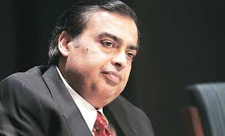
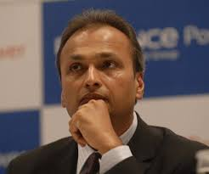
Yao’s Millionaires’ Problem
Protocols for Secure Computations (Extended Abstract). FOCS 1982: 160-164
Turing award winner Andrew Yao
Yao’s millionaires’ problem
?
<
=
>
₹ X
₹ Y
Find the richer without disclosing exact value of individual assets

Slide 4

Secure 2-PC
f ( x , y )
P₁ : x
P₂ : y
f(x, y)
f(x, y)
- Mutually distrusting entities with individual private data
- Want to compute a joint function of their inputs without revealing anything beyond

Slide 5

Secure Multiparty Computation (MPC)
MPC – holy grail
–
Setup:
- n parties P₁,....,P_{n} ; ‘some’ are corrupted
- P_{i} has private input x_{i}
- A common n-input function f
Goals:
Correctness: Compute f(x₁,x₂,..x_{n})
Privacy: Nothing beyond function output must be leaked
Applications: (Dual need of data privacy & data usability)
Preventing Satellite Collision
E-auction
Data Analytics
Privacy-preserving ML
Outsourcing
E-voting

Slide 6




Application of 2PC- Privacy-preserving Data mining
How many patients suffering from AIDS in total ?
Are there any common patient registered for disease X in all the hospitals ?
Varieties of other statistics …

Slide 7
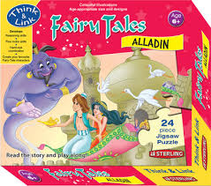

How to solve 2PC?
Trusted third party (TTP) → solution for secure 2PC
Send input to TTP, obtain function output : Ideal solution
x
y
x
y
f(x,y)
f(x,y)
f(x,y)
TTP
IDEAL world secure 2PC protocol
TTPs exist only in fairy tales!!

Slide 8
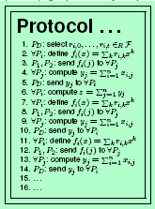
Security goal of 2PC
Goal of a secure 2PC protocol : emulate the role of a TTP
De-centralizing the trust
x
y
f(x,y)
f(x,y)
x
y
f(x, y)
f(x, y)
TTP
2PC protocol
≈
IDEAL world
REAL world

Slide 9
A fundamental Approach to MPC
(Efficiently computable function)
f
Boolean/Arithmetic circuit C
Input wires taking inputs of f
(AND, OR, NOT)/ (Addition, Multiplication)
- MPC is done via secure circuit evaluation
- Communication/computation complexity depend on |C|.

Slide 10

Circuit Abstraction Example: $≥$
X, Y: L-bit non-negative integers
X
x_{L}
x_{L-1}
…
x₂
x₁
Y
y_{L}
y_{L-1}
…
y₂
y₁
1-bit comparator
c₁ = 1
c_{i}
x₁
>
y₁
c₂
x_{i}
>
y_{i}
x₂
>
y₂
c_{i+1}
c_{L}
x_{L}
>
y_{L}
c_{i+1} = 1 ↔ (x_{i} > y_{i}) OR ([x_{i} = y_{i}] AND [c_{i} = 1])
c_{L+1}
c_{i+1} = x_{i} ⊕ [(x_{i} ⊕ c_{i}) ∧ (y_{i} ⊕ c_{i})]
X ≥ Y ↔ c_{L+1} = 1

Slide 11
Circuit Garbling [BHR12]
initial
Boolean circuit
f : {0,1}^{n}→ {0,1} ^{m}
f = En Ev De
f
°
°
input
output
x
Gb
y
e
d
C
En
De
X
Ev
Y
encoding
function
decoding
function
garbled
input
garbled
Circuit evaluation
garbled
output
Credit to BHKR14

Slide 12
Circuit Garbling [BHR12]
A garbling scheme = (Gb, En, Ev, De)
Garbler
Evaluator
Gb
C
Ev
1^{n}
Y
De
e
En
f
X
y
x
d
Privacy: Input privacy
Obliviousness: Input and output privacy when d is withheld
Authenticity: Unforgeability of the output of Ev

Slide 13








The making of Garbled Circuit ((C, e, d)= Gb)
a
b
a
b
0
1
0
1
0
1
0 | 0 | 0
0 | 1 | 0
1 | 0 | 0
1 | 1 | 1
c
c
0
0
0
1
0
1
0 | 0 | 0
0 | 1 | 1
1 | 0 | 1
1 | 1 | 1
0
0
1

Slide 14
Evaluating a Garbled circuit (En, Ev, De)
a
b
a
b
0
1
0 | 0 | 0
0 | 1 | 0
1 | 0 | 0
1 | 1 | 1
c
c
0
0
0 | 0 | 0
0 | 1 | 1
1 | 0 | 1
1 | 1 | 1
0
0

Slide 15
Something is wrong?
a
b
a
b
0
1
What happens if the ciphertexts are given in the order?
0 | 0 | 0
0 | 1 | 0
1 | 0 | 0
1 | 1 | 1
c
c
0
0
0 | 0 | 0
0 | 1 | 1
1 | 0 | 1
1 | 1 | 1
0

Slide 16





Replacing key-box with Cryptographic Mechanisms
a
b
a
b
0
1
0
1
0
1
k₁
k₁
k₂
k₂
C₁
0 | 0 | 0
0 | 1 | 0
1 | 0 | 0
1 | 1 | 1
$$E_{k_{1}^{0}}(E_{k_{2}^{0}}(k_{3}^{0}))$$
C₂
$$E_{k_{1}^{0}}(E_{k_{2}^{1}}(k_{3}^{0}))$$
C₃
$$E_{k_{1}^{1}}(E_{k_{2}^{0}}(k_{3}^{0}))$$
C₄
c
$$E_{k_{1}^{1}}(E_{k_{2}^{1}}(k_{3}^{0}))$$
c
0
1
0
1
0
0
k₃
k₃
k₄
k₄
0 | 0 | 0
0 | 1 | 1
1 | 0 | 1
1 | 1 | 1
C₅
C₆
C₇
C₈
0
0
1
k₅
k₅
($G,E,D$) = Symmetric Key Encryption (SKE)

Slide 17




Something may be wrong…
a
b
a
b
0
1
0
1
0
1
k₁
k₁
k₂
k₂
$$E_{k_{1}^{0}}(E_{k_{2}^{0}}(k_{3}^{0}))$$
- Which ciphertext to decrypt?
C₁
$$E_{k_{1}^{0}}(E_{k_{2}^{1}}(k_{3}^{0}))$$
- Try all
C₂
$$E_{k_{1}^{1}}(E_{k_{2}^{0}}(k_{3}^{0}))$$
C₃
$$E_{k_{1}^{1}}(E_{k_{2}^{1}}(k_{3}^{0}))$$
- Which decrypted value to go for?
C₄
c
c
- SKE with `special correctness’
0
1
0
1
0
k₃
k₃
k₄
k₄
C₅
C₆
C₇
C₈
0
0
1
k₅
k₅
($G,E,D$) = Symmetric Key Encryption (SKE)

Slide 18
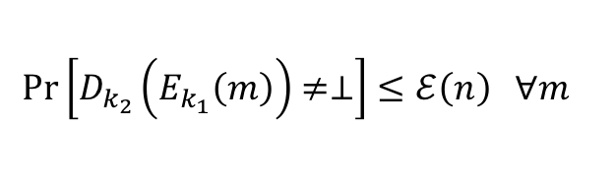
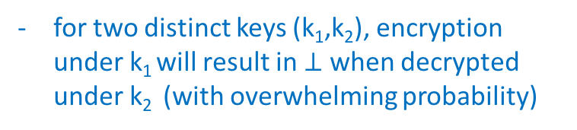
Making things all right…
(G,E,D) has `special correctness’
a
b
0
1
0
1
for two distinct keys (k₁,k₂), encryption under k₁ will result in $⊥$ when decrypted under k₂ (with overwhelming probability)
k₁
k₁
k₂
k₂
$$E_{k_{1}^{0}}(E_{k_{2}^{0}}(k_{3}^{0}))$$
C₁
$$E_{k_{1}^{0}}(E_{k_{2}^{1}}(k_{3}^{0}))$$
C₂
$$E_{k_{1}^{1}}(E_{k_{2}^{0}}(k_{3}^{0}))$$
$$\operatorname{Pr}\left[D_{k_{2}}\left(E_{k_{1}}\left(m\right)\right)≠⊥\right]≤ℰ\left(n\right) ∀m$$
$$E_{k_{1}^{1}}(E_{k_{2}^{1}}(k_{3}^{0}))$$
C₃
C₄
c
0
1
0
1
k₃
k₃
k₄
k₄
C₅
C₆
C₇
C₈
0
1
k₅
k₅
($G,E,D$) = Symmetric Key Encryption (SKE)

Slide 19
SKE with special Correctness
K = {0, 1}^{n} M = {0, 1}^{n} C = {0, 1}^{3n}
k
k
k ∈_{R} K
m ∈ M
Enc_{k}(m)
- r in {0, 1}^{n}
- c = (r, m0^{n}⊕ F_{k}(r))
c
c ∈ C
m
Gen
Dec_{k}(c = (c₀,c₁))
- m = c₁⊕F_{k}(c₀)
F_{k}: {0,1}^{n} → {0, 1}^{2n}
CPA-security?

Slide 20
Evaluating Garbled circuit vs. Evaluating a circuit
a
b
a
b
0
1
0
1
k₁
k₂
C₁
C₂
C₃
C₄
c
c
0
0
0
k₃
k₄
C₅
C₆
C₇
C₈
0
k₅
0
1
k₅
k₅
($G,E,D$) = Symmetric Key Encryption (SKE) with `special correctness’

Slide 21


What security from SKE is needed?
a
b
0
1
- an bad evaluator should have no info about what the three unopened ciphertext contain
k₁
k₂
C₁
- if it can guess the unopened message are same for an AND gate, then it knows the meaning of the key it decrypted!
C₂
C₃
C₄
c
0
0
k₃
k₄
k₀, k₁
(x₀,y₀,z₀), (x₁,y₁,z₁)
c₀ ← Enc_{k0} (Enc_{k’1}(x_{b}))
c₁ ← Enc_{k’0} (Enc_{k1} (y_{b}))
C₅
c₂ ← Enc_{k’0} (Enc_{k’1} (z_{b}))
C₆
k’₀, k’₁
C₇
b’ ∈ {0, 1}
b
C₈
0
k₅
+ `chosen double ciphertext security’
0
1
k₅
k₅
($G,E,D$) = Symmetric Key Encryption (SKE) with `special correctness’

Slide 22





Chosen Double Encryption (CDE) Security
cde
PrivK ($n$)
k₀, k₁
Π = (Gen, Enc, Dec), $ℳ$, $𝒦$
A, Π
Pre-challenge Oracle Training Enc**(Enc_{k’1}(**)) Enc_{k’0}(Enc** (**))
PPT Attacker A
(x₀,y₀,z₀), (x₁,y₁,z₁) ∈ $ℳ$³
k’₀, k’₁
Gen
c₀ ← Enc_{k0} (Enc_{k’1}(x_{b}))
c₁ ← Enc_{k’0} (Enc_{k1} (y_{b}))
Let me verify
b ← {0, 1}
I can break Π
c₂ ← Enc_{k’0} (Enc_{k’1} (z_{b}))
Post-challenge Oracle Training Enc**(Enc_{k’1}(**)) Enc_{k’0}(Enc** (**))
b’ ∈ {0, 1}
b = b’
Game Output
b ≠ b’
1 --- attacker won
0 --- attacker lost
Π is CDE-secure if for every PPT A, there is a negligible function negl, such that:
cde
Pr
PrivK ($n$)
½ + negl($n$)
= 1
≤
A, Π

Slide 23

Chosen Plain-text Attack (CPA) Security
cpa
PrivK ($n$)
Π = (Gen, Enc, Dec), $ℳ$, $𝒦$
A, Π
Pre-challenge Oracle Training Enc_{k}(**)
PPT Attacker A
x₀, x₁ ∈ $ℳ$²
k
c_{b} ← Enc_{k}(m_{b})
Gen
Let me verify
b ← {0, 1}
I can break Π
Post-challenge Oracle Training Enc_{k}(**))
b’ ∈ {0, 1}
b = b’
Game Output
b ≠ b’
1 --- attacker won
0 --- attacker lost
Π is CPA-secure if for every PPT A, there is a negligible function negl, such that:
cpa
Pr
PrivK ($n$)
½ + negl($n$)
= 1
≤
A, Π
RA: Prove that if Π is CPA-secure then it is also CDE-secure

Slide 24

Oblivious Transfer
r = ?
m_{1-r} = ?
m₁
m₂
r
R
S
$$\left({2 \atop 1}\right)\text{OT}$$
m_{r}

Slide 25
Yao’s 2-Party Protocol
x
y
GC Constructor
0
0
GC Evaluator
P₀
P₁
x
z
0
y
z
z = xy
0
1
0
1
k₁
k₁
k₂
k₂
0
0
0
1
k₁
k₂
k₃
k₃
GC: (C₁,C₂,C₃,C₄)+ decoding info: ( )
0
C₁
The keys for x:
k₁
C₁
C₂
C₂
C₃
k⁰₂
0
C₃
C₄
OT
k¹₂
k⁰₂
C₄
0
1
k₃
k₃
0
k₃
0
1
k₃
k₃
0
0

Slide 26
Yao’s 2-Party Protocol
GC Constructor
GC Evaluator
P₀
P₁
X = (x₁,x₂,…x_{k} )
Y = (y₁,y₂,…y_{k} )
Z
Z
Garbled Circuit + decoding information
The keys for X
k⁰₁
y₁
k¹₁
OT₁
k^{y1}₁
k⁰_{k}
y_{k}
k¹_{k}
OT_{k}
k^{yk}_{k}
Z

Slide 27
Circuit Garbling- Tracing the history
- Point-and-permute [NPS99]:
- No `special correctness’ needed
- Only one ciphertext needs to be decrypted
- Garbled Row Reduction:
[NPS99]: 4-to-3 ciphertexts
[PSSW09,GNLP15,ZRE15]: 4-to-2 ciphertexts (optimal for AND)
[KKKS15]: 4 bits (for formulaic circuits)
[Kol05]: 0 bits (for formulaic circuits + key length dependent on depth )
- Free XOR/FleXOR [KS08,KMR14]: No ciphertext and no crypto operations for XOR gates
- From technique to primitive [BHR12a,BHR12b]: Privacy, Obliviousness, Authenticity and verifiability
- Applications in ZK, outsourcing computation [JKO13]: Privacy-free GC

Slide 28
Stay tuned to our reading group

Slide 29
Circuit Garbling- Recent Results
- Size-zero Privacy-free Garbled circuits for Formulas [KP17]: Crypto’17
- Zero knowledge Protocols from Garbled circuits [GKPS17]: Under submission
3,2 and 1 round protocols
Any private garbled circuits is also authentic
- Non-interactive Secure Computation [PS17]: Under submission

Slide 30


