Slide 1

Foundations of Secure Computation
Arpita Patra

Slide 2
Welcome!
>> Course Homepage: http://drona.csa.iisc.ernet.in/~arpita/FoSC17.html
>> References:
Secure Multiparty Computation and Secret Sharing - An Information Theoretic Approach – by Ronald Cramer, Ivan Damgaard and Jesper Buus Nielsen
Efficient Two-party Protocols- Techniques and Constructions- by Carmit Hazay and Yehuda Lindell
Recent papers and a few lecture notes
Notes:
Welcome to an exciting journey together! I promise you that you will never regret your decision to walk and explore the lanes/by-lanes, the cross roads /main roads of secure computation with me. I, as your instructor will try my best to ensure that this journey become a memorable one, a huge learning experience!

Slide 3
Evaluation Policy
Tuned to ensure that you learn and enjoy the learning!
Scribe (20%): Every student will have to scribe 2/3 lectures. Deadline in 1 week.
Project (50%):
>> theoretical or practical in nature
>> theoretical projects will involve answering deep and exciting theoretical questions
>> practical projects will involve implementing and improving challenging practical secure computation tasks
>> Topics will be proposed during the lecture. Complete literature survey and decide on an exciting problem by midterm. Make non-trivial theoretical progress/ implement the best solution in the second half. All coding has to be done in C++ using the low level primitives from CrIS Repository.
Chalk & Talk Seminar (30%): Two presentations (one in each half of the course).

Slide 4
We are in the age of Information!
> Individual: Age, Salary, Bank Details (balance, netbanking login password), Citizenship, Parents/family member details, Identity details (passport no., PAN card, Voter ID, AADHAR id ), Income Tax Details, Your vehicle details (cycle, two wheeler, car), Medical data: diseases, biometric traits (face, fingerprint, iris, speech), genome signature, minimum age of watching porn/taking drug, Child adoption details
> Profitable Organization (MS/IBM/TCS/Infosys): List of employees and their details, Profit, loss, turnover, salaries.
> Educational Organization (IISc/IITs/IIITs/IISERs/NISERs/NITs): List of employees and their details, students and their details, awards, recognitions, scientific publications, products, dropouts, drug addicts, suicides, sexual harassments,
> Hospitals: List of patients and their medical history and details. List of doctors, nurses and their details
> Security Agencies (RAW/ IB/ CBI/NIA): List of employees and details, list of criminals and details, list of incidents and details
> Military Organizations (Army/Air Force/Navy): List of soldiers, colonels and details, list of operations and details, intercepted messages and details
> Country: List of citizens and details, prime minister, presidents, MLA, MPs, celebrities, under-privileged. Satellites / Nuclear weapons / Submarines information

Slide 5
Secret Information
> Individual: Age, Salary, Bank Details (balance, netbaking login password), Identity details (passport no., PAN card, Voter ID, AADHAR id ), Income Tax Details, Your vehicle details (cycle, two wheeler, car), Medical data: diseases, biometric traits (face, fingerprint, iris, speech), genome signature, minimum age of watching porn/taking drug, Child adoption details
> Profitable Organization (MS/IBM/TCS/Infosys): List of employees and their details, Profit, loss, turnover, salaries.
> Educational Organization (IISc/IITs/IIITs/IISERs/NISERs/NITs): List of employees and their details, students and their details, awards, recognitions, scientific publications, products, dropouts, drug addicts, suicides, sexual harassments,
> Hospitals: List of patients and their medical history and details. List of doctors, nurses and their details
> Security Agencies (RAW/ IB/ CBI/NIA): List of employees and details, list of criminals and details, list of incidents and details, list of intercepted messages
> Military Organizations (Army/Air Force/Navy): List of soldiers, colonels and details, list of operations and details, intercepted messages and details
> Country: List of citizens and details, prime minister, presidents, MLA, MPs, celebrities, under-privileged. Satellites / Nuclear weapons / Submarines information

Slide 6
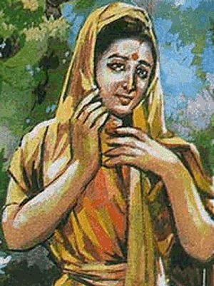
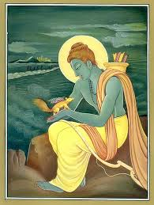
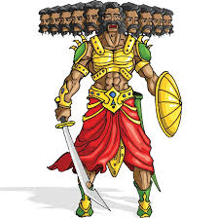
Secure Communication/Storage (Traditional Crypto)
m₁
Goals:
m₂
Privacy
m₃
Integrity
??
We know how to achieve the goal (various encryption schemes)
> Not trivial to achieve the goal
> But the purpose is simple to state and well-understood

Slide 7
Secure (multiparty) Computation [Yao82]
demands data privacy and computation on the data at the same time!
f(x₁, x₂, …, x_{n})
P₁ : x₁
P₂ : x₂
P_{i} : x_{i}
P_{n} : x_{n}
> A large amount of added value can be obtained by combining confidential information from several sources and from this computing some result that holds an interest for all parties
> Encryption does not help!
> Analogy: Can not wear (compute on) ornaments (messages) while keeping them in the locker (encrypted)

Slide 8
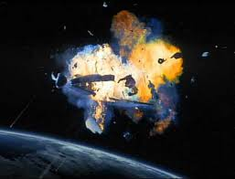
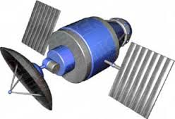
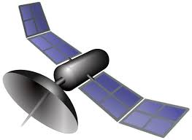
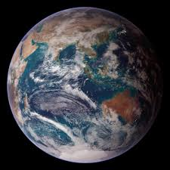


Applications of MPC- Secure Satellite collision Prevention
(Secret trajectory)
(Secret trajectory)
Collisions quite possible --- loss of worth billions
Several collisions reported in the past
Find chances of collision without disclosing the trajectories

Slide 9




Applications of MPC- (Privacy Preserving) Data Mining
Hospitals do not want to share their patient records
But want to data-mine on combined data
Notes:
AIDS

Slide 10




Applications of MPC- (Privacy Preserving) Data Mining
They do not want to share their count of sexual abuse cases/ drug addicted cases
But want to data-mine on combined data
Notes:
AIDS

Slide 11

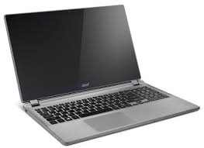

Applications of MPC- Outsourcing of Computation
Please compute f(x) for me
f, x
Payment
Computationally weak
Cloud server
y = f(x)
Potentially great solution with lots of risks !!
What if the service provider is corrupted ?
No data privacy
No guarantee of correct output

Slide 12



Applications of MPC- Outsourcing of Computation
“Split” data among multiple servers
Servers run an MPC protocol
x
Privacy of data and robustness of computation is ensured if majority of the servers are “honest”

Slide 13


MPC: Tool for Distributed Data Analytics
Issue I: limited functions can be computed
Enc_{k}(Data)
Issue II: Key management
Issue III: Single point failure
S₁
S₂
S₃
S₄
S₅
Run MPC to do any data analytics
Encrypted Data Analytics
Distributed Data Analytics
Notes:
Two reasons: First, we think replicating the secret will make it more vulnerable. Second, computation on data is easy when it is kept in the same place. We say instead of a single server, employ a number of servers. Distribute your secret data into shares and store them separately in those servers so that unless all the servers are corrupted your data is safe. The computation on the data can be done via MPC. Each server is a party and their private input is their share.

Slide 14
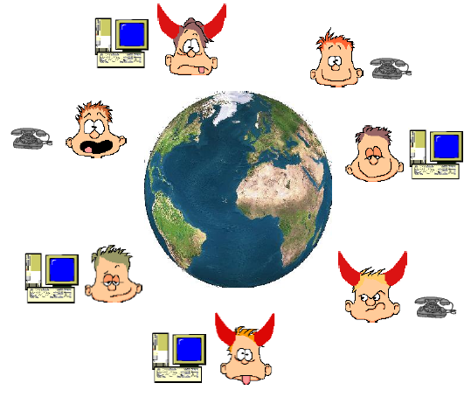
Secure Multiparty Computation (MPC)
MPC – holy grail
–
Setup:
- n parties P₁,....,P_{n} ; ‘some’ are corrupted
- P_{i} has private input x_{i}
- A common n-input function f
Goals:
Correctness: Compute f(x₁,x₂,..x_{n})
Privacy: Nothing about the inputs of the parties should be leaked
- Consider f(x₁,x₂) = x₁ AND x₂
Privacy: Nothing more than function output should be revealed

Slide 15


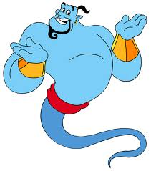
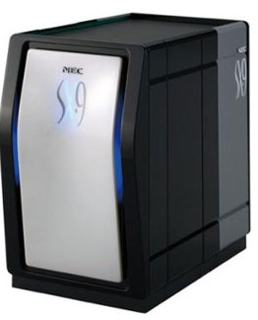

MPC is easy if we could trust someone
x₁
x₂
Any task
x₃
x₄
y = f(x₁,x₂,x₃,x₄)

Slide 16

Can we Trust Someone?
x₁
x₂
Some problem in the solution..
>> Creates a single point failure
Any task
>> Why we are doing secure computation? Because of the lack of trust. How suddenly we will get someone who is cent percent trusted?
y
y
y
y
>> Trust is very rare, volatile.
x₃
x₄
>> If there is trust in the world
y = f(x₁,x₂,x₃,x₄)
MPC

Slide 17
But there will be dis-trust in the world..
Because..
> Without darkness, one cannot know light
> Without hatred, one cannot feel love
> Without war, one cannot realize the price peace
> Without noise, one cannot appreciate serenity
> Without distrust, one cannot value trust
The contrasts are the hallmarks of the great Magician!!
So we have to solve MPC without a trusted party..
But looks impossible. How is it possible to compute f(x₁,x₂,x₃,x₄) without anyone knowing all the inputs. So do we have to really trust someone..
Looks like we are stuck. Does the journey of secure computation end here?
Notes:
With the right tools, we can do it! By no means it is impossible!!

Slide 18
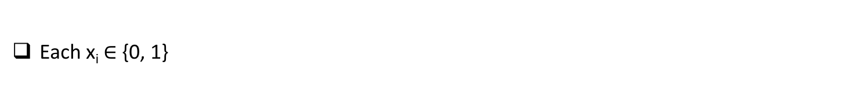
Secure Addition and Voting
y = f(x₁,x₂,..,x_{n}) = x₁ + x₂ +…+ x_{n}
…
x₁
x₂
x₃
x_{n}
y
y
y
y
P₁
P₂
P₃
P_{n}
Each x_{i} $∈${0, 1}
Each P_{i} should not learn more about other party’s vote, other than what can be inferred from its own vote x_{i} and the final outcome y
Primitive no 1 : Secret-sharing scheme

Slide 19
Secret Sharing
Provides a way for a designated party, called dealer, to spread information about a secret, say s, across all the parties so that together they hold full information about x, yet individual (or subset of parties) has no information about x
Secret s
Dealer

Slide 20
Secret Sharing
Secret s
Dealer
…
s₁
s₂
s₃
s_{n}

Slide 21
Secret Sharing
Secret s
Dealer
…
s₁
s₂
s₃
s_{n}
Individual players have no information on s

Slide 22
Secret Sharing
Secret s
Dealer
…
s₁
s₂
s₃
s_{n}
Together all the parties know s
Secret s
Notes:
Information theoretically

Slide 23
Secret Sharing : Instantiation
We will need a finite field (where we can do both “+” and “*”)
Ex: The set $ℤ$_{p} = {0, 1, …, p - 1}, where p is a prime
Theorem: F = ($ℤ$_{p} , + mod p (+), * mod p (*) ) is a field
($ℤ$_{p}, +) is a group
($ℤ$_{p} – {0}, *) is a group
* distributes over +
In general, we can use ANY finite field
Ex: Galois's field F = GF(p^{k}), where p is any prime
For simplicity, we will work on F = ($ℤ$_{p} , + mod p (+), * mod p (*) )
The secret to be shared and the shares will be elements of F

Slide 24
Secret Sharing : Instantiation
Choose random values v₁,..v_{n} from F_{p} s. t. v₁ + …+ v_{n} = s
S = {v₁,.. v_{n} }
s from F_{p}
…
…
S\v₁
S\v₂
S\v₃
S\v_{n}
S\v_{i}
P₁
P₂
P₃
P_{i}
P_{n}
Share for the party P_{i} is s_{i} = S\v_{i}
Together all the parties can reconstruct the secret
P₁, …, P_{n} can exchange their shares and combine them to get s

Slide 25
Secret Sharing : Instantiation
Choose random values v₁,..v_{n} from F_{p} s. t. v₁ + …+ v_{n} = s
S = {v₁,.. v_{n} }
s from F_{p}
…
…
S\v₁
S\v₂
S\v₃
S\v_{n}
S\v_{i}
P₁
P₂
P₃
P_{i}
P_{n}
Share for the party P_{i} is s_{i} = S\v_{i}
Individual party gets no information about s from its share
Ex: P_{i} cannot find s from s_{i}. The view of P_{i} will be: {v₁, …, v_{i-1}, v_{i+1}, ..., v_{n}}
Pr[s_{i} = (v₁, …, v_{i-1}, v_{i+1}, ..., v_{n}) | secret = s] = Pr[v_{i} = s – (v₁ + … + v_{i-1}, v_{i+1}, ..., v_{n})] = 1/$𝔽$
Pr[s_{i} = (v₁, …, v_{i-1}, v_{i+1}, ..., v_{n}) | secret = s*] = Pr[v_{i} = s* – (v₁ + … + v_{i-1}, v_{i+1}, ..., v_{n})] = 1/$𝔽$
The view of P_{i} is distributed independently of the shared secret
From this we can derive that Pr[secret = s | s_{i} = (v₁, …, v_{i-1}, v_{i+1}, ..., v_{n})] = Pr[secret = s]

Slide 26
Secure Addition y = x₁+x₂+x₃ (assume n=3 parties)
P₁
P₂
P₃
All computation done over F. Ex: If F =F_{p} then every + is done modulo p
x₁
x₂
x₃
x₁₁ x₁₂ x₁₃
x₂₁ x₂₂ x₂₃
x₃₁ x₃₂ x₃₃
P₁
x₁₂
x₁₃
x₂₂
x₂₃
+
x₃₂
x₃₃
=
s₂
s₃
+
x₁₁
x₁₃
x₂₁
x₂₃
x₃₁
x₃₃
s₁
s₃
P₂
+
+
=
P_{i}
y = s₁ + s₂ + s₃
x₁₁
x₁₂
x₂₁
x₂₂
x₃₁
x₃₂
s₁
s₂
P₃
+
+
=
No party even with unbounded power learns no additional information about x_{i} values
The same is done for all P_{i}

Slide 27
Secure Addition y = x₁+x₂+x₃
Primitives 1 (Secret Sharing Schemes): A magic primitive and one of the fundamental building blocks of MPC
P₁
x₁₂
x₁₃
x₂₂
x₂₃
+
x₃₂
x₃₃
=
s₂
s₃
+
x₁
x₁₁
x₁₃
x₂₁
x₂₃
x₃₁
x₃₃
s₁
s₃
P₂
+
+
=
P_{i}
y = s₁ + s₂ + s₃
x₂
x₁₁
x₁₂
x₂₁
x₂₂
x₃₁
x₃₂
s₁
s₂
P₃
+
+
=
x₃
Can P₁ learn anything additional about x₂ and x₃ by participating in the protocol ?
The shares of x₂ and x₃ does not help P₁ to find x₂ and x₃
P₁ also sees s₁ in the protocol. Does it reveal anything additional about x₂ and x₃ ?
P₁ has the output y and already knows s₂, s₃. So it already knows s₁ as s₁ = y – (s₂ + s₃)

Slide 28
Secure bit multiplication y = x₁ • x₂ and Match-making (assume n=2 parties)
P₁
P₂
y = x₁ • x₂
= (x₁₁ + x₁₂ )•(x₂₁ + x₂₂ )
= (x₁₁•x₂₁ + x₁₁•x₂₂ + x₁₂•x₂₁ + x₁₂•x₂₂)
x₁
x₂
x₁₁ x₁₂
x₂₁ x₂₂
P₁
x₁₂
•
x₂₂
= x₁₂•x₂₂
x₁₁•x₂₂
P₂
x₁₁
x₂₁
= x₁₁•x₂₁
•
Looks like we are stuck ☹

Slide 29
1-out-of-2 Oblivious Transfer
Message Transfer:
S
m
m
R
Oblivious Transfer (OT):
S
m₀
m₁
b
R
m_{b}
S does not learn b
R does not learn m_{1-b}
m₀
b
1-out-of-2
OT
m₁
m_{b}

Slide 30
Secure Bit multiplication y = x₁ • x₂
0
x₂
P₁
1-out-of-2
OT
P₂
x₁
x₁•x₂
x₁
x₂
a₀
b
1-out-of-2
OT
a₁
(1-b)•a₀ + b•a₁ = a_{b}
Primitive 2 (Oblivious Transfer): Another magic primitive and one of the fundamental building blocks of MPC

