Slide 1

Foundations of Secure Computation
Arpita Patra

Slide 2


Vishwaroop of MPC
Notes:
Today we will see how vast, how broad and how rich the area of MPC is. We will see its expanse. We will discuss its various facets and dimensions. Today’s class is very important in that it will help to make up your mind on which facet of MPC you like most and want to focus on. It is strong enough to capture all most everything, if not everything in cryptography.

Slide 3
Expanding the scope of MPC
Dimension 1 (Models of Computation): Any polynomially computable function can be computed securely.
>> So far you have seen how to compute addition and bit multiplication securely
>> less than, equal to, greater than
>> AES encryption function,
>> any encryption function (key and message in different location or shared),
>> satellite collision probability computation function
>> set intersection
………

Slide 4
Two models of Computation
Boolean Circuit (AND, OR, NOT, XOR)
Arithmetic Circuit over finite field (Addition and Multiplication)
x₁
x₂
x₃
x₄
x₁
x₂
x₃
x₄
∧
+
•
∨
⊕
•
f(x₁, x₂, x₃, x₄); inputs are bits
f(x₁, x₂, x₃, x₄); inputs are field elements
Secure Circuit evaluation: Nothing other than the output gate value will be revealed
Notes:
It is not without a reason that we call MPC a holy grail and it is strong enough to capture all most everything, if not everything in cryptography.

Slide 5
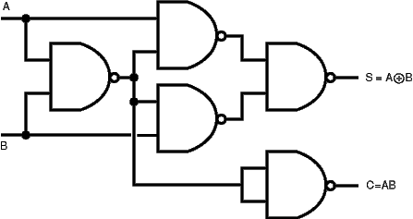
Which one will you prefer?
Boolean Circuit (AND, OR, NOT, XOR)
Arithmetic Circuit over finite field (Addition and Multiplication)
More than one gate
x₁
x₂
+
x₁+x₂
f(x₁,x₂) = x₁+x₂; x₁, x₂ are from F₅
Depends on f that you want to compute
Non-linear operation (comparison, greater than etc are more concisely represented in Boolean circuit)
Dimension 1: Any polynomially computable function can be computed securely.
Notes:
It is not without a reason that we call MPC a holy grail and it is strong enough to capture all most everything, if not everything in cryptography.

Slide 6
Which one will you prefer?
Boolean Circuit (AND, OR, NOT, XOR)
Arithmetic Circuit over finite field (Addition and Multiplication)
Huge body of work
Huge body of work
Combination(B + A)
+ Very less amount of work
+ Scope for Research
Dimension 1: Any polynomially computable function can be computed securely.
Notes:
It is not without a reason that we call MPC a holy grail and it is strong enough to capture all most everything, if not everything in cryptography.

Slide 7
Expanding the scope of MPC
Dimension 2.1: Varieties of network (complete vs. incomplete )
Complete Network
Incomplete Network
Most of the works in this model
Very less explored
Practical for applications involving very few parties (less than 10)
Practical for applications where billions can participate (E-election)
Notes:
Information theoretically

Slide 8

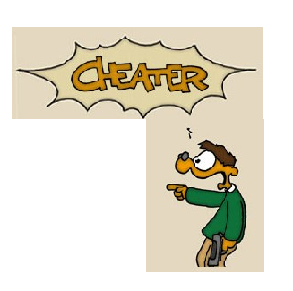

Expanding the scope of MPC
Synchronous Network
Asynchronous Network
Global Clock
Channels have fixed delay
Knows how long to wait
x
...
...
Compute and send x
Wait to receive x
Dimension 2.2: Varieties of network (synchronous vs. asynchronous)
Notes:
Information theoretically

Slide 9


Asynchronous Network
No Global Clock
Channels have arbitrary yet finite delay
Does not Know how long to wait
x
...
...
Compute and send x
Wait to receive x

Slide 10
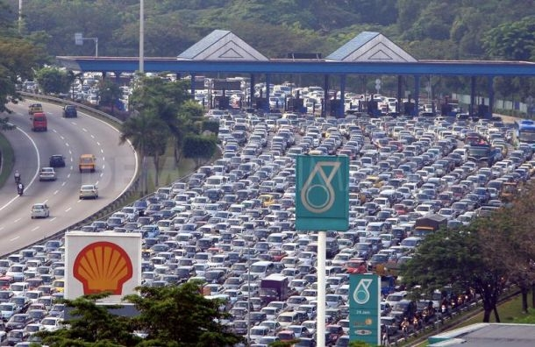
Asynchronous Network
No Global Clock
Oh! I have to drop the message
Is he cheating or slow ?
Channels have arbitrary yet finite delay
Does not Know how long to wait
x
...
...
Compute and send x
Wait to receive x

Slide 11
Asynchronous Network
n parties and t of them may cheat
x₁
Cannot wait for all
Else endless waiting
x₂
n parties
can afford to wait to listen from (n-t) parties
x_{n}
But leads to ignoring messages of t honest parties

Slide 12
Secure Addition y = x₁+x₂+x₃ with (n=3,t=1) in asynchronous settings
P₁
P₂
P₃
x₁
x₂
x₃
No input provision!
x₁₁ x₁₂ x₁₃
x₂₁ x₂₂ x₂₃
x₃₁ x₃₂ x₃₃
No protocol with n parties where t parties cheat works when n ≤ 4t (without error) and n ≤ 3t (with error)
P₁
x₁₂
x₁₃
x₂₂
x₂₃
+
x₃₂
x₃₃
=
s₂
s₃
+
x₁₁
x₁₃
x₂₁
x₂₃
x₃₁
x₃₃
s₁
s₃
P₂
+
+
=
P_{i}
y = s₁ + s₂ + s₃
x₁₁
x₁₂
x₂₁
x₂₂
x₃₁
x₃₂
s₁
s₂
P₃
+
+
=
One of the parties may cheat.
This simple protocol does not work!

Slide 13
Expanding the scope of MPC
Synchronous Network
Hybrid Network- Synchronous up to some point and asynchronous afterwards
Asynchronous Network
Most of the works in this model
Simple to comprehend
Models small local network
Less explored
Models real-life networks better than synchronous network
Hard and challenging to deal with
Many impossibility results
Scope of work
Very less explored again
Models real-life networks better than synchronous network
Some of the impossibility results in asynchronous network is shown to be possible here
Scope of work
Dimension 2.3: Varieties of network (synchronous vs. asynchronous vs. hybrid)

Slide 14
Expanding the scope of MPC
Dimension 3: Modelling Dis-trust
P₁
P₂
P₃
x₁
x₂
x₃
x₁₁ x₁₂ x₁₃
x₂₁ x₂₂ x₂₃
x₃₁ x₃₂ x₃₃
P₁
x₁₂
x₁₃
x₂₂
x₂₃
+
x₃₂
x₃₃
=
s₂
s₃
+
x₁₁
x₁₃
x₂₁
x₂₃
x₃₁
x₃₃
s₁
s₃
P₂
+
+
=
y_{i}
y = s₁ + s₂ + s₃
x₁₁
x₁₂
x₂₁
x₂₂
x₃₁
x₃₂
s₁
s₂
P₃
+
+
=
Protected against a single curious party
What if they parties are curious and join hand?
Notes:
Information theoretically

Slide 15
Expanding the scope of MPC
Bad people work together
To model this, we assume that there is a single monolithic/centralized entity who we call as adversary (A) and who controls a number of parties out of n parties.
Dimension 3: Modelling Dis-trust (centralized vs. decentralized )

Slide 16

Redefine MPC
–
>> n parties P₁,....,P_{n}
‘some’ are corrupted by A
>> P_{i} has private input x_{i}
>> A common n-input function f
Goals:
>> Correctness: Compute f(x₁,x₂,..x_{n})
>> Privacy: Nothing more than y is leaked to A

Slide 17
Secure Addition y = x₁+x₂+x₃+x₄ with n=4 and t=2
P₁
P₂
P₃
P₄
x₁
x₂
x₃
x₄
x₁₁ x₁₂ x₁₃ x₁₄
x₂₁ x₂₂ x₂₃ x₂₄
x₃₁ x₃₂ x₃₃ x₃₄
x₄₁ x₄₂ x₄₃ x₄₄
P₁
x₁₂
x₁₃
x₁₄
x₂₂
x₂₃
x₂₄
x₃₂
x₃₃
x₃₄
+
x₄₂
x₄₃
x₄₄
=
s₂
s₃
s₄
+
+
P₂
x₁₁
x₁₃
x₁₄
x₂₁
x₂₃
x₂₄
x₃₁
x₃₃
x₃₄
x₄₁
x₄₃
x₄₄
s₁
s₃
s₄
+
+
+
=
P_{i}
x₂₁
x₂₂
x₂₄
y = s₁ + s₂
+ s₃ + s₄
P₃
x₁₁
x₁₂
x₁₄
+
+
x₃₁
x₃₂
x₃₄
+
x₄₁
x₄₂
x₄₄
=
s₁
s₂
s₄
P₄
x₁₁
x₁₂
x₁₃
+
x₂₁
x₂₂
x₂₃
+
x₃₁
x₃₂
x₃₃
+
x₄₁
x₄₂
x₄₃
=
s₁
s₂
s_{s}
Can you modify the secret sharing and tolerate coalition of two?

Slide 18
Secure Addition y = x₁+x₂+x₃+x₄ with n=4 and t=2
P₁
P₂
P₃
P₄
x₁
x₂
x₃
x₄
x₁₁ x₁₂ x₁₃ x₁₄
x₂₁ x₂₂ x₂₃ x₂₄
x₃₁ x₃₂ x₃₃ x₃₄
x₄₁ x₄₂ x₄₃ x₄₄
P₁
x₁₁
x₂₁
x₃₁
x₃₁
s₁
+
+
+
=
P₂
x₁₂
+
x₂₂
+
x₃₂
+
x₃₂
=
s₂
P_{i}
P₃
x₁₃
+
x₂₃
+
x₃₃
+
x₃₃
=
s₃
P₄
x₁₄
x₂₄
x₃₄
x₃₄
s₄
y = s₁ + s₂ + s₃ + s₄
+
+
+
=
All the parties together hold the secret. Any two parties hold no info about the secret

Slide 19
Expanding the scope of MPC
Dimension 4.1: Various Characteristics of adversary A (threshold vs. non-threshold)
Threshold: A can corrupt at most t out of n (n: total no of participating parties; t = threshold; t < n)
Non-Threshold: Adversaries behavior is captured by a set of subset of parties. A can corrupt one of the sub-sets.
Eg. P = {P₁ , P₂ , P₃}
A = {{P₁}, {P₂ , P₃}}
>> Most of the works in this model because of its simplicity
>> Generalization of threshold
>> Less explored
>> Models real-life scenarios
>> Very non-intuitive
>> Non-threshold secret sharing
Notes:
Information theoretically

