Slide 1

Foundations of Secure Computation
Arpita Patra

Slide 2
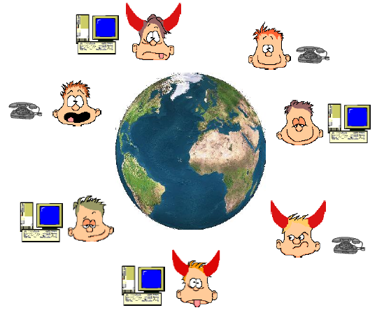
The major Question That Remains: How to Define Security of MPC
–
n parties P₁,....,P_{n}
‘some’ are corrupted by A
P_{i} has private input x_{i}
A common n-input function f
Goals:
Correctness: Compute f(x₁,x₂,..x_{n})
Privacy: Nothing additional other than what can be inferred from y and the inputs of corrupted parties should be leaked to A

Slide 3
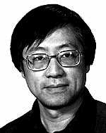
How MPC is Defined Formally ?
Do you think the previous definition is fine?
You are wrong!
Does not capture all needs. It is one of the most non-trivial tasks in the MPC literature.
Many protocols came before the definition was settled. Only later the security is proven
Yao’s protocol came without proof! Only in 2006, Yehuda and Benny came up with the full proof.
Yehuda Lindell, Benny Pinkas: A Proof of Security of Yao's Protocol for Two-Party Computation. J. Cryptology 22(2): 161-188 (2009)
Andew Chi Chih Yao, Turing Award winner 2000 for his pioneering work in cryptography
Andrew Chi-Chih Yao: Protocols for Secure Computations (Extended Abstract). FOCS 1982: 160-164

Slide 4
Defining Security of MPC
Consider a secure auction protocol (with secret bids). The following security properties are desired:
An adversary may wish to learn the bids of honest parties – to prevent this, require PRIVACY
An adversary may wish to win with a lower bid than the highest – to prevent this, require CORRECTNESS
But, the adversary may also wish to ensure that it always gives the highest bid – to prevent this, require INDEPENDENCE OF INPUTS
-- An adversary may try to abort the execution if its bid is not the highest – require FAIRNESS

Slide 5
General Security Properties Expected from MPC
Privacy: only the output is revealed
Correctness: the function is computed correctly
Independence of inputs: parties cannot choose inputs based on others’ inputs
Fairness: if corrupted party receives output, honest parties also receive output
Guaranteed output delivery: No matter how the corrupted parties behave honest parties must get output
More???

Slide 6
Defining Security
Option 1: Analyze security properties for each specific problem
Auctions: as in above
Elections: privacy and correctness only (?)
Problems with Option 1:
How do we know that all concerns are covered?
Definitions are application dependent (need to redefine each time).
Option 1 is clearly bad.
Desirable: A single definition, which is generic and caters to all functions f and tells what exactly it captures!
Alternative Option?

Slide 7
Real World/Ideal World Based Security
How do you judge a person (person’s particular quality)/ a product
We set a standard/ideal
Find out how close are we to the ideal
When it comes to cricket, you may like to choose Sachin/Bradman/Virat
When it comes to Football, you may like to choose Pele/MaradonaMessi
For every product, there is an ISO standard
We will do exactly the same for MPC
Set an ideal/standard/benchmark for a general MPC task
Define security based on the closeness of the protocol to the ideal solution
Real World/Ideal World Security Definition Paradigm:
State the ideal world: Clean/Concise specification, can be easily stated, well-understood, we know what properties it gives in an obvious way, we can change specification it according to our need.
Show that the real world protocol “emulates” the ideal world.
Notes:
Phenomenal Idea

Slide 8
Setting That We Consider Now
Dimension 2 (Networks)
Complete
Synchronous
Dimension 3 (Distrust)
Centralized
Dimension 4 (Adversary)
Threshold
Polynomially Bounded/ Unbounded
Semi-honest
Static

Slide 9
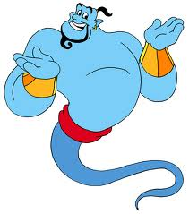
Ideal World MPC
x₁
x₂
Any task
x₃
x₄
(y₁,y₂,y₃,y₄) = f(x₁,x₂,x₃,x₄)

Slide 10
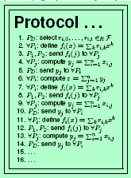
Ideal World MPC
x₁
x₂
x₁
x₂
y₁
y₂
Any task
y₃
y₄
y₁
y₂
y₃
y₄
x₃
x₄
x₃
x₄
(y₁,y₂,y₃,y₄) = f(x₁,x₂,x₃,x₄)
(y₁,y₂,y₃,y₄) = f(x₁,x₂,x₃,x₄)
The Ideal World
The Real World

Slide 11
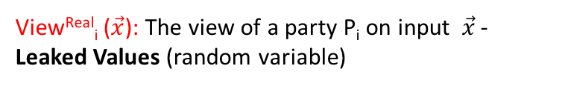
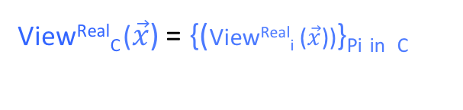
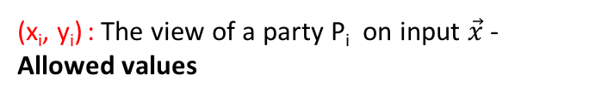
How to Compare Real World with Ideal World?
Fix the inputs of the parties, say x₁,….x_{n} . Call it $\vec{x}$
Real-world view of adv should contain no more info than the ideal-world view of adv
y₁
y₂
y₁
y₂
x₁
x₂
x₁
x₂
x₄
x₄
y₃
y₃
y₄
y₄
x₃
{x₃, y₃, r₃, protocol transcript}
x₃
(x_{i}, y_{i}) : The view of a party P_{i} on input $\vec{x}$ - Allowed values
View^{Real}_{i} ($\vec{x}$): The view of a party P_{i} on input $\vec{x}$ - Leaked Values (random variable)
Ideal-world view of adv is {(x_{i}, y_{i})}_{Pi in} _{C}
Let C be the set of corrupted parties. Then the real-world view of the adversary is:
View^{Real}_{C} ($\vec{x}$) = {(View^{Real}_{i} ($\vec{x}$))}_{Pi} _{in} _{C}
A real-world protocol is secure if the leaked values contain no more info than allowed values
Notes:
From the view point of the adversary.

Slide 12
Real-world (leaked values) vs. Ideal world (allowed values)
y₁
y₂
y₁
y₂
{x₃, y₃}
y₄
{x₃, y₃, r₃, protocol transcript}
y₄
When can we say that the real-world view (leaked values) of adv contain no more info than the ideal-world view of adv
If the leaked values can be efficiently computed (by some algorithm) from the allowed values.
Such an algorithm is called SIMULATOR ---denoted as SIM
Takes input {(x_{i}, y_{i})}_{Pi} $∈$ _{C} and simulates the view of the adversary in the real protocol.
It is enough if SIM creates a view of the adversary that is “close enough” to the real view so that adv. can not distinguish the simulated view from its real view.

Slide 13


Real-world (leaked values) vs. Ideal world (allowed values)
y₁
y₂
y₁
y₂
x₁
x₂
x₁
x₂
x₄
x₄
SIM
{x₃, y₃}
y₄
{x₃, y₃, r₃, protocol transcript}
y₄
Interaction with real-world adversary on behalf of the honest parties
SIM produces the simulated view
≈
View^{Real}_{C} ($\vec{x}$)
SIM({(x_{i}, y_{i})}_{Pi} $∈$ _{C} ) = View^{Ideal}_{C} ($\vec{x}$)
Random Variable/distribution (over the random coins of SIM and adv)
Random Variable/distribution (over the random coins of parties)
SIM: Ideal Adversary
The Ideal World
The Real World

Slide 14


Real-world vs. Ideal world
y₁
y₂
y₁
y₂
x₁
x₂
x₁
x₂
x₄
x₄
SIM
{x₃, y₃}
y₄
{x₃, y₃, r₃, protocol transcript}
y₄
Interaction on behalf of the honest parties
≈
{View^{Ideal}_{C} ($\vec{x}$)}
{View^{Real}_{C} ($\vec{x}$)}
If the two views (distributions) are perfectly indistinguishabe (even for a computationally unbounded distinguisher) then we get perfect privacy
If the two views (distributions) are statistically indistinguishabe (even for a computationally unbounded distinguisher) then we get statistical privacy
If the two views (distributions) are computationally indistinguishabe then we get computational privacy

