Slide 1

Foundations of Secure Computation
Arpita Patra

Slide 2

Ideal World MPC
x₁
x₂
Any task
x₃
x₄
(y₁,y₂,y₃,y₄) = f(x₁,x₂,x₃,x₄)

Slide 3
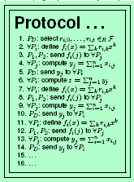
Ideal World MPC
x₁
x₂
x₁
x₂
y₁
y₂
Any task
y₃
y₄
y₁
y₂
y₃
y₄
x₃
x₄
x₃
x₄
(y₁,y₂,y₃,y₄) = f(x₁,x₂,x₃,x₄)
(y₁,y₂,y₃,y₄) = f(x₁,x₂,x₃,x₄)
The Ideal World
The Real World

Slide 4

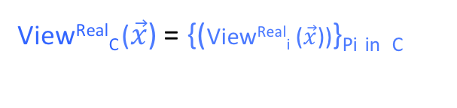
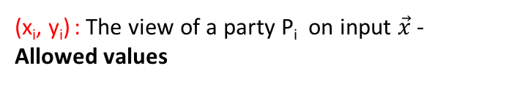
How to Compare Real World with Ideal World?
Fix the inputs of the parties, say x₁,….x_{n} . Call it $\vec{x}$
Real-world view of adv should contain no more info than the ideal-world view of adv
y₁
y₂
y₁
y₂
x₁
x₂
x₁
x₂
x₄
x₄
y₃
y₃
y₄
y₄
x₃
{x₃, y₃, r₃, protocol transcript}
x₃
(x_{i}, y_{i}) : The view of a party P_{i} on input $\vec{x}$ - Allowed values
View^{Real}_{i} ($\vec{x}$): The view of a party P_{i} on input $\vec{x}$ - Leaked Values (random variable)
Ideal-world view of adv is {(x_{i}, y_{i})}_{Pi in} _{C}
Let C be the set of corrupted parties. Then the real-world view of the adversary is:
View^{Real}_{C} ($\vec{x}$) = {(View^{Real}_{i} ($\vec{x}$))}_{Pi} _{in} _{C}
A real-world protocol is secure if the leaked values contain no more info than allowed values
Notes:
From the view point of the adversary.

Slide 5
Real-world (leaked values) vs. Ideal world (allowed values)
y₁
y₂
y₁
y₂
{x₃, y₃}
y₄
{x₃, y₃, r₃, protocol transcript}
y₄
When can we say that the real-world view (leaked values) of adv contain no more info than the ideal-world view of adv
If the leaked values can be efficiently computed (by some algorithm) from the allowed values.
Such an algorithm is called SIMULATOR ---denoted as SIM
Takes input {(x_{i}, y_{i})}_{Pi} $∈$ _{C} and simulates the view of the adversary in the real protocol.
It is enough if SIM creates a view of the adversary that is “close enough” to the real view so that adv. can not distinguish the simulated view from its real view.

Slide 6


Real-world (leaked values) vs. Ideal world (allowed values)
y₁
y₂
y₁
y₂
x₁
x₂
x₁
x₂
x₄
x₄
SIM
{x₃, y₃}
y₄
{x₃, y₃, r₃, protocol transcript}
y₄
Interaction with real-world adversary on behalf of the honest parties
SIM produces the simulated view
≈
View^{Real}_{C} ($\vec{x}$)
SIM({(x_{i}, y_{i})}_{Pi} $∈$ _{C} ) = View^{Ideal}_{C} ($\vec{x}$)
Random Variable/distribution (over the random coins of SIM and adv)
Random Variable/distribution (over the random coins of parties)
SIM: Ideal Adversary
The Ideal World
The Real World

Slide 7


Real-world vs. Ideal world
y₁
y₂
y₁
y₂
x₁
x₂
x₁
x₂
x₄
x₄
SIM
{x₃, y₃}
y₄
{x₃, y₃, r₃, protocol transcript}
y₄
Interaction on behalf of the honest parties
≈
{View^{Ideal}_{C} ($\vec{x}$)}
{View^{Real}_{C} ($\vec{x}$)}
If the two views (distributions) are perfectly indistinguishabe (even for a computationally unbounded distinguisher) then we get perfect privacy
If the two views (distributions) are statistically indistinguishabe (even for a computationally unbounded distinguisher) then we get statistical privacy
If the two views (distributions) are computationally indistinguishabe then we get computational privacy

Slide 8
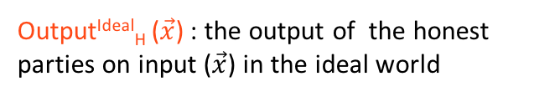
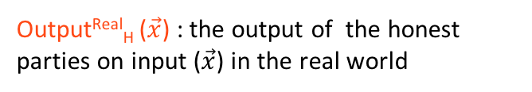
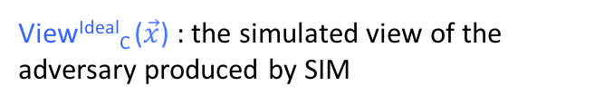
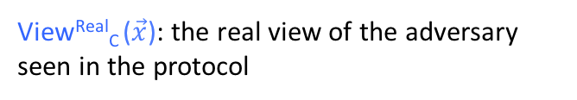
Real-world vs. Ideal world : Some Notations
y₁
y₂
y₁
y₂
x₁
x₂
x₁
x₂
x₄
x₄
SIM
{x₃, y₃}
y₄
{x₃, y₃, r₃, protocol transcript}
y₄
Interaction on behalf of the honest parties
View^{Real}_{C} ($\vec{x}$)
SIM({(x_{i}, y_{i})}_{Pi} $∈$ _{C} ) = View^{Ideal}_{C} ($\vec{x}$)
Output^{Ideal}_{H} ($\vec{x}$) : the output of the honest parties on input ($\vec{x}$) in the ideal world
Output^{Real}_{H} ($\vec{x}$) : the output of the honest parties on input ($\vec{x}$) in the real world
View^{Ideal}_{C} ($\vec{x}$) : the simulated view of the adversary produced by SIM
View^{Real}_{C} ($\vec{x}$): the real view of the adversary seen in the protocol

Slide 9




Real-world vs. Ideal world : Definition 1 (For Deterministic Functionalities )
y₁
y₂
y₁
y₂
x₁
x₁
x₂
x₂
x₄
x₄
SIM
{x₃, y₃}
y₄
{x₃, y₃, r₃, protocol transcript}
y₄
Separate conditions for correctness and privacy
A protocol for computing f is perfectly-secure if it satisfies the following conditions:
Correctness:
Privacy:
Output^{Ideal}_{H} ($\vec{x}$) = Output^{Real}_{H} ($\vec{x}$)
{View^{Ideal}_{C} ($\vec{x}$)} = {View^{Real}_{C} ($\vec{x}$)}
A protocol for computing f is statistically-secure if it satisfies the following conditions:
Correctness:
Privacy:
s
≈
|Output^{Ideal}_{H} ($\vec{x}$) - Output^{Real}_{H} ($\vec{x}$)|$≤$ negl(k)
{View^{Ideal}_{C} ($\vec{x}$)} {View^{Real}_{C} ($\vec{x}$)}

Slide 10


Real-world vs. Ideal world : Definition 1 (For Deterministic Functionalities )
y₁
y₂
y₁
y₂
x₁
x₁
x₂
x₂
x₄
x₄
SIM
{x₃, y₃}
y₄
{x₃, y₃, r₃, protocol transcript}
y₄
Separate conditions for correctness and privacy
A protocol for computing f is computationally-secure if it satisfies the following conditions:
Correctness:
Privacy:
c
≈
|Output^{Ideal}_{H} ($\vec{x}$) - Output^{Real}_{H} ($\vec{x}$)|$≤$ negl(k)
{View^{Ideal}_{C} ($\vec{x}$)} {View^{Real}_{C} ($\vec{x}$)}

Slide 11


Real-world vs. Ideal world : Definition 1 (For Deterministic Functionalities )
y₁
y₂
y₁
y₂
x₁
x₁
x₂
x₂
x₄
x₄
SIM
{x₃, y₃}
y₄
{x₃, y₃, r₃, protocol transcript}
y₄
Perfect-security:
Output^{Ideal}_{H} ($\vec{x}$) = Output^{Real}_{H} ($\vec{x}$)
{View^{Ideal}_{C} ($\vec{x}$)} = {View^{Real}_{C} ($\vec{x}$)}
Statistical-security:
|Output^{Ideal}_{H} ($\vec{x}$) - Output^{Real}_{H} ($\vec{x}$)|$≤$ negl(k)
s
≈
{View^{Ideal}_{C} ($\vec{x}$)} {View^{Real}_{C} ($\vec{x}$)}
Computational-security:
c
≈
|Output^{Ideal}_{H} ($\vec{x}$) - Output^{Real}_{H} ($\vec{x}$)|$≤$ negl(k)
{View^{Ideal}_{C} ($\vec{x}$)} {View^{Real}_{C} ($\vec{x}$)}
For deterministic functions, output is fixed once inputs are fixed (irrespective of the random coins)
So no probability distribution considered over Output^{Ideal}_{H} ($\vec{x}$) and Output^{Real}_{H} ($\vec{x}$)

Slide 12
Making “Very Small/Negligible” Precise– Asymptotic Approach
>> “ Very Small / negligible in n” means those f(n) :
- for every polynomial in n, p(n), there exists some positive integer N, such that f(n) < 1/p(n) , for all n > N
- “grows slower than any inverse poly”
n: Security parameter. A tunable parameter that tunes how difficult it is to break a cryptosystem
>> Example: 1/2^{n} , 1/2^{n/2}
>> How about 1/n¹⁰ ?
For 1/n²⁰ there is NO N s.t. 1/n¹⁰ < 1/n²⁰
- The more the value of n, the tougher the life of the adversary is.

Slide 13
Real-world vs. Ideal world : Definition 2 (For Randomized Functionalities )
y₁
y₂
y₁
y₂
x₁
x₁
x₂
x₂
x₄
x₄
SIM
{x₃, y₃}
y₄
{x₃, y₃, r₃, protocol transcript}
y₄
For randomized functions, output is not fixed even if inputs are fixed
Need to consider probability distribution considered over Output^{Ideal}_{H} ($\vec{x}$) and Output^{Real}_{H} ($\vec{x}$)
Correctness and privacy combined in a single condition
Perfect-security:
{Output^{Ideal}_{H} ($\vec{x}$), View^{Ideal}_{C} ($\vec{x}$)} = {Output^{Real}_{H} ($\vec{x}$), View^{Real}_{C} ($\vec{x}$)}
Statistical-security:
s
≈
{Output^{Ideal}_{H} ($\vec{x}$), View^{Ideal}_{C} ($\vec{x}$)} {Output^{Real}_{H} ($\vec{x}$), View^{Real}_{C} ($\vec{x}$)}
Computational-security:
c
≈
{Output^{Ideal}_{H} ($\vec{x}$), View^{Ideal}_{C} ($\vec{x}$)} {Output^{Real}_{H} ($\vec{x}$), View^{Real}_{C} ($\vec{x}$)}

Slide 14
Real-world vs. Ideal world : Definition 2 vs Definition 1
y₁
y₂
y₁
y₂
x₁
x₁
x₂
x₂
x₄
x₄
SIM
{x₃, y₃}
y₄
{x₃, y₃, r₃, protocol transcript}
y₄
Perfect-security:
{Output^{Ideal}_{H} ($\vec{x}$), View^{Ideal}_{C} ($\vec{x}$)} = {Output^{Real}_{H} ($\vec{x}$), View^{Real}_{C} ($\vec{x}$)}
Statistical-security:
s
{Output^{Ideal}_{H} ($\vec{x}$), View^{Ideal}_{C} ($\vec{x}$)} {Output^{Real}_{H} ($\vec{x}$), View^{Real}_{C} ($\vec{x}$)}
≈
Computational-security:
c
≈
{Output^{Ideal}_{H} ($\vec{x}$), View^{Ideal}_{C} ($\vec{x}$)} {Output^{Real}_{H} ($\vec{x}$), View^{Real}_{C} ($\vec{x}$)}
Definition 2 subsumes definition 1 (definition 2 is stronger)
Definition 2 captures randomized functions as well

Slide 15

Randomized Function and Definition 1
f( , ) = (r , ) r is a random bit
.
.
.
.
r
r
.
Sample r randomly and output
Sample r randomly
SIM
Interaction on behalf of the honest party
Sample and send a random r’
>> Does this protocol achieve privacy ?
No!
{View^{Ideal}_{C} ($\vec{x}$)} = {View^{Real}_{C} ($\vec{x}$)}
{r’ : r’ random}
{r : r is random}
The proof says the protocol achieves privacy !
The Ideal World
The Real World

Slide 16




Randomized Function and Definition 2
f( , ) = (r , ) r is a random bit
.
.
.
.
r
r
.
Sample r randomly and output
Sample r randomly
SIM
Interaction on behalf of the honest party
Sample and send a random r’
>> Is this protocol secure?
No!
The proof says the protocol is insecure!
{View^{Ideal}_{C} ($\vec{x}$)} = {View^{Real}_{C} ($\vec{x}$)}
{Output^{Ideal}_{H} ($\vec{x}$), View^{Ideal}_{C} ($\vec{x}$)}
{Output^{Real}_{H} ($\vec{x}$), View^{Real}_{C} ($\vec{x}$)}
$$≠$$
{(r , r’}) | r,r’ random and independent}
{(r , r)} | r random
The Ideal World
The Real World

Slide 17
Definition 1 is Enough!
Consider the case when n = 2, t = 1 (the argument holds for general n and t)
Let g(x, y; r) be a randomized functionality
P₁ and P₂ has inputs x and y respectively
The functionality picks a uniform randomness r and then computes g(x, y; r)
Can we can replace functionality g by a deterministic functionality, where randomness r is ”contributed” by P₁ and P₂ (apart from their usual inputs x and y) ?
Define f((x, r₁), (y, r₂)) $≝$ to compute g(x, y; r) where r₁+r₂ can act as r.
Party P₁ will input (x, r₁)
Party P₂ will input (y, r₂)
The role of r played by r₁ + r₂
If P_{i} is honest then r_{i} will be random and so will be r
For the rest of the course, we will consider only deterministic functionalities

Slide 18
Definition Applies for
Dimension 2 (Networks)
Complete
Synchronous
Dimension 3 (Distrust)
Centralized
Dimension 4 (Adversary)
Threshold/non-threshold
Polynomially Bounded and unbounded powerful
Semi-honest
Static

