Slide 1


Secure Computation
(Lecture 1)
Arpita Patra

Slide 2
Welcome to an exciting Journey ☺
>> Course Homepage: http://drona.csa.iisc.ernet.in/~arpita/SecureComputation15.html
>> References:
Secure Multiparty Computation and Secret Sharing - An Information Theoretic Approach – by Ronald Cramer, Ivan Damgaard and Jesper Buus Nielsen
Efficient Two-party Protocols- Techniques and Constructions- by Carmit Hazay and Yehuda Lindell
Recent papers and a few lecture notes
Notes:
Welcome to an exciting journey together! I promise you that you will never regret your decision to walk and explore the lanes/by-lanes, the cross roads /main roads of secure computation with me. I, as your instructor will try my best to ensure that this journey become a memorable one, a huge learning experience!

Slide 3
Evaluation Policy
>> Tuned to ensure that you learn and you enjoy the learning!
Scribe (18%): Every student will have to scribe 2/3 lectures
Chalk & Talk Seminar (14*2 + 4 = 32%): Every student will make two presentations (one in each half of the course) and write a small blog on one of her/his friend’s seminar.
Project (25 + 35 = 60%): Two projects (midterm and end-term)
>> theoretical or practical in nature
>> theoretical projects will involve answering deep and exciting theoretical questions
>> practical projects will involve implementing and improving challenging practical secure computation tasks
>> Both project topics may be same. Complete literature survey and decide on an exciting problem by midterm. Make non-trivial theoretical progress/ implement the best solution in the second half.

Slide 4
We are in the age of Information!
Information Everywhere:
> Individual: Age, Salary, Bank Details (balance, netbaking login password), Citizenship, Parents/family member details, Identity details (passport no., PAN card, Voter ID, AADHAR id ), Income Tax Details, Your vehicle details (cycle, two wheeler, car), Medical data: diseases, biometric traits (face, fingerprint, iris, speech), genome signature, minimum age of watching porn/taking drug, Child adoption details
> Profitable Organization (MS/IBM/TCS/Infosys): List of employees and their details, Profit, loss, turnover, salaries.
> Educational Organization (IISc/IITs/IIITs/IISERs/NISERs/NITs): List of employees and their details, students and their details, awards, recognitions, scientific publications, products, dropouts, drug addicts, suicides, sexual harassments,

Slide 5
We are in the age of Information!
> Hospitals: List of patients and their medical history and details. List of doctors, nurses and their details
> Security Agencies (RAW/ IB/ CBI/NIA): List of employees and details, list of criminals and details, list of incidents and details
> Military Organizations (Army/Air Force/Navy): List of soldiers, colonels and details, list of operations and details, intercepted messages and details
> Country: List of citizens and details, prime minister, presidents, MLA, MPs, celebrities, under-privileged. Satellites / Nuclear weapons / Submarines information
…….

Slide 6
Secret Information
> Individual: Age, Salary, Bank Details (balance, netbaking login password), Identity details (passport no., PAN card, Voter ID, AADHAR id ), Income Tax Details, Your vehicle details (cycle, two wheeler, car), Medical data: diseases, biometric traits (face, fingerprint, iris, speech), genome signature, minimum age of watching porn/taking drug, Child adoption details
> Profitable Organization (MS/IBM/TCS/Infosys): List of employees and their details, Profit, loss, turnover, salaries.
> Educational Organization (IISc/IITs/IIITs/IISERs/NISERs/NITs): List of employees and their details, students and their details, awards, recognitions, scientific publications, products, dropouts, drug addicts, suicides, sexual harassments,

Slide 7
Secret Information
> Hospitals: List of patients and their medical history and details. List of doctors, nurses and their details
> Security Agencies (RAW/ IB/ CBI/NIA): List of employees and details, list of criminals and details, list of incidents and details, list of intercepted messages
> Military Organizations (Army/Air Force/Navy): List of soldiers, colonels and details, list of operations and details, intercepted messages and details
> Country: List of citizens and details, prime minister, presidents, MLA, MPs, celebrities, under-privileged. Satellites / Nuclear weapons / Submarines information
…….

Slide 8
Secret Communication
We know how to solve (Encryption schemes)
>> Not trivial to achieve the goal
>> But the purpose is simple to state and well-understood

Slide 9
Privacy Preserving Information Processing (Computation)
Many scenarios that:
>> demands data privacy and computation on the data at the same time!
>> A large amount of added value can be obtained by combining confidential information from several sources and from this computing some result that holds an interest for all parties

Slide 10
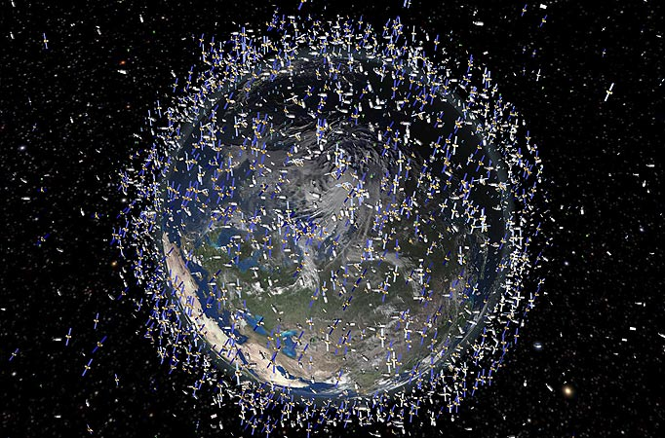
Preventing Satellite Collision in Space

Slide 11
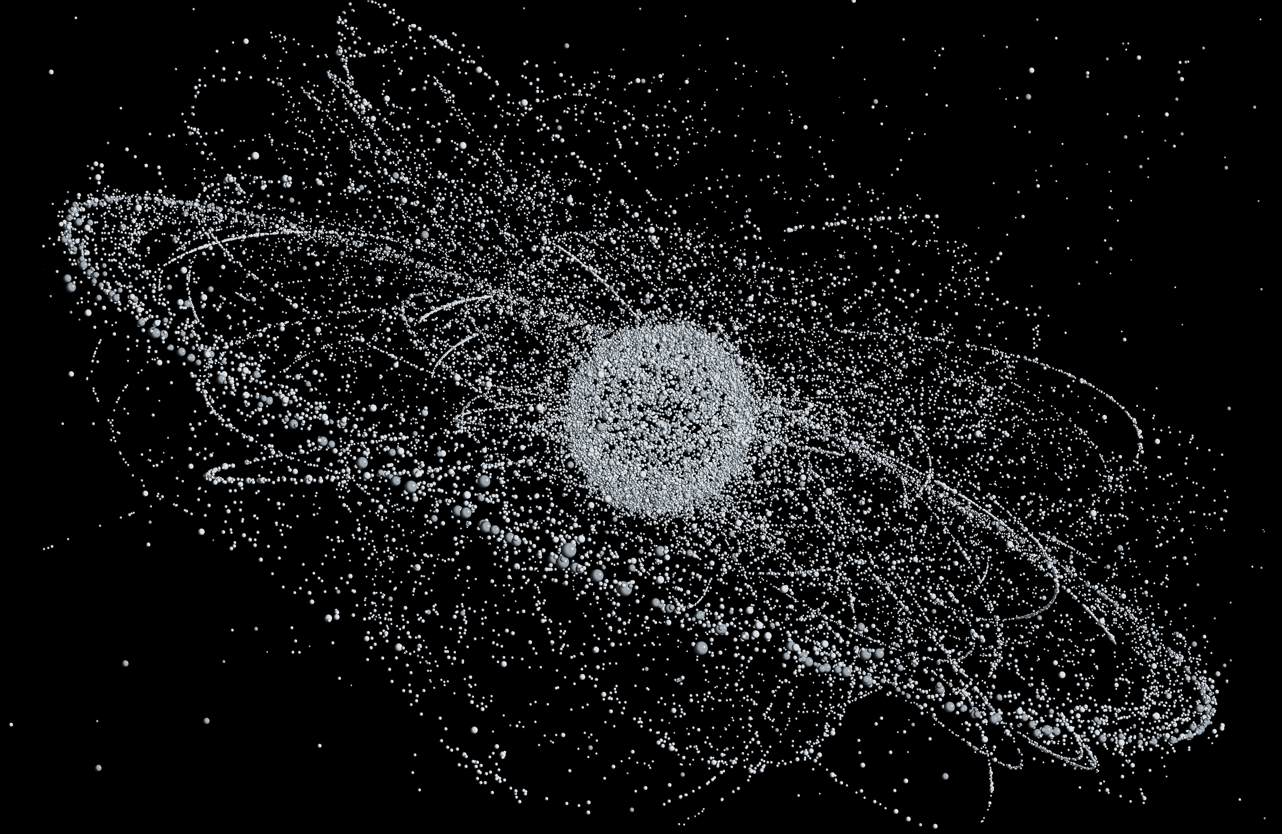
Preventing Satellite Collision in Space

Slide 12

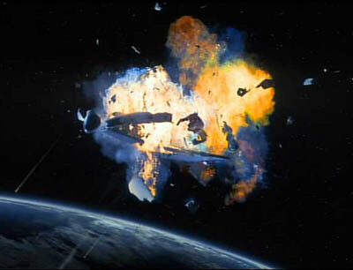
Preventing Satellite Collision in Space
NASA tracks 7,000 space crafts and 21,000 objects in space
Approximately 20,00,00,000 pairs
Notes:
Artificial satellites orbiting the Earth today is around 8,300. Of these, about 3,000 are not operational having lived out their useful life and are part of the space debris.

Slide 13
Preventing Satellite Collision in Space
List of High-speed Collisions:
The 1996 collision between the French Cerise military
reconnaissance satellite and debris from Ariane rocket
The 2009 collision between the Iridium 33 communications satellite and the derelict Russian Kosmos 2251 spacecraft over Siberia, which resulted in the destruction of both satellites
The 22 May 2013 collision between Ecuador's NEE-01 Pegaso and Argentina's CubeBug-1, and the particles of a debris cloud left over from the launch of Kosmos 1666
On Jan. 22, 2013, debris from the destroyed Chinese satellite Fengyun 1C collided with a small Russian laser-ranging retro-reflector satellite called BLITS ("Ball Lens in The Space").

Slide 14
Preventing Satellite Collision in Space
NASA tracks 7,000 space crafts and 21,000 objects in space
Approximately 20,00,00,000 pairs
High-accuracy positional information
High-accuracy positional information is privy to operators
National secret
Notes:
Artificial satellites orbiting the Earth today is around 8,300. Of these, about 3,000 are not operational having lived out their useful life and are part of the space debris.

Slide 15
Preventing Satellite Collision in Space
To date, there have been no observed collisions between natural satellites of any Solar System planet or moon.

Slide 16

(Secure) Electronic Auction

Slide 17
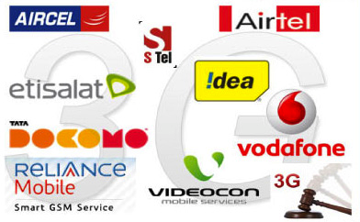
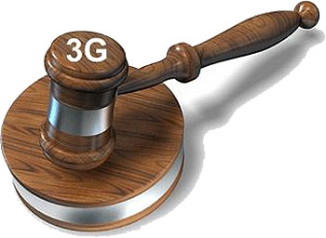
(Secure) Electronic Auction
Nothing other than the winner and winning bid should be revealed

Slide 18




(Privacy Preserving) Data Mining
Hospitals do not want to share their patient records
But want to data-mine on combined data
Notes:
AIDS

Slide 19



(Privacy Preserving) Data Mining
They do not want to share their count of sexual abuse cases/ drug addicted cases
But want to data-mine on combined data
Notes:
AIDS

Slide 20
Many more applications..
>> Secure Set Intersection
>> Secure Bench-marking
>> Secure/private information retrieval….
There is something common among all the problems.
…can we find an abstraction?
Notes:
AIDS

Slide 21
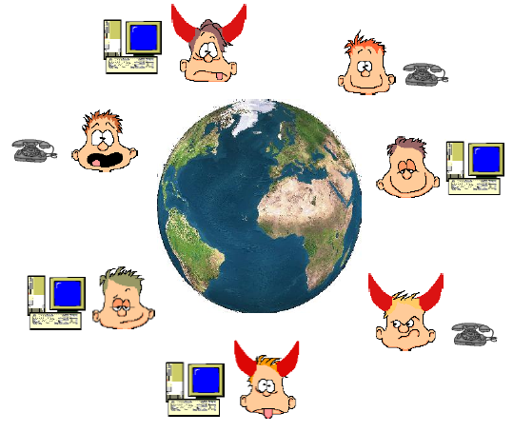
Secure (Multiparty) Computation (MPC)
MPC is the holy grail: Abstracts all that we have seen so far and many more
–
>> n parties P₁,....,P_{n}
Do not trust each other
>> P_{i} has private input x_{i}
>> A common n-input function f
Goals:
>> Correctness: Compute f(x₁,x₂,..x_{n})
>> Privacy: Nothing about the inputs of the parties should be leaked
>> Consider f(x₁,x₂) = x₁ AND x₂
>> Refined Privacy: Nothing more than function output should be revealed

Slide 22



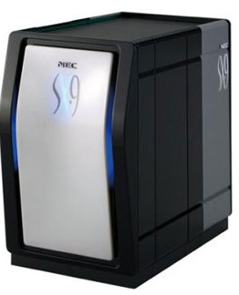

MPC is easy if we could trust someone
x₁
x₂
Any task
x₃
x₄
y = f(x₁,x₂,x₃,x₄)

Slide 23

Can we Trust Someone?
x₁
x₂
Some problem in the solution..
>> Creates a single point failure
Any task
>> Why we are doing secure computation? Because of the lack of trust. How suddenly we will get someone who is cent percent trusted?
y
y
y
y
>> Trust is a very rare, volatile.
x₃
x₄
>> If there is trust in the world
y = f(x₁,x₂,x₃,x₄)
MPC

Slide 24
But there will be dis-trust in the world..
Because..
>> Without darkness, one cannot know light
>> Without hatred, one cannot feel love
>> Without war, one cannot realize the price peace
>> Without noise, one cannot appreciate serenity
>> Without distrust, one cannot value trust
The contrasts are the hallmarks of the great Magician!!
So we have to solve MPC without a trusted party..
>> But looks impossible. How is it possible to compute f(x₁,x₂,x₃,x₄) without anyone knowing all the inputs. So do we have to really trust someone..
Looks like we are stuck. Does the journey of secure computation end here?
Notes:
With the right tools, we can do it! By no means it is impossible!!

Slide 25
Secure Addition and Voting
y = f(x₁,x₂,..,x_{n}) = x₁ + x₂ +…+ x_{n}
…
x₁
x₂
x₃
x_{n}
y
y
y
y
P₁
P₂
P₃
P_{n}
Notes:
With the right tools, we can do it! By no means it is impossible!!

Slide 26
Secret Sharing
Provides a way for a party, say P₁ to spread information about a secret x across all the parties so that together they hold full information about x, yet individual (or subset of parties) has no information about x
Secret s
Dealer

Slide 27
Secret Sharing
Secret s
Dealer
…
s₁
s₂
s₃
s_{n}

Slide 28
Secret Sharing
Secret s
Dealer
…
v₁
v₂
v₃
v_{n}
Individual players have no information on s

Slide 29
Secret Sharing
Secret s
Dealer
…
s₁
s₂
s₃
s_{n}
Together all the parties know s
Secret s
Notes:
Information theoretically

Slide 30
Secret Sharing Instantiation
Z_{p} : {0,1….p-1}, p is a prime
Theorem: F_{p} = (Z_{p} , + mod p (+), . mod p (•) ) is a field
Closure
Associativity
Identity: 0 and 1
Inverse: for every a there exist –a, a⁻¹ so that a ⊕ (-a) = 0 and
a ⊗ a⁻¹ = 1
Distributive: . mod p over + mod p

Slide 31
Secret Sharing Instantiation
>> Choose random shares s₁,..s_{n} from F_{p} s. t. s₁ + …+ s_{n} = s
>> S = {s₁,.. s_{n} }
s from F_{p}
…
S\s₁
S\s₂
S\s₃
S \ s_{n}
>> Together all the parties know s (in fact any two parties know s)
>> Individual party has no information about s.
The probability of guessing s before secret sharing = the probability of guessing s after secret sharing (does not depend on the computing power of the parties)
F_{p} = (Z_{p} , +, •) is a field

Slide 32
Secure Addition y = x₁+x₂+x₃ (assume n=3 parties)
P₁
P₂
P₃
Primitives 1 (Secret Sharing Schemes): A magic primitive and one of the fundamental building blocks of MPC
x₁
x₂
x₃
x₁₁ x₁₂ x₁₃
x₂₁ x₂₂ x₂₃
x₃₁ x₃₂ x₃₃
P₁
x₁₂
x₁₃
x₂₂
x₂₃
+
x₃₂
x₃₃
=
s₂
s₃
+
x₁₁
x₁₃
x₂₁
x₂₃
x₃₁
x₃₃
s₁
s₃
P₂
+
+
=
P_{i}
y = s₁ + s₂ + s₃
x₁₁
x₁₂
x₂₁
x₂₂
x₃₁
x₃₂
s₁
s₂
P₃
+
+
=
No party even with unbounded power learns nothing more than y !
The same is done for all P_{i}

Slide 33
Secure bit multiplication y = x₁ • x₂ and Match-making (assume n=2 parties)
P₁
P₂
y = x₁ • x₂
= (x₁₁ + x₁₂ )•(x₂₁ + x₂₂ )
= (x₁₁•x₂₁ + x₁₁•x₂₂ + x₁₂•x₂₁ + x₁₂•x₂₂)
x₁
x₂
x₁₁ x₁₂
x₂₁ x₂₂
P₁
x₁₂
•
x₂₂
= x₁₂•x₂₂
P₂
x₁₁
x₂₁
= x₁₁•x₂₁
•
Looks like we are stuck ☹

Slide 34
1-out-of-2 Oblivious Transfer
Message Transfer:
S
m
m
R
S
m₀
m₁
b
R
m_{b}
S does not know b
R does not know m_{1-b}
m₀
b
1-out-of-2
OT
m₁
m_{b}

Slide 35
Secure bit multiplication y = x₁ • x₂
0
x₂
P₁
1-out-of-2
OT
P₂
x₁
x₁•x₂
x₁
x₂
a₀
b
1-out-of-2
OT
a₁
(1-b)•a₀ + b•a₁ = a_{b}
Primitive 2 (Oblivious Transfer): Another magic primitive and one of the fundamental building blocks of MPC

Slide 36
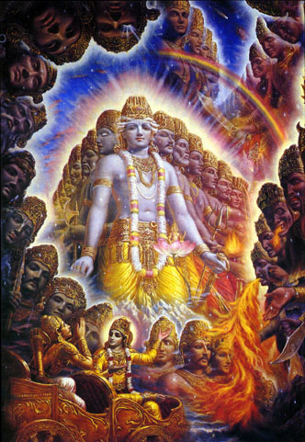
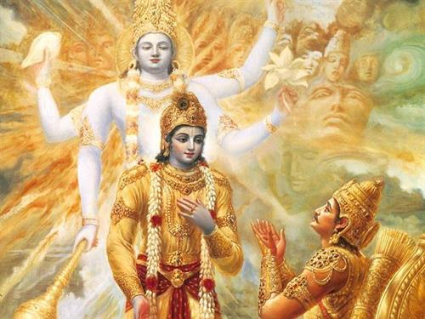
Time to show Vishwaroop of MPC
Notes:
It is not without a reason that we call MPC a holy grail and it is strong enough to capture all most everything, if not everything in cryptography.

