Slide 1


Secure Computation Lecture 15-16
Arpita Patra

Slide 2
Recap
>> i.t MPC with Honest Majority
Semi-honest Adversary
> Shamir Secret-sharing
> BGW Protocol based on secret-sharing
> Offline/Online phase
> Creating offline material and how to use them in online phase (Beaver’s trick etc)
>> i.t MPC with DisHonest Majority Impossible
>> Crypto MPC
> OT (from PKE with public-key samplability / Dual-mode Encryption)
> GMW (2 and n-party) Protocol from OT and additive secret-sharing
> Optimizations of GMW- preprocessing OT, Domain Extension, OT Extension (IKNP/KK13)
> Yao Protocol using garbled circuit and OT
> Optimazations- point-and-permute, garbled row reduction, Free-XOR
> Multi-party Yao i.e. BMR

Slide 3

Entering into the world of Malicious Adversary

Slide 4


i.t Multi-party Computation [BGW]
2
1
5
9
⊕
⊗
(n, t)- secret share each input
3
⊕
45
3
2. Find (n, t)-sharing of each intermediate value
⊗
48
Linear gates: Linearity of Shamir Sharing - Non-Interactive
144
Non-linear gate: Require degree-reduction Technique. Interactive
3. Reconstruct the Shamir-sharing of the output by exchanging shares with each other

Slide 5
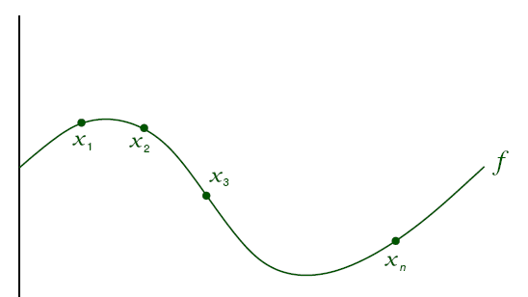
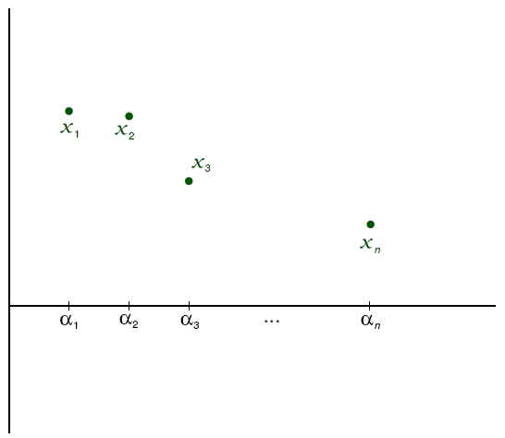
Sharing Phase: (n,t) – Secret-Sharing
Random polynomial of degree t over F_{p} s.t p>n
…
x₁
x₂
x₃
x_{n}
P₁
P₂
P₃
P_{n}

Slide 6
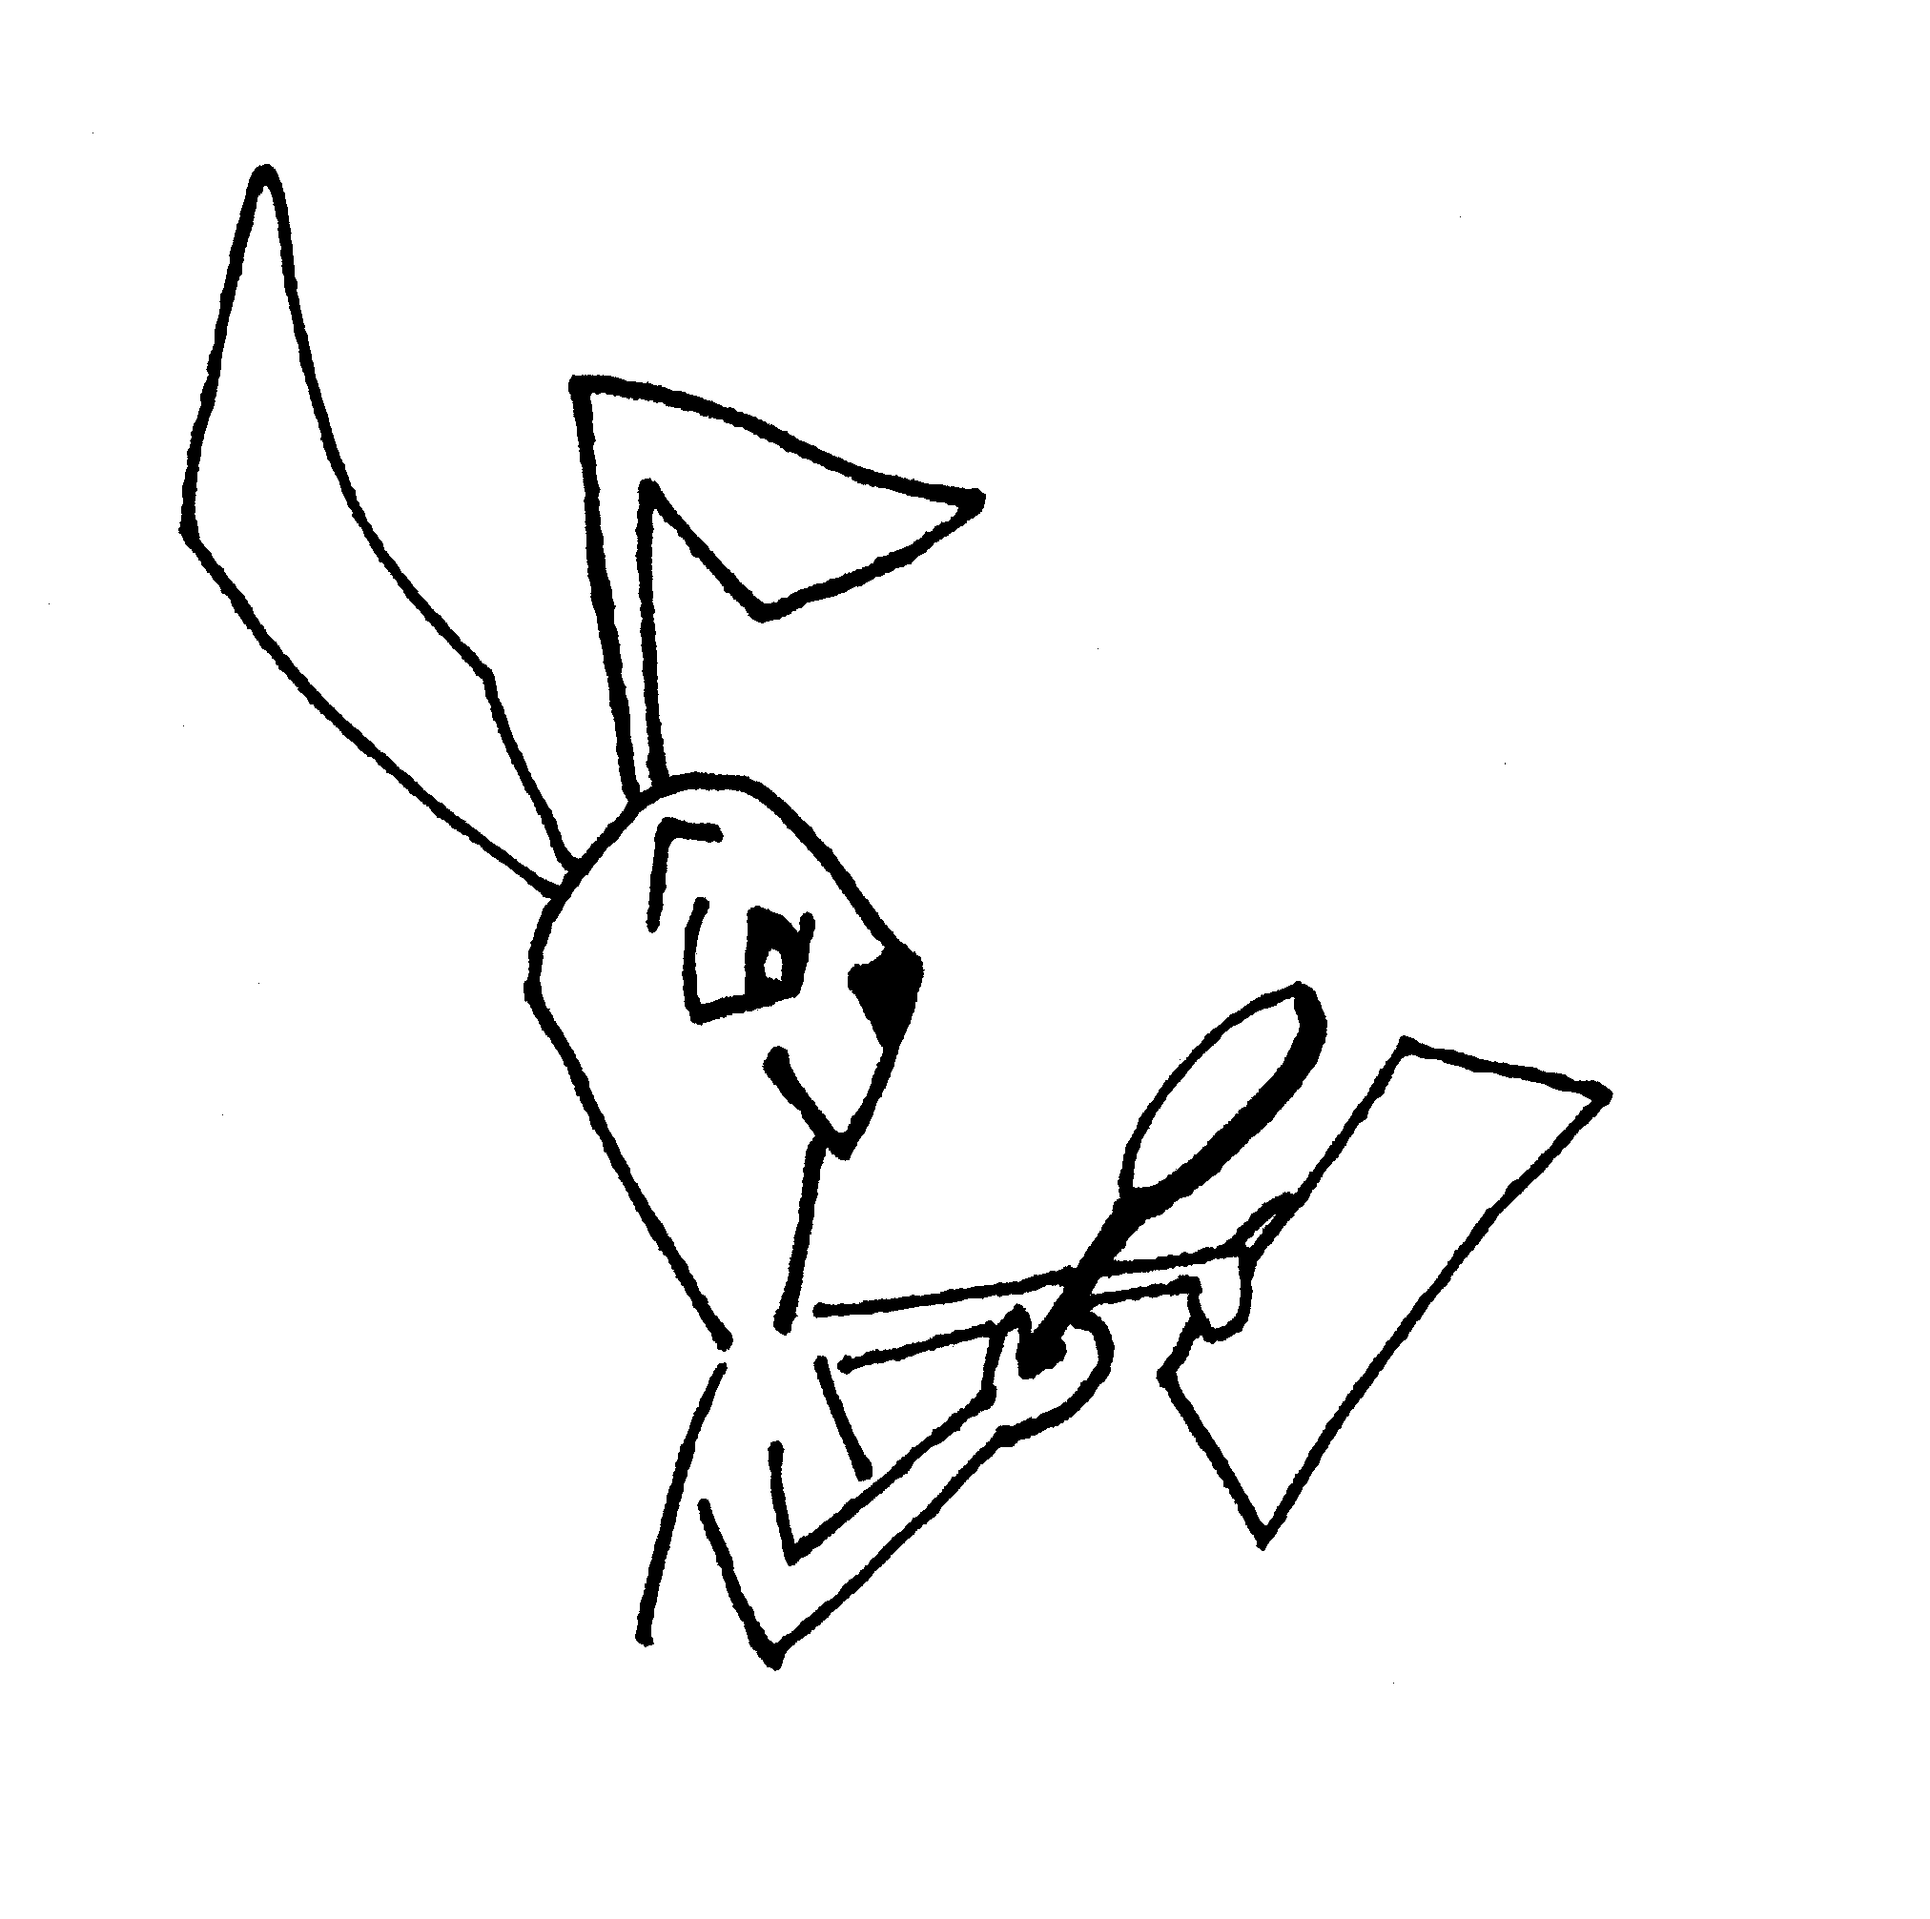
Secret Sharing with Malicious Dealer
Verifiable Secret Sharing (VSS)
Duality: An honest dealer must pass where a malicious one should fail
Inconsistent share
Inconsistent share
Inconsistent Share
………….
Inconsistent share
Verifiability
Shamir Sharing: Points on a polynomial of degree more than t
Notes:
Security argument

Slide 7
Reconstruction Phase: (n,t)-Shamir-sharing
P₁
x₁
P₂
x₂
P_{i}
P₃
x₃
P_{n}
x_{n}
Lagrange’s Interpolation
The same is done for all P_{i}

Slide 8
Reconstruction Phase: (n,t)-Shamir-sharing Malicious A_{t}
Verifiable Secret Sharing (VSS) handles this too!
Notes:
Security argument

Slide 9

Definition of VSS [CGMA85]
Extends Secret Sharing to the case of malicious corruption
s is committed
Secret s
Dealer
s is secure
Sharing
Phase
…
v₁
v₂
v₃
v_{n}
Reconstruction
Phase
Secret s

Slide 10
Definition of VSS [CGMA85] Continued..
n parties P = {P₁, …, P_{n}}, dealer D (e.g., D = P₁)
t corrupted parties (possibly including D) → A_{t}
Secrecy
If D is honest, then A_{t} has no information about secret s during the Sharing phase
Correctness
If D is honest, then secret s will be correctly reconstructed during reconstruction phase
Strong Commitment
Corrupted D commits a unique s*
- s* should be uniquely reconstructed

Slide 11
SS to VSS
SS
A_{t} is semi-honest
Dealer is Honest
SS with Cheaters / Honest Dealer VSS
A_{t} is malicious
Dealer is honest
VSS
A_{t} is malicious
Dealer may be controlled by A_{t}!
Notes:
Security argument

Slide 12
i.t Multi-party Computation
2
1
5
9
⊕
⊗
(n, t)- secret share each input
3
⊕
45
3
2. Find (n, t)-sharing of each intermediate value
⊗
48
Linear gates: Linearity of Shamir Sharing - Non-Interactive
144
Non-linear gate: Require degree-reduction Technique. Interactive
3. Reconstruct the Shamir-sharing of the output by exchanging shares with each other

Slide 13
Secure Multiplication Gate Evaluation
x
y
x•y
P₁
where
x₁
y₁
x₁•y₁ = z₁
P₂
x₂
y₂
x₂•y₂ = z₂
Recombination Vector (r₁, …,r_{n})
P₃
x₃
y₃
x₃•y₃ =z₃
P_{n}
x_{n}
y_{n}
x_{n}•y_{n} = z_{n}
f₁ (x)
f₂ (x)
f(x) = f₁ (x)•f₂ (x) of degree 2t

Slide 14
Secure Multiplication Gate Evaluation
x
y
x•y
x•y
P₁
x₁
y₁
x₁•y₁ = z₁
Shamir-share
z₁
P₂
x₂
y₂
Shamir-share
z₂
x₂•y₂ = z₂
r₁z₁ +..+r_{n}z_{n}
P₃
x₃
y₃
Shamir-share
z₃
x₃•y₃ =z₃
Shamir-share
z_{n}
P_{n}
x_{n}
y_{n}
x_{n}•y_{n} = z_{n}
f₁ (x)
f₂ (x)
f(x) = f₁ (x)•f₂ (x) of degree 2t
Recombination Vector (r₁, …,r_{n})

Slide 15
Secure Multiplication Gate Evaluation
x
y
x•y
x•y
P₁
x₁
y₁
x₁•y₁ = z₁
VSS-share
z₁
P₂
x₂
y₂
VSS-share
z₂
x₂•y₂ = z₂
r₁z₁ +..+r_{n}z_{n}
P₃
x₃
y₃
VSS-share
z₃
x₃•y₃ =z₃
VSS-share
z_{n}
P_{n}
x_{n}
y_{n}
x_{n}•y_{n} = z_{n}
f₁ (x)
f₂ (x)
f(x) = f₁ (x)•f₂ (x) of degree 2t
Recombination Vector (r₁, …,r_{n})

Slide 16
Secure Multiplication Gate Evaluation
x
y
x•y
z
P₁
x₁
y₁
x₁•y₁ = z₁
VSS-share
z₁
P₂
x₂
y₂
VSS-share
z₂
x₂•y₂ = z₂
r₁z₁ +..+r_{n}z’_{n}
P₃
x₃
y₃
z’₃
O1: Prevent them in doing this. n ≥ 2t+1
x₃•y₃ =z₃
VSS-share
O2: Find a mechanism so that we can correct the errors- n ≥ 3t+1
VSS-share
z’_{n}
P_{n}
x_{n}
y_{n}
x_{n}•y_{n} = z_{n}
f₁ (x)
f₂ (x)
f(x) = f₁ (x)•f₂ (x) of degree 2t
Recombination Vector (r₁, …,r_{n})

Slide 17
i.t Multi-party Computation
2
1
5
9
⊕
⊗
(n, t)- secret share each input
3
⊕
45
3
2. Find (n, t)-sharing of each intermediate value
⊗
48
Linear gates: Linearity of Shamir Sharing - Non-Interactive
144
Non-linear gate: Require degree-reduction Technique. Interactive
3. Reconstruct the Shamir-sharing of the output by exchanging shares with each other
VSS with n ≥ 3t+1
For perfect security n ≥ 3t+1 is necessary and sufficient.

Slide 18
Perfect VSS with n>= 3t+1
Bivariate Polynomial of degree t in x,y as the basis- F(x,y)
Univariate Polynomial of degree t in x as the basis – f(x)
F(0,0)- secret
f(0)- secret
F(x,i) & F(i,y)- ith share
f(i)- ith share
t F(x,i)’s and F(i,y)’s will leak NO info about F(0,0)
t f(i)’s will leak NO info about f(0)
t+1 F(x,i)’s (F(i,y)’s) will completely determine F(x,y) – Lagrange’s formula
t+1 f(i)’s will completely determine f(x) – Lagrange’s formula
Pi
Pj
F(x,i)
F(i,y)
F(x,j)
F(j,y)
Ensure every pair Happy
F(j,i)
F(j,i)
F(i,j)
F(i,j)

Slide 19
Perfect VSS with n>= 3t+1
Bivariate Polynomial of degree t in x,y as the basis- F(x,y)
Univariate Polynomial of degree t in x as the basis – f(x)
F(0,0)- secret
f(0)- secret
F(x,i) & F(i,y)- ith share
f(i)- ith share
t F(x,i)’s and F(i,y)’s will leak NO info about F(0,0)
t f(i)’s will leak NO info about f(0)
t+1 F(x,i)’s (F(i,y)’s) will completely determine F(x,y) – Lagrange’s formula
t+1 f(i)’s will completely determine f(x) – Lagrange’s formula
Two random univariate polynomials of degree at most t with the secret F(0,0) as the constants.
F(0,y) and F(x,0)
Pi has F(0,i) and F(i,0)- Shamir share of F(0,0)

Slide 20
Rest on the board
Matrix view of bivariate polynomial
Claim: t F(x,i)’s and t F(i,y)’s will leak NO info about F(0,0).
Claim: (t+1) F(x,i)’s or (t+1) F(i,y)’s completely determines F(x,y).
Six round VSS and proof
Reducing the number of rounds to four

Slide 21
Feasibility of VSS
Round Complexity
(Sharing Phase)
How big t is compared to n?
Adversary (A_{t}) | Characterization
Polynomially Bounded Adversary | n ≥ 2t + 1 , t ≥1
Unbounded Adversary and no error allowed | n ≥ 3t + 1 , t ≥1
Unbounded Adversary and error allowed in reconstruction | n ≥ 2t+ 1 , t ≥1
No. of Interaction
2
3
3
Notes:
Motivation and definition of VSS is complete now. Let us turn to some of the fundamental questions that can be asked on VSS.

Slide 22
Interplay of Round Complexity and Fault tolerance in VSS
Adversary (A_{t}) | Characterization | Round Complexity
Polynomially Bounded Adversary | n ≥ 2t + 1 , t ≥1 t = 1; n ≥ 4 | 2 1
Unbounded Adversary and no error allowed | n ≥ 3t + 1 , t ≥1 n ≥ 4t + 1 , t ≥1 t = 1; n ≥ 5 | 3 2 1
Unbounded Adversary and error allowed in reconstruction | n ≥ 2t+ 1 , t ≥1 n ≥ 3t+ 1 , t ≥1 t = 1; n ≥ 4 | 3 2 1
ASIACRYPT’11
[BKP]
STOC’01 [GIKT]
TCC’06
[FGGRS]
Unbounded Powerful Adversary
CRYPTO’09 [PCRR],
ASIACRYPT’10
[KPR]
Notes:
The trend is that the less the allowed rounds the more stringent condition for characterization. “The round complexity of verifiable secret sharing and secure multicast”

Slide 23
Chalk & Talks
CT1 [PCRR09]: The Round Complexity of Verifiable Secret Sharing Revisited
http://eprint.iacr.org/2008/172
CT3 [BH08]: Perfectly secure MPC with Linear Communication Complexity.
http://cs.au.dk/~vpastro/study_groups/spring_2011/papers/BeeHir08.pdf
CT4 [BFO12]: Near-Linear Unconditionally-Secure Multiparty Computation with a Dishonest Minority. http://eprint.iacr.org/2011/629

Slide 24


