Slide 1


Secure Computation (Lecture 3 & 4)
Arpita Patra

Slide 2
Recap
>> Why secure computation?
>> What is secure (multi-party) computation (MPC)?
>> Secret Sharing and Secure sum protocol
>> OT and Secure multiplication protocol
>> Expanding Scope of MPC
> Dimension 1: Models of computation (Boolean vs. Arithmetic)
> Dimension 2: Network models (Complete vs. Incomplete | Synchronous vs. Hybrid vs. Asynchronous (impossibility results) )
> Dimension 3: Modelling Dis-trust (Centralized vs. decentralized adversary)
> Dimension 4: Modelling adversary(threshold vs. non-threshold | polynomially bounded vs. unbounded powerful (impossibility) | semi-honest vs. covert vs. malicious)

Slide 3
Expanding the scope of MPC
Dimension 4.3: Various Characteristics of adversary A (semi-honest vs. malicious vs. covert)
Passive/Semi-honest: A is a passive observer, eavesdrops the corrupted parties
Active/Malicious: A takes full control over the corrupted parties
Covert: A behaves maliciously only when its prob. Of getting caught is low
>> Well explored
>> Often acts as a starting point for malicious protocols
>> Well explored
>> final goal
>> Demands a whole lot of new primitives, Commitment, Zero-knowledge Proofs, Byzantine agreement/broadcast
>> Very less explored
>> More efficient solutions than maliciously secure protocols
>> Scope of work
One of the earlier demarcations made in the study MPC.
First half: semi-honest Second Half: Malicious
Notes:
Adv is allowed to use whatever input he wants on behalf of the corrupted parties. But he should not be allowed to act other than the way the protocol specifies it to do!

Slide 4
Secure Addition y = x₁+x₂+x₃ with n=3 and t=1 in Malicious Setting
P₁
P₂
P₃
P₁ under the influence of A may not send his shares to others!
x₁
x₂
x₃
x₁₁ x₁₂ x₁₃
x₂₁ x₂₂ x₂₃
x₃₁ x₃₂ x₃₃
P₁
x₁₁
+
x₂₁
x₃₁
s₁
+
=
P₂
x₁₂
+
x₂₂
+
x₃₂
=
s₂
P_{i}
y = s₁ + s₂ + s₃
P₃
x₁₃
+
x₂₃
+
x₃₃
=
s₃

Slide 5
Secure Addition y = x₁+x₂+x₃ with n=3 and t=1 in Malicious Setting
P₁
P₂
P₃
A can make P₂ and P₃ to output different sums!
x₁
x₂
x₃
x₁₁ x₁₂ x₁₃
x₂₁ x₂₂ x₂₃
x₃₁ x₃₂ x₃₃
If you are thinking that the problem can be resolved by exchanging the outputs, you are absolutely wrong!
P₁
x₁₁
+
x₂₁
x₃₁
s₁
+
=
s’₁
P₂
y = s₁ + s₂ + s₃
P₂
x₁₂
+
x₂₂
+
x₃₂
=
s₂
P₃
y’ = s’₁ + s₂ + s₃
P₃
x₁₃
+
x₂₃
+
x₃₃
=
s₃
Primitive 3 (Byzantine Agreement/broadcast): Another fundamental building block of MPC

Slide 6


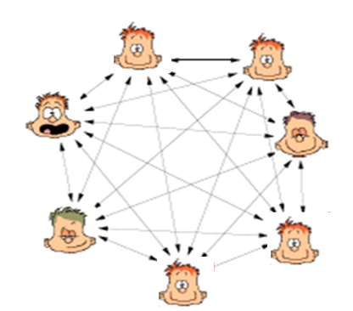
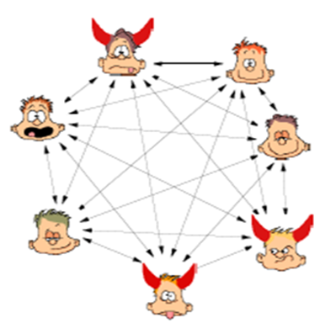
Broadcast
Sender
Goal: to allow a sender to send m identically
Message m
No disagreement even when sender is corrupted
n parties {P₁, …, P_{n}} connected by pair-wise channels
At most t parties under the control of a malicious (Byzantine) adversary A

Slide 7

Byzantine Agreement
b₁
b₂
n parties {P₁, …, P_{n}}
b_{n}
At most t parties under the control of an adversary A
b
Party P_{i} has a private bit
b_{i} ∈ {0, 1}
b_{j}
Goal: to make the honest parties agree on a common bit b.
b_{i}

Slide 8
Secure Addition y = x₁+x₂+x₃ with n=3 and t=1 in Malicious Setting
P₁
P₂
P₃
x₁
x₂
x₃
x₁₁ x₁₂ x₁₃
x₂₁ x₂₂ x₂₃
x₃₁ x₃₂ x₃₃
P₁
x₁₁
+
x₂₁
x₃₁
s₁
+
=
P₂
x₁₂
+
x₂₂
+
x₃₂
=
s₂
P_{i}
y = s₁ + s₂ + s₃
P₃
x₁₃
+
x₂₃
+
x₃₃
=
s₃
No robustness and fairness, but there is agreement among the honest parties

Slide 9
Commitment Schemes
>> 2-party Coin-tossing f( , ) = (r,r): Two parties want to toss a coin together.
A
Random m_{S}
B
Random
m_{R}
m_{S} + m_{R}
m_{S} + m_{R}
If R is bad, he will choose his contribution so that the sum is biased
Notes:
Information theoretically

Slide 10


Commitment Schemes
C
m
m
Committer Alice
Verifier
Bob
C = Commit(m)
m = Commit(C) ?
Binding:
Hiding:
Alice cannot change the message associated with C
Bob cannot guess the message associated with C

Slide 11
Commitment Schemes
2-party distributed Coin-tossing: Two parties want to flip a coin together.
S
Random m_{S}
C = Commit(m)
R
Random
m_{R}
Open C
m_{S} + m_{R}
m_{S} + m_{R}

Slide 12
Zero Knowledge Proof
>> The purpose of a traditional proof is to convince somebody, but typically the details of a proof give the verifier more info about the assertion.
>> A proof is a zero-knowledge if the verifier does not get from the prover other than the assertion that the statement is true or false
I know the message in C
Committer Alice
Verifier
Bob
C = Commit(m)

Slide 13
Expanding the scope of MPC
Dimension 4.4: Various Characteristics of adversary A (static vs. adaptive)
Static: A corrupts parties at the onset of protocol
Adaptive: A corrupts parties on the fly dynamically
Notes:
Information theoretically

Slide 14
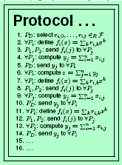
Static Adversary

Slide 15
Adaptive Adversary

Slide 16

Adaptive Corruption stronger than Static Corruption
Hackers constantly trying to break into computers running secure protocols but could do so after the protocol has started.
The attacker first looks at the communication and then decide who to corrupt (not allowed in static model)

Slide 17
Expanding the scope of MPC
Dimension 4.2: Various Characteristics of adversary A (static vs. adaptive vs.)
Static: A corrupts parties at the onset of protocol
Adaptive: A corrupts parties on the fly dynamically
Semi-adaptive, One-sided Adaptive, Partial-erasure Adaptive
>> Most of the works in this model
>> Generalization of Static and more powerful
>> Less explored
>> Models real-life scenarios
>> Very non-intuitive
>> Many things are not achieved yet
>> Scope of Work
>> Very less explored again
>> Some of the results not achieved in adaptive world is shown to be achievable in these
>> Scope of work

Slide 18
Expanding the scope of MPC: Summary
Dimension 1 (Models of Computation)
Boolean vs. Arithmetic
Dimension 4 (Adversary)
4.1 Threshold vs. Non-threshold
4.2 Polynomially Bounded vs. Unbounded Powerful
4.3 Semi-honest vs. Malicious vs. Covert
4.4 Static vs. Adaptive
Dimension 2 (Networks)
2.1 Complete vs. Incomplete
2.2 Synchronous vs. Asynchronous vs. Hybrid
Dimension 3 (Distrust)
Centralized vs. Decentralized
2
×
5
×
2
×
9
Many more ways of extending the scope of MPC. The saga of MPC continues…….
Notes:
In the course we will learn how to do MPC in the non-underlined settings and the the underlined settings will be taken for seminar talks/projects…does not mean there are no problem left in the traditional models..there are still a huge no. of unsolved problems..so now time to discuss the problems/questions that we are interested to solve in MPC

Slide 19
Attributes of MPC Protocols
Parameter 1 (Resilience): The no. of corrupted parties among n parties that it can tolerate.
Parameter 2 (Quality):
2.1 Perfect (error-free) / Statistical
2.2 Robust / non-robust
2.3 Fair / unfair
Parameter 3 (Complexity):
3.1 Communication complexity: Total number of bits communicated by the honest parties
3.2 (Round Complexity): Total number of rounds of interaction in the protocol
3.3 (Computation Complexity): Computation time required for running protocol
Notes:
Information theoretically

Slide 20
Questions in MPC
Question 1 (Possibility/Impossibility): Given network type, adversary type, under what conditions MPC is possible?
Information theoretic MPC is possible iff n > 2t
In synchronous networks, perfect (i.t) MPC is possible iff n > 2t
In asynchronous networks, statistical (i.t) MPC is possible iff n > 3t
In asynchronous networks, perfect (i.t) MPC is possible iff n > 4t
In synchronous networks, computational robust fair MPC is possible iff n > 2t
……..
Question 2 (Efficiency): Given network type, adversary type, how efficient (communication/round/computation) MPC can be designed?
Question 3 (Optimality): Given network type, adversary type, what is the optimal complexity we can achieve? Design such optimal protocols.

Slide 21
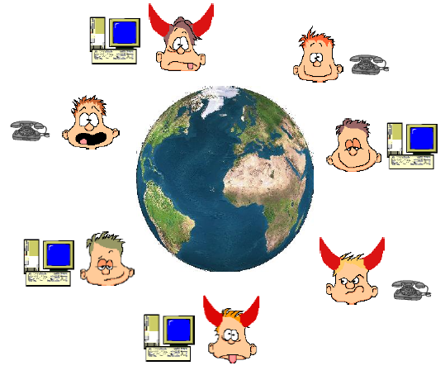
The major Question That remains: How to define security of MPC
–
>> n parties P₁,....,P_{n}
‘some’ are corrupted by A
>> P_{i} has private input x_{i}
>> A common n-input function f
Goals:
>> Correctness: Compute f(x₁,x₂,..x_{n})
>> Privacy: Nothing more than y is leaked to A

Slide 22
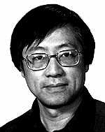
How MPC is defined formally
>> Do you think this definition is fine?
You are wrong!
>> Does not capture all needs. It is one of the most non-trivial tasks in MPC literature.
>> Many protocols came before the definition was settled. Only later the security is proven
>> Yao protocol came without proof!
>> Only in 2006, Yehuda and Benny came up with the full proof.
Andew Chi Chih Yao, Turing Award winner 2000 for his pioneering work on MPC in 1981

Slide 23
Defining Security
>> Consider a secure auction (with secret bids):
An adversary may wish to learn the bids of all parties – to prevent this, require PRIVACY
An adversary may wish to win with a lower bid than the highest – to prevent this, require CORRECTNESS
But, the adversary may also wish to ensure that it always gives the highest bid – to prevent this, require INDEPENDENCE OF INPUTS
An adversary may try to abort the execution if its bid is not the highest – require FAIRNESS

Slide 24
General Security Properties expected from MPC
Privacy: only the output is revealed
Correctness: the function is computed correctly
Independence of inputs: parties cannot choose inputs based on others’ inputs
Fairness: if corrupted party receives output, honest parties also receive output
Guaranteed output delivery: No matter how the corrupted parties behave honest parties must get output
More???

Slide 25
Defining Security
>> Option 1: Analyze security concerns for each specific problem
Auctions: as in above
Elections: privacy and correctness only (?)
Problems with Option 1:
How do we know that all concerns are covered?
Definitions are application dependent (need to redefine each time).
No!
A single definition: Generic and caters to all functions f and tells what exactly it captures!
Alternative Option?

Slide 26
Real World/Ideal World based Security
>> How do you judge a person (person’s particular quality)/ a product
> We set a standard/ideal
> Find out how close are we to the ideal
When it comes to cricket, you may like to choose Sachin/Bradman
When it comes to Football, you may like to choose Pele/Maradona
For every product, there is ISO standard
>> We will do exactly the same for MPC
> Set an ideal/standard/benchmark for MPC.
> Define security based on the closeness to the ideal solution
>> Real World/Ideal World Security Definition Paradigm:
> Ideal world: Clean/Concise specification, can be easily stated, well-understood, we know what it properties it gives in an obvious way, we can change specification it according to our need.
> Real world: Emulates the ideal world.
Notes:
Phenomenal Idea

Slide 27
Setting that we consider now
Dimension 2 (Networks)
Complete
Synchronous
Dimension 3 (Distrust)
Centralized
Dimension 4 (Adversary)
Threshold
Polynomially Bounded
Semi-honest
Static

Slide 28
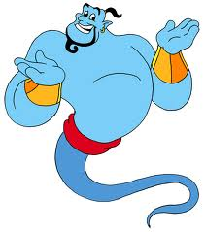
Ideal World MPC
x₁
x₂
Any task
x₃
x₄
(y₁,y₂,y₃,y₄) = f(x₁,x₂,x₃,x₄)

Slide 29
Ideal World MPC
x₁
x₂
x₁
x₂
y₁
y₂
Any task
y₃
y₄
y₁
y₂
y₃
y₄
x₃
x₄
x₃
x₄
(y₁,y₂,y₃,y₄) = f(x₁,x₂,x₃,x₄)
(y₁,y₂,y₃,y₄) = f(x₁,x₂,x₃,x₄)
The Ideal World
The Real World

Slide 30
How do you compare Real world with Ideal World?
>> Fix the inputs of the parties, say x₁,….x_{n}
>> Real world view of adv contains no more info than ideal world view
y₁
y₂
y₁
y₂
{x₃, y₃}
y₄
{x₃, y₃, r₃, protocol transcript}
y₄
View^{Ideal}_{i} : The view of P_{i} on input (x₁,….x_{n}) - Allowed values
View^{Real}_{i} : The view of P_{i} on input (x₁,….x_{n}) - Leaked Values
{View^{Ideal}_{i}}_{Pi in C}
{View^{Real}_{i}}_{Pi in C}
Our protocol is secure if the leaked values contains no more info than allowed values
The Ideal World
The Real World
Notes:
From the view point of the adversary.

Slide 31
Real world (leaked values) vs. Ideal world (allowed values)
y₁
y₂
y₁
y₂
{x₃, y₃}
y₄
{x₃, y₃, r₃, protocol transcript}
y₄
>> If leaked values can be efficiently computed from allowed values.
>> Such an algorithm is called SIMULATOR (simulates the view of the adversary in the real protocol).
>> It is enough if SIM creates a view of the adversary is “close enough” to the real view so that adv. can not distinguish from its real view.
The Ideal World
The Real World

Slide 32
Real world (leaked values) vs. Ideal world (allowed values)
y₁
y₂
y₁
y₂
SIM
{x₃, y₃}
y₄
{x₃, y₃, r₃, protocol transcript}
y₄
Interaction on behalf of the honest parties
≈
{View^{Ideal}_{i}}_{Pi in C}
{View^{Real}_{i}}_{Pi in C}
Random Variable/distribution (over the random coins of SIM and adv)
Random Variable/distribution (over the random coins of parties)
SIM: Ideal Adversary
The Ideal World
The Real World

Slide 33
Real world / Ideal World Security
>> Joint distribution of output & view of the honest & corrupted parties in both the worlds can not be told apart – also captures randomized functions
Output^{Ideal}_{i} : The output of P_{i} on input (x₁,….x_{n}) when P_{i} is honest.
Output^{Real}_{i} : The output of P_{i} on input (x₁,….x_{n}) when P_{i} is honest.
View^{Ideal}_{i} : As defined before when P_{i} is corrupted.
View^{Real}_{i} : As defined before when P_{i} is corrupted.
[ {View^{Ideal}_{i}}_{Pi in C} , {Output^{Ideal}_{i}}_{Pi in H} ]
≈
[ {View^{Real}_{i}}_{Pi in C} , {Output^{Real}_{i}}_{Pi in H} ]
Previous definition is enough when we have deterministic function.
Previous definition is enough!
Since any randomized function can be written as a deterministic function.
g(x₁,x₂; r₁+r₂) =g((x₁,r₁), (x₂,r₂))
The Ideal World
The Real World

Slide 34


