Slide 1

Introduction to
Non-Malleable Codes
IISC-IACR School on Cryptology
6 Jan, 2018, Indian Institute of Science, Bangalore
Stefan Dziembowski
University of Warsaw

Slide 2
Plan
Introduction to tampering attacks
Introduction to error correcting/detecting codes
Definition of non-malleable codes and an existential result
Algebraic manipulation detection codes
Non-malleable codes secure against independent bit tampering
Non-malleable codes in the split-state model
Extensions and applications

Slide 3
Non-Malleable Codes
compared to error correcting/detecting codes:
weaker security guarantee
tolerate a broader class of manipulations
codes designed for securing computer memory against physical tampering attacks
cryptographic attacks that go beyond the standard black-box model
Introduced in [D., Pietrzak, Wichs, ICS 2010].

Slide 4
Standard model in cryptography: black-box
key
attack algorithm
(“the adversary”)
crypto algorithm
modelled as a Turing Machine with bounded computing time
4

Slide 5

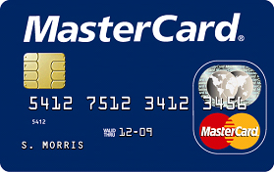
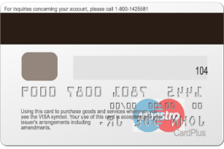
Example: smart cards
key
card inserted
even a malicious ATM should not be able to clone the card
Note: such cards are much more secure than cards with magnetic stripe.

Slide 6
“Black-Box Cryptography” – the situation
In general the problem of constructing basic cryptographic protocols secure in this model appears to be solved.
For example in symmetric encryption:
  even the “ancient” cipher DES (from 1970s) is broken only because its key is too short.
  (all other attacks are “theoretical”)
Can we relax?

Slide 7
Is the black-box model realistic?
No: Smart Cards can be broken by physical attacks.
The adversary obtains a temporary access to the device and can “play with it”.
In particular: he can exploit its physical properties
Much more powerful than the traditional “black-box” attacks!

Slide 8
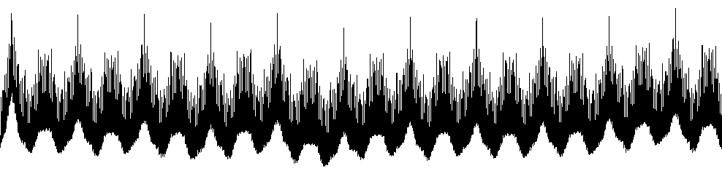


Physical attacks on the implementation
Example: power consumption measurements
1. Information
leakage
(side-channel attacks)
2. Tampering attacks
(malicious modifications)
Example: raising voltage or temperature, tampering with clock, focusing UV light on the device…
today we focus on this

Slide 9

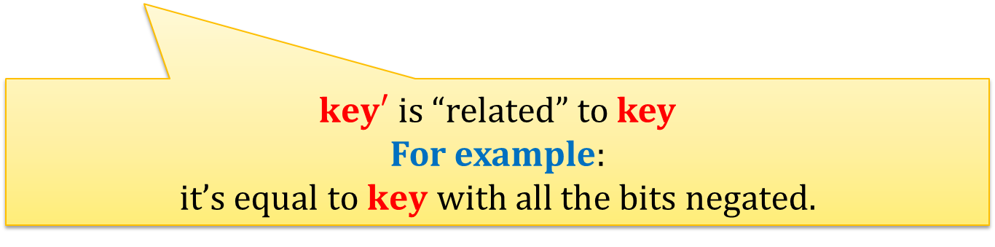

How can the adversary exploit the tampering attacks?
Example: related key attacks
key
interacts
tampers
$$key′$$
interacts
$key′$ is “related” to key
For example:
it’s equal to $key$ with all the bits negated.

Slide 10

This way the adversary obtains more power than in the black-box model!
key
black-box model
crypto algorithm
related-key attack
key
$$key′$$
crypto algorithm
crypto algorithm
Many successful attacks are based on this!

Slide 11
Countermeasures?
Lots of ad hoc practical solutions (a market worth billions of dollars)
  – usually based on a trial-and-error methodology…
A more formal approach?
cryptographic devices are everywhere: payment cards, tickets, SIM cards, pay TV cards, etc..

Slide 12
An idea: incorporate physical attacks to the formal model
(standard) black-box access
crypto algorithm
additional access
to the internal data
Hundreds of papers during the last decade!

Slide 13
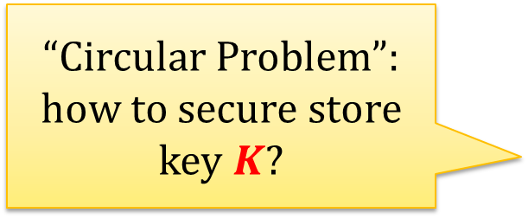
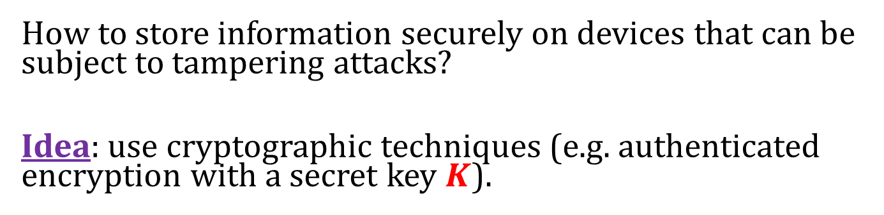


Question
How to store information securely on devices that can be subject to tampering attacks?
Idea: use cryptographic techniques (e.g. authenticated encryption with a secret key $K$).
“Circular Problem”:
how to secure store key $K$?
$Encrypt_{K}$(M)
“ciphertext”
C
message: M
We need “key-less” procedures!
That is: encoding, not encrypting.
De$crypt_{K}$(M)

Slide 14
Plan
Introduction to tampering attacks
Introduction to error correcting/detecting codes
Definition of non-malleable codes and an existential result
Algebraic manipulation detection codes
Non-malleable codes secure against independent bit tampering
Non-malleable codes in the split-state model
Extensions and applications

Slide 15
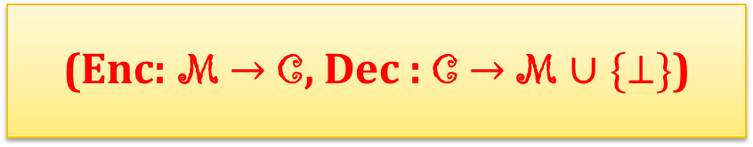



“Codes” (or: “encoding schemes”)
A pair of randomized functions $Enc$ and $Dec$:
we sometimes skip this
set of messages
(Enc: M $→$ C, Dec : C $→$ M $∪\{⊥\}$)
note: no key
set of codewords
$$∀$$
Such that:
$$Dec\left(Enc\left(M\right)\right)=M$$
$$M∈\text{M}$$
+ some additional properties hold (depending on the application)

Slide 16
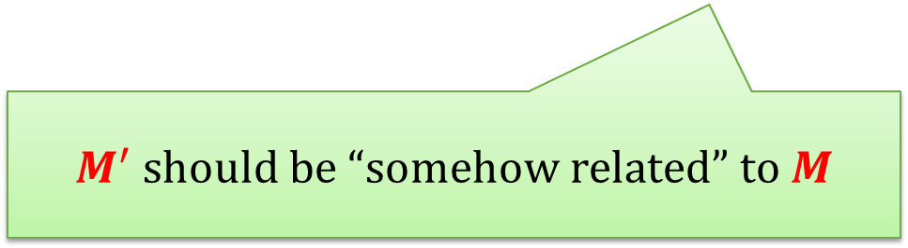
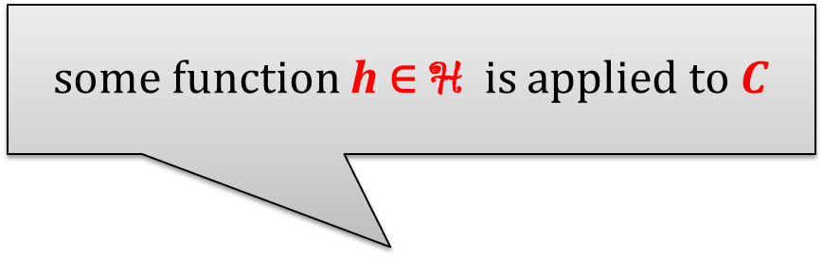
Code properties – abstractly
Typically the following experiment is considered
some function h ∈ H is applied to $C$
Enc
h
Dec
M
C = Enc(M)
C’ = h(C)
M’ = Dec(C’)
$M^{′}$ should be “somehow related” to $M$

Slide 17


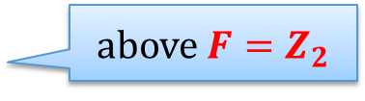

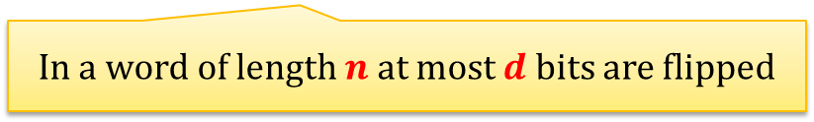
Traditional applications of codes
Protecting digital communication against transmission errors.
“noisy link”
$$C$$
$$C′=h\left(C\right)$$
1 | 1 | 0 | 0 | 1 | 0
1 | 0 | 0 | 0 | 1 | 1
Alice
Bob
In a word of length $n$at most $d$ bits are flipped
More generally:
words are elements of $F^{n}$ (for some finite field $F$)
the word $C′$ differs from $C$ on at most $d$coordinates.
above $F=Z_{2}$
In other words: the Hamming distance between $C$and $C^{′}$is at most $d$.

Slide 18
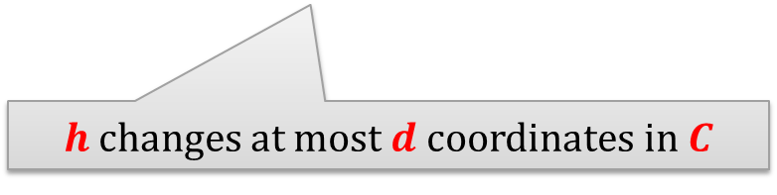
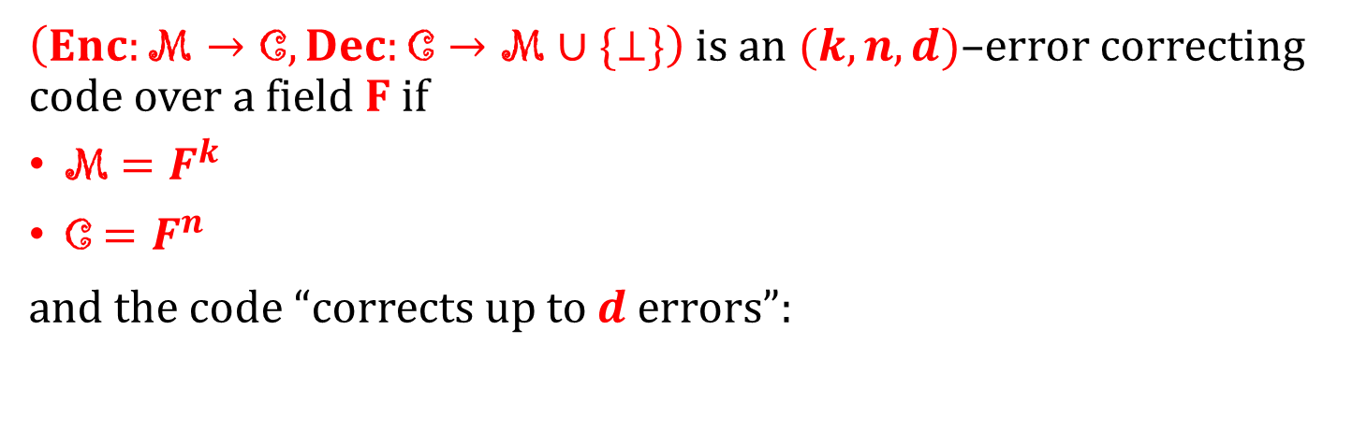

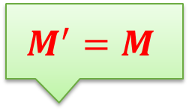
Error-correcting codes
$\left(Enc:\text{M}→\text{C},Dec:\text{C}→\text{M}∪\{⊥\}\right)$ is an $(k,n,d)$–error correcting code over a field $F$ if
M ${=F}^{k}$
C $=F^{n}$
and the code “corrects up to $d$ errors”:
$$M^{′}=M$$
Enc
h
Dec
M
C = Enc(M)
C’ = h(C)
M’ = Dec(C’)
$h$ changes at most $d$coordinates in $C$
A weaker requirement – error detection:
$M^{′}=M$ or $M^{′}= ⊥$

Slide 19

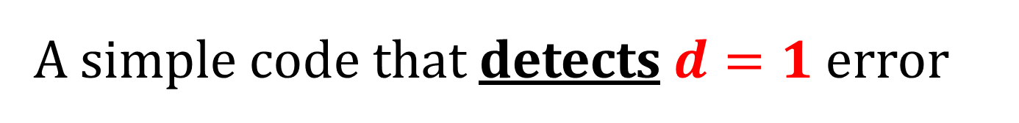
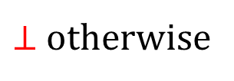
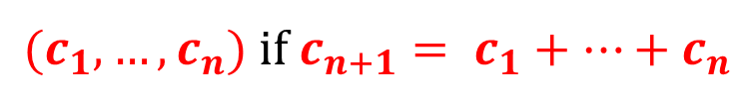
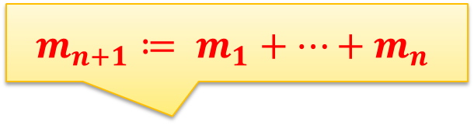
A simple code that detects $d=1$error
$$\left(Enc:F^{n}→F^{n+1},Dec:F^{n+1}→F^{n}∪\{⊥\}\right)$$
with
$$Enc\left(m_{1},…,m_{n}\right)=(m_{1},…,m_{n+1})$$
$$Dec\left(c_{1},…,c_{n+1}\right)=$$
$$m_{n+1}≔ m_{1}+…+m_{n}$$
$(c_{1},…,c_{n})$ if $c_{n+1}= c_{1}+…+c_{n}$
$⊥$ otherwise

Slide 20
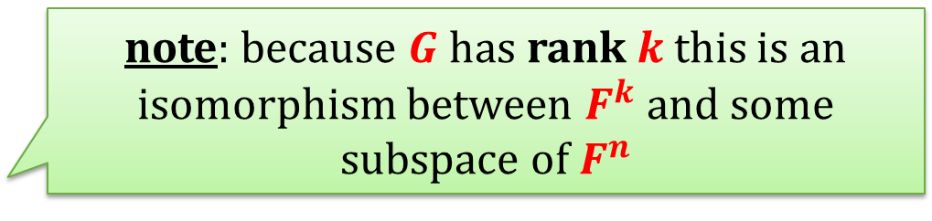
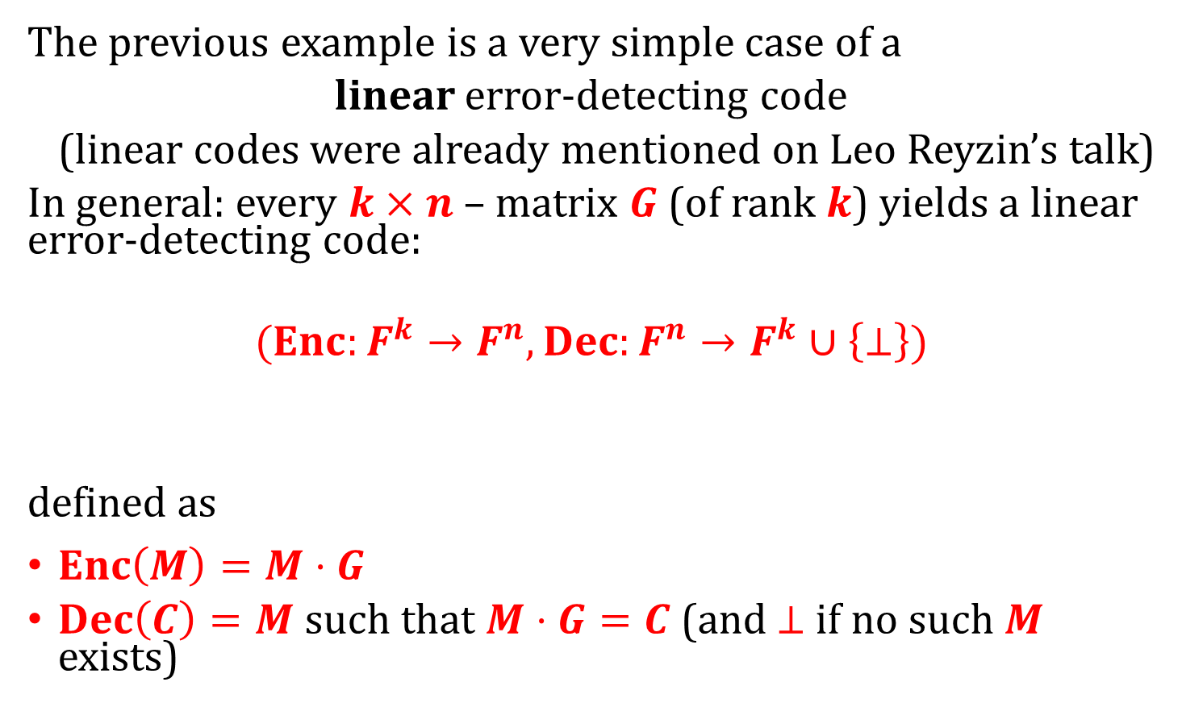
More generally
The previous example is a very simple case of a
linear error-detecting code
(linear codes were already mentioned on Leo Reyzin’s talk)
In general: every $k×n$– matrix $G$ (of rank $k$) yields a linear error-detecting code:
$$(Enc:F^{k}→F^{n}, Dec:F^{n}→F^{k}∪\left\{⊥\right\})$$
defined as
$Enc\left(M\right)=M⋅G$
$Dec\left(C\right)=M$such that $M⋅G=C$(and $⊥$ if no such $M$ exists)
note: because $G$ has rank $k$this is an isomorphism between $F^{k}$ and some subspace of $F^{n}$

Slide 21


Which matrices make good error-detecting codes?
Informally: the vectors in the subspace $\left\{M⋅G :M∈F^{k}\right\}⊆F^{n}$ need to be far from each other in the sense of Hamming distance.
More precisely: the code will detect up to $d$ errors if there are no
$$C,C′∈\left\{M⋅G :M∈F^{k}\right\}$$
whose Hamming distance is $d$.
Fact:
Random matrix $G$ (of rank $k$) yields a pretty good code.
distance $≤d$
“random linear code”

Slide 22
Plan
Introduction to tampering attacks
Introduction to error correcting/detecting codes
Definition of non-malleable codes and an existential result
Algebraic manipulation detection codes
Non-malleable codes secure against independent bit tampering
Non-malleable codes in the split-state model
Extensions and applications

Slide 23
Question
How to construct codes secure against the tampering attacks?
Enc
codeword
C = Enc(M)
message: M
Dec
Ideally we would like to have codes that:
are secure against as broad class of manipulations as possible (in particular: manipulations that touch every bit of the codeword)
have strong security guarantees

Slide 24
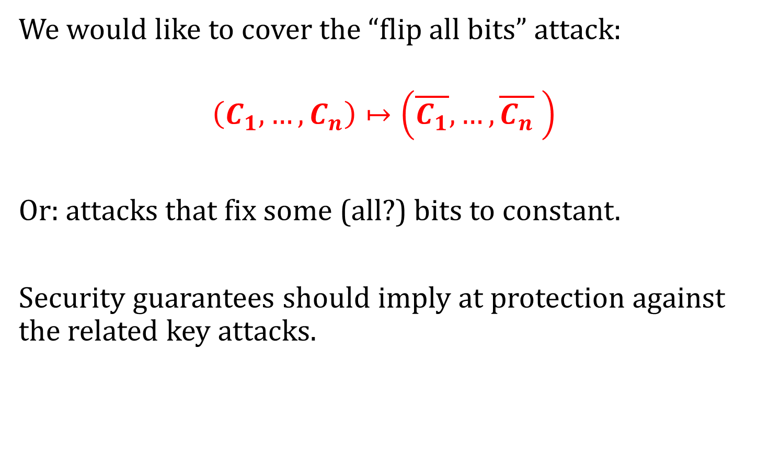
For example
We would like to cover the “flip all bits” attack:
$$\left(C_{1},…,C_{n}\right)↦\left(\overline{C_{1}},…,\overline{C_{n}} \right)$$
Or: attacks that fix some (all?) bits to constant.
Security guarantees should imply at protection against the related key attacks.
Let’s start with a description of the model

Slide 25
Consider the following tampering experiment
chooses h ∈ H
Enc
Dec
M
C = Enc(M)
C’ = h(C)
M’ = Dec(C’)
induces:
M
h’
M’ = Dec(C’)

Slide 26
What functions can the adversary induce?
Even for very restricted families H he can
make h’(M) = M
or
make h’(M) = constant X “independent from M”
choosing h(C) = C
choosing h(C) = Enc(X)

Slide 27
Non-Malleable Codes (NMC)
The “identity” and the “constant” attacks should be the only thing that the adversary can do.
In other words: M should be either
equal to M’
or unrelated to it

Slide 28
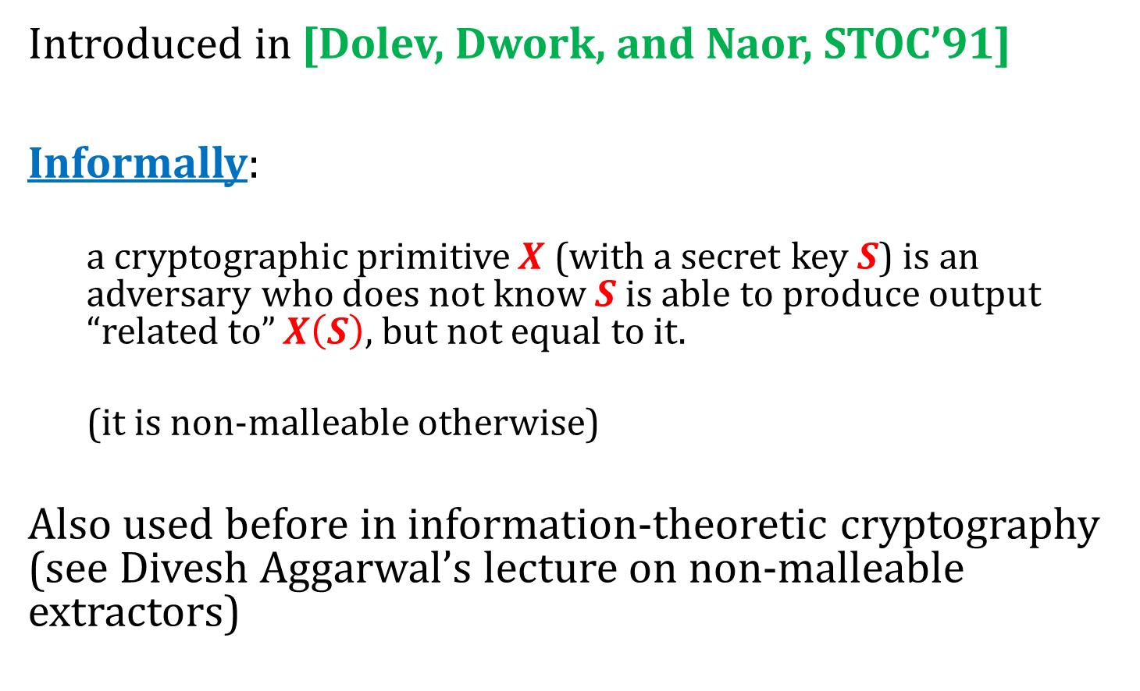
Non-malleability in cryptography
Introduced in [Dolev, Dwork, and Naor, STOC’91]
Informally:
  a cryptographic primitive $X$ (with a secret key $S$) is an adversary who does not know $S$ is able to produce output “related to” $X\left(S\right)$, but not equal to it.
  (it is non-malleable otherwise)
Also used before in information-theoretic cryptography (see Divesh Aggarwal’s lecture on non-malleable extractors)

Slide 29
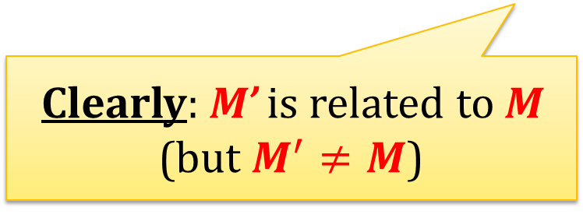
Can we have an NMC secure against the family of all functions?
no!
Attack example:
Decodes M = Dec(C)
Let M’ := M with all bits negated
Let C’ := Dec(M’)
Enc
C
h ∈ H
C’
Dec
M’
M
Clearly: M’ is related to M
(but $M^{′}≠M$)

Slide 30
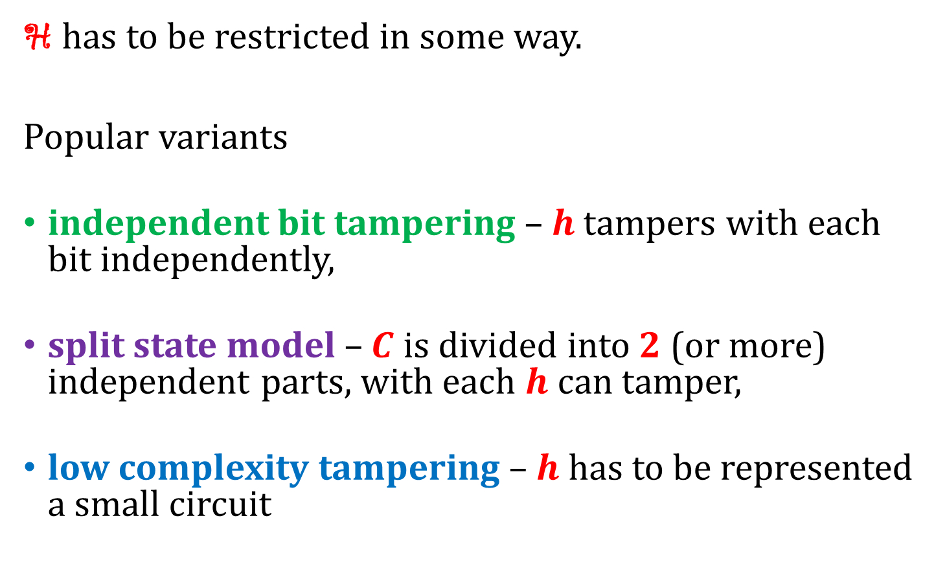
Moral
H has to be restricted in some way.
Popular variants
independent bit tampering – $h$ tampers with each bit independently,
split state model – $C$ is divided into 2 (or more) independent parts, with each $h$ can tamper,
low complexity tampering – $h$ has to be represented a small circuit

Slide 31
A very popular topic
Conference papers from 2014–2016 with “non-malleable codes” in the title:
A. Kiayias, F. L., Y. Tselekounis: Practical Non-Malleable Codes from l-more Extractable Hash Functions. ACM CCS 2016
M. Ball, D. Dachman-Soled, M. Kulkarni, T. Malkin: Non-malleable Codes for Bounded Depth, Bounded Fan-In Circuits. EUROCRYPT 2016
N. Chandran, V. Goyal, P. Mukherjee, O. Pandey, J. Upadhyay: Block-Wise Non-Malleable Codes. ICALP 2016
D. Aggarwal, J. Briët: Revisiting the Sanders-Bogolyubov-Ruzsa theorem in Fpn and its application to non-malleable codes. ISIT 2016
E. Chattopadhyay, V. Goyal, X. Li: Non-malleable extractors and codes, with their many tampered extensions. STOC 2016
N. Chandran, B. Kanukurthi, S. Raghuraman: Information-Theoretic Local Non-malleable Codes and Their Applications. TCC 2016
D. Aggarwal, S. Agrawal, D. Gupta, H. K. Maji, O. Pandey, M. Prabhakaran: Optimal Computational Split-state Non-malleable Codes. TCC 2016
E. Chattopadhyay, V. Goyal, X. Li: Non-malleable extractors and codes, with their many tampered extensions. STOC 2016
S. Agrawal, D. Gupta, H. K. Maji, O. Pandey, M. Prabhakaran: Explicit Non-malleable Codes Against Bit-Wise Tampering and Permutations. CRYPTO 2015
S. Agrawal, D. Gupta, H. K. Maji, O. Pandey, M. Prabhakaran: A Rate-Optimizing Compiler for Non-malleable Codes Against Bit-Wise Tampering and Permutations. TCC 2015
D. Aggarwal, S. Dziembowski, T. Kazana, M. Obremski: Leakage-Resilient Non-malleable Codes. TCC 2015
D. Dachman-Soled, F. L., E. Shi, H.-S. Zhou: Locally Decodable and Updatable Non-malleable Codes and Their Applications. TCC 2015
Z. Jafargholi, D. Wichs: Tamper Detection and Continuous Non-malleable Codes. TCC 2015
S. Coretti, U. Maurer, B. Tackmann, D. Venturi: From Single-Bit to Multi-bit Public-Key Encryption via Non-malleable Codes. TCC 2015
S. Faust, P. Mukherjee, D. Venturi, D. Wichs: Efficient Non-malleable Codes and Key-Derivation for Poly-size Tampering Circuits. EUROCRYPT 2014
E. Chattopadhyay, D. Zuckerman: Non-malleable Codes against Constant Split-State Tampering. FOCS 2014
M. Cheraghchi, V. Guruswami: Non-malleable Coding against Bit-Wise and Split-State Tampering. TCC 2014
M. Cheraghchi, V. Guruswami: Capacity of non-malleable codes. ITCS 2014
D. Aggarwal, Y. Dodis, S. Lovett: Non-malleable codes from additive combinatorics. STOC 2014
S. Faust, P. Mukherjee, J. Buus Nielsen, D. Venturi: Continuous Non-malleable Codes. TCC 2014

Slide 32

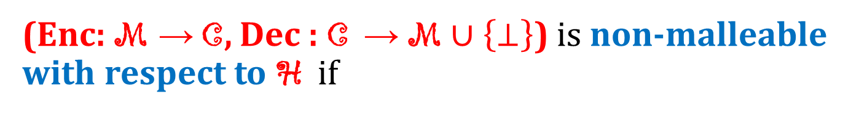
Security definition: first attempt
(Enc: M → C, Dec : C → M$∪\left\{⊥\right\}$) is non-malleable with respect to H if
∀
$$∃$$
equality of distributions
h ∈ H
D – distribution on M
∀
such that
Dec( h( Enc(M) ) ) $≡$ D
M ∈ M
Problem: what to do with the “identity” functions?

Slide 33
How to deal with the identity functions?
We present two solutions:
stronger (“Strongly Non-Malleable Codes”):
whenever the codeword is modified to the decoded message is independent of the original message
easier to define
harder to construct
weaker (“(Standard) Non-Malleable Codes”) :
h’ can be represented as a probabilistic combination of the identity function and the constant functions
slightly harder to define
easier to construct
good enough for most applications

Slide 34
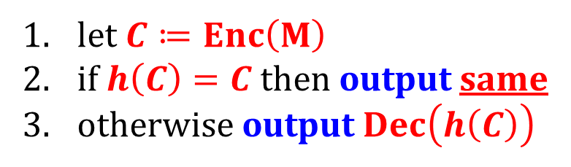
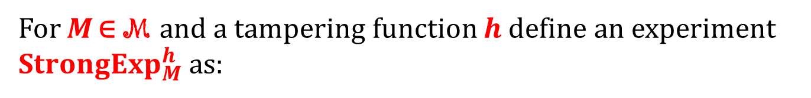
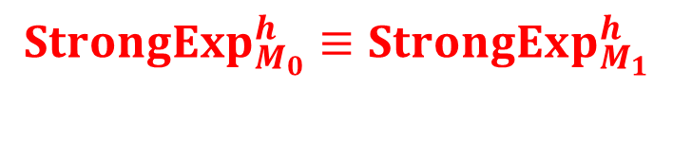

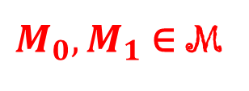
Strongly Non-Malleable Codes
For M ∈ M and a tampering function $h$define an experiment $StrongExp_{M}^{h}$as:
let $C≔Enc\left(M\right)$
if $h\left(C\right)=C$then output same
otherwise output $Dec\left(h\left(C\right)\right)$
$$StrongExp_{M}^{h}≔$$
(Enc, Dec) is non-malleable with respect to H if
∀
$$StrongExp_{M_{0}}^{h}≡StrongExp_{M_{1}}^{h}$$
h ∈ H
$M_{0},M_{1}$ ∈ M

Slide 35
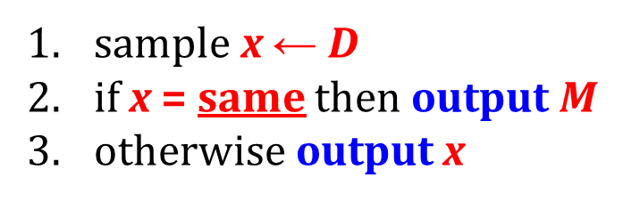
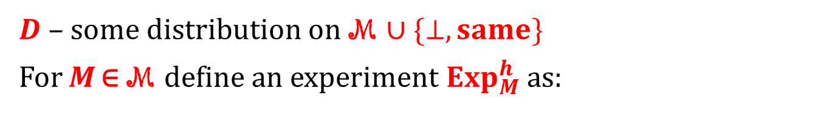



(Standard) Non-Malleable Codes
$D$ – some distribution on M $∪\{⊥,same\}$
For M ∈ M define an experiment $Exp_{M}^{h}$ as:
sample x ← $D$
if x = same then output M
otherwise output x
$$Exp_{M}^{D}≔$$
(Enc, Dec) is non-malleable with respect to H if
∀
∃
∀
such that
$$Dec(h\left(Enc\left(M\right)\right)≡Exp_{M}^{D_{h}}$$
h ∈ H
$$D_{h}$$
M ∈ M

Slide 36
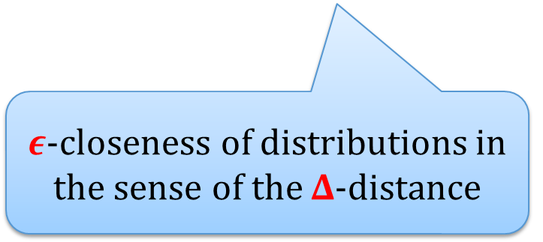
Relaxing these definitions a bit...
(Enc, Dec) is 𝜖-non-malleable w.r.t. H if
∀
∃
∀
such that
Dec( h( Enc(M) ) ) ≈^{𝜖} Tamper_{M}(D)
h ∈ H
D
M ∈ M
$ε$-closeness of distributions in the sense of the $Δ$-distance
Analogously for strong non-malleable codes.

Slide 37
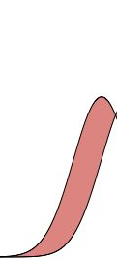
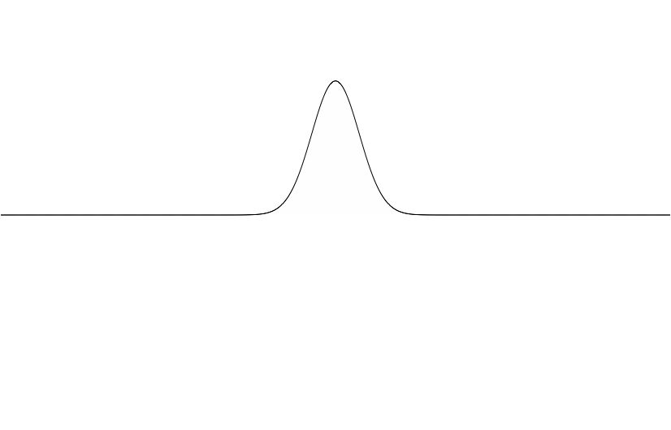
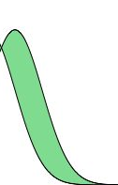


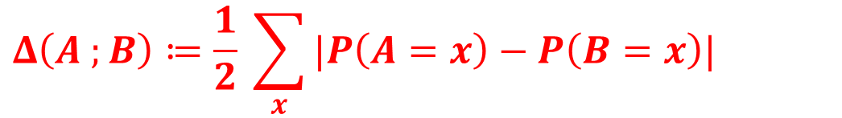
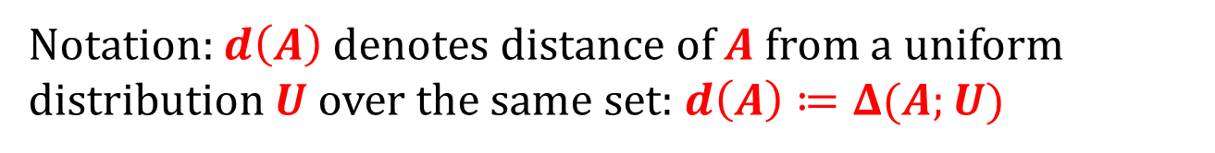
To define “closeness to uniform” recall the definition of the statistical distance
(See also Kai-Min Chung’s lecture.)
$$Δ\left(A ;B\right)≔\frac{1}{2} \sum_{x}{|P\left(A=x\right)−P\left(B=x\right)|}$$
probability
$$A$$
$$B$$
Notation: $d\left(A\right)$ denotes distance of $A$ from a uniform distribution $U$ over the same set: $d\left(A\right)≔Δ(A;U)$

Slide 38
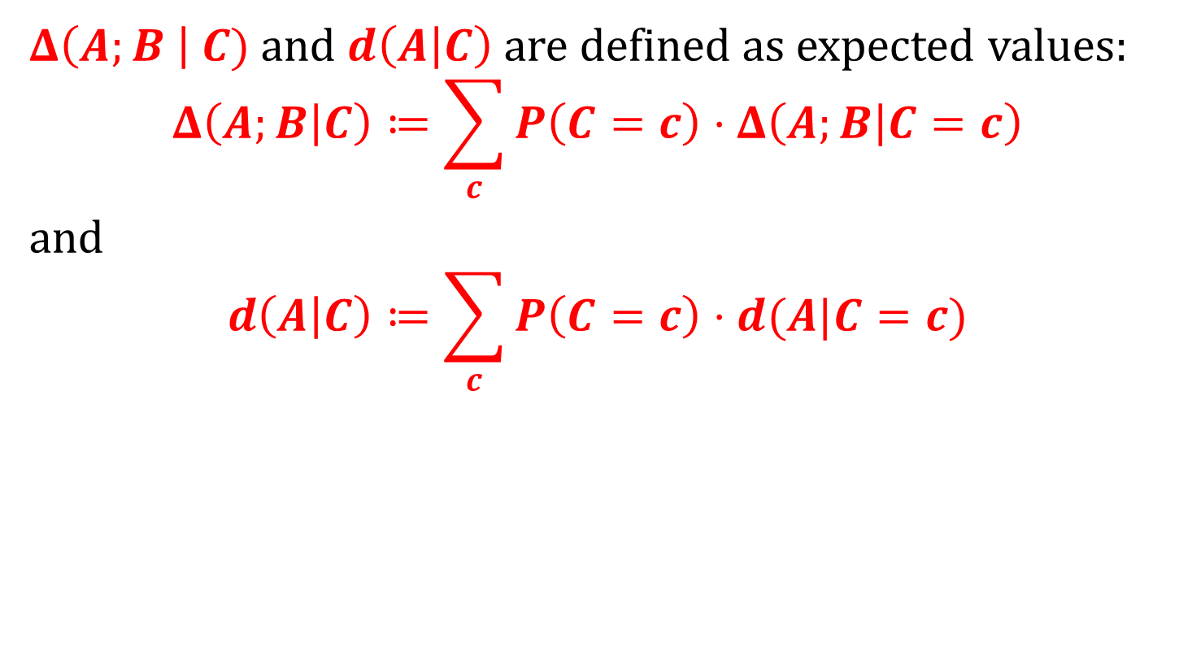
Recall also the conditional versions
$Δ\left(A;B \right| C)$and $d\left(A | C\right)$ are defined as expected values:
$$Δ\left(A;B | C\right)≔\sum_{c}{P\left(C=c\right)⋅Δ\left(A;B | C=c\right)}$$
and
$$d\left(A | C\right)≔\sum_{c}{P\left(C=c\right)⋅d(A|C=c)}$$

Slide 39
One way to look at it
The adversary can either
leave the device unchanged,
or
reset it or destroy it completely

Slide 40
Why it protects against the related key attacks?
interacts
tampers
interacts
If the key after tampering is either identical or independent then tampering is useless for the adversary.

Slide 41
NMCs: strong vs. standard
Fact
If a codes is strongly non-malleable with respect to some family H , then it is non-malleable with respect to H with the same error.
(but not the other way around for typical families H ).
Proof: exercise

Slide 42
Results of [D., Pietrzak and Wichs 2010]
Explicit construction of non-malleable codes with respect to independent bit tampering
Existence of non-malleable codes for small enough families H via probabilistic argument

Slide 43
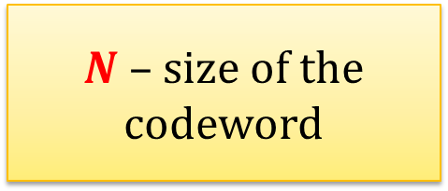
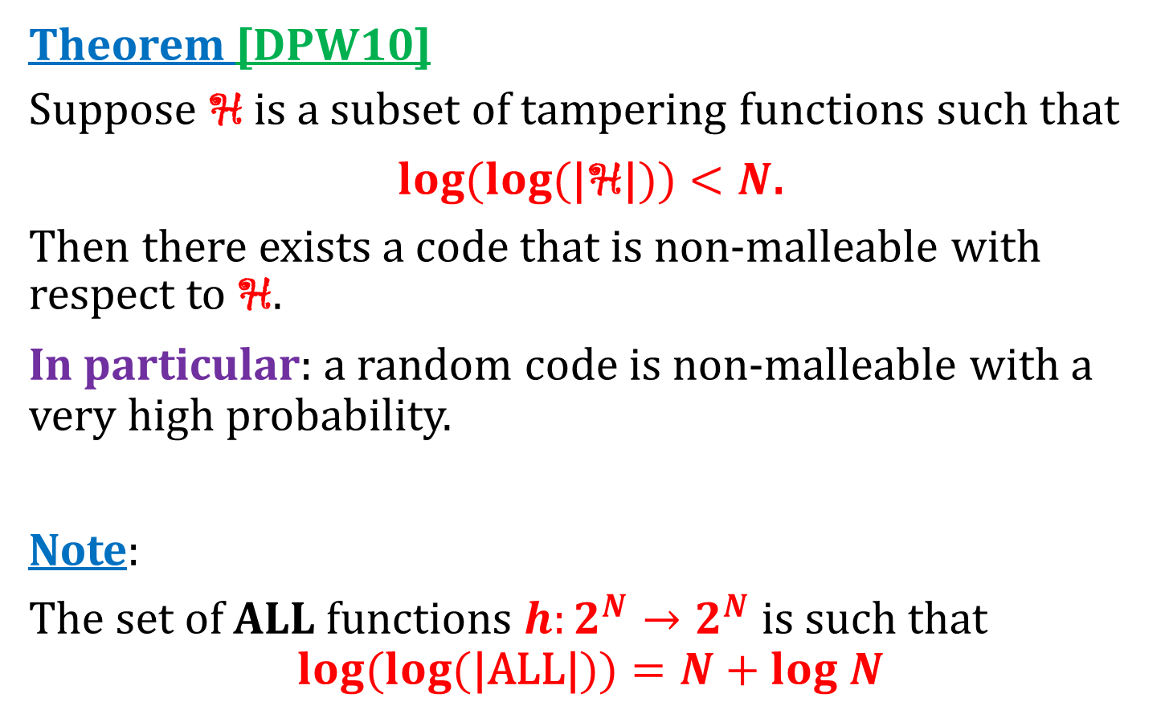
The existential result
$N$ – size of the codeword
Theorem [DPW10]
Suppose H is a subset of tampering functions such that
$\log{(\log{(\text{|}\text{H}\text{|}))<N}}$.
Then there exists a code that is non-malleable with respect to H.
In particular: a random code is non-malleable with a very high probability.
Note:
The set of ALL functions $h:2^{N}→2^{N}$ is such that
$$\log{(\log{(\text{|}\text{ALL}\text{|}))=N+log N}}$$

Slide 44
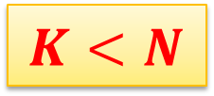
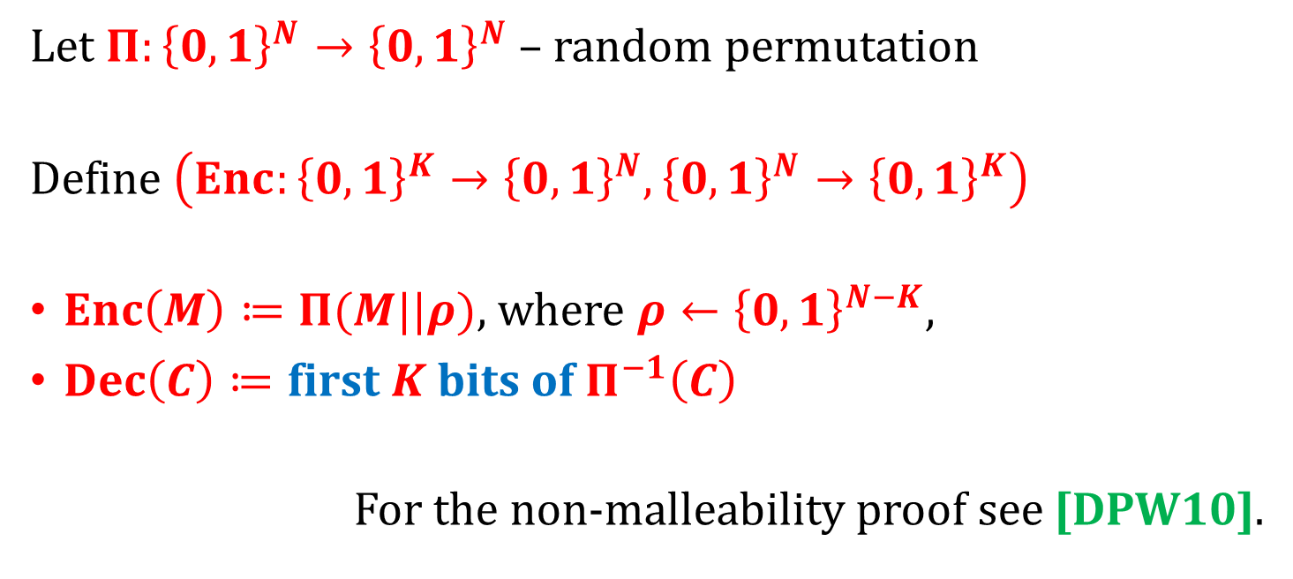
NMC in the random oracle model
By [Coron et al, 2014] this can be constructed from a random oracle.
$$K<N$$
Let $Π:{\left\{0,1\right\}}^{N}→{\left\{0,1\right\}}^{N}$ – random permutation
Define $\left(Enc:{\left\{0,1\right\}}^{K}→{\left\{0,1\right\}}^{N},{\left\{0,1\right\}}^{N}→{\left\{0,1\right\}}^{K}\right)$
$Enc\left(M\right)≔Π(M||ρ)$, where $ρ←{\left\{0,1\right\}}^{N−K}$,
$Dec\left(C\right)≔\text{first} K \text{bits} \text{of} Π^{−1}\left(C\right)$
For the non-malleability proof see [DPW10].

Slide 45
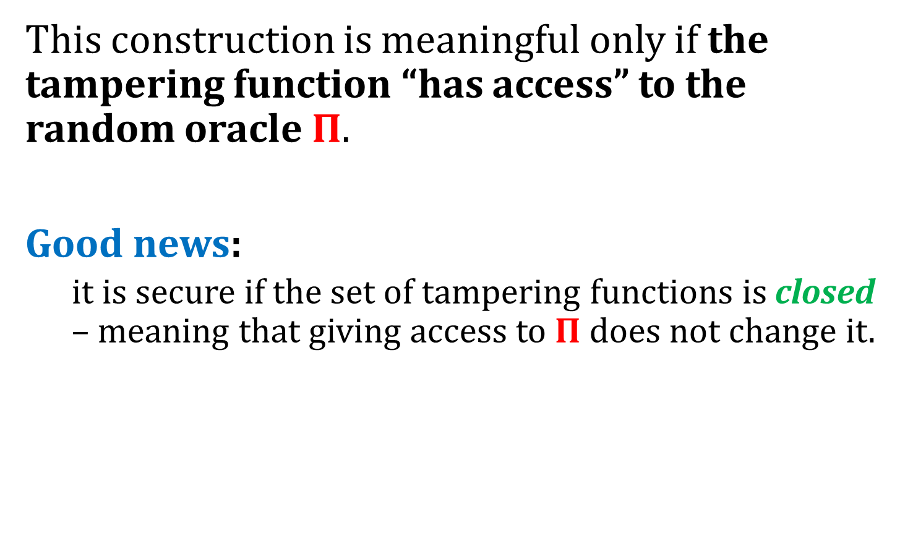
Caveat
This construction is meaningful only if the tampering function “has access” to the random oracle $Π$.
Good news:
  it is secure if the set of tampering functions is closed – meaning that giving access to $Π$ does not change it.

Slide 46
Plan
Introduction to tampering attacks
Introduction to error correcting/detecting codes
Definition of non-malleable codes and an existential result
Algebraic manipulation detection codes
Non-malleable codes secure against independent bit tampering
Non-malleable codes in the split-state model
Extensions and applications

Slide 47

A very restricted class off tampering: “additive attacks”
2 types of functions acting on bits:
c
keep
c
c
flip
$$\overline{c}$$
C₁ | C₂ | C₃ | C₄ | C₅ | C₆ | C₇ | C₈ | C₉ | C₁₀
keep
keep
flip
keep
keep
flip
flip
keep
flip
keep
C₁ | C₂ | $$\overline{C_{3}}$$ | C₄ | C₅ | $$\overline{C_{6}}$$ | $$\overline{C_{7}}$$ | C₈ | $$\overline{C_{9}}$$ | C₁₀

Slide 48
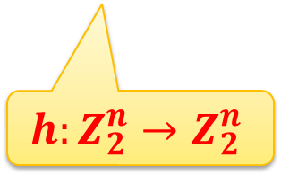
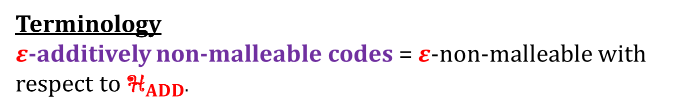




In other words
If we treat bits as elements of $Z_{2}$then the tampering family has a form
${\text{H}}_{ADD}$ $={\left\{h:h\left(C\right)=C+X\right\}}_{X∈Z_{2}^{n}}$
$$C∈Z_{2}^{n}$$
$$X∈Z_{2}^{n}$$
addition in vector space $Z_{2}^{n}$
$$h:Z_{2}^{n}→Z_{2}^{n}$$
Terminology
$ε$-additively non-malleable codes = $ε$-non-malleable with respect to ${\text{H}}_{ADD}$.

Slide 49




How to design an additively non-malleable code?
Question: maybe the standard error correcting/detecting codes will work?
Answer: No!
Reason: such codes correct up to $t$errors, while ${h∈\text{H}}_{ADD}$ is allowed to change every bit of $C$.
Example:
  Linear code $Enc\left(M\right)≔M⋅G$
  Let $X ≔\left(1,…,1\right)⋅G$ and $h\left(C\right)≔C+X$
Enc
h
$$C^{′} =M⋅G+\left(1,…,1\right)⋅G$$
M
$C≔M⋅G$
$$=\left(M+1,…,M+1\right)⋅G$$
Dec
related but not equal
$$(M+1,…,M+1)⋅G$$

Slide 50
Good news: very similar codes have been constructed before
In fact: their more general version is known under the name “Algebraic manipulation detection codes”
Introduced in [Cramer, Dodis, Fehr, Padro, Wichs, 2008]

Slide 51






Algebraic Manipulation Detection (AMD) Codes
Let $F$ and $G$be additive groups.
A code $\left(Enc:F→H,Dec:H→F∪\{⊥\}\right)$ is an $\left(F,H,ε\right)$ – algebraic manipulation detection code if:
or: $ε$-secure AMD code
$$∀$$
$$P\left(Dec\left(Enc(M)+Δ\right)≠⊥\right)≤ε$$
$$M∈F$$
$$Δ≠0$$

Slide 52






AMDs vs NMCs
AMDs are even stronger than the strong NMCs.
More precisely: every $\left(F,H,ε\right)$ – algebraic manipulation detection code is also $ε$-nonmalleable with respect to the class
$${\left\{h_{X}:h_{X}\left(M\right)≔M+X\right\}}_{X∈F}$$
Why?
doesn’t depend on $M$
since the code is AMD
let $C≔Enc\left(M\right)$
if $h_{X}\left(C\right)=C$then
output same
otherwise
output $Dec\left(h\left(C\right)\right)$
let $C≔Enc\left(M\right)$
if $X=0$then
output same
otherwise
output $⊥$
$$StrongExp_{M}^{h_{X}}≔$$
$$≡$$
(But not the other way around - exercise)

Slide 53

Constructions of AMDs
[Cramer et al] – a construction for any
$d∈N$ and
a field $F$ of characteristic $p$ such that $d+2$ is not divisible by $p$
of an $(F^{d},F^{d}×F×F,(d+1)/|F|)$-AMD code

Slide 54




The AMD code of [Cramer et al]
denote it $f(M,X)$
Let
$$Enc\left(M\right)≔\left(M, X, X^{d+2}+\sum_{i=1}^{d}{M_{i}⋅X^{i}}\right)$$
message
$$M=(M_{1},…,M_{d})$$
random
$X$
$$M \text{if} f\left(M,X\right)=T$$
$Dec\left(M,X,T\right)≔$
$⊥$ otherwise

Slide 55




Proof that that this code is $(F^{d},F^{d}×F×F,(d+1)/|F|)$-AMD:
$$Enc\left(M\right)=$$
$$M$$ | $$X$$ | $$f(M,X)$$
tampering
$+Δ_{0}$ | $+Δ_{1}$ | $$+Δ_{2}$$
$$Enc\left(M′\right)=$$
$$M+Δ_{0}$$ | $$X+Δ_{1}$$ | $$f\left(M,X\right)+Δ_{2}$$
$$M^{′}≔$$
We need to show:
$$∀$$
$$P\left(f\left(M+Δ_{0},X+Δ_{1}\right)=f\left(M,X\right)+Δ_{2}\right)≤(d+1)/|F|$$
$$M,\left(Δ_{0},Δ_{1},Δ_{2}\right)≠(0,0,0)$$
equivalently
$$∀$$
$$P\left(f\left(M′,X+Δ_{1}\right)=f\left(M,X\right)+Δ_{2}\right)≤(d+1)/|F|$$
$$M≠M^{′},\left(Δ_{1},Δ_{2}\right)≠(0,0)$$

Slide 56







Assume that $M≠M^{′},\left(Δ_{1},Δ_{2}\right)≠(0,0)$ and transform:
$$f\left(M′,X+Δ_{1}\right)=f\left(M,X\right)+Δ_{2}$$
$${(X+Δ_{1})}^{d+2}+\sum_{i=1}^{d}{M_{i}^{′}⋅{\left(X+Δ_{1}\right)}^{i}}$$
$${= X}^{d+2}+\sum_{i=1}^{d}{M_{i}⋅X^{i}}+Δ_{2}$$
polynomial of degree that most $d$
$$=X^{d+2}+\left(d+2\right){⋅Δ}_{1}⋅X^{d+1}+{ Δ}_{1}⋅poly\left(x\right)+\sum_{i=1}^{d}{M_{i}^{′}⋅{ X}^{i} }$$
Subtracting RHS from LHS we get:
$$\left(d+2\right)⋅Δ_{1}⋅X^{d+1}+Δ_{1}⋅poly\left(x\right)+\sum_{i}^{d}{\left(M_{i}^{′}−M_{i}\right)⋅X^{i}}−Δ_{2}=0$$
We now claim that this is a non-zero polynomial.

Slide 57

Claim
Polynomial
$$π\left(X\right)≔\left(d+2\right)⋅Δ_{1}⋅X^{d+1}+Δ_{1}⋅poly\left(X\right)+\sum_{i=1}^{d}{\left(M_{i}^{′}−M_{i}\right)⋅X^{i}}−Δ_{2}=0$$
is non-zero.
Why?
If $Δ_{1}≠0$ then we are done (here we use the assumption that the $d+2$is not divisible by the characteristic of field $F$)
Otherwise (if $Δ_{1}=0$):
$$π\left(X\right)= \sum_{i=1}^{d}{\left(M_{i}^{′}−M_{i}\right)⋅X^{i}−Δ_{2}}$$
which is equal to $0$only if $M′=M$ and $Δ_{2}=0$.
Which contradicts the assumption that $M≠M^{′} \text{and} \left(Δ_{1},Δ_{2}\right)≠(0,0)$.

Slide 58


Finishing the proof
We now know that
$f\left(M′,X+Δ_{1}\right)=f\left(M,X\right)+Δ_{2}$ if $π\left(X\right)=0.$
Let $Q$ denote the set of zeros of $π$. Since $π$ is of degree at most $d+1$ thus $\left|Q\right|≤d+1$.
Hence
$$P\left(f\left(M′,X+Δ_{1}\right)=f\left(M,X\right)+Δ_{2}\right)=P(X∈Q)$$
$$≤(d+1)/|F|$$

Slide 59


How to instantiate this
Take
$$F=GF(2^{k})$$
Galois Field of order $2^{k}$
elements are strings $(M_{1},…,M_{k})$
and the addition is defined as
$$\left(M_{1},…,M_{k}\right)+\left({M_{1}^{′}}_{ },…,M_{k}^{′}\right)=\left(M_{1}+M_{1}^{′},…,M_{k}+M_{k}^{′}\right)$$
In other words: the additive of $GF\left(2^{k}\right)$ is $Z_{2}^{k}$.
Then the [Cramer et al] construction yields an $(Z_{2}^{k⋅d},Z_{2}^{k⋅\left(d+2\right)},\left(d+1\right)⋅2^{−k})$-AMD code.

Slide 60
Plan
Introduction to tampering attacks
Introduction to error correcting/detecting codes
Definition of non-malleable codes and an existential result
Algebraic manipulation detection codes
Non-malleable codes secure against independent bit tampering
Non-malleable codes in the split-state model
Extensions and applications

Slide 61

A more general class: independent bit tampering
c
keep
c
4 types of functions acting on bits:
c
flip
$$\overline{c}$$
c
set to 0
0
c
set to 1
1
C₁ | C₂ | C₃ | C₄ | C₅ | C₆ | C₇ | C₈ | C₉ | C₁₀
keep
set to 0
flip
keep
set to 0
set to 1
flip
set to 1
flip
keep
C₁ | 0 | $$\overline{C_{3}}$$ | C₄ | 0 | $$1$$ | $$\overline{C_{7}}$$ | 1 | $$\overline{C_{9}}$$ | C₁₀

Slide 62


More formally
${\text{H}}_{BIT}$ $={\left\{h:h\left(c_{1},…,c_{n}\right)=(h_{1}\left(c_{1}\right),…,h_{n}\left(c_{n}\right)\right\}}_{{(h}_{1},…,h_{n})}$
Q: Can we design codes secure against such tampering class?
A: Yes!
[DPW10] – a construction of an efficient non-malleable code secure against independent bit tampering.
It achieves the rate of ≈ 0.1887.
Each $h_{i}∈Z_{2}^{Z_{2}}$

Slide 63



Additive attacks vs. independent bit tampering
Independent bit tampering is obviously stronger:
The tampering function can overwrite the codeword $C$ with another codeword $C$ $⟹$ no hope for the property
that “any tampering results in $⊥$”.
Q: Maybe additively non-malleable that we constructed are independent bit non-malleable “by accident”?
No: consider $h$ that overwrites the last two coordinates of $C$ as follows:
$h\left(M, X, T\right) ≔\left(M,\left(0,…,0\right),f\left(\left(0,…0\right),\left(0,…,0\right)\right)\right)$
$$=: C′$$
If $M=(0,…,0)$ then $Dec\left(C^{′}\right)=M$ and otherwise $Dec\left(C^{′}\right)= ⊥$.
Hence additively non-malleable codes are malleable with resect to class ${\text{H}}_{BIT}$.

Slide 64



Construction technique
Combine:
AMD codes with
a special type of linear codes called linear error-correcting secret-sharing (LECSS)
Encode:
Decode:
AMD
encode
LECSS
encode
LECSS
decode
AMD
decode
$$M$$
$$C$$
$$M$$
Main idea: LECSS codes will guarantee that the only possible attacks are either “additive”, or“constant”.

Slide 65




Linear error-correcting secret-sharing
$$\left(Enc_{SS}:{\left\{0,1\right\}}^{k}→{\left\{0,1\right\}}^{n},Dec_{SS}\right)$$
is $(d,t)$-linear error-correcting secret-sharing scheme (LECSS) if the following conditions hold:
linearity: For all $C∈{\left\{0,1\right\}}^{n}$ such that $Dec_{SS}\left(C\right)≠⊥$ we have that
$Dec_{SS}\left(C+Δ\right)=$
distance $d$: for all non-zero $\tilde{C}$ with Hamming weight at most $d$ we have $Dec_{SS}\left(\tilde{C}\right)= ⊥.$
secrecy $t$: see next slide.
$⊥$ if$Dec_{SS}\left(Δ\right)= ⊥$
$Dec_{SS}\left(C\right)+Dec_{SS}(Δ)$ otherwise
Hamming weight = Hamming distance from $(0,…,0)$

Slide 66
















What do we mean by “secrecy $t$”?
This is related to secret-sharing schemes.
$(t+1)$-out-of-$n$ secret sharing [Shamir79]:
here
$$n=5$$
dealer’s secret $M$
$$C1$$
$$C2$$
$$C3$$
$$C4$$
$$C5$$
Every set of more than $t$ players can reconstruct $M$.
Any set of at most $t$ players has no information about $M$.
for distinct $i_{1},…,i_{t}$ the variables $C_{i_{1}},…,C_{i_{t}}$ are individually independent and uniform (over some set)

Slide 67



“secrecy $t$” of a code is defined in the same way as secrecy of secret sharing
For any fixed $M∈{\left\{0,1\right\}}^{k}$ define the random variable
$$\left(C_{1},…,C_{n}\right)=Enc_{SS}\left(M\right)$$
Then the random variables $C_{1},…,C_{n}$ are such that for distinct $i_{1},…,i_{t}$ the variables $C_{i_{1}},…,C_{i_{t}}$ are individually independent and uniform over $\{0,1\}$.
this is also called $t$-wise independence

Slide 68
What remains
We do not show this construction on this talk.
For the details see [DPW10].
Essentially: a random linear code is good (for the right choice of parameters)
Construct LECSS codes with good parameters.
Show that LECSS + AMD codes gives a non-malleable code secure with respect to independent bit tampering.

Slide 69


Theorem
Let:
$(Enc_{AMD}:{\left\{0,1\right\}}^{k}→{\left\{0,1\right\}}^{n^{′}},Dec_{AMD})$ be a $ρ$-secure AMD code.
$(Enc_{SS}:{\left\{0,1\right\}}^{n^{′}}→{\left\{0,1\right\}}^{n},Dec_{SS})$ be a $\left(d,t\right)$-LECSS with $d>n/4$.
Define the composed code $(Enc,Dec)$ as
$Enc\left(M\right)=Enc_{SS}\left(Enc_{AMD}\left(M\right)\right)$
$Dec\left(C\right)=$
Then $\left(Enc,Dec\right)$ is non-malleable with respect to the family ${\text{H}}_{BIT}$ with error $max\left(ρ,2^{−Ω\left(t\right)}\right)$.
$⊥$ if $Dec_{SS}(C)= ⊥$
$Dec_{AMD}(Dec_{SS}\left(C\right))$ otherwise

Slide 70




Proof outline
Fix a tampering function $h$ and define $A⊆\{1,…,n\}$
$A=\{set$ of the indices $i$such that $h_{i}$ is constant$\}$
Consider 4 cases:
$\left|A\right|≤t$
$t<\left|A\right|<n/2$
$n/2$ $≤\left|A\right|<n−t$
$n−t≤|A|$
For each of these cases we need to find a distribution $D_{h}$ that satisfies the non-malleability definition.
On the next slides
$Δ^{M}≔h\left(Enc\left(M\right)\right) −Enc(M)$.
sample x ← $D$
if x = same then
output M
otherwise output x
$$Exp_{M}^{D}≔$$
∀
$$Dec(h\left(Enc\left(M\right)\right)≡Exp_{M}^{D_{h}}$$
M ∈ M

Slide 71




Case 1 ($\left|A\right|≤t$)
Positions in $A$ are fixed to $0$ or $1$.
Positions not in $A$ are either kept or negated.
So this attack can be represented as:
$h\left(C\right)=\text{“}C+X$ except that up to $t$ positions are fixed ”
From “secrecy $t$” the values on these positions in $C$ are uniform and random.
Hence this can be represented as adding a vector $Δ^{h}$ that is equal to $0$ on positions in $A$, and random on other positions.
Thus $h\left(C\right)=C+X+Δ^{h}$, where $X$ is constant, and $Δ^{h}$ is independent from $C$.
We can now use the linearity of LECSS.

Slide 72









Case 1 – continued
linearity: For all $C∈{\left\{0,1\right\}}^{n}$ such that $Dec_{SS}\left(C\right)≠⊥$ we have that
$Dec_{SS}\left(C+Δ\right)=$
$⊥$ if$Dec_{SS}\left(Δ\right)= ⊥$
$Dec_{SS}\left(C\right)+Dec_{SS}(Δ)$ otherwise
From the previous slide we know that $h\left(C\right)=C+X+Δ^{h}.$
$Δ^{M}$ (independent from $C$)
Let $p$ be probability that $Dec_{SS}\left(Δ^{M}\right)=⊥$
We get:
$⊥$ with probability $p$
so it’s an “additive attack” and the AMD code take care of it!
$$Dec_{SS}\left(h(C)\right) =$$
$Dec\left(C\right)+Z$ with probability $1−p$
$$= Dec_{SS}\left(X+Δ^{M}\right)$$

Slide 73



Case 4 ($n−t≤|A|$)
If $\left|A\right|≥n−t$ then at most $t$ bits of $h(C)$ depend on $C$ (the remaining ones are constant).
So $h(C)$ can be represented as
$$h\left(C\right)=Z+C^{′}$$
where:
$Z$ is constant and does not depend on $C$
$C′$ consists of at most $t$ bits of $C$
Hence $h(C)$ is independent from $C$, and therefore $Dec\left(h\left(C\right)\right)$ also does not depend on it.
From “secrecy $t$” the values on these positions do not depend on $C$

Slide 74


Case 2 (“$t<\left|A\right|<n/2$”)
We show that with overwhelming probability $Dec_{SS}\left(h\left(C\right)\right)= ⊥.$
For a message $M$ again let $Δ^{M}≔h\left(C\right)−C.$
From the linearity of LECSS it suffices to show that$Dec_{SS}\left(Δ^{M}\right)= ⊥$ with overwhelming probability.
We know that $Δ^{M}$ is fixed on some set
$B=\left\{1,…,n\right\}∖A$
of positions. Let $W∈Z_{2}^{n}$ be a vector that agrees with $Δ^{M}$ on positions in $B$ and such that $Dec\left(W\right)≠ ⊥$
(if no such $W$ exists then we are done).
Since the remaining positions are $t$-wise independent (from “secrecy $t$”), thus:
$P\left(Δ^{M}=W\right)≤2^{−t}$.

Slide 75







Case 2 – continued
Observe that if $Dec\left(Δ^{M}\right)≠ ⊥$ then the Hamming distance between $Δ^{M}$ and $W$ has to be at least $d$ (from the “distance $d$” property of the LECSS code)
distance $≤d$
$$Δ^{M}$$
$$W$$
Hence what remains is to show that the Hamming distance between $Δ^{M}$ and $W$ is less than $d$ with high probability.
Since each bit of $Δ^{M}$ (on positions from $A$) is uniform over $Z_{2}$ thus the expected Hamming distance between $Δ^{M}$ and $W$ is equal to $\left|A\right|/2$.
Note that this is less than code’s distance $d$ which was assumed to be larger than $n/4$
$≤n/$4 since we assumed that $\left|A\right|≤n/2$

Slide 76

Case 2 – the final step
So, we know that the expected Hamming distance between $Δ^{M}$ and $W$ is smaller than the code distance $d$.
We would like to get that is it is smaller than $d$ with very high probability.
What to do?
Apply the concentration of measure bounds (Chernoff-type) for $t$-wise dependence (see [DPW10] for details).

Slide 77



Case 3 ($n/2$ $≤\left|A\right|<n−t$)
We again show that with overwhelming probability
$$Dec_{SS}\left(h\left(C\right)\right)= ⊥.$$
The proof is similar to Case 2, except that we directly focus on showing $Dec_{SS}\left(h\left(C\right)\right)= ⊥$ (in Case 2 we were showing that $Dec_{SS}\left(h\left(C\right)−C\right)= ⊥$ ).
Observe that $h\left(C\right)$ is
“fixed” on at least $n/2$ positions, and
$t$-wise independent of the remaining positions.
So, using the same analysis, as in Case 2 (where it was applied to $Δ^{M}$) we get that
$P\left(Dec_{SS}\left(h\left(C\right)\right)= ⊥\right)$is overwhelming.
$$Δ^{M}$$

Slide 78
Plan
Introduction to tampering attacks
Introduction to error correcting/detecting codes
Definition of non-malleable codes and an existential result
Algebraic manipulation detection codes
Non-malleable codes secure against independent bit tampering
Non-malleable codes in the split-state model
Extensions and applications

Slide 79

Split-state model
Suppose that
$$Enc:\text{M}→\text{L}×\text{R}$$
$$Dec:\text{L}×\text{R}→\text{M}$$
Enc(M) = (L, R)
(f,g) – arbitrary tampering functions
f and g are applied separately to L and R :
L
f
L’
Enc(M)
Dec(L’,R’)=M’
R
g
R’

Slide 80
Split-state model: motivation
easily implementable in practice
well-studied model in the leakage-resilient crypto
generalizes some other models (e.g. the independent bit tampering)

Slide 81
An open problem from [DPW10]
Construct an explicit and efficient non-malleable code secure in the split-state model.
Closed in the recent (2012-2015) line of work.
(we will now talk more about it)

Slide 82
Progress towards solving this problem
[DPW10]: existential result
[Liu and Lysyanskaya, Crypto 2012]: computational-security, assuming common reference string
[D., Kazana, Obremski, Crypto 2013]: secure encoding for 1-bit messages (Enc : {0,1} → C, Dec: C → {0,1})
[Aggarwal, Dodis, and Lovett, STOC 2014]: first result for messages of arbitrary length.
[Chattopadhyay and Zuckerman, FOCS’14] improving capacity.
we will show this now

Slide 83


Fact
Scheme (Enc : {0,1} → C, Dec: C → {0,1} ) is 𝜖-non-malleable with respect to family H if:
P(M ≠ h’(M)) $≤\frac{1}{2}+ε$
where M is uniformly distributed over {0,1}.
$$∀$$
Recall:
h’(M) = Dec(h(Enc(M))
h ∈ H

Slide 84



hard to negate $⇒$ non-malleable
$$\frac{1}{2}⋅P\left(h’\left(1\right)=0\right)+\frac{1}{2}⋅P\left(h’\left(0\right)=1\right)≤\frac{1}{2}$$
look at the distributions of:
$$P\left(h’\left(1\right)=0\right)+ P\left(h’\left(0\right)=1\right)≤1$$
h’(0):
probability of 0
probability of 1
h’(1):
probability of 0
probability of 1
D:
probability of 0
same
probability of 1

Slide 85


non-malleable $⇒$ hard to negate
P(h’(0) = 1)
distributions of
h’(0):
probability of 0
probability of 1
D:
probability of 0
same
probability of 1
h’(1):
probability of 0
probability of 1
P(h’(1) = 0)
Hence: P(h’(1)=0) + P(h’(0)=1) $≤$ 1

Slide 86

Look again at our problem:
M ← {0,1}
Enc(M)
L
R
L’
R’
M’ := Dec(L’,R’)
Goal:
construct encoding where P(M’ ≠ M)$≤\frac{1}{2}+ ε$

Slide 87

Idea
Encode message $M$ using a two-source extractor encoding.
Motivation: it’s a very popular tool for protecting against side-channel leakage, so maybe it will also work against tampering.

Slide 88


Two-source extractor encoding
$F$ – finite field
$$(Enc:F→F^{N},Dec:F^{N}→F)$$
Defined as
Enc(M) := random (L,R) such that $〈L,R〉=M$
Dec(L,R) := $〈L,R〉$
“inner product”
$$〈{(L}_{1},…,L_{N}),(R_{1},….,R_{N})〉=\sum_{i=1}^{N}{L_{i}⋅R_{i}}$$

Slide 89

Why is it used in leakage-resilient cryptography?
Informally:
complete knowledge of one of $L$ and $R$, and
a partial knowledge the other one
does not reveal much information about $M.$
This follows from the fact that the inner product is a strong randomness extractor (see Kai-Min Chung’s lecture for an introduction to extractors and min-entropy).
Recall that $ext$ is an $(ε,k)$-strong two source extractor if
$d\left(ext\left(L,R\right) | L\right)≤ε$ (provided $H_{min}\left(L\right)≥k$), and
$d\left(ext\left(L,R\right) | R\right)≤ε$ (provided $H_{min}\left(L\right)≥k$).
(This can also be extended to average case extractors by using the notion of conditional entropy.)

Slide 90




In leakage-resilient cryptography “leakage from a variable $R$” is often captured by a function $f$ (applied to $R$) with short output.
R
L
f
$$L$$
$$f(R)$$
It can be shown that
$H_{min}\left(R | f\left(R\right)\right)$ is large
(if $|f\left(R\right)|$ is short).
So even if the adversary learns $L$ he doesn’t know much about $ext(L,R)$
(and symmetrically).

Slide 91

Is this encoding non-malleable?
No!
Problem: linearity of the inner product (let c ∈ F)
$$〈c⋅L,R〉=c⋅〈L,R〉$$
So: if we choose
f(L) = c ⋅ L and g(R) = R
then M’ = c ⋅ M

Slide 92
Observation
If F = Z₂ then then c can only be 0 or 1
if c = 0 then it is a “constant attack”:
M’ = 0 for every M
if c = 1 then it is an “identity attack”
M’ = M for every M

Slide 93

Hope: maybe it works over Z₂
Unfortunately here another attack is possible:
set $L_{1}$ := 1 and $R_{1}$:= 1
L₁ | L₂ | L₃ | L₄ | L₅ | L₆ | L₇ | L₈
R₁ | R₂ | R₃ | R₄ | R₅ | R₆ | R₇ | R₈
f
g
1 | L₂ | L₃ | L₄ | L₅ | L₆ | L₇ | L₈
1 | R₂ | R₃ | R₄ | R₅ | R₆ | R₇ | R₈
Note: the inner product changes iff L₁R₁ = 0.
This happens with probability 3/4.

Slide 94
Observation
The attack from the previous slide does not work if |F| is exponential.
This is because
P(L₁R₁ ≠ 0) ≈ (1 – 1/|F|)²

Slide 95

So, this is the situation:
 | large F | F = {0,1}
the “linear attack” | works | doesn’t work
the “$L_{1}$ := 1 and $R_{1}$= 1” attack | doesn’t work | works
Question: is it possible to combine these two solutions so that none of these attacks works?

Slide 96




Answer: yes! (for messages of length 1)
Define
$$(Enc:Z_{2}→F^{n}×F^{n}, Dec:F^{n}×F^{n}→Z_{2})$$
random (L,R) such that $〈L,R〉=0$ if M = 0
Enc(M) :=
random (L,R) such that $〈L,R〉≠0$ if M = 1
Dec(L,R) just computes $〈L,R〉$ and checks if it is 0.

Slide 97



In fact
The inner product can be replaced by any sufficiently strong two-source extractor with large output.
Let ext: L × R → M be a $\left(k,ε\right)$-strong two-source extractor. And let $c∈$ M. Define
$(Enc:Z_{2}$→ L × R$, Dec:\text{L} \text{×} \text{R} \text{→}Z_{2})$
as
random $\left(L,R\right)$ such that $ext\left(L,R\right)=c$ if M = 0
Enc(M) :=
random (L,R) such that $ext\left(L,R\right)≠c$if M = 1
Dec(L,R) just checks if $ext\left(L,R\right)=c$.

Slide 98

Theorem [DKO13] (informally)
If ext: L × R → M be a $\left(k,ε\right)$-strong two-source extractor then the construction from previous slide is a $ε^{′}$-non-malleable code in the split-state model
(where $ε′$ is small provided $ε$ is small, and $k$ is “reasonably larger that $0$”).
This can be extended to cover side-channel leakage from $L$ and $R$. The “amount” of tolerated leakage depends on $k$.

Slide 99
Proof: the general idea
L
f
L’
Enc(M)
Dec(L’,R’)=M’
R
g
R’
First observe that:
If f or g are both constant then obviously M’ is not correlated with M.
Actually: it’s enough if one of f and g is constant.
Or even: if it “glues” sufficiently many inputs.

Slide 100

Why is this?
L
R
f
“gluing” ≈ “forgetting”
from “strongness” of the extractor:
even if one learns R
the fact that
L ∈ L’
doesn’t reveal anything about
〈L,R$〉$
L’
Which means that $M′$ is not correlated with $M.$

Slide 101

Hence
If any of $f,g$ “glues too much” then $M′$ is almost not correlated with $M.$
So, the probability of “negating $M$” is around $1/2$.

Slide 102

Now, suppose f and g don’t glue too many elements together
L
R
g
f
In this case: f(L) and g(R) have a lot of min-entropy.
This fact can be used to show that if 〈L, R$〉$ ≠ 0 then it is very unlikely that 〈f(L), g(R)$〉$= 0.
Informally: “it is hard to negate $1$”

Slide 103

Putting it together
Suppose the adversary applies one of the following strategies
at least one of $f,g$ is “close to constant” (i.e. it “glues” many elements together) – in this case the probability of negating is around 1/2.
or
both $f and g$ are “far from constant” – in this case the probability of negating 1 is small, so the total probability of negating M is also at most around 1/2.

Slide 104
Full proof is more complicated
The adversary can apply a mix of strategies, e.g.
here do not “glue” much
For the details see [DKO13].
here “glue” a lot

Slide 105

Encoding for messages of arbitrary length
[Aggarwal, Dodis, and Lovett, STOC 2014]
General outline of their method:
show that mauling the inner product encoding can induce only affine functions h’
(or their random combinations)
on top of it use encoding that is resilient to affine mauling.
A property of their construction:
$$\left|C\right|=O({\left|M\right|}^{7})$$

Slide 106


Why affine? Look at this:
Let $M=〈L,R〉$, $M^{′}=〈f\left(L\right),g\left(R\right)〉$
How can $M′$ depend on $M$?
if $f\left(L\right)=b⋅L$(for $b∈$F) then $M^{′}=b⋅M$
more generally: let $A$ be an invertible $(N×N)$ -matrix. Let:
$$f\left(L\right)=b⋅L⋅A, g\left(R\right)=A^{−1}⋅R$$
Then $M^{′}=〈f\left(L\right),g\left(R\right)〉$
$=〈b⋅L⋅A,A^{−1}⋅R〉$
$=b⋅L⋅A⋅A^{−1}⋅R$
$=b⋅L⋅R$
$=b⋅M$
the adversary can also make $M$ equal to any constant $a$ chosen by him.
all these are affine functions
$$f\left(M\right)=a⋅M+b$$

Slide 107
Main observation of [ADL14]
The affine functions are the only ones that the adversary can induce!
  They show it using the techniques from additive combinatoris (Quasi-polynomial Freiman-Ruzsa Theorem)

Slide 108
A construction with linear blow-up
[Chattopadhyay and Zuckerman, FOCS’14]:
a construction with linear blow-up that needs 10 memory parts.

Slide 109
Plan
Introduction to tampering attacks
Introduction to error correcting/detecting codes
Definition of non-malleable codes and an existential result
Algebraic manipulation detection codes
Non-malleable codes secure against independent bit tampering
Non-malleable codes in the split-state model
Extensions and applications
  continuous non-malleable codes
  CCA-secure encryption

Slide 110












Continual non-malleable codes
[Faust, Mukherjee, Nielsen, Venturi, TCC 2014]
chooses
$$f_{1},f_{2},…$$
adaptively
$C_{0}$ = Enc(M)
$$M_{1}= Dec(C_{1})$$
$C_{1}=f_{1}(C_{0})$
$$M_{1}^{′}≔$$
same if $M_{1}^{′}=M_{1}$
$M_{1}$ otherwise
$$M_{1}^{′}$$
$$M_{2}= Dec(C_{2})$$
$C_{2}=f_{2}(C_{1})$
$$M_{2}^{′}≔$$
same if $M_{2}^{′}=M_{2}$
$M_{2}$ otherwise
$$M_{2}^{′}$$
...
The game stops after the first $M_{i}= ⊥$ (the device “self-destructs”).

Slide 111




Actually, their model is a bit stronger
$C_{0}$ = Enc(M)
The tampering is done always on the original codeword.
Obviously such an adversary can “simulate” to previous one
(as long as the tampering functions are closed under the composition).
$C_{1}=f_{1}(C_{0})$
$C_{2}=f_{2}(C_{1})$
$C_{3}=f_{3}(C_{2})$

Slide 112
The construction of [FMNV14]
A split-state continual NMC.
Based on:
the inner product function,
collision-resistant hashing,
non-interactive zero-knowledge proofs of knowledge
requirement: an untamperable common reference string.

Slide 113
Plan
Introduction to tampering attacks
Introduction to error correcting/detecting codes
Definition of non-malleable codes and an existential result
Algebraic manipulation detection codes
Non-malleable codes secure against independent bit tampering
Non-malleable codes in the split-state model
Extensions and applications
  continuous non-malleable codes
  CCA-secure encryption

Slide 114

An application of the NMC
[Coretti, Maurer, Tackmann, and Venturi, TCC 2015]
A construction of
a SD-CCA-secure Multi-Bit Public-Key Encryption
from
a SD-CCA-secure Single-Bit Public-Key Encryption
Their construction uses continually-secure NMC in the independent bit tampering model.
SD-CCA – after the first query that yields $⊥$ the decryption oracle halts.

Slide 115







How it works
$(Enc:{\left\{0,1\right\}}^{K}→{\left\{0,1\right\}}^{N},Dec:{\left\{0,1\right\}}^{N}→{\left\{0,1\right\}}^{K})$ – NMC continually-secure NMC in the independent bit tampering model.
$(E,D)$ – SD-CCA-secure Single-Bit Public-Key Encryption
Construction of the SD-CCA-secure Single-Bit Public-Key Encryption:
public key: $pk_{1},…,pk_{N}$ - public keys of $(E,D)$
secret key: ${sk}_{1},…,sk_{N}$ - corresponding secret keys of $(E,D)$
message $M$
Enc
$$C_{1}$$ | $$C_{2}$$ | $$C_{3}$$ |  |  |  |  |  |  | $$C_{N}$$
$${E_{pk}}_{1}$$
$${E_{pk}}_{2}$$
$${E_{pk}}_{3}$$
$${E_{pk}}_{N}$$
$${C′}_{1}$$ | $${C′}_{2}$$ | $${C′}_{3}$$ |  |  |  |  |  |  | $${C′}_{N}$$
Decryption: decrypt bit-by-bit and decode.
Proof – see the paper.

Slide 116
Conclusion
NMC – a very active area of research.
Applications beyond the tampering attacks.
Probably the most interesting research direction:
  do something beyond encoding
  (like: tamper-resilient circuit compilers)

Slide 117
Thank you!

Slide 118
©2018 by Stefan Dziembowski. Permission to make digital or hard copies of part or all of this material is currently granted without fee provided that copies are made only for personal or classroom use, are not distributed for profit or commercial advantage, and that new copies bear this notice and the full citation.

