Slide 1
Probabilistic Automaton
Ashish Srivastava
Harshil Pathak

Slide 2
Outline
Introduction to Probabilistic Automaton
Deterministic Probabilistic Finite Automata
Probabilistic Finite Automaton
Probably Approximately Correct (PAC) learnability

Slide 3
Motivation
Serves the purpose of modeling and analyzing asynchronous, concurrent systems with discrete probabilistic choice in a formal and precise way
  randomized, distributed algorithms
  probabilistic communication protocols
  the Binary Exponential Back Off protocol
  fault tolerant systems
  speech recognition

Slide 4
Probabilistic Automaton
It’s an extension (generalization) of Finite Automata.
It includes the probability of a transition into the transition function.
Languages recognised by probabilistic automaton are called stochastic languages.

Slide 5
Definition
Finite set of states Q
finite set of input symbols Σ
a transition function ẟ:Q x Σ -> 2^{Q}
transition probabilities P: Q x Σ x Q -> [0,1]
final-state probabilities F: Q -> [0,1]
Stochastic Matrix P gives the probability of transition from one state to another taking a particular symbol.
∀q∈Q, F(q) + Σ_{a,q} p(q,a,q’) = 1

Slide 6
Distributions over strings
Given a finite alphabet Σ, the set Σ* of all strings over Σ is enumerable and therefore a distribution can be defined.
A probabilistic language D is a probability distribution over Σ* .
The probability of a string x ∈ Σ* under the distribution D is denoted by a non-negative value Pr_{D}(x) and these probabilities must add to one.

Slide 7
Usefulness
They do not tell us if a string belongs to a language.
They are good candidates for grammar induction
  e.g. Having seen so far “abbaba”, what is the next symbol
This distribution, if learnt from data, can in turn be used to disambiguate, by finding the most probable string corresponding to a pattern, or to predict by proposing the next symbol for a given prefix, when the structure of the automaton is unknown.
If the structure is known, the problem becomes probability estimation problem.

Slide 8
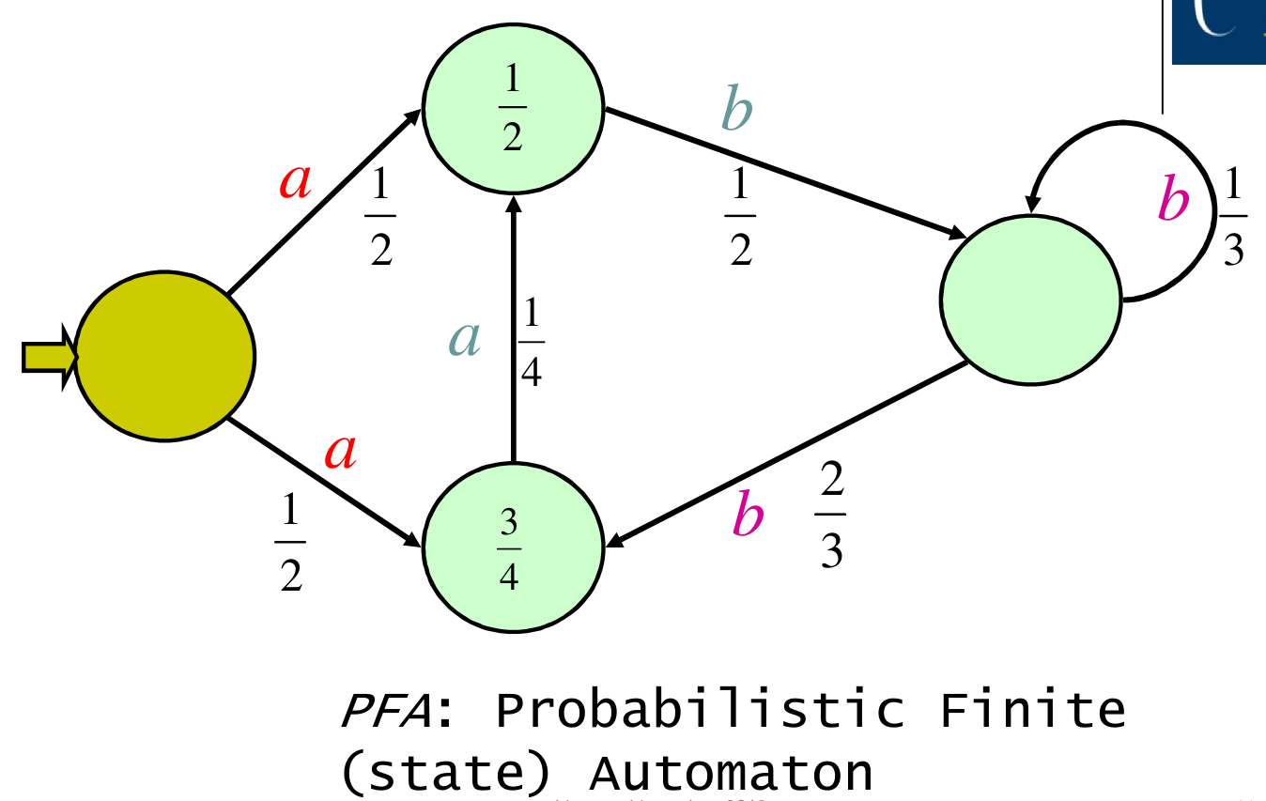
PFA

Slide 9
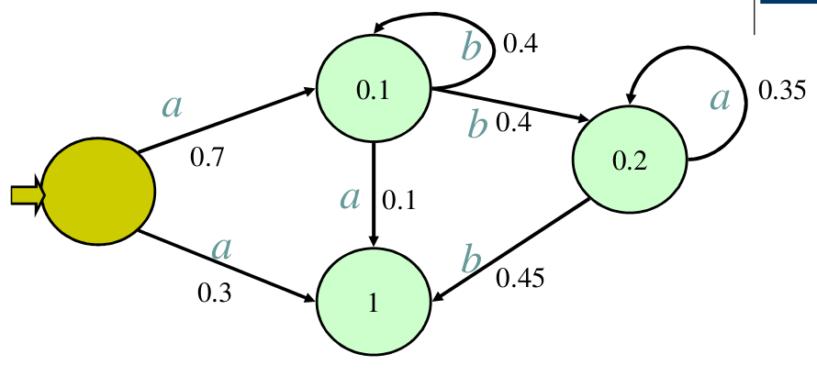
Probability of string “aba” in given PFA
Pr(aba) = 0.7*0.4*0.1*1 + 0.7*0.4*0.35*0.2 = 0.028 + 0.0252 = 0.0532

Slide 10
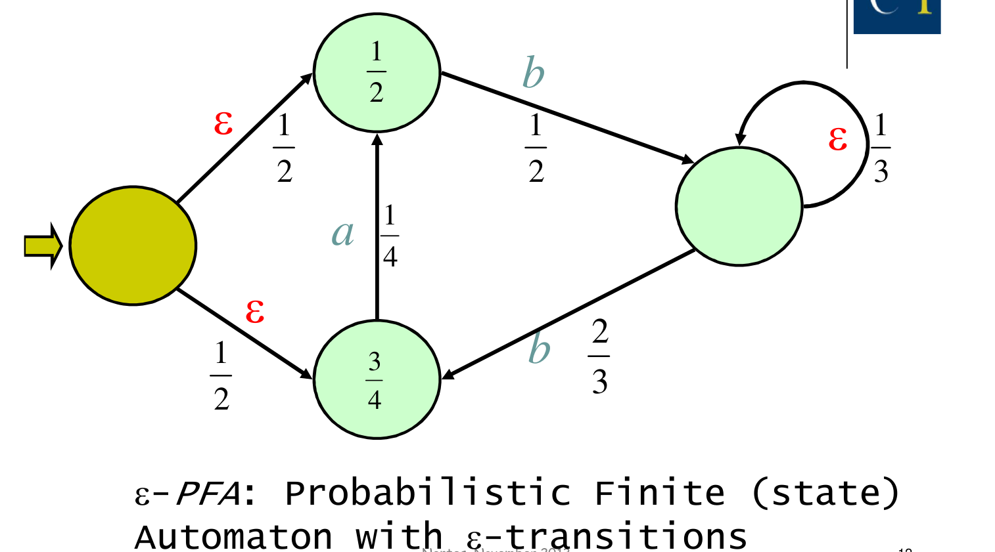
epsilon-PFA

Slide 11
DPFA
Even though determinism restricts the class of distributions that can be generated, we introduce deterministic probabilistic finite-state automata because of the following reasons:
Parsing is easier as only one path has to be followed.
Some intractable problems (finding the most probable string, comparing two distributions) become tractable.
There are a number of positive learning results for DPFA that do not hold for PFA .

Slide 12
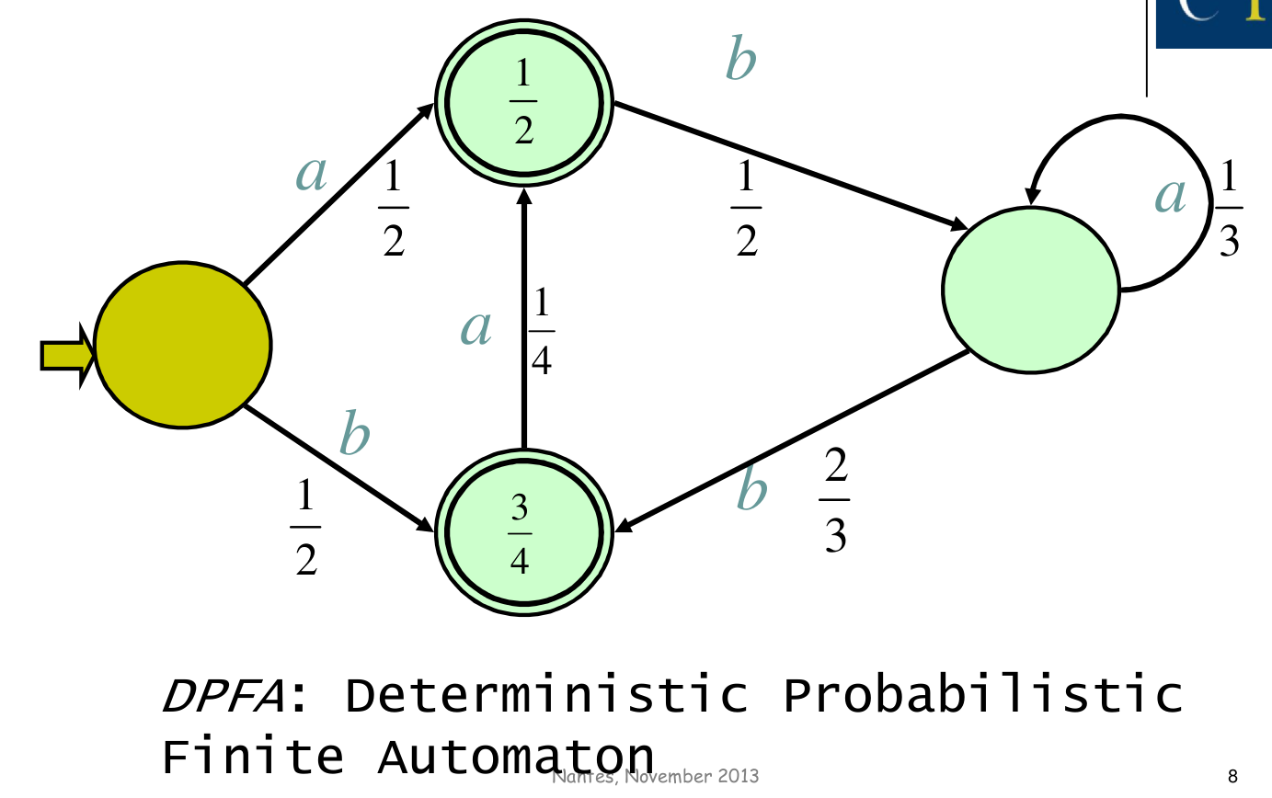
DPFA

Slide 13
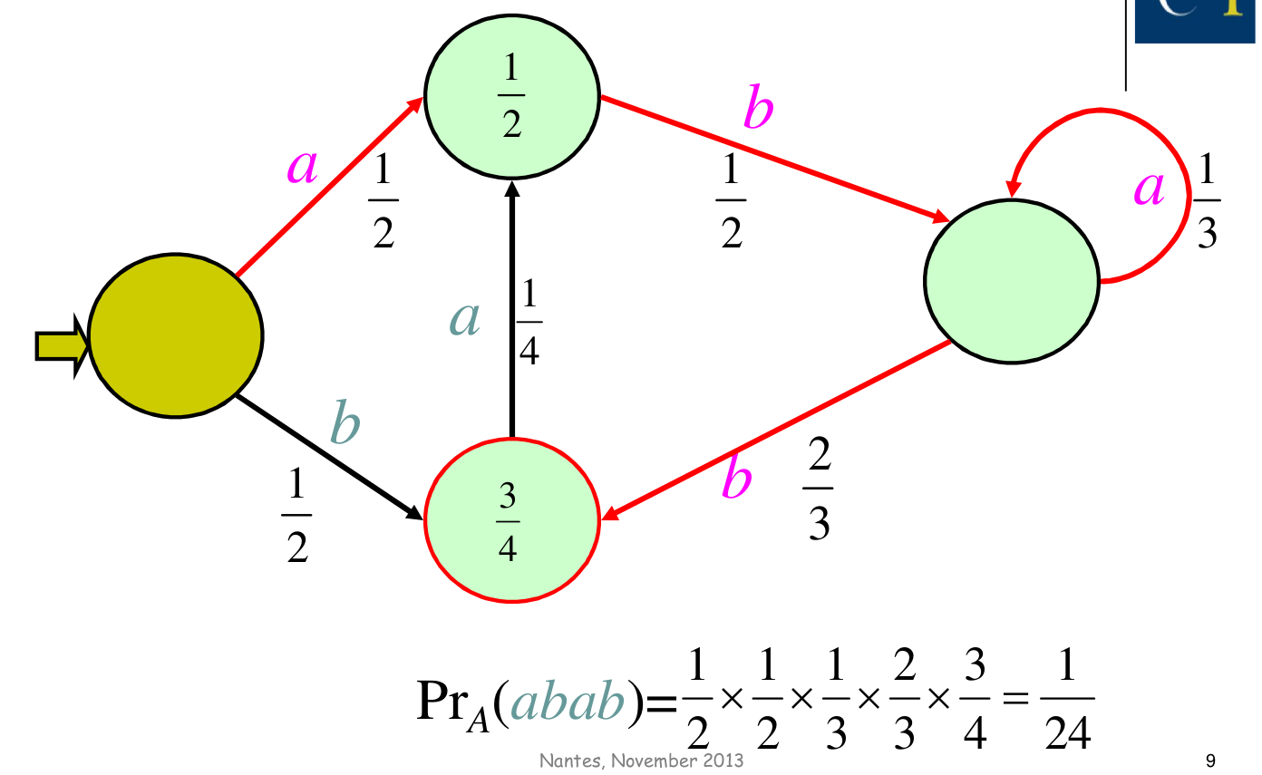
Computing Probability of “abab”

Slide 14
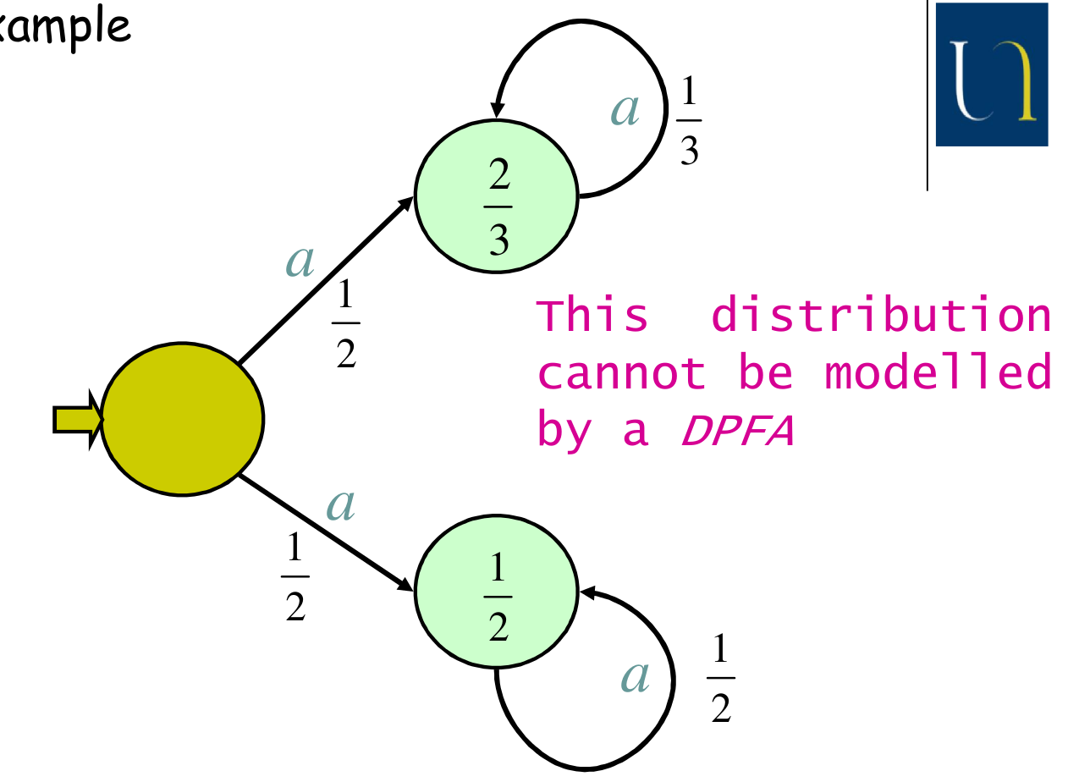
PFA is strictly more powerful than DPFA

Slide 15
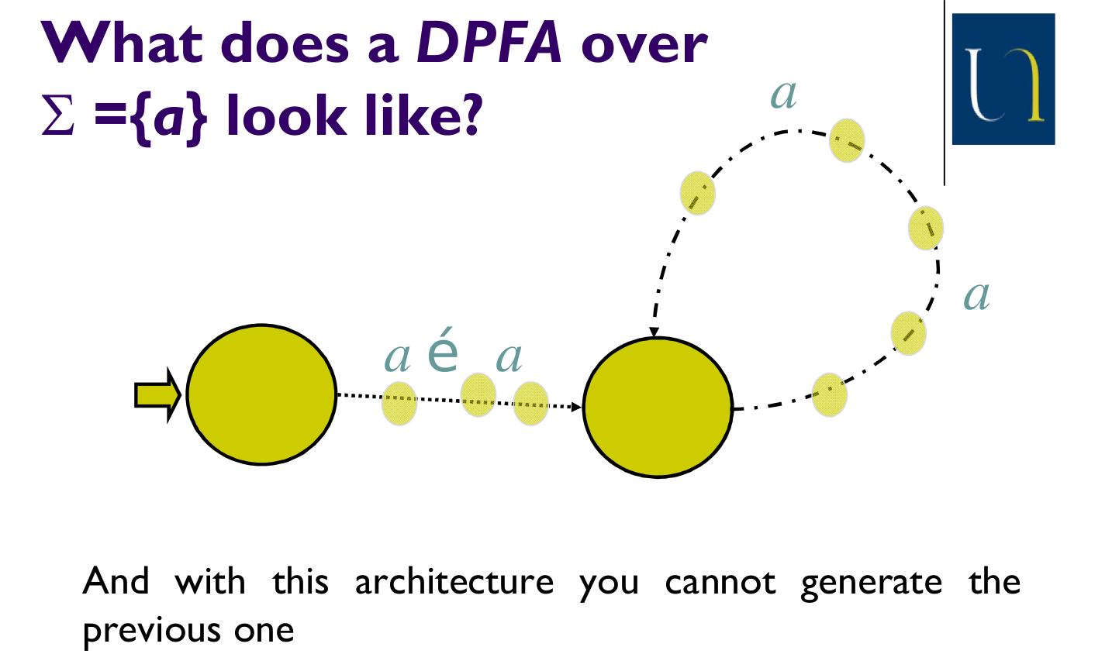

Slide 16
Computing Probabilities
The computation of the probability of a string is by dynamic programming : O(n²m)
Backward and Forward algorithm (popularly used in Hidden Markov Models)
If we want the most probable derivation to define the probability of a string, then we can use the Viterbi algorithm

Slide 17
Learning Paradigm for DPFA
Given a class of stochastic languages or distributions C over Σ*, an algorithm A Probably Approximately Correctly (PAC) learns C if there is a polynomial q such that for all c in C, all 𝝐 > 0 and ẟ > 0, A is given a sample S_{n} and produces a hypothesis G_{n}, such that Pr[D(c||G_{n}) > 𝝐] < ẟ, whenever m > q(1/𝝐,1/ẟ, |c|), where |c| is some measure of the complexity of the target. We say ẟ is the confidence parameter and 𝝐 is the error parameter.

Slide 18
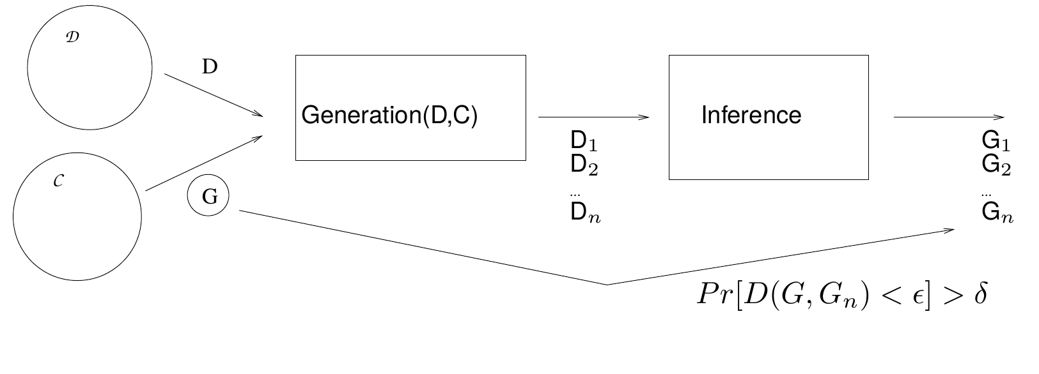
PAC Learning for DPFA

Slide 19
Distance measure
Two distributions over Σ* : D and D’
Kullback Leibler divergence (or relative entropy) between D and D’ :
Σ_{w∈Σ*} Pr_{D}(W) * [log (Pr_{D}(w) / Pr_{D’}(w))]

Slide 20
References
Clark, Alexander, and Franck Thollard. "PAC-learnability of probabilistic deterministic finite state automata." The Journal of Machine Learning Research 5 (2004): 473-497.
De la Higuera, Colin. Grammatical inference: learning automata and grammars. Cambridge University Press, 2010.
Probabilistic Finite State Machines. Franck Thollard.
Stoelinga, Mariëlle. "An introduction to probabilistic automata." Bulletin of the EATCS 78.176-198 (2002): 2.
Vidal, Enrique, et al. "Probabilistic finite-state machines-part I." Pattern Analysis and Machine Intelligence, IEEE Transactions on 27.7 (2005): 1013-1025.

Slide 21
Thank You!!

