Slide 1
Un-decidability of Post Correspondence Problem
Gaurav Sharma
ME-CSA
(01 Dec 2016)

Slide 2
The Path Ahead
Introduction
Post Correspondence Problem
Proof
Ambiguity Problem of CFG
Conclusion

Slide 3
Introduction
Post Correspondence Problem (PCP) is an example of a problem that does not mentions TM’s in its statement and yet it is un-decidable
Not important in itself but from PCP we can prove many other non-TM problems un-decidable ( ex problems related to CFL’s)
Notes:
These problems are unrelated to TM’s but are related to matters like CFL that were NOT developed for the purpose of exposing un-decidable problem. What we mean is that we study grammers for usual matters like describing the structure of programming language . We have no intent to describe problems that turn out to be undecidable. It just turnned out that there are undecidable problems lurking in CFG

Slide 4
Post Correspondence Problem

Slide 5
Post Correspondence Problem
PCP Instance
An instance of PCP is a set of pairs of non-empty strings over some input alphabet Σ , ex . (w₁ , x₁) , (w₂ , x₂) , (w₃ , x₃) ,…, (w_{n}, x_{n}) .
The answer to any instance of PCP problem is “YES” iff there exist a non empty sequence of indices i₁ ,i₂ , i₁ , …. , i_{k} such that w_{i1} . w_{i2} ….w_{ik} = x_{i1} .x_{i2} …..x_{ik} .

Slide 6
PCP Example-1
Let Σ = {0 ,1}
Let the PCP instance consist of two pairs : (0,01), (100,001).
We claim that there is no solution for this PCP instance !
1
0
01
2
100
001
2
100
001
2
100
001
1
0
01
1
0
01
2
100
001
1
0
01
Notes:
Reasons . : you cannot start with index 2 pair as ( 100,001) both have starting characters deifferent. So no matter what combination we use we will not get a soln.
Further if we start with index 1 pair in which one string is prefix of the other (0, 01) the if we build a soln

Slide 7
PCP Example-2
Let Σ = {0 ,1}
Let the PCP instance consist of three pairs : (0,01), (100,001), (110,10).
We have a solution – 0110
In fact , any sequence of indexes in 12*3 is a solution
1
0
01
3
110
10
1
0
01
2
100
001
3
110
10
Notes:
Reasons . : you cannot start with index 2 pair as ( 100,001) both have starting characters deifferent. So no matter what combination we use we will not get a soln.
Further if we start with index 1 pair in which one string is prefix of the other (0, 01) the if we build a soln

Slide 8
Proof of PCP

Slide 9
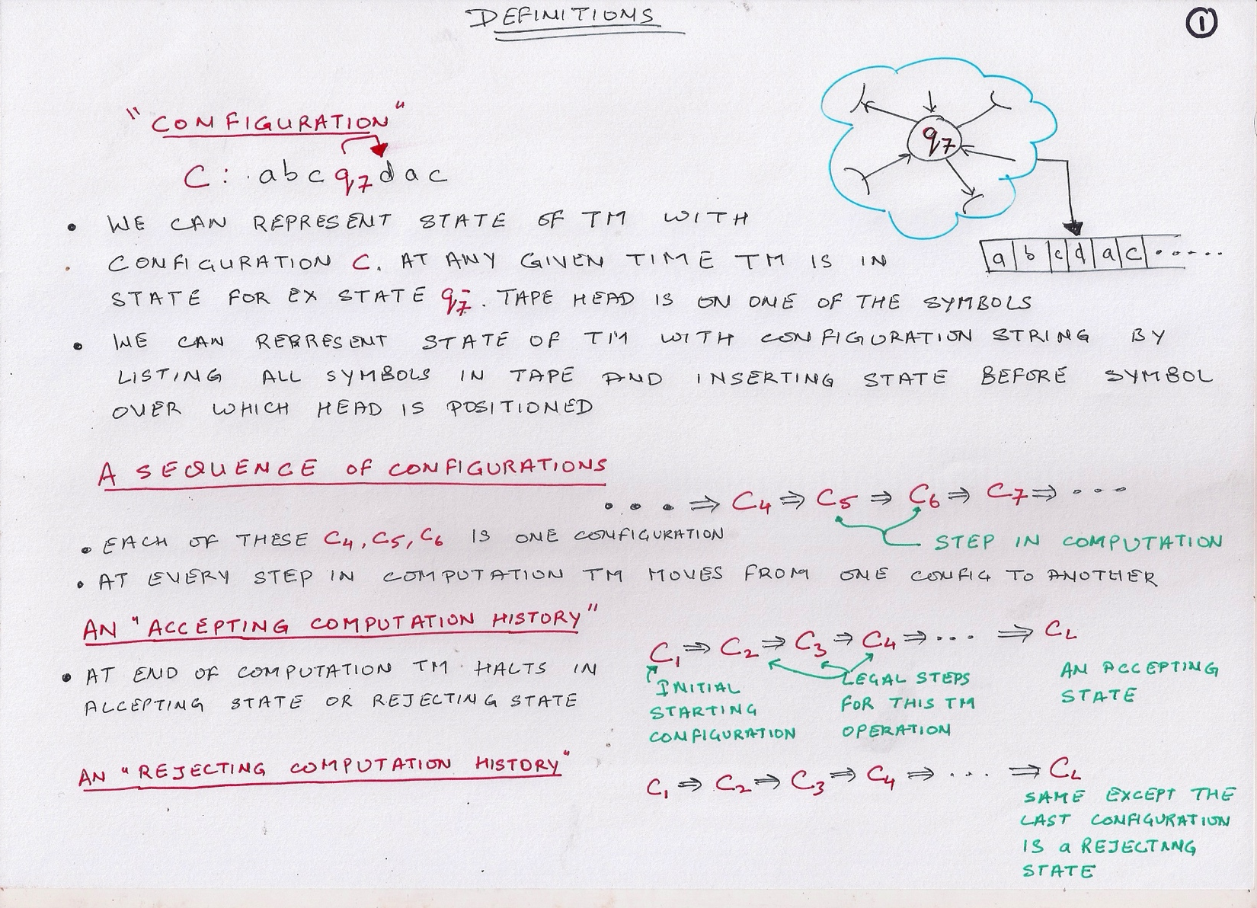

Slide 10
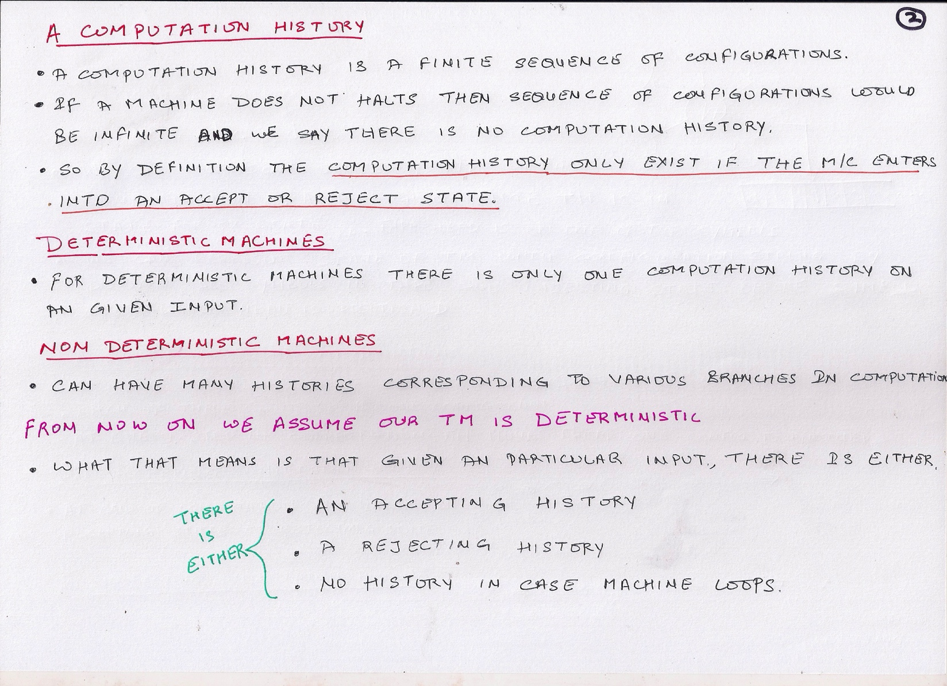

Slide 11
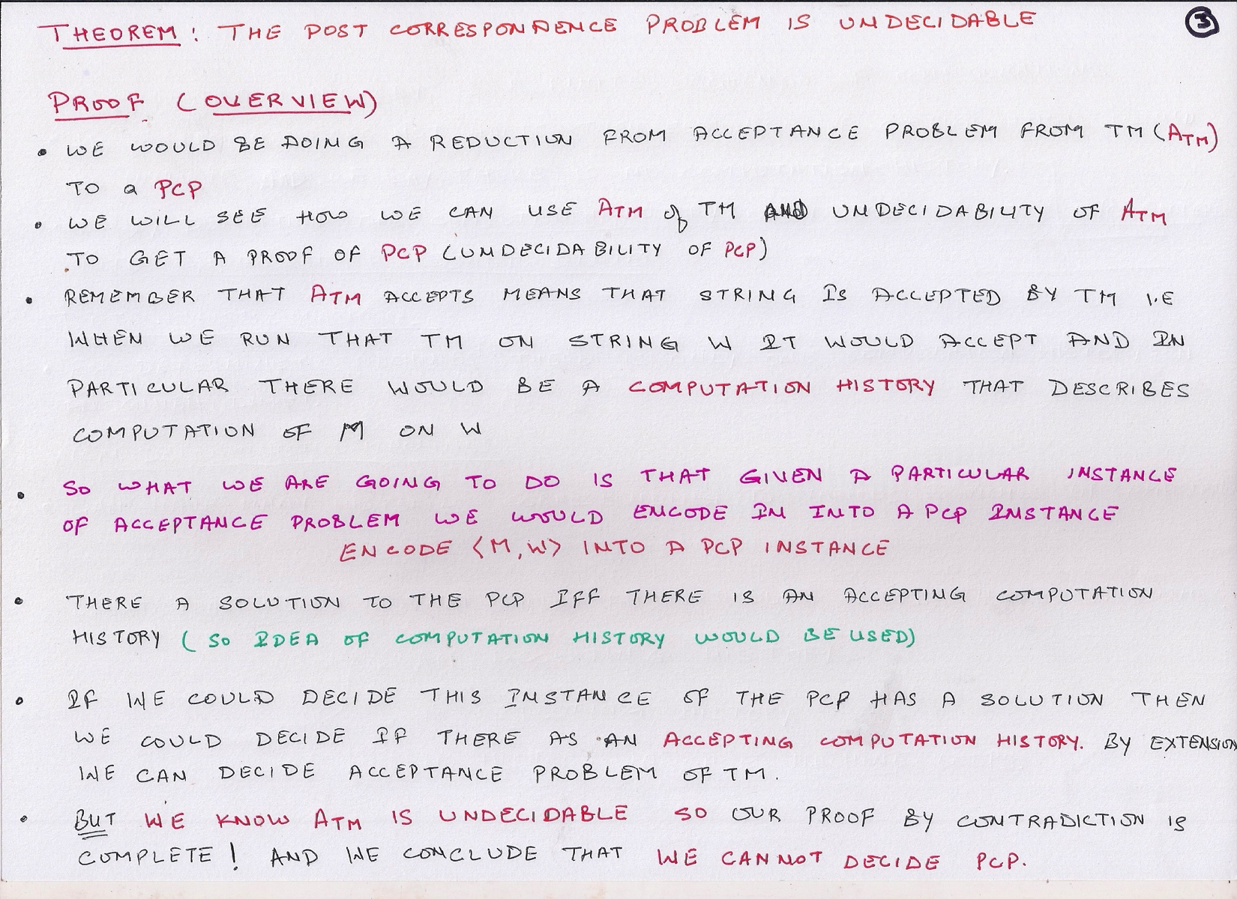

Slide 13
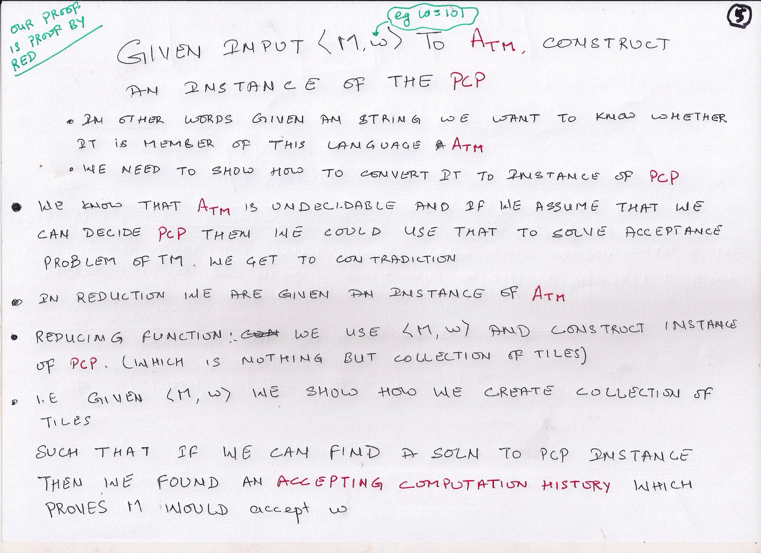

Slide 14
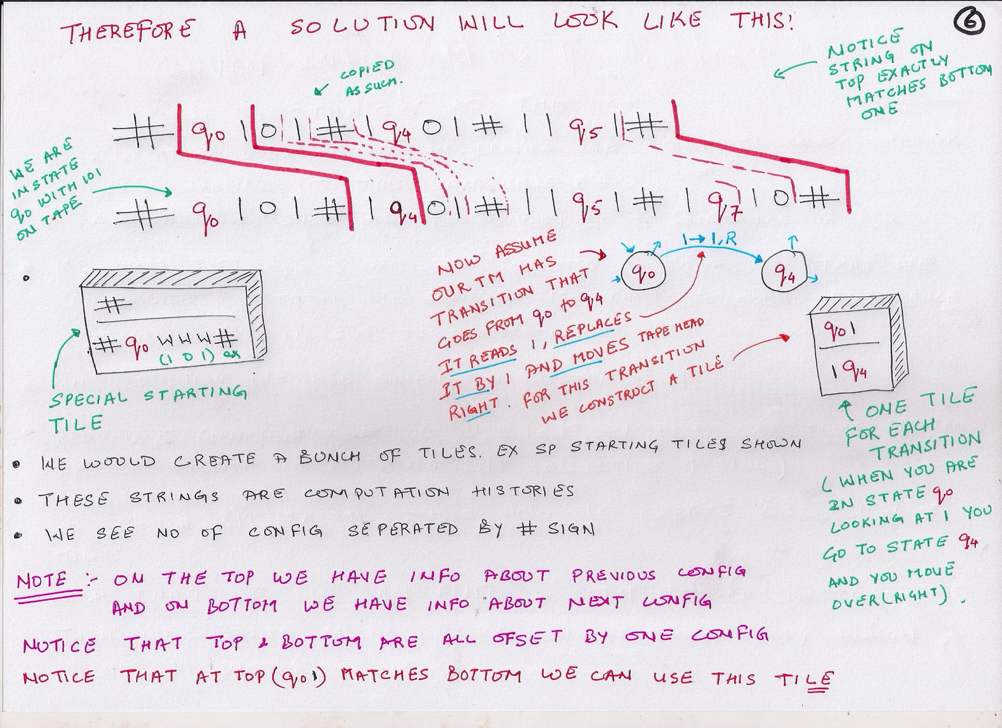

Slide 15
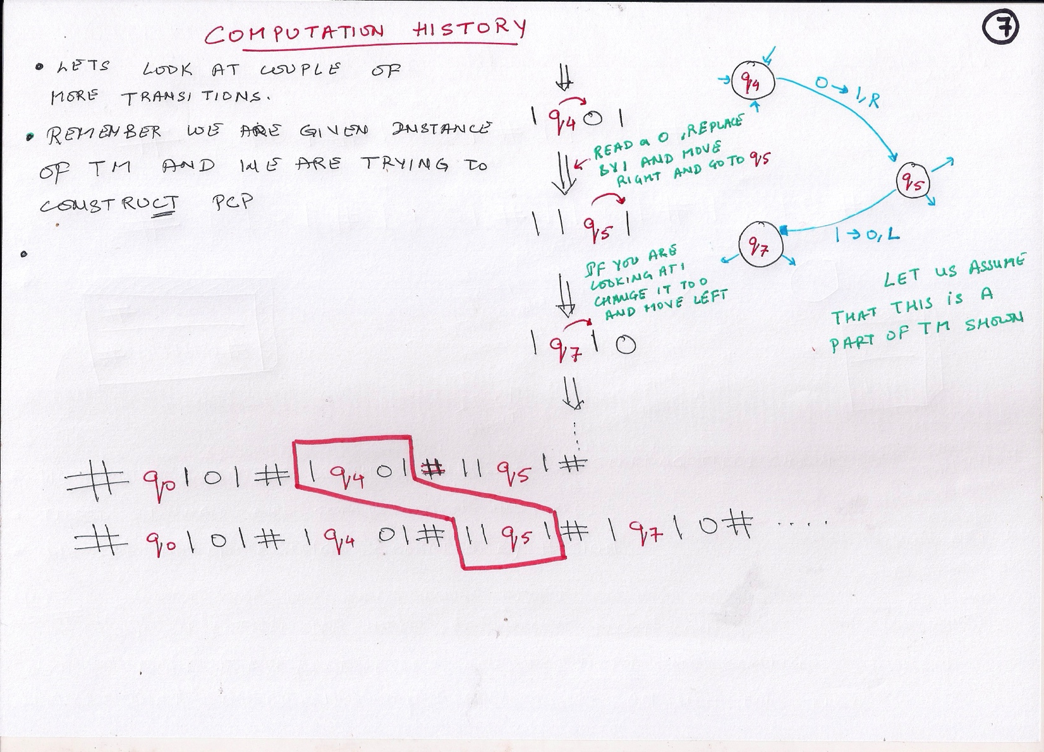

Slide 16
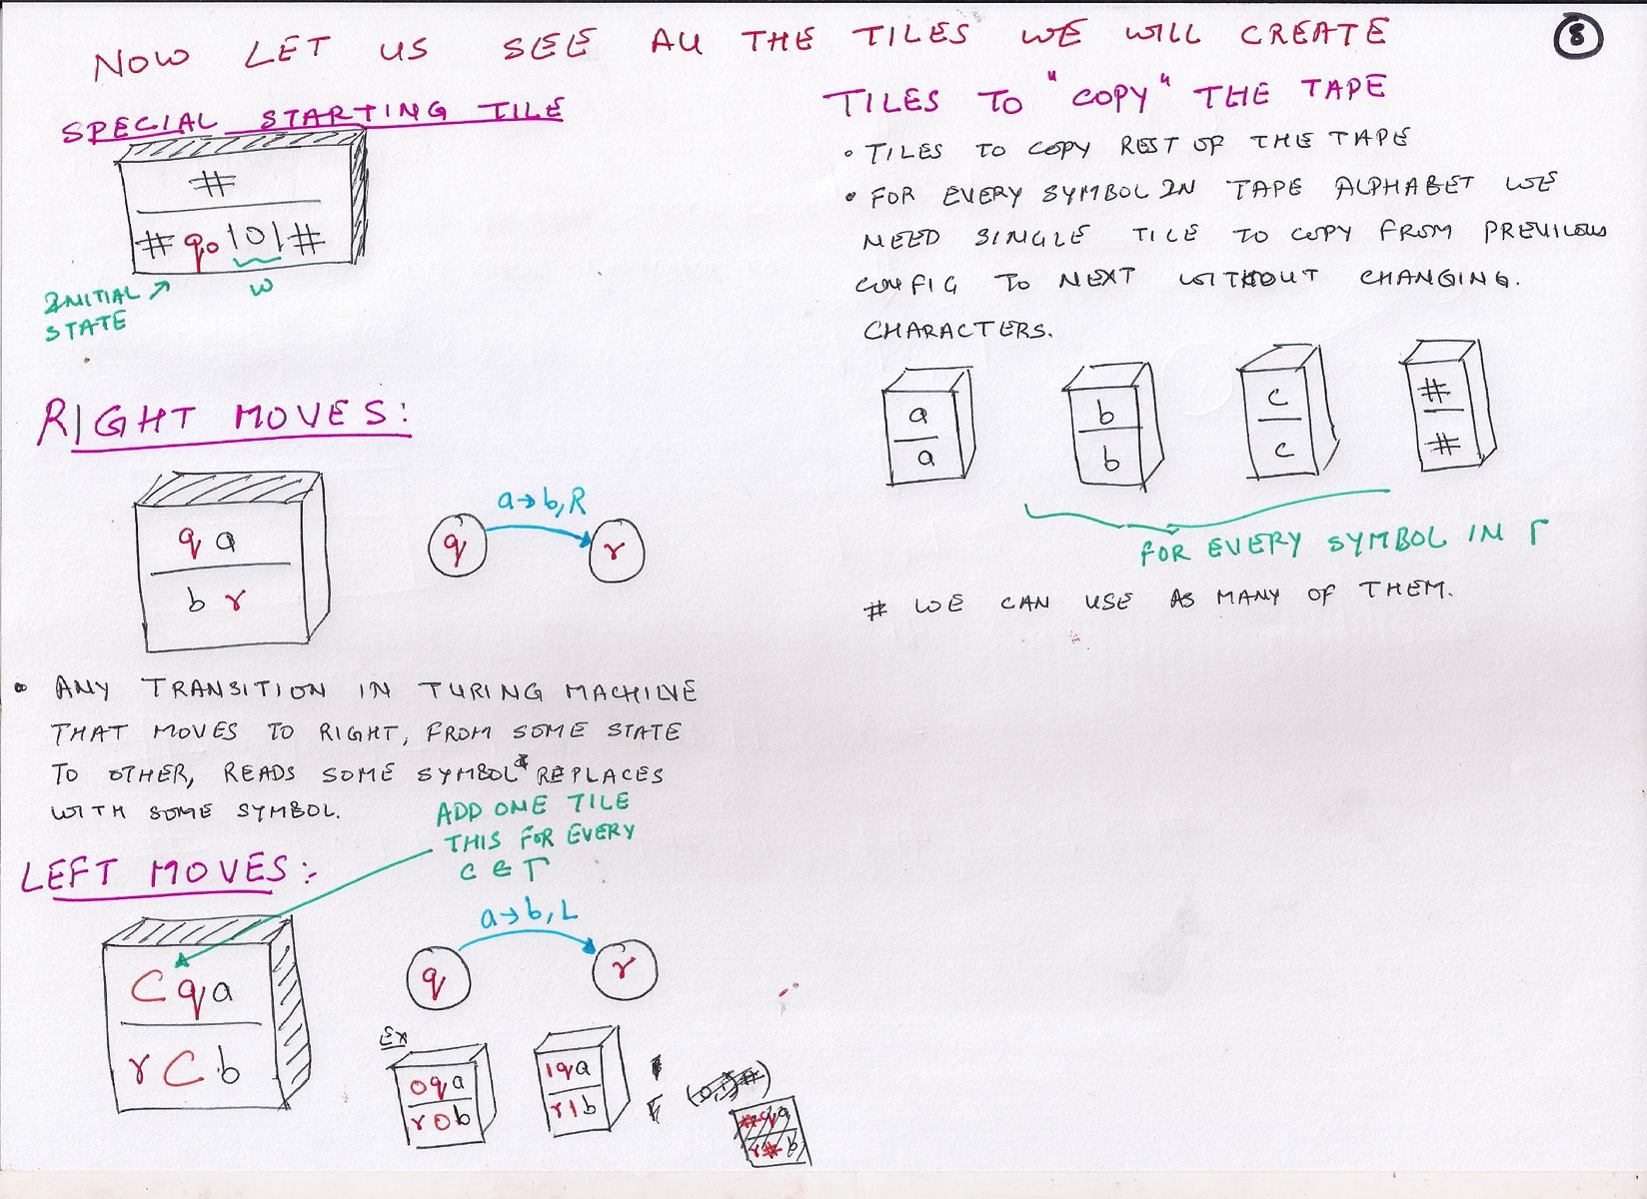

Slide 17
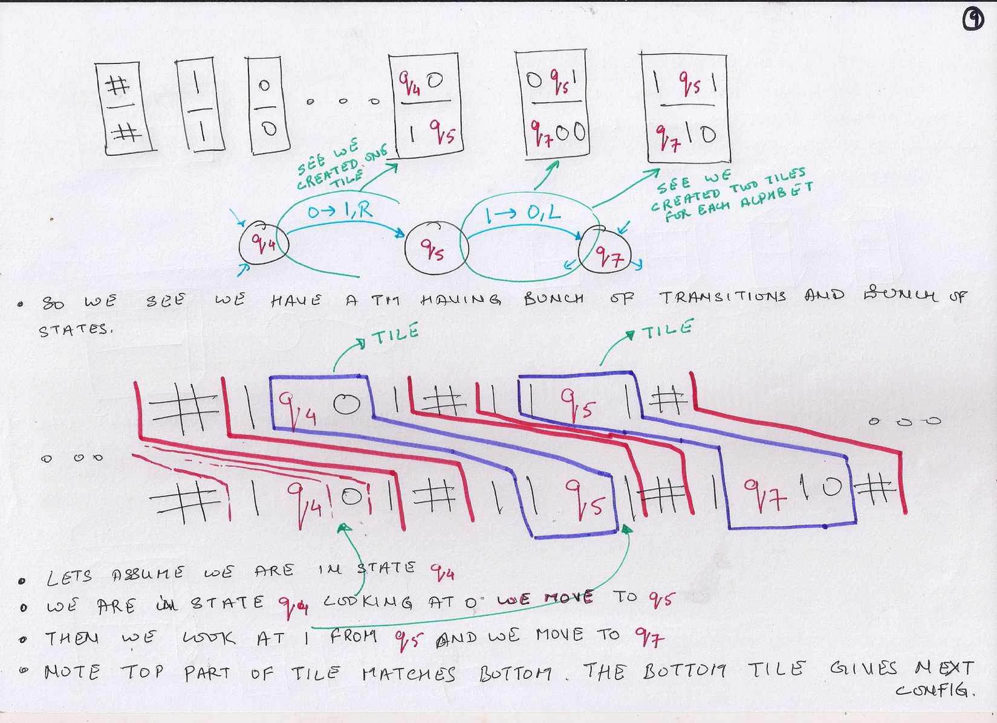

Slide 18
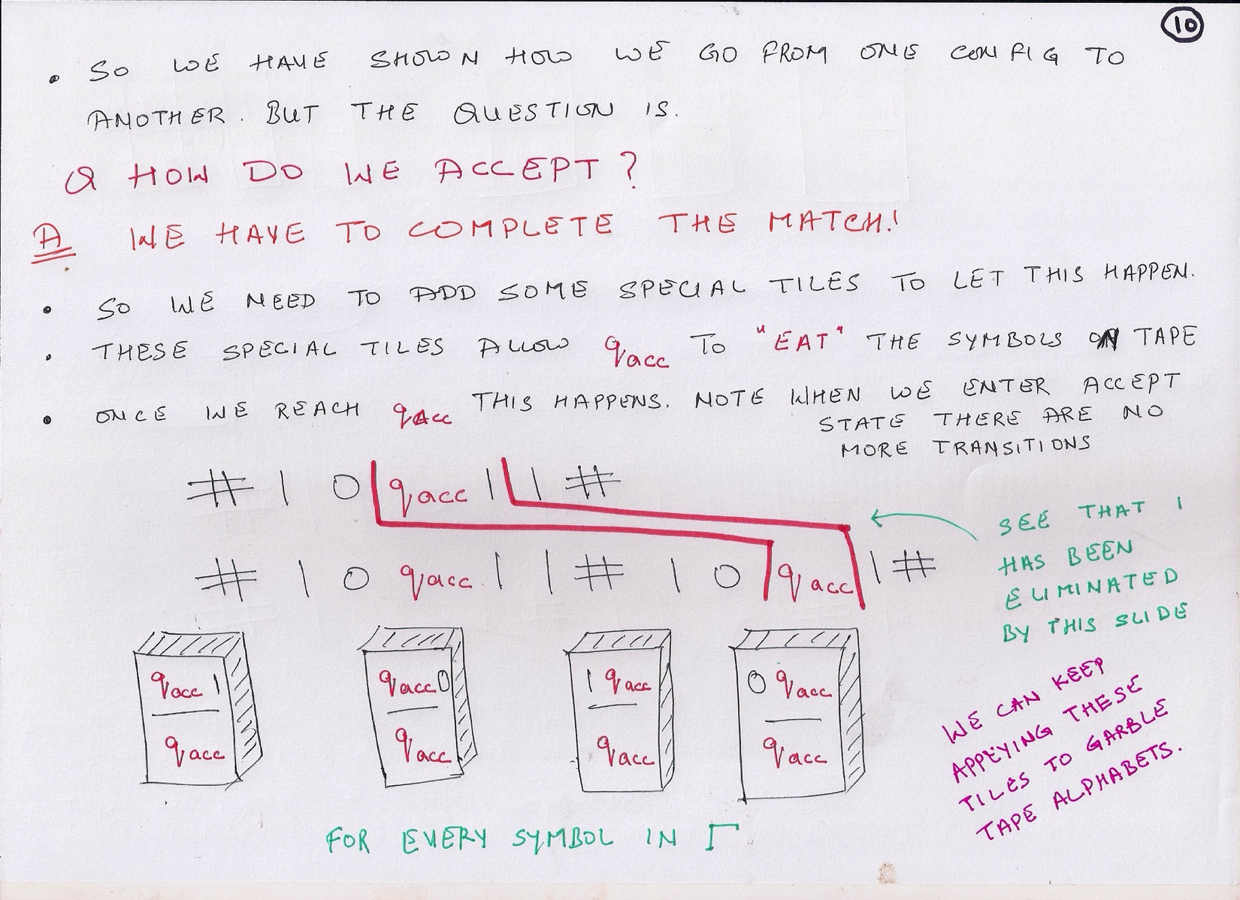

Slide 20
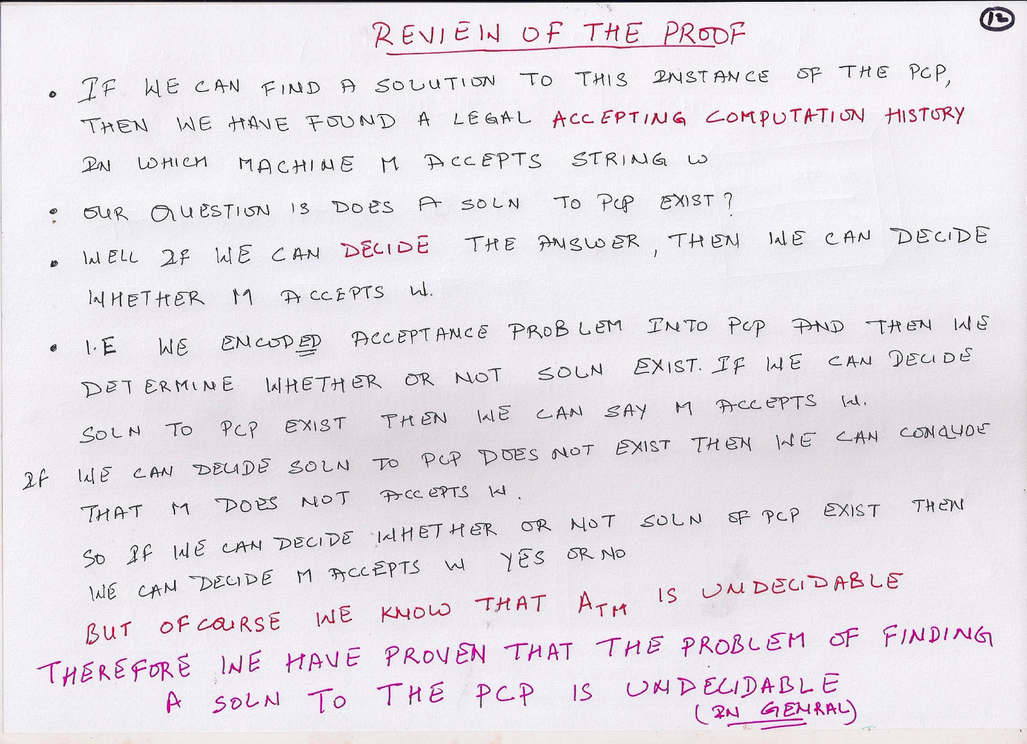

Slide 21
Ambiguity Problem of CFG

Slide 22
Ambiguity Problem of CFG
Using PCP to prove the un-decidability of the problem
"Is a given CFG ambiguous ?"

Slide 23
Construction
Consider a PCP instance with k pairs, such that i^{th} pair is (w_{i} ,x_{i} ).
Assume k index symbols a₁,……, a_{k} .
Introduce two non-terminals A and B, that will incorporate productions for first and second element of a PCP pair, for all pairs.
For each PCP pair (w_{i} ,x_{i} ), add following productions in the grammar:
A w_{i}A a_{i} |w_{i}a_{i} , and
B x_{i}Ba_{i} |x_{i} a_{i}
And finally the production: S A|B

Slide 24
Example
Consider a PCP instance (a , ab), (baa, aab),(bba , ba).
using 1, 2, 3 as index symbols for these pairs in order,
A aA1|baaA2|bbaA3|a1|baa2|bba3
B abB1|aabB2|baB3|ab1|aab2|ba3
S A|B

Slide 25
Reduction of PCP to Ambiguity Problem
Given a PCP instance, construct corresponding grammar, with variables A and B.
The resulting grammar is ambiguous if and only if there is a solution to the PCP instance.

Slide 26
Example
Reduction to Ambiguity
A aA1|baaA2|bbaA3|a1|baa2|bba3
B abB1|aabB2|baB3|ab1|aab2|ba3
S A|B
There is a solution 1,3.
Correspondingly, abba31 has two leftmost derivations starting from A and B.
S A aA1 abba31
S B abB1 abba31

Slide 27
Example
If a₁ a₂ a₃ ... a_{k} is a solution then w₁ ..w_{k} a_{k}..a₁ equals x₁ ..x_{k} a_{k} ..a₁ and has two derivations one starting from S A and other from S B.

Slide 28
Conclusion

Slide 29
Questions

