Slide 1
Büchi Automata
Nabarun Deka(UG Maths)
Deepak Poonia(Mtech CSA)

Slide 2
Overview :
Buchi’s Motivation.
Buchi Automata (Definition)
Deterministic Buchi Automata and it’s characterization
Non-deterministic Buchi automata are more powerful than Deterministic Buchi Automata.
Characterization of Buchi Recognizable languages.
Closure Properties (Union, Intersection, Projection)
MSO Theory of one successor
Equivalence of S1S formula and $ω$regular languages.
Complementation of Buchi Automata

Slide 3
Motivation :
Bϋchi’s motivation: Decision procedure for deciding truth of first-order logic statements about natural numbers and their ordering.
He was interested in showing that the Monadic second order(MSO) logic of infinite sequences was decidable.

Slide 4
Bϋchi Automata :
Definition :
A Bϋchi Automaton is a finite automaton A = (Q, Σ, δ, S, F), where
Q : Finite set of states.
Σ : Finite set of input alphabet.
S : Set of Start states.
F : Set of final states.
δ ⊆ (Q × Σ × Q ) is the transition relation.

Slide 5
Acceptance Condition for Bϋchi Automata :
In any run ρ of a word α, some states of Q are visited only finite number of times and some others are visited infinitely often. Let us call these sets fin(ρ) and inf(ρ).
language accepted by such an automaton is
L(A) = {α | there is a run ρ over α such that inf(ρ) ∩ F ≠ ∅}.
A language L ⊆ ${\text{Σ}}^{ω}$ is said to be buchi recognizable if it is accepted by some Bϋchi automaton.

Slide 6
Example 1 :
Accepts all words over {a,b} that have infinitely many a’s.

Slide 7
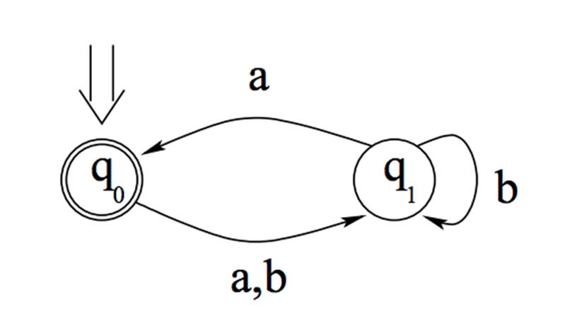
Example 1 :
Accepts all words over {a,b} that have infinitely many a’s.

Slide 8
Example 1 :
Accepts all words over {a,b} that have infinitely many a’s.
Observe that this is a DBA.

Slide 9
Example 2 :
Accepts all words over {a,b} that have Only finitely many a’s.

Slide 10
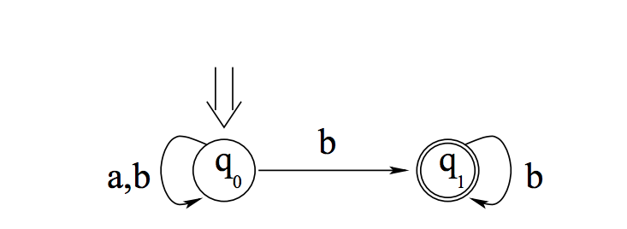
Example 2 :
Accepts all words over {a,b} that have Only finitely many a’s.

Slide 11
Example 2 :
Accepts all words over {a,b} that have Only finitely many a’s.
Observe that this is NBA.

Slide 12
Deterministic Bϋchi Automata :
Limit languages :
Let U ⊆ Σ* be a language of finite strings. The limit of U, lim(U) is the set
lim(U) = {α ∈ ${\text{Σ}}^{\text{ω}}$| ${\text{∃}}^{\text{ω}}$n ∈ ${\text{ℕ}}_{\text{0}}$: α[0..n] ∈ U}
So, a word belongs to lim(U) iff it has infinitely many prefixes in U.

Slide 13
Deterministic Bϋchi Automata :
Limit languages :
Let U ⊆ Σ* be a language of finite strings. The limit of U, lim(U) is the set
lim(U) = {α ∈ ${\text{Σ}}^{\text{ω}}$| ${\text{∃}}^{\text{ω}}$n ∈ ${\text{ℕ}}_{\text{0}}$: α[0..n] ∈ U}
Theorem 1: A language L ⊆ ${\text{Σ}}^{\text{ω}}$ is recognizable by a deterministic Bϋchi automaton iff L is of the form lim(U) for some regular language U ⊆ Σ*.
Proof :

Slide 14
Proof :
(Only if part) : Treat the DBA as a DFA over finite words.
(If part) : Treat the DFA as DBA.

Slide 15
NBA Vs. DBA :
NBA has strictly more power than DBA.
There exists languages that can be recognized by NBAs But No DBA can recognize them.
Example : Can we design a deterministic Buchi automaton that accepts the set of words over {a , b} with only finite number of a’s?

Slide 16
NBA Vs. DBA :
NBA has strictly more power than DBA.
There exists languages that can be recognized by NBAs But No DBA can recognize them.
Example : Can we design a deterministic Buchi automaton that accepts the set of words over {a , b} with only finite number of a’s?
No DBA can recognize this language.
Why?

Slide 17
Proof :
Proof by contradiction.
Assume some DBA recognizes this language L.
So, by Theorem 1, L is of the form lim(U) for some regular language U.
${\text{b}}^{\text{w}}\text{∈}$L → $\text{∃}$ n₀ , ${\text{b}}^{\text{n}\text{0}} \text{∈}$U.
${\text{b}}^{\text{n}\text{0}}$a${\text{b}}^{\text{w}}$ $\text{∈}$ L → $\text{∃}$ n₁, ${\text{b}}^{\text{n}\text{0}}$a${\text{b}}^{\text{n}\text{1}}$ $\text{∈}$ U
${\text{b}}^{\text{n}\text{0}}$a${\text{b}}^{\text{n}\text{1}}$a${\text{b}}^{\text{w}}$ $\text{∈}$ L → $\text{∃}$ n₂, ${\text{b}}^{\text{n}\text{0}}$a${\text{b}}^{\text{n}\text{1}}$a${\text{b}}^{\text{n}\text{2}}$ $\text{∈}$ U
Similarly, ${\text{b}}^{\text{n}\text{0}}$a${\text{b}}^{\text{n}\text{1}}$a…. ${\text{b}}^{\text{n}\text{i}}$ $\text{∈}$ U
So, ${\text{b}}^{\text{n}\text{0}}$a${\text{b}}^{\text{n}\text{1}}$a…. ${\text{b}}^{\text{n}\text{i}}$…. $\text{∈}$ Lim(U) = L (by Theorem 1)
Hence, Contradiction.

Slide 18
Characterizing Bϋchi-recognizable languages:
Let U ⊆ Σ*. Then define
${\text{U}}^{\text{ω}}$= {α ∈ ${\text{Σ}}^{\text{ω}}$ | α = u₀u₁u₂ ··· where u_{i} ∈ U for all i ∈ ${\text{ℕ}}_{\text{0}}$}.
Let U ⊆ Σ* and L ⊆ ${\text{Σ}}^{\text{ω}}$ then define
UL = {α | ∃u ∈ U : ∃β ∈ L : α = uβ}.

Slide 19
Characterizing Bϋchi-recognizable languages:
$ω$- regular expression :
G = U₁ V₁$ω$+ U₂ V₂$ω$ + …. + U_{n} V_{n}$ω$
Is called $ω$ regular expression, Where U_{1,} U_{2 ,} V_{1,} V_{2…} are regular expressions and $∈ ∉$ L(V_{i}), for all 1 ≤ i ≤ n
ω-regular languages : A language L ⊆ ${\text{Σ}}^{\text{ω}}$ is said to be ω-regular if it is of the form $⋃$_{i∈[1..n]} U_{i}V_{i}^{ω} , where each U_{i} and V_{i} is a regular language of finite words.
i.e. $ω$- regular language is the language described by $ω$ regular expression.

Slide 20
Characterizing Bϋchi-recognizable languages:
Theorem 2 : A language is Bϋchi-recognizable iff it is ω-regular.

Slide 21
Proof :
Theorem 2 : A language is Bϋchi-recognizable iff it is ω-regular.
(Only If part) : Let L be recognized by a Bϋchi automaton
A = (Q, Σ, δ, S, F).
For s, s’ ∈ Q, let $V$_{ss’} = {w ∈ Σ* | s ^{w}→⁺ s’ }
It is easy to see that $V$_{ss’} is regular.
it follows that we can write L(A) as $⋃$_{s∈S,f ∈ F} $V$_{sf} ${Vff}^{w}$.

Slide 22
Proof :
(If part) :
the set of Bϋchi-recognizable languages satisfies the following closure properties:
If U is regular, then U^{ω} is Bϋchi-recognizable.
If U is regular and L is Bϋchi-recognizable then UL is Buchi recognizable.
(iii) If L₁, L₂,...,L_{n} are Bϋchi-recognizable, so is $⋃$ _{i∈[1..n]} L_{i} .
From this, it follows that every language of the form $⋃$_{i∈[1..n]} $U$_{i} ${Vi}^{w}$ , where each U_{i} and V_{i} is regular, is Bϋchi-recognizable.

Slide 23
If U is regular, then U^{ω} is Bϋchi-recognizable.

Slide 24
If U is regular, then U^{ω} is Bϋchi-recognizable.

Slide 25
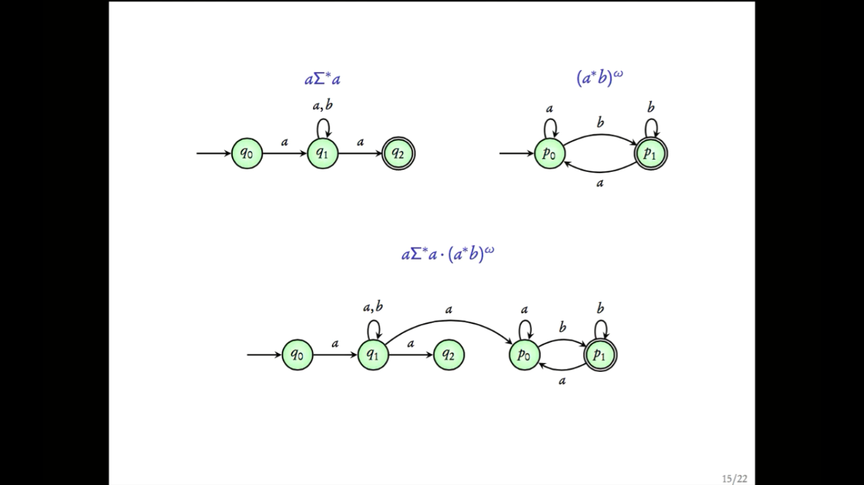
If U is regular and L is Bϋchi-recognizable then UL is Buchi recognizable.

Slide 26
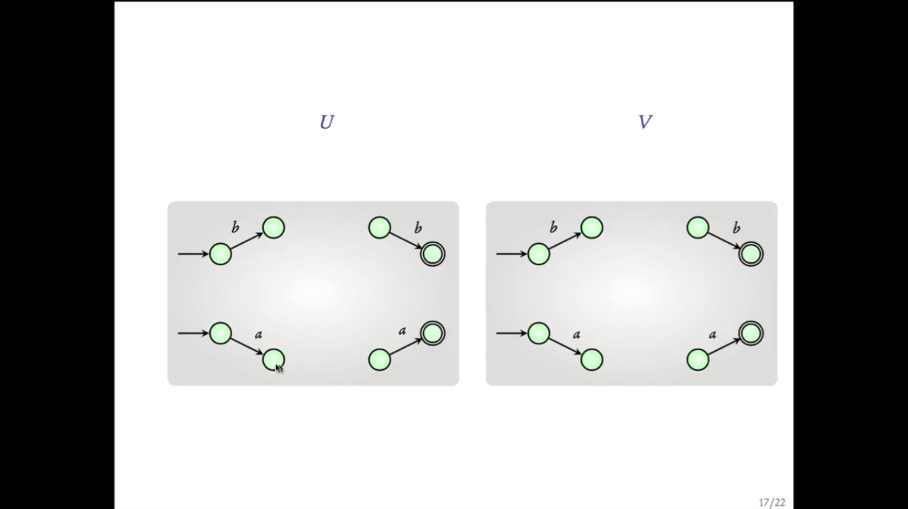
If U is regular and L is Bϋchi-recognizable then UL is Buchi recognizable.

Slide 27
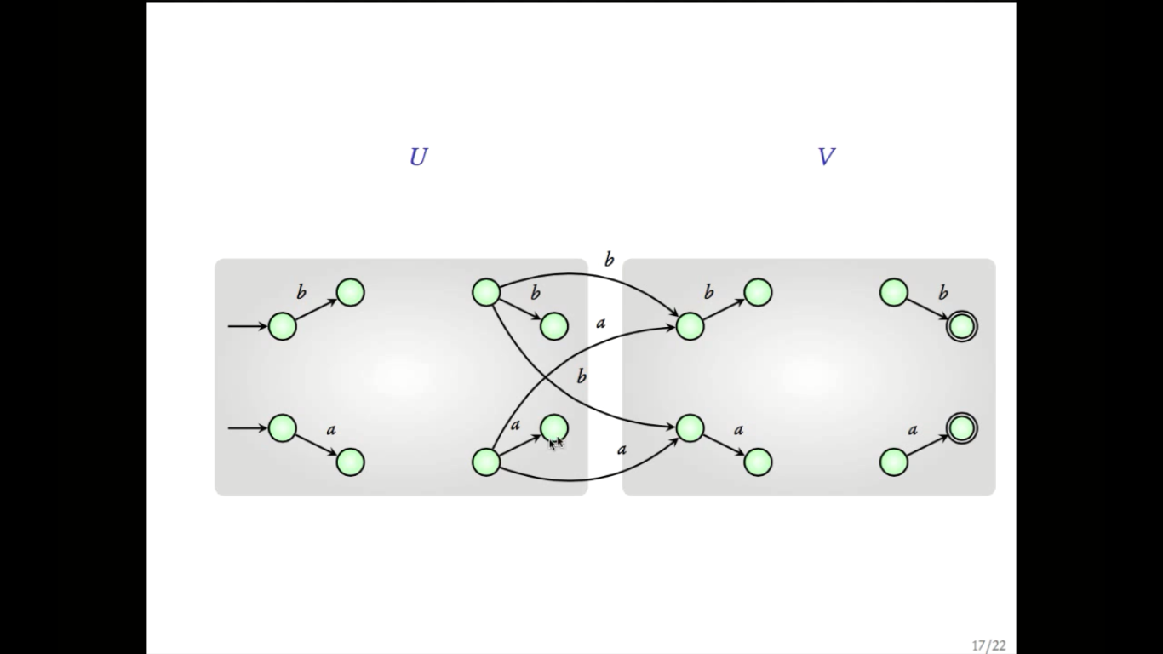
If U is regular and L is Bϋchi-recognizable then UL is Buchi recognizable.

Slide 28
Closure Properties :
Buchi recognizable languages are closed under the following operations:
Finite Union.
Finite Intersection.
Projection
Complementation

Slide 29
Closure under Finite Union :
Let L₁ and L₂ be languages over ∑⍵ , that are recognised by Büchi automata
B₁ = (Q₁, Σ, δ₁, S₁, F₁) and B₂ = (Q₂, Σ, δ₂, S₂ , F₂ ) respectively, then,
Recogniser for L₁ U L₂ is :
B = (Q₁∪ Q₂ , δ₁ ∪ δ₂ , S₁∪ S₂ , F₁ ∪ F₂ ).
It is easy to see that for every word w ∈ ∑⍵, the NBA B has an accepting run on w iff at least one of the NBA’s B₁ and B₂ has an accepting run on w.

Slide 30
Closure under finite intersection :
Naïve approach : We can try Product construction like we did for Automata over finite words.
Issue is in defining the accept states.
Example : Let
L₁ = {w | w[2n] = a, $∀$n $∈$ $\text{ℕ}$}
L₂ = {w | w[2n+1] = b, $∀$n $∈$ $\text{ℕ}$}
Then if we do the usual product construction, it will fail.

Slide 31
Construction for Intersection :
G = S1 × G2 × {2}.
Image source : Survey report of Buchi Automata by Madhvan Mukund, 2011.

Slide 32
Construction for Intersection :
We can verify that L(A) = L₁ $∩$ L₂.

Slide 33
Closure under Projection :
Let $Σ$₁ and $Σ$₂ be two alphabets with a projection map
$π$ : $Σ$₁ → $Σ$₂
Let L be a language over $Σ1$ recognized by the automaton
A₁ = (Q₁, $Σ1$,$δ1$,S₁,F₁)
Define
$π$(L) = {w| w[i] = $π$(v[i]) for some v $∈$ L}
Then, we can construct an automaton for $π$(L) as

Slide 34
Closure under Projection :
A = (Q₁, $Σ2$,$δ2$,S₁,F₁)
where
(q,a,q’) $∈$ $δ2$ iff (q,b,q’) $∈$ $δ1$ for some b $∈$ $Σ1$ such that $π$(b) = a
It is easy to see that L(A) = $π$(L)

Slide 35
Closure under complementation :
The construction for complementation is highly non-trivial, so we will visit it at the end.

Slide 36
MSO theory of one successor
Buchi’s original motivation to study automata on infinite words was to solve a decision problem from logic.
The logic he looked at is called the Monadic Second Order logic of One successor (abbreviated as S1S).
The logic is interpreted over the natural numbers (N_0). Its called a logic of one successor because we are dealing with the natural numbers, where each number has one unique successor.

Slide 37
MSO theory of one successor
Formally, the logic is defined as follows:
Terms : 0, x, y, z, succ(x), succ(succ(y)), succ(0)
Atomic Formulas: Let t,t’ be terms. The atomic formulas are
t = t’
t \in X , where X is a subset variable
Formulas: These are built from atomic formulas using Boolean operators AND, OR and NOT, and the existential quantifier \exists. (since it’s a second order logic, we can quantify over subsets also)
We have the usual notion of interpretation of formulas.

Slide 38
Examples

Slide 39
S1S formulas as $ω$ – regular languages

Slide 41
Theorem:
Proof Strategy :
Step 1 : Simplify the syntax (This is purely for convenience)
Step 2 : Induct on the structure of the simplified formula –
i) Construct automatons that recognize atomic formulas
ii) Use the closure properties of ω – regular languages to construct automatons for general formulas

Slide 42
Simplification of Syntax
We remove all individual variables from the formula. Our simplified formula has only set variables.
Atomic formulas:

Slide 43
Simplification of Syntax
Eliminate nested occurrences of successor function.
Example : for the atomic formula
we replace it by

Slide 44
Simplification of Syntax
We then eliminate the atomic formula
by replacing it with

Slide 45
Simplification of Syntax
Finally, we eliminate singleton variables using the formula
For example
will be written as

Slide 46
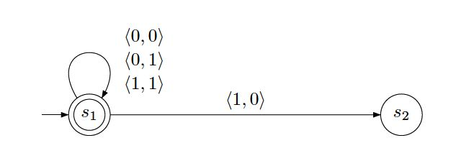
Automaton for

Slide 47
Automaton for

Slide 48
Inductive step
The inductive step follows from the closure properties of regular languages.

Slide 49
Issue with sentences
The construction works for formulas.
If the formula is a sentence, when we project out the last free variable, we will end up with an unlabeled directed graph. We just check if there is an unlabelled path that starts from a start state and visits a final state infinitely often.
This is equivalent to checking if the graph has a strongly connected component X which contains a final state f, and is reachable from some start state.

Slide 50
ω- regular languages are S1S definable

Slide 51
ω- regular languages are S1S definable
Theorem

Slide 52
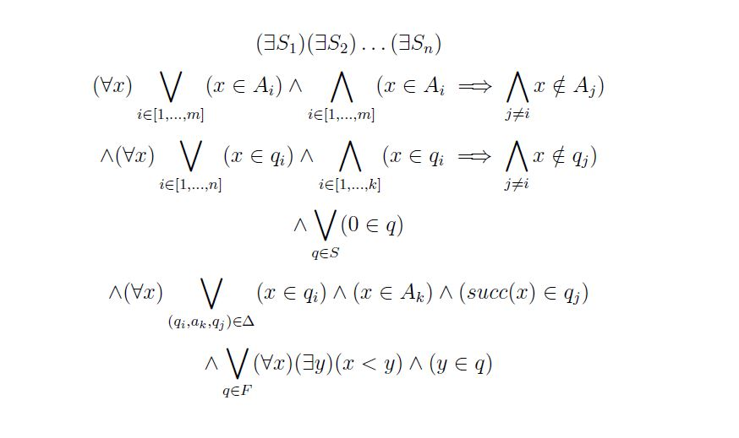

Slide 53
Complementing deterministic Buchi automata

Slide 54
Complementing non deterministic Buchi automata
https://www.react.uni-saarland.de/teaching/automata-games-verification-08/notes/notes3.pdf
https://www.react.uni-saarland.de/teaching/automata-games-verification-08/notes/notes4.pdf

Slide 55
References :
https://www.cmi.ac.in/~sri/Courses/MCSV/Slides/lecture6.pdf
https://www.cmi.ac.in/~kumar/words/lecture07.pdf
https://www.cmi.ac.in/~madhavan/papers/pdf/iisc2011-buchi.pdf
https://nptel.ac.in/courses/106/106/106106136/

