Slide 1
Model Based Projection +
Synthesis: Theory and Practice
(What works and what doesn’t)
Stanly Samuel
26 May 2021

Slide 2
Overview:
Model Based Projection (MBP) (Quantifier Elimination)
Solving AE using MBP
(Validity of AE Fragment of FOL and synthesizing a witness)
Application of AE solving to Synthesis:
Functional
Reactive

Slide 3
Background and Intuition:
Solving a sentence containing Existential Quantifier:
If True, return a witness
∃x. x² = x + 6

Slide 4
Background and Intuition:
Solving a sentence containing Existential Quantifier:
If True, return a witness
∃x. x² = x + 6
∀x ∃y. [0<=x<=10 => (y = x + 1 and y <=5) ]

Slide 5
Background and Intuition:
Solving a sentence containing Existential Quantifier:
If True, return a witness
∃x. x² = x + 6
∀x ∃y. [0<=x<=10 => (y = x + 1 and y <=5) ]
∀x ∃y. (0<=x<=10 => y = x + 1)

Slide 6
Background and Intuition:
Solving a sentence containing Existential Quantifier:
If True, return a witness
∃x. x² = x + 6
∀x ∃y. [0<=x<=10 => (y = x + 1 and y <=5) ]
∀x ∃y. (0<=x<=10 => y = x + 1)

Slide 7
Background and Intuition:
Extracting a witness for:
∀x ∃y. (0<=x<=10 => y = x + 1)

Slide 8
Background and Intuition:
Extracting a witness for:
∀x ∃y. (0<=x<=10 => y = x + 1)
∀x. (0<=x<=10 => f(x) = x + 1)

Slide 9
Background and Intuition:
Extracting a witness for:
∀x ∃y. (0<=x<=10 => y = x + 1)
∀x. (0<=x<=10 => f(x) = x + 1)
Theory of UF + T (LIA) + Universal Quantifier

Slide 10
Background and Intuition:
Extracting a witness for:
∀x ∃y. (0<=x<=10 => y = x + 1)
∀x. (0<=x<=10 => f(x) = x + 1)
Theory of UF + T (LIA) + Universal Quantifier
“Synthesize” a function f which satisfies the formula (specification) on ALL inputs denoted by x.
Functional Synthesis!

Slide 11
Background and Intuition:
Extracting a witness for:
∀x ∃y. (0<=x<=10 => y = x + 1)
∀x. (0<=x<=10 => f(x) = x + 1)
Theory of UF + T (LIA) + Universal Quantifier
“Synthesize” a function f which satisfies the formula (specification) on ALL inputs denoted by x.
Formally:
Functional Synthesis!

Slide 12
Functional Synthesis:
Functional Synthesis: Synthesizing a correct-by-construction program from a given declarative specification.
SOL
Specification (What you want)
∃f. ∀x,y. f(x,y) >=x and f(x,y) >=y and [ f(x,y) =x or f(x,y) =y ]
Synthesizer
Correct-by-construction program

Slide 13
Functional Synthesis:
Functional Synthesis: Synthesizing a correct-by-construction program from a given declarative specification.
FOL
Specification (What you want)
∀x,y. f(x,y) >=x and f(x,y) >=y and [ f(x,y) =x or f(x,y) =y ]
Synthesizer
Correct-by-construction program

Slide 14
Functional Synthesis:
Functional Synthesis: Synthesizing a correct-by-construction program from a given declarative specification.
FOL
Specification (What you want)
∀x,y. f(x,y) >=x and f(x,y) >=y and [ f(x,y) =x or f(x,y) =y ]
Synthesizer
Correct-by-construction program

Slide 15
Background and Intuition:
Functional Synthesis!
Extracting a witness for:
∀x ∃y. (0<=x<=10 => y = x + 1)
∀x. (0<=x<=10 => f(x) = x + 1)
Synthesize a function f which satisfies the formula (specification) on ALL inputs denoted by x.
Theory of UF + T (LIA) + Universal Quantifier
Hard Problem!
Undecidable in theory!

Slide 16
Background and Intuition:
Functional Synthesis!
Extracting a witness for:
∀x ∃y. (0<=x<=10 => y = x + 1)
∀x. (0<=x<=10 => f(x) = x + 1)
Synthesize a function f which satisfies the formula (specification) on ALL inputs denoted by x.
Theory of UF + T (LIA) + Universal Quantifier
Need specialized synthesis algorithms to solve. E.g. SyGuS solver using CHC’s (Sumanth)

Slide 17
Andrew Reynolds’ slides

Slide 18
∀x,y. f(x,y) >=x and f(x,y) >=y and [ f(x,y) =x or f(x,y) =y ]
Come back to the AE world!
(Anti - Skolemize)
∀x,y ∃z. z >=x and z >=y and [ z =x or z =y ]

Slide 19
∀x,y. f(x,y) >=x and f(x,y) >=y and [ f(x,y) =x or f(x,y) =y ]
Come back to the AE world!
(Anti - Skolemize)
Output: True/False. HOW TO GET WITNESS?
∀x,y ∃z. z >=x and z >=y and [ z =x or z =y ]

Slide 20
Motivation for a specialized AE solver:
∀x,y ∃z. z >=x and z >=y and [ z =x or z =y ]
Skolemize to solve for a function
∀x,y. f(x,y) >=x and f(x,y) >=y and [ f(x,y) =x or f(x,y) =y ]
Come back to the AE world!
(Anti - Skolemize)
Output: True/False. HOW TO GET WITNESS?
∀x,y ∃z. z >=x and z >=y and [ z =x or z =y ]

Slide 21
Overview:
Model Based Projection (MBP) (Quantifier Elimination)
Solving AE using MBP
(Validity of AE Fragment of FOL and synthesizing a witness)
Application of AE solving to Synthesis:
Functional
Reactive

Slide 22
Model Based Projection (MBP) for LRA and LIA
CAV 2014
MBP
QE
Naive QE is expensive.
FM QE has quadratic complexity in a single elimination step.
MBP underapproximates QE lazily and is more efficient in practice (linear in the size of the formulas)
MBP for LRA is done using Loos Weispfenning QE method.
MBP exists for any theory that admits quantifier elimination.

Slide 23
Model Based Projection (MBP) Intuition
(Ignore Theory specific QE algorithms such as LW method for now)
LPAR 20

Slide 24
Model Based Projection (MBP) Intuition
∃y. y = x + 1

Slide 25
Model Based Projection (MBP) Intuition
∃y. (y = x + 1 and y <=5)

Slide 26
Solving AE Fragment of FOL:
AE Formula
AE-VAL Decision
Procedure
MBP
(Valid + Skolem Function) / Invalid

Slide 27
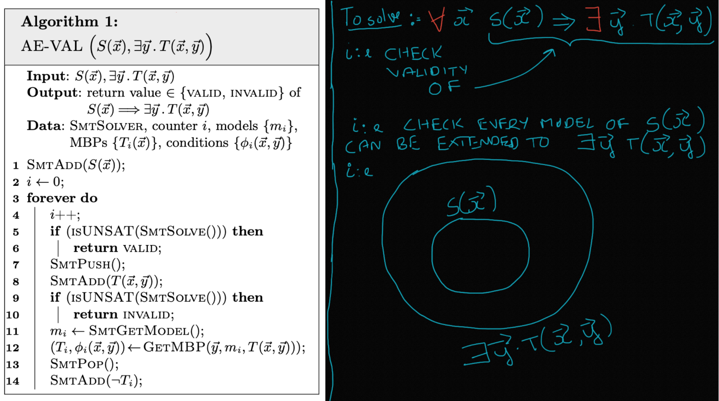
Intuition of AE-VAL algorithm:

Slide 28
AE-VAL: Deciding Validity of AE Formulae
∀x [ x<=2 => ∃y. (y = x + 1 and y <=5) ]

Slide 30
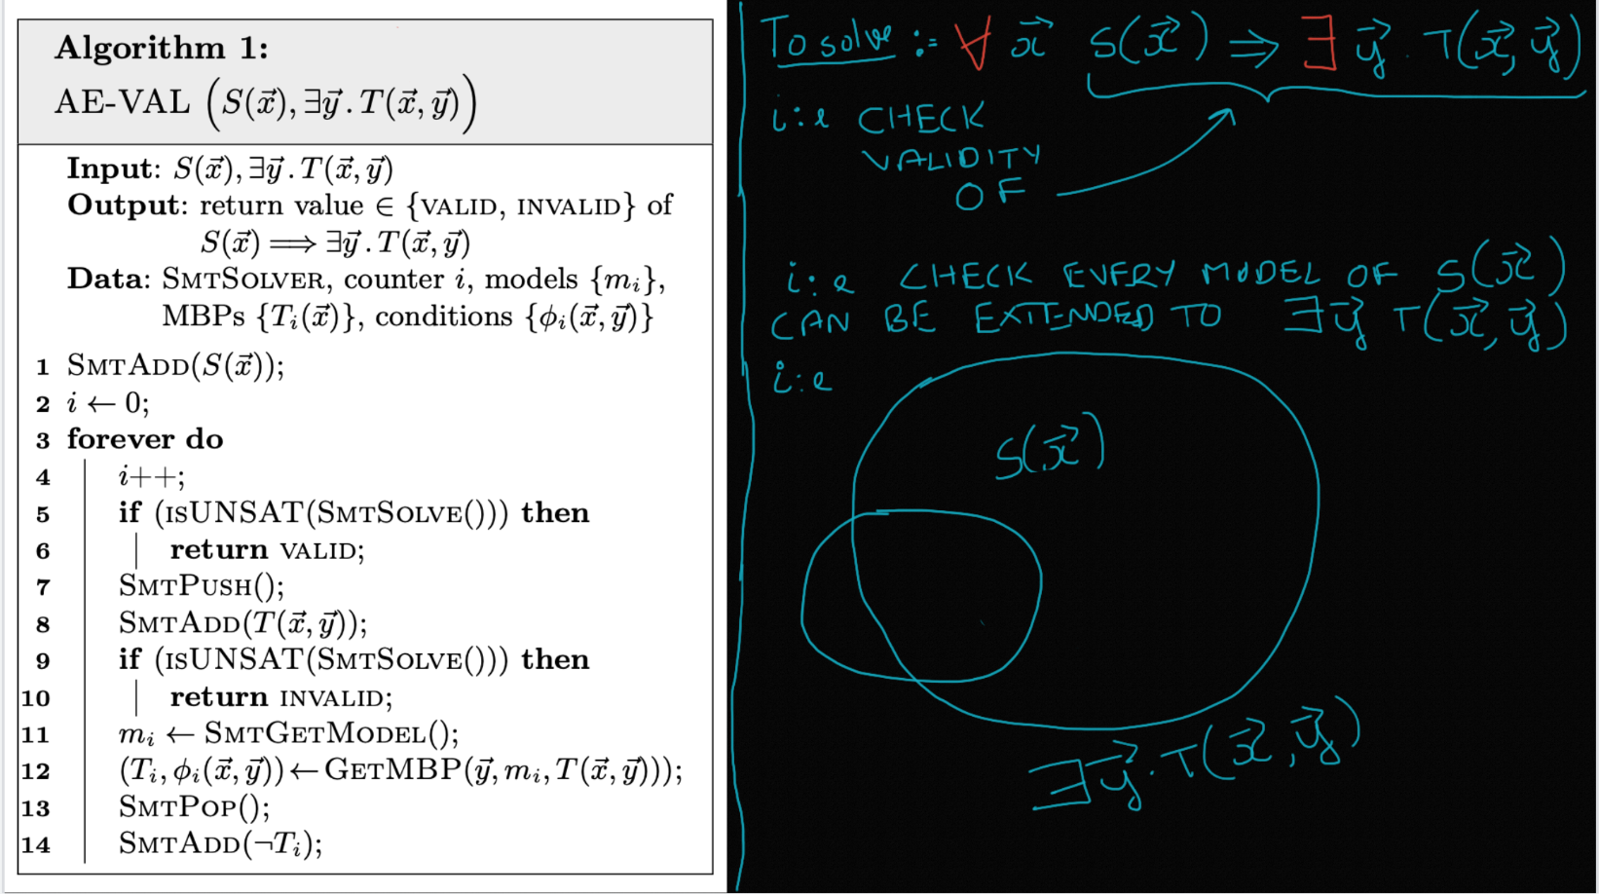

Slide 31
Model Based Projection (MBP) Intuition

Slide 32
Model Based Projection (MBP) Intuition
T(x,y) = (y = x + 1 and y <=5)

Slide 33
Loos Weispfenning Quantifier Elimination for Linear Rational Arithmetic:

Slide 34
Importance of
[(x<=2) and (x<=4)] => ∃y. (y = x + 1 and y <=5)

Slide 35
AE-VAL: Skolem Extraction
S(x) = (x<=2)
T₁(x) = (x<=4)
Φ₁(x,y) = (y=x+1)

Slide 36
AE-VAL: Skolem Extraction

Slide 37
AE-VAL: Correctness of Skolem Extraction

Slide 38
Program Synthesis:
Program Synthesis: Synthesizing a correct-by-construction program from a given declarative specification.
Two broad categories:
Functional Synthesis
Reactive Synthesis
Specification (What you want)
Synthesizer
Correct-by-construction program

Slide 39
Practical Motivation: Reactive Synthesis

Slide 40
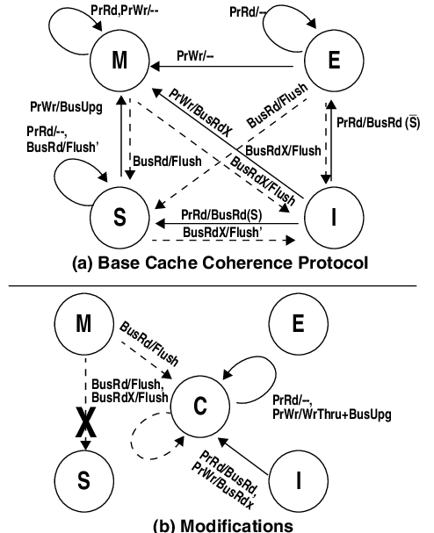
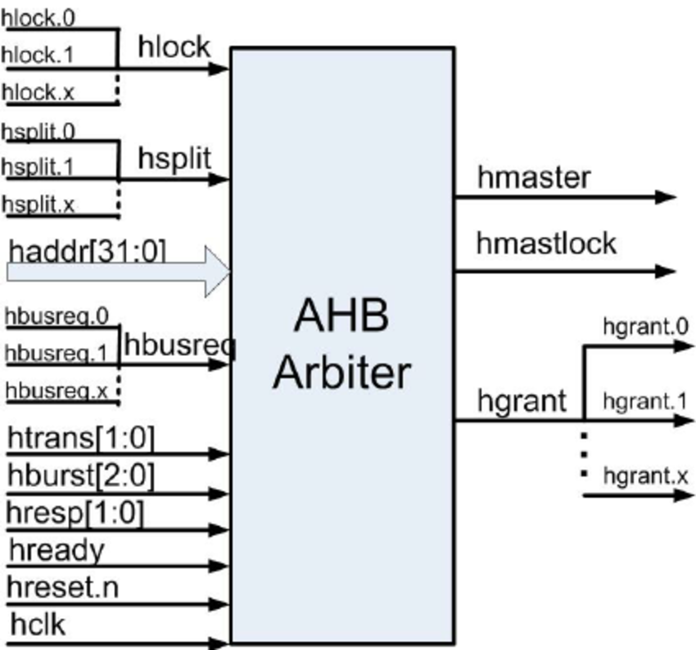
Practical Motivation: Reactive Synthesis
Finite state systems:
AMBA Bus Arbiter
Cache Coherence Protocols

Slide 41
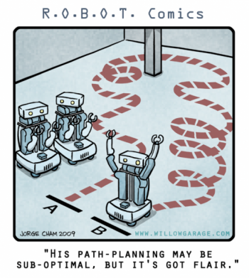
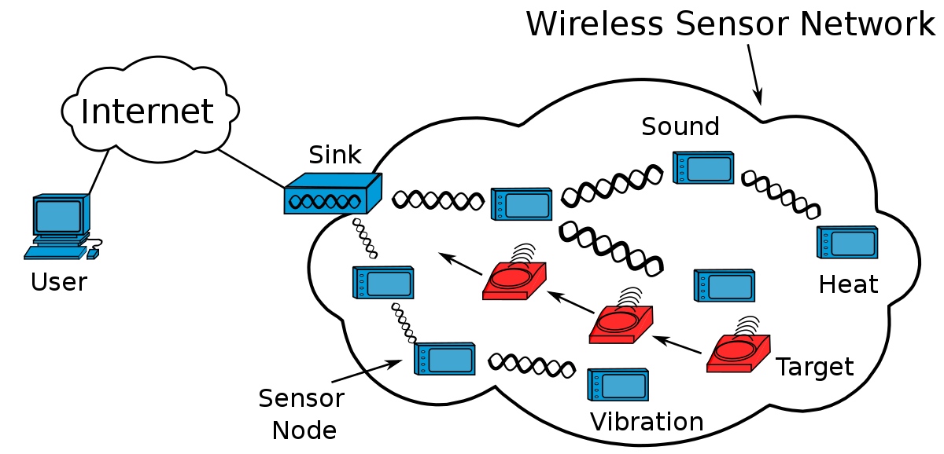
Practical Motivation: Reactive Synthesis
Infinite state systems:
Robot Motion Planning
Minimum Backlog Problem in Wireless Sensor Networks

Slide 42
A Two Player Infinite Game over an Infinite State Space
Controller
Environment
Game

Slide 43
A Two Player Infinite Game over an Infinite State Space
Controller
Environment
Game
State space: s

Slide 44
A Two Player Infinite Game over an Infinite State Space
Controller
Environment
Game
State space: s Safe region: G(s)

Slide 45
A Two Player Infinite Game over an Infinite State Space
Controller
Environment
Con(s,s’)
Env(s,s’)
Game
State space: s Safe region: G(s)

Slide 46
A Two Player Infinite Game over an Infinite State Space
Controller
Environment
Con(s,s’)
Env(s,s’)
Game
State space: s Safe region: G(s)
Play of the game:
s
s’
s’’
s’’’ …

Slide 47
A Two Player Infinite Game over an Infinite State Space
Controller
Environment
Con(s,s’)
Env(s,s’)
Goal:
Output:
Realizable / Unrealizable
Strategy, if Realizable
for Controller
Game
State space: s Safe region: G(s)
Play of the game:
s
s’
s’’
s’’’ …

Slide 48
Cinderella-Stepmother Game
Cinderella
Stepmother
Game

Slide 49
Cinderella-Stepmother Game
Cinderella
Stepmother
Con(s,s’)
Env(s,s’)
Game

Slide 50
Cinderella-Stepmother Game
Cinderella
Stepmother
Con(s,s’)
Env(s,s’)
Game
State space: s = {b1, b2, b3, b4, b5}

Slide 51
Cinderella-Stepmother Game
Cinderella
Stepmother
Con(s,s’)
Env(s,s’)
Game
State space: s = {b1, b2, b3, b4, b5}
“Empty any two adjacent buckets”
“Arbitrarily distribute one unit of water across the 5 buckets”

Slide 52
Cinderella-Stepmother Game
Cinderella
Stepmother
Con(s,s’)
Env(s,s’)
Game
State space: s = {b1, b2, b3, b4, b5}
Safe region: G(s) = {b1 <= C and ... b5 <= C}
“Empty any two adjacent buckets”
“Arbitrarily distribute one unit of water across the 5 buckets”

Slide 53
Cinderella-Stepmother Game
Cinderella
Stepmother
Con(s,s’)
Env(s,s’)
Game
State space: s = {b1, b2, b3, b4, b5}
Safe region: G(s) = {b1 <= C and ... b5 <= C}
“Empty any two adjacent buckets”
“Arbitrarily distribute one unit of water across the 5 buckets”
Wins for C >= 2.0
Wins for 0.0 <= C < 2.0

Slide 54
Cinderella-Stepmother Game
Cinderella
Stepmother
Con(s,s’)
Env(s,s’)
Game
State space: s = {b1, b2, b3, b4, b5}
Safe region: G(s) = {b1 <= C and ... b5 <= C}
“Empty any two adjacent buckets”
“Arbitrarily distribute one unit of water across the 5 buckets”
Wins for C >= 2.0
Wins for 0.0 <= C < 2.0
Challenging range: 1.5 < C < 2.0

Slide 55
Summary:
Model Based Projection (MBP) (Quantifier Elimination)
Solving AE using MBP
(Validity of AE Fragment of FOL and synthesizing a witness)
Application of AE solving to Synthesis:
Functional
Reactive

Slide 56
Summary:
Why A Formulae with UF and a background theory is hard
Why AE formulas without UF are hard to solve but still better that 1

