Slide 1
Program Synthesis meets Machine Learning
Lecture 1, Part (a)
Sriram Rajamani

Slide 2
Course logistics
2 lectures per week: Monday & Wednesday 3:30-5:00PM
Course instructors:
Chiranjib Bhattacharya, Deepak D’Souza, Sriram Rajamani
Teaching Assistants:
P. Habeeb and Rekha Pai
Grading
Assignments + Presentation (30%)
Mid-semester exam (30%)
Project and final (40%)

Slide 3
Rough Timeline
January – Mid February. Foundations (~6-7 weeks)
Course overview (Sriram)
Constraint based methods for synthesis(Sriram)
Enumerative techniques for synthesis (Deepak)
Black box learning (Deepak)
Machine learning background for synthesis (Chiranjib)
(includes graded assignments)
Mid-late February: Mid-semester exam
Mid-February – Late March:
Research paper presentations by students (~5 weeks)
March – April 15: Course project, with final project presentations in April

Slide 4
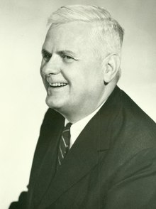
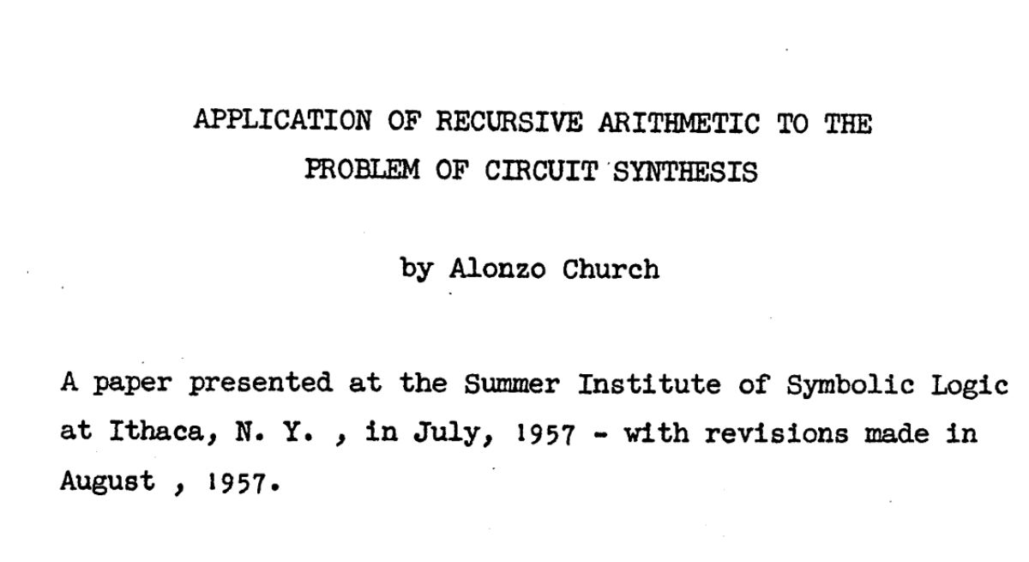
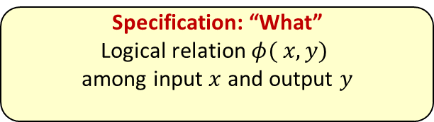
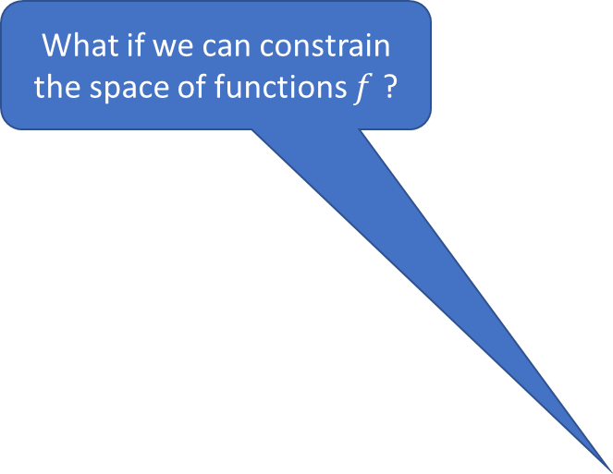
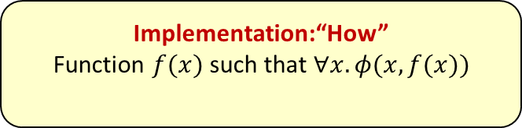

What if we can constrain the space of functions $f$ ?
Specification: “What”
Logical relation $φ( x,y)$
among input $x$ and output $y$
Synthesizer
Constructive proof of
$∃f. ∀x$ $φ(x,f(x))$
Implementation:“How”
Function $f(x)$such that $∀x. φ(x,f(x))$
Solutions provided by Buchi and Landweber (1969) and M O Rabin (1972), first based on specifications in Monadic Second Order Logics (non elementary complexity), then temporal logics (PSPACE or EXP Time) etc.
Largely of theoretical interest

Slide 5
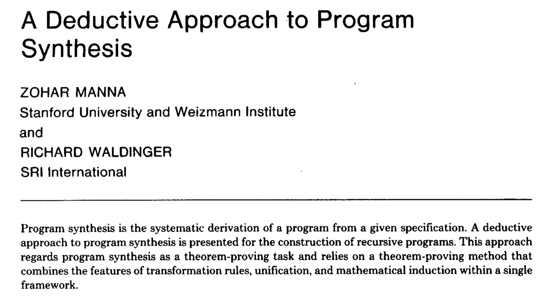
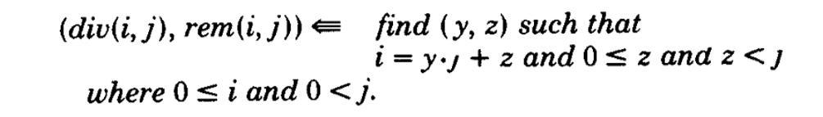
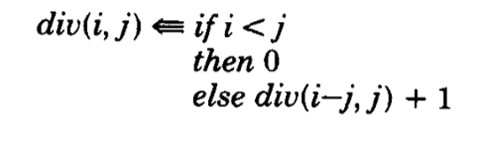
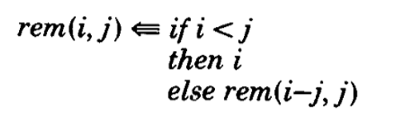
From TOPLAS 1980

Slide 6
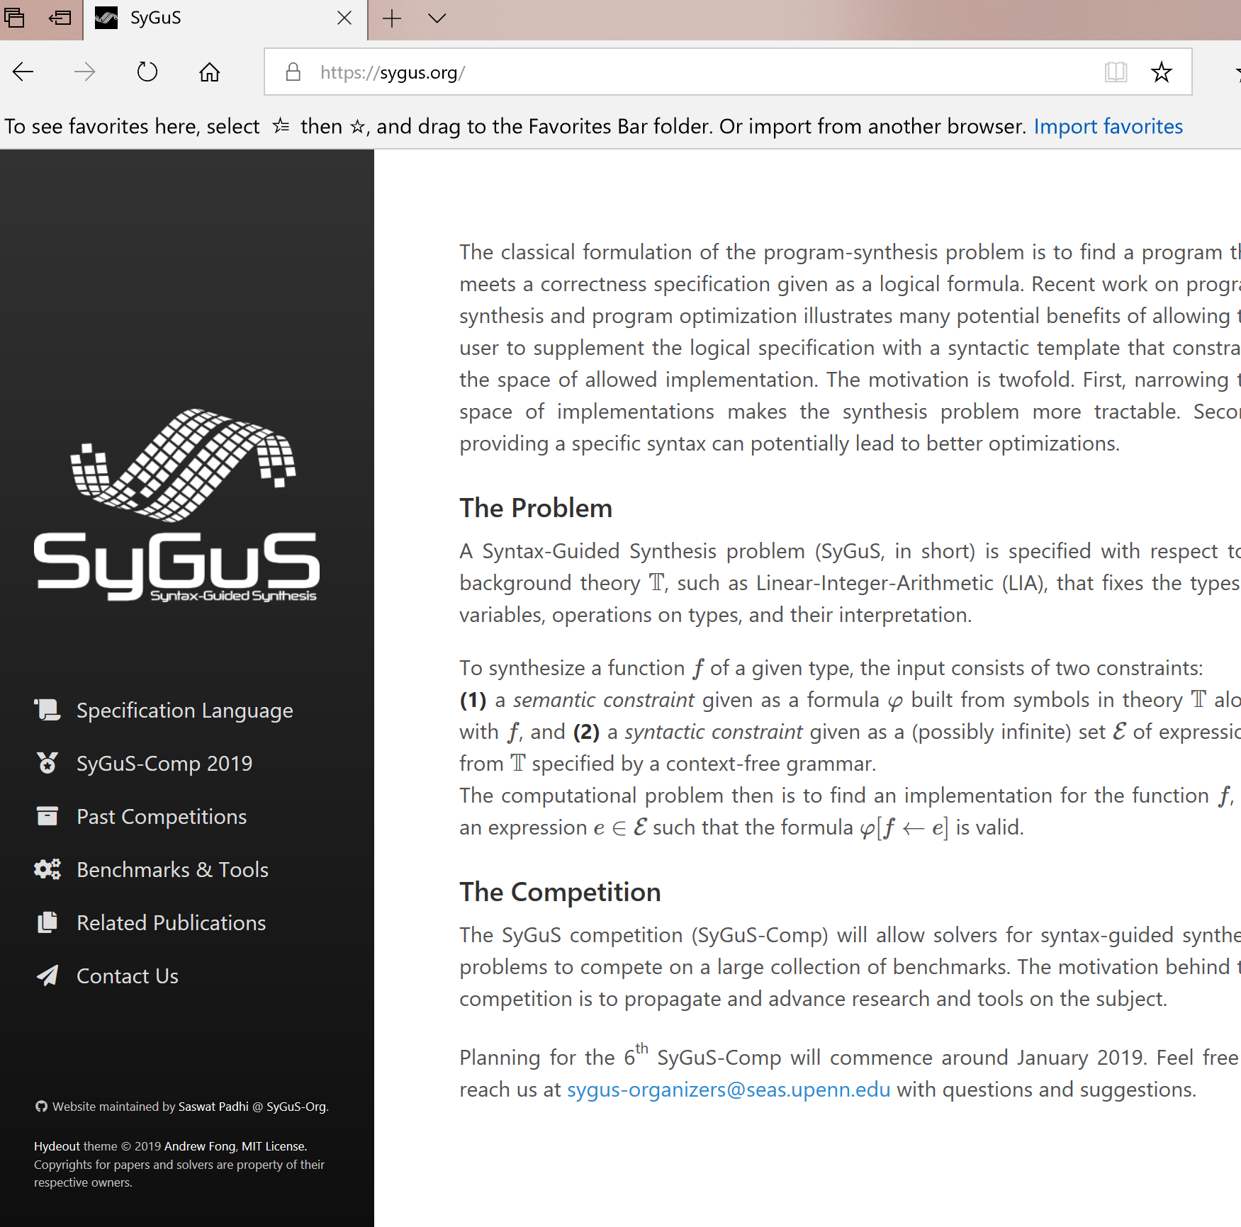
Modern synthesis
Constrain the space of functions using a template or a sketch [Bodik-Lezama 2008]
Flashfill and PROSE: Specify using input-output examples, and search for solutions using clever enumeration over all programs in a DSL [Gulwani 2011, Gulwani-Polozov 2015]

Slide 7

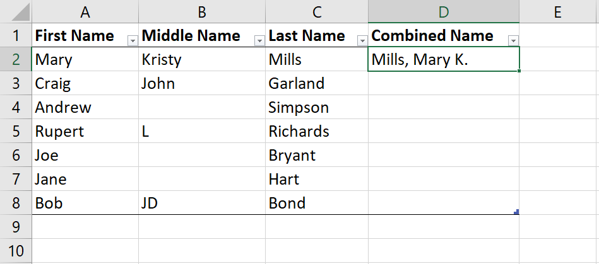
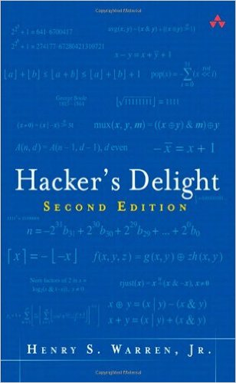
Examples
Desired program P: bit-vector transformation that resets rightmost substring of contiguous 1’s to 0’s:
1. P should be constructed from standard bit-vector operations
|, &, ~, +, -, <<, >>, 0, 1, …
2. P specified using input-output examples
00101 → 00100
01010 → 01000
10110 → 10000
Desired solution:
x & ( 1 + (x | (x-1 )))
if (input[1] == ‘’) then Concat(input[2], Const(“, ”), input[0], Const(“.”)) else Concat(input[2], Const(“, ”), input[0], Const(“ ”), let v = input[1] in Substring(v, AbsPos(v, 0), RegexPos(v, UpperCase, ‘’, -1)), Const(“.”))

Slide 8
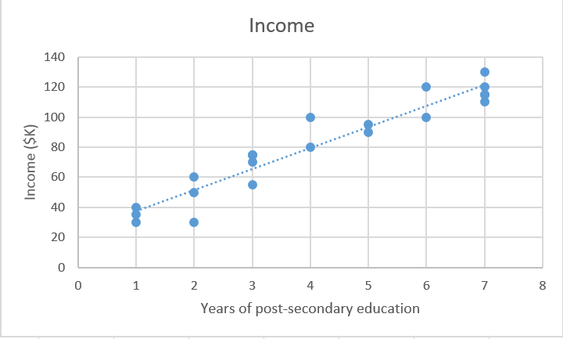
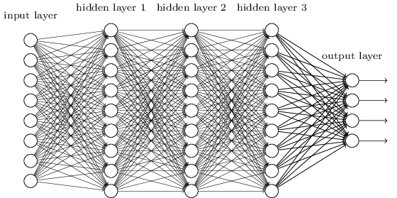
Supervised learning has similar goals, but different perspective
Specifications: Loss functions
“DSL”: Model schema with parameters to learn
Search technique: Continuous optimization methods (e.g. Gradient descent)

Slide 9
Program Synthesis
Machine Learning
Specification: Logical formulas, small number of homogeneous examples, Domain Specific Language (DSLs)
Search Algorithm: Combinatorial search
Output: Program which satisfies specification
Characteristics:
Synthesized program is interpretable, expressiveness configurable using DSL
Has difficulty handling noisy data
Specification: Large amount of training data, loss function, model schema
Search Algorithm: Optimization (e.g., gradient descent)
Output: Function which minimizes loss
Characteristics:
Successful ML methods produce functions that are not interpretable
Robust to noise, generalization
Can we combine the strengths of the two approaches?
What problems can we solve by such a combination?

Slide 10
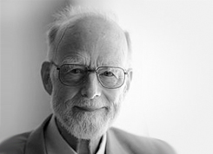
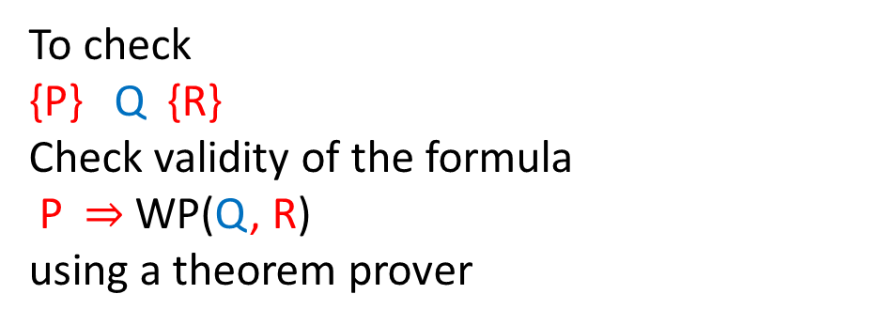
Program Verification
{true}
max = -MAXINT;
i = 0;
while (i < N) {
if( a[i] > max) max = a[i];
i = i+1;
}
{∀ 0≤ 𝑗< 𝑁. 𝑎[𝑗]≤ max⁡}
A “Hoare triple” is a formula of the form
{P} Q {R} where
P and R are predicates
Q is a program statement
Meaning: If we start the program at a state satisfying P, and run the statement Q, the statement terminates and results in a state satisfying R
To check
{P} Q {R}
Check validity of the formula
P $⇒$WP(Q, R)
using a theorem prover

Slide 11
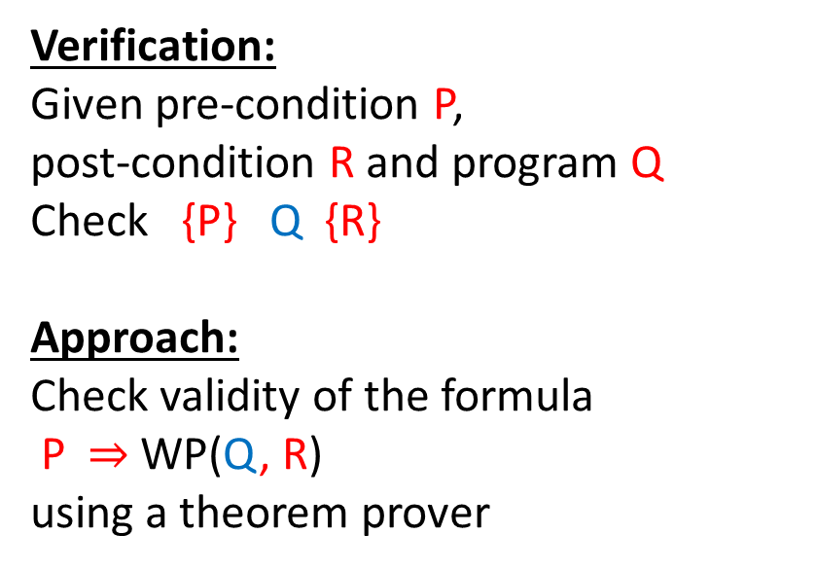
Synthesis is the “inverse” of verification
Verification:
Given pre-condition P,
post-condition R and program Q
Check {P} Q {R}
Approach:
Check validity of the formula
P $⇒$WP(Q, R)
using a theorem prover
Synthesis:
Given pre-condition P,
post-condition R, synthesize a program program Q such that
{P} Q {R}
Sketching:
Given pre-condition P,
post-condition R, a partial program Q with “holes”, synthesize a completion C of holes such that
{P} Q[C] {R}

Slide 12
Tutorial introduction to synthesis using Sketch
Sketch is a constraint-based synthesis system developed by Armando Solar Lezama
Download from: https://people.csail.mit.edu/asolar/

Slide 13
Synthesizing a constant (1)
void doublesketch (int x)/*double.sk:1*/
{
assert ((x * 2) == (x + x)); //Assert at double.sk:3 (2)
}
/*double.sk:1*/
harness void doublesketch(int x)
{
int t = x * ??;
assert t == x + x;
}

Slide 14
Synthesizing a constant (2)
harness void doublesketch (bit[8] x){
bit[8] t = (x << ?? );
assert t == x + x;
}
void doublesketch (bit[8] x)/*double-ls.sk:1*/
{
assert ((x << 1) == (x + x)); //Assert at double-ls.sk:3 (2)
}
/*double-ls.sk:1*/

Slide 15
Least zero-bit
(~(x + 0) & (x + 1))
Problem:
Detect the least significant bit in a word with 0 value, and mark that bit as 1 in the output, and reset all other bits to 0.
Do this with a program of the form:
~(x + K1) & (x + K2)
Examples:
00010111 → 00001000
00010110 → 00000001
11111111 → 00000000
int W = 32;
bit[W] least_sig0(bit[W] x){
return (~(x + ??) & (x + ??));
}
bit[W] simple_least_sig0(bit[W] x){
bit[W] ret = 0;
for (int i = 0; i < W; i++){
if (!x[i]) { ret[i] = 1; return ret;}
}
return ret; }
harness void main(bit[W] x){
assert least_sig0(x) == simple_least_sig0(x);
}

Slide 16
Least one-bit
(~(x + 0xFFFFFFFF) & (x +0))
Problem:
Detect the least significant bit in a word with 1 value, and mark that bit as 1 in the output, and reset all other bits to 0.
Do this with a program of the form:
~(x + K1) & (x + K2)
Examples:
00010111 → 00000001
00010110 → 00000010
00000000 → 00000000
int W = 32;
bit[W] least_sig0(bit[W] x){
return (~(x + ??) & (x + ??));
}
bit[W] simple_least_sig0(bit[W] x){
bit[W] ret = 0;
for (int i = 0; i < W; i++){
if (x[i]) { ret[i] = 1; return ret;}
}
return ret; }
harness void main(bit[W] x){
assert least_sig0(x) == simple_least_sig0(x);
}

Slide 17
Swapping
x = x^y
y = x^y
x = x^y
Problem:
Swap two inputs with a sequence of assignments using “exor” and no temporary variables.
That is, using a program of the form
x = x ^ y
y = x ^ y
..
With 3 assignment statements
int W = 32;
void swap(ref bit[W] x, ref bit[W] y){
if(??){ x = x ^ y; }else{ y = x ^ y; }
if(??){ x = x ^ y; }else{ y = x ^ y; }
if(??){ x = x ^ y; }else{ y = x ^ y; }
}
harness void main(bit[W] x, bit[W] y){
bit[W] xold = x, yold = y;
swap(x,y);
assert y == xold && x == yold;
}

Slide 18
Homework (1)
Desired program P: bit-vector transformation that resets rightmost 1 to 0:
1. P should be constructed from standard bit-vector operations
|, &, ~, +, -, <<, >>, 0, 1, …
2. P specified using input-output examples
00101 → 00100
01010 → 01000
10110 → 10100
Homework:
Synthesize a solution to this problem using Sketch

Slide 19
Homework (2)
Desired program P: bit-vector transformation that resets rightmost substring of contiguous 1’s to 0’s:
1. P should be constructed from standard bit-vector operations
|, &, ~, +, -, <<, >>, 0, 1, …
2. P specified using input-output examples
00101 → 00100
01010 → 01000
10110 → 10000
Desired solution:
x & ( 1 + (x | (x-1 )))
Homework:
Synthesize a solution to this problem using Sketch

Slide 20
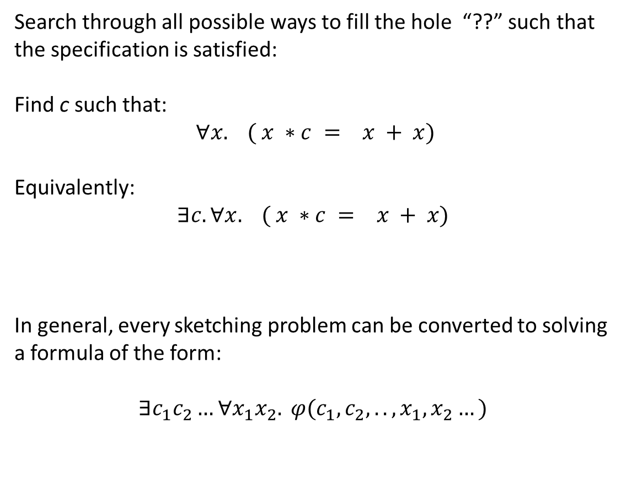
How does Sketch work?
Search through all possible ways to fill the hole “??” such that the specification is satisfied:
Find c such that:
$$∀x. ( x ∗c = x + x)$$
Equivalently:
$$∃c. ∀x. ( x ∗c = x + x)$$
In general, every sketching problem can be converted to solving a formula of the form:
$$∃c_{1}c_{2}…∀x_{1}x_{2}. φ(c_{1},c_{2}, .., x_{1},x_{2}…)$$
harness void doublesketch(int x)
{
int t = x * ??;
assert t == x + x;
}

Slide 21
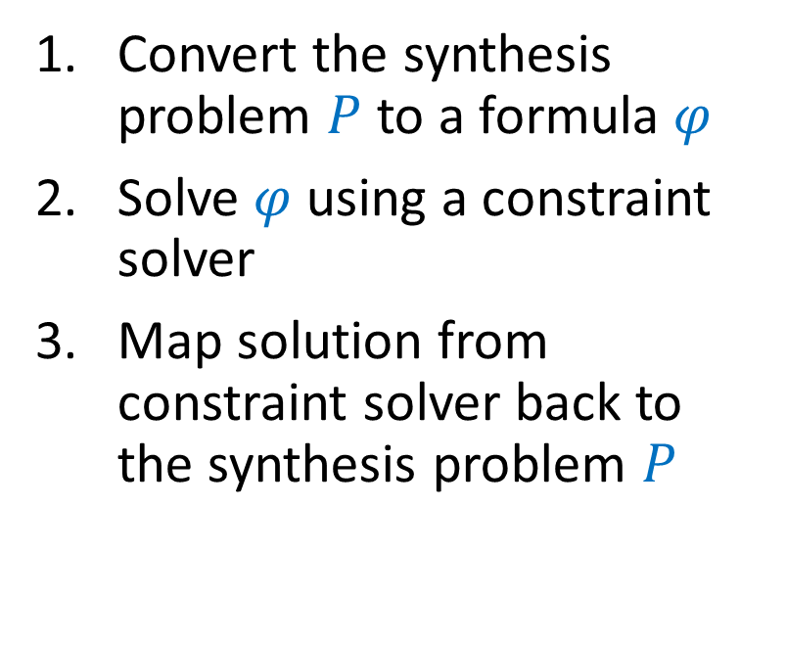
Recipe for Constraint based synthesis
Convert the synthesis problem $P$ to a formula $φ$
Solve $φ$ using a constraint solver
Map solution from constraint solver back to the synthesis problem $P$
Types of constraint solvers:
SAT Solvers (Boolean Satisfiability)
SMT Solvers (Satisfiability Modulo Theories)
Solvers for Quantified Formulas (QBF or CEGIS solvers)

