Slide 1
Hoare Logic: Bridging Programs and Formulas
Lecture 1, part (b)
Sriram Rajamani

Slide 2
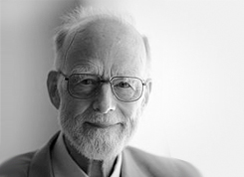
A “Hoare triple” is a formula of the form
{P} Q {R} where
P and R are predicates
Q is a program statement
Partial correctness: If we start the program at a state satisfying P, and run the statement Q, and the execution of Q terminates, the resulting state satisfies the predicate R
Total correctness: If we start the program at a state satisfying P, and run the statement Q, the execution of Q terminates and the resulting state satisfies the predicate R

Slide 3
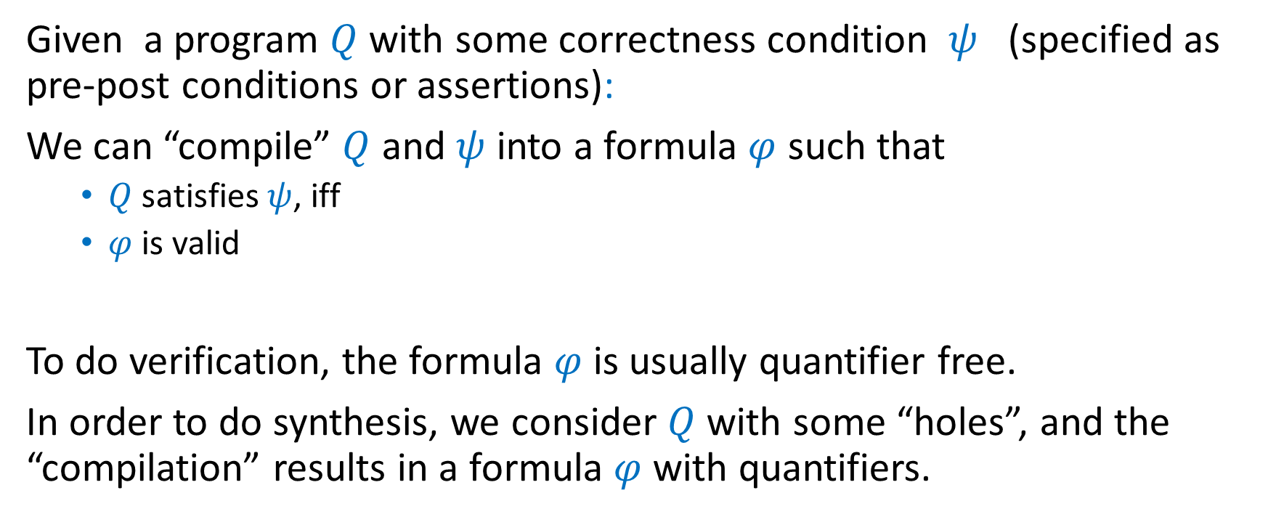
Verification and synthesis using Hoare Logic
Given a program $Q$ with some correctness condition $ψ$ (specified as pre-post conditions or assertions):
We can “compile” $Q$ and $ψ$ into a formula $φ$ such that
$Q$ satisfies $ψ$, iff
$φ$ is valid
To do verification, the formula $φ$ is usually quantifier free.
In order to do synthesis, we consider $Q$ with some “holes”, and the “compilation” results in a formula $φ$with quantifiers.

Slide 4
Hoare Logic
A logical system that connects imperative programs to formulas
Basis of all conversions between programs and formulas, as well as for mixing programs and formulas

Slide 5
Example (1)
{true}
max = -MAXINT;
i = 0;
while (i < N) {
if( a[i] > max) max = a[i];
i = i+1;
}
{∀j 0≤ 𝑗< 𝑁. 𝑎[𝑗]≤ max⁡}

Slide 6
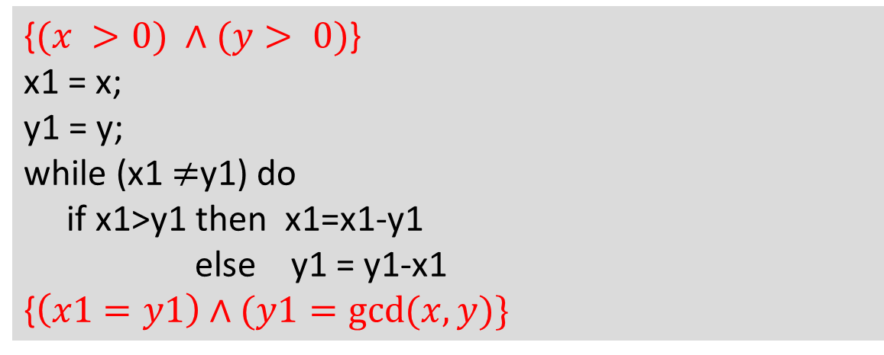
Example (2)
{$(x >0) ∧(y> 0)$}
x1 = x;
y1 = y;
while (x1$≠$y1) do
if x1>y1 then x1=x1-y1
else y1 = y1-x1
{⁡$\left(x1=y1\right)∧(y1=\gcd{(x,y})\}$

Slide 7
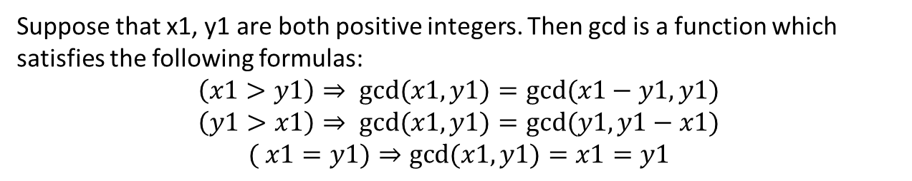
Example (2)
{$(x >0) ∧(y> 0)$}
x1 = x;
y1 = y;
while (x1$≠$y1) do
if x1>y1 then x1=x1-y1
else y1 = y1-x1
{⁡$\left(x1=y1\right)∧(y1=\gcd{(x,y})\}$
Suppose that x1, y1 are both positive integers. Then gcd is a function which satisfies the following formulas:
$$\left(x1>y1\right)⇒ gcd⁡(x1,y1)=gcd⁡(x1−y1,y1)$$
$$\left(y1>x1\right)⇒ gcd⁡(x1,y1)=gcd⁡(y1,y1−x1)$$
$$( x1=y1)⇒gcd⁡(x1,y1)=x1=y1$$

Slide 8
Proof rules for Hoare logic
A recipe of rules
We will first go through the rules and do manual proofs
Then we will look at automation

Slide 9

Assignment rule
$\{p[y←t]\} y =t \{p\}$
Examples
{y+5=10} y=y+5 {y=10}
{y+y<z} x =y {x+y<z}
{2*(y+5)>20} y =2*(y+5) {y>20}

Slide 10
Sequential Composition

Slide 11






Sequential Composition

Slide 12
Sequential Composition
Show:
{x+1=y+2} x:=x+1; y:=y+2 {x=y}

Slide 13








Conditional Composition

Slide 14














Conditional Composition

Slide 15




























Two more rules

Slide 16
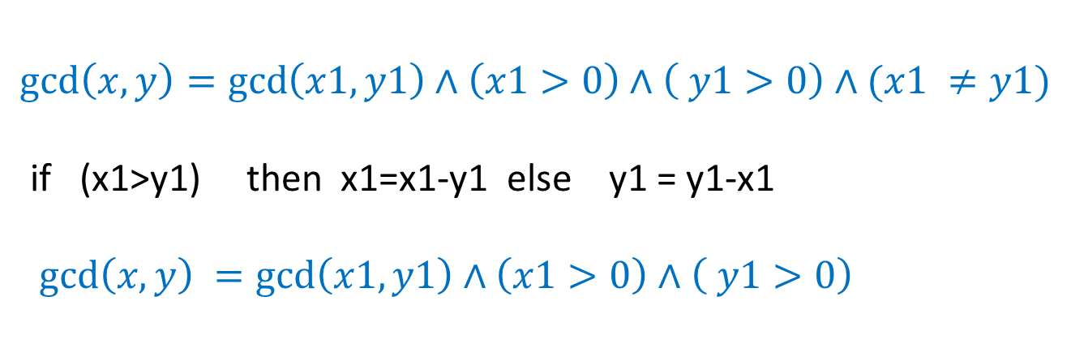

Conditional Composition
$$\gcd\left(x,y\right)=\gcd\left(x1,y1\right)∧\left(x1>0\right)∧\left( y1>0\right)∧(x1 ≠y1)$$
if (x1>y1) then x1=x1-y1 else y1 = y1-x1
$$\gcd\left(x,y\right) =\gcd\left(x1,y1\right)∧\left(x1>0\right)∧\left( y1>0\right)$$

Slide 17





Rule for while loop

Slide 18

Rule for while loop

Slide 19
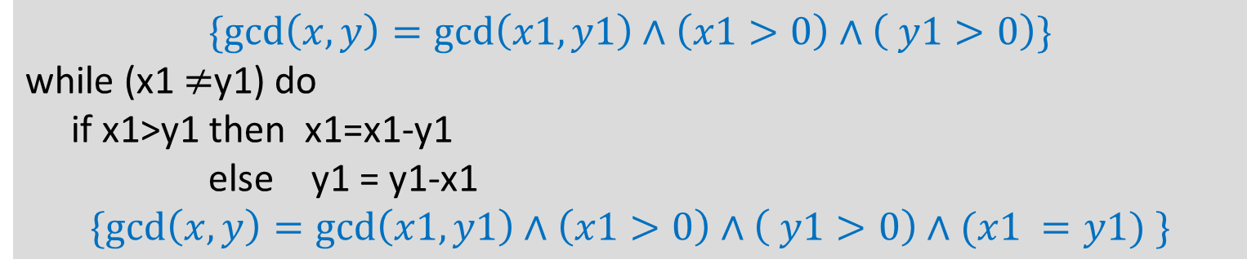
Rule for while loop
$$\{gcd\left(x,y\right)=\gcd\left(x1,y1\right)∧\left(x1>0\right)∧\left( y1>0\right)\}$$
while (x1$≠$y1) do
if x1>y1 then x1=x1-y1
else y1 = y1-x1
$$\{gcd\left(x,y\right)=\gcd\left(x1,y1\right)∧\left(x1>0\right)∧\left( y1>0\right)∧(x1 =y1) \}$$

Slide 20
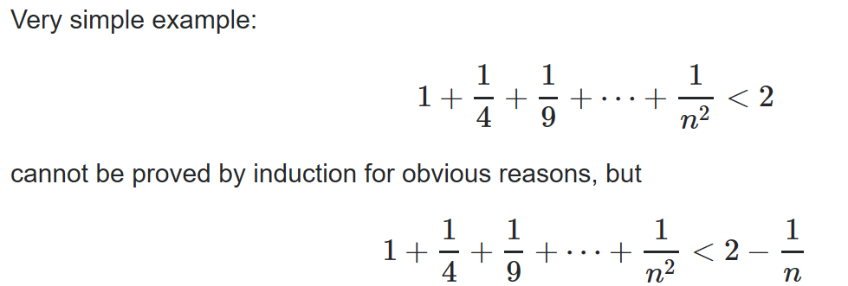
Connection to mathematical induction
In many cases the loop invariant needs to be stronger than the postcondition of the loop.
This is similar to proof by induction, when in some cases the induction hypothesis needs to be stronger than the desired conclusion

Slide 21
Can you now prove?
{$(x >0) ∧(y> 0)$}
x1 = x;
y1 = y;
while (x1$≠$y1) do
if x1>y1 then x1=x1-y1
else y1 = y1-x1
{⁡$\left(x1=y1\right)∧(y1=\gcd{(x,y})\}$

Slide 22
Can you prove?
{true}
max = -MAXINT;
i = 0;
while (i < N) {
if( a[i] > max) max = a[i];
i = i+1;
}
{∀j 0≤ 𝑗< 𝑁. 𝑎[𝑗]≤ max⁡}

Slide 23
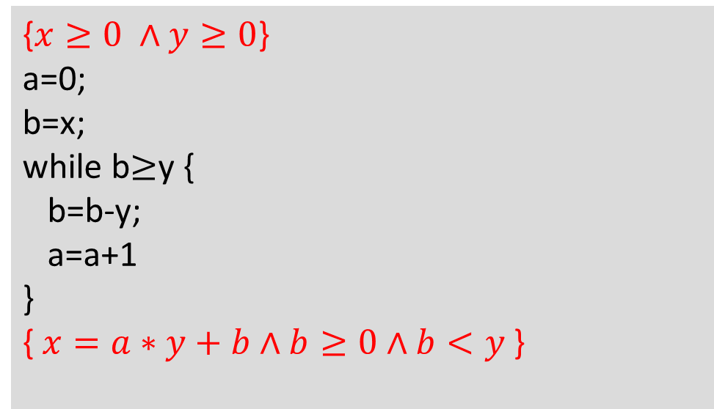
Homework: Prove the following
{$x≥0 ∧y≥0$}
a=0;
b=x;
while b$≥$y {
b=b-y;
a=a+1
}
{ $x=a∗y+b∧b≥0∧b<y$⁡}

Slide 24
Partial vs total correctness
We covered only partial correctness. Total correctness can also be proved with Hoare logic, but with an extra rule that reasons about a ranking function to prove termination.

Slide 25
Soundness and completeness
Every assertion proved by Hoare logic is correct. This is called “soundness”. Soundness follow from each of the rules (or axioms) of Hoare logic being correct.
However, not every correct assertion can be proved using Hoare logic. Hence, Hoare logic is incomplete.
Also note the connection to the halting problem. If we can prove {true} S {false}, then we know that S may not halt.

Slide 26
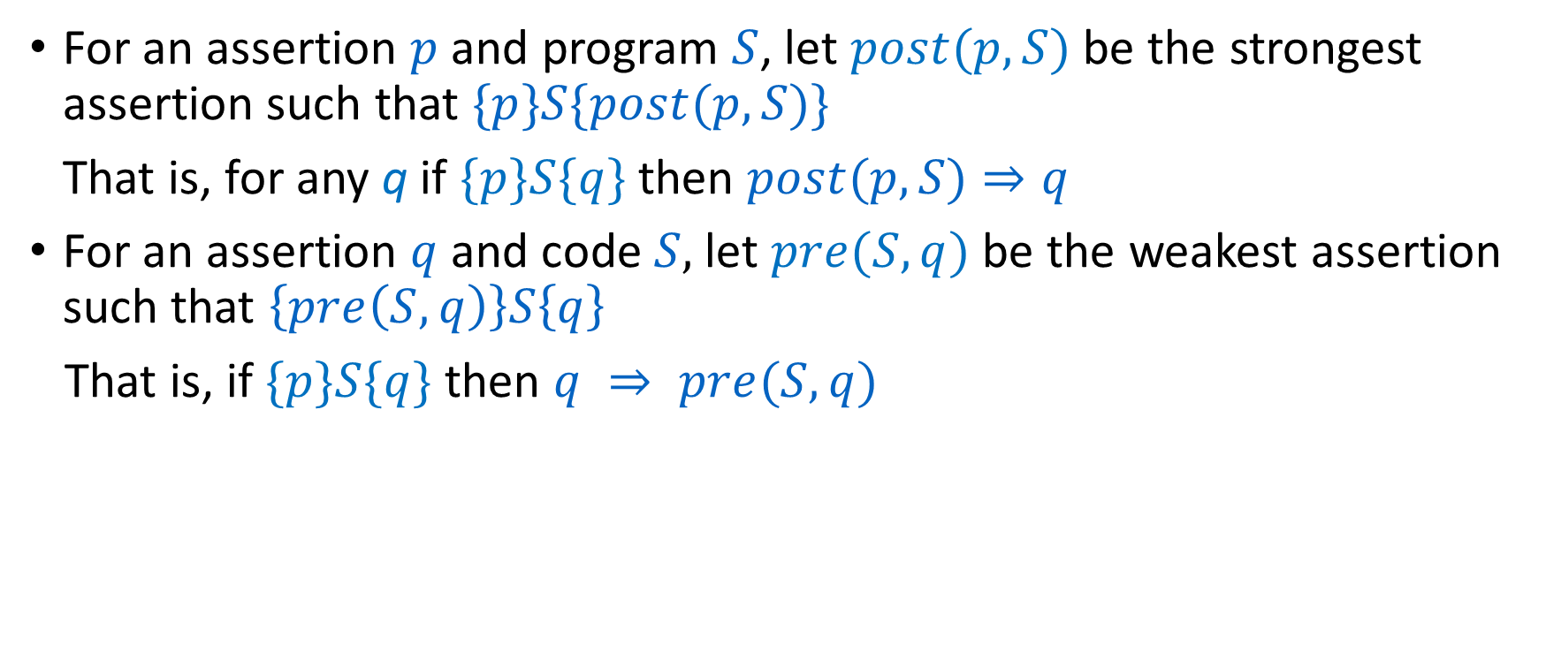
Weakest precondition, Strongest postcondition
For an assertion $p$ and program $S$, let $post(p,S)$ be the strongest assertion such that $\{p\}S\{post(p,S)\}$
That is, for any q if $\{p\}S\{q\}$ then $post(p,S)⇒q$
For an assertion $q$and code $S,$ let $pre(S,q)$ be the weakest assertion such that $\left\{pre\left(S,q\right)\right\}S\left\{q\right\}$
That is, if $\{p\}S\{q\}$ then $q ⇒ pre(S,q)$

Slide 27
Homework
Find out concrete algorithms to calculate strongest post conditions, weakest preconditions, and in general “verification condition generation”
Check out Boogie. https://www.microsoft.com/en-us/research/project/boogie-an-intermediate-verification-language/
Read the following paper on Sketch: Armando Solar-Lezama. 2013. Program sketching. Int. J. Softw. Tools Technol. Transf. 15, 5-6 (October 2013), 475-495. DOI: https://doi.org/10.1007/s10009-012-0249-7 Available at: https://core.ac.uk/download/pdf/78071595.pdf

