Slide 1
SAT Solvers
Lecture 2(a)
Sriram Rajamani
(some parts adapted from notes/slides by Emina Torlak, Vijay Ganesh and Leo De Moura)

Slide 2
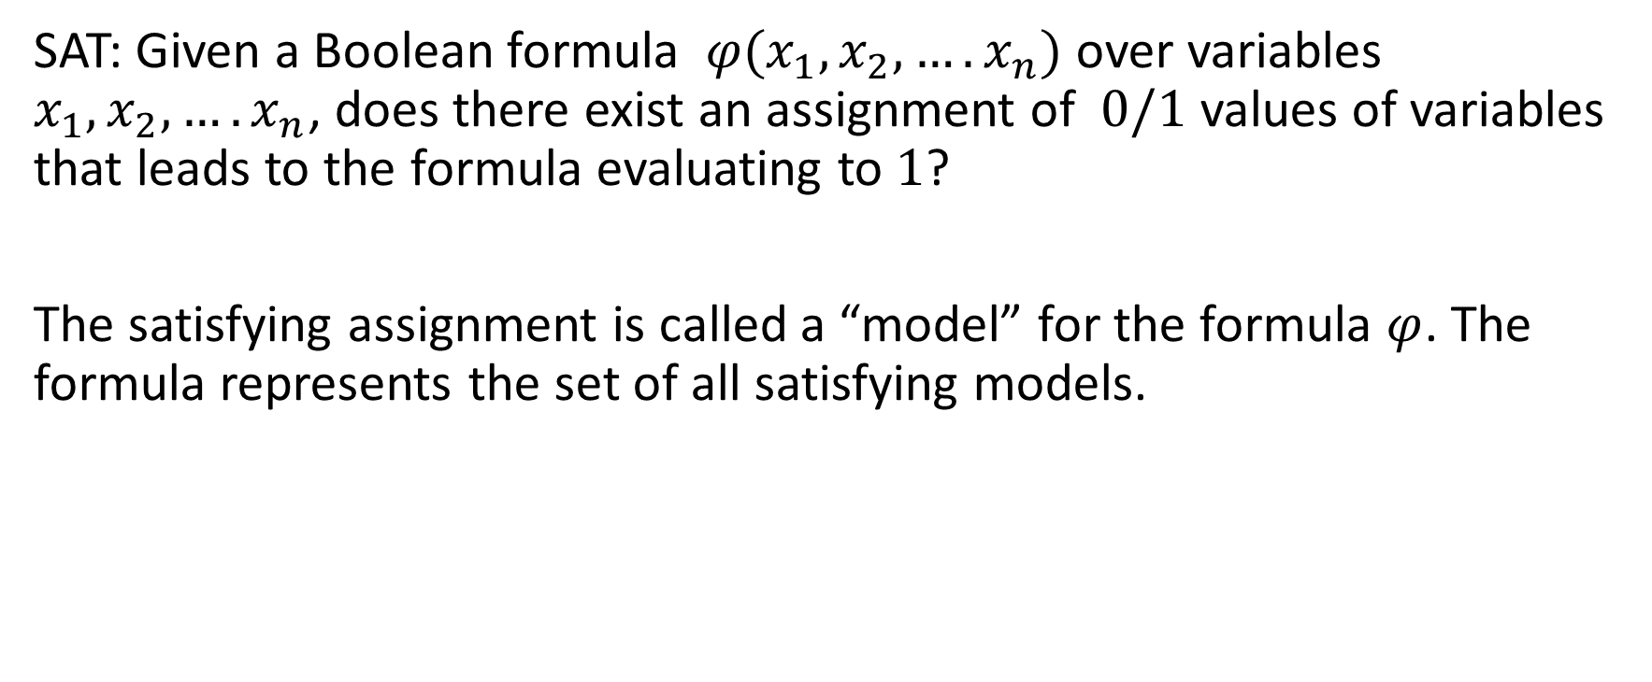
SAT solvers
SAT: Given a Boolean formula $φ(x_{1},x_{2},….x_{n})$ over variables $x_{1},x_{2},….x_{n}$, does there exist an assignment of $0/1$ values of variables that leads to the formula evaluating to $1$?
The satisfying assignment is called a “model” for the formula $φ$. The formula represents the set of all satisfying models.

Slide 3
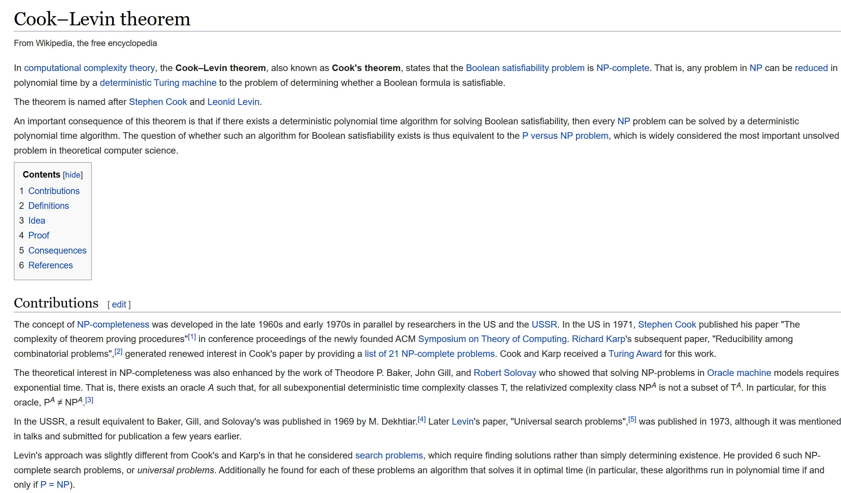

Slide 4
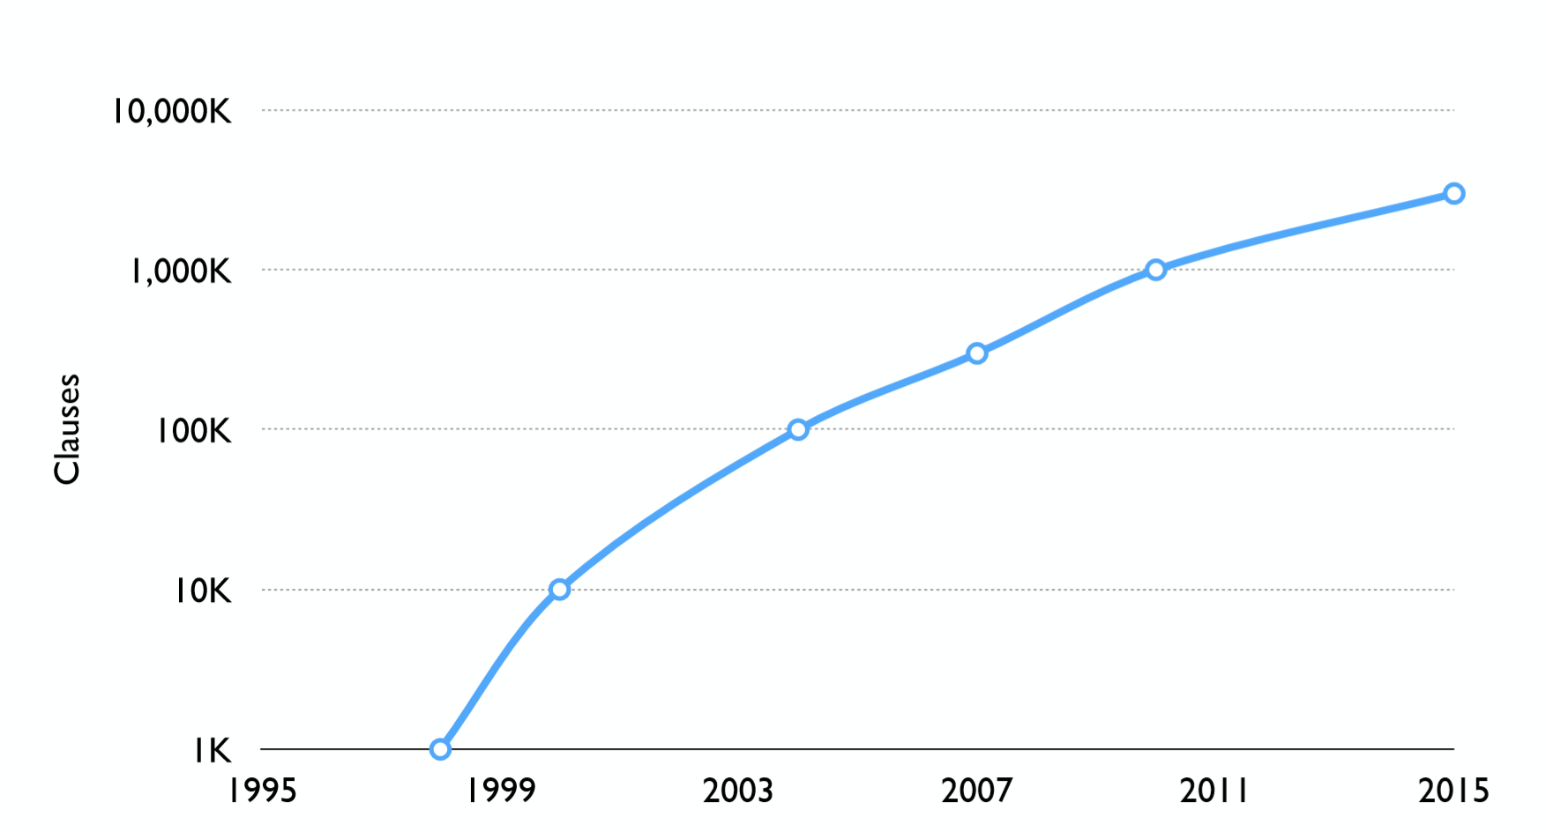
Practical progress in SAT solving
With attribution to Vijay Ganesh

Slide 5
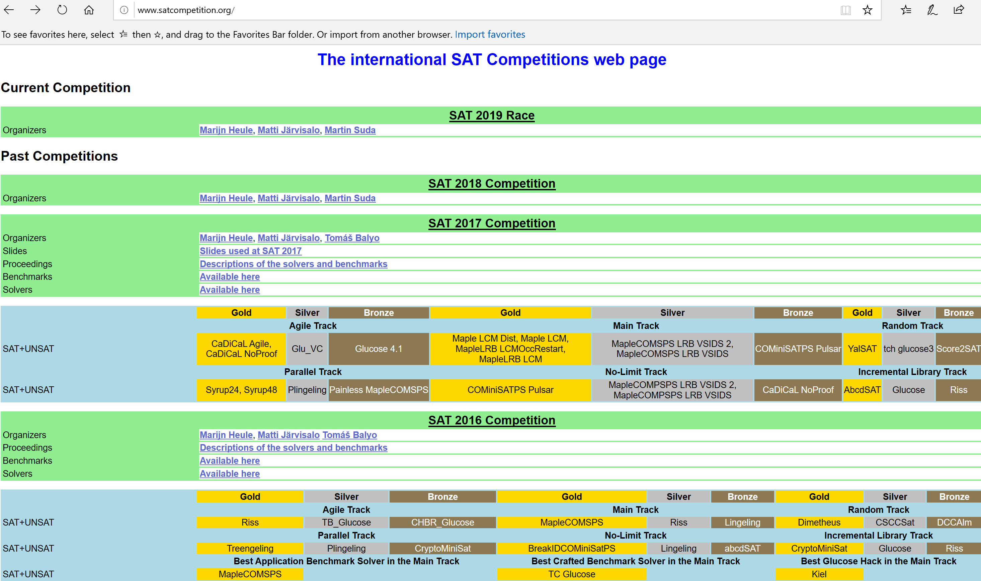

Slide 6
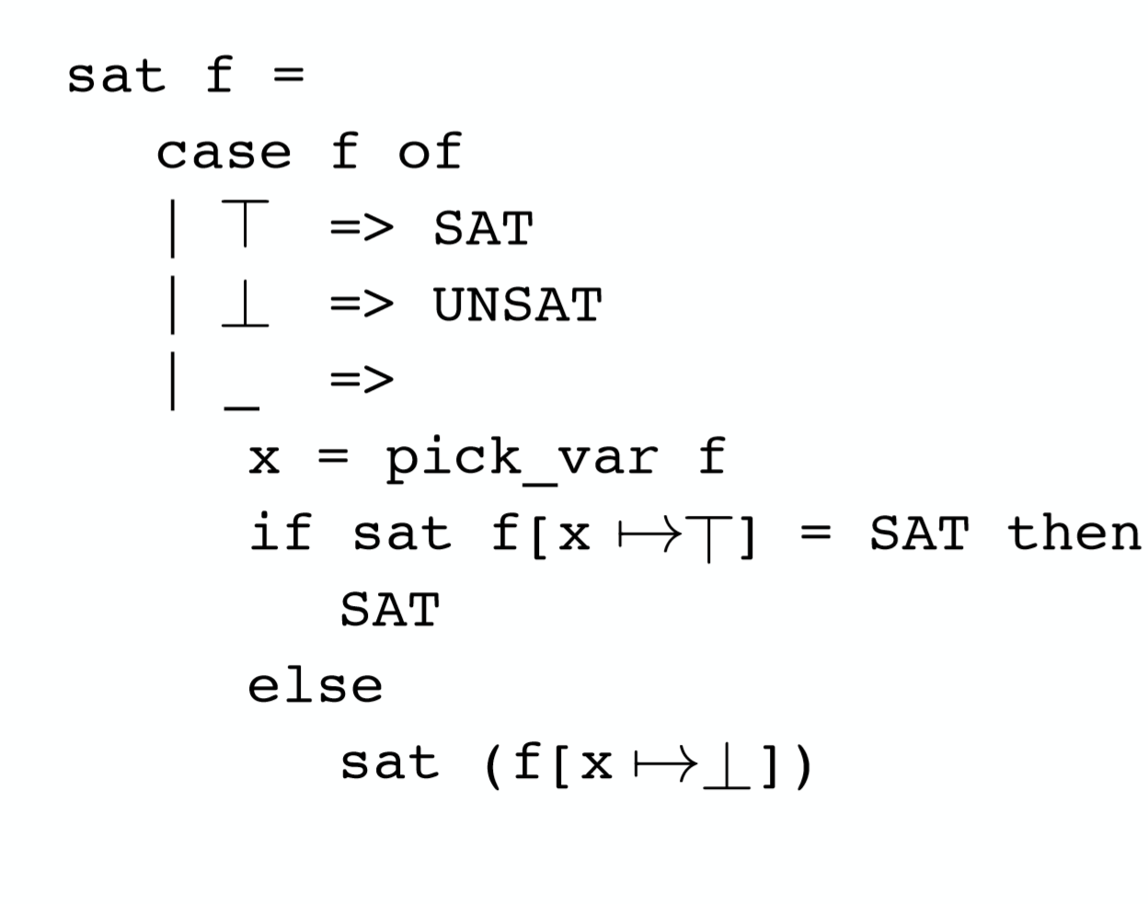
SAT solver – Take 1

Slide 7



SAT solver – Take 1
This is a simple algorithm, but does not work well in practice
Number of splitting decisions needed tends to be exponential on the number of variables
Modern SAT solvers do much better by using a few simple additional ideas

Slide 8
Modern SAT solvers
First convert a formula to CNF (Conjunctive Normal Form)
Use variant of DPLL (Davis Putnam Logeman Loveland procedure, from 1962, with a few new insights)

Slide 9

















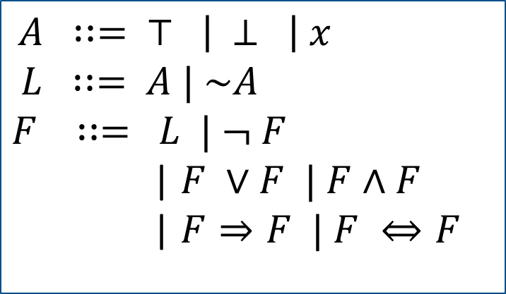







Syntax of SAT formulas
$A$ $∷=$ $⊤ \left| ⊥ \right| x$
$L$ $∷=$ $A | \sim A$
$F$ $∷=$ $L | ¬ F$
| $F ∨F | F∧F$ | $F⇒F | F ⇔F$

Slide 10



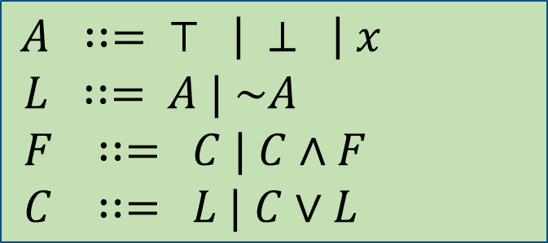

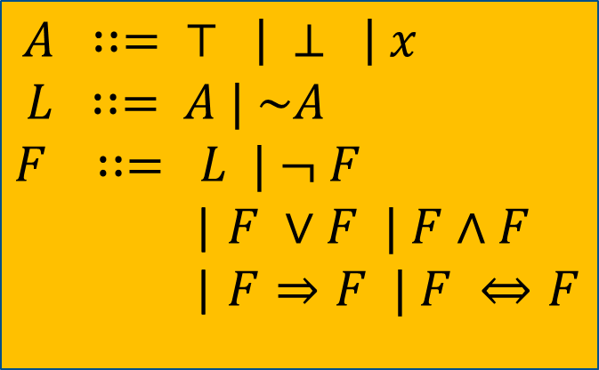

CNF: Conjunctive Normal Form
$A$ $∷=$ $⊤ \left| ⊥ \right| x$
$L$ $∷=$ $A | \sim A$
$F$ $∷=$ $L | ¬ F$
| $F ∨F | F∧F$ | $F⇒F | F ⇔F$
$A$ $∷=$ $⊤ \left| ⊥ \right| x$
$L$ $∷=$ $A | \sim A$
$F$ $∷=$ $C | C∧F$
$C$ $∷=$ $L | C∨L$

Slide 11


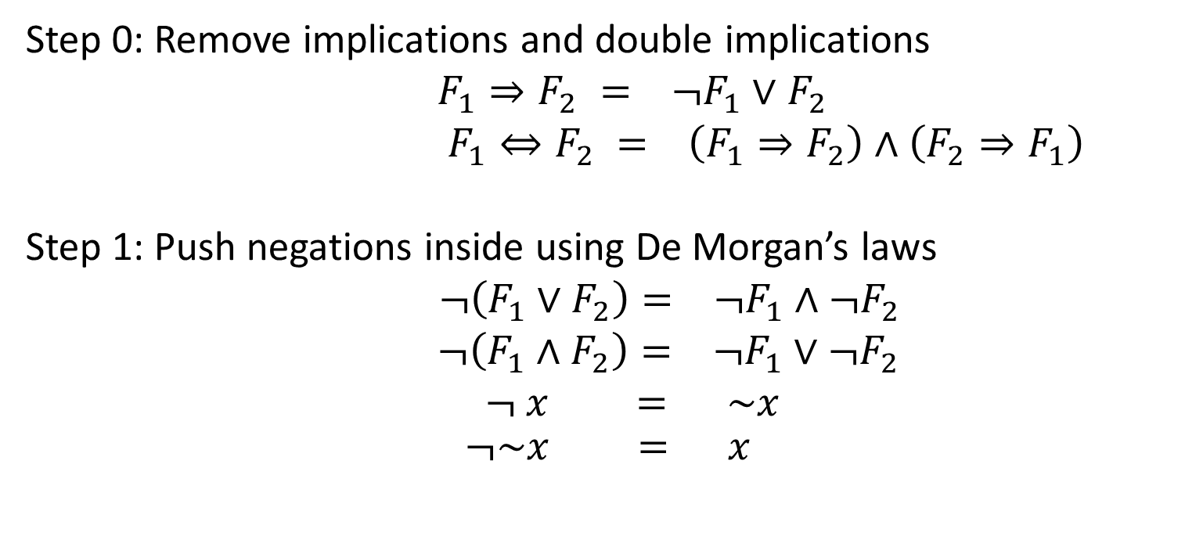


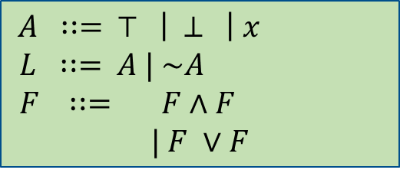
Converting formulas to NNF
$A$ $∷=$ $⊤ \left| ⊥ \right| x$
$L$ $∷=$ $A | \sim A$
$F$ $∷=$ $L | ¬ F$
| $F ∨F | F∧F$ | $F⇒F | F ⇔F$
Step 0: Remove implications and double implications
$F_{1}⇒F_{2} = ¬F_{1}∨F_{2}$
$F_{1}⇔F_{2} = \left(F_{1}⇒F_{2}\right)∧\left(F_{2}⇒F_{1}\right)$
Step 1: Push negations inside using De Morgan’s laws
$¬\left(F_{1}∨F_{2}\right)= ¬F_{1}∧¬F_{2}$
$¬\left(F_{1}∧F_{2}\right)= ¬F_{1}∨¬F_{2}$
$¬ x = \sim x$
$$¬\sim x = x$$
$A$ $∷=$ $⊤ \left| ⊥ \right| x$
$L$ $∷=$ $A | \sim A$
$F$ $∷=$ $F∧F$
$$| F ∨F$$

Slide 12



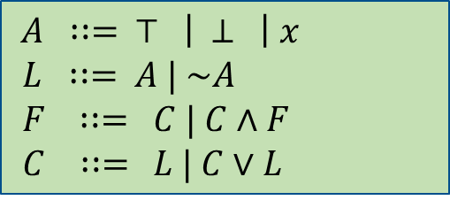

NNF to CNF
$A$ $∷=$ $⊤ \left| ⊥ \right| x$
$L$ $∷=$ $A | \sim A$
$F$ $∷=$ $F∧F$
$$| F ∨F$$
Main issue:
How to deal with disjunction of conjuncts, such as:
$\left(x_{1}∧x_{2}∧⋯∧x_{n}\right)∨(y_{1}∧y_{2}∧⋯∧y_{m})$
$A$ $∷=$ $⊤ \left| ⊥ \right| x$
$L$ $∷=$ $A | \sim A$
$F$ $∷=$ $C | C∧F$
$C$ $∷=$ $L | C∨L$

Slide 13
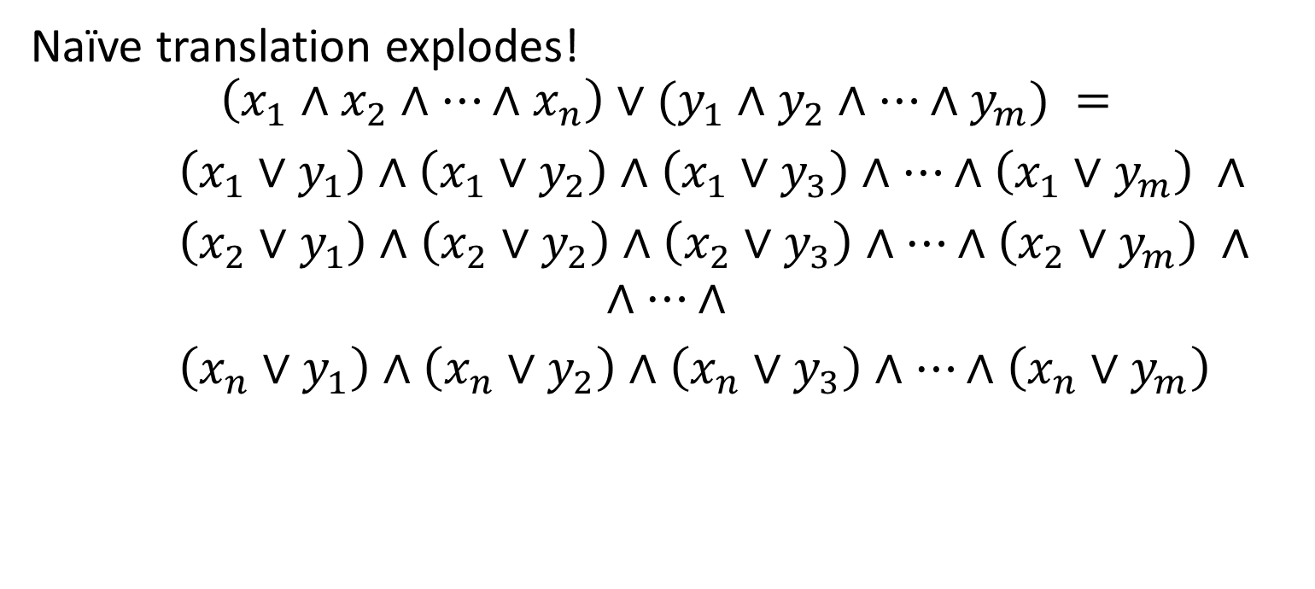
NNF to CNF
$A$ $∷=$ $⊤ \left| ⊥ \right| x$
$L$ $∷=$ $A | \sim A$
$F$ $∷=$ $F∧F$
$$| F ∨F$$
Naïve translation explodes!
$$\left(x_{1}∧x_{2}∧⋯∧x_{n}\right)∨(y_{1}∧y_{2}∧⋯∧y_{m}) =$$
$\left(x_{1}∨y_{1}\right)∧\left(x_{1}∨y_{2}\right)∧\left(x_{1}∨y_{3}\right)∧⋯∧\left(x_{1}∨y_{m}\right) ∧$
$\left(x_{2}∨y_{1}\right)∧\left(x_{2}∨y_{2}\right)∧\left(x_{2}∨y_{3}\right)∧⋯∧\left(x_{2}∨y_{m}\right) ∧$
$$∧⋯∧$$
$\left(x_{n}∨y_{1}\right)∧\left(x_{n}∨y_{2}\right)∧\left(x_{n}∨y_{3}\right)∧⋯∧\left(x_{n}∨y_{m}\right)$
$A$ $∷=$ $⊤ \left| ⊥ \right| x$
$L$ $∷=$ $A | \sim A$
$F$ $∷=$ $C | C∧F$
$C$ $∷=$ $L | C∨L$

Slide 14
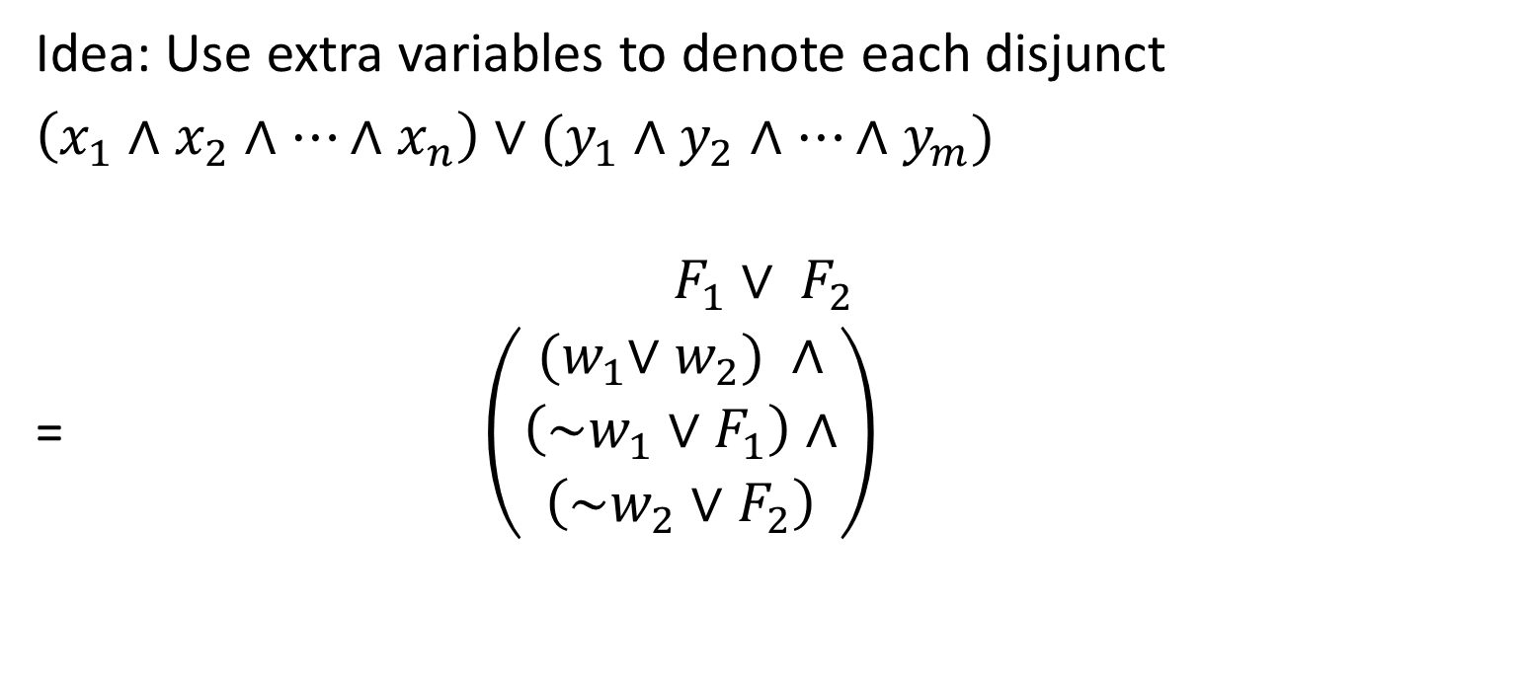
NNF to CNF
$A$ $∷=$ $⊤ \left| ⊥ \right| x$
$L$ $∷=$ $A | \sim A$
$F$ $∷=$ $F∧F$
$$| F ∨F$$
Idea: Use extra variables to denote each disjunct
$\left(x_{1}∧x_{2}∧⋯∧x_{n}\right)∨(y_{1}∧y_{2}∧⋯∧y_{m})$
$$F_{1}∨ F_{2}$$
= $\left(\begin{aligned}{(w}_{1}∨w_{2}) ∧ \\ \begin{aligned}\left(\sim w_{1}∨F_{1}\right)∧ \\ \left(\sim w_{2}∨F_{2}\right)\end{aligned}\end{aligned}\right)$
$A$ $∷=$ $⊤ \left| ⊥ \right| x$
$L$ $∷=$ $A | \sim A$
$F$ $∷=$ $C | C∧F$
$C$ $∷=$ $L | C∨L$

Slide 15









NNF to CNF
Notes:
The resultant formula is equisatisfiable to the original formula
The translation is linear
Equisatisfiability is weaker than equivalence (but suffices to check satisfiability)
This idea is due to Tseitin (and called Tseitin’s transformation)
Idea: Use extra variables to denote each disjunct
$\left(x_{1}∧x_{2}∧⋯∧x_{n}\right)∨(y_{1}∧y_{2}∧⋯∧y_{m})$
$$\left(x_{1}∧x_{2}∧⋯∧x_{n}\right)∨(y_{1}∧y_{2}∧⋯∧y_{m})$$
=

Slide 16
NNF to CNF
$A$ $∷=$ $⊤ \left| ⊥ \right| x$
$L$ $∷=$ $A | \sim A$
$F$ $∷=$ $F∧F$
$$| F ∨F$$
Idea: Use extra variables to denote each disjunct
$\left(x_{1}∧x_{2}∧⋯∧x_{n}\right)∨(y_{1}∧y_{2}∧⋯∧y_{m})$
$$\left(x_{1}∧x_{2}∧⋯∧x_{n}\right)∨(y_{1}∧y_{2}∧⋯∧y_{m})$$
=
$A$ $∷=$ $⊤ \left| ⊥ \right| x$
$L$ $∷=$ $A | \sim A$
$F$ $∷=$ $C | C∧F$
$C$ $∷=$ $L | C∨L$

Slide 17


















With CNF, we can do resolution!

Slide 18










Special case of resolution: unit resolution or BCP (binary constraint propagation)

Slide 19
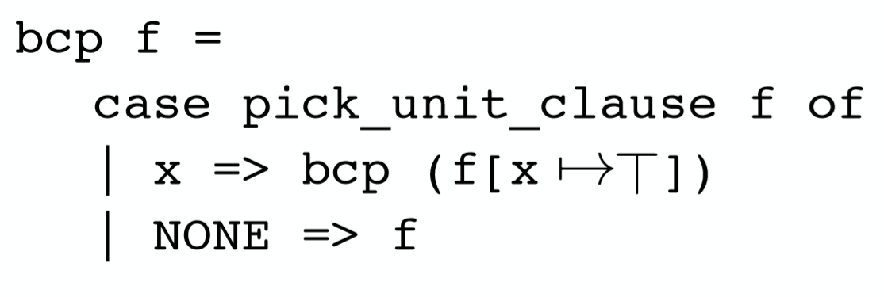
Two inference rules: BCP and PLP
BCP = Binary Constraint Propagation
PLP = Pure Literal Propagation
1. If a literal occurs only positively set it to true
2. If a literal occurs only negatively set if to false

Slide 20
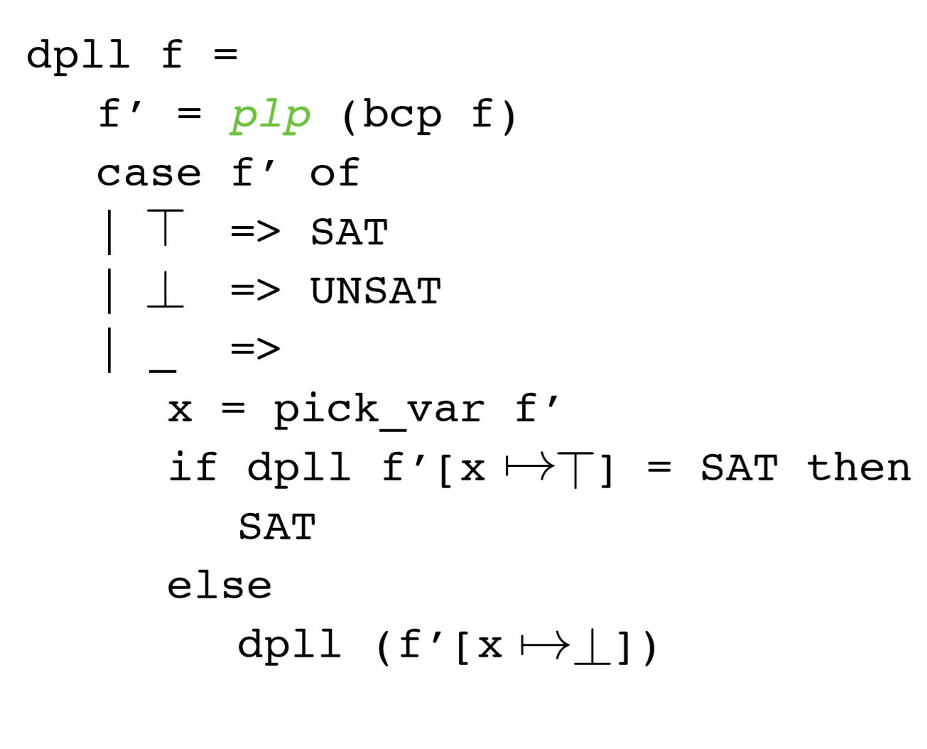
Davis Putnam Logeman Loveland (DPLL) with PLP

