Slide 1
SAT Solvers
Lecture 2(b)
Sriram Rajamani
(based on notes/slides by Matt Fredrickson, Andre Platzer,
Emina Torlak and Leonardo De Moura)

Slide 2
Modern SAT solvers
First convert a formula to CNF (Conjunctive Normal Form)
Use variant of DPLL (Davis Putnam Logeman Loveland procedure, from 1962, with a few new insights)

Slide 3
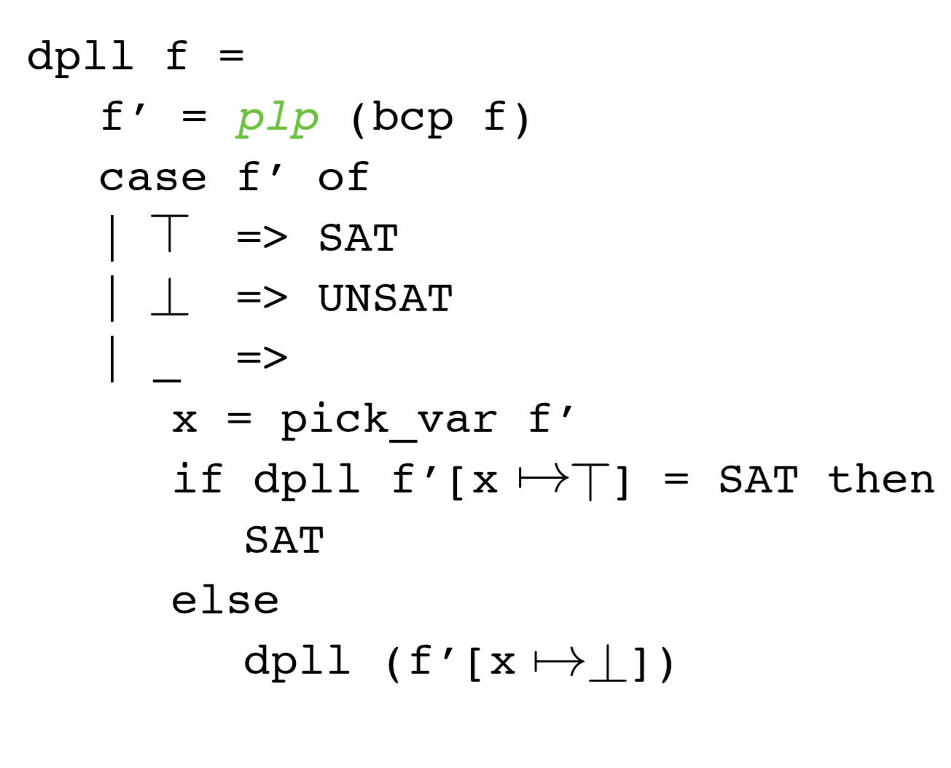
Davis Putnam Logeman Loveland (DPLL) with PLP

Slide 4
Let us try out DPLL on an example

Slide 5

Let us try out DPLL on an example

Slide 6










Let us try out DPLL on an example

Slide 7











Let us try out DPLL on an example

Slide 8
Let us try out DPLL on an example

Slide 9



Let us try out DPLL on an example

Slide 10







Let us try out DPLL on an example

Slide 11


Let us try out DPLL on an example

Slide 12



Let us try out DPLL on an example

Slide 13
Let us try out DPLL on an example

Slide 14
Let us try out DPLL on an example

Slide 15


Let us try out DPLL on an example

Slide 16






Let us try out DPLL on an example

Slide 17





Let us try out DPLL on an example

Slide 18








Let us try out DPLL on an example

Slide 19
Improvements to DPLL
Conflict clauses “memorize” the reasons for UNSAT and prevent repeating the same explorations in future searches
Picking a good ordering of variables to split can greatly improve efficiency
When a search fails, it is better to back track to the right level. This is called “non-chronological” backtracking

Slide 20
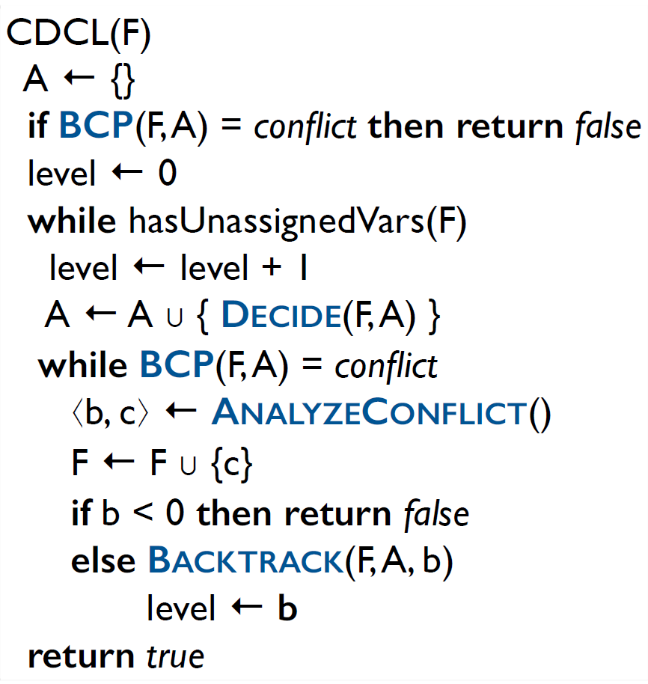
CDCL: Conflict Driven Clause Learning
Conflict clauses “memorize” the reasons for UNSAT and prevent repeating the same explorations in future searches
When a search fails, it is better to back track to the right level. This is called “non-chronological” backtracking

Slide 21
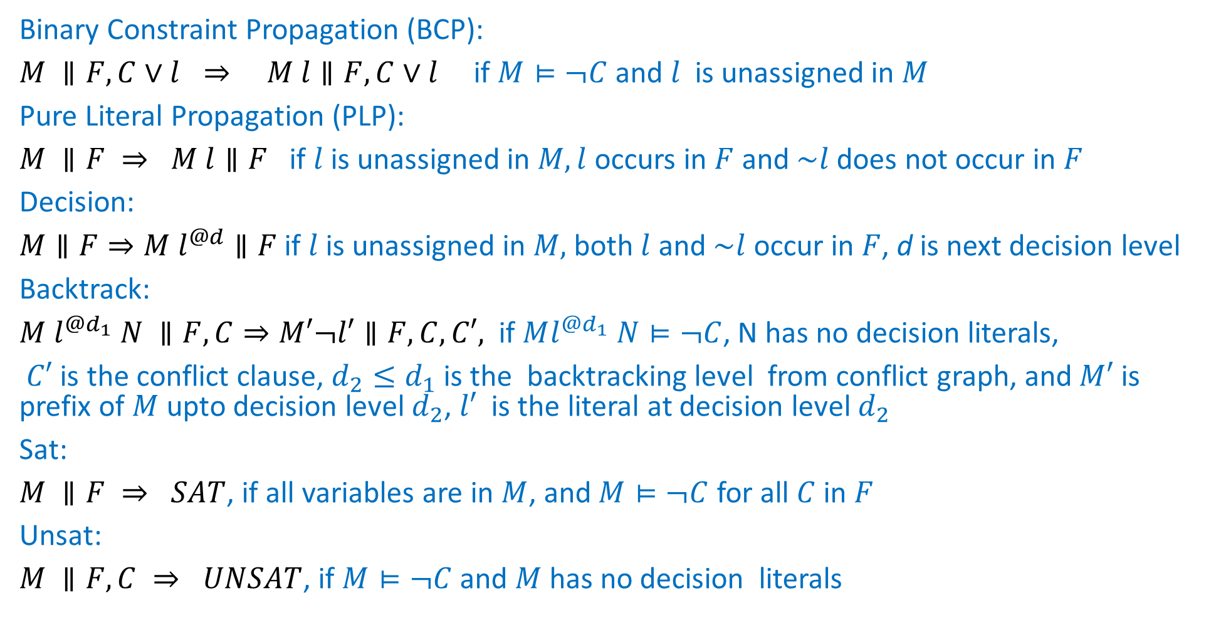
Abstract DPLL (with CDCL) in declarative style
Binary Constraint Propagation (BCP):
$M ∥F, C∨l ⇒ M l∥F, C∨l$ if $M⊨¬C$ and $l$ is unassigned in $M$
Pure Literal Propagation (PLP):
$M ∥F ⇒ M l∥F$ if $l$is unassigned in $M, l$ occurs in $F$ and $\sim l$ does not occur in $F$
Decision:
$M∥F⇒M l^{@d}∥F$ if $l$is unassigned in $M,$both $l$ and $\sim l$ occur in $F$, d is next decision level
Backtrack:
$M$ $l^{@d_{1}} N ∥F,C⇒M′¬l′∥F,C,C′,$ if $Ml^{@d_{1}} N⊨¬C$, N has no decision literals,
$C′$ is the conflict clause, $d_{2}≤d_{1}$ is the backtracking level from conflict graph, and $M′$ is prefix of $M$ upto decision level $d_{2}$, $l′$ is the literal at decision level $d_{2}$
Sat:
$M ∥F ⇒ SAT$, if all variables are in $M$, and $M⊨¬C$ for all $C$ in $F$
Unsat:
$M ∥F, C ⇒ UNSAT$, if $M⊨¬C$ and $M$has no decision literals

Slide 22
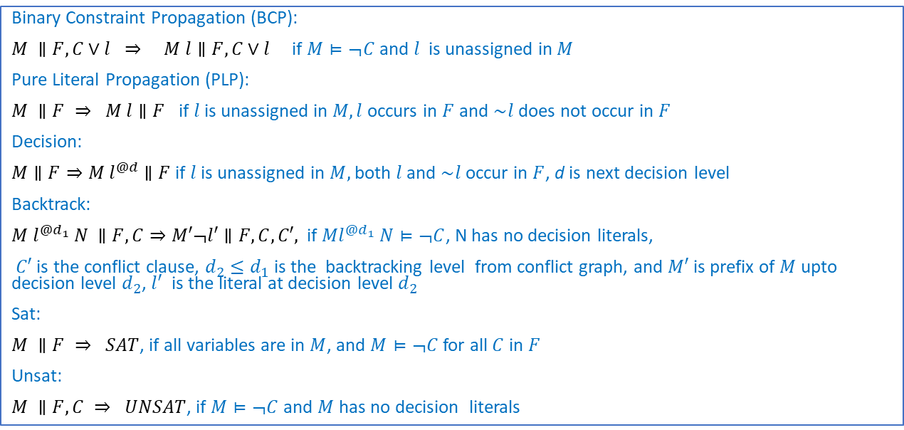
Try out abstract DPLL
Binary Constraint Propagation (BCP):
$M ∥F, C∨l ⇒ M l∥F, C∨l$ if $M⊨¬C$ and $l$ is unassigned in $M$
Pure Literal Propagation (PLP):
$M ∥F ⇒ M l∥F$ if $l$is unassigned in $M, l$ occurs in $F$ and $\sim l$ does not occur in $F$
Decision:
$M∥F⇒M l^{@d}∥F$ if $l$is unassigned in $M,$both $l$ and $\sim l$ occur in $F$, d is next decision level
Backtrack:
$M$ $l^{@d_{1}} N ∥F,C⇒M′¬l′∥F,C,C′,$ if $Ml^{@d_{1}} N⊨¬C$, N has no decision literals,
$C′$ is the conflict clause, $d_{2}≤d_{1}$ is the backtracking level from conflict graph, and $M′$ is prefix of $M$ upto decision level $d_{2}$, $l′$ is the literal at decision level $d_{2}$
Sat:
$M ∥F ⇒ SAT$, if all variables are in $M$, and $M⊨¬C$ for all $C$ in $F$
Unsat:
$M ∥F, C ⇒ UNSAT$, if $M⊨¬C$ and $M$has no decision literals

Slide 23





Try out DPLL+CDCL
Binary Constraint Propagation (BCP):
$M ∥F, C∨l ⇒ M l∥F, C∨l$ if $M⊨¬C$ and $l$ is unassigned in $M$
Pure Literal Propagation (PLP):
$M ∥F ⇒ M l∥F$ if $l$is unassigned in $M, l$ occurs in $F$ and $\sim l$ does not occur in $F$
Decision:
$M∥F⇒M l^{@d}∥F$ if $l$is unassigned in $M,$both $l$ and $\sim l$ occur in $F$, d is next decision level
Backtrack:
$M$ $l^{@d_{1}} N ∥F,C⇒M′¬l′∥F,C,C′,$ if $Ml^{@d_{1}} N⊨¬C$, N has no decision literals,
$C′$ is the conflict clause, $d_{2}≤d_{1}$ is the backtracking level from conflict graph, and $M′$ is prefix of $M$ upto decision level $d_{2}$, $l′$ is the literal at decision level $d_{2}$
Sat:
$M ∥F ⇒ SAT$, if all variables are in $M$, and $M⊨¬C$ for all $C$ in $F$
Unsat:
$M ∥F, C ⇒ UNSAT$, if $M⊨¬C$ and $M$has no decision literals

Slide 24
Homework
1. Read Lecture notes on SAT solvers and DPLL by Fredrikson & Platzer
https://www.cs.cmu.edu/~15414/f17/lectures/10-dpll.pdf
2. Try downloading and playing with SAT solvers (look at SAT competition site for winning solvers as well as benchmarks)
3. Formulate suitable problems from your research interests, and convert them to SAT and try existing SAT solvers on them

Slide 25
SAT solvers and SAT competitions
Minisat: www.minisat.se
Open sourced SAT solver, with a big community
Has won many competitions in the past
The SAT competition: http://www.satcompetition.org
Search the WEB: “SAT benchmarks”

