Slide 1
Satisfiability Modulo Theories
Lecture 3(a)
Sriram Rajamani
(some parts adapted from notes/slides by Leo DeMoura and Emina Torlak)

Slide 2
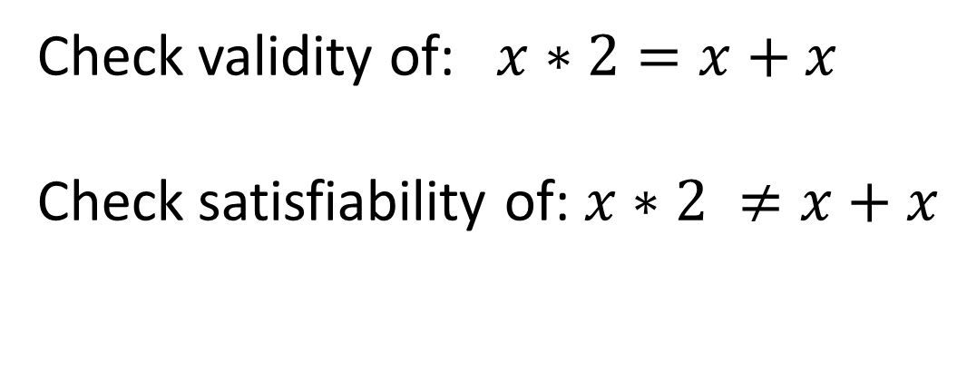
Recall example from first class
void doublesketch (int x)/*double.sk:1*/
{
assert ((x * 2) == (x + x)); //Assert at double.sk:3 (2)
}
/*double.sk:1*/
harness void doublesketch(int x)
{
int t = x * ??;
assert t == x + x;
}
How can we check if the synthesized program is correct?
(that is, the assertion is always satisfied)
Check validity of: $x∗2=x+x$
Check satisfiability of: $x∗2 ≠x+x$

Slide 3
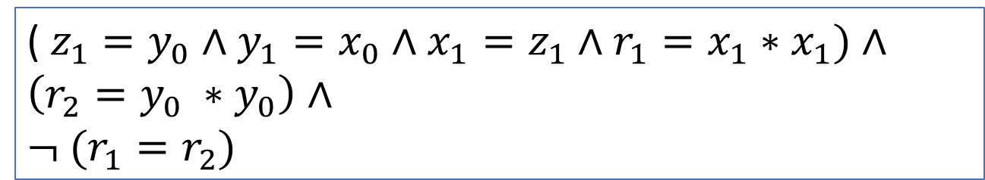
Another example..
Can we check if the two programs here are not equivalent?
int fun1(int y) {
int x, z;
z = y;
y = x;
x = z;
return x*x;
}
int fun2(int y) {
return y*y;
}
(Example from Sanjit Seshia)
($z_{1}=y_{0}∧y_{1}=x_{0}∧x_{1}=z_{1}∧r_{1}=x_{1}∗x_{1})∧$
$$\left(r_{2}=y_{0} ∗y_{0}\right)∧$$
$$¬ (r_{1}=r_{2})$$
With 32 bit integers, SAT solver fails to return an answer after 5 minutes

Slide 4
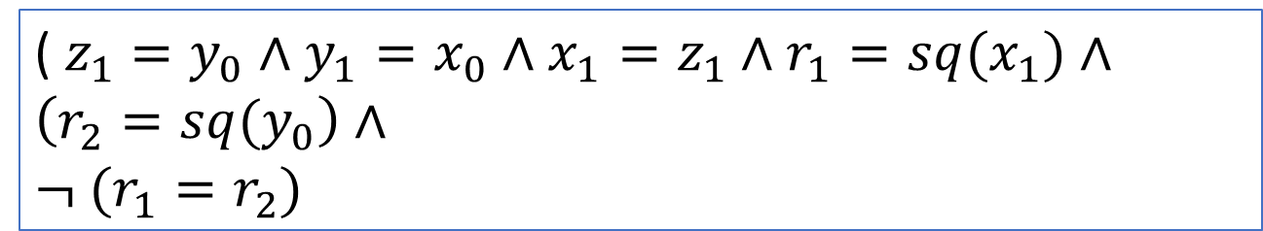
Another example..
Can we check if the two programs here are not equivalent?
int fun1(int y) {
int x, z;
z = y;
y = x;
x = z;
return x*x;
}
int fun2(int y) {
return y*y;
}
(Example from Sanjit Seshia)
($z_{1}=y_{0}∧y_{1}=x_{0}∧x_{1}=z_{1}∧r_{1}={sq(x}_{1})∧$
$$\left(r_{2}={sq(y}_{0}\right)∧$$
$$¬ (r_{1}=r_{2})$$
SMT solver returns unsat in a fraction of a second, treating sq as an “uniterpreted function”, using EUF theory

Slide 5
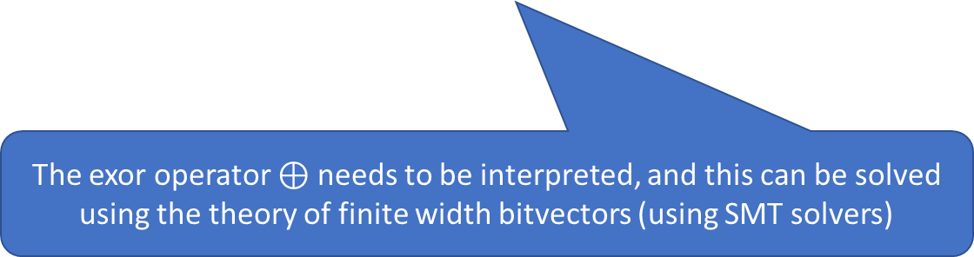
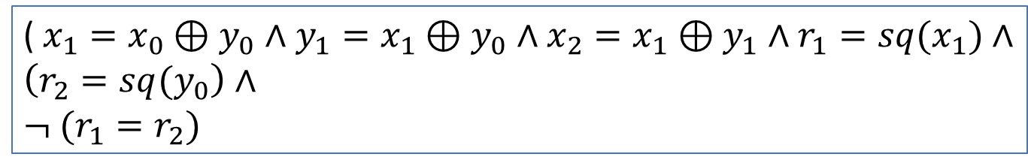
Yet another example..
Can we check if the two programs here are not equivalent?
int fun1(int y) {
int x;
x = x ^ y;
y = x ^ y;
x = x ^ y;
return x*x;
}
int fun2(int y) {
return y*y;
}
(Example from Sanjit Seshia)
($x_{1}={x_{0}⊕y}_{0}∧y_{1}={x_{1}⊕y}_{0}∧x_{2}={x_{1}⊕y}_{1}∧r_{1}={sq(x}_{1})∧$
$$\left(r_{2}={sq(y}_{0}\right)∧$$
$$¬ (r_{1}=r_{2})$$
The exor operator $⊕$ needs to be interpreted, and this can be solved using the theory of finite width bitvectors (using SMT solvers)

Slide 6
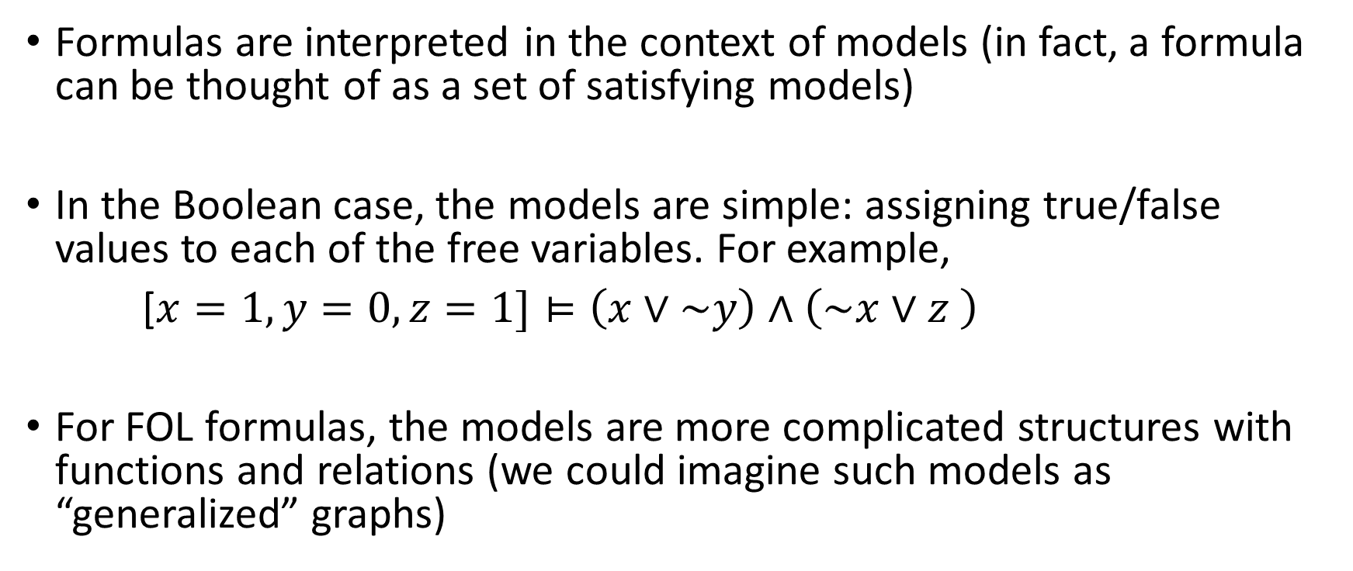
Models: from Boolean formulas to First Order Logic (FOL)
Formulas are interpreted in the context of models (in fact, a formula can be thought of as a set of satisfying models)
In the Boolean case, the models are simple: assigning true/false values to each of the free variables. For example,
[$x=1, y=0, z=1]⊨\left(x∨\sim y\right)∧\left(\sim x∨z \right)$
For FOL formulas, the models are more complicated structures with functions and relations (we could imagine such models as “generalized” graphs)

Slide 7
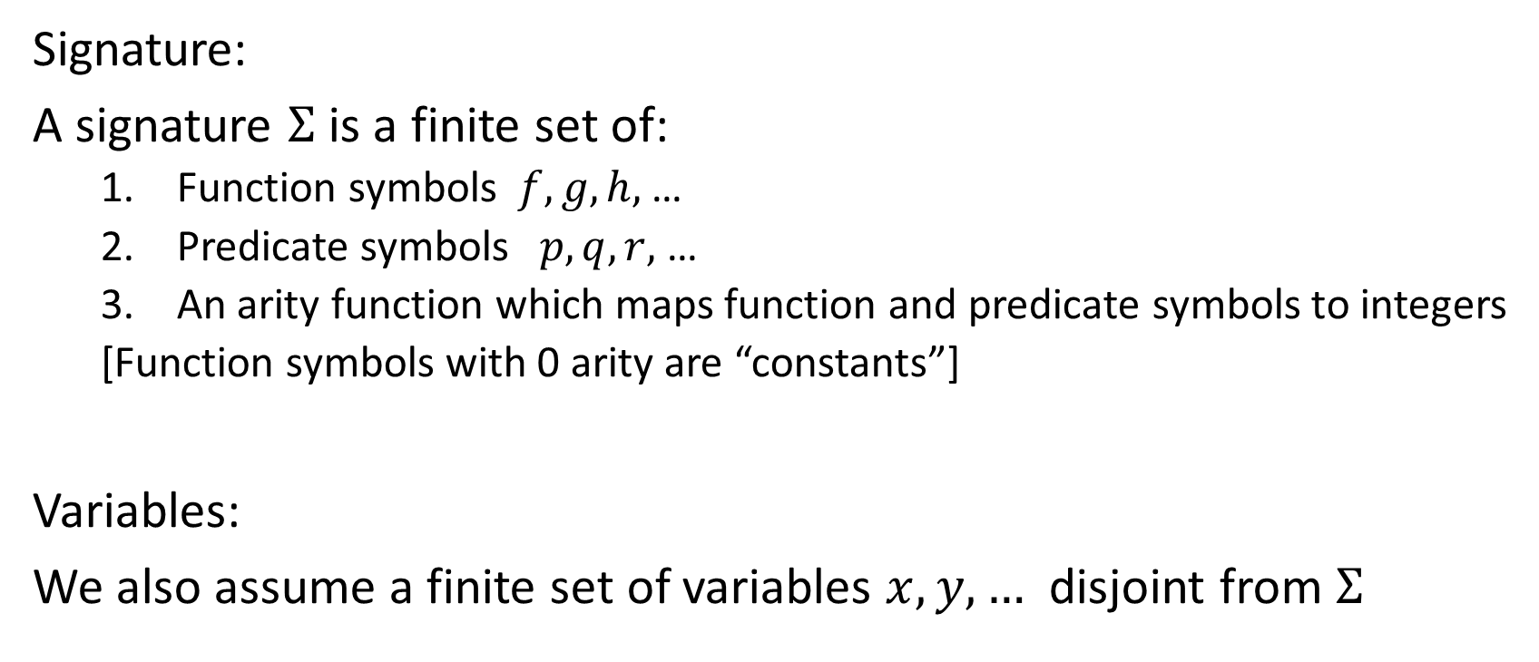
First Order Logic
Signature:
A signature $Σ$ is a finite set of:
Function symbols $f, g, h,$ …
Predicate symbols $p, q, r,$ …
An arity function which maps function and predicate symbols to integers
[Function symbols with 0 arity are “constants”]
Variables:
We also assume a finite set of variables $x,y,…$ disjoint from $Σ$

Slide 8
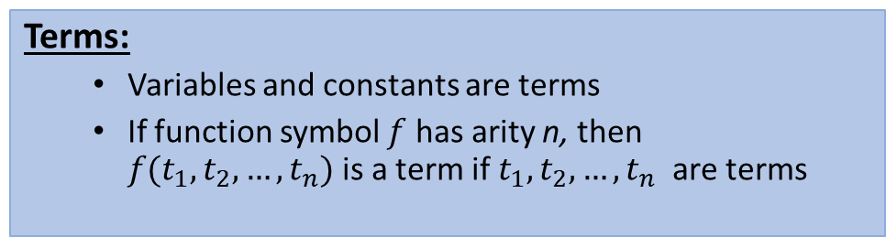
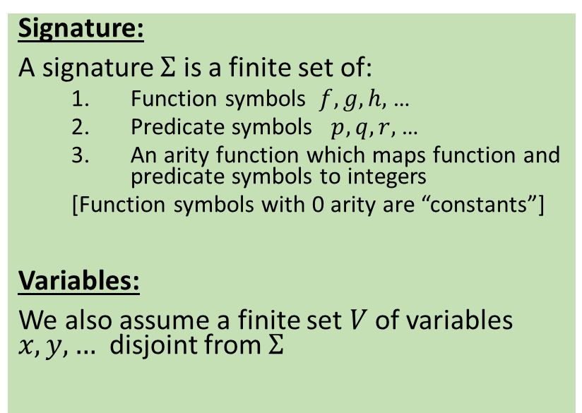
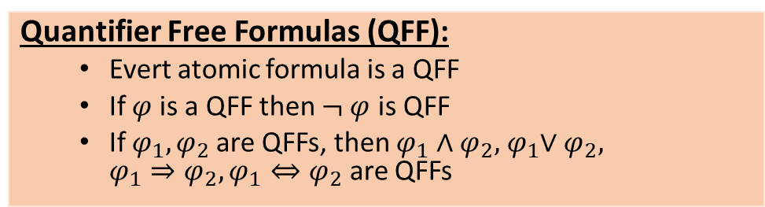
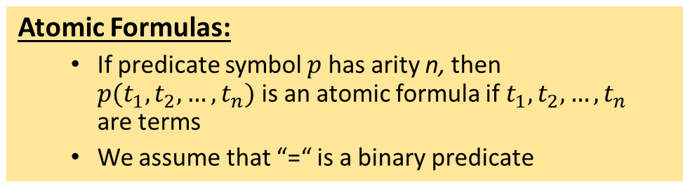
First Order Logic
Terms:
Variables and constants are terms
If function symbol $f$ has arity n, then $f(t_{1}, t_{2}, …, t_{n})$is a term if${ t}_{1}, t_{2}, …, t_{n}$ are terms
Signature:
A signature $Σ$ is a finite set of:
Function symbols $f, g, h,$ …
Predicate symbols $p, q, r,$ …
An arity function which maps function and predicate symbols to integers
[Function symbols with 0 arity are “constants”]
Variables:
We also assume a finite set $V$of variables $x,y,…$ disjoint from $Σ$
Atomic Formulas:
If predicate symbol $p$ has arity n, then $p(t_{1}, t_{2}, …, t_{n})$is an atomic formula if${ t}_{1}, t_{2}, …, t_{n}$ are terms
We assume that “=“ is a binary predicate
Quantifier Free Formulas (QFF):
Evert atomic formula is a QFF
If $φ$is a QFF then $¬ φ$ is QFF
If $φ_{1},φ_{2}$are QFFs, then $φ_{1}∧φ_{2}, { φ}_{1}∨φ_{2}, {φ_{1}⇒φ}_{2}, φ_{1}⇔φ_{2}$ are QFFs
First Order Logic Formulas (FOLF):
The set of FOLFs is the closure of QFFs under existential and universal quantification of variables.
Free variables are variables not bound by quantifiers
A FOLF without free variables is called a sentence

Slide 9
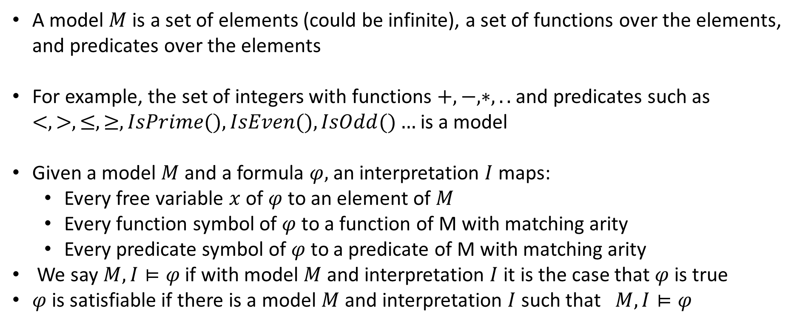
Models and interpretations
A model $M$ is a set of elements (could be infinite), a set of functions over the elements, and predicates over the elements
For example, the set of integers with functions $+, −, ∗, ..$and predicates such as $<, >, ≤, ≥,IsPrime(), IsEven(), IsOdd()…$is a model
Given a model $M$and a formula $φ,$an interpretation $I$maps:
Every free variable $x$ of $φ$to an element of $M$
Every function symbol of $φ$to a function of M with matching arity
Every predicate symbol of $φ$to a predicate of M with matching arity
We say $M, I⊨φ$if with model $M$ and interpretation $I$ it is the case that $φ$is true
$φ$ is satisfiable if there is a model $M$ and interpretation $I$such that$M, I⊨φ$

Slide 10
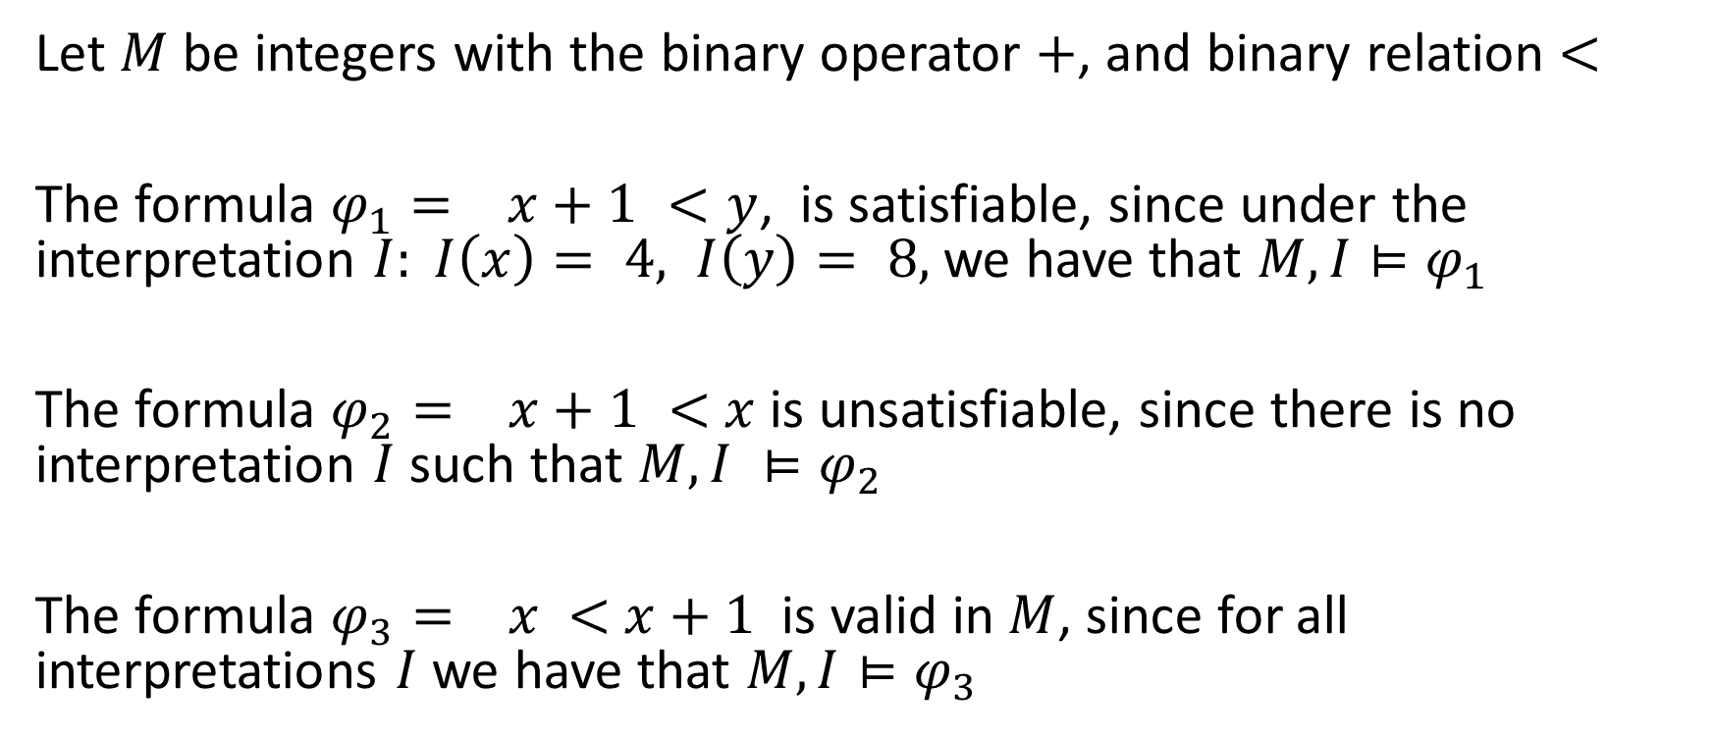
Examples (1)
Let $M$ be integers with the binary operator $+$, and binary relation $<$
The formula $φ_{1}= x+1 <y$, is satisfiable, since under the interpretation $I: I\left(x\right)= 4, I\left(y\right)= 8,$ we have that $M, I⊨φ_{1}$
The formula $φ_{2}= x+1 <$ $x$ is unsatisfiable, since there is no interpretation $I$ such that $M, I ⊨φ_{2}$
The formula $φ_{3}= x <$ $x+1$ is valid in $M$, since for all interpretations $I$ we have that $M, I⊨φ_{3}$

Slide 11

Examples (2)
Consider the model $R,$ which is the set of reals with unary predicates $isPrime(), isInteger()$ and the unary function $sqrt()$:
The formula $φ_{4}=$ $isPrime\left(x\right)⇒¬ isInteger(sqrt(x))$
is valid in $R$, since for all interpretations $I$ we have that $R, I⊨φ_{4}$

Slide 12

























Example (3)
Unsatisfiable
Valid

Slide 13

Example 4
$M$ = Boolean algebra with true/false values to $n$ variables
$$φ_{1}=\left(x∨\sim y\right)∧\left(\sim x∨z \right)$$
$$φ_{2}=\left(\sim x∨y\right)∧\left(\sim y∨\sim x \right)∧\left(x\right)$$
Satisfiable
Unsatisfiable

Slide 14
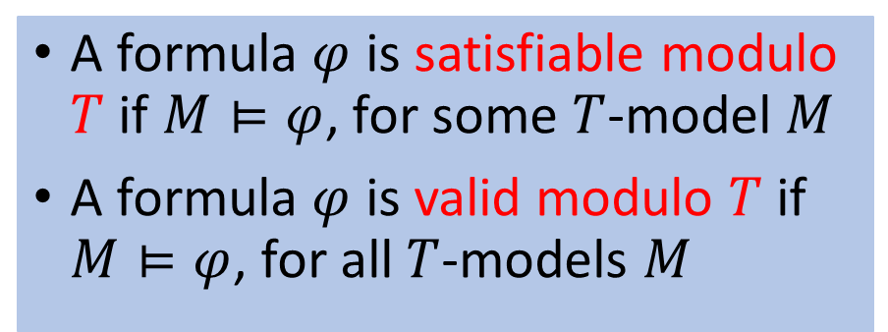
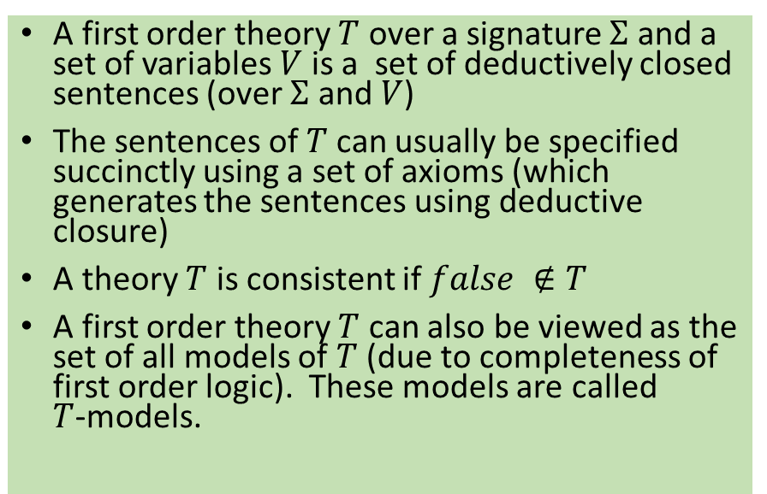
Satisfiability Modulo Theories (SMT)
A first order theory $Τ$ over a signature $Σ$ and a set of variables $V$ is a set of deductively closed sentences (over $Σ$ and $V$)
The sentences of $Τ$can usually be specified succinctly using a set of axioms (which generates the sentences using deductive closure)
A theory $Τ$ is consistent if $false ∉Τ$
A first order theory $Τ$ can also be viewed as the set of all models of $Τ$ (due to completeness of first order logic). These models are called $Τ$-models.
A formula $φ$ is satisfiable modulo $T$ if $M⊨φ$, for some $T$-model $M$
A formula $φ$ is valid modulo $T$ if $M⊨φ$, for all $T$-models $M$

Slide 15
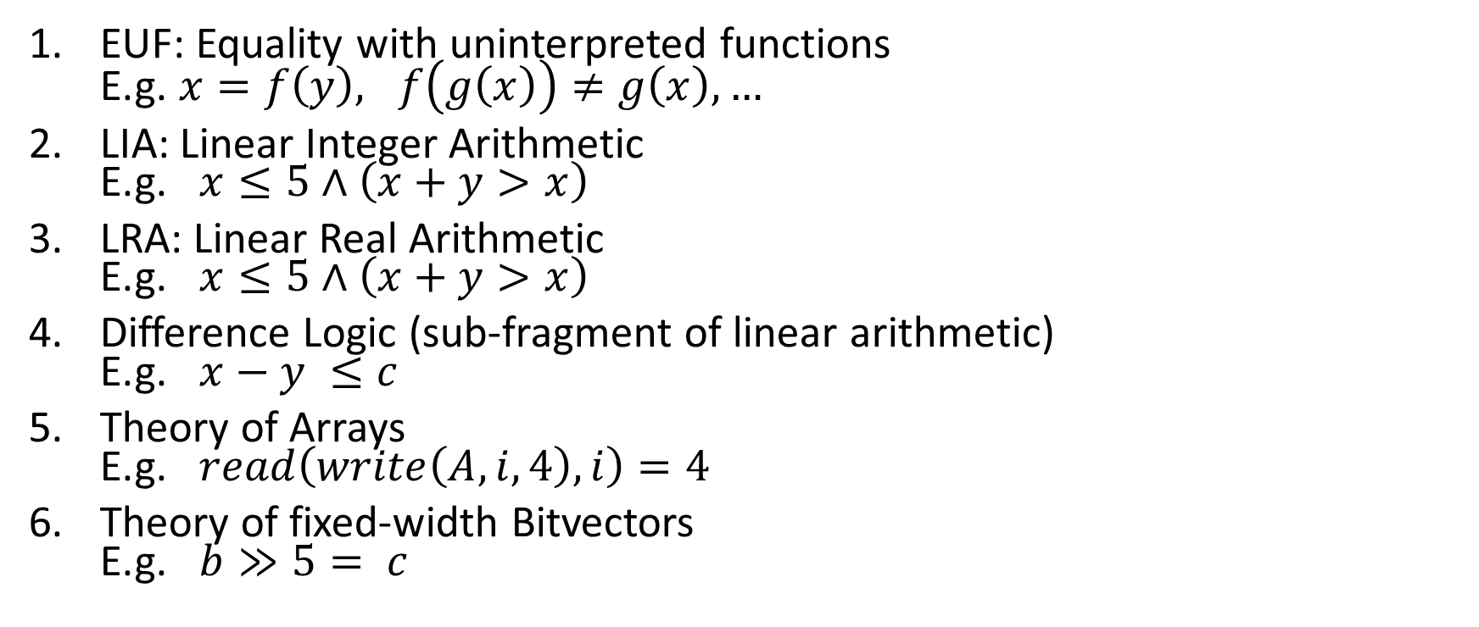
Common Theories
EUF: Equality with uninterpreted functions E.g. $x=f\left(y\right), f\left(g\left(x\right)\right)≠g\left(x\right),…$
LIA: Linear Integer Arithmetic E.g. $x≤5∧\left(x+y>x\right)$
LRA: Linear Real Arithmetic E.g. $x≤5∧\left(x+y>x\right)$
Difference Logic (sub-fragment of linear arithmetic) E.g. $x−y ≤c$
Theory of Arrays E.g. $read\left(write\left(A, i, 4\right), i\right)=4$
Theory of fixed-width Bitvectors E.g. $b≫5= c$

Slide 16
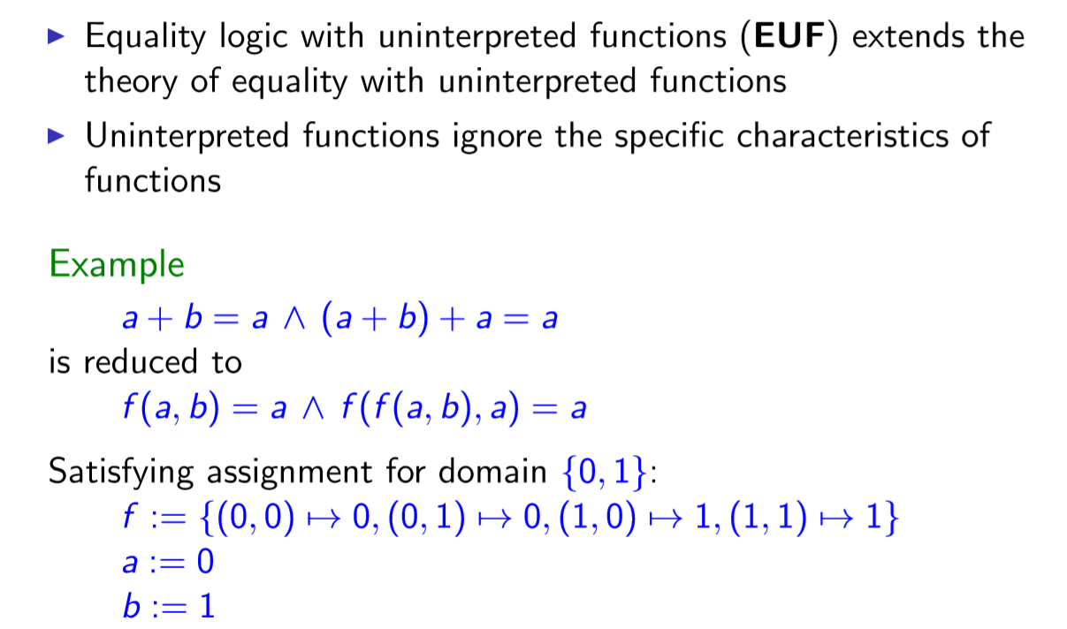
EUF: Equality with uninterested functions

Slide 17
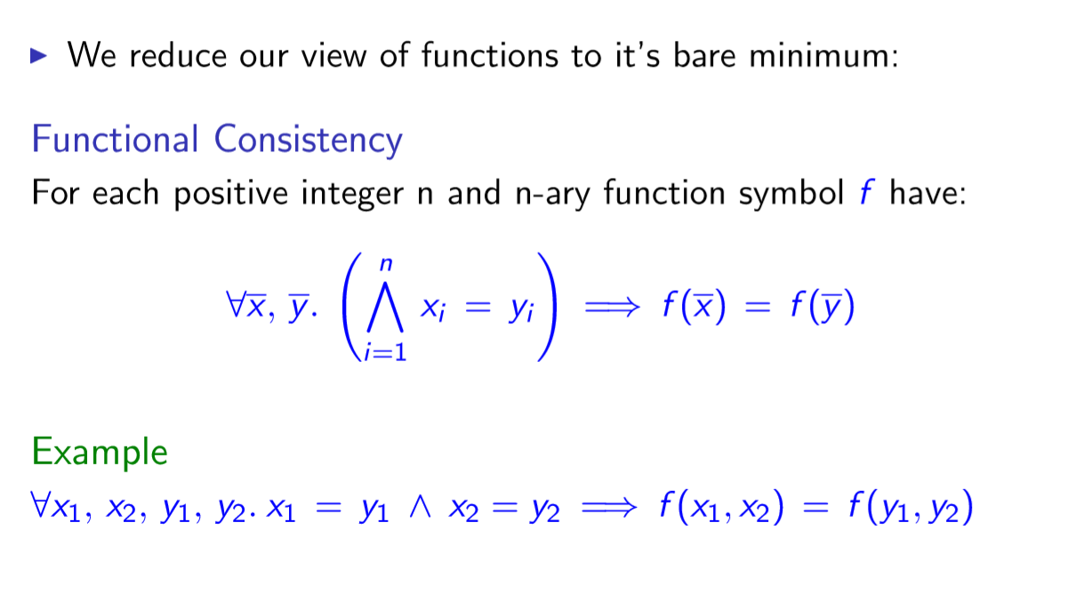
Axioms for EUF
(SAT for QF conjunctive formulas) Decidable in polynomial time

Slide 18
Theory of Fixed-width bitvectors (QF_BV)
Signature
Constants
Fixed-width words (ints, longs,etc)
Arithmetic operations (+, -, *, /…) --semantics encoded using circuits
Bitwise operations (&, |, ^, …)
Comparison operators (< , >)
Equality =
Quantifier free Satisfiability problem is NP complete

Slide 19
Theory of Linear Integer Arithmetic (QF_LIA)
Signature
Domain: {……,-2, -1, 0, 1, 2, ….}
Functions: +, -,…
Relations =, >, <,…
(Quantifier free) Satisfiability problem is NP complete

Slide 20
Theory of Linear Real Arithmetic (QF_LRA)
Signature
Domain: Reals
Functions: +, -,…
Relations =, >, <,…
(Quantifier free) Satisfiability decidable in polynomial time (though exponential methods –Simplex– used in practice)

Slide 21
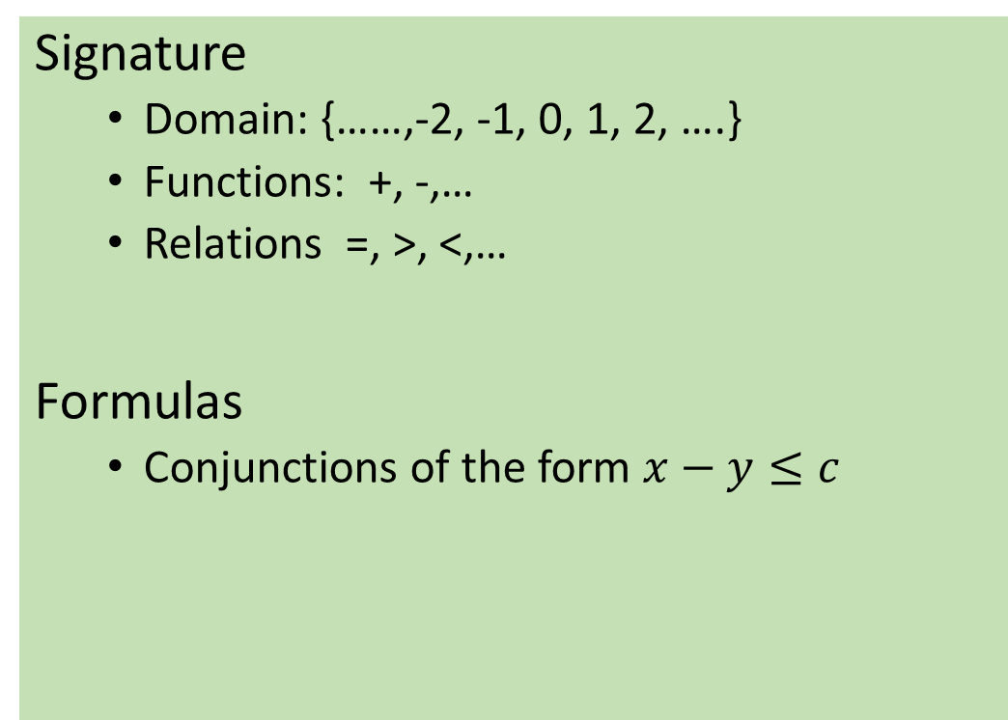
Theory of Difference Logic(QF_DIA)
Signature
Domain: {……,-2, -1, 0, 1, 2, ….}
Functions: +, -,…
Relations =, >, <,…
Formulas
Conjunctions of the form $x−y≤c$
(Quantifier free) Satisfiability decidable in polynomial time

Slide 22
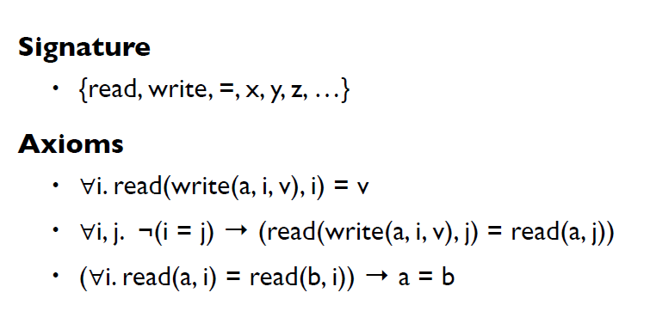
Theory of arrays
(Quantifier free) Satisfiability problem is NP complete

