Slide 1
Satisfiability Modulo Theories
Lecture 3(b)
Sriram Rajamani
(some parts adapted from notes/slides by Leo DeMoura and Emina Torlak)

Slide 2
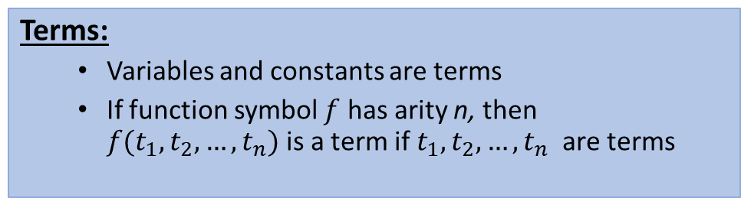
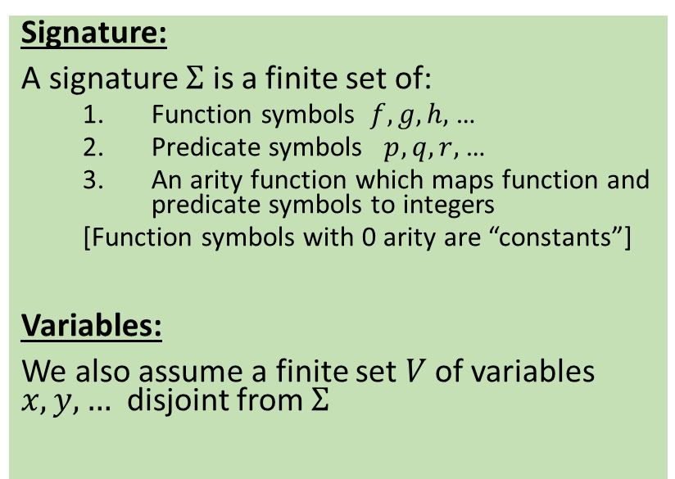
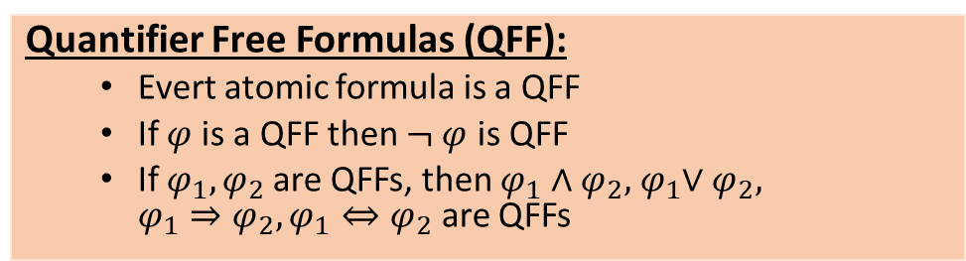
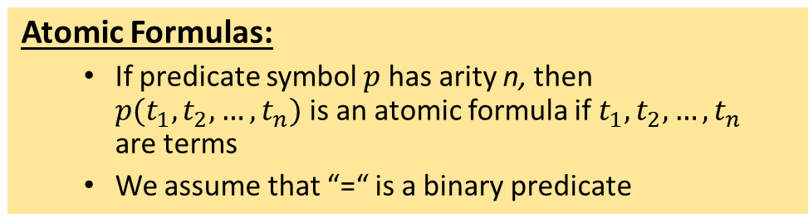
First Order Logic
Terms:
Variables and constants are terms
If function symbol $f$ has arity n, then $f(t_{1}, t_{2}, …, t_{n})$is a term if${ t}_{1}, t_{2}, …, t_{n}$ are terms
Signature:
A signature $Σ$ is a finite set of:
Function symbols $f, g, h,$ …
Predicate symbols $p, q, r,$ …
An arity function which maps function and predicate symbols to integers
[Function symbols with 0 arity are “constants”]
Variables:
We also assume a finite set $V$of variables $x,y,…$ disjoint from $Σ$
Atomic Formulas:
If predicate symbol $p$ has arity n, then $p(t_{1}, t_{2}, …, t_{n})$is an atomic formula if${ t}_{1}, t_{2}, …, t_{n}$ are terms
We assume that “=“ is a binary predicate
Quantifier Free Formulas (QFF):
Evert atomic formula is a QFF
If $φ$is a QFF then $¬ φ$ is QFF
If $φ_{1},φ_{2}$are QFFs, then $φ_{1}∧φ_{2}, { φ}_{1}∨φ_{2}, {φ_{1}⇒φ}_{2}, φ_{1}⇔φ_{2}$ are QFFs
First Order Logic Formulas (FOLF):
The set of FOLFs is the closure of QFFs under existential and universal quantification of variables.
Free variables are variables not bound by quantifiers
A FOLF without free variables is called a sentence

Slide 3


















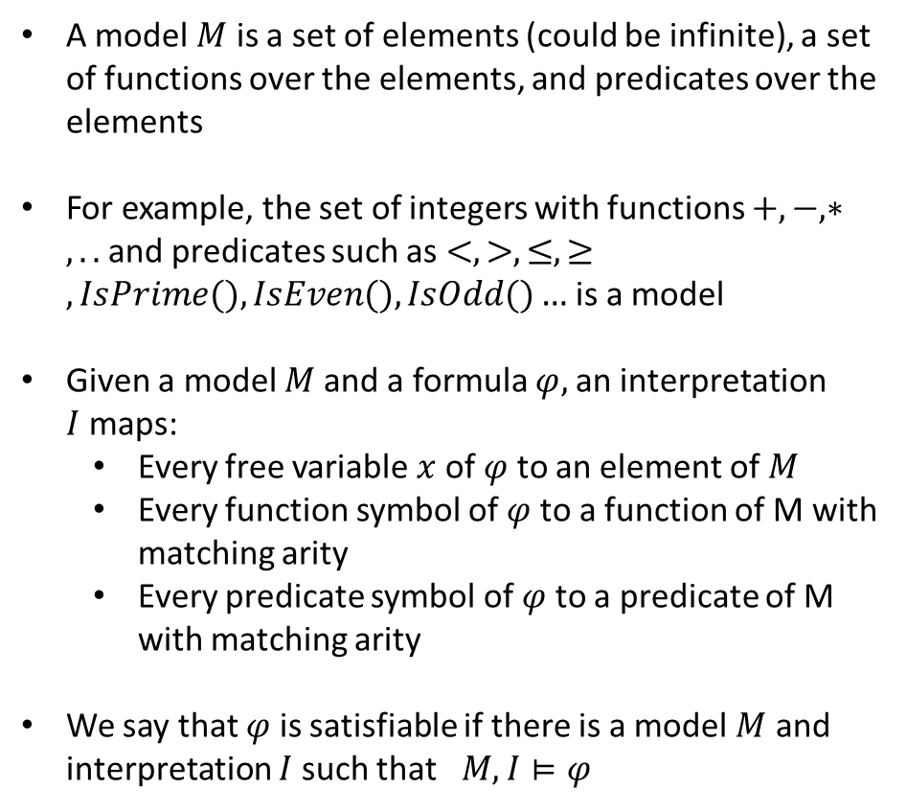






Models and interpretations
A model $M$ is a set of elements (could be infinite), a set of functions over the elements, and predicates over the elements
For example, the set of integers with functions $+, −, ∗, ..$and predicates such as $<, >, ≤, ≥,IsPrime(), IsEven(), IsOdd()…$is a model
Given a model $M$and a formula $φ,$an interpretation $I$maps:
Every free variable $x$ of $φ$to an element of $M$
Every function symbol of $φ$to a function of M with matching arity
Every predicate symbol of $φ$to a predicate of M with matching arity
We say that $φ$ is satisfiable if there is a model $M$ and interpretation $I$such that$M, I⊨φ$
Unsatisfiable
Valid

Slide 4
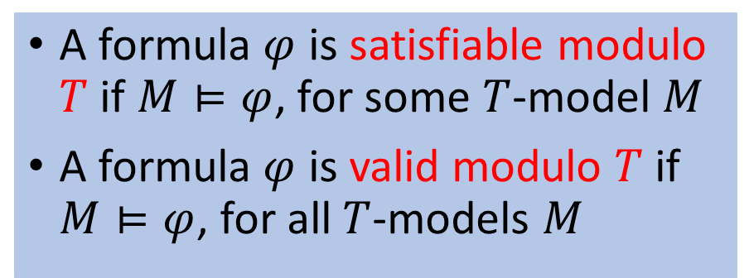
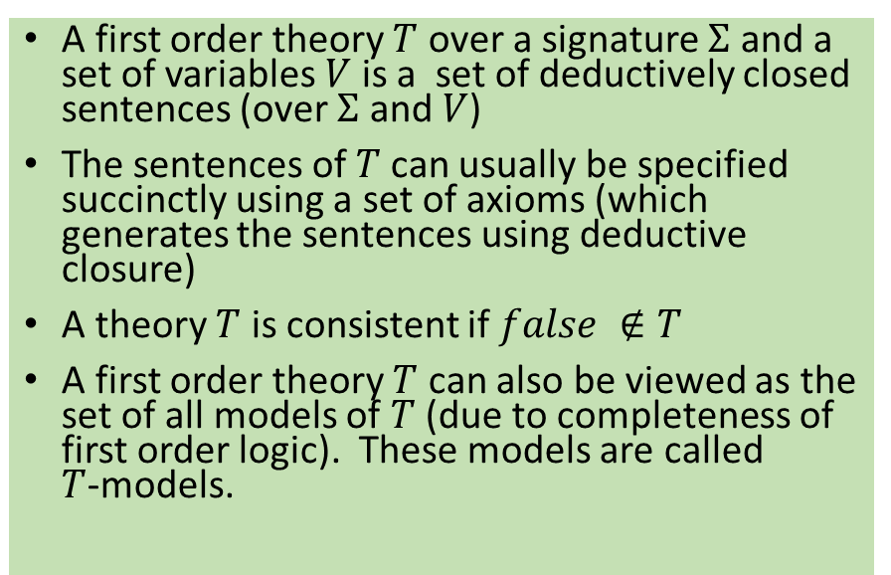
Satisfiability Modulo Theories (SMT)
A first order theory $Τ$ over a signature $Σ$ and a set of variables $V$ is a set of deductively closed sentences (over $Σ$ and $V$)
The sentences of $Τ$can usually be specified succinctly using a set of axioms (which generates the sentences using deductive closure)
A theory $Τ$ is consistent if $false ∉Τ$
A first order theory $Τ$ can also be viewed as the set of all models of $Τ$ (due to completeness of first order logic). These models are called $Τ$-models.
A formula $φ$ is satisfiable modulo $T$ if $M⊨φ$, for some $T$-model $M$
A formula $φ$ is valid modulo $T$ if $M⊨φ$, for all $T$-models $M$

Slide 5
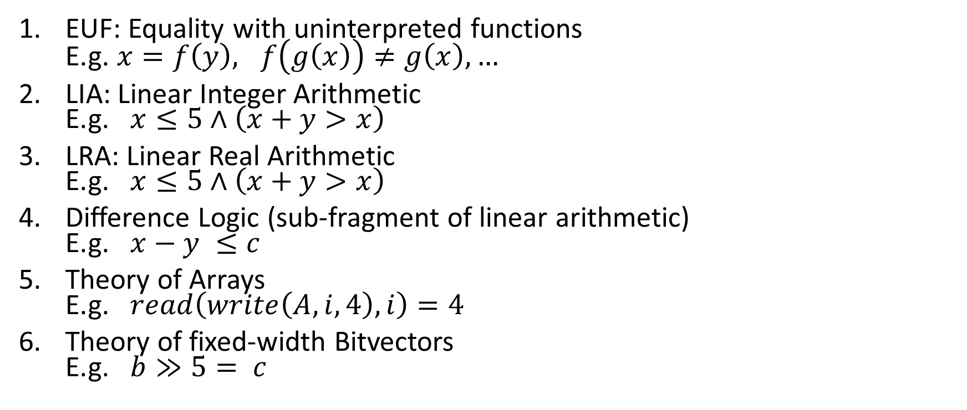
Common Theories
EUF: Equality with uninterpreted functions E.g. $x=f\left(y\right), f\left(g\left(x\right)\right)≠g\left(x\right),…$
LIA: Linear Integer Arithmetic E.g. $x≤5∧\left(x+y>x\right)$
LRA: Linear Real Arithmetic E.g. $x≤5∧\left(x+y>x\right)$
Difference Logic (sub-fragment of linear arithmetic) E.g. $x−y ≤c$
Theory of Arrays E.g. $read\left(write\left(A, i, 4\right), i\right)=4$
Theory of fixed-width Bitvectors E.g. $b≫5= c$

Slide 6
Decision procedure for EUF
First let us consider only equalities and disequalities (add uninterpreted functions later)
Idea:
Maintain equivalence classes of variables
Merge equivalence classes related by equalities
Maintain disequalities between equivalence classes

Slide 7
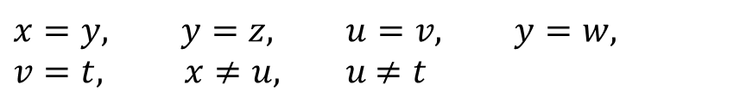
Decision procedure for EUF
First let us consider only equalities and disequalities (add uninterpreted functions later)
Idea:
Maintain equivalence classes of variables
Merge equivalence classes related by equalities
UNSAT if disequalty is in the same clas
$$x=y, y=z, u=v, y=w,$$
$v=t, x≠u, u$ $≠t$

Slide 8








Decision procedure for EUF
First let us consider only equalities and disequalities (add uninterpreted functions later)
Idea:
Maintain equivalence classes of variables
Merge equivalence classes related by equalities
UNSAT if disequalty is in the same clas
$$x=y, y=z, u=v, y=w,$$
$v=t, x≠u, u$ $≠t$

Slide 9
Decision procedure for EUF
First let us consider only equalities and disequalities (add uninterpreted functions later)
Idea:
Maintain equivalence classes of variables
Merge equivalence classes related by equalities
UNSAT if disequalty is in the same clas
$$x=y, y=z, u=v, y=w,$$
$v=t, x≠u, u$ $≠t$

Slide 10




Decision procedure for EUF
First let us consider only equalities and disequalities (add uninterpreted functions later)
Idea:
Maintain equivalence classes of variables
Merge equivalence classes related by equalities
UNSAT if disequality is in the same class
$$x=y, y=z, u=v, y=w,$$
$v=t, x≠u, u$ $≠t$

Slide 11
Decision procedure for full EUF
Idea:
Maintain equivalence classes of variables
Merge equivalence classes related by equalities
Propagate congruences implied by merging
UNSAT if disequality is in the same class
$$f\left(x,y\right)=x f\left(f\left(x,y\right),x\right)≠x$$

Slide 12








Decision procedure for full EUF
Idea:
Maintain equivalence classes of variables
Merge equivalence classes related by equalities
Propagate congruences implied by merging
UNSAT if disequality is in the same class
$$f\left(x,y\right)=x f\left(f\left(x,y\right),y\right)≠x$$

Slide 13

Decision procedure for full EUF
Idea:
Maintain equivalence classes of variables
Merge equivalence classes related by equalities
Propagate congruences implied by merging
UNSAT if disequality is in the same class
$$f\left(x,y\right)=x f\left(f\left(x,y\right),y\right)≠x$$

Slide 14

Decision procedure for full EUF
Idea:
Maintain equivalence classes of variables
Merge equivalence classes related by equalities
Propagate congruences implied by merging
UNSAT if disequality is in the same class
$$f\left(x,y\right)=x f\left(f\left(x,y\right),y\right)≠x$$

Slide 15

Decision procedure for full EUF
Idea:
Maintain equivalence classes of variables
Merge equivalence classes related by equalities
Propagate congruences implied by merging
UNSAT if disequality is in the same class
$$f\left(x,y\right)=x f\left(f\left(x,y\right),y\right)≠x$$
Can be implemented in almost-linear-time using union-find trees

Slide 16

Homework
Work out the decision procedure for EUF on this example.
Is the formula below satisfiable in the theory of EUF?
$a=b, b=c, d=e, b=s, d=t, f(a, g(d)) ≠ f(b, g(e))$

Slide 17
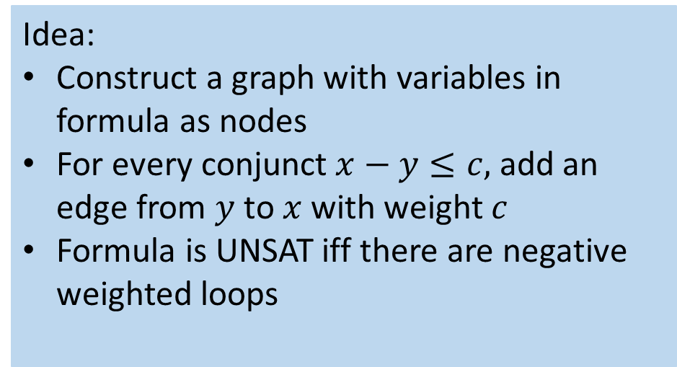
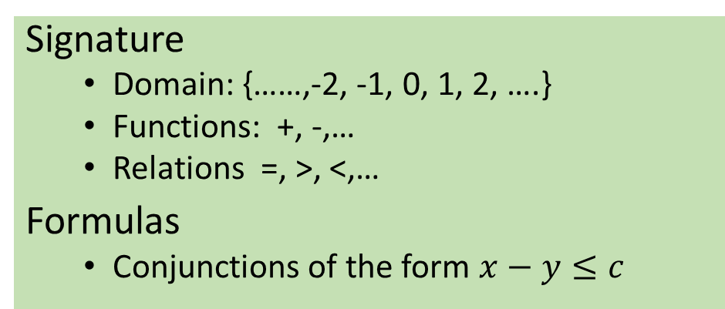
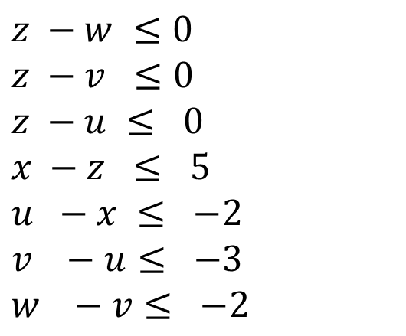
Decision Procedure for Difference logic
Signature
Domain: {……,-2, -1, 0, 1, 2, ….}
Functions: +, -,…
Relations =, >, <,…
Formulas
Conjunctions of the form $x−y≤c$
$$z −w ≤0$$
$$z −v ≤0$$
$$z −u ≤ 0$$
$$x −z ≤ 5$$
$$u −x ≤ −2$$
$$v −u≤ −3$$
$$w −v≤ −2$$
Idea:
Construct a graph with variables in formula as nodes
For every conjunct $x−y≤c,$ add an edge from $y$ to $x$ with weight $c$
Formula is UNSAT iff there are negative weighted loops

Slide 18







Decision Procedure for Difference logic
Signature
Domain: {……,-2, -1, 0, 1, 2, ….}
Functions: +, -,…
Relations =, >, <,…
Formulas
Conjunctions of the form $x−y≤c$
$$z −w ≤0$$
$$z −v ≤0$$
$$z −u ≤ 0$$
$$x −z ≤ 5$$
$$u −x ≤ −2$$
$$v −u≤ −3$$
$$w −v≤ −2$$
Idea:
Construct a graph with variables in formula as nodes
For every conjunct $x−y≤c,$ add an edge from $y$ to $x$ with weight $c$
Formula is UNSAT iff there are negative weighted loops

Slide 19


Decision Procedure for Difference logic
Can be implemented in O(mn) time using Bellman-Ford algorithm
Signature
Domain: {……,-2, -1, 0, 1, 2, ….}
Functions: +, -,…
Relations =, >, <,…
Formulas
Conjunctions of the form $x−y≤c$
$$z −w ≤0$$
$$z −v ≤0$$
$$z −u ≤ 0$$
$$x −z ≤ 5$$
$$u −x ≤ −2$$
$$v −u≤ −3$$
$$w −v≤ −2$$
Idea:
Construct a graph with variables in formula as nodes
For every conjunct $x−y≤c,$ add an edge from $y$ to $x$ with weight $c$
Formula is UNSAT iff there are negative weighted loops

Slide 20
Decision procedures for LIA and LRA
LRA
Domain: Reals
Functions: +, -,…
Relations =, >, <,…
Many solvers implement variants of simplex or Fouier-Motzkin methods in spite of worst-case exponential complexity.
LIA
Domain: {……,-2, -1, 0, 1, 2, ….}
Functions: +, -,…
Relations =, >, <,…
Solutions include branch and bound (extension of Simplex), Omega test(extension of Fourier-Motzkin), or using small domain encodings followed by SAT

Slide 21
Next time
How do wereason about conjunctions which involve formulas from multiple theories?(Nelson-Oppen Method)
How to reason about disjunctions? (use SAT solvers together with theory solvers)
How to reason about quantifiers, which are needed to solve synthesis problems? (CEGIS..)

