Slide 1
Satisfiability Modulo Theories
Lecture 4(a)
Sriram Rajamani
(some parts adapted from notes/slides by Leo DeMoura and Emina Torlak)

Slide 2
What we have covered so far
Last week: SAT solvers
Last lecture: SMT (Satsifiability Modulo Theories)
  Theory solvers (to decide satisfiability of conjunctive quantifier free formulas)
    EUF - Congruence closure
    DIA - Negative cycle detection --Bellman Ford
    LRA - Simplex, Fourier-Motzkin
    LIA - Branch and bound, combinatorial search
Today:
  Nelson-Oppen method for combining theories (still conjunctive, quantifier free formulas)
  Deciding satisfiability of disjunctive theory formulas using SAT solvers

Slide 3

Solvers for combination of theories
Example: $f\left(x+g\left(y\right)\right)≤g\left(x\right)+f\left(y\right)$
Contains functions and relations from two different theories:
  EUF
  LRA

Slide 4
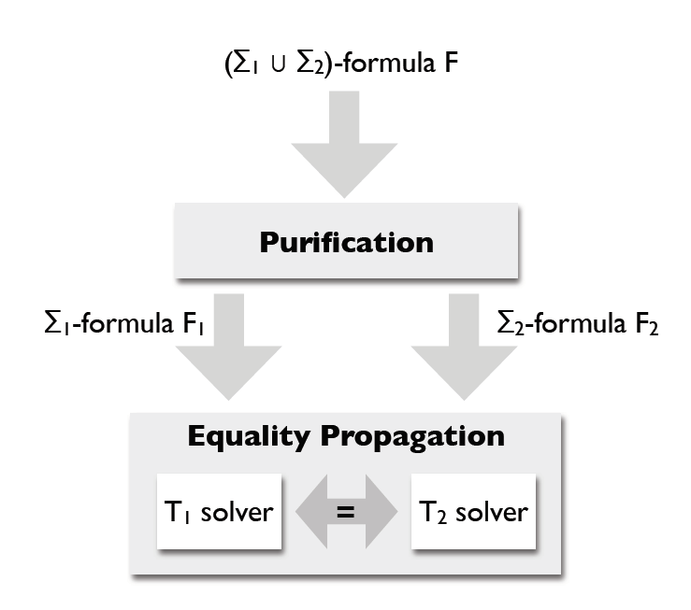

Nelson-Oppen procedure
Example: $f\left(x+g\left(y\right)\right)≤g\left(x\right)+f\left(y\right)$

Slide 5
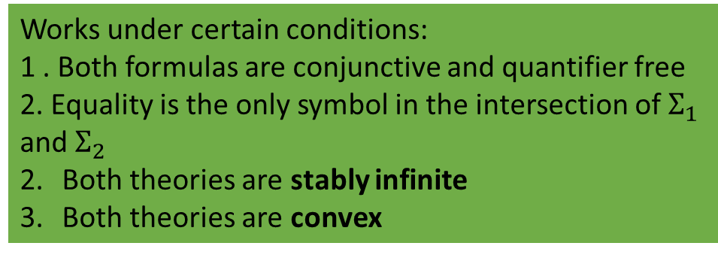

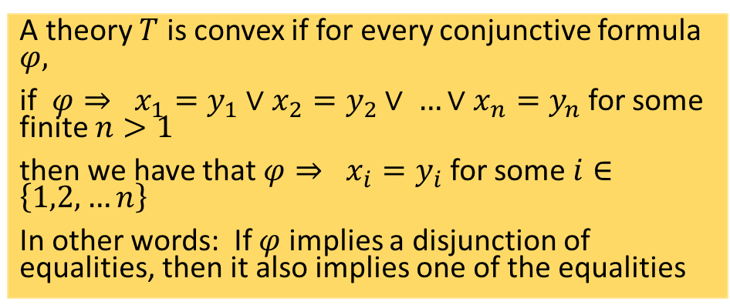
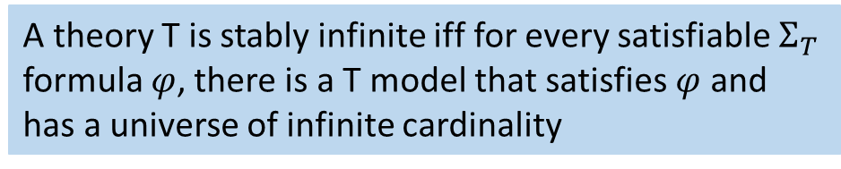
Nelson-Oppen procedure
Works under certain conditions:
1 . Both formulas are conjunctive and quantifier free
2. Equality is the only symbol in the intersection of $Σ_{1}$ and $Σ_{2}$
Both theories are stably infinite
Both theories are convex
Example: $f\left(x+g\left(y\right)\right)≤g\left(x\right)+f\left(y\right)$
A theory T is stably infinite iff for every satisfiable $Σ_{T}$ formula $φ$, there is a T model that satisfies $φ$ and has a universe of infinite cardinality
A theory $T$ is convex if for every conjunctive formula $φ,$
if $φ⇒ x_{1}=y_{1}∨x_{2}=y_{2}∨ …∨x_{n}=y_{n}$ for some finite $n>1$
then we have that $φ⇒ x_{i}=y_{i}$ for some $i∈\left\{1,2,…n\right\}$
In other words: If $φ$ implies a disjunction of equalities, then it also implies one of the equalities

Slide 6
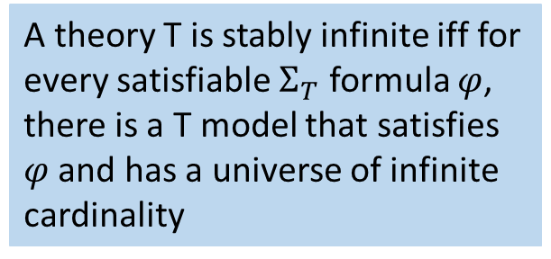

Stably infinite?
$Σ_{T}=\left\{a,b,=\right\}$
Axiom$: ∀x. \left(x=a∨x=b\right)$
2. Fixed width bit vectors
3. EUF
4. LIA
5. LRA
6. Arrays
A theory T is stably infinite iff for every satisfiable $Σ_{T}$ formula $φ$, there is a T model that satisfies $φ$ and has a universe of infinite cardinality

Slide 7






Stably infinite?
$Σ_{T}=\left\{a,b,=\right\}$
Axiom$: ∀x. \left(x=a∨x=b\right)$
2. Fixed width bit vectors
3. EUF
4. LIA
5. LRA
6. Arrays
A theory T is stably infinite iff for every satisfiable $Σ_{T}$ formula $φ$, there is a T model that satisfies $φ$ and has a universe of infinite cardinality

Slide 8

Convex ?
LIA
LRA
EUF
A theory $T$ is convex if for every conjunctive formula $φ,$
if $φ⇒ x_{1}=y_{1}∨x_{2}=y_{2}∨ …∨x_{n}=y_{n}$ for some finite $n>1$
then we have that $φ⇒ x_{i}=y_{i}$ for some $i∈\left\{1,2,…n\right\}$
In other words: If $φ$ implies a disjunction of equalities, then it also implies one of the equalities

Slide 9

Convex ?
LIA
$1≤ x ∧ x ≤ 2 ⇒x = 1 ∨ x = 2,$but
$1≤ x ∧ x ≤ 2⇏x = 1$and
$1≤ x ∧ x ≤ 2⇏x =$2
LRA
EUF
A theory $T$ is convex if for every conjunctive formula $φ,$
if $φ⇒ x_{1}=y_{1}∨x_{2}=y_{2}∨ …∨x_{n}=y_{n}$ for some finite $n>1$
then we have that $φ⇒ x_{i}=y_{i}$ for some $i∈\left\{1,2,…n\right\}$
In other words: If $φ$ implies a disjunction of equalities, then it also implies one of the equalities

Slide 10




Convex ?
LIA
$1≤ x ∧ x ≤ 2 ⇒x = 1 ∨ x = 2,$but
$1≤ x ∧ x ≤ 2⇏x = 1$and
$1≤ x ∧ x ≤ 2⇏x =$2
LRA
EUF
A theory $T$ is convex if for every conjunctive formula $φ,$
if $φ⇒ x_{1}=y_{1}∨x_{2}=y_{2}∨ …∨x_{n}=y_{n}$ for some finite $n>1$
then we have that $φ⇒ x_{i}=y_{i}$ for some $i∈\left\{1,2,…n\right\}$
In other words: If $φ$ implies a disjunction of equalities, then it also implies one of the equalities

Slide 11

Purification: example
$f\left(x+g\left(y\right)\right)≤$ $g\left(x\right)+f(y)$
Purification

Slide 12




Purification: example
$f\left(x+g\left(y\right)\right)≤$ $g\left(x\right)+f(y)$
Purification

Slide 13

Purification: example
$f\left(x+g\left(y\right)\right)≤$ $g\left(x\right)+f(y)$
Purification

Slide 14
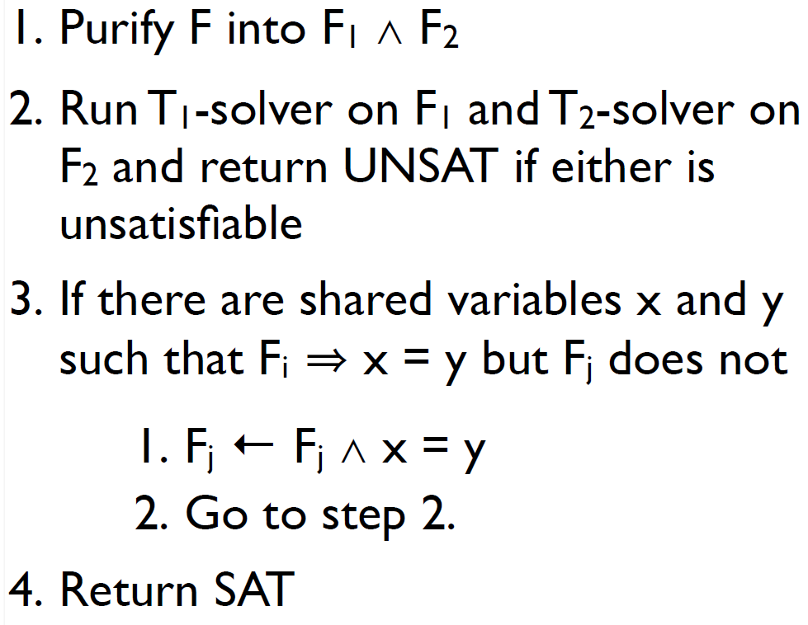
Nelson-Oppen procedure (for Convex theories)

Slide 15
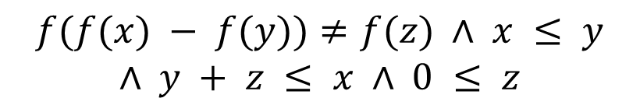
Nelson-Oppen procedure (for Convex theories)
$$f(f(x) − f(y))≠f(z) ∧ x ≤ y$$
$$∧ y + z ≤ x ∧ 0 ≤ z$$

Slide 16
Nelson-Oppen procedure (for Convex theories)
$$f(f(x) − f(y))≠f(z) ∧ x ≤ y$$
$$∧ y + z ≤ x ∧ 0 ≤ z$$

Slide 17

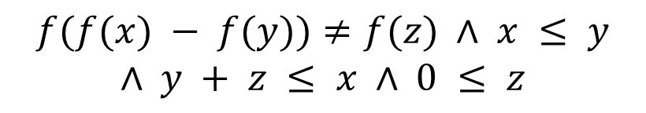
Nelson-Oppen procedure (for Convex theories)
$$f(f(x) − f(y))≠f(z) ∧ x ≤ y$$
$$∧ y + z ≤ x ∧ 0 ≤ z$$
(will formally define convexity later)

Slide 18
Nelson-Oppen procedure (for Convex theories)
$$f(f(x) − f(y))≠f(z) ∧ x ≤ y$$
$$∧ y + z ≤ x ∧ 0 ≤ z$$
(will formally define convexity later)

Slide 19
Homework
Nelsson-Oppen procedure can be extended to non-convex theories, at more computational cost. Find out how to do this.

Slide 20
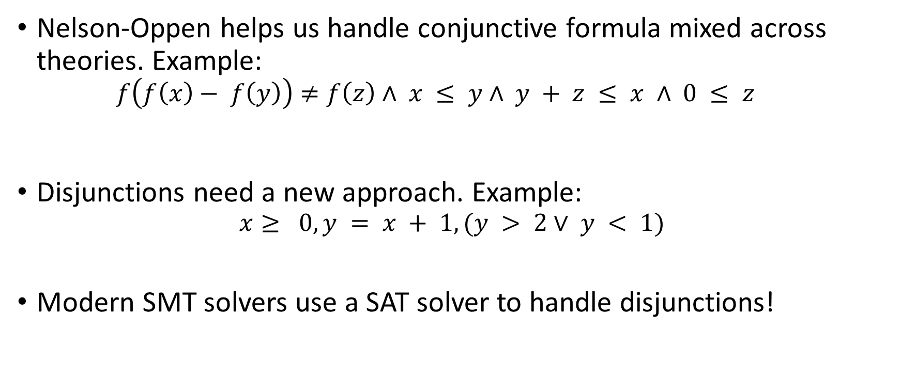
How to handle disjunctions?
Nelson-Oppen helps us handle conjunctive formula mixed across theories. Example:
  $$f\left(f\left(x\right)− f\left(y\right)\right)≠f\left(z\right)∧ x ≤ y∧ y + z ≤ x ∧ 0 ≤ z$$
Disjunctions need a new approach. Example:
$$x≥ 0, y = x + 1, (y > 2∨ y < 1)$$
Modern SMT solvers use a SAT solver to handle disjunctions!

Slide 21
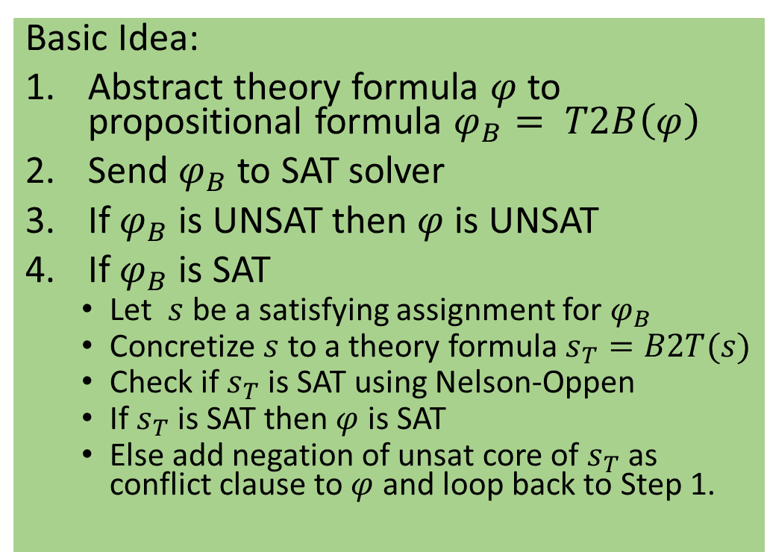
DPLL(T): Handling disjunctions using SAT
Basic Idea:
Abstract theory formula $φ$ to propositional formula $φ_{B}= T2B\left(φ\right)$
Send $φ_{B}$ to SAT solver
If $φ_{B}$ is UNSAT then $φ$ is UNSAT
If $φ_{B}$is SAT
  Let $s$ be a satisfying assignment for $φ_{B}$
  Concretize $s$ to a theory formula $s_{T}=B2T(s)$
  Check if $s_{T}$ is SAT using Nelson-Oppen
  If $s_{T}$ is SAT then $φ$ is SAT
  Else add negation of unsat core of $s_{T}$ as conflict clause to $φ$ and loop back to Step 1.
$$x≥ 0, y = x + 1, (y > 2∨ y < 1)$$

Slide 22


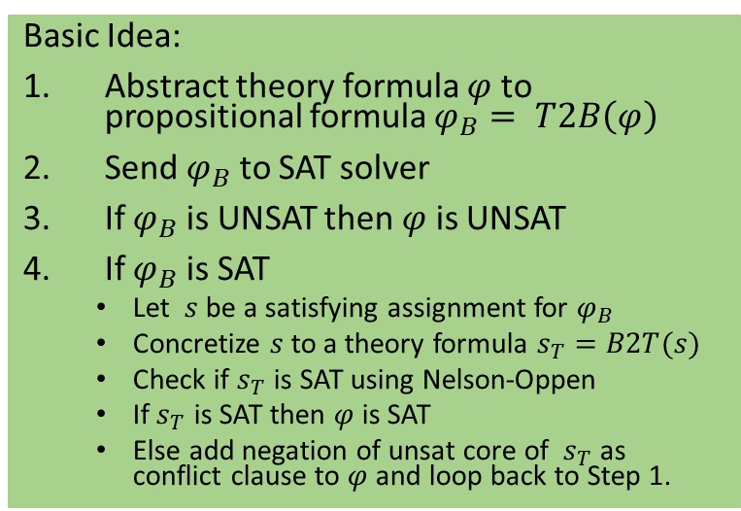

DPLL(T): Handling disjunctions using SAT
Basic Idea:
Abstract theory formula $φ$ to propositional formula $φ_{B}= T2B\left(φ\right)$
Send $φ_{B}$ to SAT solver
If $φ_{B}$ is UNSAT then $φ$ is UNSAT
If $φ_{B}$is SAT
  Let $s$ be a satisfying assignment for $φ_{B}$
  Concretize $s$ to a theory formula $s_{T}=B2T(s)$
  Check if $s_{T}$ is SAT using Nelson-Oppen
  If $s_{T}$ is SAT then $φ$ is SAT
  Else add negation of unsat core of $s_{T}$ as conflict clause to $φ$ and loop back to Step 1.
$$x≥ 0, y = x + 1, (y > 2∨ y < 1)$$

Slide 23
DPLL(T): Optimizations(1)
Incrementality:
Pass literals to the Theory solver as they are assigned by the SAT solver
$$p_{1}= x≥ 0, p_{2}= y = x + 1, p_{3}= y > 2,$$
$${ p}_{4}= y < 1, p_{5}=x<2$$

Slide 24

DPLL(T): Optimizations(1)
Incrementality:
Pass literals to the Theory solver as they are assigned by the SAT solver
$$p_{1}= x≥ 0, p_{2}= y = x + 1, p_{3}= y > 2,$$
$${ p}_{4}= y < 1, p_{5}=x<2$$

Slide 25
DPLL(T): Optimizations(2)
Theory Propagation:
SMT equivalent of unit propagation
$$p_{1}= x≥ 0, p_{2}= y = x + 1, p_{3}= y > 2,$$
$${ p}_{4}= y < 1, p_{5}=x<2$$

Slide 26
DPLL(T): Optimizations(2)
Theory Propagation:
SMT equivalent of unit propagation
$$p_{1}= x≥ 0, p_{2}= y = x + 1, p_{3}= y > 2,$$
$${ p}_{4}= y < 1, p_{5}=x<2$$

Slide 27



DPLL(T): Optimizations(2)
Theory Propagation:
SMT equivalent of unit propagation
$$p_{1}= x≥ 0, p_{2}= y = x + 1, p_{3}= y > 2,$$
$${ p}_{4}= y < 1, p_{5}=x<2$$

Slide 28
Homework
Go through Z3 online tutorial at https://rise4fun.com/z3/tutorial
Come up with problems from your own research interests that can be encoded as SMT formulas and try running Z3 on these

