Slide 1
Program Synthesis Using SAT/SMT Solvers
Lecture 4(b)
Sriram Rajamani
(adapted from lectures/talks by Armando Solar Lezama, Rajeev Alur and Sanjit Seshia)

Slide 2
Recall our sketching example (1)
void doublesketch (int x)/*double.sk:1*/
{
assert ((x * 2) == (x + x)); //Assert at double.sk:3 (2)
}
/*double.sk:1*/
harness void doublesketch(int x)
{
int t = x * ??;
assert t == x + x;
}

Slide 3
And swapping example..
Problem:
Swap two inputs with a sequence of assignments using “exor” and no temporary variables.
That is, using a program of the form
x = x ^ y
y = x ^ y
..
With 3 assignment statements
int W = 32;
void swap(ref bit[W] x, ref bit[W] y){
if(??){ x = x ^ y; }else{ y = x ^ y; }
if(??){ x = x ^ y; }else{ y = x ^ y; }
if(??){ x = x ^ y; }else{ y = x ^ y; }
}
harness void main(bit[W] x, bit[W] y){
bit[W] xold = x, yold = y;
swap(x,y);
assert y == xold && x == yold;
}

Slide 4
A sketch as a constraint system
int lin(int x){
if(x > ??₁)
return ??₂*x + ??₃;
else
return ??₄*x;
}
void main(int x){
int t1 = lin(x);
int t2 = lin(x+1);
if(x<4) assert t1 >= x*x;
if(x>=3) assert t2-t1 == 1;
}
x > ??₁
x+1 > ??₁
??₂*x + ??₃
??₂*(x+1) + ??₃
??₄*x
??₄*(x+1)
mux
mux
x>=4
-
1
x*x
x<3
=
>=
or
or
and

Slide 5
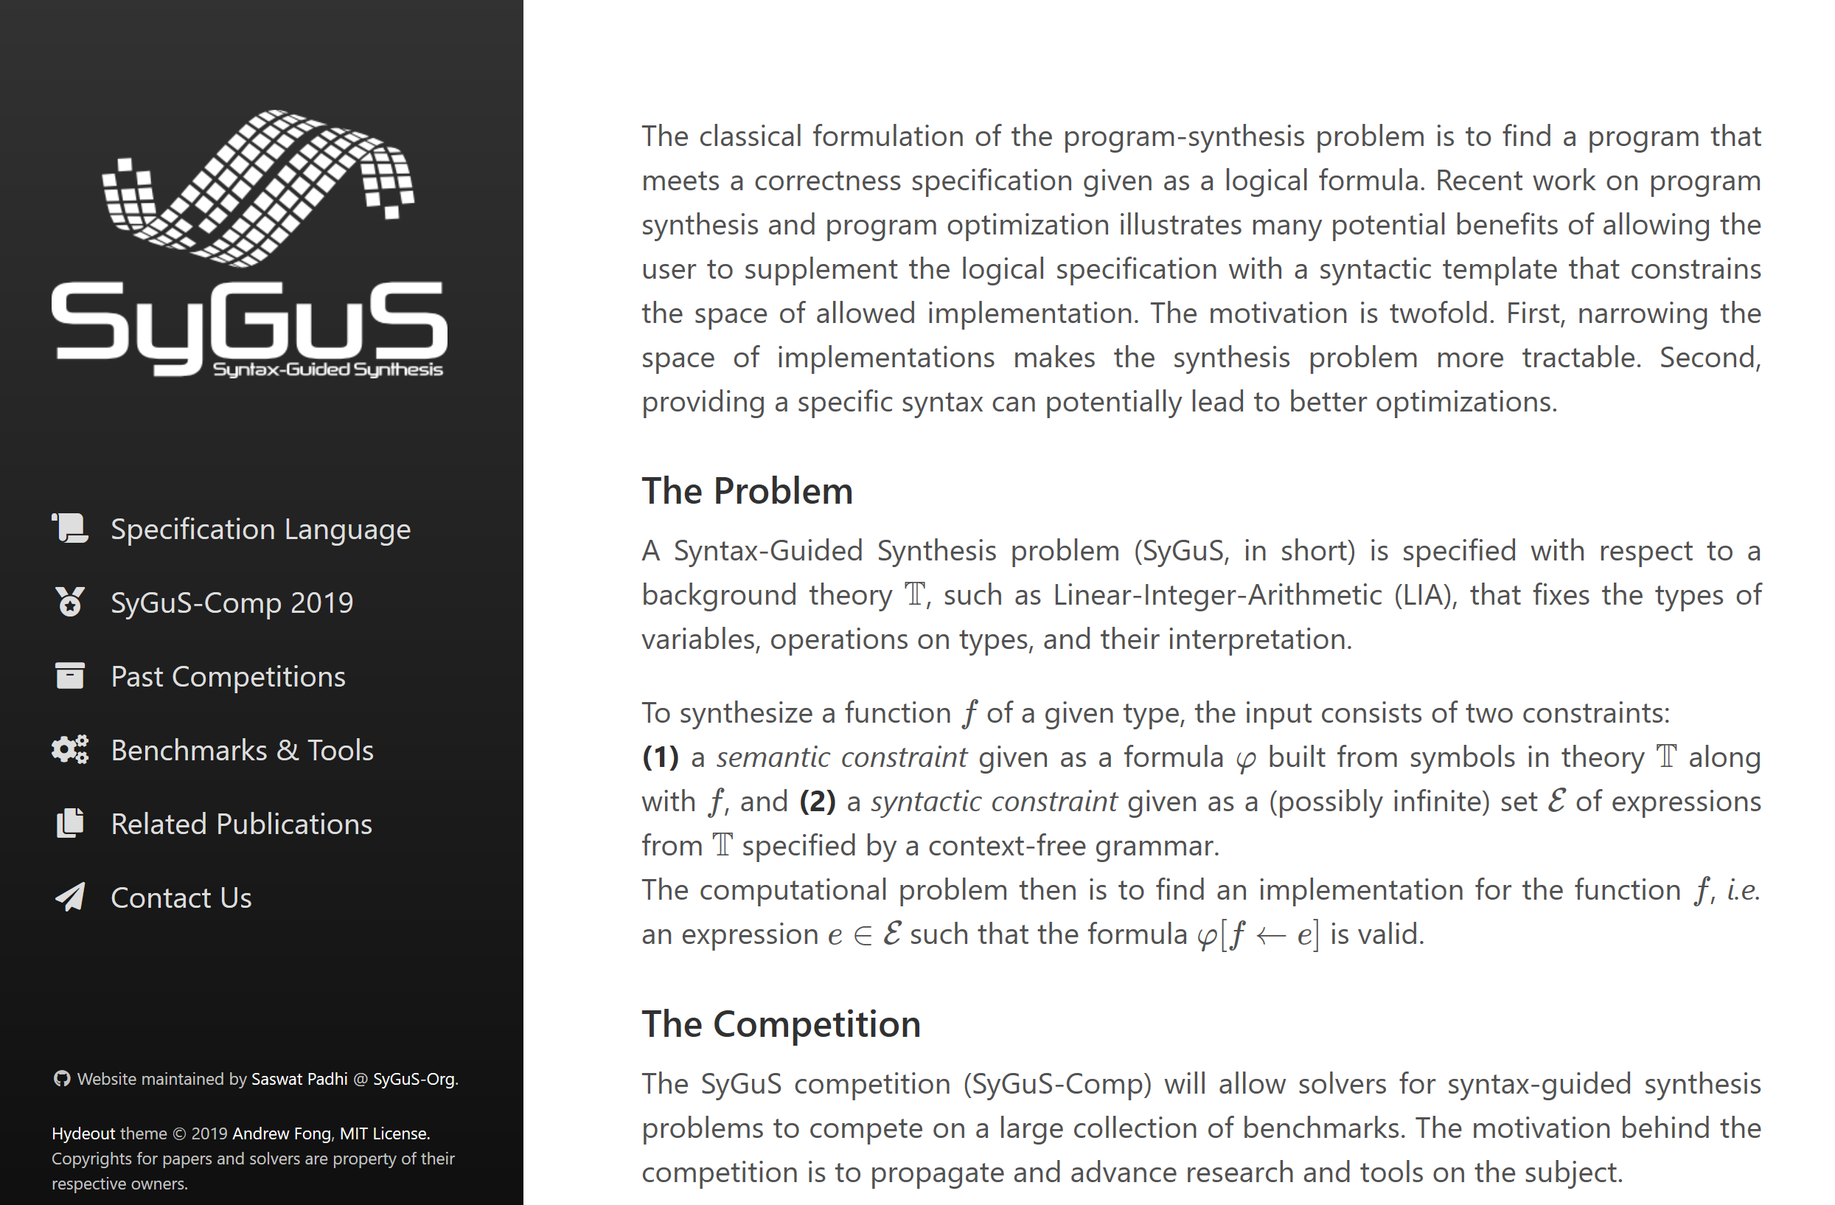

SyGus: Syntax Guided Synthesis
Fix a background theory $T:$ fixes types and operations
Function to be synthesized: name $f$along with its type
General case: multiple functions to be synthesized
Inputs to SyGuS problem:
Specification $φ(x, f(x))$
Typed formula using symbols in $T$ + symbol $f$
Set of expressions given by a context-free grammar $G$
Set of candidate expressions that use symbols in $T$
Computational problem
Output $e$ from grammar $G$, such that $φ [e→f]$is valid (in theory T)
Syntax-guided synthesis; FMCAD’13
Alur, Bodik, Juniwal, Martin, Raghothaman, Seshia, Singh, Solar-Lezama, Torlak, Udupa

Slide 6
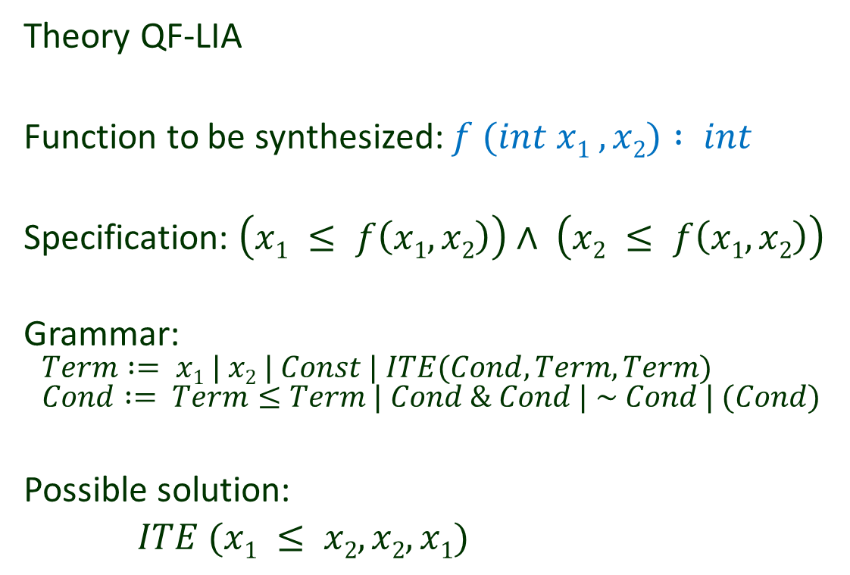
SyGus Example
(set-logic LIA)
(synth-fun f ((x Int) (y Int)) Int
((Start Int
(x y 0 1 (+ Start Start)(- Start Start)
(ite StartBool Start Start)))
(StartBool Bool
((and StartBool StartBool)
(or StartBool StartBool)
(not StartBool)
(<= Start Start)))))
(declare-var x Int)
(declare-var y Int)
(constraint (>= (f x y) x))
(constraint (>= (f x y) y))
(check-synth)
Theory QF-LIA
Function to be synthesized: $f (int x1 , x2) : int$
Specification: $\left(x1 ≤ f\left(x1, x2\right)\right)∧ \left(x2 ≤ f\left(x1, x2\right)\right)$
Grammar:
$$Term := x1 | x2 | Const | ITE(Cond, Term, Term) \\ Cond := Term≤Term | Cond \& Cond | \sim Cond | (Cond)$$
Possible solution:
$ITE (x1 ≤ x2, x2, x1)$

Slide 7
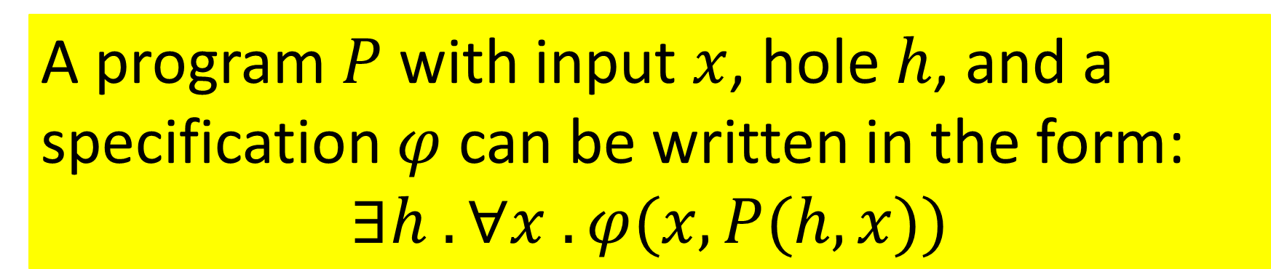
Formulating synthesis as a constraint
A program $P$with input $x$, hole $h$, and a specification $φ$ can be written in the form:
$$∃h . ∀x . φ(x,P(h,x))$$

Slide 8
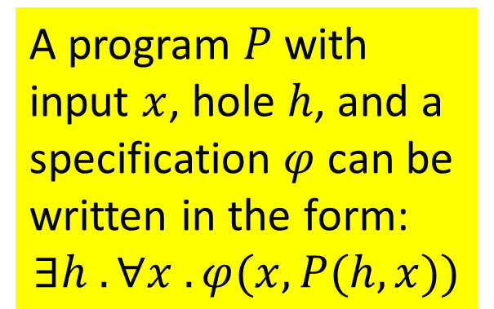
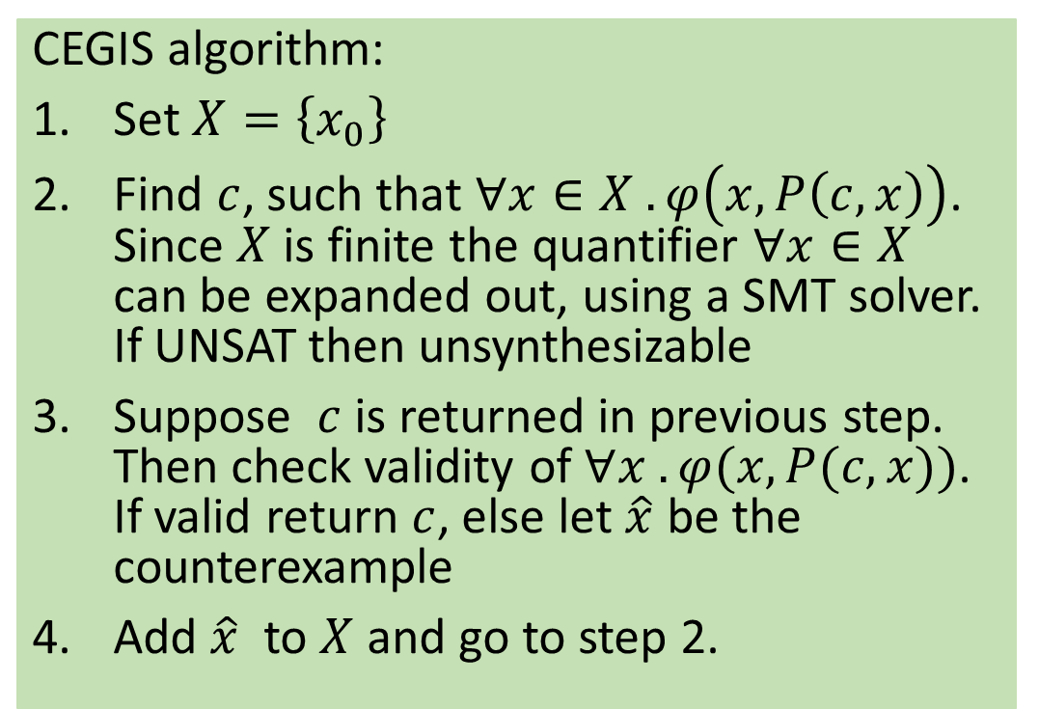
CEGIS: Solving constraint-based synthesis
CEGIS algorithm:
Set $X=\left\{x_{0}\right\}$
Find $c$, such that $∀x∈X . φ\left(x,P\left(c,x\right)\right)$. Since $X$ is finite the quantifier $∀x∈X$ can be expanded out, using a SMT solver. If UNSAT then unsynthesizable
Suppose $c$is returned in previous step. Then check validity of $∀x . φ(x, P(c,x))$. If valid return $c$, else let $\hat{x}$ be the counterexample
Add $\hat{x}$ to $X$ and go to step 2.
A program $P$with input $x$, hole $h$, and a specification $φ$ can be written in the form:
$$∃h . ∀x . φ(x,P(h,x))$$

Slide 9





CEGIS: Solving constraint-based synthesis
A program $P$with input $x$, hole $h$, and a specification $φ$ can be written in the form:
$$∃h . ∀x . φ(x,P(h,x))$$
Synthesize
$$c$$
Check
$$∃c s.t. φ({x, P}_{c}(x))$$
$∃ x_{i} s.t. ¬φ(x_{i}, P_{c}(x_{i})$)
$$x_{i}$$
$$\{x_{0} \}$$

Slide 10

CEGIS: Solving constraint-based synthesis
A program $P$with input $x$, hole $h$, and a specification $φ$ can be written in the form:
$$∃h . ∀x . φ(x,P(h,x))$$
Synthesize
$$c$$
Check
$$∃c s.t. φ({x, P}_{c}(x))$$
$∃ x_{i} s.t. ¬φ(x_{i}, P_{c}(x_{i})$)
$$x_{i}$$
$$\{x_{0}, x_{1},…x_{k}\}$$

Slide 11
Other approaches to solving synthesis problems
Enumerative approach
Iteratively construct all programs of size K until one is consistent with the current inputs.
If two programs produce the same output on all current inputs, keep just one of the two.
[Udupa et al, PLDI 2011]
Stochastic Search
Use Metropolis-Hastings to sample expressions
Mutate the current candidate program and keep the mutation with probability proportional to its correctness w.r.t. the current inputs
[Schkufza et al, ASPLOS 2013]

Slide 12




OGIS: Oracle Guided Inductive Synthesis (General Search-Verify architecture)
Specification
Candidate
programs
Search
Algorithm
Verification
Oracle
Examples
Counter Examples
Susmit Jha, Sumit Gulwani, Sanjit A. Seshia, and Ashish Tiwari, Oracle guided component-based program synthesis. ICSE 2010

Slide 13
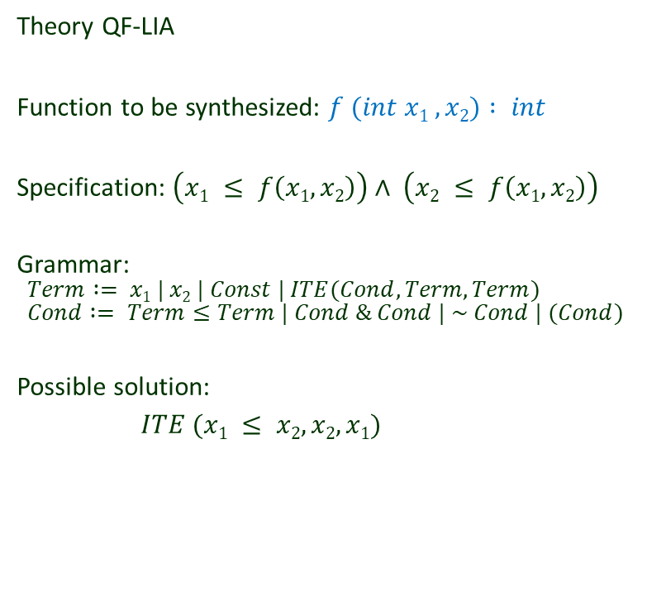

Search and Verify
Specification
Theory QF-LIA
Function to be synthesized: $f (int x1 , x2) : int$
Specification: $\left(x1 ≤ f\left(x1, x2\right)\right)∧ \left(x2 ≤ f\left(x1, x2\right)\right)$
Grammar:
$$Term := x1 | x2 | Const | ITE(Cond, Term, Term) \\ Cond := Term≤Term | Cond \& Cond | \sim Cond | (Cond)$$
Possible solution:
$ITE (x1 ≤ x2, x2, x1)$
Candidate
f(x₁, x₂) = x₁
Verification
Oracle
Search
Algorithm
I = { }
Counter Example
(x₁=0, x₂=1)

Slide 14
Search and Verify
Specification
Theory QF-LIA
Function to be synthesized: $f (int x1 , x2) : int$
Specification: $\left(x1 ≤ f\left(x1, x2\right)\right)∧ \left(x2 ≤ f\left(x1, x2\right)\right)$
Grammar:
$$Term := x1 | x2 | Const | ITE(Cond, Term, Term) \\ Cond := Term≤Term | Cond \& Cond | \sim Cond | (Cond)$$
Possible solution:
$ITE (x1 ≤ x2, x2, x1)$
Candidate
f(x₁, x₂) = x₁
Verification
Oracle
Search
Algorithm
I = {(x₁=0, x₂=1)}
Counter Example
(x₁=1, x₂=0)

Slide 15
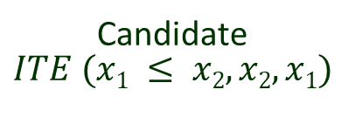
Search and Verify
Specification
Theory QF-LIA
Function to be synthesized: $f (int x1 , x2) : int$
Specification: $\left(x1 ≤ f\left(x1, x2\right)\right)∧ \left(x2 ≤ f\left(x1, x2\right)\right)$
Grammar:
$$Term := x1 | x2 | Const | ITE(Cond, Term, Term) \\ Cond := Term≤Term | Cond \& Cond | \sim Cond | (Cond)$$
Possible solution:
$ITE (x1 ≤ x2, x2, x1)$
Candidate
$$ITE (x1 ≤ x2, x2, x1)$$
Verification
Oracle
Search
Algorithm
I = {(x₁=0, x₂=1), (x₁=1, x₂=0),
(x₁=0, x₂=0),
(x₁=1, x₂=1)}
Counter Example
None!

Slide 16
Black box specifications and distinguishing inputs
In some cases, we only have a black box specification (eg, legacy implementation, binary executable, human oracle etc).
Such an oracle cannot check equivalence of a candidate program with the specification. It can only produce outputs for specific inputs.
In such cases, Verification Oracle can look for a “distinguishing counterexample”
an input that yields different behavior for the current candidate program P and some other possible candidate P* (which is still consistent with the all the existing inputs).
If such input does not exist, then all programs that are consistent with the chosen set of inputs are semantically equivalent – they produce the same outputs on all inputs
Search for distinguishing counterexample can be phrased as a SAT query
Black box specification
Candidate
program
Search
Algorithm
Verification
Oracle
Examples
Distinguishing Counterexample
Susmit Jha, Sumit Gulwani, Sanjit A. Seshia, and Ashish Tiwari, Oracle guided component-based program synthesis. ICSE 2010

Slide 17
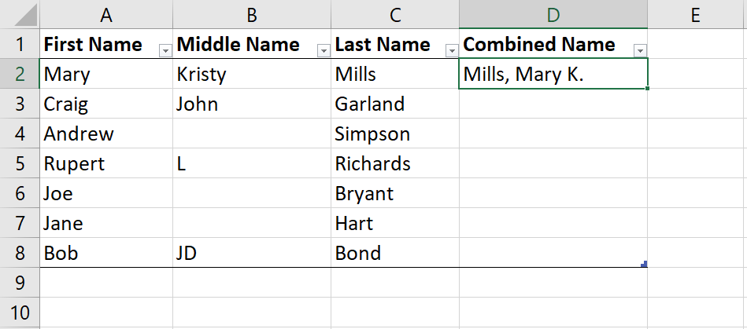

PBE: Programming By Example Use only examples as specification!
Many candidate solutions possible.
Need to use ranking to order the candidate solutions, so that we pick solutions that generalize!
if (input[1] == ‘’) then Concat(input[2], Const(“, ”), input[0], Const(“.”)) else Concat(input[2], Const(“, ”), input[0], Const(“ ”), let v = input[1] in Substring(v, AbsPos(v, 0), RegexPos(v, UpperCase, ‘’, -1)), Const(“.”))

Slide 18
Homework
Further Reading
Syntax-guided synthesis, Alur, Bodik, Juniwal, Martin, Raghothaman, Seshia, Singh, Solar-Lezama, Torlak, Udupa, FMCAD 13
Oracle guided component-based program synthesis, Susmit Jha, Sumit Gulwani, Sanjit A. Seshia, and Ashish Tiwari, ICSE 2010
Browse through benchmarks from the Sygus competion website
Try out synthesis tools from Sygus competition website

