Slide 1
Quantifier handling and model generation in SMT solvers
Sriram Rajamani
Lecture 5 (b)
(adapted from material by Leo DeMoura, Pascal Fontaine and Emina Torlak)

Slide 2
What we have covered so far
SAT solvers: DPLL with conflict clause learning
SMT (Satisfiability Modulo Theories) and quantifier free formulas
Theory solvers (to decide satisfiability of conjunctive quantifier free formulas)
EUF - Congruence closure
DIA - Negative cycle detection --Bellman Ford
LRA - Simplex, Fourier-Motzkin
LIA - Branch and bound, combinatorial search
Nelson-Oppen method for combining theories (still conjunctive, quantifier free formulas)
Deciding satisfiability of disjunctive theory formulas using SAT solvers (still quantifier free)

Slide 3
Decision procedures for SMT formulas with quantifiers?
FOL is undecidable in general
Many of the theories we have studied become undecidable when we add quantifiers (e.g. EUF)
Some theories (e.g., linear arithmetic over integers, arithmetic over reals) support quantifier elimination.
What do SMT solvers do when formulas have quantifiers?
Existential quantifiers can be skolemized
Universal quantifiers are typically handled by heuristic instantiation

Slide 4
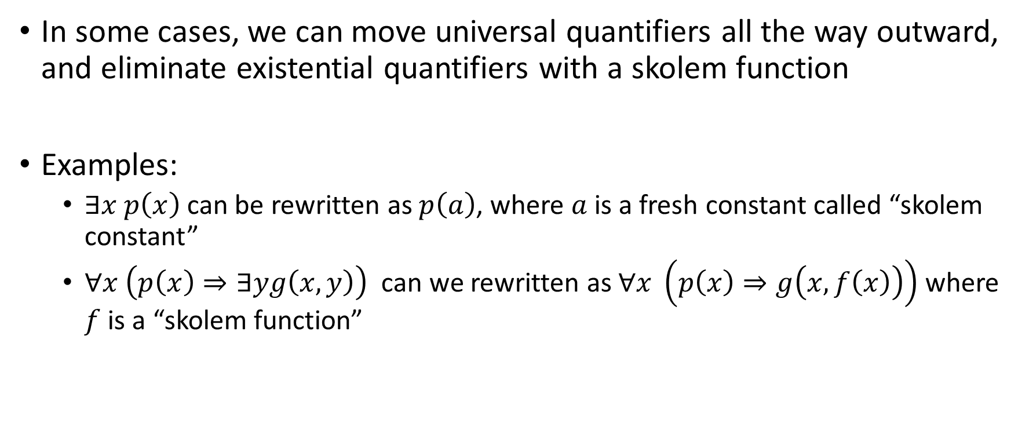
Skolemization
In some cases, we can move universal quantifiers all the way outward, and eliminate existential quantifiers with a skolem function
Examples:
$∃x p\left(x\right)$ can be rewritten as $p\left(a\right)$, where $a$ is a fresh constant called “skolem constant”
$∀x \left(p\left(x\right)⇒∃yg\left(x,y\right)\right)$ can we rewritten as $∀x \left(p\left(x\right)⇒g\left(x,f\left(x\right)\right)\right)$ where $f$ is a “skolem function”

Slide 5
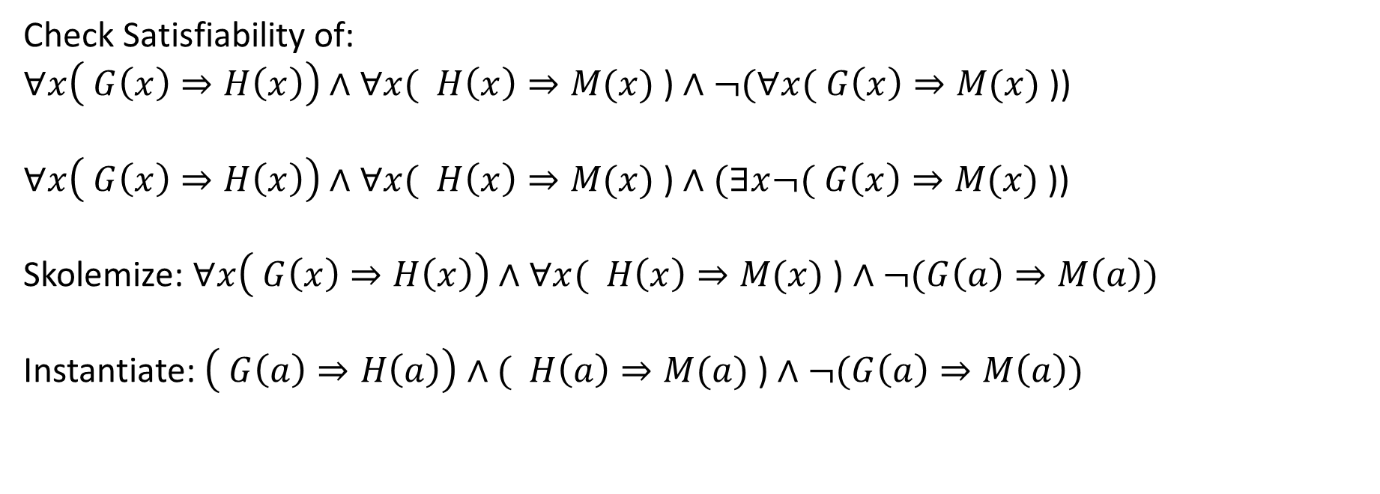
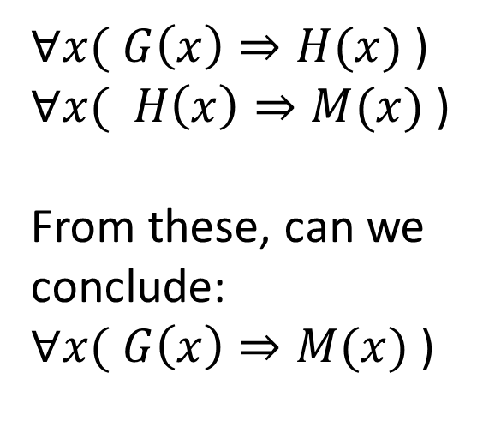
A classic question in logic
$∀x( G\left(x\right)⇒H(x)$ )
$∀x( H\left(x\right)⇒M(x)$ )
From these, can we conclude: $∀x( G\left(x\right)⇒M(x)$ )
S1: All Greeks are Humans
S2: All Humans are Mortal
From S1 and S2, we can conclude C?
C: All Greeks are Mortal
Check Satisfiability of:
$∀x\left( G\left(x\right)⇒H\left(x\right)\right)∧∀x( H\left(x\right)⇒M(x)\text{ )}∧¬(∀x( G\left(x\right)⇒M(x)\text{ )}$)
$∀x\left( G\left(x\right)⇒H\left(x\right)\right)∧∀x( H\left(x\right)⇒M(x)\text{ )}∧(∃x¬( G\left(x\right)⇒M(x)\text{ )}$)
Skolemize: $∀x\left( G\left(x\right)⇒H\left(x\right)\right)∧∀x( H\left(x\right)⇒M(x)\text{ )}∧¬(G\left(a\right)⇒M\left(a\right))$
Instantiate: $\left( G\left(a\right)⇒H\left(a\right)\right)∧( H\left(a\right)⇒M(a)\text{ )}∧¬(G\left(a\right)⇒M\left(a\right))$

Slide 6
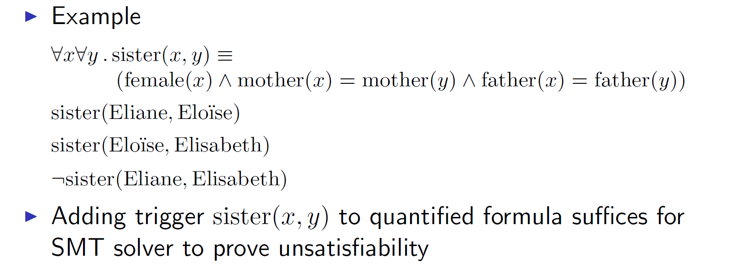
How do we decide when to instantiate a universal quantifier?
A “trigger” is a heuristic hint given to an SMT solver to instantiate a universally quantified formula
In many practical cases, triggers can be determined automatically using heuristics (called e-matching heuristics)

Slide 7
In general…
Instantiation of quantifiers needs to be done “on the fly” inside the SMT solver
Let us recall how DPLL(T) works..

Slide 8
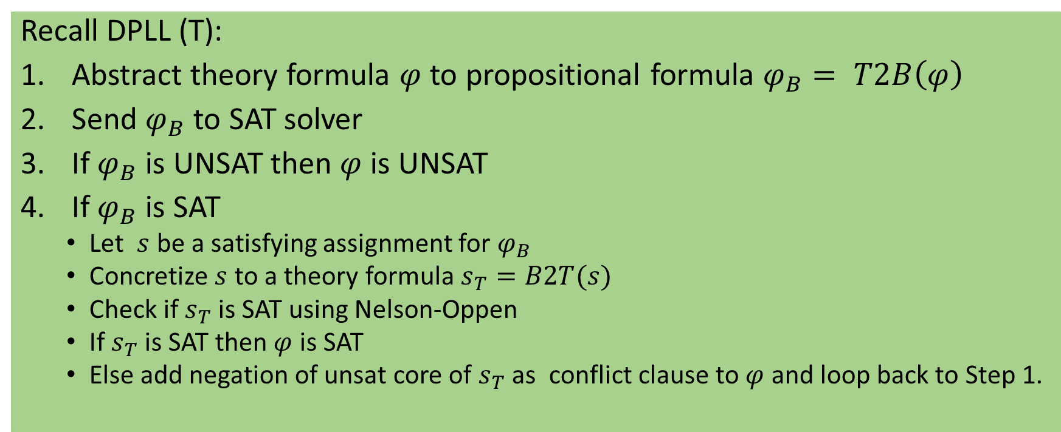
Consider this example
Recall DPLL (T):
Abstract theory formula $φ$ to propositional formula $φ_{B}= T2B\left(φ\right)$
Send $φ_{B}$ to SAT solver
If $φ_{B}$ is UNSAT then $φ$ is UNSAT
If $φ_{B}$is SAT
Let $s$ be a satisfying assignment for $φ_{B}$
Concretize $s$ to a theory formula $s_{T}=B2T(s)$
Check if $s_{T}$ is SAT using Nelson-Oppen
If $s_{T}$ is SAT then $φ$ is SAT
Else add negation of unsat core of $s_{T}$ as conflict clause to $φ$ and loop back to Step 1.

Slide 9
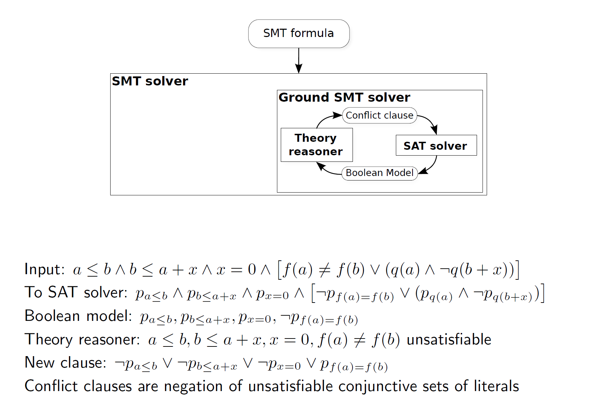

Slide 10
Now consider this quantified formula:

Slide 11
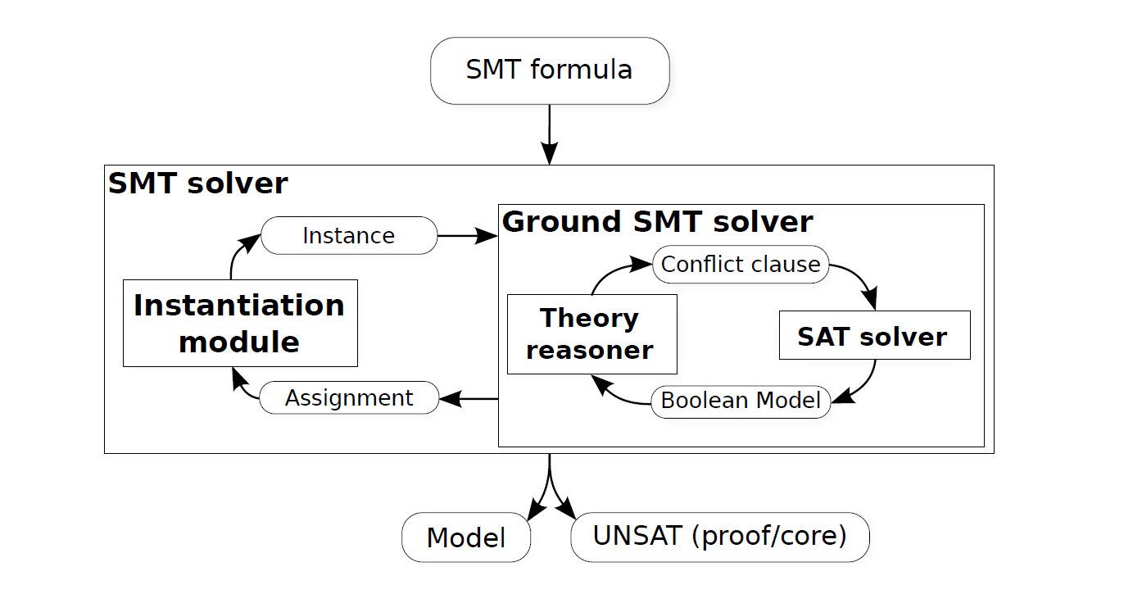
Architecture for quantified SMT formulas

Slide 12
Model finding
If a formula is satisfiable, find a suitable model finding
Most decision procedures we discussed (e.g. SAT, EUF etc) can be adapted so that they produce models when the formula is satisfiable
An alternative and popular method is to look for finite models using a finite (and usually small) universe

Slide 13
