Slide 1
Scalable Context-Sensitive Flow Analysis Using Instantiation Constraints
Manuel Fahndrich
Jakob Rehof
Manuvir Das

Slide 2
Overview
Constraint based Polymorphic Type Inference
Construction of Type Instantiation Graph (TIG)
Flow analysis on TIG

Slide 3
Introduction
Using type inference for flow analysis
Polymorphic version of Steensgaard’s points-to analysis
Polymorphism responsible for context-sensitivity
Extends naturally to higher order programs

Slide 4
Outline
Steensgaard’s Analysis and Types
Constraint Based Type Inference
Intraprocedural Type Inference
Interprocedural Type Inference without Polymorphism
Interprocedural Type Inference with Polymorphism
Semi-unification Algorithm with Interprocedural Flows
Type Instantiation Graph
Flow Analysis
Extension to Higher-order Programs
Thought Experiment – Andersen’s analysis and Type Inference

Slide 5
Steensgaard’s Analysis
x = &a;
y = x;
y = &b;
b = &c;
T1
T2
T3
x
a
c
y
b
Divides variables into equivalence classes and maintains points-to information
*example taken from pointer analysis slides by G. Ramalingam

Slide 6
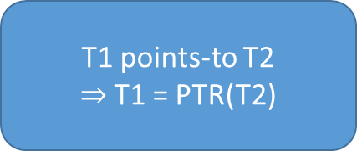
Inspired by Type Inference!
T1, T2, T3 are types of variables
Each equivalence class represents data flow information
T1
T2
T3
PTR(PTR(T))
PTR(T)
T
x
y
a
b
c
T1 points-to T2
$⇒$T1 = PTR(T2)
Variables in the same class have possible flows amongst themselves
C Analogy :
If T3 is int, T2 is int* and T1 is int**
The “direction” of flow is unknown

Slide 7
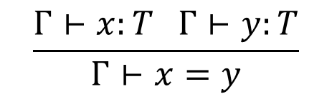
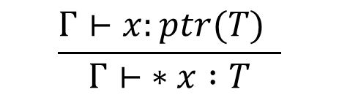
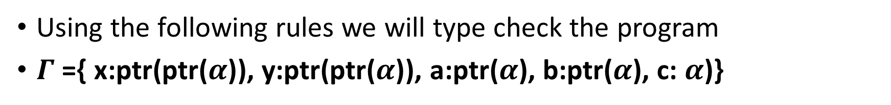

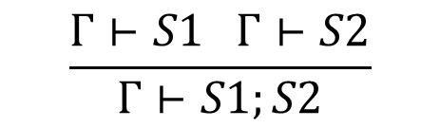
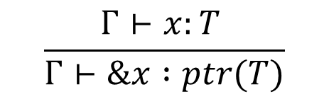
Type Checking
x = &a;
y = x;
y = &b;
b = &c;
Using the following rules we will type check the program
$Γ$ ={ x:ptr($\text{ptr}\text{(}α\text{)}$), y:ptr($\text{ptr}\text{(}α\text{)}$), a:ptr($α$), b:ptr($α$), c: $α$)}
$$\frac{Γ⊢x:ptr(T) }{Γ⊢ ∗x :T}$$
$$\frac{x:T ∈Γ}{Γ⊢x:T}$$
$$\frac{Γ⊢x:T }{Γ⊢\&x :ptr(T)}$$
[deref]
[var]
[addr]
$$\frac{Γ⊢x:T Γ⊢y:T}{Γ⊢x=y}$$
$$\frac{Γ⊢S1 Γ⊢S2}{Γ⊢S1;S2}$$
[Assign]
[seq]

Slide 8
Steensgaard’s Analysis and Type Inference
Therefore, we can use type inference to divide the program variables into equivalence classes
these equivalence classes are the flow relations between variables
types also encode the points-to information among variables

Slide 9
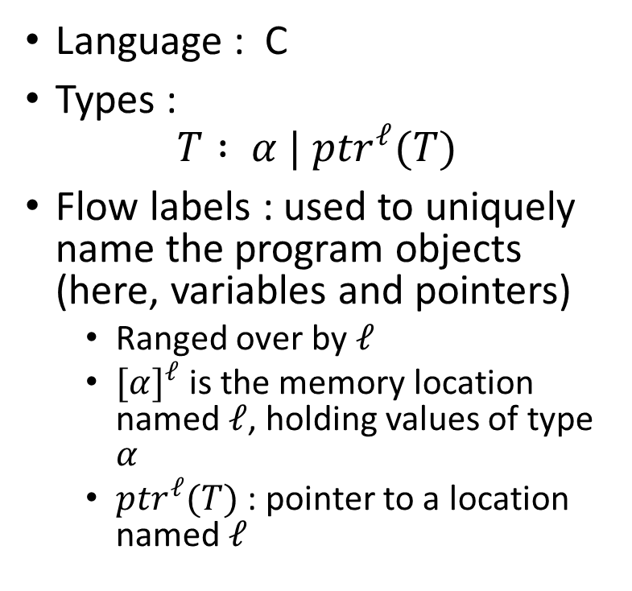
Types and Locations
Language : C
Types :
$$T : α | {ptr}^{ℓ}(T)$$
Flow labels : used to uniquely name the program objects (here, variables and pointers)
Ranged over by $ℓ$
${[α]}^{ℓ}$is the memory location named $ℓ$, holding values of type $α$
${ptr}^{ℓ}(T)$: pointer to a location named $ℓ$
PTR(PTR(T))
PTR(T)
T
x
y
a
b
c

Slide 10
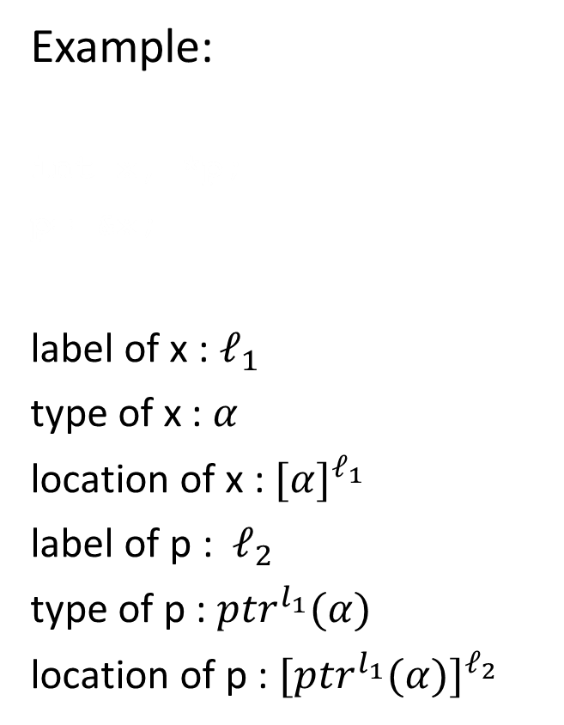
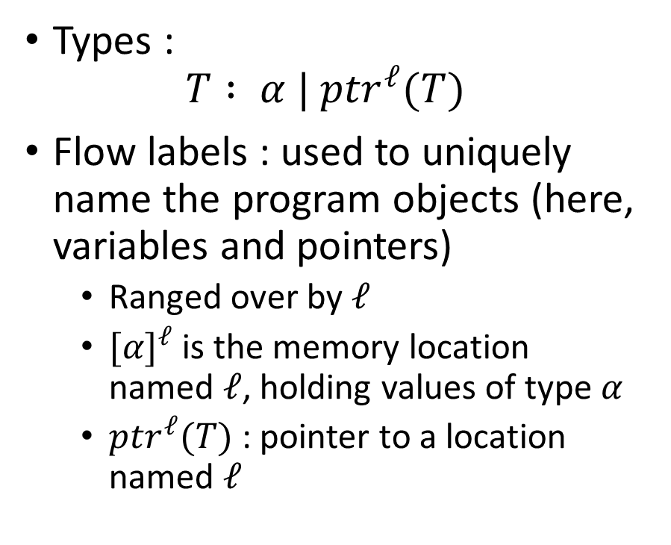
Types and Locations
Example:
int x, *p;
p= &x;
label of x : $ℓ_{1}$
type of x : $α$
location of x : ${[α]}^{ℓ_{1}}$
label of p : $ℓ_{2}$
type of p : ${ptr}^{l_{1}}(α)$
location of p : ${[{ptr}^{l_{1}}(α)]}^{ℓ_{2}}$
Types :
$$T : α | {ptr}^{ℓ}(T)$$
Flow labels : used to uniquely name the program objects (here, variables and pointers)
Ranged over by $ℓ$
${[α]}^{ℓ}$is the memory location named $ℓ$, holding values of type $α$
${ptr}^{ℓ}(T)$: pointer to a location named $ℓ$

Slide 11
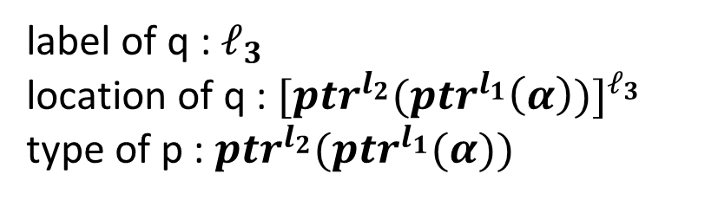
Types and Locations – Quick Practice
int x, *p, **q;
p = &x;
q = &p;
Q. Write the label, location and type of variable q.
label of q : $ℓ_{3}$
location of q : ${[{ptr}^{l_{2}}({ptr}^{l_{1}}\left(α\right))]}^{ℓ_{3}}$
type of p : ${ptr}^{l_{2}}({ptr}^{l_{1}}(α))$

Slide 12
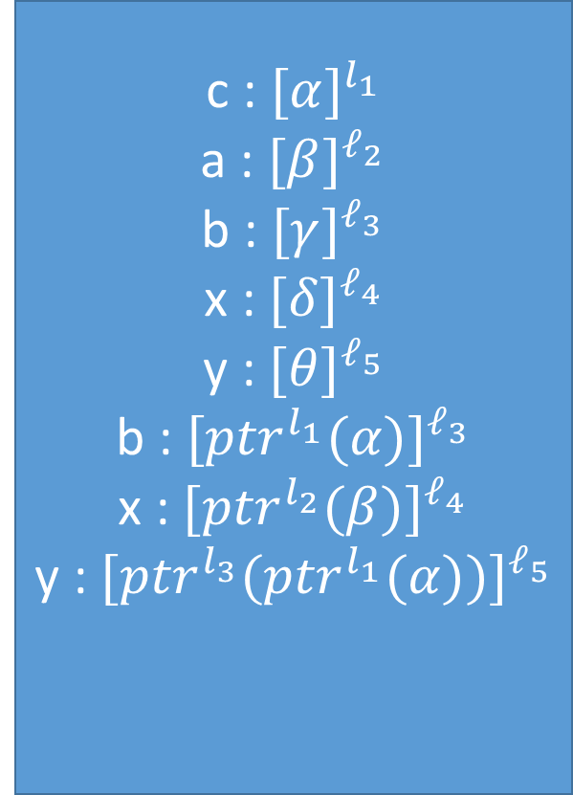
Types and Locations
c : ${[α]}^{l_{1}}$
a : ${[β]}^{ℓ_{2}}$
b : ${[γ]}^{ℓ_{3}}$
x : ${[δ]}^{ℓ_{4}}$
y : ${[θ]}^{ℓ_{5}}$
b : ${[{ptr}^{l_{1}}(α)]}^{ℓ_{3}}$
x : ${[{ptr}^{l_{2}}(β)]}^{ℓ_{4}}$
y : ${[{ptr}^{l_{3}}({ptr}^{l_{1}}(α))]}^{ℓ_{5}}$
x = &a;
y = x;
y = &b;
b = &c;
PTR(PTR(T))
PTR(T)
T
x
y
a
b
c

Slide 13

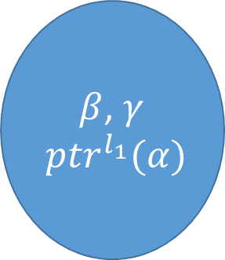

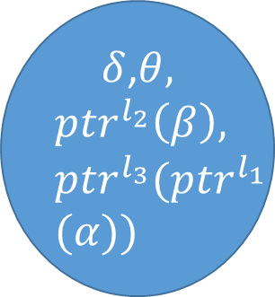

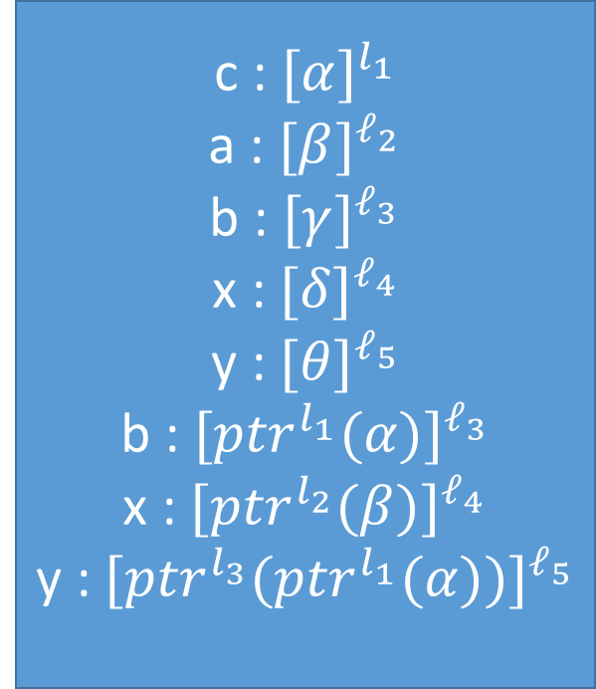
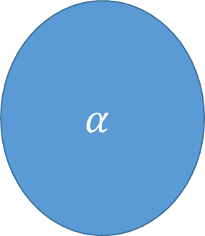
Types and Locations
c : ${[α]}^{l_{1}}$
a : ${[β]}^{ℓ_{2}}$
b : ${[γ]}^{ℓ_{3}}$
x : ${[δ]}^{ℓ_{4}}$
y : ${[θ]}^{ℓ_{5}}$
b : ${[{ptr}^{l_{1}}(α)]}^{ℓ_{3}}$
x : ${[{ptr}^{l_{2}}(β)]}^{ℓ_{4}}$
y : ${[{ptr}^{l_{3}}({ptr}^{l_{1}}(α))]}^{ℓ_{5}}$
$${ptr}^{l_{3}}({ptr}^{l_{1}}(α))$$
$${ptr}^{l_{1}}(α)$$
$$α$$
$δ$,$θ,$
$${ptr}^{l_{2}}\left(β\right),$$
$${ptr}^{l_{3}}({ptr}^{l_{1}}$$
$$(α))$$
$β$, $γ$
$${ptr}^{l_{1}}(α)$$
$$α$$
x = &a;
y = x;
y = &b;
b = &c;
Equivalence class of types – each variable can be assigned the representative of each class as its type

Slide 14
Recap
Steensgaard’s Algorithm
Steensgaard’s equivalence classes as types
Types, Locations and Labels
Next – Type inference
Notes:
Make corrections here
Steensgaard’s multiple incoming edges
Flow variables

Slide 15
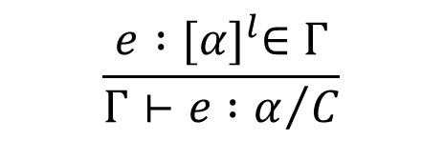
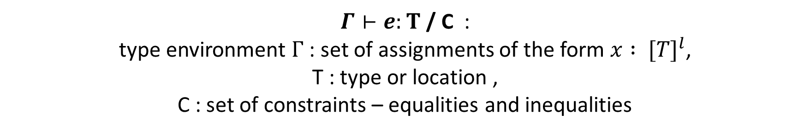
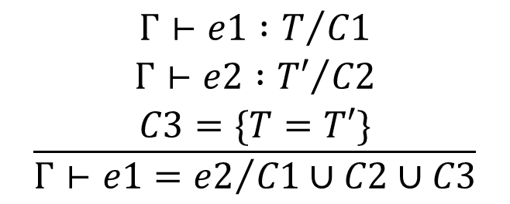
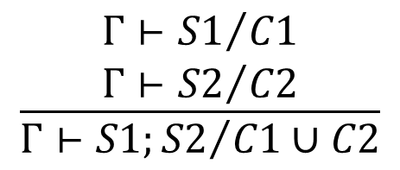
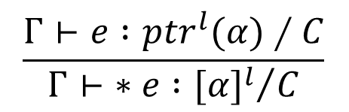
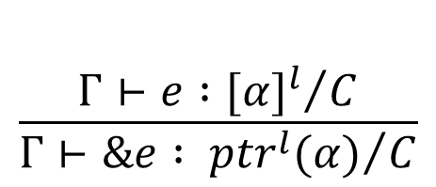
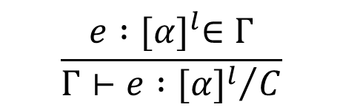
Type Inference by Constraint Generation
$Γ⊢e:T$ / C :
type environment $Γ$ : set of assignments of the form $x : {[T]}^{l}$,
T : type or location ,
C : set of constraints – equalities and inequalities
$$\frac{\begin{aligned}Γ⊢{e1 :T}/{C1} \\ Γ⊢{e2 :T′}/{C2} \\ C3=\{T=T′\}\end{aligned}}{Γ⊢{e1=e2}/{C1∪C2∪C3}}$$
$$\frac{\begin{aligned}Γ⊢{S1}/{C1} \\ Γ⊢{S2}/{C2}\end{aligned}}{Γ⊢{S1;S2}/{C1∪C2}}$$
$$\frac{e :{[α]}^{l}∈Γ}{Γ⊢{e :α}/C}$$
[seq]
[Rval]
[assign]
$$\frac{\begin{aligned} \\ Γ⊢{e :{[α]}^{l}}/C\end{aligned}}{Γ⊢{\&e : {ptr}^{l}(α)}/C}$$
$$\frac{Γ⊢e :{ptr}^{l}(α)∕C}{Γ⊢{∗e :{[α]}^{l}}/C}$$
$$\frac{e :{[α]}^{l}∈Γ}{Γ⊢{e :{[α]}^{l}}/C}$$
[deref]
[var]
[addr]

Slide 16















Type Inference by Constraint Generation
seq
{$α$ = ${ptr}^{l2}(β)$ }
=
seq
$$⊢{ptr}^{l2}(β)$$
{$α$ = $γ$}
=
seq
x
&a
{$γ$ = ${ptr}^{l4}(δ)$ }
{$δ$ = ${ptr}^{l5}(θ)$ }
$${[α]}^{l1}$$
$${[β]}^{l2}$$
y
x
=
=
$${[γ]}^{l3}$$
$${[α]}^{l1}$$
$$⊢{ptr}^{l4}(δ)$$
$$⊢{ptr}^{l5}(θ)$$
y
&b
b
&c
Post-order Walk on the AST
$${[γ]}^{l3}$$
$${[δ]}^{l4}$$
$${[δ]}^{l4}$$
$${[θ]}^{l5}$$

Slide 17
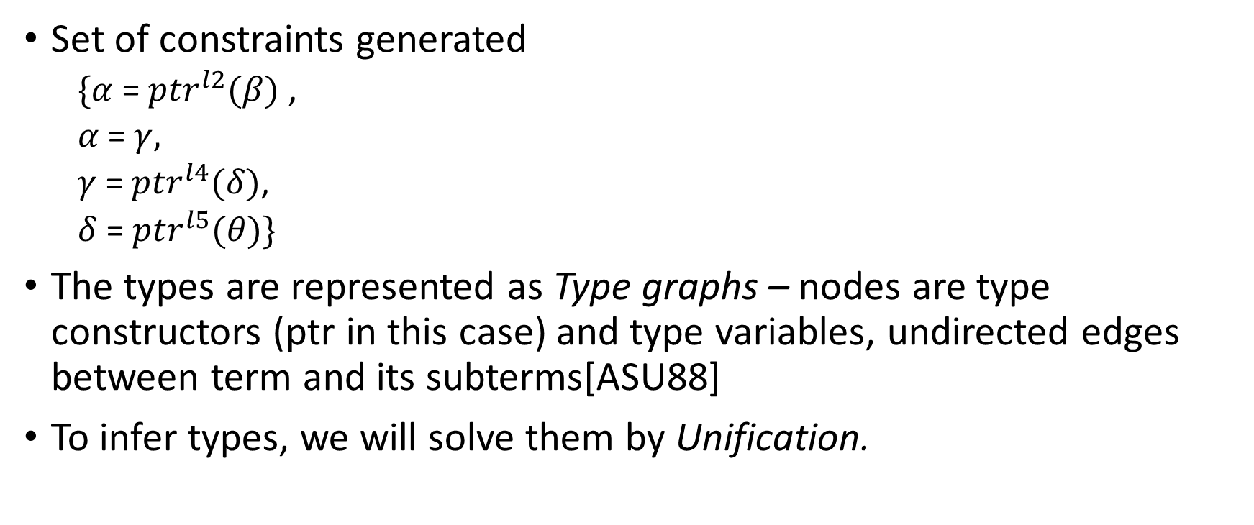
Type Inference by Constraint Generation
Set of constraints generated
$\{α$ = ${ptr}^{l2}(β)$ ,
$α$ = $γ,$
$γ$ = ${ptr}^{l4}(δ)$,
$δ$ = ${ptr}^{l5}(θ)\}$
The types are represented as Type graphs – nodes are type constructors (ptr in this case) and type variables, undirected edges between term and its subterms[ASU88]
To infer types, we will solve them by Unification.
Notes:
Show an example type graph
Write the constraints on the board
Explain unification briefly

Slide 18
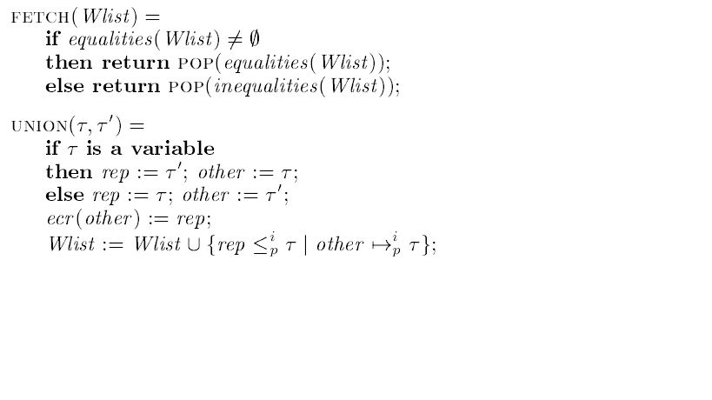
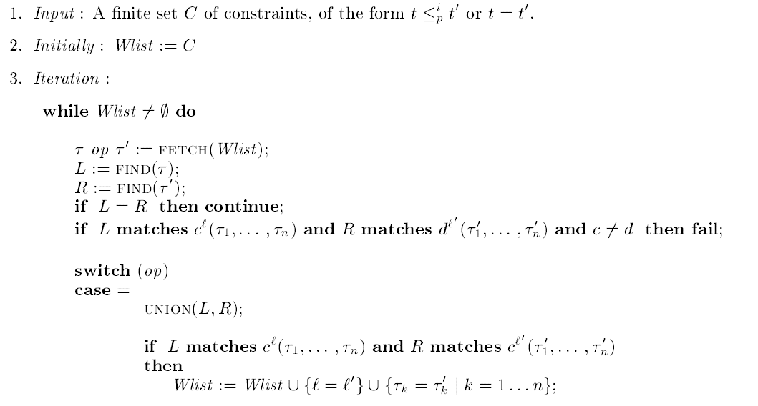
Unification Algorithm
Returns only equalities in this case
Finds the representatives and checks if they are equal
Creates an equivalence class and sets a representative
Incompatible types - error
Generate more constraints for labels and sub terms in type expressions
Notes:
Do unification on type graphs

Slide 19
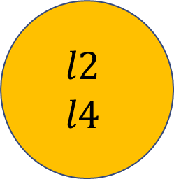


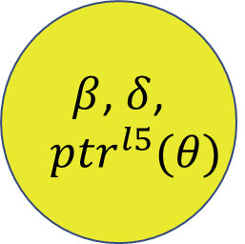


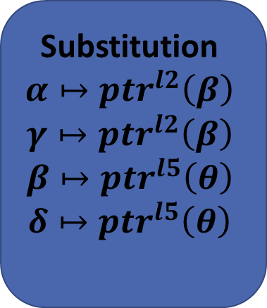

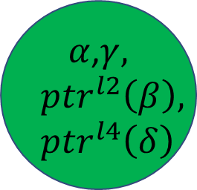









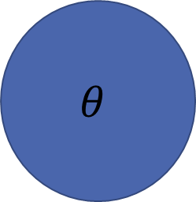
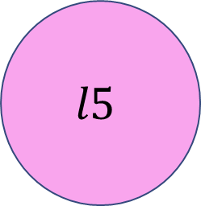


Solving Constraints
Substitution
$$α↦{ptr}^{l2}\left(β\right)$$
$$γ↦{ptr}^{l2}\left(β\right)$$
$$β↦{ptr}^{l5}\left(θ\right)$$
$$δ↦{ptr}^{l5}\left(θ\right)$$
$${ptr}^{l2}$$
$${ptr}^{l2}$$
$${ptr}^{l4}$$
$${ptr}^{l5}$$
$$α$$
Type Graphs
$${ptr}^{l5}$$
$$β$$
$$δ$$
$$θ$$
$$γ$$
$$θ$$
$${ptr}^{l2}\left(β\right)$$
$${ptr}^{l5}(θ)$$
$$θ$$
$$l2$$
$l$5
$α$,$γ,$
$${ptr}^{l2}\left(β\right),$$
$${ptr}^{l4}\left(δ\right)$$
$β$, $δ$,
$${ptr}^{l5}(θ)$$
$$θ$$
$$l2$$
$$l4$$
$$l5$$
Equivalence Classes

Slide 20
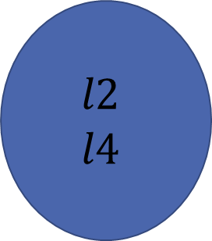
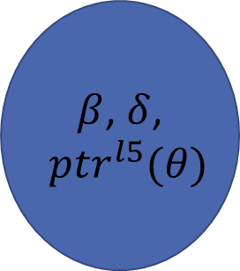

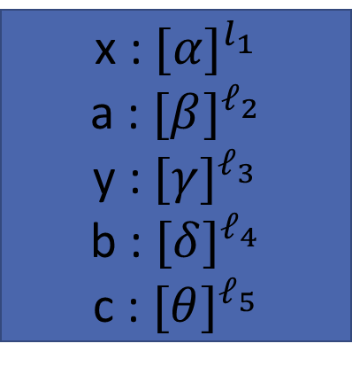
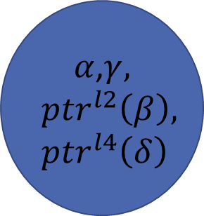




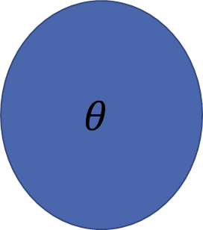
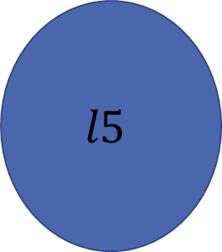
Query – are x and y aliased?
$${ptr}^{l2}\left(β\right)$$
$${ptr}^{l5}(θ)$$
$$θ$$
$$l2$$
$l$5
$α$,$γ,$
$${ptr}^{l2}\left(β\right),$$
$${ptr}^{l4}\left(δ\right)$$
$β$, $δ$,
$${ptr}^{l5}(θ)$$
$$θ$$
$$l2$$
$$l4$$
$$l5$$
x : ${[α]}^{l_{1}}$
a : ${[β]}^{ℓ_{2}}$
y : ${[γ]}^{ℓ_{3}}$
b : ${[δ]}^{ℓ_{4}}$
c : ${[θ]}^{ℓ_{5}}$
YES – they belong to the same class

Slide 21
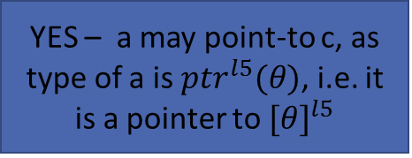
Query – does a points-to c?
$${ptr}^{l2}\left(β\right)$$
$${ptr}^{l5}(θ)$$
$$θ$$
$$l2$$
$l$5
$α$,$γ,$
$${ptr}^{l2}\left(β\right),$$
$${ptr}^{l4}\left(δ\right)$$
$β$, $δ$,
$${ptr}^{l5}(θ)$$
$$θ$$
$$l2$$
$$l4$$
$$l5$$
x : ${[α]}^{l_{1}}$
a : ${[β]}^{ℓ_{2}}$
y : ${[γ]}^{ℓ_{3}}$
b : ${[δ]}^{ℓ_{4}}$
c : ${[θ]}^{ℓ_{5}}$
YES – a may point-to c, as type of a is ${ptr}^{l5}(θ)$, i.e. it is a pointer to ${[θ]}^{l5}$

Slide 22
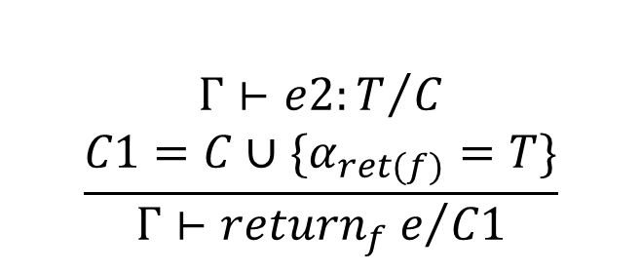
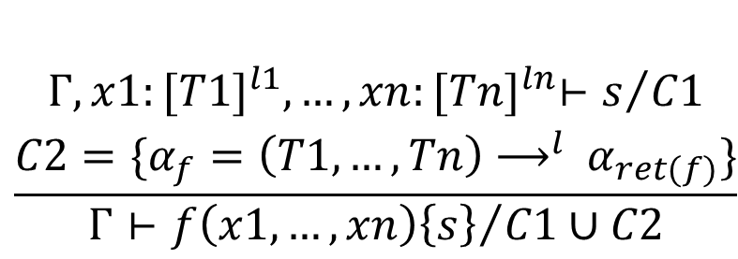
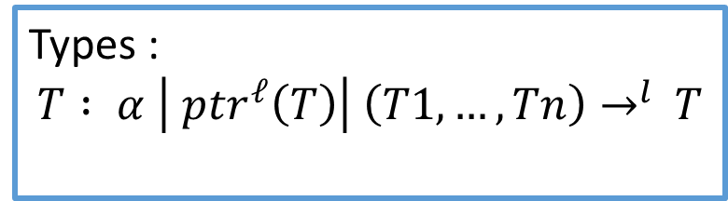
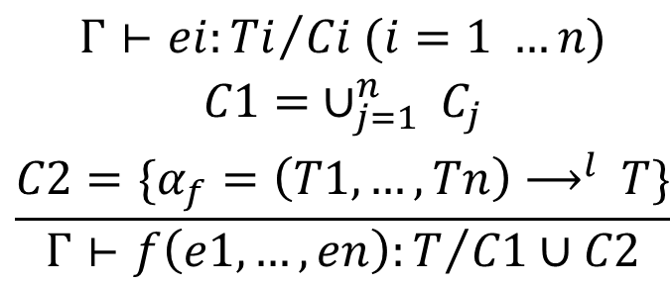
Interprocedural Analysis Using Type Inference
We can extend the framework for Interprocedural analysis
$$\frac{\begin{aligned} \\ Γ⊢{e2:T}/C \\ C1=C∪\{α_{ret(f)}=T\}\end{aligned}}{Γ⊢{{return}_{f} e}/{C1}}$$
Types :
$$T : α \left| {ptr}^{ℓ}\left(T\right)\right| \left(T1, …, Tn\right)→^{l }T$$
[return]
$$\frac{\begin{aligned}Γ⊢{ei:Ti}/{Ci (i=1 …n)} \\ C1= ∪_{j=1}^{n} C_{j} \\ C2=\{α_{f}=\left(T1,…, Tn\right)⟶^{l }T\}\end{aligned}}{Γ⊢{f\left(e1, …, en\right):T}/{C1∪C2}}$$
$$\frac{\begin{aligned} \\ Γ, x1:{[T1]}^{l1},…,xn:{[Tn]}^{ln}⊢s/{C1} \\ C2=\{α_{f}=\left(T1,…, Tn\right)⟶^{l }α_{ret(f)}\}\end{aligned}}{Γ⊢{f\left(x1, …,xn\right)\left\{s\right\}}/{C1∪C2}}$$
[call]
[def]

Slide 23
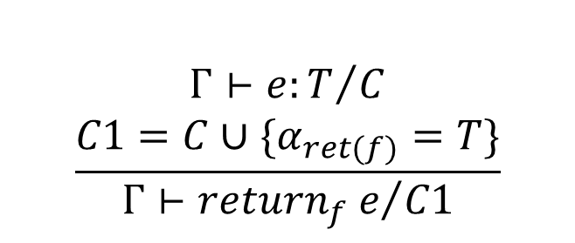
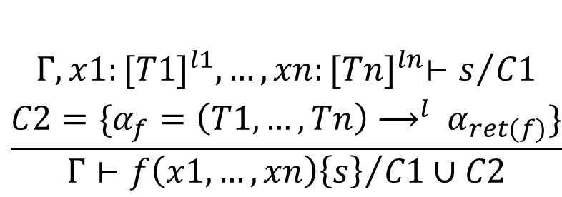
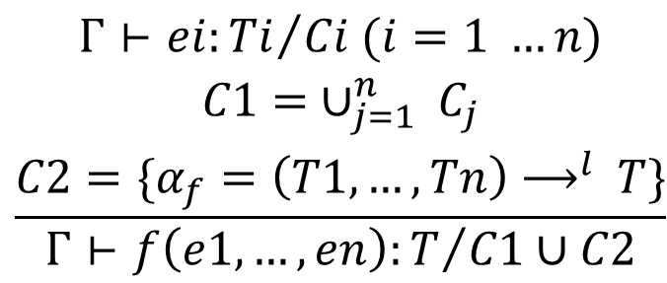
Interprocedural Analysis Using Type Inference
main(){
p = &a;
q = &b;
c = foo(p);
d = foo(q);
}
foo(x) {
return x;
}
$$\frac{\begin{aligned}Γ⊢{ei:Ti}/{Ci (i=1 …n)} \\ C1= ∪_{j=1}^{n} C_{j} \\ C2=\{α_{f}=\left(T1,…, Tn\right)⟶^{l }T\}\end{aligned}}{Γ⊢{f\left(e1, …, en\right):T}/{C1∪C2}}$$
$$\frac{\begin{aligned} \\ Γ⊢{e:T}/C \\ C1=C∪\{α_{ret(f)}=T\}\end{aligned}}{Γ⊢{{return}_{f} e}/{C1}}$$
[return]
[call]
$$\frac{\begin{aligned} \\ Γ, x1:{[T1]}^{l1},…,xn:{[Tn]}^{ln}⊢s/{C1} \\ C2=\{α_{f}=\left(T1,…, Tn\right)⟶^{l }α_{ret(f)}\}\end{aligned}}{Γ⊢{f\left(x1, …,xn\right)\left\{s\right\}}/{C1∪C2}}$$
[def]

Slide 24
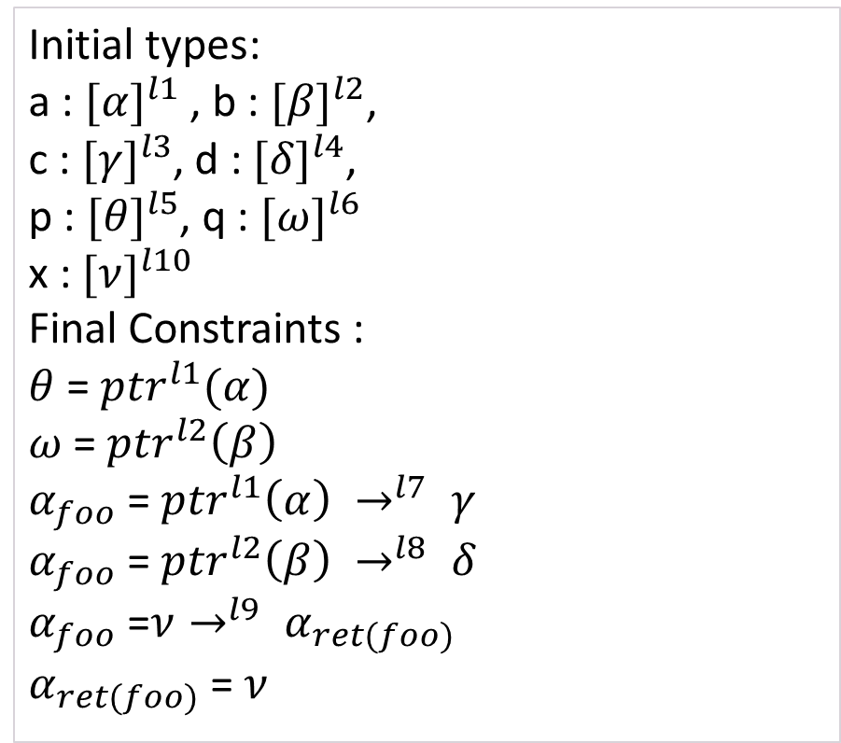
Interprocedural Analysis Using Type Inference
main(){
p = &a;
q = &b;
c = foo(p);
d = foo(q);
}
foo(x) {
return x;
}
Initial types:
a : ${[α]}^{l1}$ , b : ${[β]}^{l2}$,
c : ${[γ]}^{l3}$, d : ${[δ]}^{l4}$,
p : ${[θ]}^{l5}$, q : ${[ω]}^{l6}$
x : ${[ν]}^{l10}$
Final Constraints :
$θ$ = ${ptr}^{l1}(α)$
$ω$ = ${ptr}^{l2}\left(β\right)$
$α_{foo}$ = ${ptr}^{l1}\left(α\right) →^{l7} γ$
$α_{foo}$ = ${ptr}^{l2}\left(β\right) →^{l8} δ$
$α_{foo}$ =$ν→^{l9} α_{ret(foo)}$
$α_{ret(foo)}$ = $ν$

Slide 25
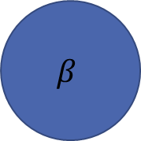
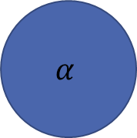

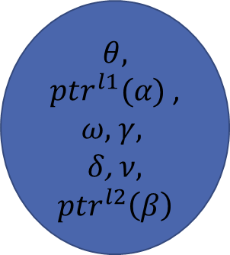


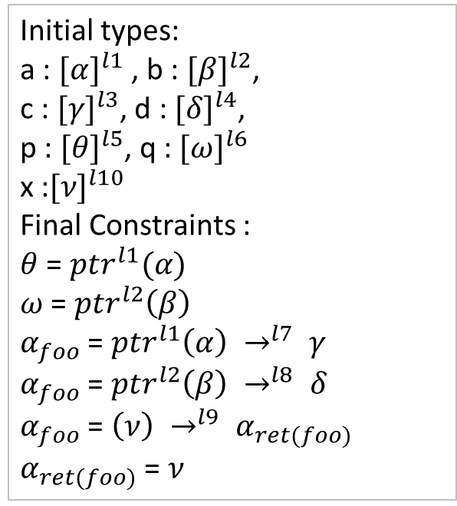
Interprocedural Analysis Using Type Inference
main(){
p = &a;
q = &b;
c = foo(p);
d = foo(q);
}
foo(x) {
return x;
}
Initial types:
a : ${[α]}^{l1}$ , b : ${[β]}^{l2}$,
c : ${[γ]}^{l3}$, d : ${[δ]}^{l4}$,
p : ${[θ]}^{l5}$, q : ${[ω]}^{l6}$
x :${[ν]}^{l10}$
Final Constraints :
$θ$ = ${ptr}^{l1}(α)$
$ω$ = ${ptr}^{l2}\left(β\right)$
$α_{foo}$ = ${ptr}^{l1}\left(α\right) →^{l7} γ$
$α_{foo}$ = ${ptr}^{l2}\left(β\right) →^{l8} δ$
$α_{foo}$ = $\left(ν\right) →^{l9} α_{ret(foo)}$
$α_{ret(foo)}$ = $ν$
${ptr}^{l1}(α)$
$$α$$
$β$
$$θ,$$
${ptr}^{l1}(α)$ ,
$ω,$ $γ,$
$δ$, $ν$,
$${ptr}^{l2}\left(β\right)$$
$$α$$
$$β$$

Slide 26
Query – are p and q aliased?
main(){
p = &a;
q = &b;
c = foo(p);
d = foo(q);
}
foo(x) {
return x;
}
Initial types:
a : ${[α]}^{l1}$ , b : ${[β]}^{l2}$,
c : ${[γ]}^{l3}$, d : ${[δ]}^{l4}$,
p : ${[θ]}^{l5}$, q : ${[ω]}^{l6}$
x :${[ν]}^{l10}$
Final Constraints :
$θ$ = ${ptr}^{l1}(α)$
$ω$ = ${ptr}^{l2}\left(β\right)$
$α_{foo}$ = ${ptr}^{l1}\left(α\right) →^{l7} γ$
$α_{foo}$ = ${ptr}^{l2}\left(β\right) →^{l8} δ$
$α_{foo}$ = $\left(ν\right) →^{l9} α_{ret(foo)}$
$α_{ret(foo)}$ = $ν$
${ptr}^{l1}(α)$
$$α$$
$β$
$$θ,$$
${ptr}^{l1}(α)$ ,
$ω,$ $γ,$
$δ$, $ν$,
$${ptr}^{l2}\left(β\right)$$
$$α$$
$$β$$
No, but the analysis says YES

Slide 27
Query – does the value of p flow to d?
main(){
p = &a;
q = &b;
c = foo(p);
d = foo(q);
}
foo(x) {
return x;
}
Initial types:
a : ${[α]}^{l1}$ , b : ${[β]}^{l2}$,
c : ${[γ]}^{l3}$, d : ${[δ]}^{l4}$,
p : ${[θ]}^{l5}$, q : ${[ω]}^{l6}$
x :${[ν]}^{l10}$
Final Constraints :
$θ$ = ${ptr}^{l1}(α)$
$ω$ = ${ptr}^{l2}\left(β\right)$
$α_{foo}$ = ${ptr}^{l1}\left(α\right) →^{l7} γ$
$α_{foo}$ = ${ptr}^{l2}\left(β\right) →^{l8} δ$
$α_{foo}$ = $\left(ν\right) →^{l9} α_{ret(foo)}$
$α_{ret(foo)}$ = $ν$
${ptr}^{l1}(α)$
$$α$$
$β$
$$θ,$$
${ptr}^{l1}(α)$ ,
$ω,$ $γ,$
$δ$, $ν$,
$${ptr}^{l2}\left(β\right)$$
$$α$$
$$β$$
No, but the analysis says YES

Slide 28








Ideal result
${ptr}^{l1}(α)$
$α$
$$θ,$$
${ptr}^{l1}(α)$
$α$
main(){
p = &a;
q = &b;
c = foo(p);
d = foo(q);
}
foo(x) {
return x;
}
${ptr}^{l2}(β)$
$β$
$$ω,$$
$${ptr}^{l2}\left(β\right)$$
$$β$$

Slide 29
Context Sensitive Analysis
The analysis is currently context-insensitive
uses monomorphic types
introduction of polymorphic types for context-sensitivity
solve with Instantiation Constraints

Slide 30

Polymorphism
We have a Principal type or the most general type T for each expression
T1 is called an instance of T if T1 = R(T) for some substitution R ( mapping of type variables to types)
expressed as T $≤$T1
Here, we will specialize the type of function at each use, by instantiating the type
constraints of the form $T_{def}≤T_{use}$ will be generated
Unification not enough for constraint solving
Notes:
Give example of instance and principal type

Slide 31
Interprocedural Analysis With Polymorphism
main(){
p = &a;
q = &b;
c = foo(p);
d = foo(q);
}
foo(x) {
return x;
}
Instantiation at each “use” of a function – here it means the call site
Def and Ret rules same as before – ignore the super- and sub- scripts for now
The type here is not the “def” type – rather depends upon the current value of expressions

Slide 32

Interprocedural Analysis With Polymorphism
Initial types:
a : ${[α]}^{l1}$ , b : ${[β]}^{l2}$, c : ${[γ]}^{l3}$, d : ${[δ]}^{l4}$,
p : ${[θ]}^{l5}$, q : ${[ω]}^{l6}$, x :${[ν]}^{l10}$
Final Constraints :
$θ$ = ${ptr}^{l1}(α)$
$ω$ = ${ptr}^{l2}\left(β\right)$
$α_{foo}$ $≤$ ${ptr}^{l1}\left(α\right) →^{l7} γ$
$α_{foo}$ $≤$ ${ptr}^{l2}\left(β\right) →^{l8} δ$
$α_{foo}$ =$ν→^{l9} α_{ret(foo)}$
$α_{ret(foo)}$ = $ν$

Slide 33

Semi-Unification
Extension of unification to solve a set of constraints involving equalities and inequalities [Hen93, KTU94]
An inequality $T≤T′$ is called solvable if $T′$ is a substitution of $T$ for some substitution instance $R$, i.e. $R\left(T\right)=T′$
Substitution $S$ is a solution to a constraint set $C$ iff $S\left(T\right)=S(T^{′})$ for every equality $T=T^{′}∈C$ and $S(T)≤S(T^{′})$ is solvable for every $T≤T^{′}∈C$.

Slide 34

Constraint Indices
Textual references to a function are tagged with a unique index i, identifying the occurrence
In first order case, it is same as tagging different call-sites with unique indices.
For each occurrence $f_{i}$,[FUN] rule gives rise to a constraint $T≤^{i}T^{′}$
Therefore, rephrasing the semi-unification definition
Substitution $S$ is a solution to a constraint set $C$ iff $S\left(T\right)=s(T^{′})$ for every equality $T=T^{′}∈C$ and $S(T)≤^{i}S(T^{′})$ is solvable for every $T≤^{i}T^{′}∈C$.

Slide 35

Constraint Polarity
Keeps track of input and output position in types
$p∈\left\{+,÷,Τ\right\}$, p is polarity
Ordering $+ ≤Τ$ and $÷ ≤Τ.$
$+$- positive polarity, $÷$ - negative polarity
Polarity of a term - Term T occurs positively if it occurs nested to the left of the type constructor ($→$ ) an even number of times, else negatively
In type -$\left(a→β\right)→γ$ –
$a, γ$ occur positively,
and $β$ and $(α→β)$ occur negatively
Targets of pointer types ptr(T) occur at polarity $T$.

Slide 36




Propagation of Constraint polarities
Each inequality carries polarity information, ${T≤}_{p}^{i} T′$
During resolution inequalities propagate to their subterms
Polarities switch according to the polarities of the subterms
[FUN] rule provides the initial polarity, ${α→β≤}_{+}^{i} γ→δ$
Propagation :
$${α→β≤}_{+}^{i} γ→δ$$
Propagation in pointers loses polarity!
$${α≤}_{÷}^{i} γ$$
$${β≤}_{+}^{i}δ$$

Slide 37



Data flow due to polarities
Decide the direction of data flow
$${α→β≤}_{+}^{i} γ→δ$$
$${α≤}_{÷}^{i}γ$$
$${β≤}_{+}^{i}δ$$
Flow opposite to the direction of inequality
Flow in the direction of inequality
From actual parameter to formal
Return value to return point

Slide 38

Exercise – Polarity Propagation
$${{(α}_{1}→α_{1})→ptr(α_{3}) ≤}_{+}^{i}\left(β_{1}→β_{2}\right)→ptr\left(β_{3}\right)$$
Solution :
$${{(α}_{1}→α_{1}) ≤}_{÷}^{i}(β_{1}→β_{2})$$
$${ptr\left(α_{3}\right)≤}_{+}^{i}ptr\left(β_{3}\right)$$
$${α_{1} ≤}_{+}^{i}β_{1}$$
$${α_{2} ≤}_{÷}^{i}β_{2}$$
$${α_{3} ≤}_{T}^{i}β_{3}$$

Slide 39

Constraints with indices
main(){
p = &a;
q = &b;
c = foo(p);
d = foo(q);
}
foo(x) {
return x;
}
Initial types:
a : ${[α]}^{l1}$ , b : ${[β]}^{l2}$, c : ${[γ]}^{l3}$, d : ${[δ]}^{l4}$,
p : ${[θ]}^{l5}$, q : ${[ω]}^{l6}$, x :${[ν]}^{l10}$
Final Constraints :
$θ$ = ${ptr}^{l1}(α)$
$ω$ = ${ptr}^{l2}\left(β\right)$
$α_{foo}$ $≤_{+}^{c}$ $θ →^{l7} γ$
$α_{foo}$ $≤_{+}^{d}ω→^{l8} δ$
$α_{foo}$ =$ν→^{l9} α_{ret(foo)}$
$α_{ret(foo)}$ = $ν$

Slide 40
Semi – Unification Algorithm

Slide 41
















Type Instantiation Graph
$$≤_{+}^{d}$$
$$≤_{+}^{c}$$
$$→^{l8}$$
$$→^{l9}$$
$$→^{l7}$$
$${ptr}^{l2}$$
$$ω$$
$$δ$$
$$θ$$
$$γ$$
$${ptr}^{l1}$$
$$≤_{T}^{c}$$
$$≤_{T}^{d}$$
$$ν$$
$$α$$
$$β$$

Slide 42








Flow Graph
+
+
$$→^{l8}$$
$$→^{l9}$$
$$→^{l7}$$
$$θ$$
$$γ$$
$${ptr}^{l2}$$
+
+
$${ptr}^{l1}$$
$$δ$$
$$ω$$
$$β$$
-
$$ν$$
$$α$$
-

Slide 43












Flow Graph
main(){
p = &a;
q = &b;
c = foo(p);
d = foo(q);
}
foo(x) {
return *x;
}
+
+
$$→^{l8}$$
$$→^{l9}$$
$$→^{l7}$$
$$θ$$
$$γ$$
$${ptr}^{l2}$$
+
+
$${ptr}^{l1}$$
$$δ$$
$$ω$$
$$β$$
-
$$ν$$
$$α$$
-
What values flow to the variable c?
Both p and q flow to c!

Slide 44
Flow Graph – PosNeg Paths
main(){
p = &a;
q = &b;
c = foo(p);
d = foo(q);
}
foo(x) {
return *x;
}
+
+
$$→^{l8}$$
$$→^{l9}$$
$$→^{l7}$$
$$θ$$
$$γ$$
$${ptr}^{l2}$$
+
+
$${ptr}^{l1}$$
$$δ$$
$$ω$$
-
$$ν$$
Restriction
Valid flow path :
any number of positive edges,
Followed by any number of negative edges
$$β$$
-
$$α$$

Slide 45
Flow Graph
main(){
p = &a;
q = &b;
c = foo(p);
d = foo(q);
}
foo(x) {
return *x;
}
+
+
$$→^{l8}$$
$$→^{l9}$$
$$→^{l7}$$
$$θ$$
$$γ$$
$${ptr}^{l2}$$
+
+
$${ptr}^{l1}$$
$$δ$$
$$ω$$
-
$$ν$$
Restriction
Valid flow path :
any number of positive edges,
Followed by any number of negative edges
$$β$$
-
$$α$$
Only p flows to c and q flows to d

Slide 46
Handling Higher order programs – function pointers

Slide 47
Thank You

