Slide 1
Pointer Analysis
Komondoor V. Raghavan
Indian Institute of Science
In collaboration with
G. Ramalingam
Microsoft Research

Slide 2
Goals
Pointer analysis or Points-to Analysis:
  Determine the set of possible values (addresses) that reside in pointer variables at each point in a program
Compute conservative over-approximation of these sets
A fundamental analysis, required by most other static analyses

Slide 3
A Constant Propagation Example
x = 3;
y = 4;
z = x + 5;
x is always 3 here
can replace x by 3
and replace x+5 by 8
and so on

Slide 4
A Constant Propagation Example
With Pointers
x = 3;
*p = 4;
z = x + 5;
Is x always 3 here?

Slide 5
A Constant Propagation Example
With Pointers
p = &y;
x = 3;
*p = 4;
z = x + 5;
if (?)
p = &x;
else
p = &y;
x = 3;
*p = 4;
z = x + 5;
p = &x;
x = 3;
*p = 4;
z = x + 5;
x is always 3
pointers affect
most program analyses
x is always 4
x may be 3 or 4
(i.e., x is unknown in Constant Propagation lattice)

Slide 6
A Constant Propagation Example
With Pointers
p = &y;
x = 3;
*p = 4;
z = x + 5;
if (?)
p = &x;
else
p = &y;
x = 3;
*p = 4;
z = x + 5;
p = &x;
x = 3;
*p = 4;
z = x + 5;
p always
points-to y
p always
points-to x
p may point-to x or y

Slide 7
Points-to Analysis
Determine the set of targets a pointer variable could point-to (at each point in the program)
  “p points-to x”
    “p stores the value &x”
    “*p denotes the location x”
  targets could be variables or locations in the heap (dynamic memory allocation)
    p = &x;
    p = new Foo(); or p = malloc (…);

Slide 8
Programming Language:
Syntax
A program consists of
  a set of variables Var
  a control-flow graph (CFG) with every node labelled by a primitive statement
A primitive statement is of the form
  x = null
  x = y
  x = *y
  x = &y;
  *x = y
  conditions
  skip
  (where x and y are variables in Var)
Omitted (for now)
Dynamic memory allocation
Pointer arithmetic
Structures and fields
Procedures

Slide 9
Programming Language:
Concrete Semantics
State ::= Var -> Var’,
where Var’ = (Var U {null})
Initial state
x:N, y:N, a:N, b:N
x = & a
x:a, y:N, a:N, b:N
y = x
x:a, y:a, a:N, b:N
*y = &b
x: a, y:a, a:b, b:N

Slide 10
Programming Language:
Operational Semantics
Meaning of primitive statements
  nstate_{stmt} : State -> 2^{State}
nstate _{x = null} (s) = { s[x → null] }
nstate _{x = &y} (s) = { s[x → y] }
nstate _{x = y} (s) = { s[x → s(y)] }
…
…
…
…
…
…

Slide 11
Programming Language:
Operational Semantics
Meaning of primitive statements
  nstate_{stmt} : State -> 2^{State}
nstate _{x = null} (s) = { s[x → null] }
nstate _{x = &y} (s) = { s[x → y] }
nstate _{x = y} (s) = { s[x → s(y)] }
nstate _{x = *y} (s) = { s[x → s(s(y))] },
if s(y) is not null
{}, otherwise
…
…
…

Slide 12
Programming Language:
Operational Semantics
Meaning of primitive statements
  nstate_{stmt} : State -> 2^{State}
nstate _{x = null} (s) = { s[x → null] }
nstate _{x = &y} (s) = { s[x → y] }
nstate _{x = y} (s) = { s[x → s(y)] }
nstate _{x = *y} (s) = { s[x → s(s(y))] },
if s(y) is not null
{}, otherwise
nstate _{*x = y} (s) = { s[s(x) → s(y)] },
if s(x) is not null
{}, otherwise

Slide 13
Programming Language:
Operational Semantics
nstate _{x==y, T} (s) =
{ s }, if s(x) = s(y)
{ }, otherwise
nstate _{x==y, F} (s) =
{ }, if s(x) = s(y)
{ s }, otherwise
nstate’ (ss $∈$ 2^{State}) = $\bigcup_{s ∈ ss}{ }$ nstate(s)

Slide 14
Collecting semantics
Let u denote any program point
Define SS(u) = { s | s is a State that can arise at point u in some execution }
  It is the collecting semantics at u

Slide 15
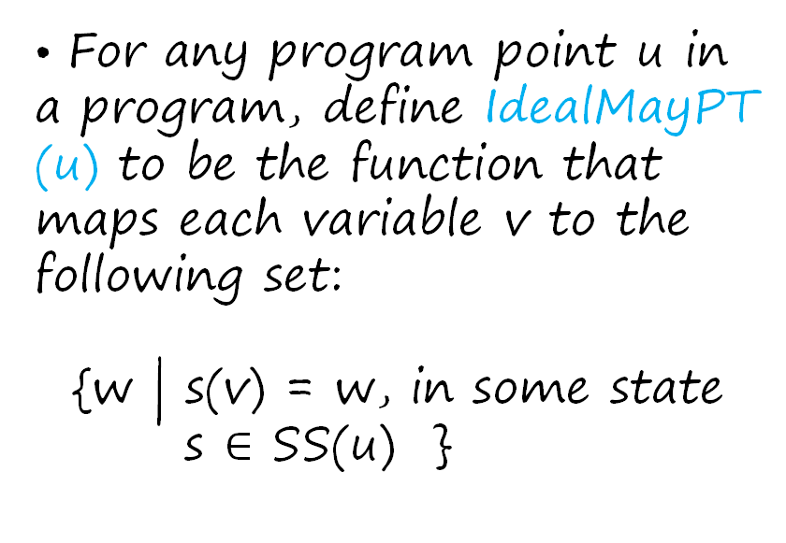
Ideal May Points-To information
For any program point u in a program, define IdealMayPT (u) to be the function ​that maps each variable v to the following set:
​
{w | s(v) = w, in some state
s $∈$ SS(u) }​
if (?)
p = &x;
else
p = &y;
q = &w;
x = 3;
*p = 4;
z = x + 5;
p:&x, q:&w
SS(u) =
p:&y, q:&w
u
IdealMayPT(u) = {p -> {x,y}, q -> {w}}

Slide 16
Problem statement
Devise an algorithm that computes a map MayPT: V -> 2^{Var’} for any given program, such that for every point u of the program,
MayPT(u) ⊇ IdealMayPT(u)

Slide 17
May-Point-To Algorithms
Compute MayPT: V -> 2^{Vars’} such that
MayPT(u) ⊇ IdealMayPT(u)
An algorithm is said to be correct if the solution MayPT it computes satisfies
∀u∈V. MayPT(u) ⊇ IdealMayPT(u)
An algorithm is said to be precise if the solution MayPT it computes satisfies
∀u∈V. MayPT(u) = IdealMayPT(u)
An algorithm 1 is said to be more precise than an algorithm 2 if for any program, MayPT1 computed by 1 and MayPT2 computed by 2 are such that for any point u in the program:
∀u∈V. MayPT1(u) ⊆ MayPT2(u)

Slide 18
Illustration
if (?)
p = &x;
else
p = &y;
q = &w;
x = 3;
*p = 4;
z = x + 5;
IdealMayPT(u) = {p -> {x,y}, q -> {w}}
p:&x, q:&w
SS(u) =
MayPT1(u) = {p -> {x,y,w}, q -> {w}}
p:&y, q:&w
MayPT2(u) = {p -> {x,y}, q -> {w,x}}
u
MayPT3(u) = {p -> {x,y,w}, q -> {w,x}}
MayPT1(u) ⊆ MayPT3(u), MayPT2(u) ⊆ MayPT3(u),
MayPT4(u) = {p -> {x}, q -> {w}}

Slide 19
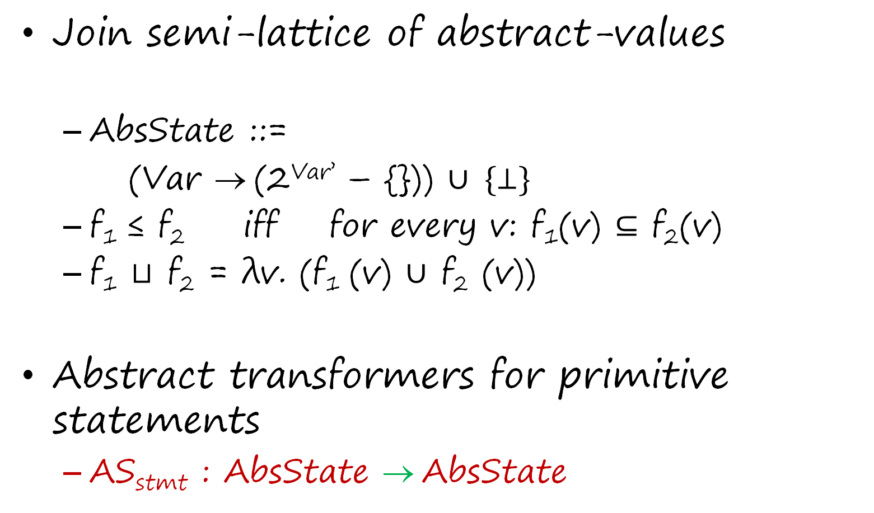
Dataflow analysis to compute points-to information
Join semi-lattice of abstract-values
  AbsState ::=
  (Var → (2^{Var’} – {})) $∪ \{⊥\}$
  f₁ ≤ f₂ iff for every v: f₁(v) $⊆$ f₂(v)
  f₁ $⊔$ f₂ = λv. (f₁ (v) $∪$ f₂ (v))
Abstract transformers for primitive statements
  AS_{stmt} : AbsState → AbsState

Slide 20
Illustration of transfer functions
p = &x;
q = &y;
if (?) {
q = p;
}
x = &a;
y = &b;
z = *q;

Slide 21
Illustration of transfer functions
p | q | x | y | z
null | null | null | null | null
x | null | null | null | null
x | y | null | null | null
x | y | null | null | null
x | x | null | null | null
x | {x,y} | null | null | null
x | {x,y} | a | null | null
x | {x,y} | a | b | null
x | {x,y} | a | b | {a,b}
p | q | x | y | z
null | null | null | null | null
x | null | null | null | null
x | y | null | null | null
x | y | null | null | null
x | x | null | null | null
x | {x,y} | null | null | null
x | {x,y} | a | null | null
x | {x,y} | a | b | null
p | q | x | y | z
null | null | null | null | null
x | null | null | null | null
x | y | null | null | null
x | y | null | null | null
x | x | null | null | null
x | {x,y} | null | null | null
x | {x,y} | a | null | null
p | q | x | y | z
null | null | null | null | null
x | null | null | null | null
x | y | null | null | null
x | y | null | null | null
x | x | null | null | null
x | {x,y} | null | null | null
p | q | x | y | z
null | null | null | null | null
x | null | null | null | null
x | y | null | null | null
x | y | null | null | null
x | x | null | null | null
p | q | x | y | z
null | null | null | null | null
x | null | null | null | null
x | y | null | null | null
x | y | null | null | null
p | q | x | y | z
null | null | null | null | null
x | null | null | null | null
x | y | null | null | null
p | q | x | y | z
null | null | null | null | null
x | null | null | null | null
p | q | x | y | z
null | null | null | null | null
p | q | x | y | z
p = &x;
q = &y;
if (?) {
q = p;
}
x = &a;
y = &b;
z = *q;

Slide 22
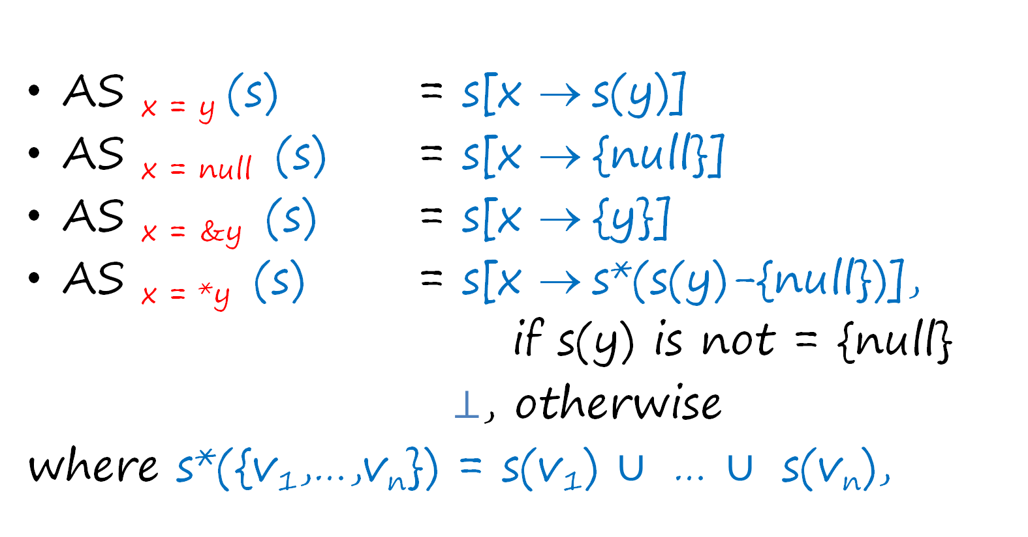
Transfer functions
AS _{x = y} (s) = s[x → s(y)]
AS _{x = null} (s) = s[x → {null}]
AS _{x = &y} (s) = s[x → {y}]
AS _{x = *y} (s) = s[x → s*(s(y)-{null})],
if s(y) is not = {null}
$⊥$, otherwise
where s*({v₁,…,v_{n}}) = s(v₁) $∪$ … $∪$ s(v_{n}),

Slide 23
The issue with store statements
x = &a;
y = &b;
if (?) {
p = &x;
} else {
p = &y;
}
*x = &c;
*p = &c;
Weak update
Weak update
Strong update
x: a
y: b
p: {x,y}
a: null
x: a
y: b
p: {x,y}
a: c
x: {a,c}
y: {b,c}
p: {x,y}
a: c

Slide 24

Transfer functions
AS _{*x = y} (s) =
$⊥$ if s(x) = {null}
s[z → s(y)] if s(x)-{null} = {z}
s[z₁ → s(z₁) $∪$ s(y)] if s(x)-{null} = {z_{1, …,} z_{k}}
[z₂ → s(z₂) $∪$ s(y)] (where k > 1)
…
[z_{k} → s(z_{k}) $∪$ s(y)]

Slide 25
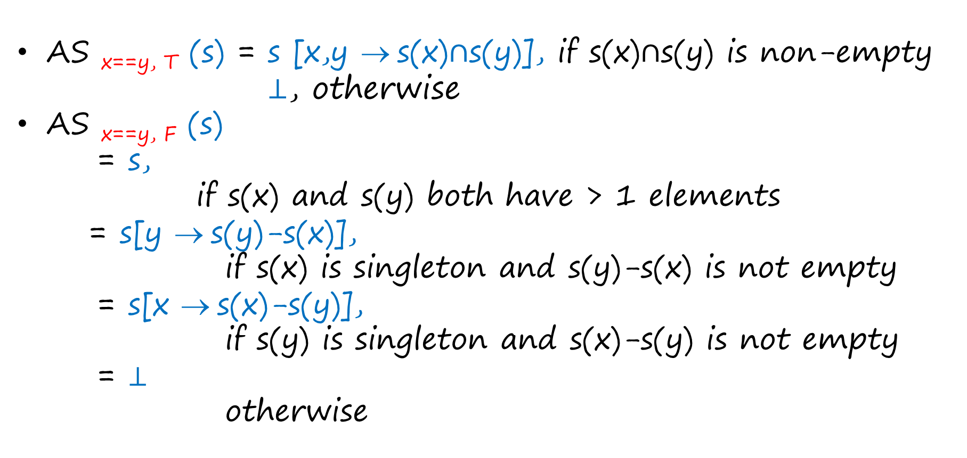
Transfer functions
AS _{x==y, T} (s) = s [x,y → s(x)$∩$s(y)], if s(x)$∩$s(y) is non-empty
  $⊥$, otherwise
AS _{x==y, F} (s)
= s,
if s(x) and s(y) both have > 1 elements
= s[y → s(y)-s(x)],
if s(x) is singleton and s(y)-s(x) is not empty
= s[x → s(x)-s(y)],
if s(y) is singleton and s(x)-s(y) is not empty
= $⊥$
otherwise

Slide 26
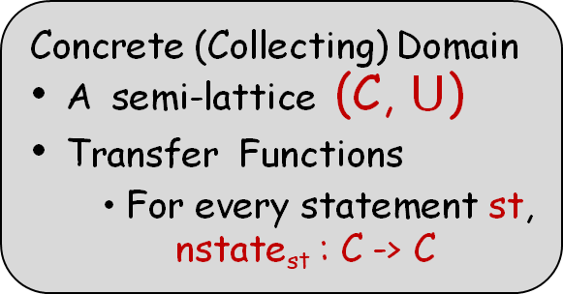
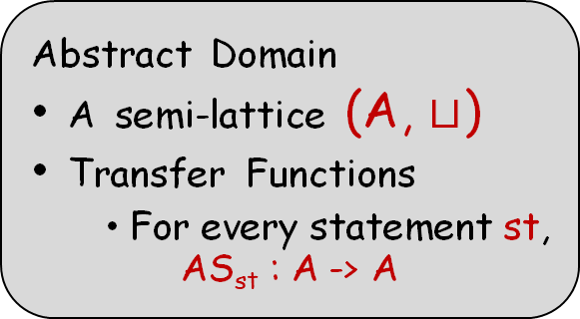
Correctness of the analysis
Concrete (Collecting) Domain
A semi-lattice (C, $⋃$)
Transfer Functions
  For every statement st,
    nstate_{st} : C -> C
α
Abstract Domain
A semi-lattice (A, $⊔$)
Transfer Functions
  For every statement st,
    AS_{st} : A -> A
γ
C ≡ 2^{State}
A ≡ AbsState

Slide 27
Correctness of the analysis
    α(S ∊ 2^{State}) = λv. {x | exists s in S such that s(v) = x }
    γ(a) = {s | for each pointer variable p, s(p) ∊ a(p)}

Slide 28
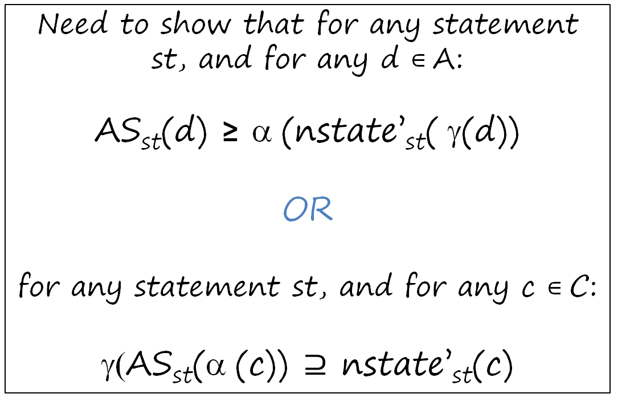
Correctness of the analysis
Need to show that for any statement st, and for any d ∊ A:
AS_{st}(d) ≥ α (nstate’_{st}( γ(d))
OR
for any statement st, and for any c ∊ C:
γ(AS_{st}(α (c)) $⊇$ nstate’_{st}(c)
Also, need to show that α, γ form a Galois connection

Slide 29
Correctness illustration
x: &y
y: &x
z: &a
γ
x: {&y}
y: {&x,&z}
z: {&a}
x: &y
y: &z
z: &a
nstate’
AS
*y = &b;
*y = &b;
x: &b
y: &x
z: &a
α
x: {&y,&b}
y: {&x,&z}
z: {&a,&b}
x: &y
y: &z
z: &b

Slide 30

Correctness illustration
x: &c
y: &x
w: &c
t: &b
α
x: &b
y: &w
w: &b
t: &c
x: {&b,&c}
y: {&w,&x}
w: {&b,&c}
t: {&b,&c}
nstate’
*y = t;
AS
*y = t;
x: {&b,&c}
y: {&w,&x}
w: {&b,&c}
t: {&b,&c}
x: &b
y: &x
w: &c
t: &b
$… ∪$ ….
γ
x: &b
y: &w
w: &c
t: &c

Slide 31






Transfer function is not distributive
x: &c
y: &x
w: &c
t: &b
$$i$$
AS
*y = t;
$$i⊔k =$$
x: {&b,&c}
y: {&w,&x}
w: {&b,&c}
t: {&b,&c}
x: &b
y: &x
w: &c
t: &b
$$j$$
AS
*y = t;
x: &b
y: &w
w: &b
t: &c
$$k$$
x: {&b,&c}
y: {&w,&x}
w: {&b,&c}
t: {&b,&c}
AS
*y = t;
x: &b
y: &w
w: &c
t: &c
$$l$$
$$j⊔l =$$
x: &b
y: {&w,&x}
w: &c
t: {&b,&c}

Slide 32
Is The Precise Solution Computable?
Claim: The set SS(u) of reachable concrete states (for our language) is precisely computable.
  (However, the dataflow formulation presented above is imprecise)
Note: This is true for any collecting semantics with a finite state space.
This is true only for the restricted language (without memory allocation)!

Slide 33
Precise Points-To Analysis: Caveats
Theorem: Precise may-alias analysis is undecidable in the presence of dynamic memory allocation.
  Add “x = new/malloc ()” to language
  State-space becomes infinite
An aside: Integer variables + conditional-branching involving integer variables also makes any precise analysis undecidable (say, constant propagation, even without pointers)
  For integer variables we can use CP or interval analysis, and simultaneously use AbsState for pointer variables

Slide 34
Dynamic Memory Allocation
s: x = new () / malloc ()
Introduce a pseudo-variable V_{s} to represent objects allocated at statement s, and use previous algorithm
  treat s as if it were “x = &V_{s}”
  also track what the fields of V_{s} point to
  allocation-site based approach

Slide 35






Illustration of transfer functions
p = new; // v₁
c = null;
do {
c = new; // v₂
c.prev = p;
p = c;
}

Slide 36
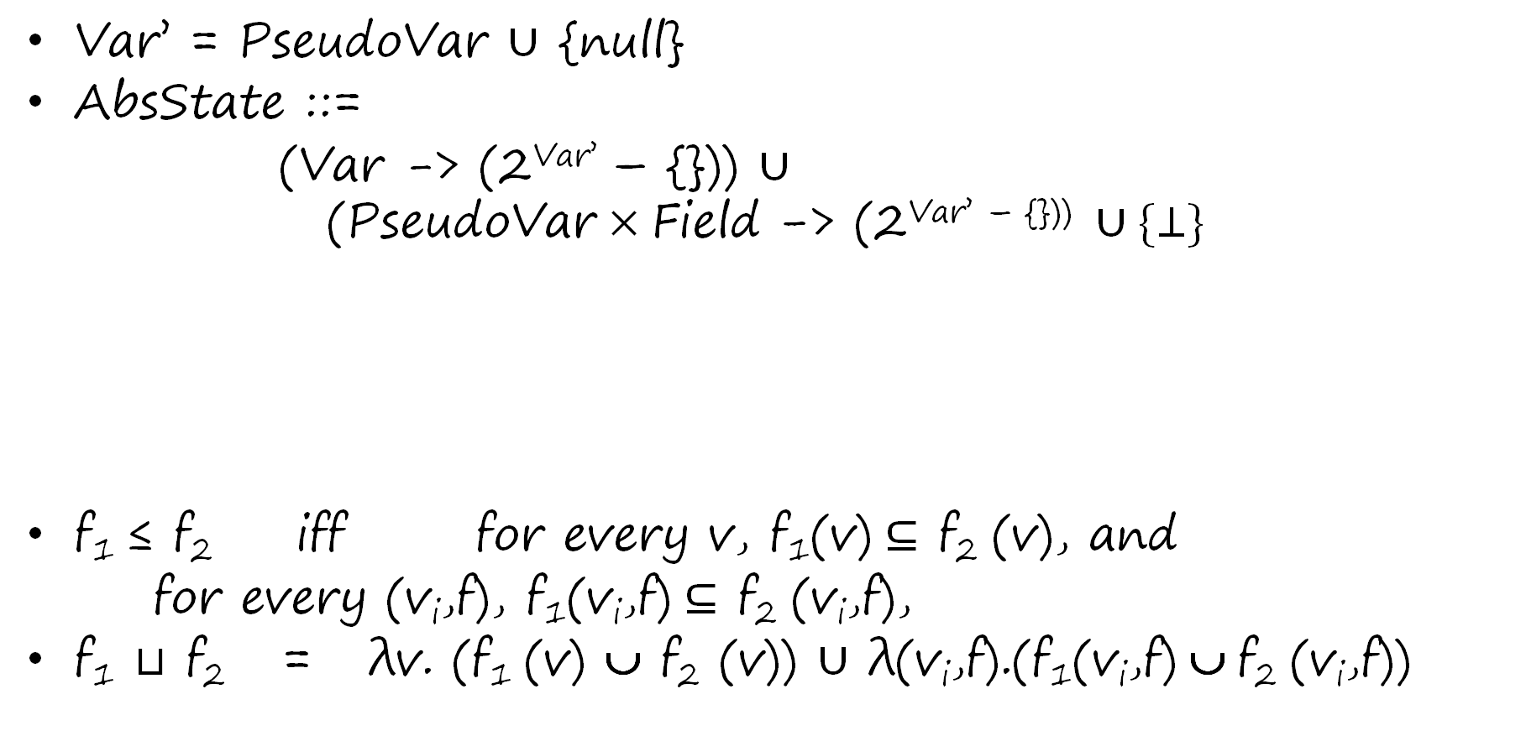
Abstract lattice definition
Var’ = PseudoVar $∪$ {null}
AbsState ::=
(Var -> (2^{Var’} – {})) $∪$
$$\text{(}\text{PseudoVar}×\text{Field}\text{ −> (2}\text{Var}\text{’ – \{\})) }∪\{⊥\}$$
f₁ ≤ f₂ iff for every v, f₁(v) $⊆$ f₂ (v), and
for every (v_{i},f), f₁(v_{i},f) $⊆$ f₂ (v_{i},f),
f₁ $⊔$ f₂ = λv. (f₁ (v) ∪ f₂ (v)) $∪$ λ(v_{i},f).(f₁(v_{i},f) ∪ f₂ (v_{i},f))

Slide 37
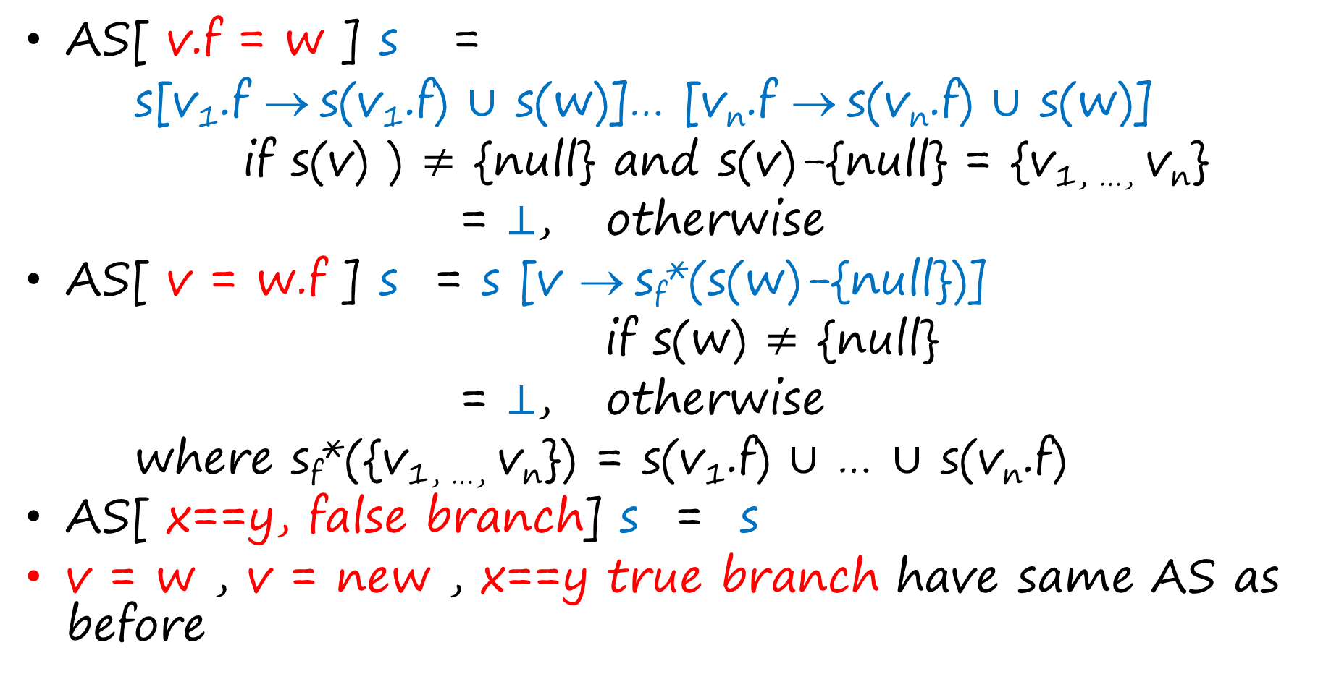
Transfer functions
AS[ v.f = w ] s =
s[v₁.f → s(v₁.f) $∪$ s(w)]… [v_{n}.f → s(v_{n}.f) $∪$ s(w)]
if s(v) ) $≠$ {null} and s(v)-{null} = {v_{1, …,} v_{n}}
= $⊥$, otherwise
AS[ v = w.f ] s = s [v → s_{f}*(s(w)-{null})]
if s(w) $≠$ {null}
= $⊥$, otherwise
where s_{f}*({v_{1, …,} v_{n}}) = s(v₁.f) $∪$ … $∪$ s(v_{n}.f)
AS[ x==y, false branch] s = s
v = w , v = new , x==y true branch have same AS as before

Slide 38












Points-to graphs
p = new; // v₁
c = null;
do {
c = new; // v₂
c.prev = p;
p = c;
}

Slide 39















Illustration of concretization function $γ$
p = new; // v₁
c = null;
do {
c = new; // v₂
c.prev = p;
p = c;
}
$$γ$$

Slide 40
Inter-procedural analysis
Context-sensitivity can be achieved using standard techniques, such as call-strings.
Pointer analysis specific context-sensitivity approaches also exist, such as object-sensitivity
Indirect (virtual) function call sites need to be resolved to candidate functions using points-to analysis. And points-to analysis needs calls to be resolved! Therefore, the two have to happen hand in hand.

Slide 41
Andersen’s Analysis
A flow-insensitive analysis
  computes a single points-to solution, which over-approximates points-to solutions at all program points
  ignores control-flow – treats program as a set of statements
  equivalent to collapsing the given program to have a single program point, and then applying Algorithm A on it.

Slide 42
Andersen’s Analysis
If program has statements s1, s2, …, sn, then create
collapsed CFG as follows:
Initial fact
Single program point that Kildall updates
?
s1
s2
……
sn
After algorithm terminates, final solution at the
single program point over-approximates result
computed by flow-sensitive analysis at any point

Slide 43
Example:
Andersen’s Analysis
x = &a;
*x = &w;
y = x;
x = &b;
*x = &t;
z = x;
Before first iteration: all variables null
After first iteration of Kildall:
x -> {a,b,null}, all other variables null
After 2nd iteration:
x -> {a,b,null}, y,z -> {a,b,null}, a,b -> {w,t,null},
all other variables null
After 3rd iteration:
X -> {a,b,null}, y,z -> {a,b,null}, a,b -> {w,t,null}, all other variables null

Slide 44
Notes about Andersen’s Analysis
Strong updates never happen in Andersen’s analysis!
  If x->{y} and y->{w} before we process statement “*x = &z”, then even if transfer function returns y->{z}, due to subsequent join, y will point to {w,z} after this step.
Flow-insensitive style can be adopted for any analysis, not just for pointer analysis

Slide 45
Why Flow-Insensitive Analysis?
Reduced space requirements
  a single points-to solution
Reduced time complexity
  no copying of points-to facts
    individual updates more efficient
  a cubic-time algorithm
Scales to millions of lines of code
  most popular points-to analysis

Slide 46
Andersen’s Analysis:
An alternative formulation
Introduce a constraint variable PT_{x} for each program variable x
Create a constraint from each assignment statement, as follows:
  x = y: PT_{y} ⊆ PT_{x}
  *x = y: PT_{y} ⊆ PT_{v,} forall variables v in PT_{x}
  x = &y: {y} ⊆ PT_{x}
  x = *y: PT_{v} ⊆ PT_{x,} forall variables v in PT_{y}
Find least solution to set of all constraints that were generated above. (A solution is a mapping from constraint variables to sets of program variables.) Emit this least solution as the final solution.
  Note: Solution s1 dominates Solution s2 if for each program variable v, s2(PT_{v}) ⊆ s1(PT_{v})
Note: This approach computes exact same result as previous approach that collapses program and then uses Algorithm A.

Slide 47
May-Point-To Analyses
Ideal-May-Point-To
more efficient / less precise
Algorithm A
more efficient / less precise
Andersen’s

Slide 48
Andersen’s Analysis:
Further Optimizations and Extensions
Fahndrich et al., Partial online cycle elimination in inclusion constraint graphs, PLDI 1998.
Rountev and Chandra, Offline variable substitution for scaling points-to analysis, 2000.
Heintze and Tardieu, Ultra-fast aliasing analysis using CLA: a million lines of C code in a second, PLDI 2001.
M. Hind, Pointer analysis: Haven’t we solved this problem yet?, PASTE 2001.
Hardekopf and Lin, The ant and the grasshopper: fast and accurate pointer analysis for millions of lines of code, PLDI 2007.
Hardekopf and Lin, Exploiting pointer and location equivalence to optimize pointer analysis, SAS 2007.
Hardekopf and Lin, Semi-sparse flow-sensitive pointer analysis, POPL 2009.

Slide 49
Context-Sensitivity Etc.
Liang & Harrold, Efficient computation of parameterized pointer information for interprocedural analyses. SAS 2001.
Lattner et al., Making context-sensitive points-to analysis with heap cloning practical for the real world, PLDI 2007.
Zhu & Calman, Symbolic pointer analysis revisited. PLDI 2004.
Whaley & Lam, Cloning-based context-sensitive pointer alias analysis using BDD, PLDI 2004.
Rountev et al. Points-to analysis for Java using annotated constraints. OOPSLA 2001.
Milanova et al. Parameterized object sensitivity for points-to and side-effect analyses for Java. ISSTA 2002.

Slide 50
Applications
Compiler optimizations
Any kind off Verification & Bug Finding
  use in preliminary phases
  use in verification itself

