Slide 1
BASE an ACID ALTERNATIVE
Group #1

Slide 2
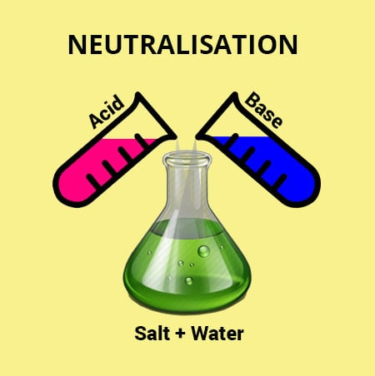
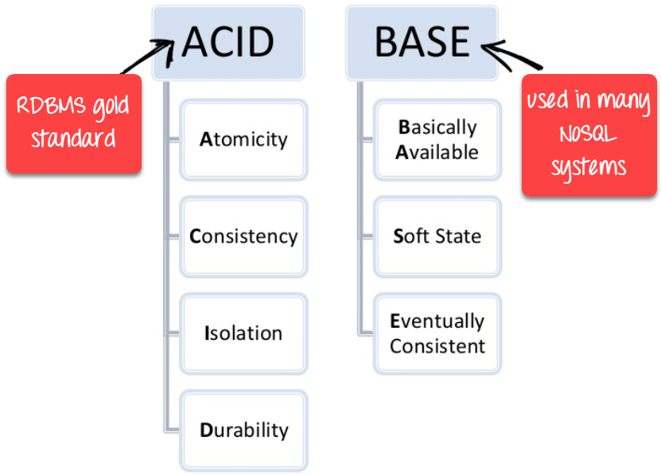
ACID vs BASE
Not this.
But this.

Slide 3
agenda
Introduction
CAP Theorem
ACID vs BASE
Simple Example
BASE Model and its implementation
Software State, Eventual Consistency and Event-Driven Architecture

Slide 4
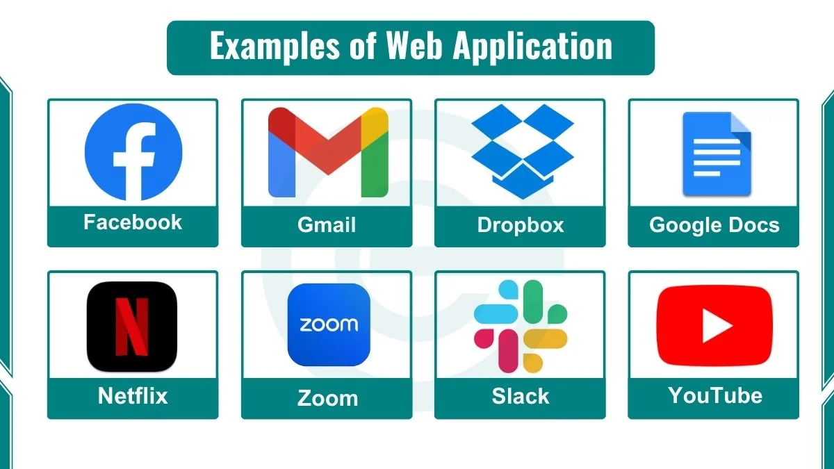



Web applications have grown in
popularity
over the past decade.
SAY you are
BUILDing your
WEB APPLICATION
What things you may need to worry about?

Slide 5
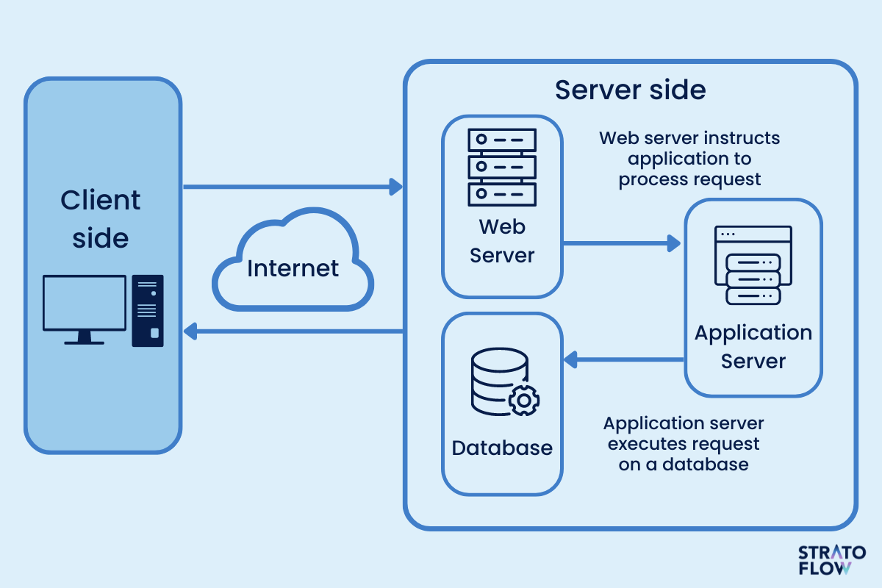
EVERYTHING AT ONE NODE
[CENTRALIZED SYSTEM]
A simple solution
Database service, web server, app server all are at one place (node)
Clients contact one server hosting service (no load balanced) via HTTP over Internet

Slide 6



You WITNESS GROWTH
Growing Popularity of Your Web Applications
Increasing demand for your application will cause:
higher traffic at your end
surging data processing requirements for your app

Slide 7


You WITNESS GROWTH
Importance of Scalability for Your Web Application
You need to scale because of:
Rapid transactional growth at your side
Performance bottlenecks issues
Data Storage as MAIN Bottleneck​
read/write performance issues
traditional databases struggle with high concurrency and large datasets

Slide 8
SO YOU WANT TO SCALE
Your pain BEGINS
Simple Solution needs to be scaled
Many Challenges in Scaling Data Storage/Web Server
YOU WANT TO IMPROVE:
Latency:
Throughput:
YOU GET TO TACKLE:
Consistency:
Scalability:

Slide 9
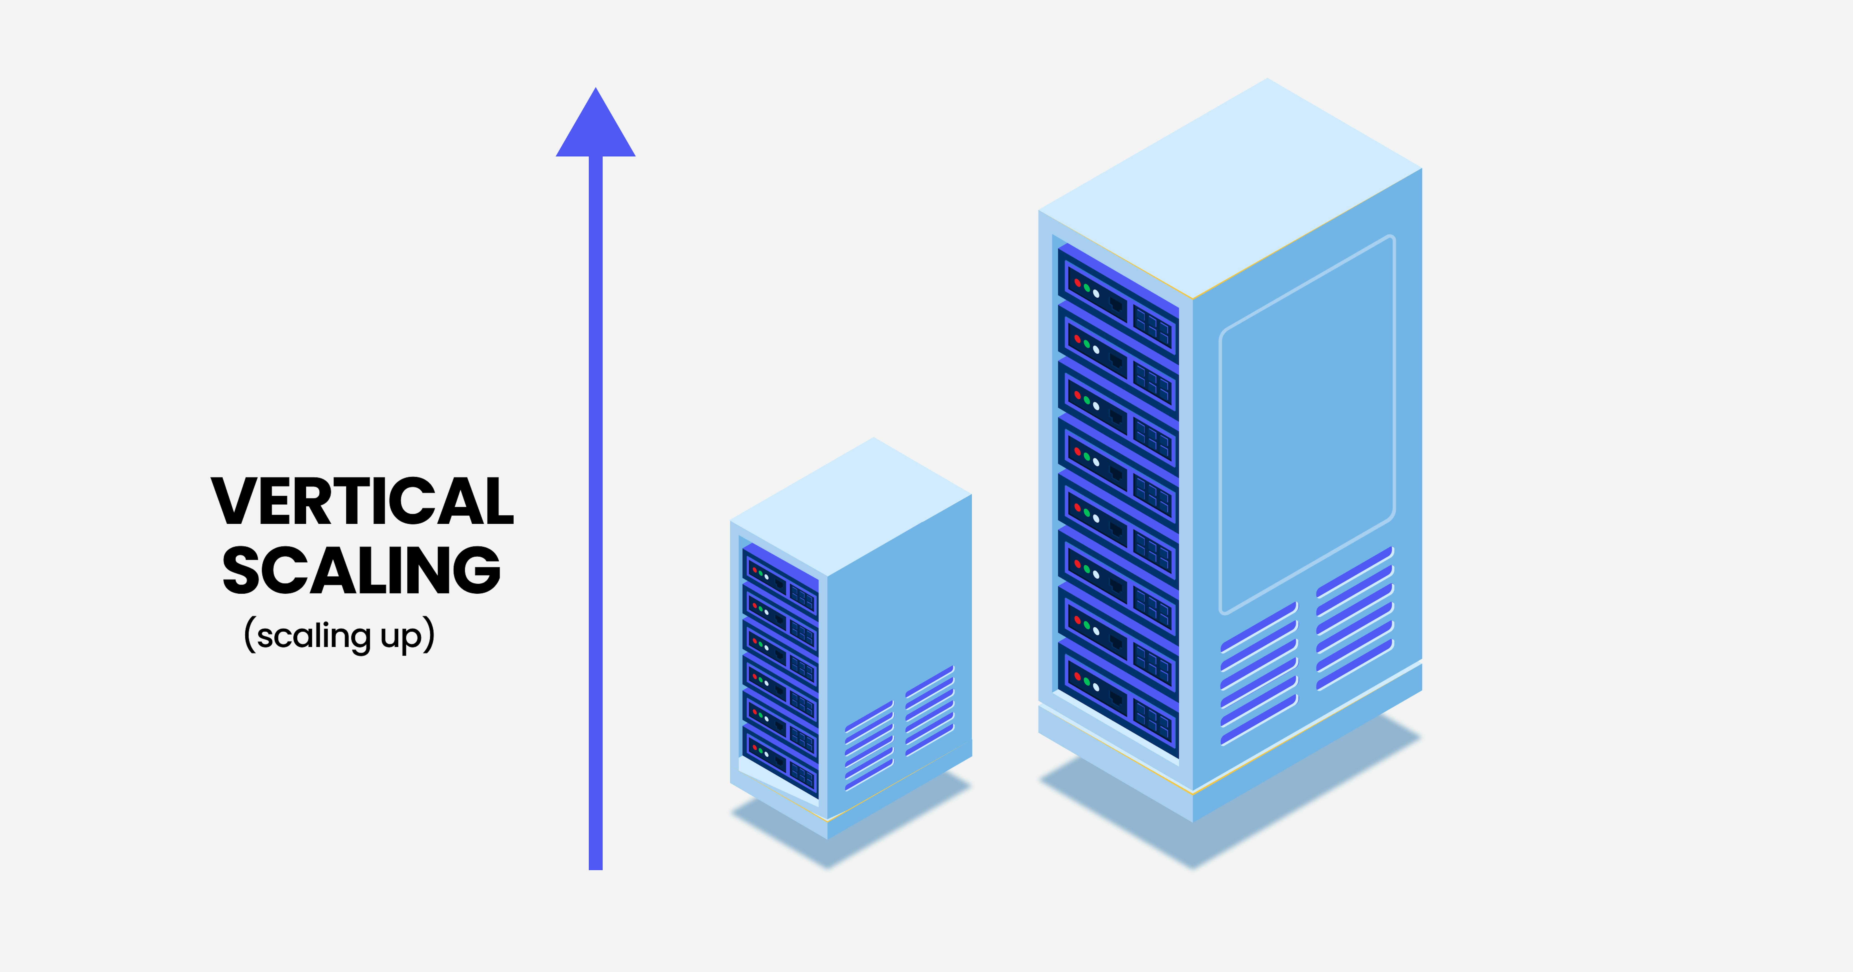
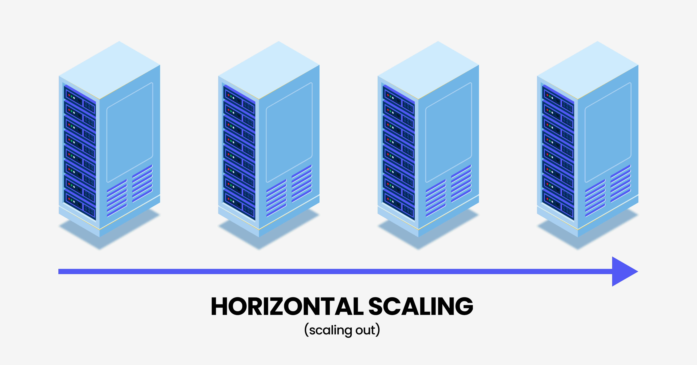
Vertical Scaling (Scaling Up)
HORIZONTAL​ Scaling
(Scaling OUT)​
Increases system capacity by upgrading the existing server’s hardware (CPU, RAM, disk)
A single machine is made more powerful to handle increased load.
Suitable for applications requiring high performance on a single instance.
Increases system capacity by adding more machines (servers) to the infrastructure.​
Traffic is distributed across multiple servers using load balancers.​
Each new server handles a portion of the requests, reducing the load on individual machines.​

Slide 10
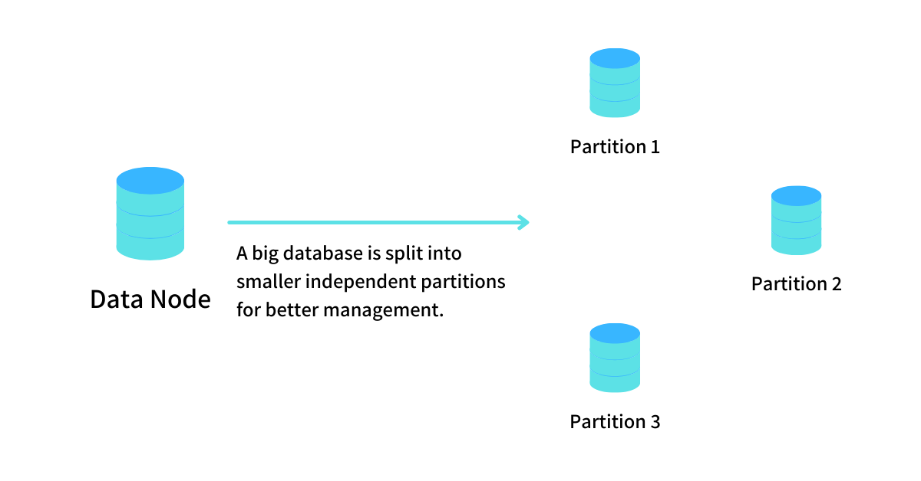
FUNCTIONAL PARTITIONING
Functional partitioning is important for achieving high degrees of scalability.
(like microservices architecture)
Any good database architecture decomposes the schema into tables grouped by functionality.

Slide 11
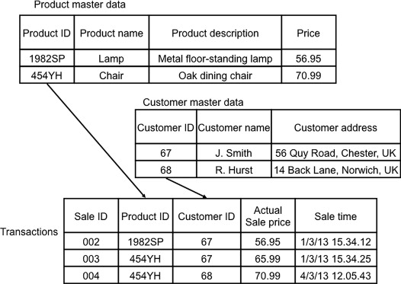
FUNCTIONAL PARTITIONING (1)
AN EXAMPLE
Functional Partitions
Customers
Products
Transactions

Slide 12
FUNCTIONAL PARTITIONING (2)
ensuring consistency:
ensuring SCALABILITY:
Foreign keys to maintain relationships between tables.
For constraints to be applied, the tables must reside on a single database server, otherwise we have to use 2PC.
Moves functional groups of data onto separate database servers.
Reduces load on a single database.
Enables independent scaling of different functional areas (e.g., scale user data separately from transactions).

Slide 13
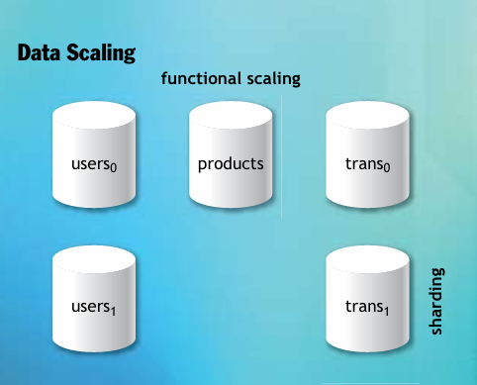
FUNCTIONAL PARTITIONING (3)
CHALLENGES?
Moving Data Constraints to the Application
Removes database-enforced constraints for flexibility in scaling.
Requires application logic to enforce data consistency.
Introduces new challenges, such as handling distributed transactions and eventual consistency or 2PC.
FUNCTIONAL PARTITIONING IS NOT SHARDING

Slide 14
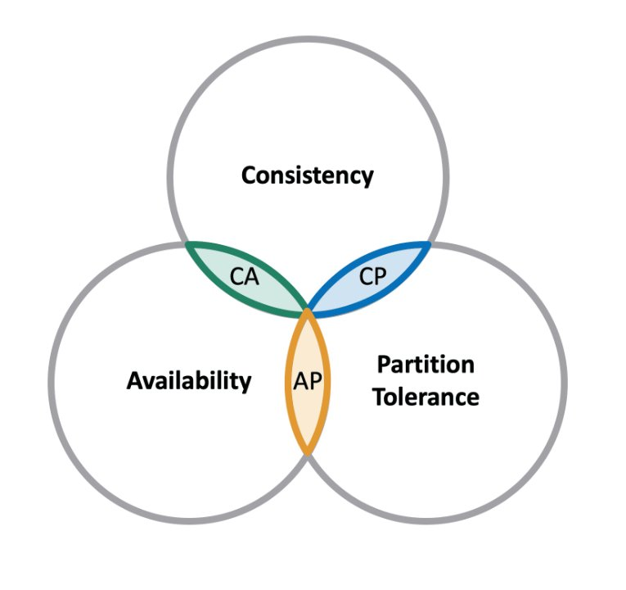
CAP THEoREM (1)
proposed by: Eric Brewer (professor at the University of California, Berkeley)
He made the conjecture that Web services cannot ensure all three of the following properties at once
Consistency (C) – Every read receives the most recent write or an error.
Availability (A) – Every request receives a response(not necessarily the most recent).
Partition Tolerance (P) – The system continues to function despite network failures (partitions).
Since network partitions always happen in distributed systems, you can only choose between Consistency (C) or Availability (A) under partition failure.

Slide 15
CAP THEOREM (2)
Distributed systems must tolerate partitions (P),
so they must choose between C or A.
AP systems prioritize
uptime and fast responses.
CP systems prioritize correctness.
Trade-offs in CAP Theorem
CP Low Availability.
  Example: HBase, MongoDB (strong consistency)
AP Delayed/no Consistency
  May return stale (outdated) data.
  Example: Cassandra, DynamoDB, CouchDB
CA No Partition Tolerance
  Not realistic for large distributed systems
  Example: Single-node databases like RDBMS
  (PostgreSQL, MySQL in single-node mode)

Slide 16
ACID
ACID database transactions greatly simplify the job of the application developer.
As signified by the acronym,
ACID transactions provide the following guarantees:
Atomicity. All of the operations in the transaction will complete, or none will.​
​
Consistency. The database will be in a consistent state when the transaction begins and ends.​
​
Isolation. The transaction will behave as if it is the only operation being performed upon the database.​
​
Durability. Upon completion of the transaction, the operation will not be reversed.

Slide 17
ACID
Commiting in a single DB
It is easy
Steps:
  Transaction begins (BEGIN TRANSACTION).
  SQL operations execute (e.g., INSERT, UPDATE, DELETE).
  Changes are held in memory (not yet permanent).
  COMMIT command is issued.
  The database writes changes to disk and updates the transaction log.
  The transaction is marked as complete.
Easier Recovery and Consistency:
If a failure occurs, a single database can quickly rollback changes because all data modifications are in the same transaction log.

Slide 18
We start with a toy example
We start with most simple ACID (& 2PC) implementation.
Present the problems.
Solving using BASE.

Slide 19
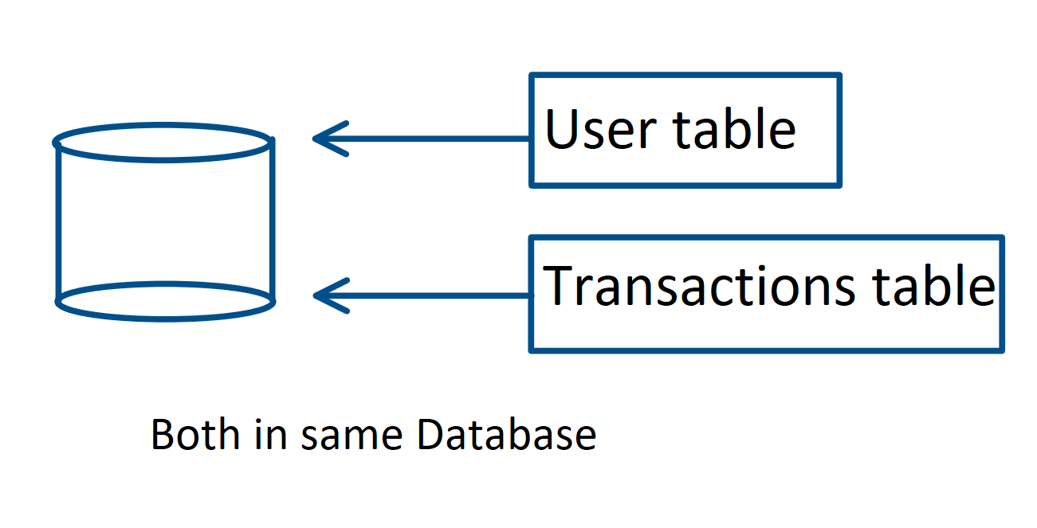
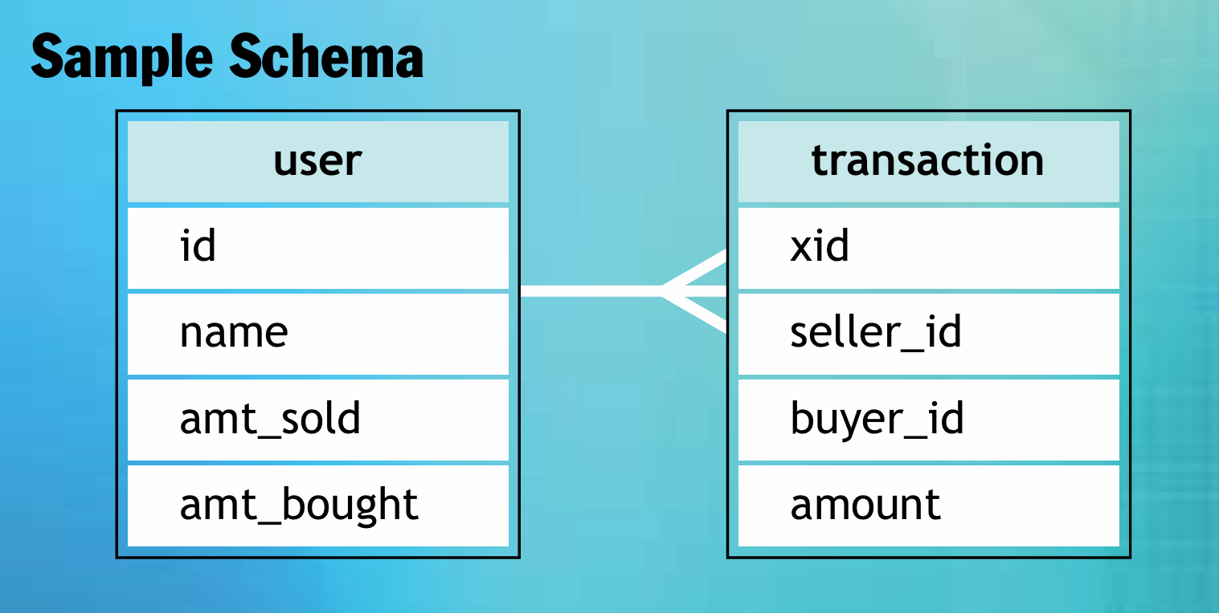
ACID transaction
TOY EXAMPLE
Example Schema in one node:
Initially all our data tables are in one database which is hosted on a single node.
We can perform operations on both tables in one single transaction.
Advantages:
Simplicity
DBMS handles ACID for us

Slide 20
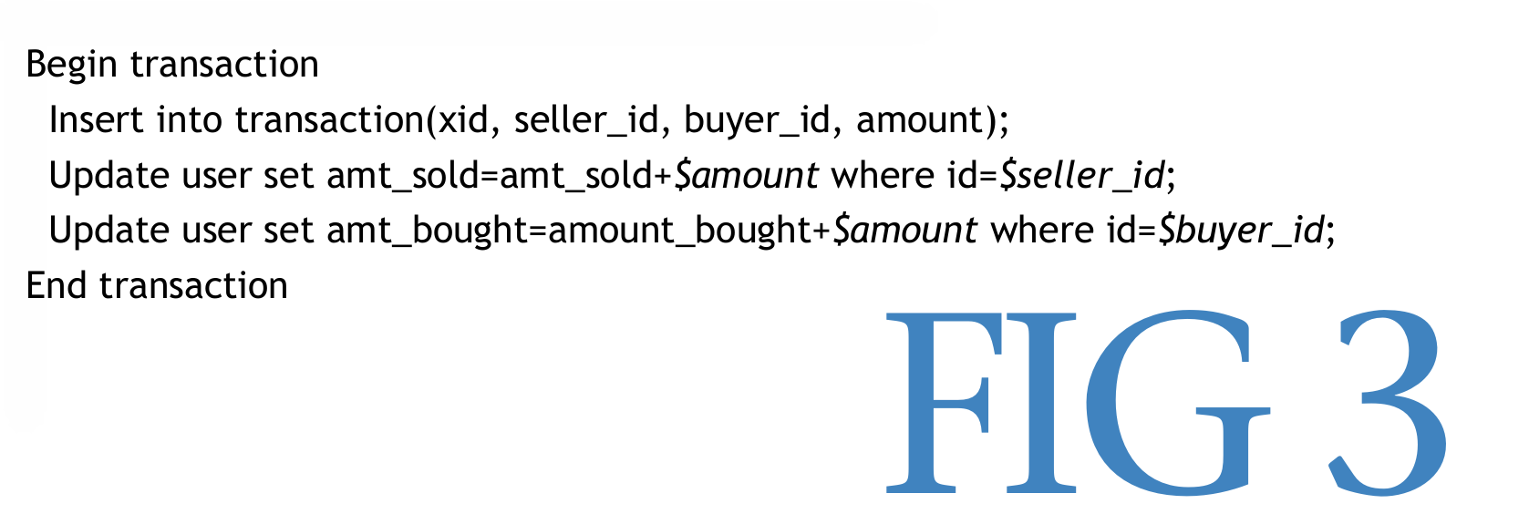
ACID transaction
TOY EXAMPLE
Example in one node:
We know this will work because on a single database on a single node, transactions will ensure consistency, and durability.
No worry about any such issues!
Improvements:
The two functional groups can be separated
No need to have one long transaction
Can do separately for better concurrency and requests handling

Slide 21
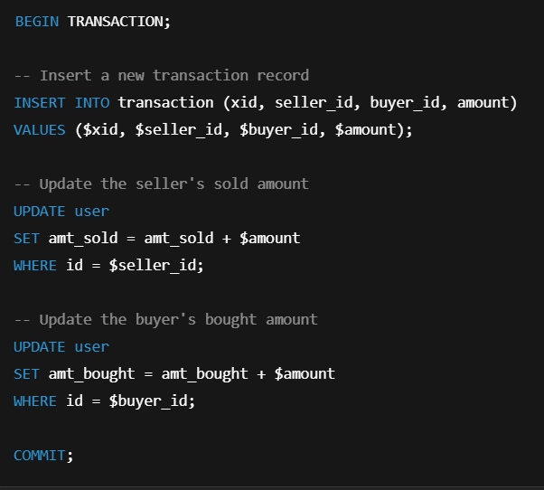
ACID transaction
TOY EXAMPLE explained
$xid – Unique transaction ID.
$seller_id – ID of the user who is selling.
$buyer_id – ID of the user who is buying.
$amount – Amount being transacted.
They are passed as parameters through application code depending upon language.

Slide 22
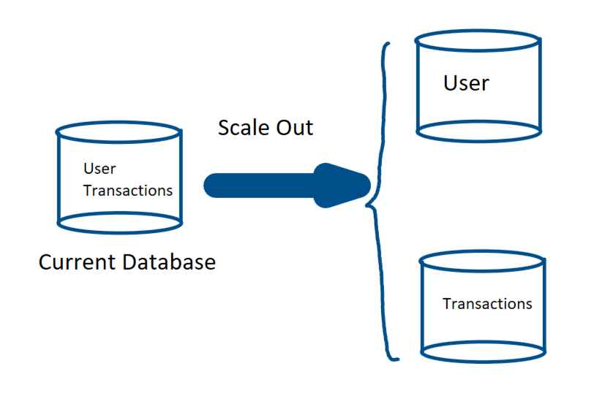
ACID Transaction
Say We want to scale
Following the microservices structure we want to scale out:
We want to separate the services for users and transactions. So, we also have to separate their databases.
Separate service can be on separate nodes, so their databases are also on different nodes.
Adds throughput and lowers latency.
We scale out to two different databases on two different nodes.

Slide 23
ACID TRANSACTION
Our schema contains two separate tables 'user' and 'transaction'.
We separate these into two functional parts.
And physically keep into two different databases on two different nodes.
Web Server
(Application)
Req / Res
Users
Transactions
node1
node2

Slide 24
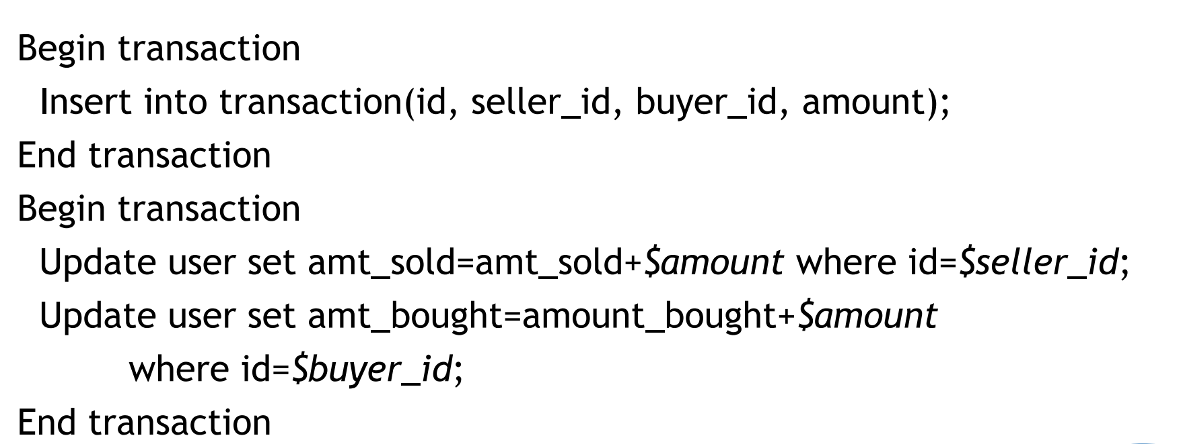
ACID TRANSACTION
After scaling:
We do two separate transactions to communicate updates to two different databases.
Transaction 1
(on node 1)
Transaction 2
(on node 2)

Slide 25
Acid transactions
How to do it?
Transaction 1
Transaction 2
Web Server
(Application)
Req / Res
Users
Transactions
node1
node2

Slide 26
Acid transactions
What can go wrong?
Txn#1 Fails, Txn#2 Goes
No transaction record persisted, but users have seen their amounts getting updated Inconsistency
Transaction 1
Transaction 2
Txn#2 Fails, Txn#1 Goes​
A transaction record persisted, but users have not seen their amounts getting updated Inconsistency​
Txn#1 Fails, Txn#2 Fails
All ok (NONE happened)
Txn#1 Goes, Txn#2 Goes
All ok (ALL happened)​

Slide 27
WE NEED 2pc PROTOCOL
FOR DATABASES IN DISTRIBUTED ENVIRONMENT
A distributed database requires extra steps:
(e.g., 2PC, consensus protocols)
to ensure atomicity across multiple nodes,
making it more complex and less available reducing overall concurrency.
What is this 2PC?
In a nutshell
The protocol is broken into two phases:
Phase1:- The transaction coordinator asks each database involved to pre-commit the operation and indicate whether commit is possible.
Phase2:- If all databases agree that the commit can proceed, then transaction coordinator asks each database to commit the data.

Slide 28
WORKING: 2pc PROTOCOL
A SIMPLE RUNDOWN
Coordinator
(master)
PREPARE PHASE: The master sends message 1and 2 to both slave nodes asking if they are ready to commit. The nodes reply with yes or no(message 3 and 4). If both the nodes agree, commit can proceed else rollback is done.
COMMIT PHASE: On receiving messages from both slave nodes, master asks them to commit by sending messages 5 and 6.
READY?(1)
READY ?(2)
COMMIT(1)
COMMIT(2)
YES(3)
YES(4)
(Node1)
(Node2)

Slide 29
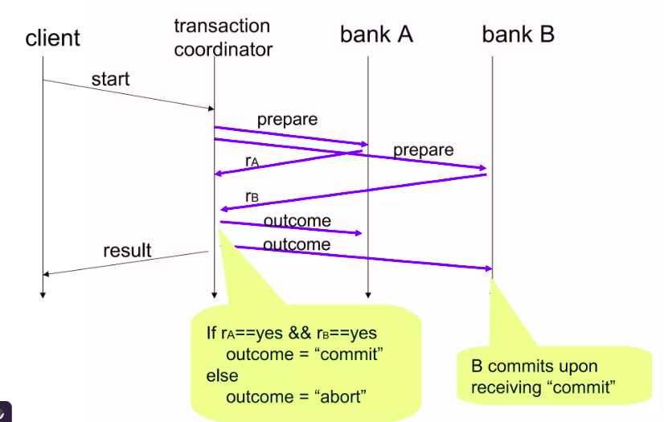
WE NEED 2pc PROTOCOL: AN EXAMPLE RUNDOWN(1)
FOR DATABASES IN DISTRIBUTED ENVIRONMENT
Client wants to save changes
Node1
Node2

Slide 30
WE NEED 2pc PROTOCOL: AN EXAMPLE RUNDOWN(1)
FOR DATABASES IN DISTRIBUTED ENVIRONMENT
Coordinator sends prepare message to A and B
Node1
Node2

Slide 31
WE NEED 2pc PROTOCOL: AN EXAMPLE RUNDOWN(1)
FOR DATABASES IN DISTRIBUTED ENVIRONMENT
Node1
Node2
Nodes reply with message r_{A} and r_{B}

Slide 32
WE NEED 2pc PROTOCOL: AN EXAMPLE RUNDOWN(1)
FOR DATABASES IN DISTRIBUTED ENVIRONMENT
Node1
Node2
Condition is checked for yes or not

Slide 33
WE NEED 2pc PROTOCOL: AN EXAMPLE RUNDOWN(1)
FOR DATABASES IN DISTRIBUTED ENVIRONMENT
Node1
Node2
Depending on received message, commit or abort is sent

Slide 34
WE NEED 2pc PROTOCOL: AN EXAMPLE RUNDOWN(1)
FOR DATABASES IN DISTRIBUTED ENVIRONMENT
Node1
Node2
Both the nodes commit if message of commit is received

Slide 35
WE NEED 2pc PROTOCOL: AN EXAMPLE RUNDOWN(1)
FOR DATABASES IN DISTRIBUTED ENVIRONMENT
Node1
Node2
Coordinator sends result back to client

Slide 36
2pc: the problem
Problem:
If any service fails, the entire transaction is blocked, reducing availability.
Applying locks on databases may compromise availability.
In distributed systems, this leads to delays, high latency, adding system downtime.
Short Example:
Say each database's uptime is 99.9%. Since we have two databases now, so total uptime is 99.8%. So, down time doubles. The availability of any system is the product of the availability of the components required of the operation.
Also, downtime may further increase due to 2PC fails, since most of the databases use locking while doing 2PC.

Slide 37
BASE
An Alternative to ACID: More Availability
If ACID and 2PC provides the consistency choice for partitioned databases,
then how do you achieve availability instead?
One answer is BASE
(Basically Available, Soft state, Eventually consistent).
Main Idea:
We want our systems to be more available (user experience better) and we can instead trade some consistency.

Slide 38
BASE
Principle
BASE is diametrically opposed to ACID.
ACID is pessimistic and forces consistency at the end of every operation.
BASE is optimistic and accepts that the database consistency will be in a state of flux.
Although this sounds impossible to cope with,
in reality it is quite manageable and leads to levels of scalability
that cannot be obtained with ACID.

Slide 39
BASE
IN DISTRIBUTED ENVIRONMENT
The availability of BASE is achieved through supporting partial failures without total system failure.
Here is a simple example:
If users are partitioned across five database servers, BASE design encourages crafting operations in such a way that one user database failure impacts only the 20 percent of the users on that particular host. There is no magic involved, but this does lead to higher perceived availability of the system.

Slide 40
BASE
EXAMPLE
Example of BASE in Action: Amazon DynamoDB
Let’s say an e-commerce site uses a BASE-compliant database like DynamoDB:
A customer places an order and a write happens on Node A.
Another customer views orders from Node B before the update propagates.
The second customer might not see the new order immediately.
However, after a few seconds (or minutes), the system synchronizes, and all nodes reflect the same data.

Slide 41
Avoiding 2PC
Using BASE
Transaction 1
Pseudocode Only
We will see actual schema for message later
Transaction 2
The buyer and seller expectations can be set so their running balances do not reflect the result of a transaction immediately.
This is not uncommon, and in fact people encounter this delay between a transaction and their running balance regularly (e.g., ATM withdrawals and cellphone calls)

Slide 42
PROBLEM !
If the contract explicitly states that the running totals are the estimates, then it may be considered acceptable.
But if not ,the changes in one table might not be consistent with the other one.
A failure between the two transactions might result in permanent inconsistency in one of the tables.

Slide 43
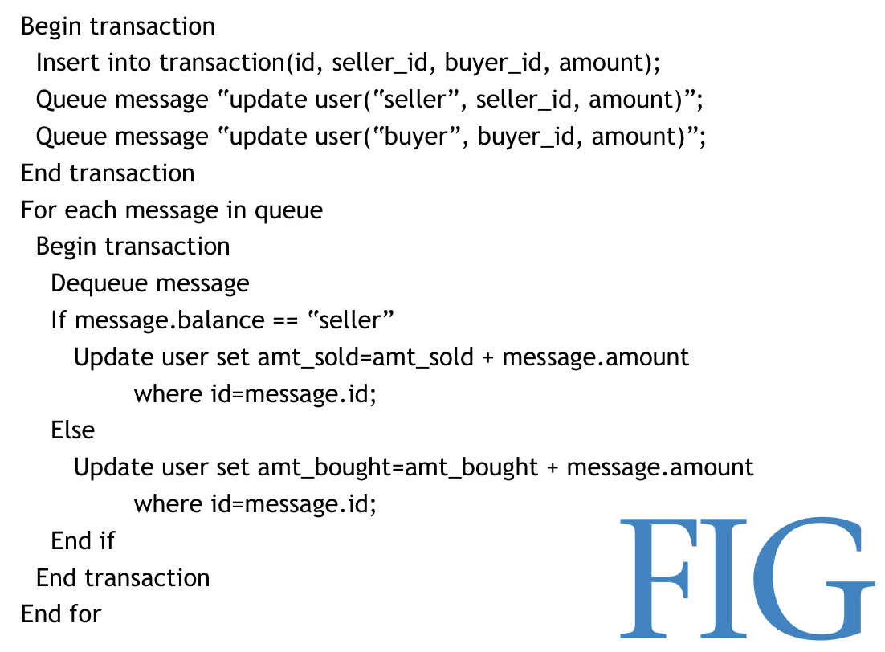
Base
Persistent Queues
Pseudocode Only
Introducing a persistent message queue solves the problem of inconsistency.
The most critical factor in implementing the queue: ensuring that the backing persistence is on the same resource as the database.
Why? : to allow the queue to be transactionally committed without involving a 2PC.

Slide 44
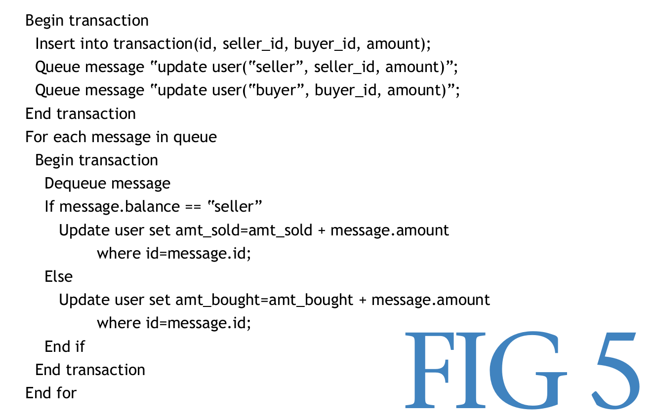
Base Persistent Queues
Pseudocode Only
Update in Transaction
Pseudocode Only
Updates in User
See Next Slide For Details

Slide 45
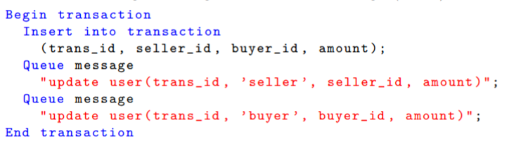
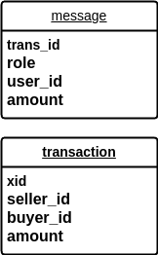
Base Persistent Queues
trans_id is uniquely generated
Inserts row in 'transaction' table and sends update to the queue of 'user' table
On same node (to avoid 2PC)
User 1 bought Laptop
Users
Queue
Transactions
M1: S sold
M2: U bought
Now, since queue is Node1 along with Transaction table, we can have one transaction to ensure both happen or none

Slide 46
Base Persistent Queues
Inserts row in 'transaction' table and sends update to the queue of 'user' table
On same node (to avoid 2PC)
User 1 bought Laptop
Users
Queue
Transactions
M1: S sold
M2: U bought
BOTH are in Node1 now, 2PC not needed to enqueue

Slide 47
Base Persistent Queues
We include [trans_id, role, user_id, amount] fields into the message schema.
message.role
The message-queue is in Node1
Based on role, we update the user accordingly
message.user_id
message.user_id
Conditional Action
Queue
Users
Dequeue
M1, M2, M3, ...
M

Slide 48
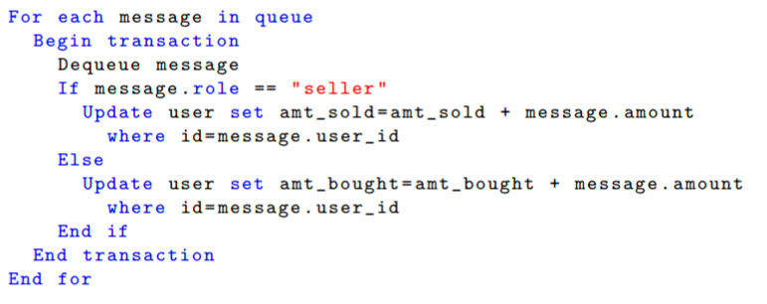
Base Persistent Queues
We include [trans_id, role, user_id, amount] fields into the message schema.
The message-queue is in Node1
So, what if the transaction at Node2 dequeues the message, but update to the users table fails?
There will be inconsistency as message is now lost, without updating users table.
Queue
Users
Dequeue
M1, M2, M3, ...
M

Slide 49
issue persists!
Messages are queued together with transactions, but processing them still requires coordination between the message queue and the users database
Again 2PC problem.
2. If an update/insert is successful to transactions table and message enqueue is successful at Node1, then users table at Node2 must be able to process message without fail/inconsistency.
User 1 bought Laptop
Node1
Node2
Yes? Commit trxn.
Users
Transactions
Queued M??
M, M1, M2,...
No? rollback trxn.

Slide 50
Solving 2pc problem
How will the Node2 able to process messages in Node1? Do we need 2PC?
One solution to the previous slow 2PC in the message-processing component is to do nothing; decouple the update into separate back-end component for Users. Still 2PC will be needed but now lower availability for business requirements is acceptable.
What if we don't want to go for 2PC? And still have inconsistency solved?
Idempotence: An operation is considered idempotent if it can be applied one time or multiple times with the same result. Idempotent operations are useful in that they permit partial failures, as applying them repeatedly does not change the final state of the system.

Slide 51
issue persists!
If we don't use 2PC, or don’t use some mechanism of message-processing,
(like idempotency handling) then there can be issue of message loss.
This creates an issue of permanent inconsistency.
Our Next Approach: idempotency handling
User 1 bought Laptop
Node1
Users
Transactions
Queue
M, M1, M2,...

Slide 52
What is Idempotence(1)
Update operations are rarely idempotent.
Increments and decrements are not idempotent as applying them more than once will not have same effect as applying once.
Example: Wallet = Wallet -100
Some updates can be idempotent.
Example: Wallet = 1000
However, in cases like above, we need to make sure that the order in which these events are received don't result in inconsistent data.

Slide 53
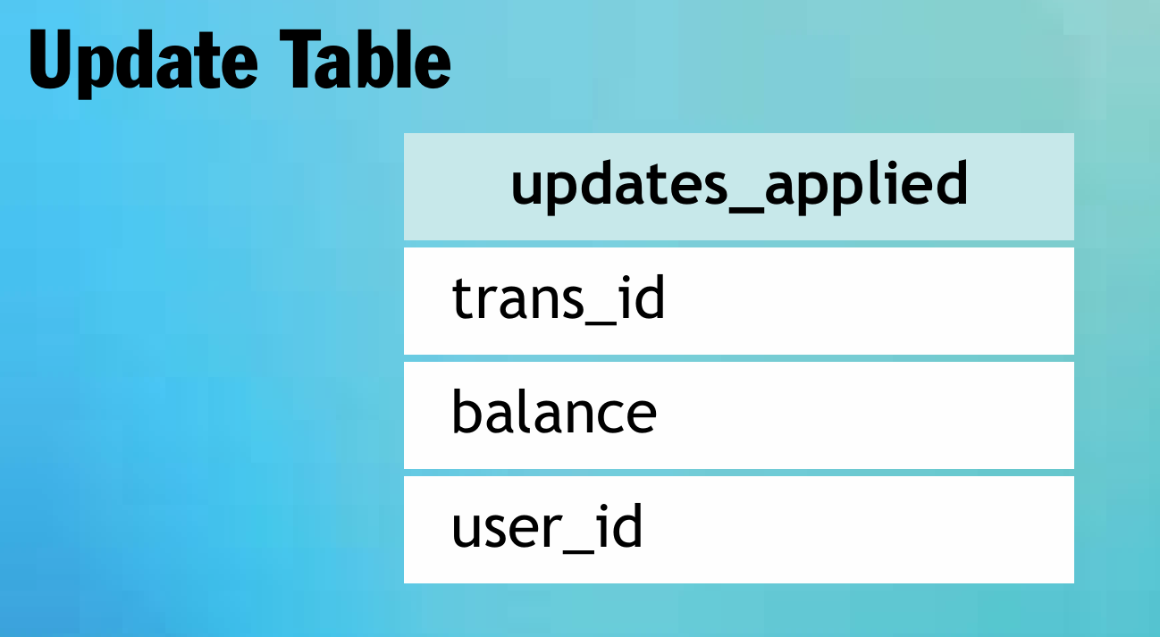
What is Idempotence(2)
Using a table that records the transaction identifiers that have been applied can help.
The table tracks the transactions ID, which balance has been updated, and the user ID where the balance was applied.
To incorporate idempotence we update our example to contain a transaction id of the update for each update. So now, whenever an update is issued, we check the 'processed' field in the db for that update and apply it accordingly.
We can keep a track of which updates have been applied.
role

Slide 54
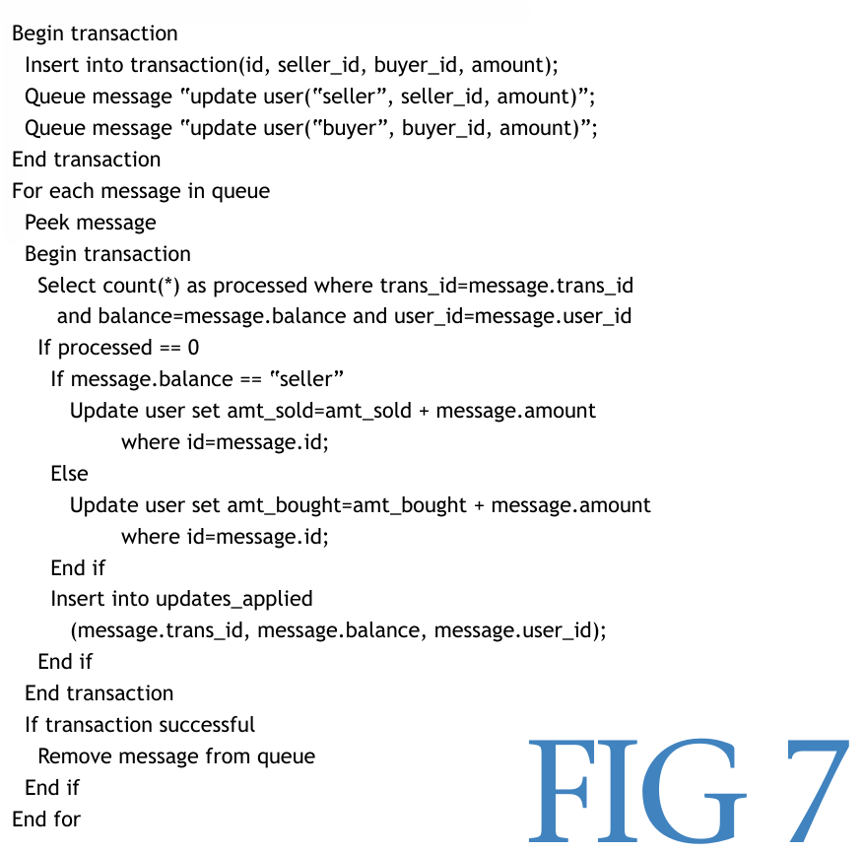
idempotency
(trans_id, seller_id, buyer_id, amount);
Block 1 remains similar but not same
(psudocode only)
In the first block, we insert the transaction record as before,
along with messages at Node1.
"update user(trans_id, "seller",seller_id, amount)";
"update user(trans_id, "buyer",buyer_id, amount)";
The two messages are enqueued into the queue through the transaction encapsulating them.
We will assume somehow the messages are enqueued into the queue without using 2PC. This is easy as transaction on single node guarantees atomicity.
message.role
message.user_id
message.user_id
message.role

Slide 55
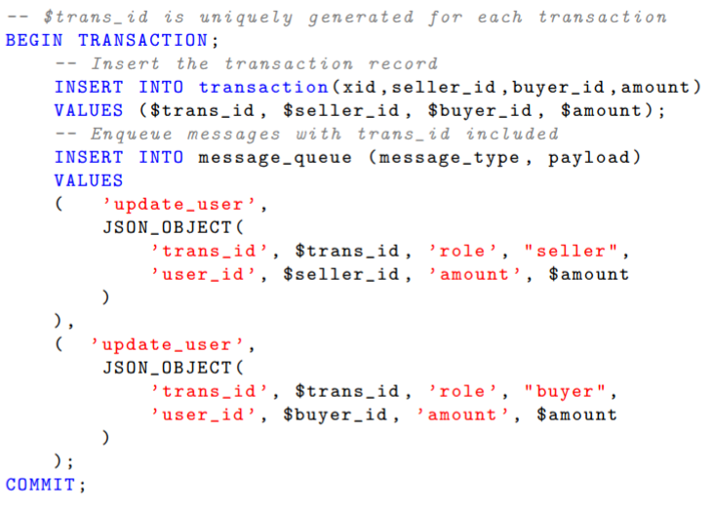
Idempotency(2)
The pseudocode of Block1 can be achieved programmatically as shown on right:
Transaction
Guarantees atomicity at Node1
We include trans_id, role, user_id, amount
fields into the message schema.

Slide 56
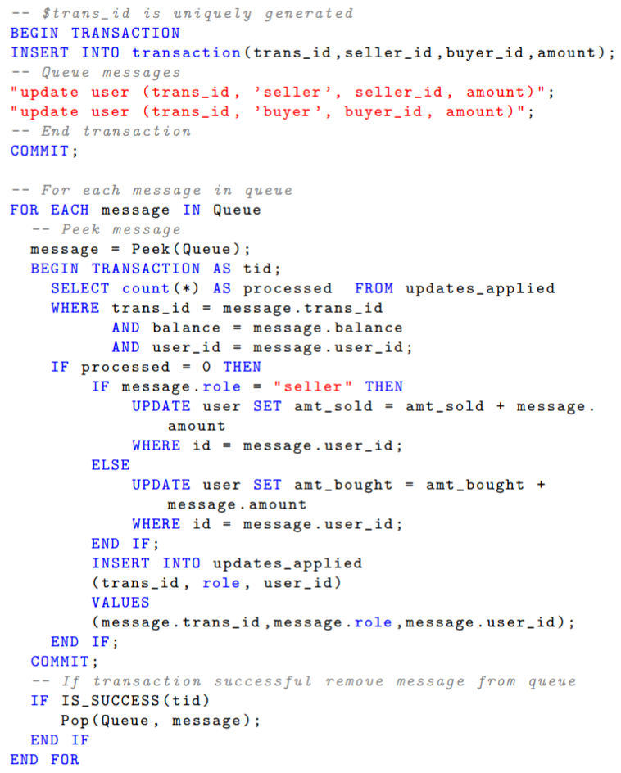
Idempotency(3)
We peek a message in the queue and remove it once success fully processed.
Node-1
Node-2
The algorithm now supports partial failures and still provides transactional guarantees without resorting to 2PC.

Slide 57
Idempotency(4)
Action at Node-2
Selects all transactions with same details as the message you peeked. Counts them.
Action for each msg in queue
message.amount
role
amount
If count is 0 i.e. no previous trxn. with same details, then processes that message.
Else, ends the db trxn.
user_id
amount
user_id
role
(We already have a table containig the trxn logs, we check that table.)
We included trans_id,role, user_id, amount
fields into the message

Slide 58
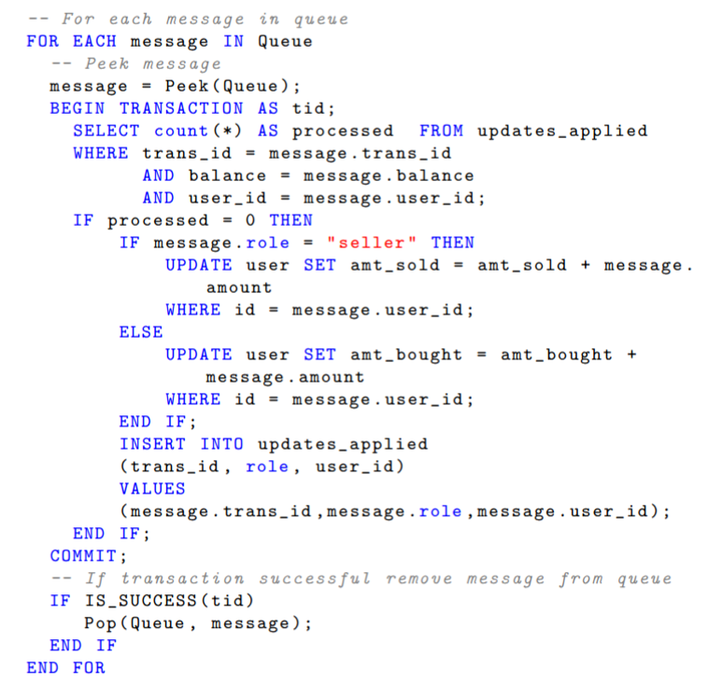
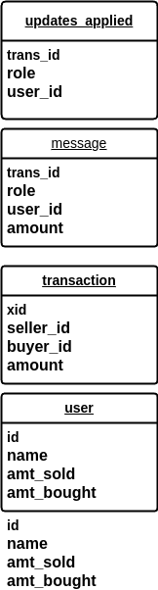
Action at Node-2
The idea can be implemented in code as follows:
message.role

Slide 59
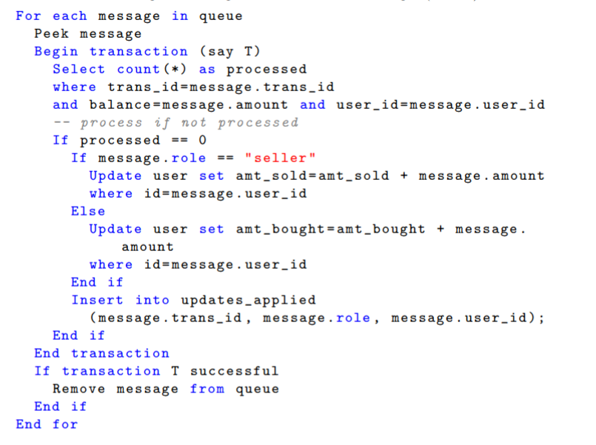
FAILURE PATTERNS ANALYSIS (for idempotency)
Action at Node-2
Action for each msg in queue
Failure within transaction anywhere
In this case, since message is not popped yet we can redo the same operations when transaction is restarted for that message.
No loss of message, no incosistency.
Failure before transaction
In this case, message peeking from Node1
is failed, so transaction is not started
as message is null.
So, there is no effect, the loop will simply retry with same or other message again.
Failure after transaction
In this case, since message is NOT popped, from Node1, but updates have been applied, so next time the message is retried, no updates will be made as processed=1

Slide 60
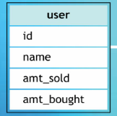
Minor Issues
Ordering Issue
We might want to preserve the ordering of the updates!
Consecutive transaction ids may be produced by the msg producer.
If we need something like 'last sale time', then we can attach a timestamp
along with trxn. id for checking.
Store last update's timestamp and compare with the current msg.
last_purchase
Sample code
Added this field to user:
For each message in queue:
Peek message
Begin Transaction
Update user set last_purchase=message.trans_date where id=message.user_id
and last_purchase < message.trans_time
End Transaction
If transaction successful
Remove message from queue
End For
{
We add one more field to message:
role, user_id, amount, trans_id, trans_time fields into the message

Slide 61
Minor Issues
Ordering Issue: SOLUTION
We modified the schemas so far: to accommodate ordering issue
This code tells that do not update if the transaction time logged into the message is smaller(indicating older message) than last_purchase indicating some newer message has been seen.
last_purchase
Sample code
Added this field to user:
For each message in queue:
Peek message
Begin Transaction
Update user set last_purchase=message.trans_date where id=message.user_id
and last_purchase < message.trans_time
End Transaction
If transaction successful
Remove message from queue
End For
{
We add one more field to message:
role, user_id, amount, trans_id, trans_time fields into the message

Slide 62
Minor Issues
Soft state: Eventual consistency
Up to this point, the focus has been on trading consistency for availability.
Consider a system where users can transfer assets to other users
There is a period of time where the asset has left one user and has not arrived at the other
If the lag between sending and receiving is a few seconds, it will be invisible or certainly tolerable to users who are directly communicating about the asset transfer.
In this situation the system behavior is considered consistent and acceptable to the users, even though we are relying upon soft state and eventual consistency in the implementation.

Slide 63
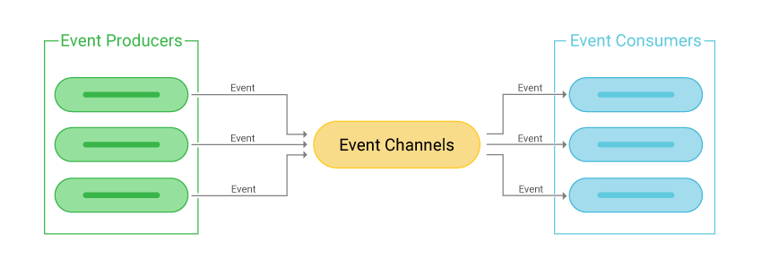
EVENT DRIVEN ARCHITECTURE to the rescue
BASE APPLICATION
Event-Driven Architecture (EDA) is a software design pattern where systems react to events instead of following a predefined flow.
It enables to communicate asynchronously through events.

Slide 64
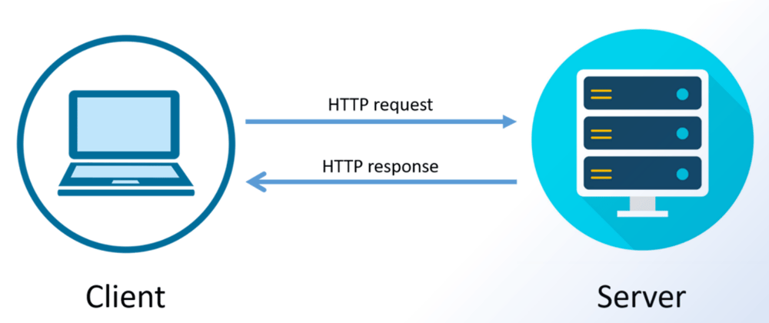
NEED FOR EDA
Why request-response model is not good
Request-Response architecture is the most popular and common messaging system .
REST is one of the most common form of messaging protocols used in distributed systems.
The client makes a Request which is serviced by the server to provide a Response.
Issues:
The problem arises as the distributed architecture gets complex.
Introduction of multiple services creates a chain of strongly connected components.
This increases the latency and wait time, and failure in one can lead to cascading failures.

Slide 65

NEED FOR EDA
Why request-response model is not good
Let’s say we have a video processing service
Processing has to happen in the given order
Only one service is front user facing
HTTP Req
HTTP Res
Can be in same node(machine) or may be a separate microservice running in its own container

Slide 66

NEED FOR EDA
Why request-response model is not good
Let’s say we have a video processing service(taking another example)
The user has to wait till each service processes the request and provides a response.
This would increase latency.
The system would also not be fault tolerant as a failure in any one of the services would lead to failure in the entire chain.
HTTP Req
HTTP Res
fails

Slide 67
NEED FOR EDA
Why EDA iS good
Let’s say we have a video processing service
Using this architecture we can scale each component individually and make them fault tolerant.
Since the messages are async we don’t have to wait for response from downstream services.
Stateless services => Anyone can pick from the queue
uploader
compressor
formatter
notification
uploader
compressor
formatter
notification
Load
Balancer
uploader
compressor
formatter
uploader
formatter
formatter
(Stateless replicas)

Slide 68
EVENT DRIVEN ARCHITECTURE to the rescue
Why go for EDA?
loose coupling
Producers and consumers can be separate microservices possibly running in their separate node/container.
Each producer/consumer may be in a container or a node in some cluster
Also, not point 2 point connection
They can be 3rd party service like AWS
or self-hosted service

Slide 69
EVENT DRIVEN ARCHITECTURE to the rescue
Why go for EDA?
scalability
A fast producer need not be blocked/waiting for a slower consumer.
The consumer can consume at its own pace/convinience.
Both need not be online at same time
Can act as a store
(Even if both are down, still messages are safe)

Slide 70
EVENT DRIVEN ARCHITECTURE (1) to the rescue
Events:
  An event is any significant change or occurrence in the system.
  Examples:
    A new order is placed.
    Event Producers:
  Components that generate events when something happens.
  Example: An e-commerce checkout system produces an event when an order is placed.
Event Brokers (or Message Brokers):
  Acts as an intermediary that routes events from producers to consumers.
  Examples: Kafka, RabbitMQ, AWS SNS, Google Pub/Sub.
Event Consumers:
  Components that listen for and react to events.
  Example: A warehouse service updates inventory when an order event is received.
Event Store (Optional):
  A database that persists events for auditing, debugging, or replaying.
  Example: Event Sourcing.

Slide 71
EVENT DRIVEN ARCHITECTURE (2) to the rescue
Event-Driven Communication Patterns
Publish-Subscribe (Pub/Sub)
  Producers publish events to a message broker.
  Multiple consumers subscribe and receive relevant topics.
  Example: A payment service publishes a "payment_successful" event, and multiple services (e.g., order service, notification service) react to it.
Event Streaming
  Continuous flow of events where consumers process them in real time.
  Events are written to a log in a strictly ordered fashion.
  Consumers can read from any point and maintain it's own pointer/counter
  Example: Kafka Streams processing financial transactions.

Slide 72
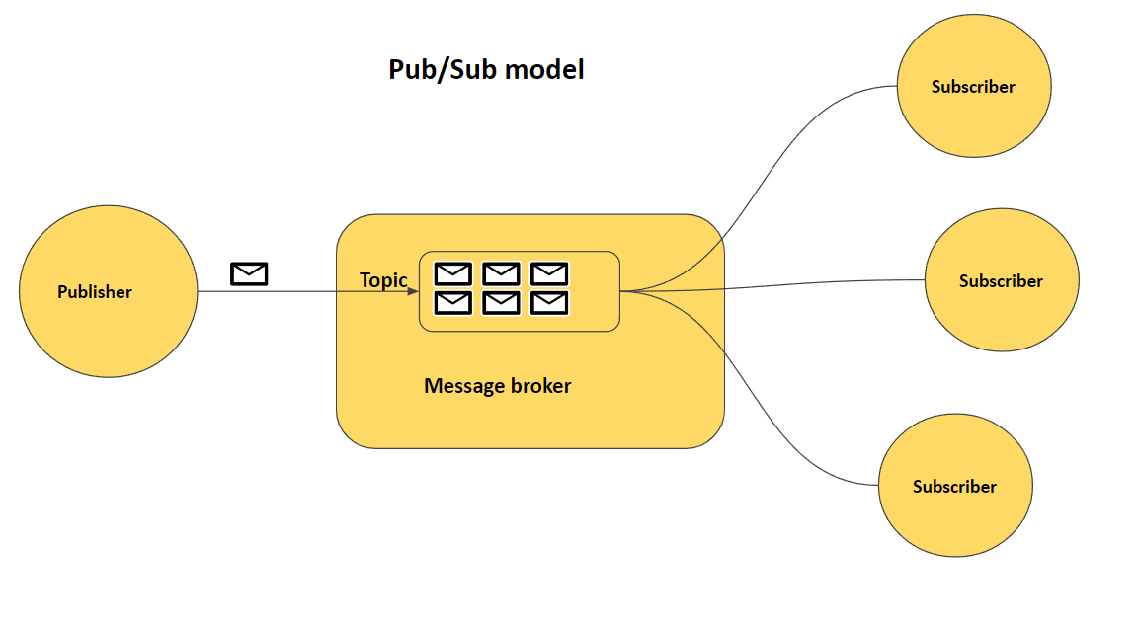
EVENT DRIVEN ARCHITECTURE (2) to the rescue
Event-Driven Communication Patterns
Publish-Subscribe (Pub/Sub) Model
e.g. whatsapp group notification

Slide 73
How BASE ACHIEVABLE
Eventual Consistency Mechanisms:
Asynchronous Replication: Updates are propagated to other nodes over time.
Vector Clocks & Versioning: Helps track changes in data across nodes (used in DynamoDB).
Conflict Resolution Strategies: Ensures that outdated values are resolved appropriately.
Partition-Tolerant and Available Systems (AP in CAP Theorem)
BASE is common in NoSQL databases like Cassandra, DynamoDB, CouchDB, and Riak.
Unlike ACID databases, these databases allow trade-offs in consistency to ensure high availability.

Slide 74
The BIG PICTURE !
Of BASE SYSTEMS
Immediately, this system feels nondeterministic and problematic.
There is a period of time where the asset has left one user and has not arrived at the other.
The size of this time window can be determined by the messaging system design.
Regardless, there is a lag between the begin and end states where neither user appears to have the asset.
We want to have higher availability and can sacrifice strong consistency.

Slide 75
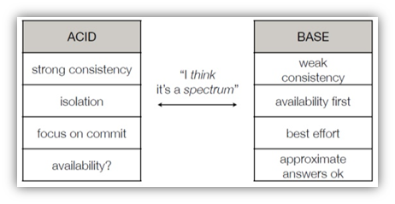
CONCLUSIONS
Scaling systems to dramatic transaction rates requires a new way of thinking about managing resources.
The traditional transactional models are problematic when loads need to be spread across a large number of components.
Decoupling the operations and performing them in turn provides for improved availability and scale at the cost of consistency.
BASE provides a model for thinking about this decoupling.

Slide 76
Thank you !
Debanjan Saha
Ikshita Pathak
Akash Maji

