Slide 1

Testing Cross-Platform Mobile App Development Frameworks
Nader Boushehrinejadmoradi, Vinod Ganapathy,
Santosh Nagarakatte, Liviu Iftode
Department of Computer Science, Rutgers University
ASE 2015

Slide 2
The Growing App Market
A steady growth on the amount of time users spend on mobile devices
By targeting multiple platforms developers can reach a larger audience
Notes:
Based on data from google and ad spending money

Slide 3
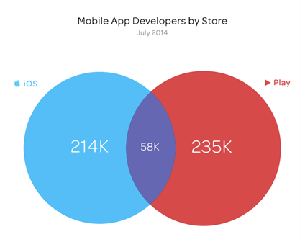
App Developer Distribution
There are a large number of mobile developers
  Many of these developers are small teams/individuals
Most developers focus on one mobile platform
  Why is that?
Image source: http://blog.appfigures.com/most-app-developers-stick-with-one-store/

Slide 4


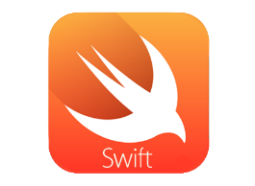
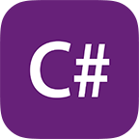



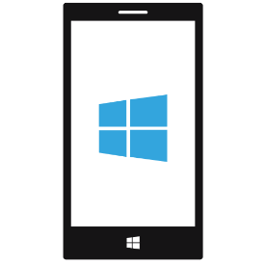

Conventional Cross-Platform Mobile Development
Porting and maintaining code is costly
  Different languages
  Different APIs
  Different tools

Slide 5

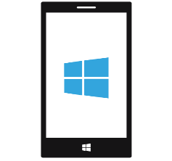
Mobile App Development with Cross-Platform Frameworks
Cross-Platform Framework
Host Language

Slide 6

An Overview of Cross-Platform Frameworks
Write code once, run on multiple platforms
  Reduce development costs
  Save development time
  Reach a larger market
Can be divided into 2 types
  Hybrid
  Native
Notes:
Reduce development and maintenance costs
Costs 80%
Time 83%
The survey doesn’t indicate how much cost/time saving has been achieved.
Survey based on infographic on: http://www.rishabhsoft.com/blog/cross-platform-app-tools-infographic
Choosing between two types is a tradeoff between performance/looks and feel/amount of shared code

Slide 7

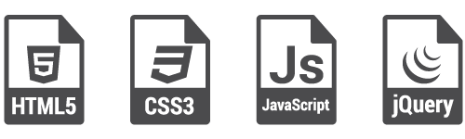


An Overview of Cross-Platform Frameworks
Write code once, run on multiple platforms
  Reduce development costs
  Save development time
  Reach a larger market
Can be divided into 2 types
  Hybrid
  Native
Notes:
Reduce development and maintenance costs
Costs 80%
Time 83%
The survey doesn’t indicate how much cost/time saving has been achieved.
Survey based on infographic on: http://www.rishabhsoft.com/blog/cross-platform-app-tools-infographic
Choosing between two types is a tradeoff between performance/looks and feel/amount of shared code

Slide 8
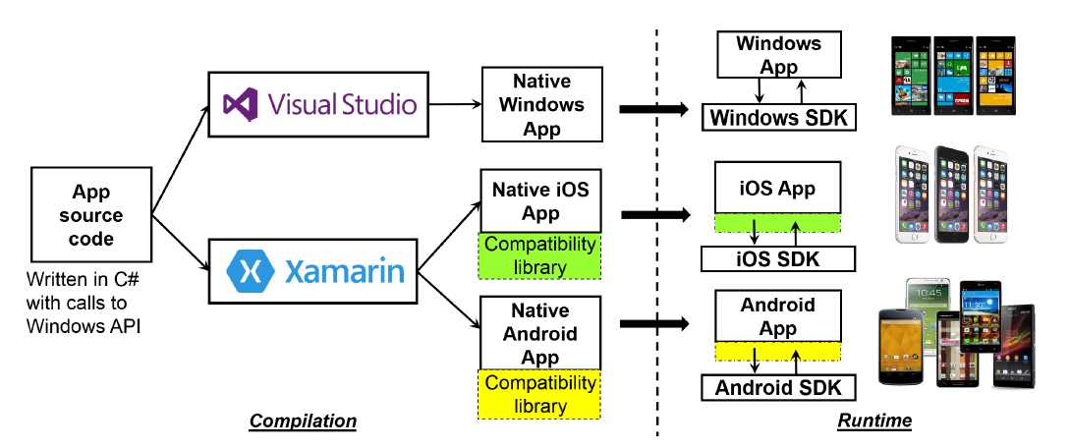
Xamarin at a Glance
Notes:
Currently the most popular native cross-platform mobile application development framework
Supports writing apps in .Net and translates them to different mobile platforms
3)Xamarin maintainers are very active. and release updates frequently
In addition it has a larger user-base compared to apportable
This is shown by the activities on forums/stackoverflow/bug repository
4) xamarin has bugs
17600 total and 5100 open
compared to apportable 820 and 449

Slide 9
Observation
A growing demand exists for cross-platform frameworks
  Ease developing new apps
  Simplify porting of existing apps
The framework has to correctly translate code to platforms that are different in many aspects
  Can inconsistencies occur in translation?
Notes:
Showing despite having issues,
certain developers

Slide 10
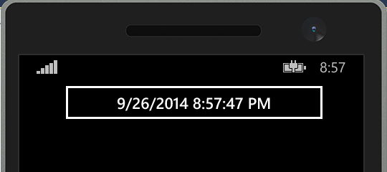
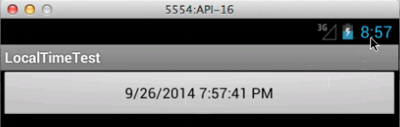
Example: Apps are not Always Consistent
A call to DateTime.Now.ToString() is made to display current time
Inconsistency in translating this method call to the target platform
https://bugzilla.xamarin.com/show_bug.cgi?id=23405
Notes:
this translation is a complex task because the platform must
correctly encode the semantics of both the home platform
and target platform SDK and the relationship between them.
This complexity translates into bugs in the frameworks. For
example, as of May 2015, Xamarin’s Bugzilla database shows
a history of about 7,100 bugs that are related to cross-platform

Slide 11
Insight
By design, Cross-platform frameworks strive to provide consistent behavior across all targeted platforms
Leverage this design assumption to automate bug finding
  Help developers to detect and fix bugs earlier
  Customers gets access to a more consistent framework
Notes:
this translation is a complex task because the platform must
correctly encode the semantics of both the home platform
and target platform SDK and the relationship between them.
This complexity translates into bugs in the frameworks. For
example, as of May 2015, Xamarin’s Bugzilla database shows
a history of about 7,100 bugs that are related to cross-platform

Slide 12
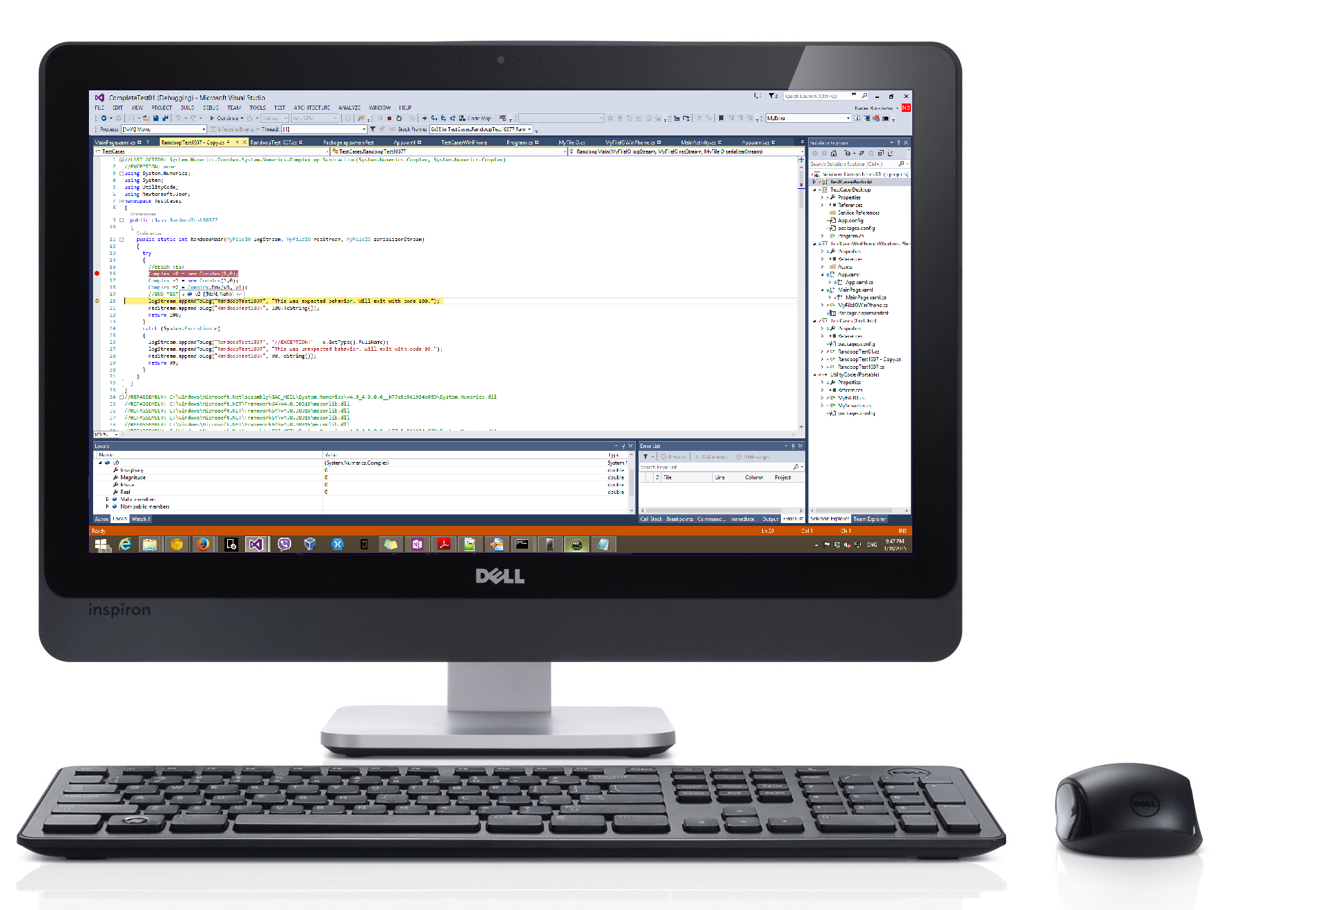
X-Checker: Cross-platform Test Tool
Shared API Library
Test Case Generator
Compare Results

Slide 13
X-Checker
A tool that automatically tests cross-platform mobile frameworks:
  Generate randomized test cases to run on different mobile platforms
  Detect inconsistencies in framework by comparing test results in different platforms

Slide 14
Test Case Generator
A Test case is a sequence of valid method calls
  Run generated sequences on one platform
  Iteratively extend valid code sequences
  Based on Randoop [Pacheho et al]
  Use all valid test cases

Slide 15



X-Checker Uses Differential Testing
A Cross platform framework is a good candidate to apply differential testing [McKeeman]
  Differential testing requires that two or more comparable systems be available to the tester
  Present the systems with a series of generated test cases
  Observe the results. if they differ, we have found a bug-exposing test case
Differential testing will not generate false positives
Notes:
Differential testing eases the cost of evaluating test cases

Slide 16
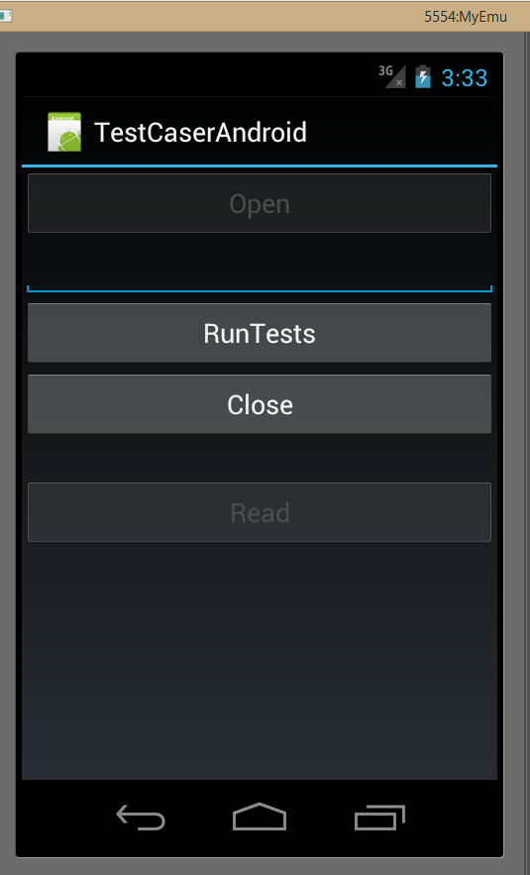
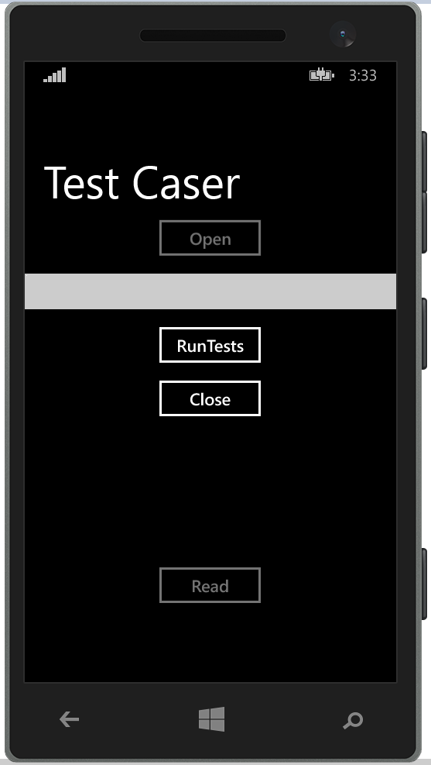
Testing Considerations
Need to ensure applications run on target platforms
Keep UI as simple as possible
Ensure a unified initial state across platform at the start of the test
Notes:
To maintain a uniform system wide state We limit I/O to Networking and File system access
3) App state → Why many test cases are packaged in one app
4) This is done to ensure that the state doesn’t diverge
Didn’t have access to recording/replay of sensor I/O which we might try to mitigate in the future
Need to insure applications run on target platforms
Include serializer in the testing application
Keep UI as simple as possible
Ensure a unified initial state across platform at the start of the test
Lack of direct feedback can generate duplicate test cases

Slide 17
Detecting Inconsistencies
Apps are run on their respective platform
  Test case either returns successfully or throws an exception
  Serialize test case state to detect inconsistencies across platforms
The test case result can either be similar on all platforms or lead to one of three types of inconsistencies
Notes:
Apps are run on their respective platform
Test case either returns successfully or throws an exception
Serialize test case state to detect inconsistencies across platforms
2) Use a top-down recursive serializer to serialize object’s state
Identify inconsistencies by comparing serialized representation of objects
last)The matching tries to see whether a serialized object is a subset on the other platform or not
private/public methods
also need some filtering

Slide 18

Inconsistency Type I
public static int TestMain( FileIO serialStream, FileIO logStream){
try{
//Simple test case which runs to completion on both platforms
Complex b = new Complex(0,0);
Complex exp = new Complex(1,0);
Complex res = Complex.Pow(b,exp);
//Serialize objects
serialStream.appendToLog(b.GetType.FullName, serializer.serialize(b));
…
return 0;
}
catch (System.Exception e){
//Not reached in this test case
…
return -1;
}
}
Test Case
Android app
Windows phone app
State
State
Windows Phone 8.1: res = 0
Android: res = NAN

Slide 19
Inconsistency Type 2
public static int TestMain( FileIO serialStream, FileIO logStream){
try{
//Simple test case which leads to different exception
string s = "test";
int index = -1;
double val = CharUnicodeInfo.GetNumericValue(s,index);
//Not reached in this test case
…
return 0;
}
catch (System.Exception e){
//Each return different exceptions
logStream(e.GetType().FullName);
return -1;
}
}
Test Case
Android app
Windows phone app
Exception
Exception
Windows Phone 8.1: ArgumentOutOfRangeException
Android: IndexOutOfRangeException

Slide 20
Inconsistency Type 3
public static int TestMain( FileIO serialStream, FileIO logStream){
try{
//Test case which leads to an exception on one platform
NameTable nt1 = new NameTable();
NameTable nt2 = new NameTable();
XmlNamespaceManager nsMgr = new XmlNamespaceManager(nt2);
…
XmlParserContext xpctxt = new XmlParserContext(nt1, nsMgr, …);
//Not reached on Windows Phone
…
return 0;
}
catch (System.Exception e){
//Each return different exceptions
logStream(e.GetType().FullName);
return -1;
}
}
Test Case
Android app
Windows phone app
Success
Exception
Windows Phone 8.1: XmlException
Android: No exception is thrown

Slide 21



Implementation
Test case generation: Randoop
Cross-platform framework: Xamarin
Object serializer: Json.net

Slide 22
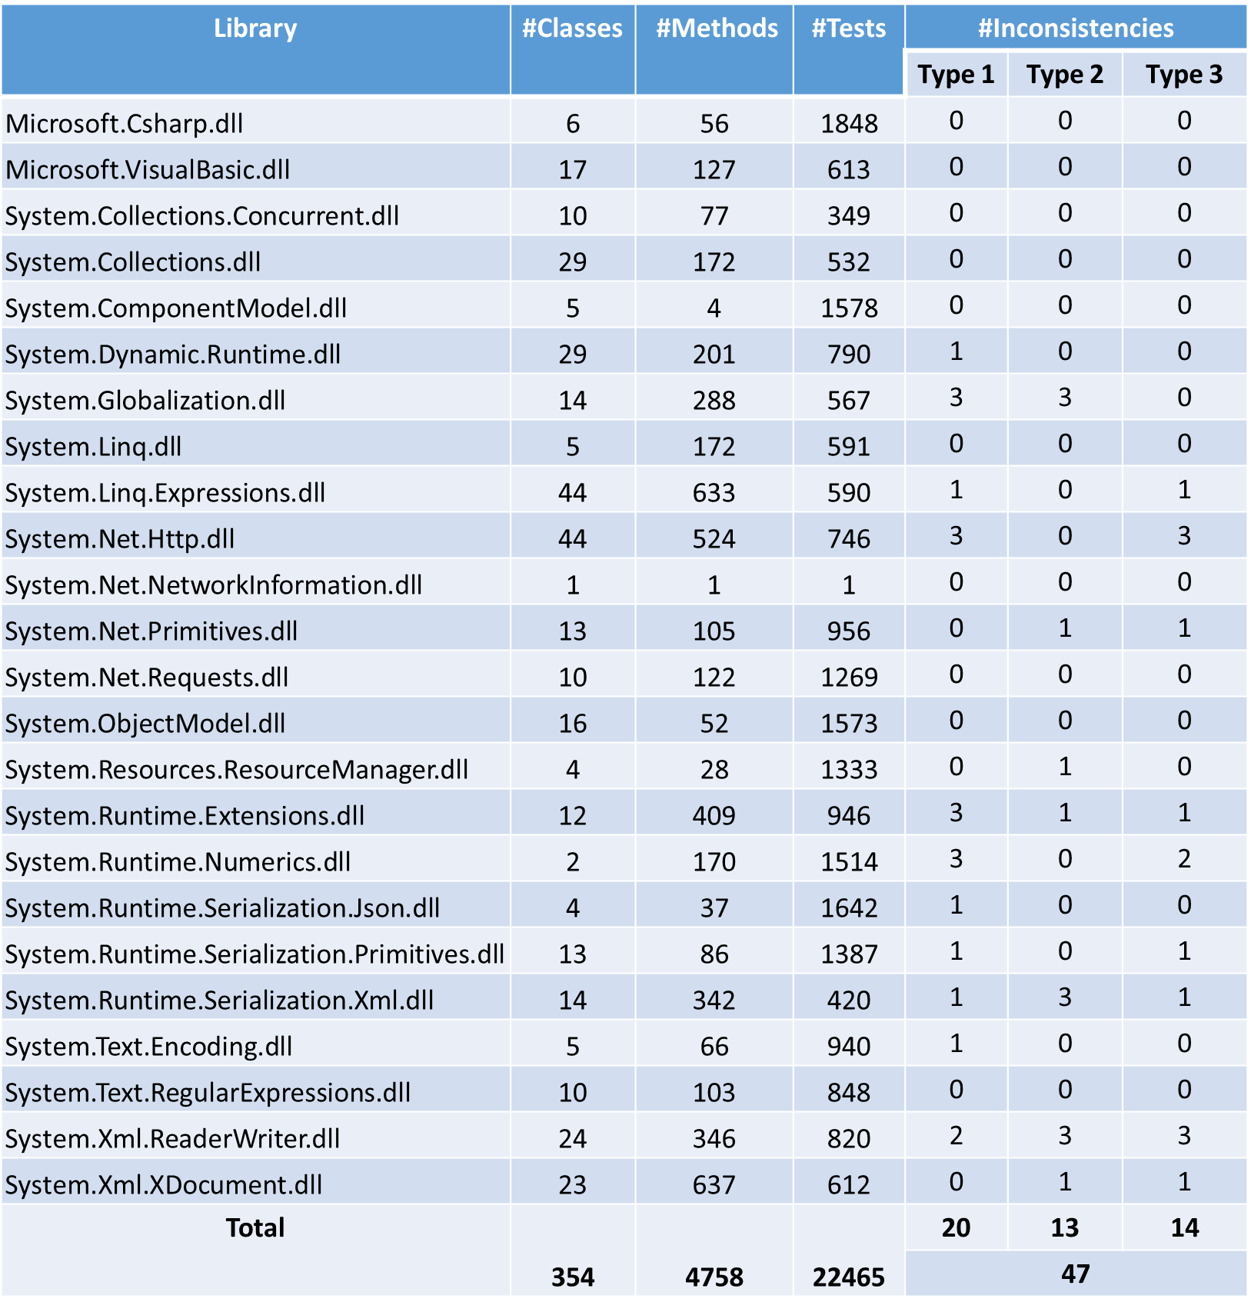
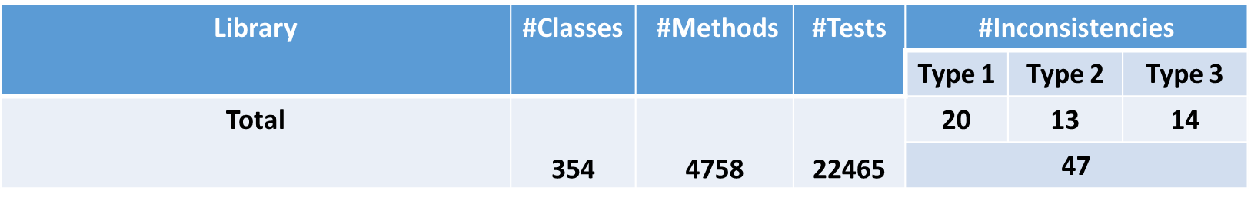

Slide 23
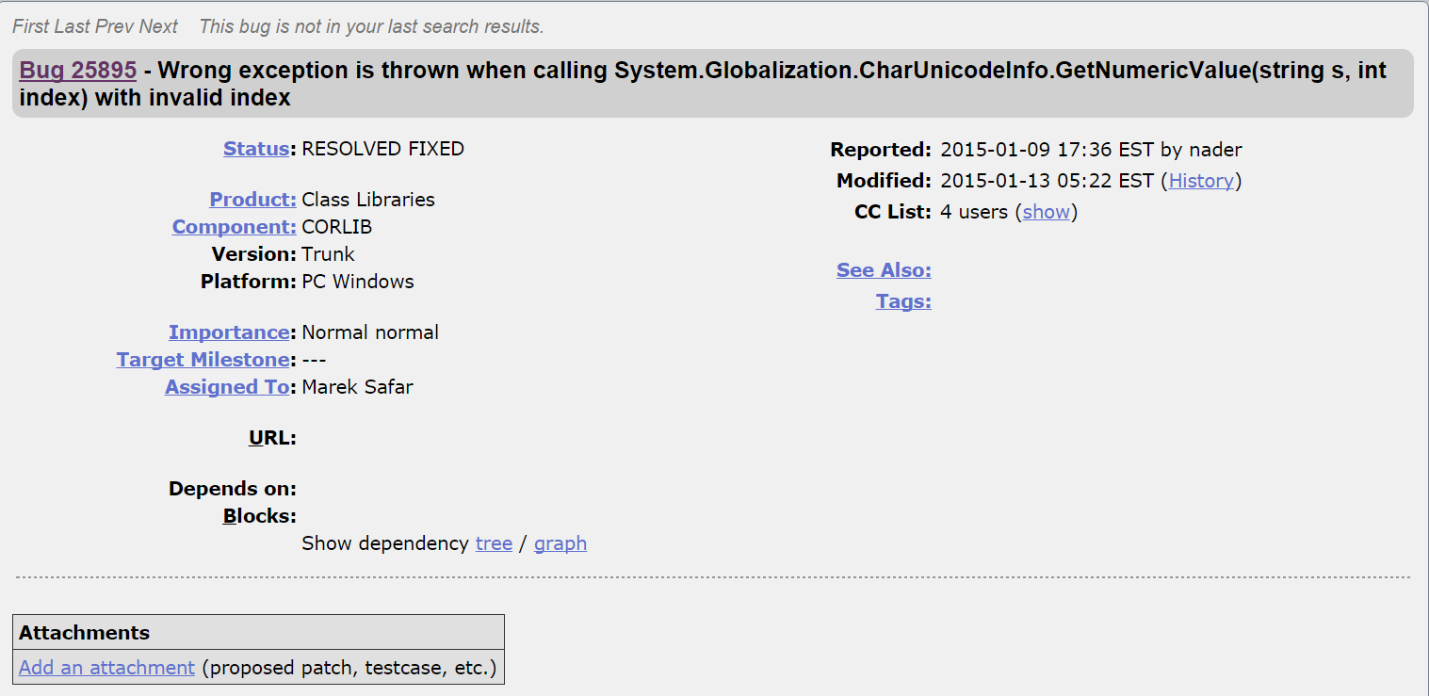
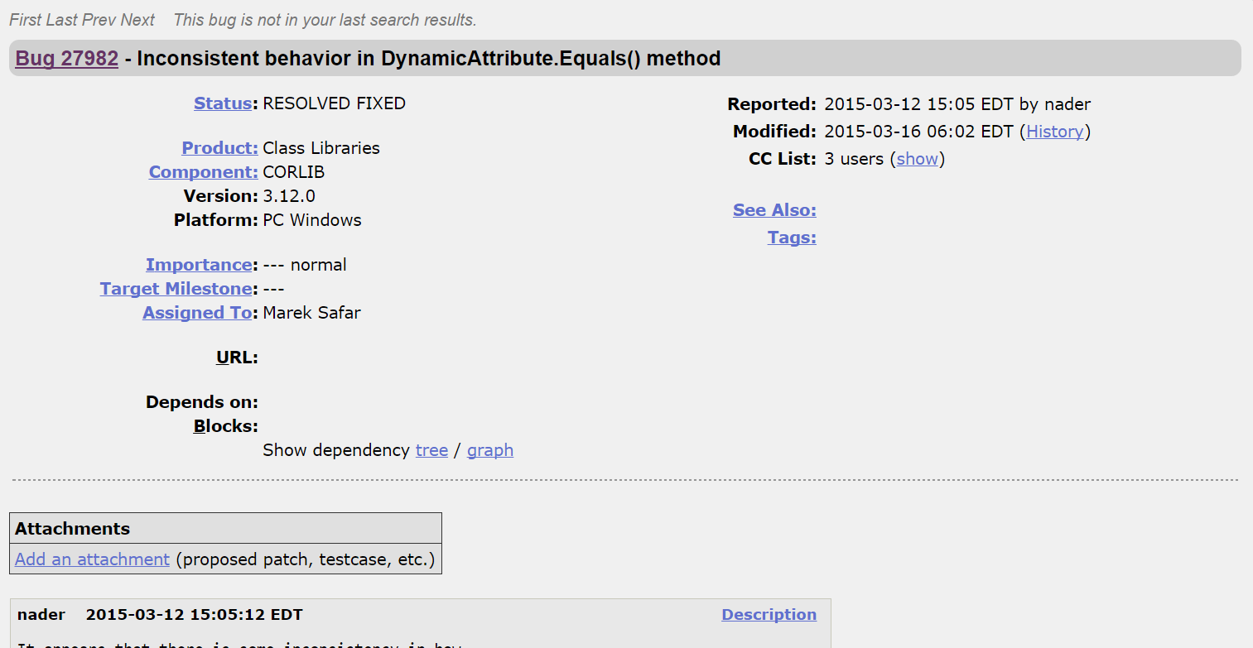
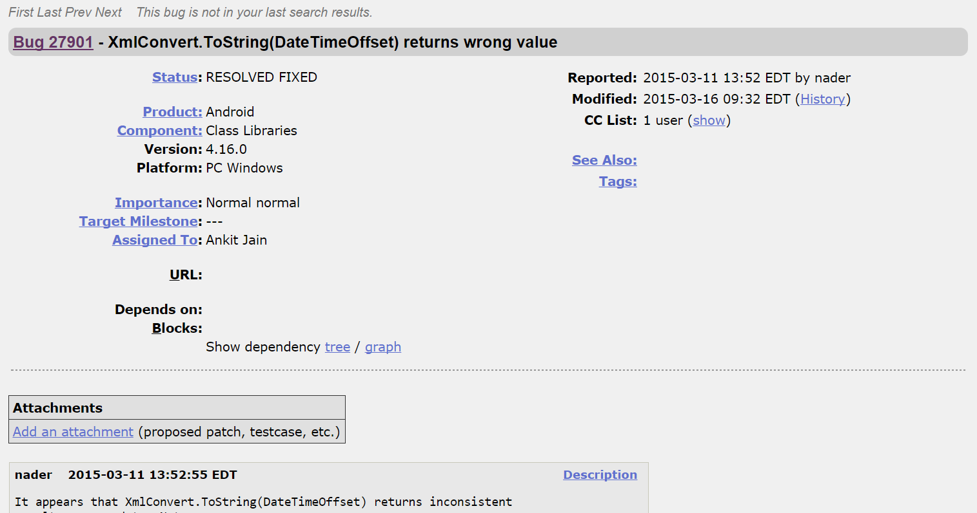
Results
Discovered 47 Unique inconsistencies
14 inconsistencies were fixed after being reported
  Most fixes were made within 1-2 weeks of the report
Notes:
after)reasons for having duplicates
test cases are ran on the desktop instead of target platform
if test case generates inconsistency in target platform there is no way to detect this and sequences get extended
discovering unique inconsistencies is partly manual plus discarding false positives which is the systems bottleneck

Slide 24
Discussion
Duplicate inconsistencies and false positives
  Test Cases with type 1 inconsistency can have duplicates
  Flaky test cases introduce false postives
  Filtering is used to remove duplicates and false positives
Not all inconsistencies are bugs
  Documented deviations of behavior
    Object.GetHashCode()
    System.UriBuilder Constructor(String)
  Undocumented deviations known to developers
    XmlDictionaryReader.ReadContentAsString()
“… Furthermore, the .NET Framework does not guarantee the default implementation of theGetHashCode method, and the value this method returns may differ between .NET Framework versions and platforms, such as 32-bit and 64-bit platforms…”
“In the .NET for Windows Store apps or the , catch the base class exception, FormatException, instead.”
Notes:
Running test cases in batches can introduce duplicate inconsistencies:
Solution is filering
UriBuilder UriFormatException
Undocumented
Marked as TODO in mono

Slide 25
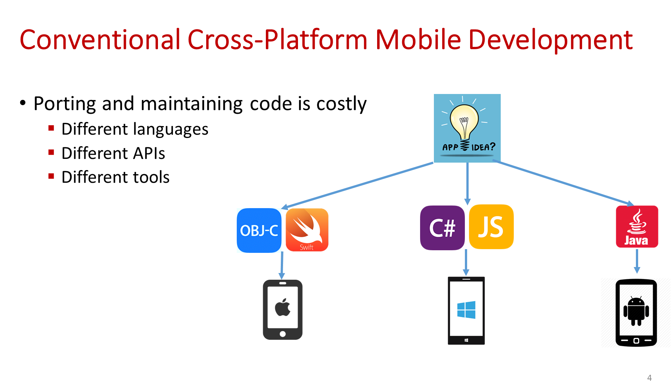
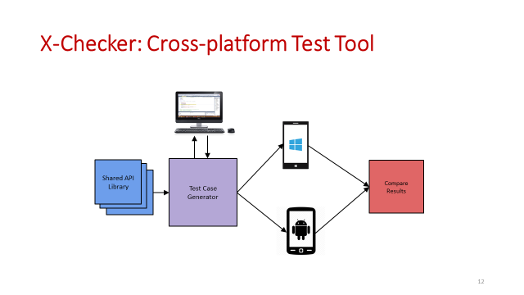
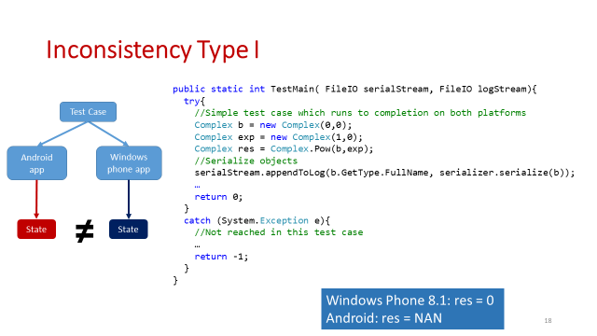
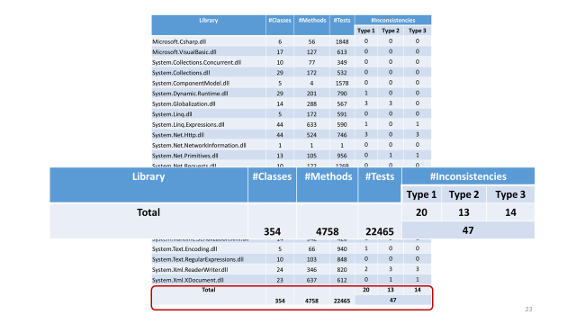
Summary
naderb@cs.rutgers.edu
Notes:
Initiated the study of cross-platform mobile app development framework
Introduced a tool to automate bug finding in such frameworks
Furutre work
Input generation & test apps
Study other platforms
Consider 3rd party code

Slide 26
Backup Slides

Slide 27
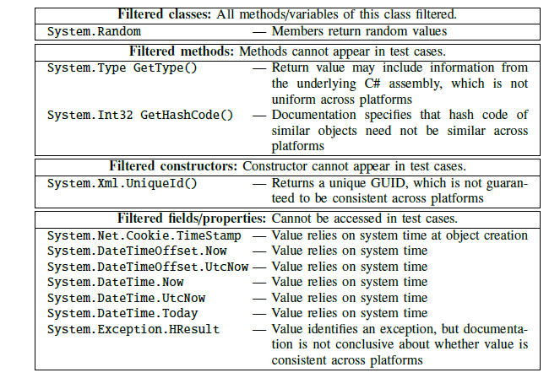
Filtering
Use filtering to eliminate problematic API calls

Slide 28
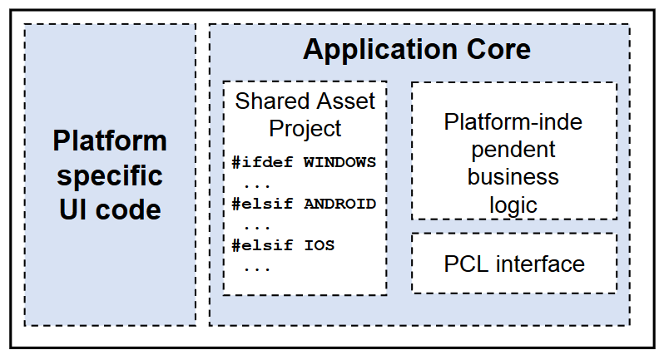
Structure of a Cross-platform Application
Applications are broken down into 2 parts
  Platform specific code
  Shared Code

