Slide 1
Towards a Richer Model of Cloud App Markets
Abhinav Srivastava¹ and Vinod Ganapathy²
AT&T Labs—Research¹, Rutgers University²
Notes:
Today, I will talk about cloud app markets and present our vision on how to increase their utility.

Slide 2
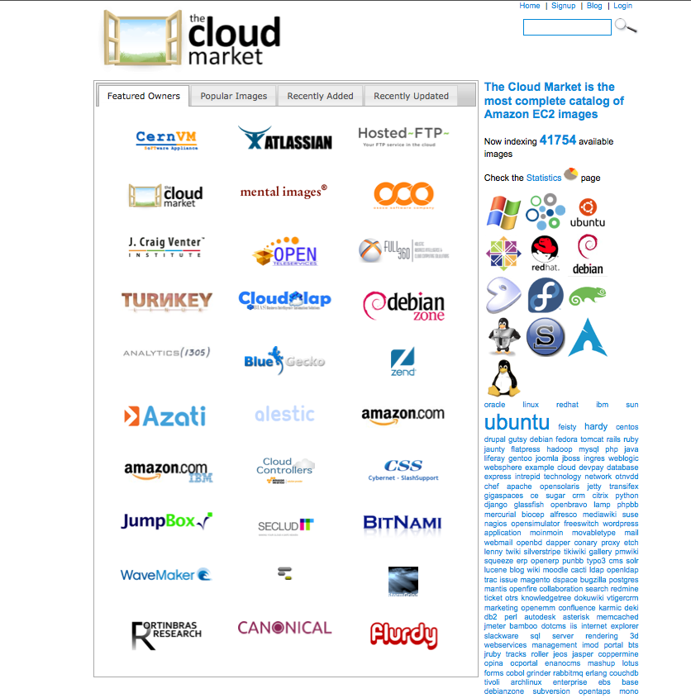
Cloud App Market
A place where
developers publish software VMs
customers find, buy, and run VMs in the cloud
providers handle billing & payment

Slide 3
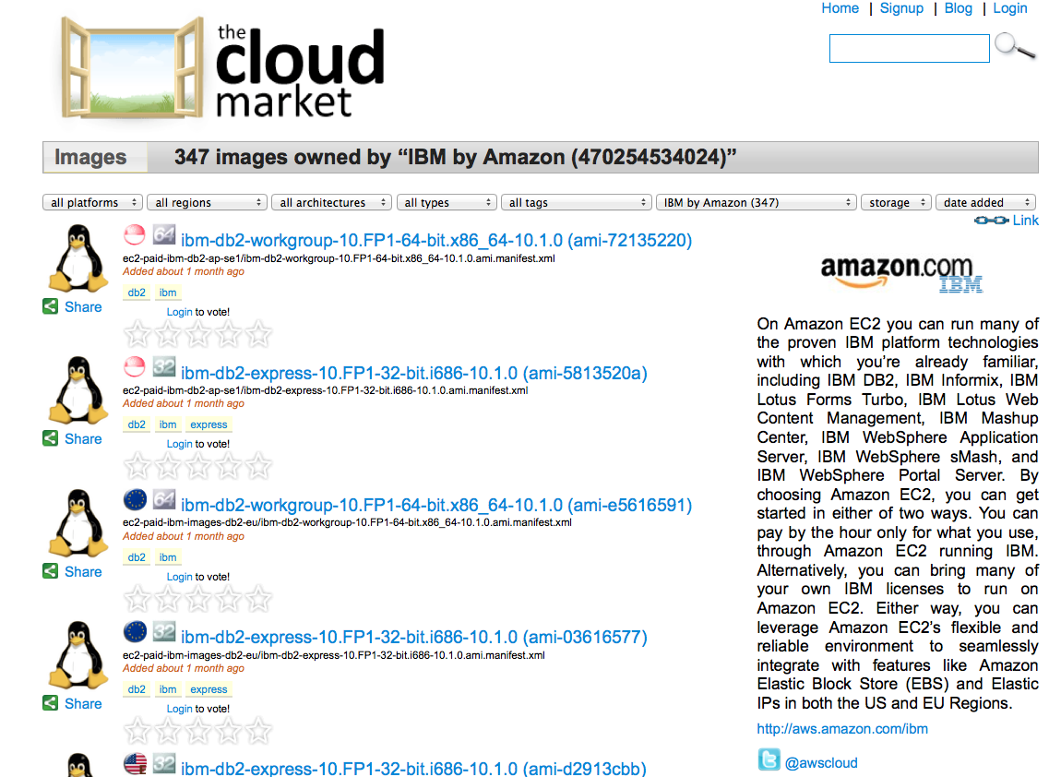
Cloud App Market
$$

Slide 4
A Cloud Platform
Provider VM
Client₁ VM
Client₂ VM
Management VM
Work VM
Work VM
Work VMs
Work VMs
Virtual machine monitor (VMM)
Hardware

Slide 5
A Cloud Platform with App
Provider VM
Client₁ VM
App VM
Management VM
Work VM
New OS/SDE VM
Work VMs
VMM
Hardware
Notes:
Apps run like any other client VMs.

Slide 6
Nascent Market
Offers only SDE and OS distributions
No interaction between App and work VMs
Analogy between process/OS and VM/VMM
Control and Flexibility

Slide 7
Current Encrypted Storage Design
Provider VM
Client VM
Storage Encryption
Disk R/W
Backend
Frontend
Disk

Slide 8
Potential Cloud App: Encrypted Storage
Provider VM
Encryption App
Client VM
Disk R/W
Backend
Frontend
Backend
Frontend
Disk

Slide 9
Potential Cloud App: Checkpoint App
Provider VM
Client VM
Checkpoint App
Management VM
Work VMs
Copy client VM’s
memory pages
VMM

Slide 10
Taxonomy of VM Apps
Standalone VM apps
Cooperative VM apps
Service VM apps
Bundled VM apps

Slide 11
Standalone Apps
Provider VM
Client₁ VM
App VM
Management VM
Work VM
New OS/SDE VM
Work VMs
VMM
Hardware

Slide 12
Cooperative Apps
Provider VM
Client₁ VM
App VM
Management VM
Work VM
Checkpoint app/Rootkit detector
Work VMs
memory
VMM
Hardware

Slide 13
Service Apps
Provider VM
Client₁ VM
App VM
Management VM
Work VM
Forensic Analysis/Firewall
Work VMs
image/packets
VMM
Hardware

Slide 14
Bundled Apps
Client₁ VM
App Bundle
Provider VM
Management VM
Work VM
Service VM
Service VM
Work VMs
Firewall
NIDS
packets
VMM
Hardware

Slide 15
Key Requirements
Trustworthy launch of VM apps
New privilege model
Preventing information leakage
Featherweight VMs
Standardized API interface
Customized plumbing I/O
Migration

Slide 16
Design Space
Virtual machine monitor modification
Nested virtualization
Para-virtualization-based Nesting
Hybrid design

Slide 17
Design Space
Virtual machine monitor modification
Provider VM
VM
App VM
Management VM
Modified VMM
Hardware

Slide 18
Design Space
Nested virtualization
Provider VM
VM
Management VM
Client VM
Nested Management VM
Client VM
Client VM
Stock VMM
VMM (with nesting support)
Hardware

Slide 19
Design Space
Nested virtualization
Provider VM
App VM
Management VM
Nested Management VM (checkpoint)
Client work VM
VM App’s VMM
Provider’s VMM (with nesting support)
Hardware

Slide 20
Design Space
Para-virtualization-based Nesting
Provider VM
VM
Management VM
Nested Management VM (checkpoint)
Client’s work VM
VMM
Blanket Layer
Stock VMM (no nesting support)
Hardware

Slide 21
Design Space
Para-virtualization-based Nesting
Provider VM
App VM
Management VM
Nested Management VM (checkpoint)
Client’s work VM
VM app’s VMM
Blanket VMM
Provider’s VMM (no nesting support)
Hardware

Slide 22
Comparison of Design Options
Design | Performance | Deployability | Capability
VMM changes
Nested virtualization
Paravirt-based nesting

Slide 23
Conclusions
Nascent market
Taxonomy of potential cloud apps
Key requirements
Design space

Slide 24
Thank You!!

Slide 25
Firewall App
Provider VM
Firewall App
Client VM
Packets
Backend
Frontend
Backend
Frontend
NIC

Slide 26
Firewall App
Provider VM
Client VM
Firewall
Packets
Backend
Frontend
NIC

Slide 27
Key Requirements
New privilege model
Privileged Operation
VMM
Is request from a management VM
NO
YES
Deny
Allow

Slide 28
Key Requirements
New privilege model
Privileged Operation
VMM
Is request from a management VM
NO
YES
Requestor has
delegated privileges??
Allow
NO
YES
Deny
Allow

Slide 29
Cloud App Market
Similar to smart-phone apps store
A place where
Developers publish software VMs and get paid
Customers find, buy, and run services (VMs) in the cloud
Providers handle billing & payment

Slide 30
Cloud App Market
Notes:
There are third-party market places.

