Slide 1
EnGarde: Mutually Trusted Inspection of SGX Enclaves
Hai Nguyen | - | Rutgers University
Vinod Ganapathy | - | Rutgers University

Slide 2
Intel SGX
Intel Software Guard Extensions (Intel SGX) is an extension of the Intel architecture
Code and data are kept confidential inside an enclave
Data
Code
Enclave
Application
Operating System

Slide 3
Intel SGX
Protect against privileged software and hardware attacks
Offer remote attestation to prove secure initialization of the enclave
Data
Code
Enclave
Application
Operating System

Slide 4
Problem: Policy compliance
Cloud providers cannot inspect the client’s code for policy compliance
On non-SGX platforms, a benign provider can verify the client’s code and data to enforce policy compliance:
Code Instrumented with certain security checks to prevent attacks: stack protection, indirect function call checks,…
Code is linked against specific versions of certain libraries: The versions of OpenSSL that are free from the HeartBleed exploit,…

Slide 5
Contributions of our work
We build EnGarde, an enclave inspection library that allows cloud providers to verify clients’ code while preserves the security properties of SGX
EnGarde incurs small overhead during code provisioning and no overhead during runtime
We evaluate the effectiveness of EnGarde on various real-world applications

Slide 6
Threat model
The provider and client are mutually distrusting
The code of EnGarde is available to both the provider and client for inspection
The client verifies that EnGarde does not leak confidential information to the provider
EnGarde does not consider covert channels via which information about the client’s code is leaked to the provider

Slide 7
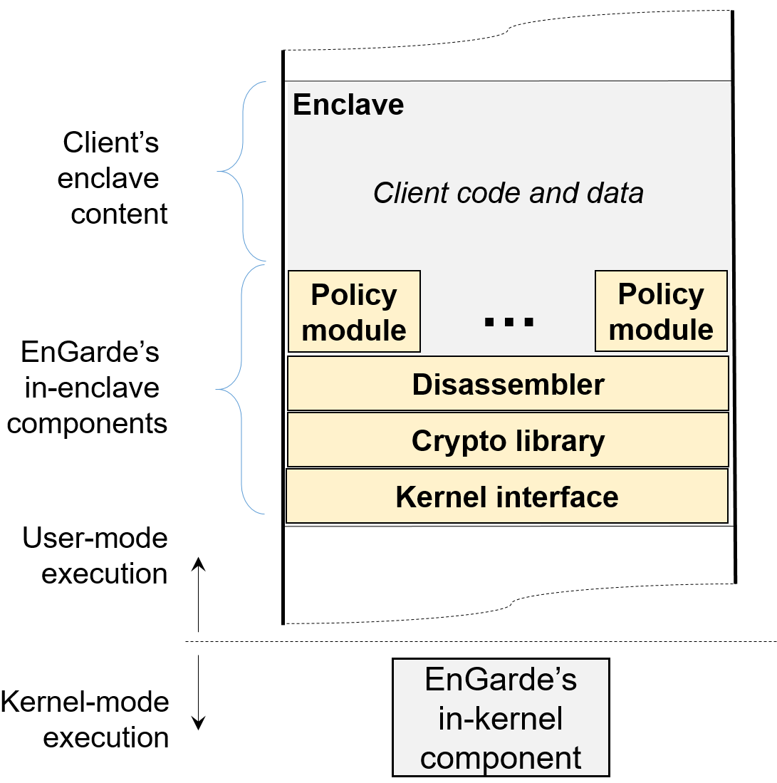
EnGarde architecture

Slide 8
Enclave initialization and remote attestation
EnGarde is loaded into a fresh enclave created by the cloud provider
The provider proves to the client that the enclave was initialized securely by using SGX’s remote attestation

Slide 9
Code provisioning
EnGarde generates a 2048 RSA key pair and sends the public key to the client
The client uses the public key to encrypt its AES key which will be used to encrypt the sensitive content it sends to EnGarde
The content includes code and data represented in an executable using ELF format
The executable is compiled as position independent code (PIC) and is statically linked

Slide 10
Code provisioning
The client sends encrypted content to EnGarde
EnGarde decrypts the content to get an in-enclave representation of the client’s executable

Slide 11
Code disassembly
EnGarde extracts all code sections of the client’s executable and disassembles the code
EnGarde’s disassembler is based on the disassembler of Google’s native client (NACL), a sandbox for native code
EnGarde uses an instruction buffer to store all disassembled instructions

Slide 12
Policy enforcement
The provider and the client mutually agree upon the policies that the client’s code must satisfy
The agreed policies are encoded into policy modules which are loaded into the enclave along with EnGarde

Slide 13
Policy enforcement
Policy modules enforce policy compliance by using the disassembled instructions from the instruction buffer
In general, policy modules examine structural properties of the client’s code
The client’s code is rejected if it is not policy compliant

Slide 14
Loading and relocating
EnGarde maps the text, data and bss segments to the enclave memory
EnGarde applies symbol relocations using relocation tables

Slide 15
Enclave page permission enforcement
Page Permission Enforcement is performed by the in-kernel component of EnGarde
The in-kernel component receives a list of code and data pages which need to be set with appropriate permissions
Code’s pages are set as executable but not writable and the pages of the data segment and bss segment are set as writable but non-executable

Slide 16
Enclave page permission enforcement
Enclave page permission is enforced at two levels:
Using page table permission bits
Manipulating the entries of an SGX’s data structure called Enclave Page Cache Map (EPCM)

Slide 17
Implementation
We implemented EnGarde on top of OpenSGX, an SGX emulation infrastructure
OpenSGX offers rich operating system support and an easy to use library interface for enclave developers
Current version of Intel SGX does not allow changing enclave page permission at the SGX level after enclave initialization and all enclave memory must be committed at build time

Slide 18
Evaluation
Goals:
Demonstrate the effectiveness of EnGarde and the overhead of EnGarde in enforcing various policies
Dell Optiplex running Ubuntu 14.04
16 GB RAM
Intel core i5 CPU
Use real world applications: Nginx, Memcached, Netperf, Otp-gen, graph-500, 401.bzip2 and 429.mcf

Slide 19
Sizes of the components of EnGarde
Components | LOC
Code Provisioning | 270
Loading and Relocating | 188
Checking Executables Linked Against musl-libc | 1,949
Checking Executables Compiled With Stack Protection | 109
Checking Executables Containing Indirect Function-Call Checks | 129
Client’s Side Program | 349
musl-libc | 90,728
Lib Crypto (OpenSSL) | 287,985
Lib SSL (OpenSSL) | 63,566
Total | 453,349

Slide 20
Compliance for library linking
Verify if applications are linked against musl-libc v1.0.5
The policy module has the SHA-256 hashes of all the functions of musl-libc v1.0.5 and store them in a hash table

Slide 21
Compliance for library linking
The policy module uses the instruction buffer and computes the target of each direct function call
If the hash of a function does not match its value in the hash table, the client has not provided the required musl-libc

Slide 22
Performance of EnGarde to check the library-linking policy
Benchmark | #Inst. | Disassembly | Policy Checking | Loading and Relocation
Nginx | 262,228 | 694,405,019 | 1,307,411,662 | 128,696
401.bzip2 | 24,112 | 34,071,240 | 148,922,245 | 4,239
Graph-500 | 100,411 | 140,307,017 | 246,669,796 | 4,582
429.mcf | 12,903 | 18,242,127 | 123,895,553 | 4,363
Memcached | 71,437 | 137,372,517 | 489,914,732 | 8,115
Netperf | 51,403 | 90,616,563 | 367,356,878 | 18,090
Otp-gen | 28,125 | 42,823,024 | 198,587,525 | 5,388

Slide 23
More results in the paper
Performance of EnGarde to check the stack protection policy
Performance of EnGarde to check the indirect function call policy

Slide 24
Conclusion
EnGarde effectively enforces policy compliance of clients’ enclave content
EnGarde preserves the security properties of SGX
EnGarde incurs no runtime overhead

Slide 25
Q&A

Slide 26
Backup Slides

Slide 27
Compliance for stack protection
Compilers emit extra code to protect against stack smashing
The LLVM compiler adds a guard variable when a function starts and checks the variable when a function exits:
19311: mov %fs : 0x28, %rax
1931a: mov %rax, (%rsp)
193fe: mov %fs : 0x28, %rax
19407: cmp(%rsp), %rax
1940b: jne 1941f
1941f: callq 8d5bf <__stack_chk_fail>

Slide 28
Compliance for stack protection
The policy module iterates through the instruction buffer and identifies each function
Within each function, the policy module checks if stack protection instructions are added at the beginning and at the end of the function

Slide 29
Performance of EnGarde to check the stack protection policy
Benchmark | #Inst. | Disassembly | Policy Checking | Loading and Relocation
Nginx | 271,106 | 719,360,640 | 713,772,098 | 128,662
401.bzip2 | 24,226 | 34,292,136 | 862,023,613 | 4,206
Graph-500 | 100,488 | 140,588,361 | 195,218,892 | 4,548
429.mcf | 12,985 | 18,288,921 | 31,459,881 | 4,330
Memcached | 71,677 | 137,877,497 | 325,442,403 | 8,081
Netperf | 51,868 | 91,577,335 | 183,274,713 | 18,057
Otp-gen | 28,217 | 43,053,386 | 217,302,816 | 5,355

Slide 30
Restricting indirect function calls
Control flow integrity (CFI) is a measure that guards against attacks that overwrite function pointers to change the flow of a program
Indirect Function-Call Checks (IFCC) protects indirect function calls by adding code at indirect call sites to transform function pointers to point within a jump table

Slide 31
Restricting indirect function calls
LLVM implementation of IFCC emits extra code:
1b459: lea 0x85c70(%rip), %rax
#<__llvm_#jump_instr_table_0_1>
1b460: sub %eax, %ecx
1b462: and $0x1ff8, %rcx
1b469: add %rax, %rcx
1b475: callq *%rcx
The policy module uses the instruction buffer to look for all indirect function calls and verifies that before each indirect call there is a sequence of instructions lea, sub, and and add with relevant data dependence between registers

Slide 32
Performance of EnGarde to check the indirect function-call policy
Benchmark | #Inst. | Disassembly | Policy Checking | Loading and Relocation
Nginx | 267,669 | 821,734,999 | 20,843,253 | 128,668
401.bzip2 | 24,201 | 34,235,817 | 1,751,276 | 4,206
Graph-500 | 100,424 | 140,429,738 | 7,014,913 | 4,548
429.mcf | 12,903 | 18,242,127 | 1,177,429 | 4,330
Memcached | 71,508 | 138,231,446 | 5,301,168 | 8,081
Netperf | 51,431 | 91,161,601 | 3,775,318 | 18,057
Otp-gen | 28,132 | 42,829,680 | 2,334,847 | 5,355

