Slide 1
Regulating ARM TrustZone Devices in Restricted Spaces
Ferdinand Brasser,
Christopher Liebchen,
Ahmad-Reza Sadeghi
Technische Universität Darmstadt
Vinod Ganapathy,
Liviu Iftode,
Daeyoung Kim
Rutgers University

Slide 2
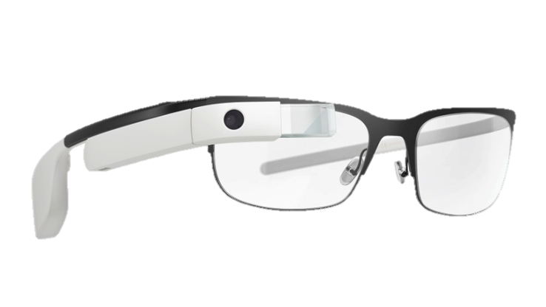
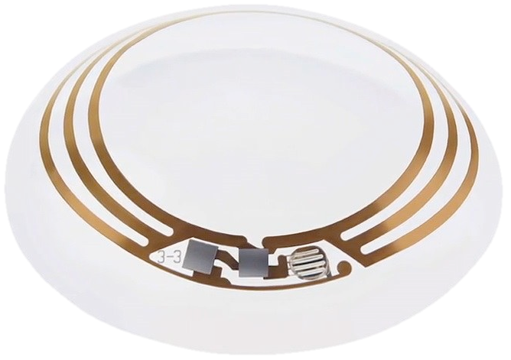
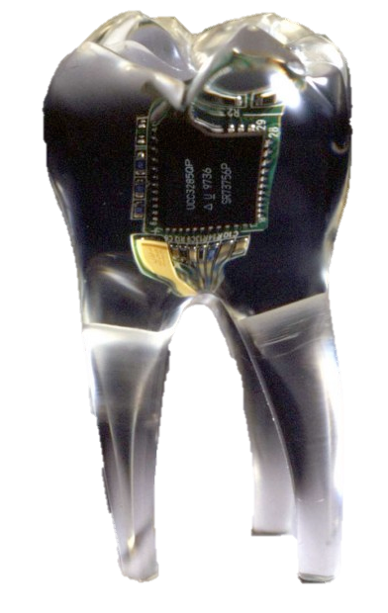


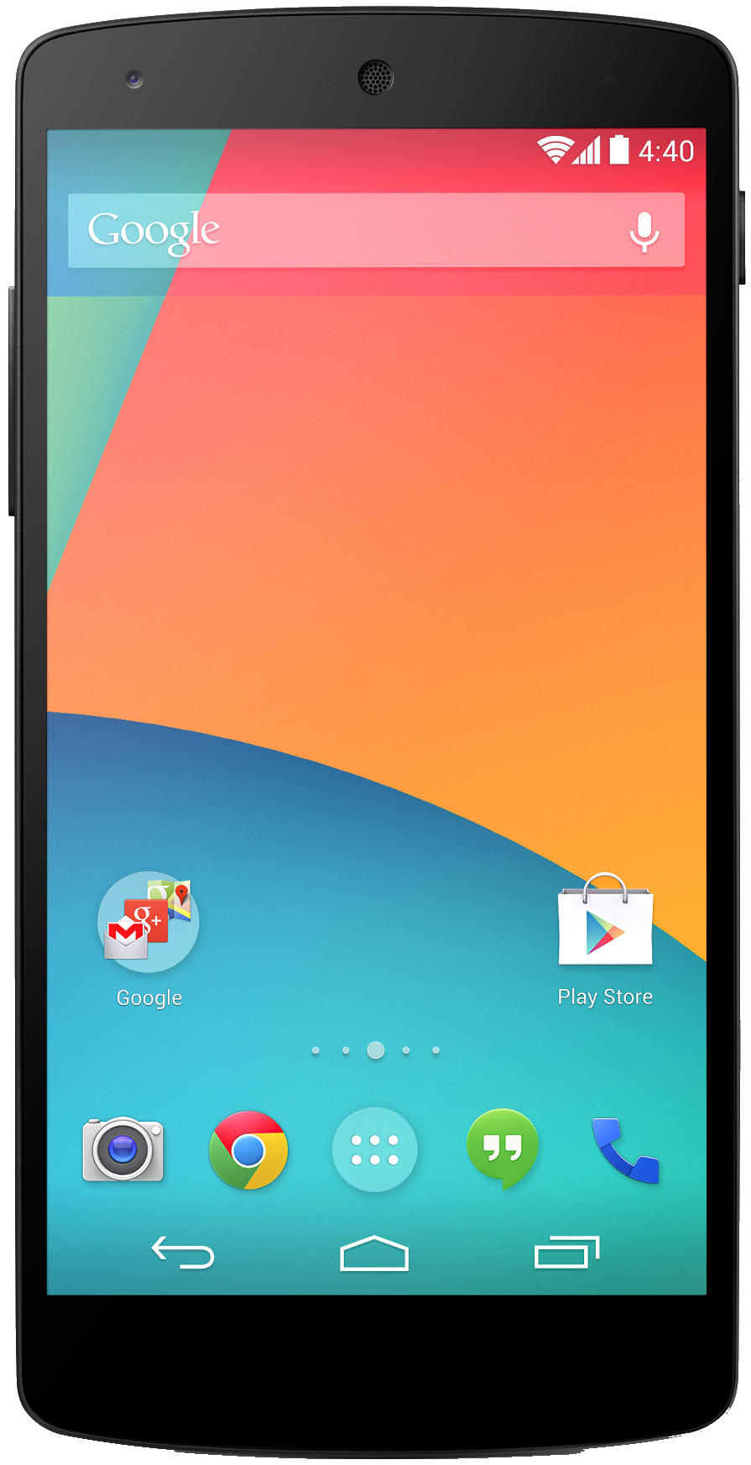
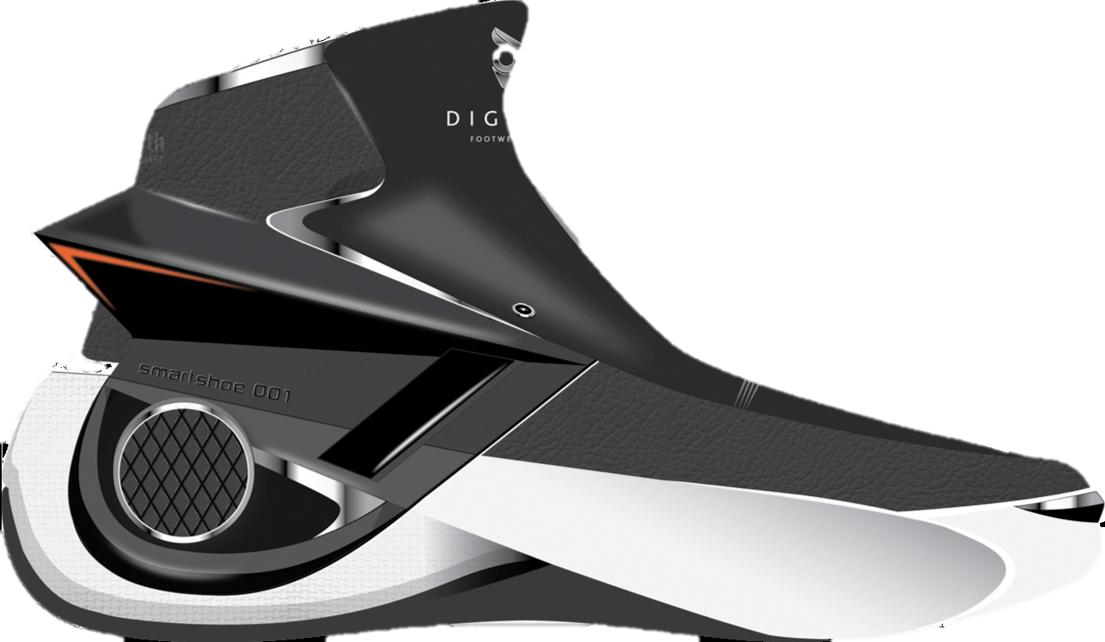

Slide 3
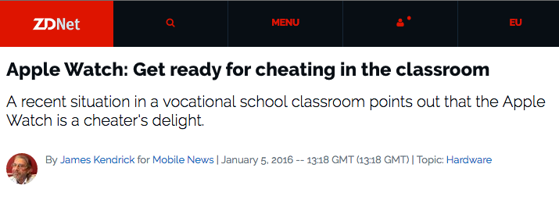
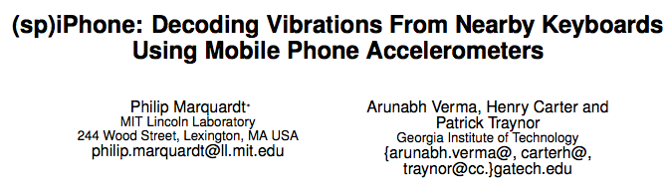
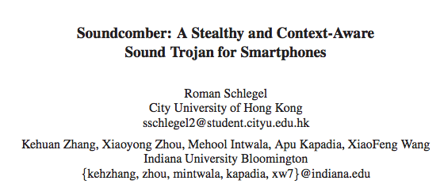
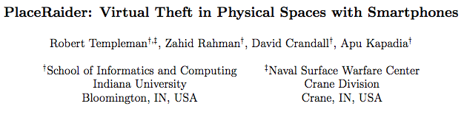
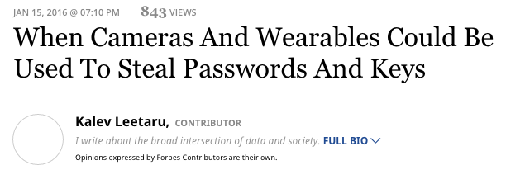
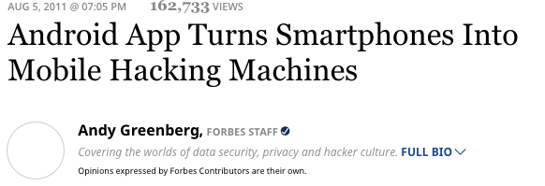
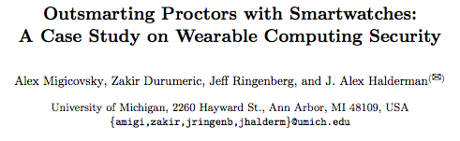
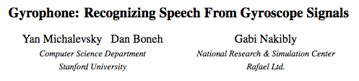
Practical and Proof-Of-Concept
Attacks are published

Slide 4
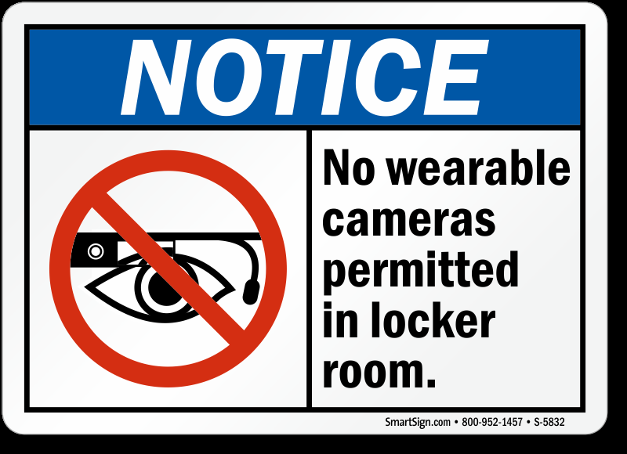
Current Solution: Not really exciting!

Slide 5


Restricted Spaces
Host needs guarantee that guest devices respect the policies
A host wants to define policies for smart devices of guests
✘
✘
The guest can verify that the policies are not malicious
Public space
Restricted space

Slide 6
Adversary and Trust Model
Hosts and guests are mutually-distrusting
  Malicious user
  Malicious sensors
  Malicious host (policies)
Trusted hardware module
  ARM TrustZone

Slide 7


Phase 1a: Check-in (Memory Examination)
Vetting service
Mutual Authentication
Request Memory Content
Forward Request Memory
✔ or ✘
Send (Kernel) Memory Image
Restricted space

Slide 8
Phase 1b: Check-in (Policy Enforcement)
✘
✘
Vetting service
Request Memory Changes
Forward Memory Changes
✔ or ✘
Apply Changes
Restricted space

Slide 9
Phase 2: Policy Enforcement Verification
✘
✘
Vetting service
Restricted space

Slide 10

Phase 2: Policy Enforecmant Verification
✘
✘
Request proof of policy compliance
Verification Token
t
Request proof of policy compliance
Verification Token
Restricted space

Slide 11
Phase 2: Policy Enforcement Verification
Phase 3: Check-out
✘
✘
Request proof of policy compliance
Verification Token
✘
t
Request proof of policy compliance
✘
Verification Token
Public space
Restricted space
Restricted space

Slide 12
Phase 3: Check-out
✘
Revert
Changes
✘
Public space
Restricted space

Slide 13
Implementation

Slide 14
ARM TrustZone (TZ)
NormalWorld
Secure World
CPU
Memory
Camera
A
p
p
A
p
p
A
p
p
Library
Microphone
Kernel
WiFi

Slide 15

Analysis of Guest Kernel Memory
App
RS-App
TZ
KernelImage
KernelImage
HMAC
Kernel Space
copy
Cam-Drv
WiFi-Drv
Drv-N
Based on prior work; see paper for details.

Slide 16
Enforcing Host Policies
App
RS-App
TZ
HMAC
KernelImage
PEE
Kernel Space
copy
Cam-Drv
Null-Drv
WiFi-Drv
Drv-N
Null
PEE: Policy Enforcement Engine

Slide 17
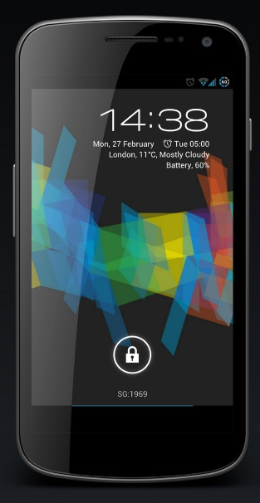
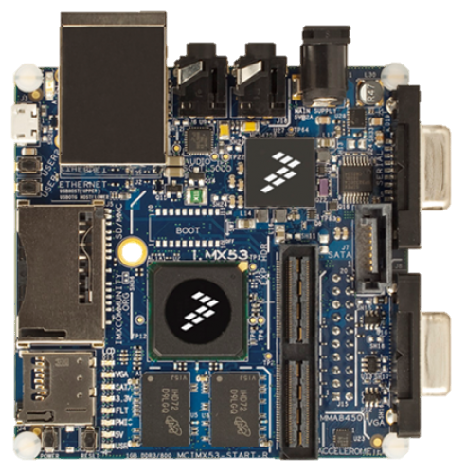
Evaluation
Robustness Evaluation
  Samsung Galaxy Nexus
  Android 4.3
Performance Evaluation
  iMX.53
  Android 2.3.4
Trusted Computing Base
  3.5 kLOC: Crypto (SHA1/HMAC/RSA/X509)
  4.0 kLOC: Environment
All Apps either failed gracefully or continued to work
Copy <1s
HMAC 54 sec

Slide 18
Take Away & Future Research
Systematic regulation of device capabilities in restricted spaces
Balance between security and privacy
Improve performance of implementation
  Use hardware accelerators, multi-core systems support, etc.
Automated kernel image analysis tool
  Identify relevant drivers, generation of dummy drivers
How can other humans know that policy is enforced? [Mirzamohammadi, Mobisys’16]
Notes:
Improve performance of implementation
Use hardware accelerators
Multi-core systems (one core is executing in TZ, other cores keep phone responsive)
Automated kernel image analysis tool
Identify relevant dirvers
Automated dummy driver generation (analyze driver interface)

