Slide 1
Regulating Smart Devices in Restricted Spaces
Vinod Ganapathy
vinodg@cs.rutgers.edu
Associate Professor of Computer Science
Rutgers, The State University of New Jersey
Appears in Proc. ACM MobiSys’16

Slide 2
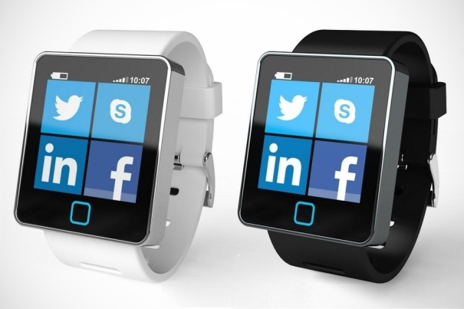
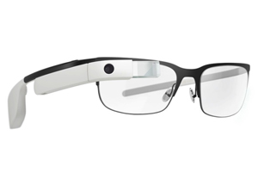
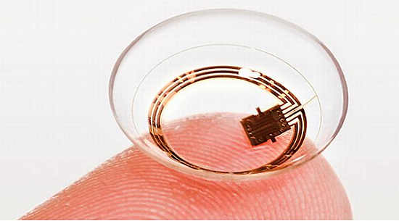
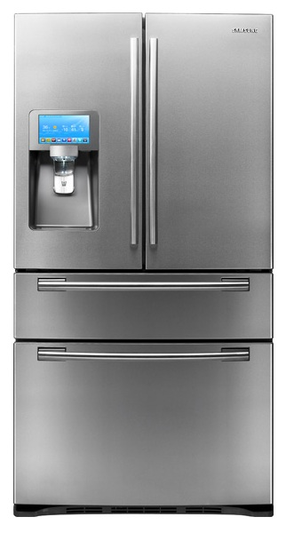
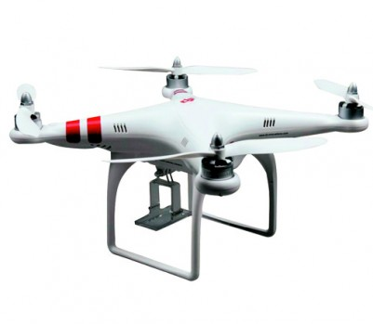
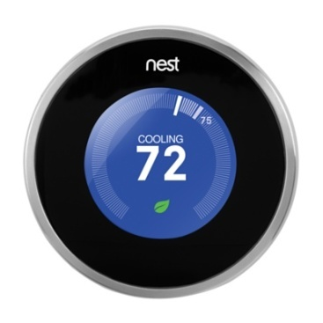
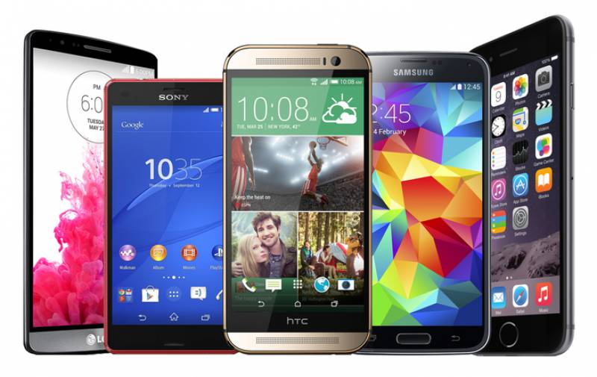
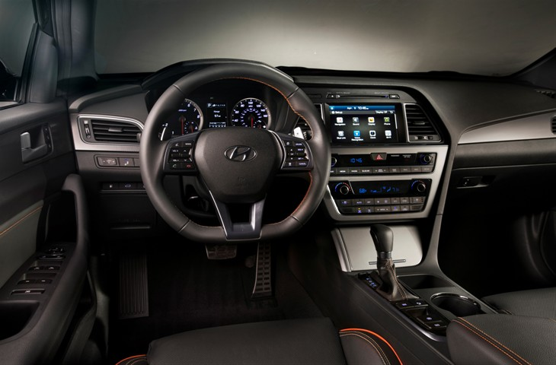
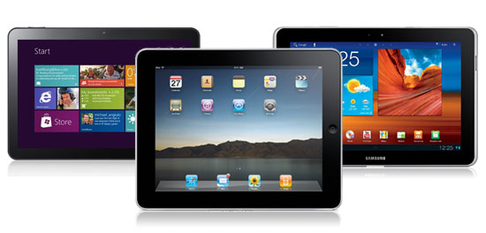
Devices are everywhere!

Slide 3
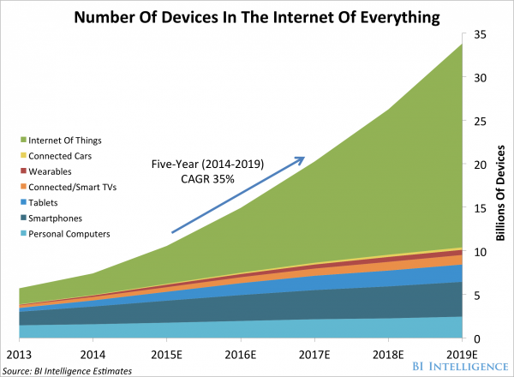
Number of devices is increasing
Predicted 1.2 billion new smart phones by 2018
Predicted 50% device use increase year over year in enterprise sector until 2018 [Gartner 2014]

Slide 4
Devices are increasingly capable
Model | CPU (GHz) | Screen (1000x) | Rear camera | Front camera | Battery (mAh) | Sensors other than Camera/Microphone
iPhone | 0.4 | 153 | 2MP | - | 1,400 | 3 (light, accelerometer, proximity)
iPhone3 | 0.6 | 153 | 3MP | - | 1,150 | 4 (+= compass)
iPhone4 | 0.8 | 614 | 5MP | 0.3MP | 1,420 | 6 (+= gyroscope, infrared)
iPhone5 | 1.3 (2 core) | 727 | 8MP | 1.2MP | 1,560 | 7 (+=fingerprint)
iPhone6 | 2.0 (2 core) | 1000 | 12MP | 5.0MP | 1,715 | 8 (+= barometer)

Slide 5
With great power …
… comes great responsibility

Slide 6
How can devices be misused?
Malicious end-users can leverage sensors to exfiltrate or infiltrate unauthorized data
Malicious apps on devices can achieve similar goals even if end-user is benign

Slide 7
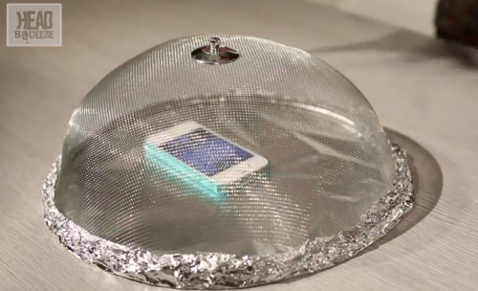
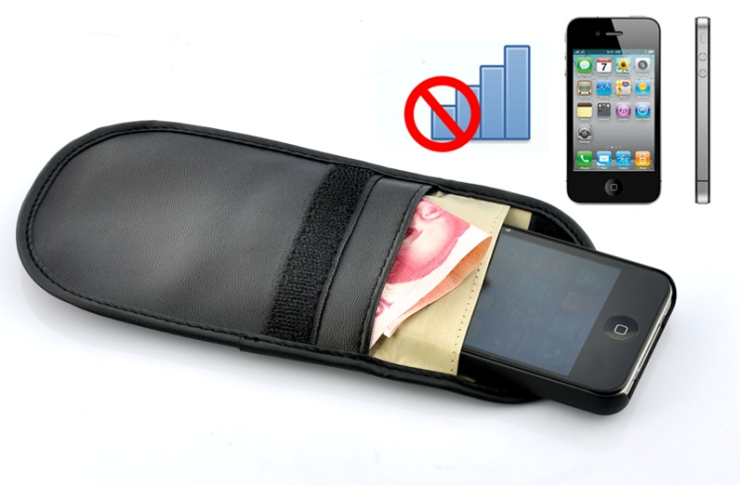
Government or corporate office
Problem: Sensitive documents and meetings can be ex-filtrated using the camera, microphone and storage media
Current solution: Physical security scans, device isolation
Faraday cages

Slide 8
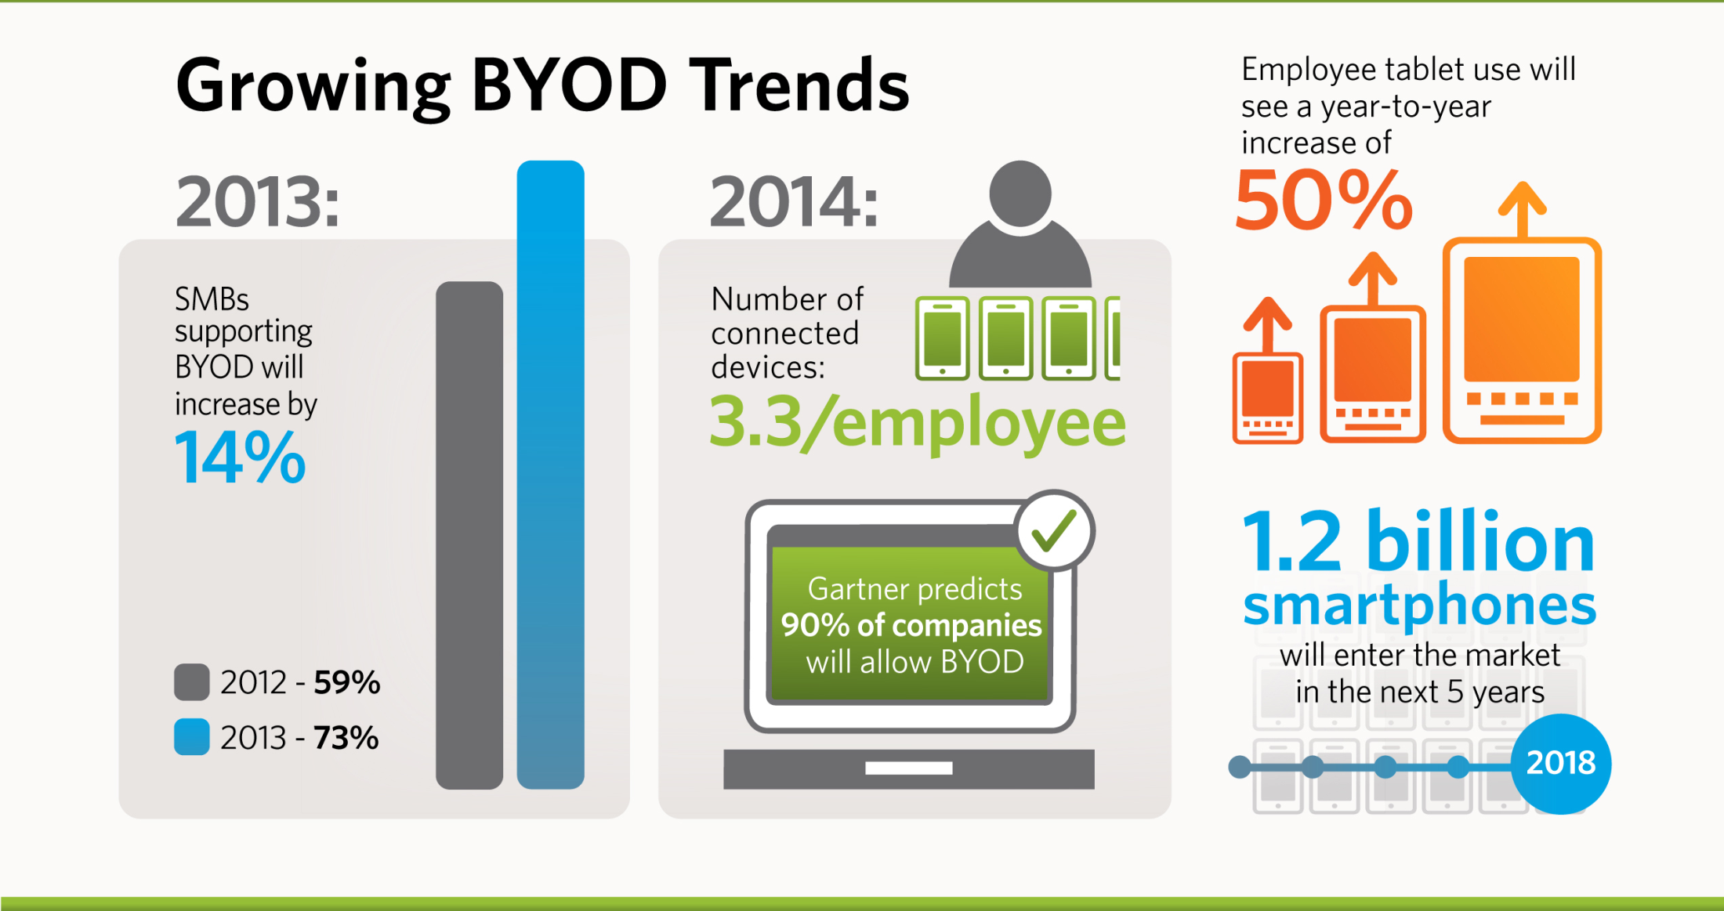
Challenge: Bring your own device

Slide 9
Classroom and exam setting

Slide 10
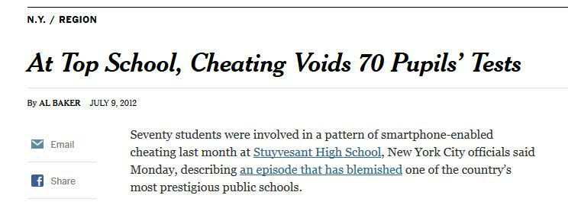
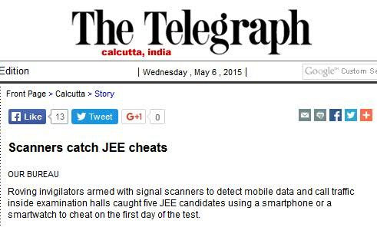
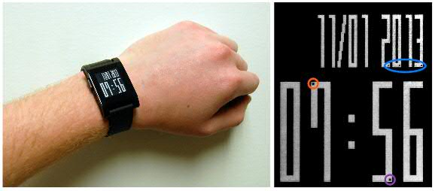
Classroom and exam setting
Problem: Personal devices can be used to infiltrate unauthorized information
[NY Times July 2012]
[Financial Crypto 2014]

Slide 11
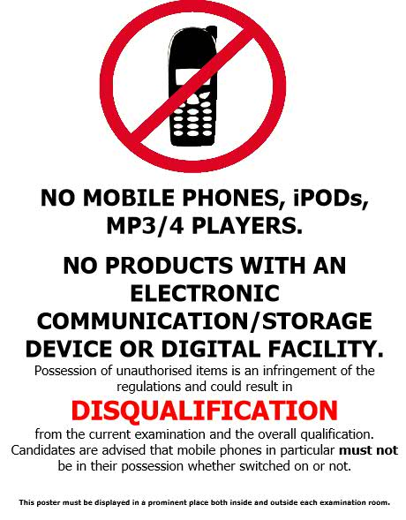
Classroom and exam setting
Current solution: Deterrence via rules and threats. Invigilation to ensure compliance

Slide 12
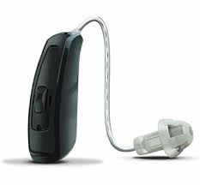
Challenge: Assistive devices
Students may wish to use devices for legitimate reasons:
Smart glass or contacts for vision correction
Bluetooth-enabled hearing aids
Smart watches to monitor time

Slide 13
Other social settings
Restaurants, conferences, gym locker rooms, private homes, …
Problems:
Recording private conversations
Pictures of individuals taken and posted to social networks without their consent
Pictures and videos of otherwise private locations, e.g., private homes

Slide 14
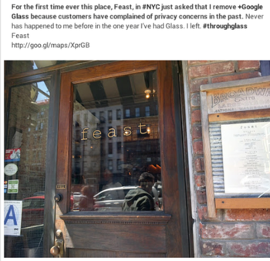
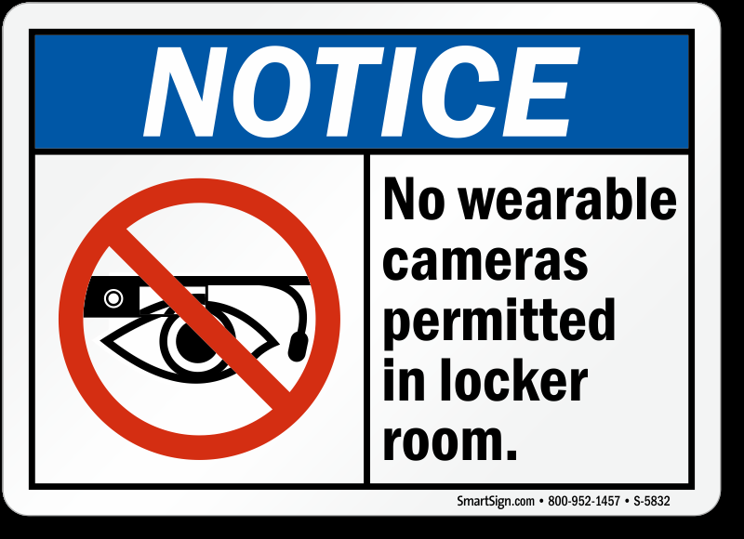
Other social settings
Current solutions: Informal enforcement
Challenge: Social isolation ☺
“For the first time ever this place, Feast, in NYC just asked that I remove Google Glass because customers have complained of privacy concerns […] I left”

Slide 15
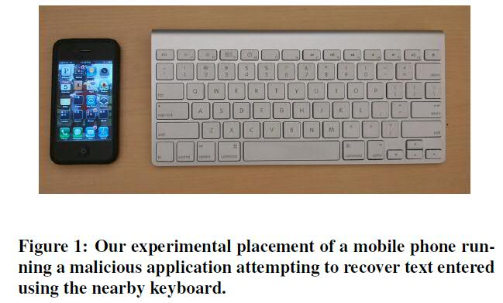
Malicious apps exploiting sensors
Sensory malware
Early example of sensory malware [CCS 2011]
Use accelerometer and record keystroke press vibrations
Up to 80% accuracy in word recovery

Slide 16
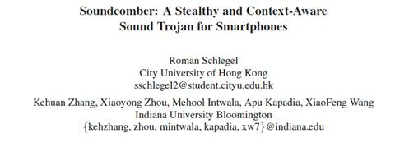
Malicious apps exploiting sensors
Sensory malware
[NDSS 2013]
[NDSS 2011]
[USENIX Security 2014]
Attacks have now been demonstrated using every imaginable sensor
Attack accuracy will improve with each generation of devices and sensors

Slide 17
Claim
Smart devices will become integrated with daily lives → Ad hoc solutions, e.g., banning device use, will no longer be acceptable
Vision
Need systematic methods to regulate
devices and ensure responsible use
Discussion: Only considering overt device use. Covert use detection still requires traditional physical security measures.

Slide 18
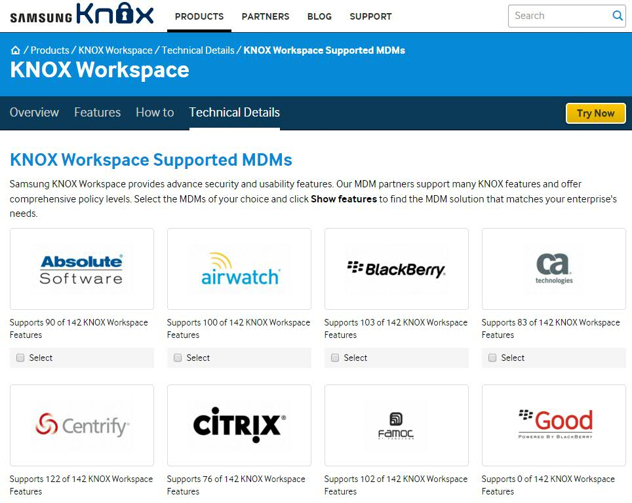
What solutions exist today?
Mobile device management (MDM) solutions

Slide 19
Mobile device management
Solution for enterprises that offer Bring your own device (BYOD) models
Employees are given a mobile device outfitted with a secure software stack
Enterprise policies “pushed” to device when employee changes device persona

Slide 20
Mobile device management
Main shortcoming of current MDM solutions
Enterprise must trust software stack on guest device to enforce policies correctly
But guest devices under control of possibly malicious end-users
Solution for enterprises that offer Bring your own device (BYOD) models
Employees are given a mobile device outfitted with a secure software stack
Enterprise policies “pushed” to device when employee changes device persona

Slide 21
Contributions of our work
Restricted space: Location owned by a host, where guest devices must follow the host’s usage policies
Enable guest devices to prove policy compliance to restricted space hosts
Use a simple, low-level API that reduces size of trusted computing base on guest devices

Slide 22
Key technical challenges
1. Guest devices are under the control of possibly malicious end-user
Solution: Use trusted hardware on guest device
2. What constitutes proof of compliance?
Solution: Send guest device configuration, showing policy compliance, to host
3. Doesn’t that compromise guest device privacy?
Solution: Allow guest to vet all communication to and from the host

Slide 23
Threat model
Trusted hardware on guest devices:
Guest devices equipped with ARM TrustZone
Hosts and guests are mutually-distrusting:
Hosts do not trust end-user of guest device or its end-user software stack
Guests do not trust host’s reconfiguration requests to ensure policy compliance
Guest devices are used overtly:
Host must still use traditional physical methods to detect covert device use

Slide 24
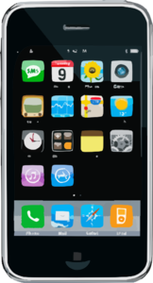
Guest device check-in
Public space
Restricted space

Slide 25
Guest device check-in
Public space
Restricted space

Slide 26
Mutual authentication
1
Host’s policy server
Mutual
authentication
Restricted space

Slide 27
Host requests guest analysis
2
Host’s policy server
Request device memory
Addr1, Addr2, Addr3, …
Restricted space

Slide 28
Guest vets host’s request
2
Host’s policy server
Forward host’s request
Addr1, Addr2, Addr3, …
Guest’s
vetting
service
Request device memory
Addr1, Addr2, Addr3, …
Restricted space

Slide 29
Guest vets host’s request
2
Host’s policy server
or
Guest’s
vetting
service
Restricted space

Slide 30
Host analyzes guest device
2
Host’s policy server
Guest’s
vetting
service
Send device memory
Addr1, Addr2, Addr3, …
Restricted space

Slide 31
Host pushes policy to guest
3
Host’s policy server
Guest’s
vetting
service
Send memory updates
Restricted space

Slide 32
Guest vets host’s updates
3
Host’s policy server
Forward host’s requested updates
Guest’s
vetting
service
Send memory updates
Restricted space

Slide 33
Guest applies host’s updates
3
Host’s policy server
Guest’s
vetting
service
Apply
memory updates
Restricted space

Slide 34
Host requests proof
4
Host’s policy server
Guest’s
vetting
service
Request proof of policy compliance
Restricted space

Slide 35
Guest sends proof
4
Host’s policy server
Guest’s
vetting
service
Verification token
Restricted space

Slide 36
Guest device check-out
Revert changes
Public space
Restricted space

Slide 37
Operational details
1. How can host trust guest to apply policy?
Answer: Leverage ARM TrustZone
2. Why memory snapshots and updates?
Answer: Powerful low-level API. Reduces TCB
3. How does vetting service ensure safety?
Answer: Simple, conservative program analysis
4. Can’t guest device simply reboot to undo?
Answer: REM-suspend protocol

Slide 38
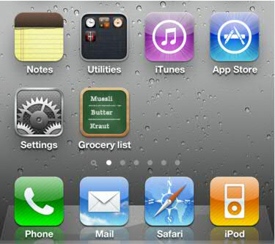
The ARM TrustZone
Guest device
Normal world
(Untrusted)
Secure world
(Protected by H/W)
Normal-world memory
Secure-world memory
ARM TrustZone

Slide 39
Secure boot protects secure world
Normal world
(Untrusted)
Secure world
Secure boot
Normal-world memory
Secure-world memory
ARM TrustZone

Slide 40
Secure world stores keys
Normal world
(Untrusted)
Secure world
Secure boot
PubKeyG, PrivKeyG
Normal-world memory
Secure-world memory
ARM TrustZone

Slide 41
Memory is partitioned
Normal world
(Untrusted)
Secure world
Secure boot
PubKeyG, PrivKeyG
Normal-world memory
Secure-world memory
ARM TrustZone

Slide 42
Memory is partitioned
Normal world
(Untrusted)
Secure world
Secure boot
PubKeyG, PrivKeyG
Normal-world memory
Secure-world memory
ARM TrustZone

Slide 43
We enhance the secure world
Normal world
(Untrusted)
Secure world
(booted securely)
Authentication
NW analysis
NW updates
Verif. tokens
1
2
3
4
Normal-world memory
Secure-world memory
ARM TrustZone

Slide 44
Mutual authentication
1
Host’s policy server
Secure world
k_{s}
k_{s}
Goal
Establish shared session key k_{s} between
host and guest
Secure-world memory
ARM TrustZone

Slide 45
Establishing session key
1
k_{s}
Simplified TLS/SSL handshake
Host’s keypair: PubKeyH, PrivKeyH
Guest’s keypair: PubKeyG, PrivKeyG
Guest ←→ Host: Exchange/verify public keys
Host → Guest: Enc_{PubKeyG}(k_{s})+ Signature_{PrivKeyH}
Guest (secure world): Verify host signature, decrypt message and obtain
k_{s}

Slide 46
Guest device analysis
2
Host’s policy server
Request device memory
k_{s}
Addr1, Addr2, Addr3, …
Send device memory
k_{s}
Addr1, Addr2, Addr3, …
Restricted space

Slide 47
SW reads NW memory
2
Normal world
(Untrusted)
Secure world
k_{s}
Normal-world memory
Secure-world memory
ARM TrustZone

Slide 48
Analysis of NW memory snapshot
2
Guest device
Host’s policy server
k_{s}
k_{s}
Infer what peripherals are installed, and where in memory their drivers are installed
Detect guest device for malware infection, including kernel-level rootkits
[Baliga, Ganapathy, Iftode, ACSAC’08, TDSC’11]

Slide 49
Why look for NW rootkits?
2
Normal world
(Untrusted)
Secure world
k_{s}
Secure world applies updates
Normal
world OS
Rootkit
Secure-world memory
ARM TrustZone

Slide 50
Why look for NW rootkits?
2
Normal world
(Untrusted)
Secure world
k_{s}
Rootkit undoes host’s changes
Normal
world OS
Rootkit
Secure-world memory
ARM TrustZone

Slide 51
Analysis of NW memory snapshot
2
Host’s policy server
Root symbols &
kernel entry points
Recursive traversal of memory data structures
?
?
Code pages
Data
structs
Code
whitelist
Data
invariants

Slide 52
Vetting host’s requests
2
Guest device
Guest’s vetting service
or
Vetting server ensures that host’s requests do not compromise guest privacy
Vetting policy: Host only allowed to request guest device’s kernel memory

Slide 53
Guest device update
3
Host’s policy server
Memory updates
Restricted space

Slide 54
SW updates NW memory
3
Normal world
(Untrusted)
Secure world
k_{s}
Secure-world memory
ARM TrustZone

Slide 55
Updating peripheral drivers
3
Device drivers in normal world control execution of device peripherals
OS Kernel
Peripheral interface
Device driver

Slide 56
Updating peripheral drivers
3
Introduce dummy driver to control peripheral (e.g., disable it). Update kernel driver hooks.
OS Kernel
Peripheral interface
Dummy driver
Original driver

Slide 57
Are driver updates effective?
3
Peripheral considered | Update size (bytes) | Guest device | Peripheral disabled?
USB webcam | 302 | i.MX53
Camera | 212 | Nexus phone
WiFi | 338 | Nexus phone
3G (Data) | 252 | Nexus phone
3G (Voice) | 224 | Nexus phone
Microphone | 184 | Nexus phone
Bluetooth | 132 | Nexus phone

Slide 58
Vetting host’s updates
3
Guest device
Guest’s vetting service
or
An untrusted host can introduce new code into guest devices
Vetting policy: Ensure that dummy drivers are a subset of the original drivers
Via ARM-binary analysis on

Slide 59
Proof of compliance
4
Host’s policy server
Request proof of policy compliance
Verification token
Restricted space

Slide 60
Verification tokens
4
Host requests proof of compliance
Secure world computes a fresh snapshot of all NW memory locations updated by host
Verification token:
Verification token matches if and only if normal world memory still in compliance with the host’s usage policy
HMAC( , )
k_{s}

Slide 61
Memory updates are ephemeral
Guest device can violate host’s usage policies by simply rebooting to undo host’s memory updates!
Once device checked in, secure world must:
Mediate all low-battery and power-off interrupts
Checkpoint device memory to disk
Upon power up, must restore device memory from checkpoint

Slide 62
Device checkpoint
Problem: Checkpoint stored on disk
Readable by untrusted end-user
But session key k_{s} must not be stored in clear
Otherwise, malicious end-user can use it to impersonate guest’s trusted secure world!
Solution: REM-suspend protocol

Slide 63
REM-suspend
ARM TrustZone equips each device with a device-specific key K_{DEV}
The key K_{DEV} is only accessible from the secure world
We use K_{DEV} to encrypt k_{s} in device checkpoint
When device is powered again, secure world uses K_{DEV} to decrypt and restore k_{s}

Slide 64
REM-suspend
Secure world
k_{s}
K_{DEV}
Guest
device
storage
k_{s}
ARM TrustZone

Slide 65
REM-suspend
Secure world
k_{s}
K_{DEV}
k_{s}
K_{DEV}
Guest
device
storage
k_{s}
ARM TrustZone

Slide 66
Are memory updates the right API?
Powerful, low-level API for device control
Simplifies design of secure world (TCB) and keeps it device-independent
TCB component | SLOC
Memory manager | 1381
Authentication | 1285
Memory ops., verification tokens | 305
REM-suspend | 609
SHA1 + HMAC | 861
X509 | 877
RSA | 2307

Slide 67
Do memory updates affect app stability?
Passive updates: Update memory and start the app
USB | MobileWebCam | ZOOM FX | Retrica | Candy Cam | HD Cam Ultra
 | App Error | Android Error | App Error | App Error | Android Error
Camera | Android Cam | Camera MX | ZOOM FX | Droid HD Cam | HD Cam Ultra
 | Android Error | App Error | App Error | Android Error | Android Error
WiFi | Spotify | Play Store | YouTube | Chrome | Facebook
 | No Connection | No Connection | No Connection | No Connection | No Connection
3G (Data) | Spotify | Play Store | YouTube | Chrome | Facebook
 | No Connection | No Connection | No Connection | No Connection | No Connection
3G (Voice) | Default call application
 | Unable to place call
Micro- phone | Audio rec | Easy voice rec | Smart voice rec | Snd/voice rec | Smart voice rec
 | App Error | App Error | App Error | App Error | App Error

Slide 68
Do memory updates affect app stability?
Active updates: Update memory with “live” app
USB | MobileWebCam | ZOOM FX | Retrica | Candy Cam | HD Cam Ultra
 | App Error | App Error | App Error | App Error | App Error
Camera | Android Cam | Camera MX | ZOOM FX | Droid HD Cam | HD Cam Ultra
 | Blank Screen | App Error | Android Error | Blank Screen | Blank Screen
WiFi | Spotify | Play Store | YouTube | Chrome | Facebook
 | No Connection | No Connection | No Connection | No Connection | No Connection
3G (Data) | Spotify | Play Store | YouTube | Chrome | Facebook
 | No Connection | No Connection | No Connection | No Connection | No Connection
3G (Voice) | Default call application
 | Unable to place call
Micro- phone | Audio rec | Easy voice rec | Smart voice rec | Snd/voice rec | Smart voice rec
 | Empty File | Empty File | Empty File | Empty File | Empty File

Slide 69
Related approaches
Device virtualization:
Heavyweight; probably not for all devices
Still requires host to trust hypervisor on guest
Mobile device management solutions:
No proofs to host
Device-dependent TCB on guest
Context-based access control:
Same shortcomings as MDM solutions above

Slide 70
Conclusion
A systematic method to regulate
devices and ensure responsible use
Low-level API allows hosts to analyze and control guests
Simplifies design and size of TCB
Hosts can obtain proofs of guest compliance
Relies on ARM TrustZone hardware
Vetting service balances guest privacy with host’s usage policies

Slide 71
Other research projects…
Generic theme: Computer Systems Security
Improving cloud platform security
[ACSAC’08a, RAID’10, CCS’12a, SOCC’14]
Operating system reliability and security
[ASPLOS’08, ACSAC’08b, ACSAC’09a, MobiSys’11, TDSC’11, TIFS’13]
Hardware support for software and system security [CCS’08, ECOOP’12a, TIFS’13, MobiSys’16, RU-DCS-TR724]
Web application and Web browser security
[ACSAC’09b, ECOOP’12a, ECOOP’12b, ECOOP’14, FSE’14]
Tools for cross-platform mobile app development [ICSE’13, ASE’15]
Retrofitting legacy software for security
[CCS’05, Oakland’06, ASPLOS’06, ICSE’07, CCS’08, CCS’12b]
Validating security retrofitting transformations in optimizing compilers
[Submitted]

Slide 72
A big thank you to my students
Graduated PhDs
Dr. Mohan Dhawan (IBM Research India)
Dr. Saman Zarandioon (Amazon.com)
Dr. Shakeel Butt (NVidia → now at Google)
Dr. Liu Yang (HP Labs → now at Baidu)
Dr. Rezwana Karim (Samsung Research America)
Dr. Amruta Gokhale (Teradata)
Former Postdocs
Dr. Arati Baliga (AT&T Security Labs)
Graduated MS students
Jeffrey Bickford (AT&T Research)
Yogesh Padmanaban (Microsoft)
Current PhD students
Jay P. Lim, Hai Nguyen, Daeyoung Kim.

Slide 73
Email: vinodg@cs.rutgers.edu URL: http://www.cs.rutgers.edu/~vinodg

