Slide 1
Exploring Security Support for Cloud-based Applications
Hai Nguyen
Defense Committee: Prof. Vinod Ganapathy (Chair), Prof. Thu Nguyen, Prof. Abhishek Bhattacharjee, Prof. Trent Jaeger (Pennsylvania State University)

Slide 2
My thesis
It is possible to enhance the security and privacy of cloud-based applications by using recent hardware advances.

Slide 3
Contributions
An enclave inspection library that preserves the security and privacy benefits offered by Intel SGX and allows the cloud provider to verify the client’s code for security compliance [ICDCS’17]
An effective approach based on Hardware Performance Counters and machine learning to detect ransomware in the cloud [Submitted to ACSAC’18]
A new cloud computing model where clients can flexibly deploy security services by simply downloading apps, implemented as virtual machines [C&S’16]

Slide 4
Part I: Enforcing security compliance of cloud-based applications within a hardware-based protected execution environment

Slide 5
Intel SGX
Intel Software Guard Extensions (Intel SGX) is an extension of the Intel architecture
Code and data are kept confidential inside an enclave
Data
Code
Enclave
Application
Operating System

Slide 6
Intel SGX
Protect against privileged software and hardware attacks
Offer remote attestation to prove secure initialization of the enclave
Data
Code
Enclave
Application
Operating System

Slide 7
Intel SGX limits the capability of cloud providers
TCB of a traditional computer system
TCB of an Intel SGX-based system
Enclave
Application
Application
Application
Application
OS
OS
VMM
VMM
Hardware
Hardware
TCB (Trusted Computing Base)
Cloud providers cannot inspect the client’s code and data within an SGX-based protected environment

Slide 8

Intel SGX limits the capability of cloud providers
TCB of an Intel SGX-based system
Now I can no longer verify your code
Enclave
Application
Application
OS
VMM
Hardware
TCB (Trusted Computing Base)
Cloud providers cannot inspect the client’s code and data within an SGX-based protected environment

Slide 9
Intel SGX limits the capability of cloud providers
TCB of an Intel SGX-based system
Is the code stack protected?
Enclave
Application
Application
OS
VMM
Hardware
TCB (Trusted Computing Base)
Cloud providers cannot inspect the client’s code and data within an SGX-based protected environment

Slide 10
Intel SGX limits the capability of cloud providers
TCB of an Intel SGX-based system
Is the code instrumented with indirect
Indirect function call checks?
Enclave
Application
Application
OS
VMM
Hardware
TCB (Trusted Computing Base)
Cloud providers cannot inspect the client’s code and data within an SGX-based protected environment

Slide 11
Our solution: EnGarde
We build EnGarde, an enclave inspection library that allows cloud providers to verify clients’ code while preserves the security properties of SGX
EnGarde incurs small overhead during code provisioning and no overhead during runtime
We evaluate the effectiveness of EnGarde on various real-world applications

Slide 12
Threat model
The provider and client are mutually distrusting
The code of EnGarde is available to both the provider and client for inspection
  The client verifies that EnGarde does not leak confidential information to the provider
EnGarde does not consider covert channels via which information about the client’s code is leaked to the provider

Slide 13
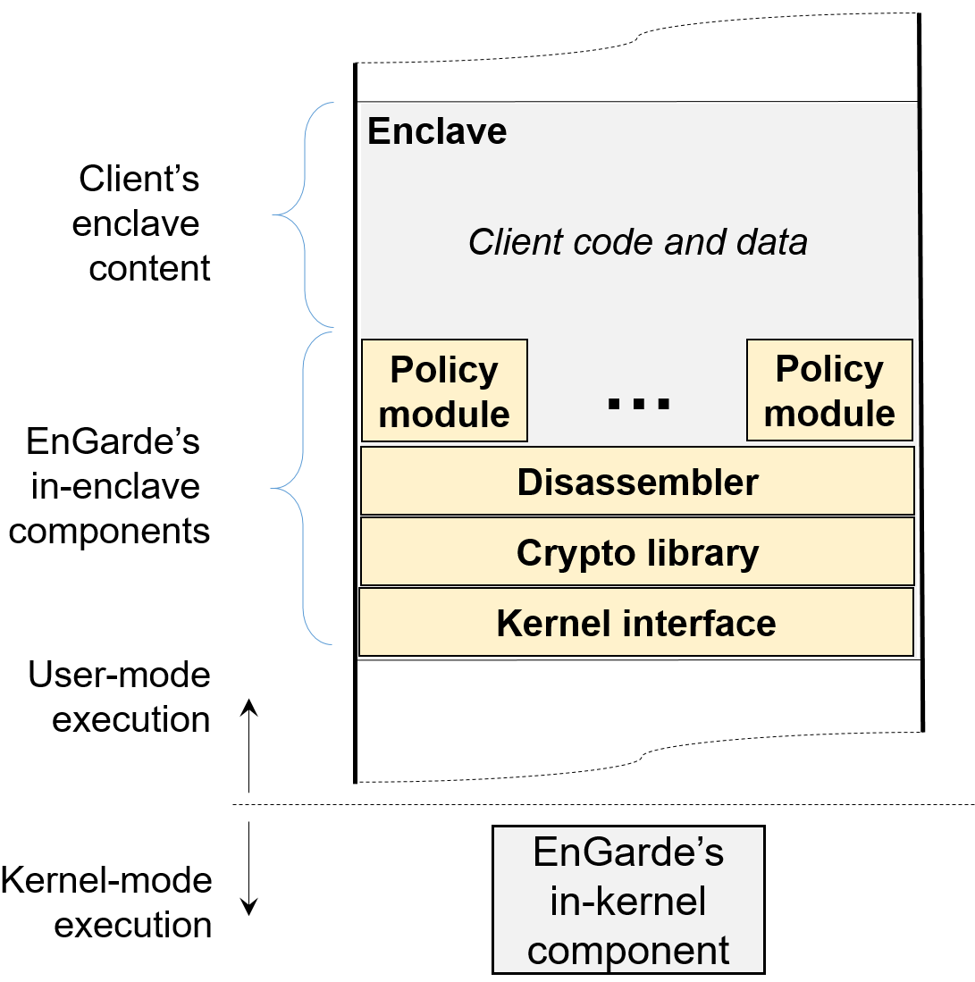
EnGarde architecture

Slide 14
Enclave initialization and remote attestation
EnGarde is loaded into a fresh enclave created by the cloud provider
The provider proves to the client that the enclave was initialized securely by using SGX’s remote attestation

Slide 15
Code provisioning
EnGarde generates a 2048 RSA key pair and sends the public key to the client
The client uses the public key to encrypt its AES key which will be used to encrypt the sensitive content it sends to EnGarde
  The content includes code and data represented in an executable using ELF format
  The executable is compiled as position independent code (PIC) and is statically linked

Slide 16
Code provisioning
The client sends encrypted content to EnGarde
EnGarde decrypts the content to get an in-enclave representation of the client’s executable

Slide 17
Code disassembling
EnGarde extracts all code sections of the client’s executable and disassembles the code
EnGarde’s disassembler is based on the disassembler of Google’s native client (NACL), a sandbox for native code
EnGarde uses an instruction buffer to store all disassembled instructions

Slide 18
Policy enforcement
The provider and the client mutually agree upon the policies that the client’s code must satisfy
The agreed policies are encoded into policy modules which are loaded into the enclave along with EnGarde

Slide 19
Policy enforcement
Policy modules enforce policy compliance by using the disassembled instructions from the instruction buffer
In general, policy modules examine structural properties of the client’s code
The client’s code is rejected if it is not policy compliant

Slide 20
Loading and relocating
EnGarde maps the text, data and bss segments to the enclave memory
EnGarde applies symbol relocations using relocation tables

Slide 21
Enclave page permission enforcement
Page Permission Enforcement is performed by the in-kernel component of EnGarde
The in-kernel component receives a list of code and data pages which need to be set with appropriate permissions
Code’s pages are set as executable but not writable and the pages of the data segment and bss segment are set as writable but non-executable

Slide 22
Enclave page permission enforcement
Enclave page permission is enforced at two levels:
  Using page table permission bits
  Manipulating the entries of an SGX’s data structure called Enclave Page Cache Map (EPCM)

Slide 23
Implementation
We implemented EnGarde on top of OpenSGX, an SGX emulation infrastructure
OpenSGX offers rich operating system support and an easy to use library interface for enclave developers
Current version of Intel SGX does not allow changing enclave page permission at the SGX level after enclave initialization and all enclave memory must be committed at build time

Slide 24
Evaluation
Goals:
  Demonstrate the effectiveness of EnGarde and the overhead of EnGarde in enforcing various policies
Dell Optiplex running Ubuntu 14.04
  16 GB RAM
  Intel core i5 CPU
Use real world applications: Nginx, Memcached, Netperf, Otp-gen, graph-500, 401.bzip2 and 429.mcf

Slide 25
Sizes of the components of EnGarde
Components | LOC
Code Provisioning | 270
Loading and Relocating | 188
Checking Executables Linked Against musl-libc | 1,949
Checking Executables Compiled With Stack Protection | 109
Checking Executables Containing Indirect Function-Call Checks | 129
Client’s Side Program | 349
musl-libc | 90,728
Lib Crypto (OpenSSL) | 287,985
Lib SSL (OpenSSL) | 63,566
Total | 453,349

Slide 26
Compliance for library linking
This policy verifies if applications are linked against musl-libc v1.0.5
The policy module has the SHA-256 hashes of all the functions of musl-libc v1.0.5 and store them in a hash table

Slide 27
Compliance for library linking
The policy module uses the instruction buffer and computes the target of each direct function call
If the hash of a function does not match its value in the hash table, the client has not provided the required musl-libc

Slide 28
Performance of EnGarde to check the library-linking policy
Benchmark | #Inst. | Disassembly | Policy Checking | Loading and Relocation
Nginx | 262,228 | 694,405,019 | 1,307,411,662 | 128,696
401.bzip2 | 24,112 | 34,071,240 | 148,922,245 | 4,239
Graph-500 | 100,411 | 140,307,017 | 246,669,796 | 4,582
429.mcf | 12,903 | 18,242,127 | 123,895,553 | 4,363
Memcached | 71,437 | 137,372,517 | 489,914,732 | 8,115
Netperf | 51,403 | 90,616,563 | 367,356,878 | 18,090
Otp-gen | 28,125 | 42,823,024 | 198,587,525 | 5,388
Number of CPU Cycles

Slide 29
Compliance for stack protection
Compilers emit extra code to protect against stack smashing
The LLVM compiler adds a guard variable when a function starts and checks the variable when a function exits:
    19311: mov %fs : 0x28, %rax
    1931a: mov %rax, (%rsp)
    193fe: mov %fs : 0x28, %rax
    19407: cmp(%rsp), %rax
    1940b: jne 1941f
    1941f: callq 8d5bf <__stack_chk_fail>

Slide 30
Compliance for stack protection
The policy module iterates through the instruction buffer and identifies each function
Within each function, the policy module checks if stack protection instructions are added at the beginning and at the end of the function

Slide 31
Performance of EnGarde to check the stack protection policy
Benchmark | #Inst. | Disassembly | Policy Checking | Loading and Relocation
Nginx | 271,106 | 719,360,640 | 713,772,098 | 128,662
401.bzip2 | 24,226 | 34,292,136 | 862,023,613 | 4,206
Graph-500 | 100,488 | 140,588,361 | 195,218,892 | 4,548
429.mcf | 12,985 | 18,288,921 | 31,459,881 | 4,330
Memcached | 71,677 | 137,877,497 | 325,442,403 | 8,081
Netperf | 51,868 | 91,577,335 | 183,274,713 | 18,057
Otp-gen | 28,217 | 43,053,386 | 217,302,816 | 5,355
Number of CPU Cycles

Slide 32
Restricting indirect function calls
Control flow integrity (CFI) is a measure that guards against attacks that overwrite function pointers to change the flow of a program
Indirect Function-Call Checks (IFCC) protects indirect function calls by adding code at indirect call sites to transform function pointers to point within a jump table

Slide 33
Restricting indirect function calls
LLVM implementation of IFCC emits extra code:
    1b459: lea 0x85c70(%rip), %rax
    #<__llvm_#jump_instr_table_0_1>
    1b460: sub %eax, %ecx
    1b462: and $0x1ff8, %rcx
    1b469: add %rax, %rcx
    1b475: callq *%rcx
The policy module uses the instruction buffer to look for all indirect function calls and verifies that before each indirect call there is a sequence of instructions lea, sub, and and add with relevant data dependence between registers

Slide 34
Restricting indirect function calls
    a19d0 <__llvm_jump_instr_table_0_289>:
    a19d0: jmpq 41090 <ngx_execute_proc>
    a19d5: nopl (%rax)
Format of a jump table entry

Slide 35
Performance of EnGarde to check the indirect function-call policy
Benchmark | #Inst. | Disassembly | Policy Checking | Loading and Relocation
Nginx | 267,669 | 821,734,999 | 20,843,253 | 128,668
401.bzip2 | 24,201 | 34,235,817 | 1,751,276 | 4,206
Graph-500 | 100,424 | 140,429,738 | 7,014,913 | 4,548
429.mcf | 12,903 | 18,242,127 | 1,177,429 | 4,330
Memcached | 71,508 | 138,231,446 | 5,301,168 | 8,081
Netperf | 51,431 | 91,161,601 | 3,775,318 | 18,057
Otp-gen | 28,132 | 42,829,680 | 2,334,847 | 5,355
Number of CPU Cycles

Slide 36
Conclusion
EnGarde effectively enforces policy compliance of clients’ enclave content
EnGarde preserves the security properties of SGX
EnGarde incurs no runtime overhead

Slide 37
Part II: Detecting ransomware attacks on cloud-based applications

Slide 38
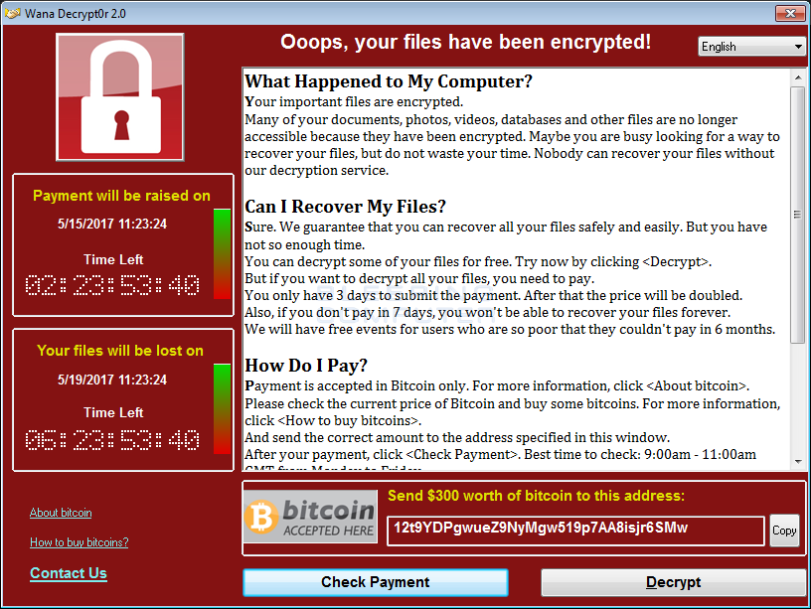
Ransomware is a growing threat
Ransomware damages costed $325 million in 2015 and are predicted to reach $11.5 billion by 2019 [Cybersecurity Ventures, Ransomware Damage Report, November 2017]

Slide 39
Ransomware attacks on cloud services
One big target of ransomware in 2018 will be cloud computing services [MIT Technology Review, Six Cyber Threats to Really Worry About in 2018, January 2018]
Cloudnine’s cloud service was disrupted for several days due to ransomware attacks

Slide 40
Ransomware attacks on cloud services
One big target of ransomware in 2018 will be cloud computing services [MIT Technology Review, Six Cyber Threats to Really Worry About in 2018, January 2018]
The Cerber ransomware targets users of Microsoft’s cloud-based productivity platform

Slide 41
Previous approaches to detect ransomware
Using file encryption as the signature behavior of ransomware
  Entropy of read/write requests, measuring the similarity of two versions of the same file before and after being modified [CryptoDrop, ICDCS’16]
  Entropy of read/write requests, monitoring the desktop to detect the display of a ransom note [ UNVEIL, Usenix Security ’16]
  Calculating the entropy of read/write operations, scanning the memory of suspicious processes for typical block cipher key schedules [ShieldFS, ACSAC’16]
These detection systems are prone to false positives because they rely on detecting file encryption activities

Slide 42
Key idea: Leverage Hardware Performance Counters (HPCs)
HPCs were introduced to profile the performance characteristics of a computer system with little overhead
HPCs are supported by all modern processor platforms
HPCs are capable of collecting a wide range of hardware related events such as cache hits/misses and retired instructions

Slide 43
Key idea: Leverage Hardware Performance Counters (HPCs)
HPCs incur low overhead to the system
HPCs raise the bar for ransomware writers to evade detection
HPCs can be used to detect ransomware

Slide 44
Previous approaches to detect ransomware
Using HPCs to detect malware
  Detect Linux rootkits or Android malware [Demme et.al. ISCA’13]
  Detect malware exploits of Internet Explorer and Adobe PDF Reader [Tang et.al. RAID’14]
  Detect kernel rootkits [Singh et.al. ASIA CCS’17]
Previous HPC-based malware detection systems did not focus on ransomware behaviors

Slide 45
Our solution
Use HPCs to gather measurements of all hardware events in the entire system for different runs of ransomware samples and benign programs
Prototype in a tool called HRD (Hardware-based ransomware detector)
Use machine learning to select the most discriminating events that clearly distinguish ransomware from benign programs

Slide 46
Threat model
Target only user space ransomware
Ransomware can have arbitrary actions such as encrypting documents or erasing users’ files

Slide 47
Experimental Setup
All experiments use an Nginx web server benchmarked with ab (the Apache HTTP server benchmarking tool) as the baseline workload
In each experiment, each ransomware sample or benign program runs along with the baseline workload for 10 minutes
Use a collection of miscellaneous file types such as .doc, .pdf, .txt, .xlsx to serve as the target of ransomware

Slide 48
Workflow
All Performance Events
Ransomware Samples
Traces of Ransomware
Candidate Events
Kernel Driver
Feature Selection
STEP 1
Event Selection

Slide 49
Workflow
Candidate Events
Ransomware Samples and Benign Programs
Training Set Traces
Kernel Driver
STEP 2
Collecting traces of candidate events for the training phase

Slide 50
Workflow
Training Set Traces
Model
Model Learning
Cross
Validation
STEP 3
Training Phase

Slide 51
Workflow
Model
Performance Events
Kernel Driver
Feature Vector Generation
Classification
STEP 4
Deployment Phase

Slide 52
The performance event collection infrastructure
Ransomware and Benign Applications
User Space
Kernel Space
Trace Receiver
Send Event Traces
Kernel Driver
Trace Merger
Traces Formatted as
Feature Vectors
Target Operating System
Disk

Slide 53
Event Selection
STEP 1
There are hundreds of available performance events (205 events of the Haswell microarchitecture)
Select a short list of events whose values are clearly affected before and after the system is infected with ransomware

Slide 54
Event Selection
STEP 1
Measuring all performance events of the system when running 76 ransomware samples
Ransomware Family | Samples
CryptoWall | 9
CTB-Locker | 14
Filecoder | 11
Locky | 15
Reveton | 10
TeslaCrypt | 17

Slide 55
Event Selection
STEP 1
Measuring all performance events of 35 runs of the baseline workload

Slide 56
Event Selection
STEP 1
Each event trace is represented as a feature vector consisting of time series of 205 events of the Haswell architecture
Each time series contains 600 data points since events are counted every one second for a duration of 10 minutes

Slide 57
Event Selection
STEP 1
Each event trace is represented as a feature vector consisting of time series of 205 events of the Haswell architecture
Each time series contains 600 data points since events are counted every one second for a duration of 10 minutes
Each feature vector has ~120,000 features

Slide 58
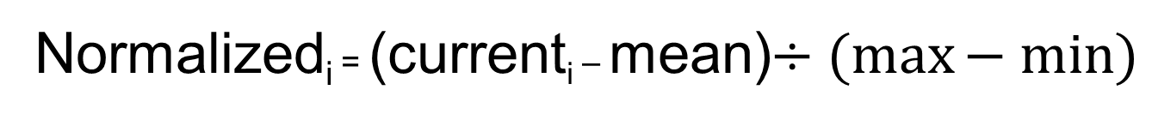
Event Selection
STEP 1
Normalized_{i} = (current_{i} – mean)$÷(\max{− min⁡)}$
Normalizing feature vectors

Slide 59
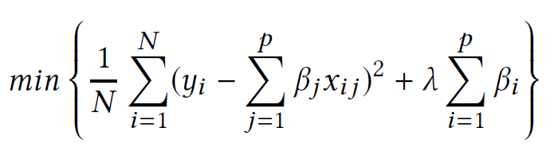
Event Selection
STEP 1
N is the number of observation
P is the number of coefficients
Yi is the response variable
X_{i1},…x_{ip} are the predictor variables
B_{i} are the coefficients
λ is a tunable parameter
Use LASSO for feature selection

Slide 60
Event Selection
STEP 1
Value of λ | Number of selected features | Number of selected events
Lambda.min | 110 | 60
Lambda.1se | 15 | 10
Number of selected features and events by running LASSO with lambda.min and lambda.1se

Slide 61
Event Selection
STEP 1
Value of λ | Number of selected features | Number of selected events
Lambda.min | 110 | 60
Lambda.1se | 15 | 10
Number of selected features and events by running LASSO with lambda.min and lambda.1se

Slide 62
Event Selection
STEP 1
Events | Timestamps | Coefficients
Number of multiply packed/scalar single precision µops allocated | 1 | 0.015461187
Cycles the RS is empty for the thread | 64 | -0.284798598
Qualify conditional near branch instructions executed, but not necessarily retired | 60 62 | 0.274112265 0.094262836
Number of far branch retired | 59 62 | 0.005279482 0.040508429
Number of near branch instructions retired that were taken but mispredicted | 6 | -0.036647073
Number of X87 FP assists due to input values | 96 | -0.047242007
Cycles with any input/output SSE* or FP assists | 74 | -0.027642710
Retired load with locked access | 59 | 0.095108911
Retired load µops that split across a cacheline boundary | 62 72 | -0.044511884 -0.033722482
Retired store µops that split across a cacheline boundary | 35 60 67 | -0.074874024 -0.047379502 -0.016483707
Events selected by running LASSO with lambda.1se

Slide 63
Event Selection
STEP 1
Events | Sum of Coefficients
Qualify conditional near branch instructions executed, but not necessarily retired | 0.368375
Cycles the RS is empty for the thread | 0.284799
Retired store µops that split across a cacheline boundary | 0.138737
Retired load µops with locked access | 0.0951089
Retired load µops that split across a cacheline boundary | 0.0782344
Number of X87 FP assists due to input values | 0.047242
Number of far branches retired | 0.0457879
Number of near branch instructions retired that were taken but mispredicted | 0.0366471
Cycles with any input/output SSE* or FP assists | 0.0276427
Number of multiply packed/scalar single precision µops allocated | 0.0154612
Sum of coefficients of each event

Slide 64
Event Selection
STEP 1
Events | Average of Coefficients
Cycles the RS is empty for the thread | 0.284799
Qualify conditional near branch instructions executed, but not necessarily retired | 0.184188
Retired load μops with locked access | 0.0951089
Number of X87 FP assists due to input values | 0.047242
Retired store μops that split across a cacheline boundary | 0.0462457
Retired load μops that split across a cacheline boundary | 0.0391172
Number of near branch instructions retired that were taken but mispredicted | 0.0366471
Cycles with any input/output SSE* or FP assists | 0.0276427
Number of far branches retired | 0.022894
Number of multiply packed/scalar single precision μops allocated | 0.0154612
Average of coefficients of each event

Slide 65
Event Selection
STEP 1
Events | Number of Coefficients
Retired store μops that split across a cacheline boundary | 3
Qualify conditional near branch instructions executed, but not necessarily retired | 2
Number of far branches retired | 2
Retired load μops that split across a cacheline boundary | 2
Number of multiply packed/scalar single precision μops allocated | 1
Cycles the RS is empty for the thread | 1
Number of near branch instructions retired that were taken but mispredicted | 1
Number of X87 FP assists due to input values | 1
Cycles with any input/output SSE* or FP assists | 1
Retired load μops with locked access | 1
Number of coefficients of each event

Slide 66
Event Selection
STEP 1
Schemes | Naïve Bayes | Logistic Regression | SVM | Random Forest | Neural Networks
1 | 0.978 | 0.935 | 0.882 | 0.981 | 0.984
2 | 0.993 | 0.971 | 0.928 | 0.985 | 0.984
3 | 0.990 | 0.978 | 0.890 | 0.995 | 0.995
Ideal | 1 | 0.992 | 0.958 | 0.997 | 0.999
Area under the ROC curve of five classifiers under different schemes

Slide 67
Collecting traces for the training phase
STEP 2
Ransomware Family | Samples
Crowti | 18
Cryptodefense | 15
Cryptolocker | 31
CryptoWall | 59
CTB-Locker | 76
FileCoder | 61
Locky | 93
Reveton | 129
TeslaCrypt | 136
Tobfy | 23
Virlock | 65
Urausy | 44
Measuring candidate events of the system when running
ransomware samples from VirusTotal

Slide 68
Collecting traces for the training phase
STEP 2
Run each benign program 50 times to obtain 50 traces, then use 80% of these traces for the training phase
IE: browser 23 web pages of various types, some web pages use HTTPS protocol
7-zip: compress and encrypt the same target files
AESCrypt: encrypt the same target files
Measuring candidate events of the system when running
benign programs with ransomware-like behavior

Slide 69
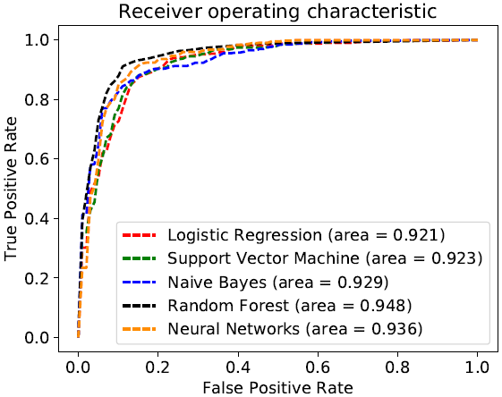
Training phase
STEP 3
Area under the ROC curve of various classifiers built using the second feature selection scheme

Slide 70
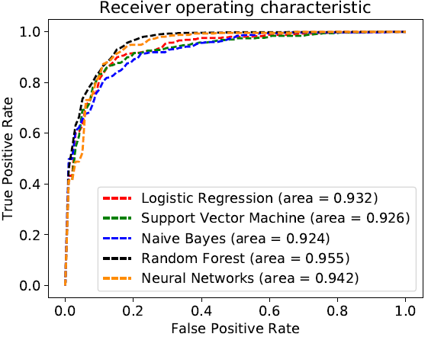
Training phase
STEP 3
Area under the ROC curve of various classifiers built using the third feature selection scheme

Slide 71
Effectiveness Evaluation
Schemes | Ransomware | IE | 7-zip | AESCrypt
2 | 0.820 | 1 | 1 | 0.847
3 | 0.820 | 1 | 1 | 0.873
Accuracy of the random forest model in predicting class labels of different programs

Slide 72
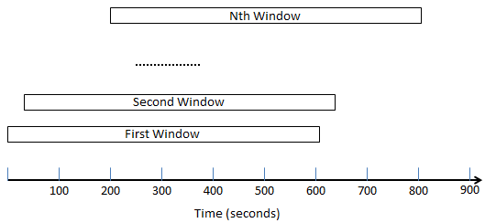
Deployment Phase
STEP 4
The kernel driver keeps measuring the target device’s 4 performance counters every second
Use a sliding window to convert the measurements into feature vectors

Slide 73
Deployment Phase
STEP 4
Apply the model learned in the training phase to classify the feature vectors generated from the sliding windows
Alert the device’s user or administrator if a window is classified as ransomware

Slide 74
Case study: the Wannacry ransomware
Start malicious activities a few seconds after it infects the system
Communicate with its C&C server shortly after it starts encrypting files
Show a pop-up window asking the victim to pay $300 worth of bitcoin to a bitcoin’s address within three days

Slide 75
Case study: the Wannacry ransomware
Schemes | Detection Accuracy
2 | 0.86
3 | 0.94
Accuracy of the random forest model in detecting the WannaCry ransomware

Slide 76
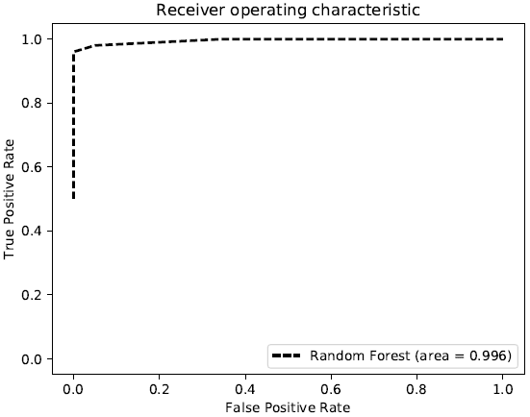
Case study: the Wannacry ransomware
Area under the ROC curve of the random forest classifier in classifying the Wannacry ransomware in the testing set selected using the second scheme

Slide 77
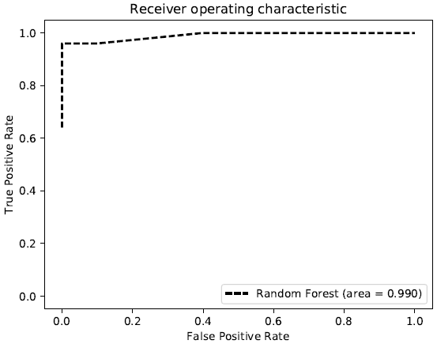
Case study: the Wannacry ransomware
Area under the ROC curve of the random forest classifier in classifying the Wannacry ransomware in the testing set selected using the third scheme

Slide 78
Conclusion
Engarde [ICDCS’17] effectively enforces security policies for various real world application while preserves the security benefits of SGX
HRD [Submitted to ACSAC’18] is able to detect unseen ransomware with high accuracy and is capable of distinguishing ransomware from benign programs with high precision

Slide 79
Acknowledgements
Advisor:
  Prof. Vinod Ganapathy
Committee members:
  Prof. Thu Nguyen, Prof. Abhishek Bhattacharjee, Prof. Trent Jaeger
Co-authors:
  Pratyusa Manadhata, Abhinav Srivastava, Shivaramakrishnan Vaidyanathan
Department of computer science, Rutgers:
  Prof. Liviu Iftode, Prof. Santosh Nagarakatte
Discolab members
  Deayoung Kim, Amruta Gokhale, Shakeel Butt, Rezwana Karim, Nader Boushehrinejadmoradi, Daehan Kwak, Ruilin Liu

Slide 80
Thank you.

Slide 81
Part III: Exploring infrastructure support for app-based services on cloud platforms

Slide 82
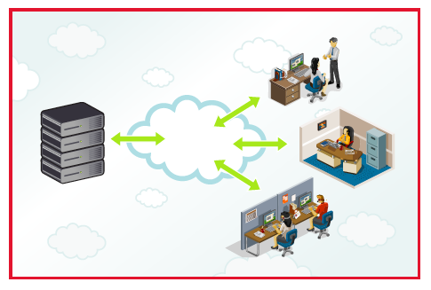
Cloud Platforms
By 2015, 90% of government agencies and large companies will use the cloud [Gartner, “Market Trends: Application Development Software, Worldwide, 2012-2016,” 2012]
The cloud market size is forecast to touch $222 billion by 2015

Slide 83



Cloud Platforms
Management
VM
Work
VM
Work
VM
Hypervisor
I/O
Memory
CPUs
Hardware

Slide 84
Problems
Complicate administrative tasks:
  Client-controlled middleboxes
  System-level services
  Storage services

Slide 85







Problems
I want to deploy some
middleboxes
Proxy
Firewall
Load Balancer
IDS/IPS
VPN Device
Cloud Provider
Client
WAN Optimizer
Middleboxes
Problem #1
Deployment of Middleboxes
Lack of support for introspection services

Slide 86



Problems
I want to deploy some
middleboxes
Outside
Firewall
Load Balancer
Cloud Provider
Client
Webserver
Problem #1
Deployment of Middleboxes
Lack of support for introspection services

Slide 87

Problems
Outside
Only Load Balancing Service
Web
Server 1
Web
Server 1
Amazon EC2
Instance
Amazon EC2
Instance
AWS
Amazon Web Service
Problem #1
Deployment of Middleboxes
Lack of support for introspection services

Slide 88
Possible Solutions
Install all virtual middleboxes in the same VM
As the client's application
Web Server
Performance Degration
Firewall
NIDS
Problem #1
Deployment of Middleboxes
Lack of support for introspection services

Slide 89
Possible Solutions
Manually Configure the network to deploy
middleboxes
Gateway
Manual Efforts
Trouble-shooting
Outside
Firewall
Load Balancer
Webserver
Problem #1
Deployment of Middleboxes
Lack of support for introspection services

Slide 90
Previous Work
Many previous works related to control middleboxes
    CloudNaas [Benson et al, SOCC 2011]
    SIMPLE [Qazi et al, ACM SIGCOMM 2013]
Use Software Defined Networking (SDN) to place virtual middleboxes
Problem #1
Deployment of Middleboxes
Lack of support for introspection services

Slide 91
Problems
I want to run a rootkit
detector
Cloud Provider
Client
Problem #2
Deployment of System-Level Services
Lack of support for introspection services

Slide 92


Rootkit Detection
Management VM
Checking daemon
2
Process the
Page
Rules
Work
VM
?
3
1
Hypervisor
[Patagonix, Usenix Security 2008]
Problem #2
Deployment of System-Level Services
Lack of support for introspection services

Slide 93
Previous Work
Self-Service Cloud Computing
Client's meta-domain
Management
VM
UDom0
Service
VM
Work
VM
Hypervisor
I/O
Memory
CPUs
Hardware
Problem #2
Deployment of System-Level Services
Lack of support for introspection services

Slide 94
Goals
Build a framework that unifies prior work on using VMs to implement cloud based services
Propose a model where clients can download a VM that provides cloud based services
  Cloud appliance or cloud app
Cloud apps can be written by third parties

Slide 95
Main Contributions
A description of an end-to-end ecosystems needed to support cloud apps:
  System-level apps
  Network service apps
  Storage service apps
Exploration of design spaces for the ecosystem
An evaluation of various cloud apps

Slide 96
Threat Model
Three entities: the cloud provider, the client, the cloud apps

Slide 97
Threat Model
The cloud provider is trusted: TPM, IOMMU units
Not aim to protect the client's VMs from malicious cloud administrators
Cloud apps are not trusted:
  Each cloud app must state its required permissions
  Clients examine permissions prior to installing apps
Not aim to protect against side-channel attacks

Slide 98
Taxonomy of Cloud Apps
Network Services
System-Level Services
Storage Services
Hybrid Services

Slide 99
Outline
Threat Model
The Platform Design
Evaluation
Conclusion

Slide 100
The CloudApp Platform
App Composition Specification
Manifest
File
Policy Specification
Permission Checking
Identity of a
Bundled App
Permission
Module
Policy
Generator
App Composition
Module
Decision
Sequence of
Cloud Apps
System Service Policy
Middlebox Policy
Cloud App
Client's
VM
System Service
Composer
Middlebox
Composer
OpenFlow
Controller
Hypercalls
System Service
Policy
Permission Checking
Hypervisor
System Service
Module
System Service
Policy Module
Decision

Slide 101
The CloudApp Platform
App Composition Specification
Manifest
File
Policy Specification
Permission Checking
Identity of a
Bundled App
Permission
Module
Policy
Generator
App Composition
Module
Decision
Sequence of
Cloud Apps
System Service Policy
Middlebox Policy
System Service
Composer
Middlebox
Composer
OpenFlow
Controller

Slide 102
Permission Module
App Composition Specification
Manifest
File
Policy Specification
Permission Checking
Identity of a
Bundled App
Permission
Module
Policy
Generator
App Composition
Module
Decision
Sequence of
Cloud Apps
System Service Policy
Middlebox Policy
Cloud App
Client's
VM
System Service
Composer
Middlebox
Composer
OpenFlow
Controller
Hypercalls
System Service
Policy
Permission Checking
Hypervisor
System Service
Module
System Service
Policy Module
Decision

Slide 103

Permission
Examine the manifest
Manifest
File
Permission
Module
Cloud App
Permissions | Description
Kernel Memory | Access kernel memory of the client's VM
User Space Memory | Access user space memory of the client's VM
Network Middlebox | Intercept network packets to/from the client's VM
Storage Service | Intercept storage stream read/written by the client's VM

Slide 104
Policies
Policy Specification
App Composition Specification
Manifest
File
Permission Checking
Identity of a
Bundled App
Permission
Module
Policy
Generator
App Composition
Module
Decision
Sequence of
Cloud Apps
System Service Policy
Middlebox Policy
Cloud App
Client's
VM
System Service
Composer
Middlebox
Composer
OpenFlow
Controller
Hypercalls
System Service
Policy
Permission Checking
Hypervisor
System Service
Module
System Service
Policy Module
Decision

Slide 105
Policies
A policy is a set of rules to steer data flows between cloud apps:
  Network Packets
  Memory Pages
Memory
Pages
Network
Packets
M₁
M₂
M_{n}
Client's
VM

Slide 106
Policies
C → [M₁,M₂,...,M_{n}], where C is a policy class and M₁,M₂,...,M_{n} are sequence of cloud apps
System-level service: C = Identity of the client's VM
Network and storage traffic: C = IP 5-tuple <source IP, destination IP, source port, destination port, protocol>
Data Flows
M₁
M₂
M_{n}
Client's
VM

Slide 107
Policies
<Any, Any, IP of WebServer, Port of WebServer, TCP>
Data Flows
M₁
M₂
M_{n}
Client's
VM

Slide 108
Middlebox Composer
App Composition Specification
Manifest
File
Policy Specification
Permission Checking
Identity of a
Bundled App
Permission
Module
Policy
Generator
App Composition
Module
Decision
Sequence of
Cloud Apps
System Service Policy
Middlebox Policy
Cloud App
Client's
VM
System Service
Composer
Middlebox
Composer
OpenFlow
Controller
Hypercalls
System Service
Policy
Permission Checking
Hypervisor
System Service
Module
System Service
Policy Module
Decision

Slide 109
Network Middlebox Composition
OpenFlow
Controller
Direct packets
Between switches
Define Network Flows
Modify packets'
headers
Tunnel packets
SDN
switch

Slide 110



Network Middlebox Composition
Firewall
Web
server
NIDS
In
SW3
SW2
SW1
Policy: C → [Firewall → NIDS → Web Server]
Where C = <srcIP = external prefixes, dst IP = IP of the web server, src port = any, dst port = 80, protocol = TCP>

Slide 111
Network Middlebox Composition
Firewall
Web
server
NIDS
In
SW3
SW2
SW1
Tag packets
Ambiguity: Forward
To Firewall or SW1?
Policy: C → [Firewall → NIDS → Web Server]
Where C = <srcIP = external prefixes, dst IP = IP of the web server, src port = any, dst port = 80, protocol = TCP>

Slide 112
Network Middlebox Composition
Firewall
Web
server
NIDS
In
NIDS
FW
SW3
SW2
SW1
Policy: C → [Firewall → NIDS → Web Server]
Where C = <srcIP = external prefixes, dst IP = IP of the web server, src port = any, dst port = 80, protocol = TCP>

Slide 113
Network Middlebox Composition
Firewall
Web
server
NIDS
In
SW3
SW2
SW1
Policy Class | In | Tag ID | Out | Tag
C | In | - | SW2 | -
C | SW2 | 1 (FW) | NIDS | -
C | NIDS | - | SW2 | 2 (NIDS)
Policy Class | In | Tag ID | Out | Tag
C | SW3 | - | FW | -
C | FW | - | SW3 | 1 (FW)
C | SW3 | 2 (NIDS) | SW1 | -
Policy Class | In | Tag ID | Out | Tag
C | SW2 | - | Web Server | -
Policy: C → [Firewall → NIDS → Web Server]
Where C = <srcIP = external prefixes, dst IP = IP of the web server, src port = any, dst port = 80, protocol = TCP>

Slide 114
System-Level Service
Components
App Composition Specification
Manifest
File
Policy Specification
Permission Checking
Identity of a
Bundled App
Permission
Module
Policy
Generator
App Composition
Module
Decision
Sequence of
Cloud Apps
System Service Policy
Middlebox Policy
Cloud App
Client's
VM
System Service
Composer
Middlebox
Composer
OpenFlow
Controller
Hypercalls
System Service
Policy
Permission Checking
Hypervisor
System Service
Module
System Service
Policy Module
Decision

Slide 115
System-Level Service
Management
VM
Client's VM
Memory
Pages
Memory Mapping
Hypervisor

Slide 116

System-Level Service
Management
VM
Client's VM
Memory
Pages
Memory Mapping
Hypervisor

Slide 117
System-Level Service
Cloud App
Client's VM
Memory
Pages
Hypercalls
System Service
Module
Hypervisor
Design I

Slide 118
System-Level Service
Cloud App
Client's VM
Cloud App
Management
VM
Memory
Pages
Memory Mapping
Hypervisor (L1)
Hypervisor (L0)
Design II

Slide 119
System Service Policies
Memory
Pages
M₁
M₂
M_{n}
Client's
VM

Slide 120
System Service Policies
Memory
Checkpointing
App
Rootkit
Detector
Client's
VM
3
4
2
1
System Service
Policy Module
Hypervisor

Slide 121
Storage Service
Virtual
Disk
I/O Stream
I/O Stream
Cloud App
Client's VM
Hypervisor

Slide 122
Storage Service
Management
VM
Cloud App
Client's VM
Back-end
Block
Device
Back-end
Block
Device
Encryption
Back-end
Block
Device
Front-end
Block
Device
Decryption
Hypervisor
Design I

Slide 123
Storage Service
Virtual
Disk
MiddleBox
I/O Stream
Cloud App
Client's VM
NFS
Server
NFS
Client
Network Traffic
Hypervisor
Design II

Slide 124
Composition of Cloud Apps
App Composition Specification
Manifest
File
Policy Specification
Permission Checking
Identity of a
Bundled App
Permission
Module
Policy
Generator
App Composition
Module
Decision
Sequence of
Cloud Apps
System Service Policy
Middlebox Policy
Cloud App
Client's
VM
System Service
Composer
Middlebox
Composer
OpenFlow
Controller
Hypercalls
System Service
Policy
Permission Checking
Hypervisor
System Service
Module
System Service
Policy Module
Decision

Slide 125
Prototype
Modify KVM hypervisor 3.12.8
Use Floodlight as the OpenFlow controller

Slide 126
Evaluation
Goals
  Measure the overhead introduced by the cloud app model
Conduct experiments for each class of services
Three physical machines in the same LAN
  Intel Core i7, 8GB of memory, Intel Gigabit NIC
  Intel Xeon(R), 24 GB of memory, two NetXtreme BCM5722 Gigabit Ethernet cards
  Measurement host: Intel core i5, 4 GB of memory

Slide 127
System-Level Services
Cloud App
Checking daemon
2
Process the
Page
Rules
Web Server
?
3
1
Hypervisor

Slide 128
System-Level Services
Running Time of SPEC CINT under the three setups

Slide 129
Network Middlebox Services
Measurement
Host
Network Traffic
NIDS
Network Traffic
Web Server
Physical Machine 1
Physical Machine 2
Same Host Setup

Slide 130
Network Middlebox Services
Measurement
Host
Network Traffic
NIDS
Network Traffic
Web Server
Physical Machine 1
Physical Machine 2
Physical Machine 3
Different Host Setup

Slide 131
Network Middlebox Services
Setup | Throughput (Mbps) | RTT (ms)
Traditional | 93.87 | 0.713
Cloud App | 90.64 | 1.631
Baseline overhead of networked services SAMEHOST configuration
Setup | Throughput (Mbps) | RTT (ms)
Traditional | 90.12 | 1.68
Cloud App | 86.44 | 2.281
Baseline overhead of networked services DIFFHOST configuration

Slide 132
Network Middlebox Services
Setup | Throughput (Mbps) | RTT (ms)
Traditional | 91.58 | 0.980
Cloud App | 87.15 | 1.871
Overhead of the NIDS app
SAMEHOST configuration
Setup | Throughput (Mbps) | RTT (ms)
Traditional | 88.36 | 1.92
Cloud App | 83.37 | 2.58
Overhead of the NIDS app
DIFFHOST configuration

Slide 133
Storage Service
SDIS
Network Traffic
Client's VM
NFS
Server
NFS
Client
Physical Machine 2
Same Host Setup

Slide 134
Storage Service
SDIS
Network Traffic
Client's VM
NFS
Server
NFS
Client
Physical Machine 2
Physical Machine 3
Different Host Setup

Slide 135
Storage Services
Setup | Throughput | Time
Traditional | 89.1 | 45.15
Cloud App | 84.7 | 47.22
Baseline Overhead
Setup | Throughput | Time
Cloud App | 86.3 | 46.34
Overhead - SAMEHOST configuration
Setup | Throughput | Time
Cloud App | 82.13 | 48.5
Overhead - DIFFHOST configuration

