Slide 1
New Pattern Matching Algorithms for Network Security Applications
Liu Yang
Department of Computer Science
Rutgers University
April 4th, 2013
Notes:
Good morning everybody. Welcome to attend my thesis defense. Today I am going to present “New Pattern Matching Algorithms for Network Security Applications”.

Slide 2
Intrusion Detection Systems (IDS)
Intrusion detection
Host-based
Network-based
Anomaly-based
Signature-based
(statistics …)
(using patterns to describe malicious traffic)
Example signature¹:
alert tcp $EXTERNAL_NET any -> $HTTP_SERVERS …; pcre:“/username=[^&\x3b\r\n]{255}/si”; …
This is an example signature from Snort, an network-based intrusion detection system (NIDS)
Notes:
Modern computer and network systems rely on intrusion detection systems for security. Intrusion detection systems can be broadly categorized as host-based and network-based. Network-based IDS can be further categorized as anomaly-based and signature-based. Signature-based IDS employ patterns to describe the features of malicious traffic, called signatures. Here is an example signature from Snort, a commercial network-based IDS. The blue color part shows a pattern which will match network packets containing a string in the form of “username=” followed by 255 characters.

Slide 3


Network-based Intrusion Detection Systems
Pattern matching: detecting malicious traffic
patterns
…
= { /.*evil.*/}
…
Network traffic
NIDS
..evil..
innocent
Alerts
Network intrusion detection systems (NIDS) employ regular expressions to represent attack signatures.
Notes:
This figure demonstrates how NIDS perform deep packet inspection by matching network contents against known patterns of malicious traffic. In this figure, the pattern database has one pattern “.*evil”. Packets which do not contain the string “evil” will be allowed to pass, while packets containing string “evil” will be considered as malicious. Patterns used in real systems are more complicated.

Slide 4
Ideal of Pattern Matching
Time efficient
fast to keep up with network speed, e.g., Gbps
Space efficient
compact to fit into main memory
Notes:
Ideally, pattern matching in network security applications should meet two requirements: time efficiency and space efficiency. Since network applications are often deployed over high-speed network links, time efficiency requires the time spent on processing each byte of data to be small to keep up with the giga-bit speed of packet processing. Space efficiency requires that pattern representation should fit into the main memory of a NIDS.

Slide 5
The Reality: Time-space Tradeoff
Deterministic Finite Automata (DFAs)
Fast in operation
Consuming large space
Nondeterministic Finite Automata (NFAs)
Space efficient
Slow in operation
Recursive backtracking (implemented by PCRE, Java, etc)
Fast in general
Extremely slow for certain types of patterns
Notes:
Unfortunately, pattern matching in reality suffers from a time-space tradeoff. There are three prior approaches for pattern matching: DFA-based, NFA-based, and recursive backtracking-based approaches. DFAs are fast in operation, but suffer from space blow-up. NFAs are space efficient, but are slow in operation because an NFA can be simultaneously at multiple states at any instant. Recursive backtracking approaches are fast in general, but can be extremely slow for certain patterns.

Slide 6
The Reality: Time-space Tradeoff
Backtracking (under algorithmic complexity attacks)
NFA (non-deterministic finite automaton)
Time
My contribution
Backtracking (with benign patterns)
DFA (deterministic finite automaton)
Ideal
Space
Notes:
The time-space tradeoff of different approaches can be shown by this figure, where the x-axis denotes space, and y-axis denotes time. An ideal solution should be close to the origin of the coordinate system. As we can see, none of the prior approaches can be considered as ideal. The main contribution of this dissertation is: finding approaches that are close to the ideal.

Slide 7
Overview of My Thesis
Three types of patterns
…
“.*<embed[^>]*javascript
^file\x3a\x2f\x2f[^\n]{400}”
…
Regular expressions
NFA-OBDD [RAID’10, COMNET’11]
Regular expressions +submatch extraction
…
“.*? address (\d+\.\d+\.\d+\.\d+), resolved by (\d+\.\d+\.\d+\.\d+)”
…
Submatch-OBDD [ANCS’12]
…
“.*(NLSessionS[^=\s]*)\s*=\s*\x3B.*\1\s*=[^\s\x3B]”
…
Regular expressions +back references
NFA-backref [to submit]
Notes:
In this talk, I am going to present several new algorithms on pattern matching. In the first part, I will discuss regular expressions, which are patterns recognizable by regular languages. For that, I will present NFA-OBDD, a time and space efficient data structure for regular expressions. In the second part, I will present an extension of NFA-OBDD to model submatch extraction, an important feature in real-world patterns used by network security applications. Lastly, I will discuss patterns extended with back references, which are non-regular languages. I will present NFA-backref, an efficient matching algorithm for patterns with back references.

Slide 8
Main Contribution
Algorithms for time and space efficient pattern matching
NFA-OBDD
space efficient (60MB memory for 1500+ patterns)
1000x faster than NFAs
Submatch-OBDD:
space efficient
10x faster than PCRE and Google’s RE2
NFA-backref:
space efficient
resisting known algorithmic attacks (1000x faster than PCRE for certain types of patterns)
Notes:
I am going to show you that: (1) NFA-OBDD is capable of representing 1500 real-world patterns by 60MB memory, and it is 3 orders of magnitude faster than NFAs. (2) Submatch-OBDD is one order of magnitude faster than PCRE and Google’s RE2. (3) NFA-backref is three orders of magnitude faster than PCRE for certain types of patterns.

Slide 9
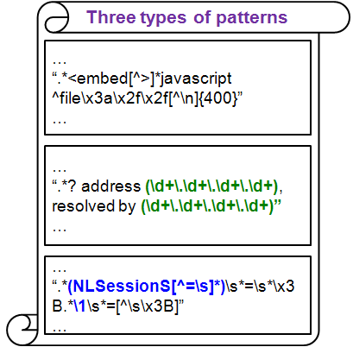
Part I: NFA-OBDD: A Time and Space Efficient Data Structure for Regular Expression Matching
Joint work with R. Karim, V. Ganapathy, and R. Smith
[RAID’10, COMNET’11]
Notes:
Now let’s start from NFA-OBDD. This is a joint work with Rezwana, Vinod, and Randy.

Slide 10
Finite Automata
Regular expressions and finite automata are equally expressive
Regular expressions
NFAs
DFAs
Notes:
Finite automata are natural representations for regular expressions. This figure shows that regular expressions, NFAs, and DFAs are equivalent in terms of expressive power. (A regular expression can be converted to an NFA using Thompson’s algorithm. An NFA can be converted to a DFA using the subset construction approach, and a DFA can be converted to a regular expressions.) Therefore, regular expression matching can be performed by operating the corresponding DFAs or NFAs.

Slide 11
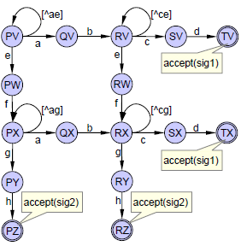
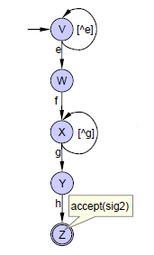
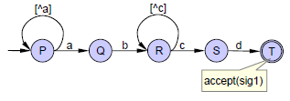
Why not DFA?
Combining DFAs: Multiplicative increase in number of states
“.*ab.*cd”
“.*ef.*gh”
“.*ab.*cd | .*ef.*gh”
Picture courtesy : [Smith et al. Oakland’08]
Notes:
Unfortunately, DFA is not a good choice due to three reasons. First, combining DFAs results in multiplicative increase in number of states. In this figure, the left side shows the DFAs of two regular expressions, and the right side shows the DFA combined from the two DFAs on the left. The individual DFAs on the left have 5 states in each, while the combined DFA has 16 states.

Slide 12
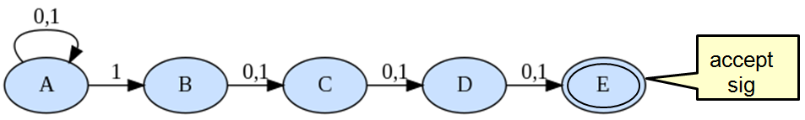
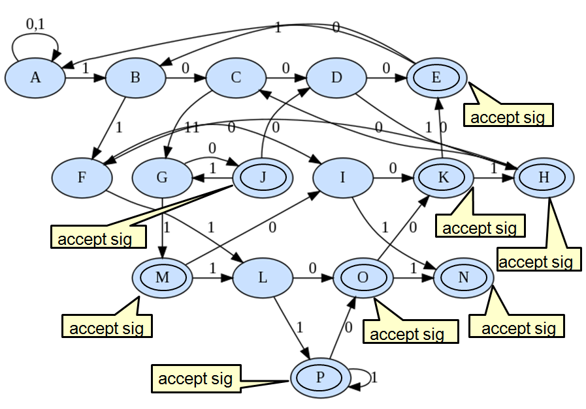
Why not DFA? (cont.)
State explosion may happen
NFA
Pattern:
“.*1[0|1] {3} ”
DFA
State explosion
n →O(2^n)
The value of quantifier n is up to 255 in Snort
Notes:
Second, the DFA construction of certain regular expressions suffers from state blow-up. For the example regular expression .*1[0|1]{3} in this slide, the NFA has 5 states, while the DFA has 16 states. In fact, the size of DFAs for such patterns is exponential to the value of quantifiers. In snort, the value of quantifier n can be up to 255, making the DFA construction infeasible.

Slide 13
Pattern Set Grows Fast
Snort rule set grows 7x in 8 years
Notes:
And lastly, pattern sets in real systems grow quickly. This figure shows that the rule set of Snort increased by 7x in the recent 8 years.

Slide 14
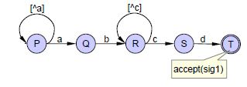
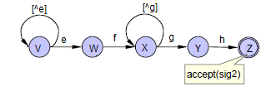
Space-efficiency of NFAs
Combining NFAs: Additive increase in number of states
M
N
“.*ab.*cd”
“.*ef.*gh”
“.*ab.*cd | .*ef.*gh”
Notes:
On the other side, combining NFAs only results in an additive increase in number of states. As is shown in this figure, combining two NFAs only needs to create a new start state and a new accept state, and add fourth epsilon transitions.

Slide 15
NFAs are Slow
NFA frontiers¹ may contain multiple states
Frontier update may require multiple transition table lookups
1. A frontier set is a set of states where NFA can be at any instant.
Notes:
However, NFAs are slow in operation, because an NFA can be simultaneously in multiple states, called frontier set, at any instant. The frontier update of an NFA often requires multiple table lookups.

Slide 16
NFAs of Regular Expressions
Example: regex=“a*aa”
a
a
a
1
2
3
Current state (x) | Input symbol (i) | Next state (y)
1 | a | 1
1 | a | 2
2 | a | 3
Transition table T(x,i,y)
Notes:
This slide shows an example regular expression “a*aa”, the corresponding NFA, and its transition table. The transition table has three columns, denoting the current state, input symbol, and next state respectively.

Slide 17
NFA Frontier Update: Multiple Lookups
regex=“a*aa”; input=“aaaa”
1
2
3
Accept
aaaa
aaaa
aaaa
aaaa
Frontier
{1}
{1,2}
{1,2,3}
{1,2,3}
{1,2,3}
Notes:
For the example NFA with input string “aaaa”, the pattern matching can be performed in the following way:
Starting from the start state {1}, with the first input symbol a, we can get the next states {1, 2} by looking up the transition table. Using {1, 2} as current frontier, with the second input symbol, we can get the next frontier set {1, 2, 3}. Continue in this way. After processing the last symbol, we can see that the input string is accepted by the NFA. It can be observed that each frontier update requires multiple table lookups. That why NFAs are slow. A question is: can we make NFAs faster?

Slide 18
Can We Make NFAs Faster?
regex=“a*aa”; input=“aaaa”
1
2
3
Accept
aaaa
aaaa
aaaa
aaaa
Frontier
{1}
{1,2}
{1,2,3}
{1,2,3}
{1,2,3}
Idea: Update frontiers in ONE step
Notes:
The idea is: updating the frontier set in one step, like this. But how?

Slide 19
NFA-OBDD: Main Idea
Represent and operate NFA frontiers symbolically using Boolean functions
Update the frontiers in ONE step: using a single Boolean formula
Use ordered binary decision diagrams (OBDDs) to represent and operate Boolean formula
Notes:
For that, I present the NFA-OBDD model. The key idea is: using Boolean functions to represent NFAs, and employing ordered binary decision diagrams (OBDD)s to improve the efficiency of Boolean operations.

Slide 20
Transitions as Boolean Functions
regex=“a*aa”
Current state (x) | Input symbol (i) | Next state (y)
1 | a | 1
1 | a | 2
2 | a | 3
(1 Λ a Λ 1)
V (1 Λ a Λ 2)
V (2 Λ a Λ 3)
T(x,i,y) =
Notes:
Let me demonstrate the idea using the same example. The transition table of an NFA can be represented by a Boolean function. An individual transition can be expressed as a conjunction of current state, input symbol, and next state. The transition function is a disjunction of all individual transitions.

Slide 21
Match Test using Boolean Functions
{1} Λ a Λ T(x,i,y)
(1ΛaΛ 1 )
V (1ΛaΛ 2 )
aaaa
Input symbol
Start states
Transition relation
Next states
(1ΛaΛ 1)
V (1ΛaΛ 2)
V (2ΛaΛ 3)
aaaa
{1,2} Λ a Λ T(x,i,y)
Current states
aaaa
(1ΛaΛ 1)
V (1ΛaΛ 2)
V (2ΛaΛ 3)
…
{1,2,3} Λ a Λ T(x,i,y)
Accept
Notes:
The NFA-based pattern matching process can be expressed by Boolean operations as well.
For the example NFA with input string “aaaa”, starting from the start state {1} with the first symbol a, the next set of states can be obtained by doing a conjunction of current state {1}, input a, and transition function T(x, i, y). Such an operation selects transitions with current state 1 and input symbol a from T(x,i,y). The selected transitions will generate the next set of states {1, 2}. Using {1, 2} as the current frontier set, do conjunctions with the second input symbol a and transition function T(x, i, y), we can get the next set of states {1,2,3}. Continue this way. After processing the last input symbol, we see that the input string is accepted by the NFA.

Slide 22
NFA Operations using Boolean Functions
Frontier derivation: finding new frontiers after processing one input symbol:
Next frontiers =
Checking acceptance:
Notes:
The pattern matching process in the last slide can be summarized by the Boolean formula in this slide. The next frontier set can be obtained by a conjunction of current state, input symbol, and transition function, followed by an existential quantification and variable mapping. To check whether an NFA is in an accept state, just check whether the intersection between accept states and the frontier set is empty.

Slide 23
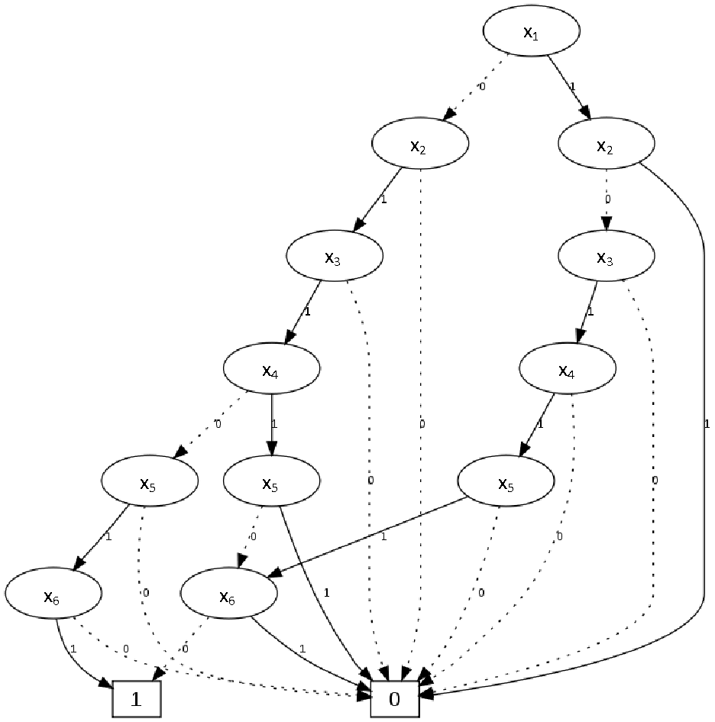
Ordered Binary Decision Diagram (OBDD) [Bryant 1986]
OBDDs: Compact representation of Boolean functions
x₁ | x₂ | x₃ | x₄ | x₅ | x₆ | F(x)
0 | 1 | 1 | 0 | 1 | 1 | 1
0 | 1 | 1 | 1 | 0 | 0 | 1
1 | 0 | 1 | 1 | 1 | 0 | 1
Notes:
To improve the efficiency of Boolean operations, we employ a data structure, called OBDD, which was proposed by Bryant in 1986. An OBDD is a graph representation of a Boolean function. The left side of the slide is a Boolean function F(x) and its function table. The right side shows the OBDD of this Boolean function F(x) with variable order of x1<x2< …<x6.
OBDDs have been widely used in model checking to deal with state explosion problem. The use of OBDDs often remove the redundant relation of a finite state machine. That in turn, improves the efficiency of Boolean operations. The cost of OBDD operations such as APPLY and RESTRICT is proportional to the number of nodes of the operand OBDDs. SATIFIABILITY using OBDDs takes constant time.

Slide 24
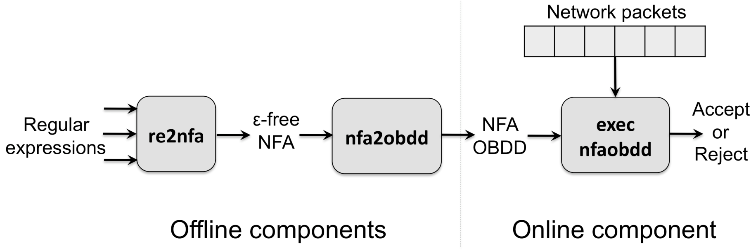
Experimental Toolchain
C++ and CUDD package for OBDDs
Notes:
To evaluate the performance of our approach, we implemented NFA-OBDD as a toolchain in C++. The C++ implementation interfaces with the CUDD package for OBDD construction and operations. CUDD is a widely used package for BDD construction and manipulation. The toolchain has three components. The first component reads regular expressions as input, and outputs the NFAs of the regular expressions. The NFAs are fed into the second component nfa2obdd, which constructs the OBDD representations of the NFAs. The third component, exec-nfaobdd loads the constructed OBDDs into memory, and matches them against a stream of network packets.

Slide 25
Regular Expression Sets
Snort HTTP signature set
1503 regular expressions from March 2007
2612 regular expressions from October 2009
Snort FTP signature set
98 regular expressions from October 2009
Extracted regular expressions from pcre and uricontent fields of signatures
Notes:
We used three sets of real-world patterns for experimentation. The first two pattern sets includes 1503 and 2612 regular expressions extracted from the HTTP rule sets of Snort 2007 and 2009; and the third pattern set includes 98 regular expressions from the FTP rule set in Snort 2009.

Slide 26
Traffic Traces
HTTP traces
Rutgers datasets
33 traces, size ranges: 5.1MB –1.24 GB
One week period in Aug 2009 from Web server of the CS department at Rutgers
DARPA 1999 datasets (11.7GB)
FTP traces
2 FTP traces
Size: 19.4MB, 24.7 MB
Two weeks period in March 2010 from FTP server of the CS department at Rutgers
Notes:
We evaluate the performance of NFA-OBDD using real-world traffic traces. The traces include HTTP and FTP traffic collected from the CS department and HTTP traces downloaded from the DARPA’99 datasets.

Slide 27
Experimental Results
For 1503 regexes from HTTP Signatures
10x
1645x
9-26x
*Intel Core2 Duo E7500, 2.93GHz; Linux-2.6; 2GB RAM*
Notes:
This figure shows the performance data of different approaches for the 1503 regular expression set. The x-axis denotes the execution time in unit of cycle/byte. The y-axis denotes the memory consumption in unit of MB. We have the following observations: First, NFA-OBDD is three orders of magnitude faster than a traditional NFA implementation, with comparable memory consumption. Second, NFA-OBDD is one order of magnitude faster than PCRE. Third, NFA-OBDD is competitive to the slowest MDFA. The fastest MDFA is 10x faster than NFA-OBDD, but consumes 5x amount of memory. For other regular expression sets, we had the similar observation. Aside from that, we observed that the MDFA implementation run out of memory for the 2612 regular expression set.

Slide 28
Summary
NFA-OBDD is time and space efficient
Outperforms NFAs by three orders of magnitude, retaining space efficiency of NFAs
Outperforms or competitive with the PCRE package
Competitive with variants of DFAs but drastically less memory-intensive
Notes:
Now I briefly summarize what I have presented so far. NFA-OBDD is a time and space efficient data structure for regular expression matching. It has three benefits. First, it outperforms NFAs by three orders of magnitude, while retaining the space efficiency of NFAs. Second, it outperforms or is competitive with the PCRE package. Third, it is competitive with variants of DFAs but consumes much less memory.

Slide 29
Part II: Extension of NFA-OBDD to Model Submatch Extraction [ANCS’12]
Joint work with P. Manadhata, W. Horne, P. Rao, and V. Ganapathy
Notes:
Having presented NFA-OBDD, now I am going to move to a more general case: regular expressions extended with submatch extraction, which is an important feature in real-world patterns used by network security applications. I will present an extension of NFA-OBDD to model submatch extraction.

Slide 30

Submatch Extraction
Extract information of interest when finding a match
…
“.*? address (\d+\.\d+\.\d+\.\d+), resolved by (\d+\.\d+\.\d+\.\d+)”
…
host address 128.6.60.45
resolved by 128.6.1.1
Submatch extraction
$1 = 128.6.60.45
$2 = 128.6.1.1
Notes:
Submatch extraction is used to extract information of interest.
The left side of this slide shows a rule dot star followed by “address” followed by a capturing group, followed by resolved by, followed by a second capturing group. The two pairs of parenthesis are used to capture substrings which match the sub-expressions within the parenthesis. A string on the right side will match the pattern on the left. The two substrings which match the two capturing groups are the two IP addresses. The process of finding such substrings is called submatch extraction.

Slide 31
Submatch Tagging: Tagged NFAs
E = (a*)aa
Tag(E) = (a*)_{t} aa
₁
Tagged NFA of “(a*)aa” with submatch tagging t₁
a/t₁
a
a
1
2
3
Current state (x) | Input symbol (i) | Next state (y) | Output tags (t)
1 | a | 1 | {t₁}
1 | a | 2 | {}
2 | a | 3 | {}
Transition table T(x,i,y,t) of the tagged NFA
Notes:
My approach to address submatch extraction is by tagging. For a pattern containing capturing groups, we can construct a NFA-like machine, called tagged-NFA, using a Thompson-like algorithm. For the example regex, we use tag t1 to denote the first capturing group. The tagged-NFA of the example pattern is shown in the slide. Transitions within a capturing group is tagged by t1. A transition table of a tagged-NFA has four columns, where the first three columns denote transitions and the fourth column denotes tags associated with corresponding transitions. For transitions which are not in capturing groups, no tag is associated with them.

Slide 32
Match Test
RE=“(a*)aa”; Input = “aaaa”
{t₁}
{t₁}
{t₁}
{t₁}
1
2
3
Accept
aaaa
aaaa
aaaa
aaaa
Frontier
{1}
{1,2}
{1,2,3}
{1,2,3}
{1,2,3}
Notes:
To test whether an input string matches a pattern, we can operate the tagged-NFA according to its transition table. For the example pattern, with input string aaaa, we can do the following:
Starting from the start state {1}, with the first input symbol a, we can get the next states {1, 2}, where the transition from 1 to 1 outputs tag t1, and the transition from 1 to 2 has no output tag. Using the same method, we can process the second, third, and fourth symbols and find out that the input string is accepted by the tagged-NFA. It can be observed that some transitions are associated with tag t1.

Slide 33
Submatch Extraction
{t₁}
{t₁}
{t₁}
{t₁}
1
2
3
accept
aaaa
aaaa
aaaa
aaaa
$1=aa
Frontier
{1}
{1,2}
{1,2,3}
{1,2,3}
{1,2,3}
Any path from an accept state to a start state generates a valid assignment of submatches.
Notes:
When an input string is accepted, we need to find out the submatches. We claim that “any path from an accept state to a start state during the match test generates a valid assignment of submatches”. The red arrows in the above figure shows such a path. We see that the first two transition edges are associated with tag t1. This tells us that the first two characters in the input string is a valid submatch. We denote the first submatch as $1, i.e., $1=aa. For reasons of why, see our explanation in the paper.

Slide 34
Submatch-OBDD
Representing tagged NFAs using Boolean functions
Updating frontiers using Boolean formula
Finding a submatch path using Boolean operations
Using OBDDs to manipulate Boolean functions
Notes:
Similar to what I did in NFA-OBDD, I employ Boolean functions to represent the process of submatch extraction, and use OBDDs to represent and manipulate the Boolean operations. I call this extension of NFA-OBDD as Submatch-OBDD.

Slide 35
Boolean Representation of Submatch Extraction
A back traversal approach: starting from the last input symbol.
Submatch extraction: the last consecutive sequence of symbols that are assigned with same tags
Notes:
The submatch extraction process can be summarized by Boolean formula shown in this slide. This slide seems complex, the only thing you need to remember is that it shows how to find a path using Boolean operations. (The basic idea here is to find a path from an accept state to a start state. After that, the submatch extraction is to collect the last consecutive sequence of symbols that are assigned with same tags.)

Slide 36
Overview of Toolchain
Toolchain in C++, interfacing with the CUDD*
input stream
Tagged
NFAs
regexes with capturing groups
re2tnfa
tnfa2obdd
OBDDs
pattern
matching
rejected
matched
submatches $1 = …
Notes:
To evaluate the performance of my approach, I implemented Submatch-OBDD as a toolchain in C++. The toolchain has similar structure as our NFA-OBDD implementation, except that it supports tagged NFAs and submatch extraction.
(The C++ implementation interfaces with the CUDD package for OBDD construction and manipulation.) The implementation has three components. The green colored fonts show the extension of this toolchain above NFA-OBDD. The first component reads regular expressions with capturing groups and constructs tagged-NFAs for them. The tagged-NFAs are input to the second component tnfa2obdd, which constructs the OBDD representation of the tagged-NFAs. The third component loads the constructed OBDDs and matches them against an input stream of strings. Submatches are output if there are any.

Slide 37
Experimental Datasets
Snort-2009
Patterns: 115 regexes with capturing groups from HTTP rules
Traces: 1.2GB CS department network traffic; 1.3GB Twitter traffic; 1MB synthetic trace
Snort-2012
Patterns: 403 regexes with capturing groups from HTTP rules
Traces: 1.2GB CS department network traffic; 1.3GB Twitter traffic; 1MB synthetic trace
Firewall-504
Patterns: 504 patterns from a commercial firewall F
Trace: 87MB of firewall logs (average line size 87 bytes)
Notes:
Our experimental datasets includes three sets of patterns. The first patterns set include 115 regular expressions with capturing groups from the Snort 2009 rule set. The second pattern set include 403 regular expressions with capturing groups from Snort 2012. The third pattern set includes 504 patterns from a commercial firewall.

Slide 38
Experimental Setup
Platform: Intel Core2 Duo E7500, Linux-2.6.3, 2GB RAM
Two configurations on pattern matching
Conf.S
patterns compiled individually
compiled pattern matched sequentially against input traces
Conf.C
patterns combined with UNION and compiled
combined pattern matched against input traces
Notes:
I test the performance of Submatch-OBDD under two configurations. In the first configuration, patterns are compiled individually and matched sequentially against input traces. In the second configuration, patterns in a data set are combined into one big pattern using the UNION operation. The combined pattern is matched against the input traces.

Slide 39
Experimental Results: Snort-2009
Submatch-OBDD is one order of magnitude faster than RE2 and PCRE
execution time (cycle/byte)
10x
Execution time (cycle/byte) of different implementations
Memory consumption: RE2 (7.3MB), PCRE (1.2MB), Submatch-OBDD (9.4MB)
Notes:
This slide shows the performance of different approaches for the Snort-2009 data set. It can be observed that Submatch-OBDD achieves its ideal performance when patterns are combined, in which Submatch-OBDD is an order of magnitude faster than PCRE and RE2. For memory consumption, Submatch-OBDD is comparable to RE2. PCRE consumes the least memory. For other data sets, I have the similar observation.

Slide 40
Summary
Submatch-OBDD: an extension of NFA-OBDD to model submatch extraction
Feasibility study
Submatch-OBDD is one order of magnitude faster than PCRE and Google’s RE2 when patterns are combined
Notes:
Now I summarize the second part of my talk. Submatch-OBDD is an extension of NFA-OBDD to model submatch extraction.
Experimental results have shown that Submatch-OBDD is one order of magnitude faster than RE2 and PCRE when pattern are combined. When patterns are compiled individually and matched sequentially, our approach is slower than RE2 and PCRE. Thus, we recommend to use Submatch-OBDD in cases where patterns can be combined.

Slide 41
PART III: Efficient Matching of Patterns with Back References
Joint work with V. Ganapathy
and P. Manadhata
Notes:
Lastly, I am going to discuss an even more complicated case of pattern matching: patterns extended with back references, which are more expressive than patterns I discussed in the first two parts.

Slide 42

Regexes Extended with Back References
Identifying repeated substrings within a string
Non-regular languages
Example:
sense sensibility
response responsibility
(sens|respons)e \1ibility
sense responsibility
response sensibility
Note: \1 denotes referencing the substring captured by the first capturing group
An example from Snort rule set: /.*javascript.+function\s+(\w+)\s*\(\w*\)\s*\{.+location=[^}]+\1.+\}/sim
Notes:
Back references are used to identify repeated substrings within an input string. Patterns with back references are non-regular languages. Here is an example pattern containing back reference. The pattern has a capturing group which will match sens or respons. A \1 means that the substring captured by the first capturing group will be repeated at this location. For the example pattern on the left, we can see that the first two strings on the right match the pattern, while the last two strings do not match since the captured substring are not repeated. A real example pattern with back reference from Snort is shown at the bottom of the slide.
Note of modifiers:
s – dot matches new line
i – case insensitive
m – multiple lines match

Slide 43
Existing Approach
Recursive backtracking (PCRE, etc.)
Fast in general
Can be extremely slow for certain patterns (algorithmic complexity attacks)
Throughput (MB/sec)
PCRE fails to return correct results when n >= 25
Nearly zero throughput
n
Throughput of PCRE when matching (a?{n})a{n}\1 with “a^{n}”
Notes:
Existing approach for back references is recursive backtracking, which has been implemented by PCRE, and the regex libraries of Java, Perl, etc. Backtracking is fast in general, but can be extremely slow for certain patterns. This figure shows how the performance of PCRE decreases for patterns in the form of a with 0 or 1 quantifier repeated n times, followed by n repeated a, followed by a back reference. For input strings of n repeated a, the throughput of PCRE quickly quickly goes down to nearly zero. In my experimentation, I have observed that PCRE failed to return correct results when n>=25. There are numerous patterns that can make PCRE very slow. For Java, I have similar observations.

Slide 44
My Approach: Relax + Constraint
Converting back-refs to conditional submatch extraction
constraint
Example:
(a*)aa\1
(a*)aa(a*), s.t. $1=$2
$1 denotes a substring captured by the 1st capturing group, and $2 denotes a substring captured by the 2nd capturing group
Notes:
My approach to tackle back reference is relax + constraint. The basic idea is to convert a back reference problem to a conditional submatch problem. For example, the pattern on the left side can be converted to a pattern on the right side, where the back reference is replaced by the capturing group it refers to. To make the re-written pattern be equivalent to the original pattern, we can add a constraint requiring that the substrings captured by the two capturing groups are equal.

Slide 45
Representing Back-refs with Tagged NFAs
Example: (a*)aa(a*), s.t. $1=$2
a/t₁
a/t₂
a
a
1
2
3
The tagged NFA constructed from (a*)aa(a*). Labels t₁ and t₂ are used to tag transitions within the 1st and 2nd capturing groups. The acceptance condition is state 3 and $1 = $2.
Notes:
Once we convert a back reference problem to a conditional submatch problem, we can use a NFA-like approach to do pattern matching. For our example pattern, we can construct a tagged-NFA shown in this figure. The acceptance condition of this automaton is state 3, plus that the two captured substrings are equal.

Slide 46
Transitions of Tagged NFAs
Example (cont.):
Current state (x) | Input symbol (i) | Next state (y) | Action
1 | a | 1 | New(t₁) or update(t₁)
1 | a | 2 | Carry-over(t₁)
2 | a | 3 | Carry-over(t₁)
3 | a | 3 | New(t₂) or Update(t₂)
New(): create a new captured substring
Update(): update a captured substring
Carry-over(): copy around the substrings captured from state to state
Notes:
The transition table of a tagged-NFA has four columns. The first three columns denote transitions, and the fourth column denotes actions to take for each transition. The actions here are used to maintain the substrings captured by the capturing groups. There are two types of transitions in the transition table. Transitions that are within a capturing group are associated with new() or update() action. A new action is used to create a new captured substring. An update action is used to update a substring by appending an input symbol to the end of the substring. Transitions that are not in any capturing group are associated with a carry-over() action, where captured strings are copied around from state to state.

Slide 47
Match Test
Frontier set
{(state#, substr₁, substr₂, …)}
Frontier derivation
table lookup + action
Acceptance condition
exist (s, substr₁, substr₂, …), s.t. s is an accept state and substr₁=substr₂
Notes:
In our design, we denote an element in a frontier set by a tuple (state#, substr1, substr2, …). The frontier update is a table lookup plus one or more actions. To check whether a tagged-NFA is in an accept configuration, we check the existence of a tuple (s, substr1, substr2) such that s is an accept state and the two captured substrings are equal.

Slide 48
Implementations
Two implementations
NFA-backref: an NFA-like C++ implementation
OBDD-backref: OBDD representation of NFA-backref
input stream
patterns with back-refs
re2tnfa
tagged NFAs
match test
matched or not
with constraint
Notes:
I implemented my new back reference approach in C++. Basically, I have two implementations. NFA-backref is an NFA-like implementation, while OBDD-backref is an implementation which employs Boolean functions and the OBDD data structure. (The implementation has two components. The first component accepts patterns with back references as input and compiles them into tagged NFAs and the corresponding accept conditions. The second component performs pattern matching by loading tagged-NFAs and matching them against a stream of input strings.)

Slide 49
Experimental Datasets
Patho-01
regexes: (a?{n})a{n}\1
input strings: a^{n} (n from 5 to 30, 100% accept rate)
Patho-02
10 pathological regexes from Snort-2009
synthetic input strings (0% accept rate)
Benign-03
46 regexes with one back-ref from Snort-2012
Synthetic input strings (50% accept rate)
Notes:
I evaluate the feasibility of my algorithm using three sets of patterns with back references. The first two set of patterns are used to test how my approach performs under algorithmic complexity attacks. The third set of patterns are used to test how my approach behaves on benign patterns. The first set of patterns are in the form of (a?{n})a{n}\1 for n = 5 to 30. The second set of patterns are revised from 10 patterns from Snort-2009 by adding back references to them. The third set of patterns are 46 patterns from Snort-2012.

Slide 50
Experimental Results: Patho-02
NFA-back-ref is >= 3 orders of magnitude faster than PCRE
regex #
Execution time (cycle/byte) of different implementations for 10 regexes revised from Snort-2009
*Intel Core2 Duo E7500, 2.93GHz; Linux-2.6; 2GB RAM*
Notes:
This slide shows how different implementations performs for the second pattern set. The x-axis pattern ID, and the y-axis denotes execution time in the unit of cycles/byte. It can be observed that my algorithm is at least 3 orders of magnitude faster than PCRE for this pattern set. It also shows that OBDD does not help in this implementation.

Slide 51
Experimental Results: Benign-03
PCRE is 10x faster than NFA-backref for benign traces, but 1000x slower than NFA-backref for pathological traces
(a) benign trace
(b) pathological trace
Execution time (cycle/byte) of different implementations for sequentially matching the 46 regexes from Snort 2012 with back references.
Notes:
This figure shows the performance of different implementations for the third pattern set. It can be observed that PCRE is one order of magnitude faster than NFA-backref for benign traces, which is in my expectation because backtracking is fast in general. However, we can see that our implement is three orders of magnitude faster than PCRE for pathological traces with the same pattern set.

Slide 52
Summary
NFA-backref: an efficient pattern matching algorithm for back references
NFA-backref: resisting known algorithmic complexity attacks (1000x faster than PCRE)
PCRE: 10x faster than NFA-backref for benign patterns
Notes:
Now I summarize the third part of my talk: I present an efficient algorithm for pattern matching with back references. Experimental results show that the new algorithm resists known algorithmic complexity attacks and outperforms existing backtracking tool PCRE by 3 orders of magnitude. PCRE is one order of magnitude faster than my implementation for benign patterns.

Slide 53
Related Work
Multiple DFAs [Yu et al., ANCS’06]
XFAs [Smith et al., Oakland’08, SIGCOMM’08]
D²FA [Kumar et al., SIGCOMM’06]
Hybrid finite automata [Becchi et al., ANCS’08]
Multibyte speculative matching [Luchaup et al., RAID’09]
DFA-based Submatch extraction [Horne et al., LATA’13]
RE2 [Cox, code.google.com/p/re2]
TNFA [Laurikari et al., SPIRE’00]
PCRE [www.pcre.org]
Many more – see my papers for details
Notes:
There are many research works regarding pattern matching. Most of them focused on patterns recognizable by regular languages. For submatch extraction, Horne et al proposed a DFA-based solution, which is time efficient but suffers from state blow-up. Google’s RE2 is a DFA/NFA mixed approach. RE2 does not support back references. PCRE is a representative implementation of recursive backtracking. For more related work, please read my papers.

Slide 54
Conclusion
New algorithms for time and space-efficient pattern matching
NFA-OBDD: a time and space efficient data structure for regular expressions
1000x faster than NFAs
Submatch-OBDD: an extension of NFA-OBDD to model submatch extraction
10x faster than RE2 and PCRE for combined patterns
NFA-backref: an NFA-based algorithm for patterns with back references
1000x faster than PCRE for certain patterns
10x slower than PCRE for benign patterns
Notes:
To conclude, my thesis addresses one question: how to perform time and space efficient pattern matching? To answer this question, I have present three contributions. (1) First, I presented NFA-OBDD, a time and space efficient data structure for patterns which can be represented by regular languages. (2) Next, I presented an extension of NFA-OBDDs which allows them to model submatch extraction, an important feature used by real-world patterns in security applications. (3) Finally, I presented a technique to efficiently matching regular expression extended with back references, which are non-regular languages. I have shown that my algorithms beat the performance of existing approaches by orders of magnitude.

Slide 55
Acknowledgment
Advisor: Prof. Vinod Ganapathy
Research directors: Prof. Vinod Ganapathy, Prof. Liviu Iftode
Thesis Committee: Prof. Vinod Ganapathy, Prof. Liviu Iftode, Prof. Badri Nath, and Dr. Abhinav Srivastava
Co-authors: Vinod Ganapathy, Liviu Iftode, Randy Smith, Rezwana Karim, Pratyusa Manadhata, William Horne, Prasad Rao, Nader Boushehrinejadmoradi, Pallab Roy, Markus Jakobsson, …
Colleagues: Mohan Dhawan, Shakeel Butt, Lu Han, Amruta Gokhale, Rezwana Karim, and Nader Boushehrinejadmoradi
My wife: Weiwei Tang
Notes:
Finally, I would like to express my thanks to people who have helped me in my Ph.D studies.

Slide 56
Future Directions
Hardware Implementation
NFA-OBDD
Submatch-OBDD
NFA-Backref
Parallel pattern matching
Multithreading using GPUs
Multithreading using multi-core processors
Speculative NFA-based pattern matching

Slide 57
Other Contributions
Enhancing Users’ Comprehension of Android Permissions [SPSM’12]
Enhancing Mobile Malware Detection with Social Collaboration [Socialcom’12]
Quantifying Security in Preference-based Authentication [DIM’08]
Love and Authentication [CHI’08]
Discount Anonymous On-demand Routing for Mobile Ad hoc Networks [SecureComm’06]

