Slide 1


Whole-Program and Non-Bare-Metal Control-Flow Attestation
Nikita Yadav
Ph.D. Advisor: Vinod Ganapathy
Indian Institute of Science, Bangalore
19 Jan 2026

Slide 2
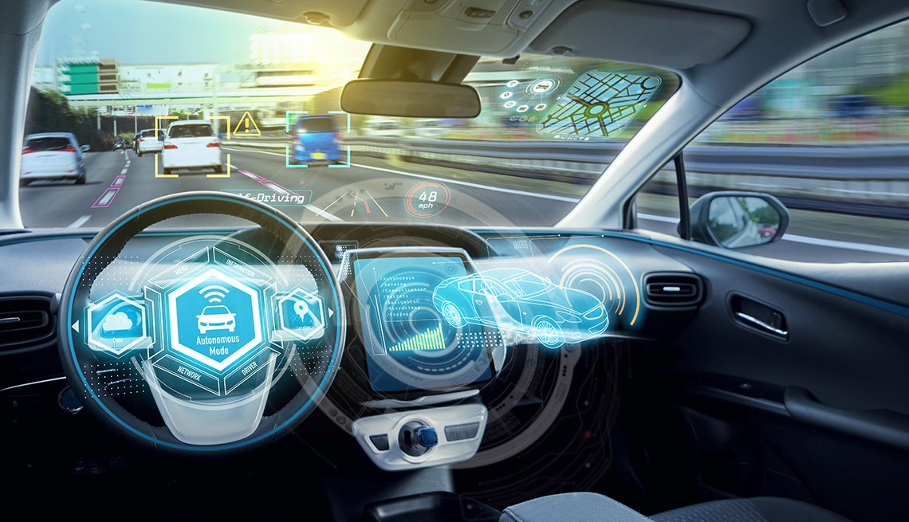
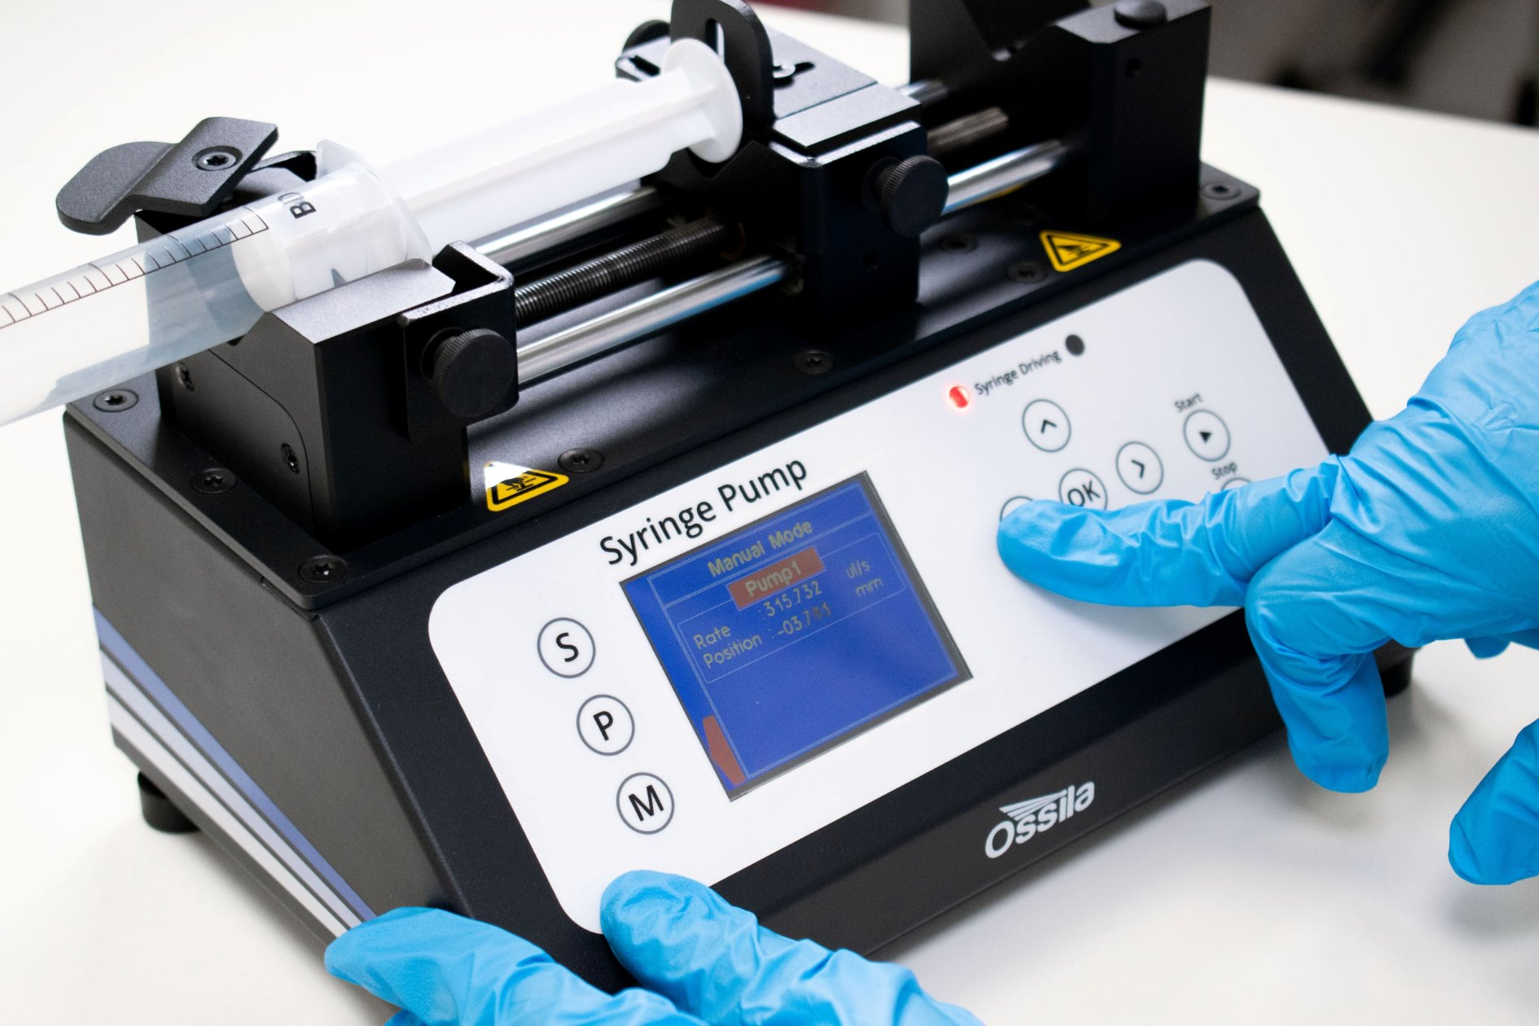
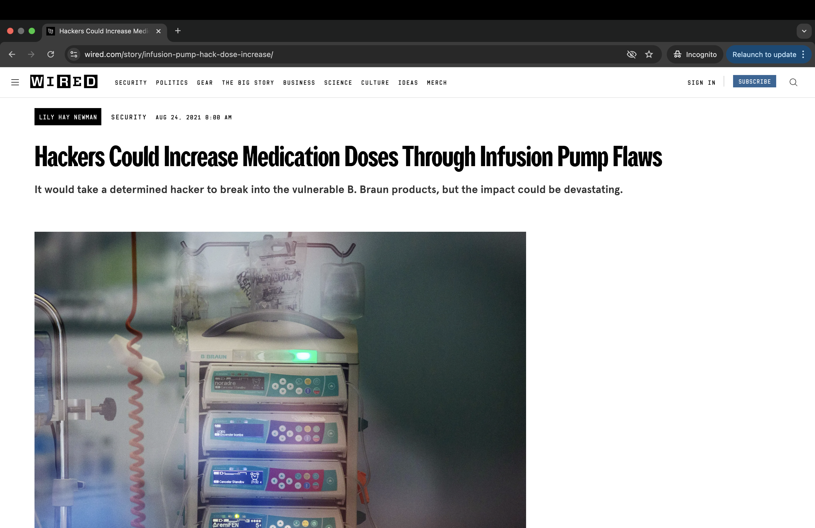
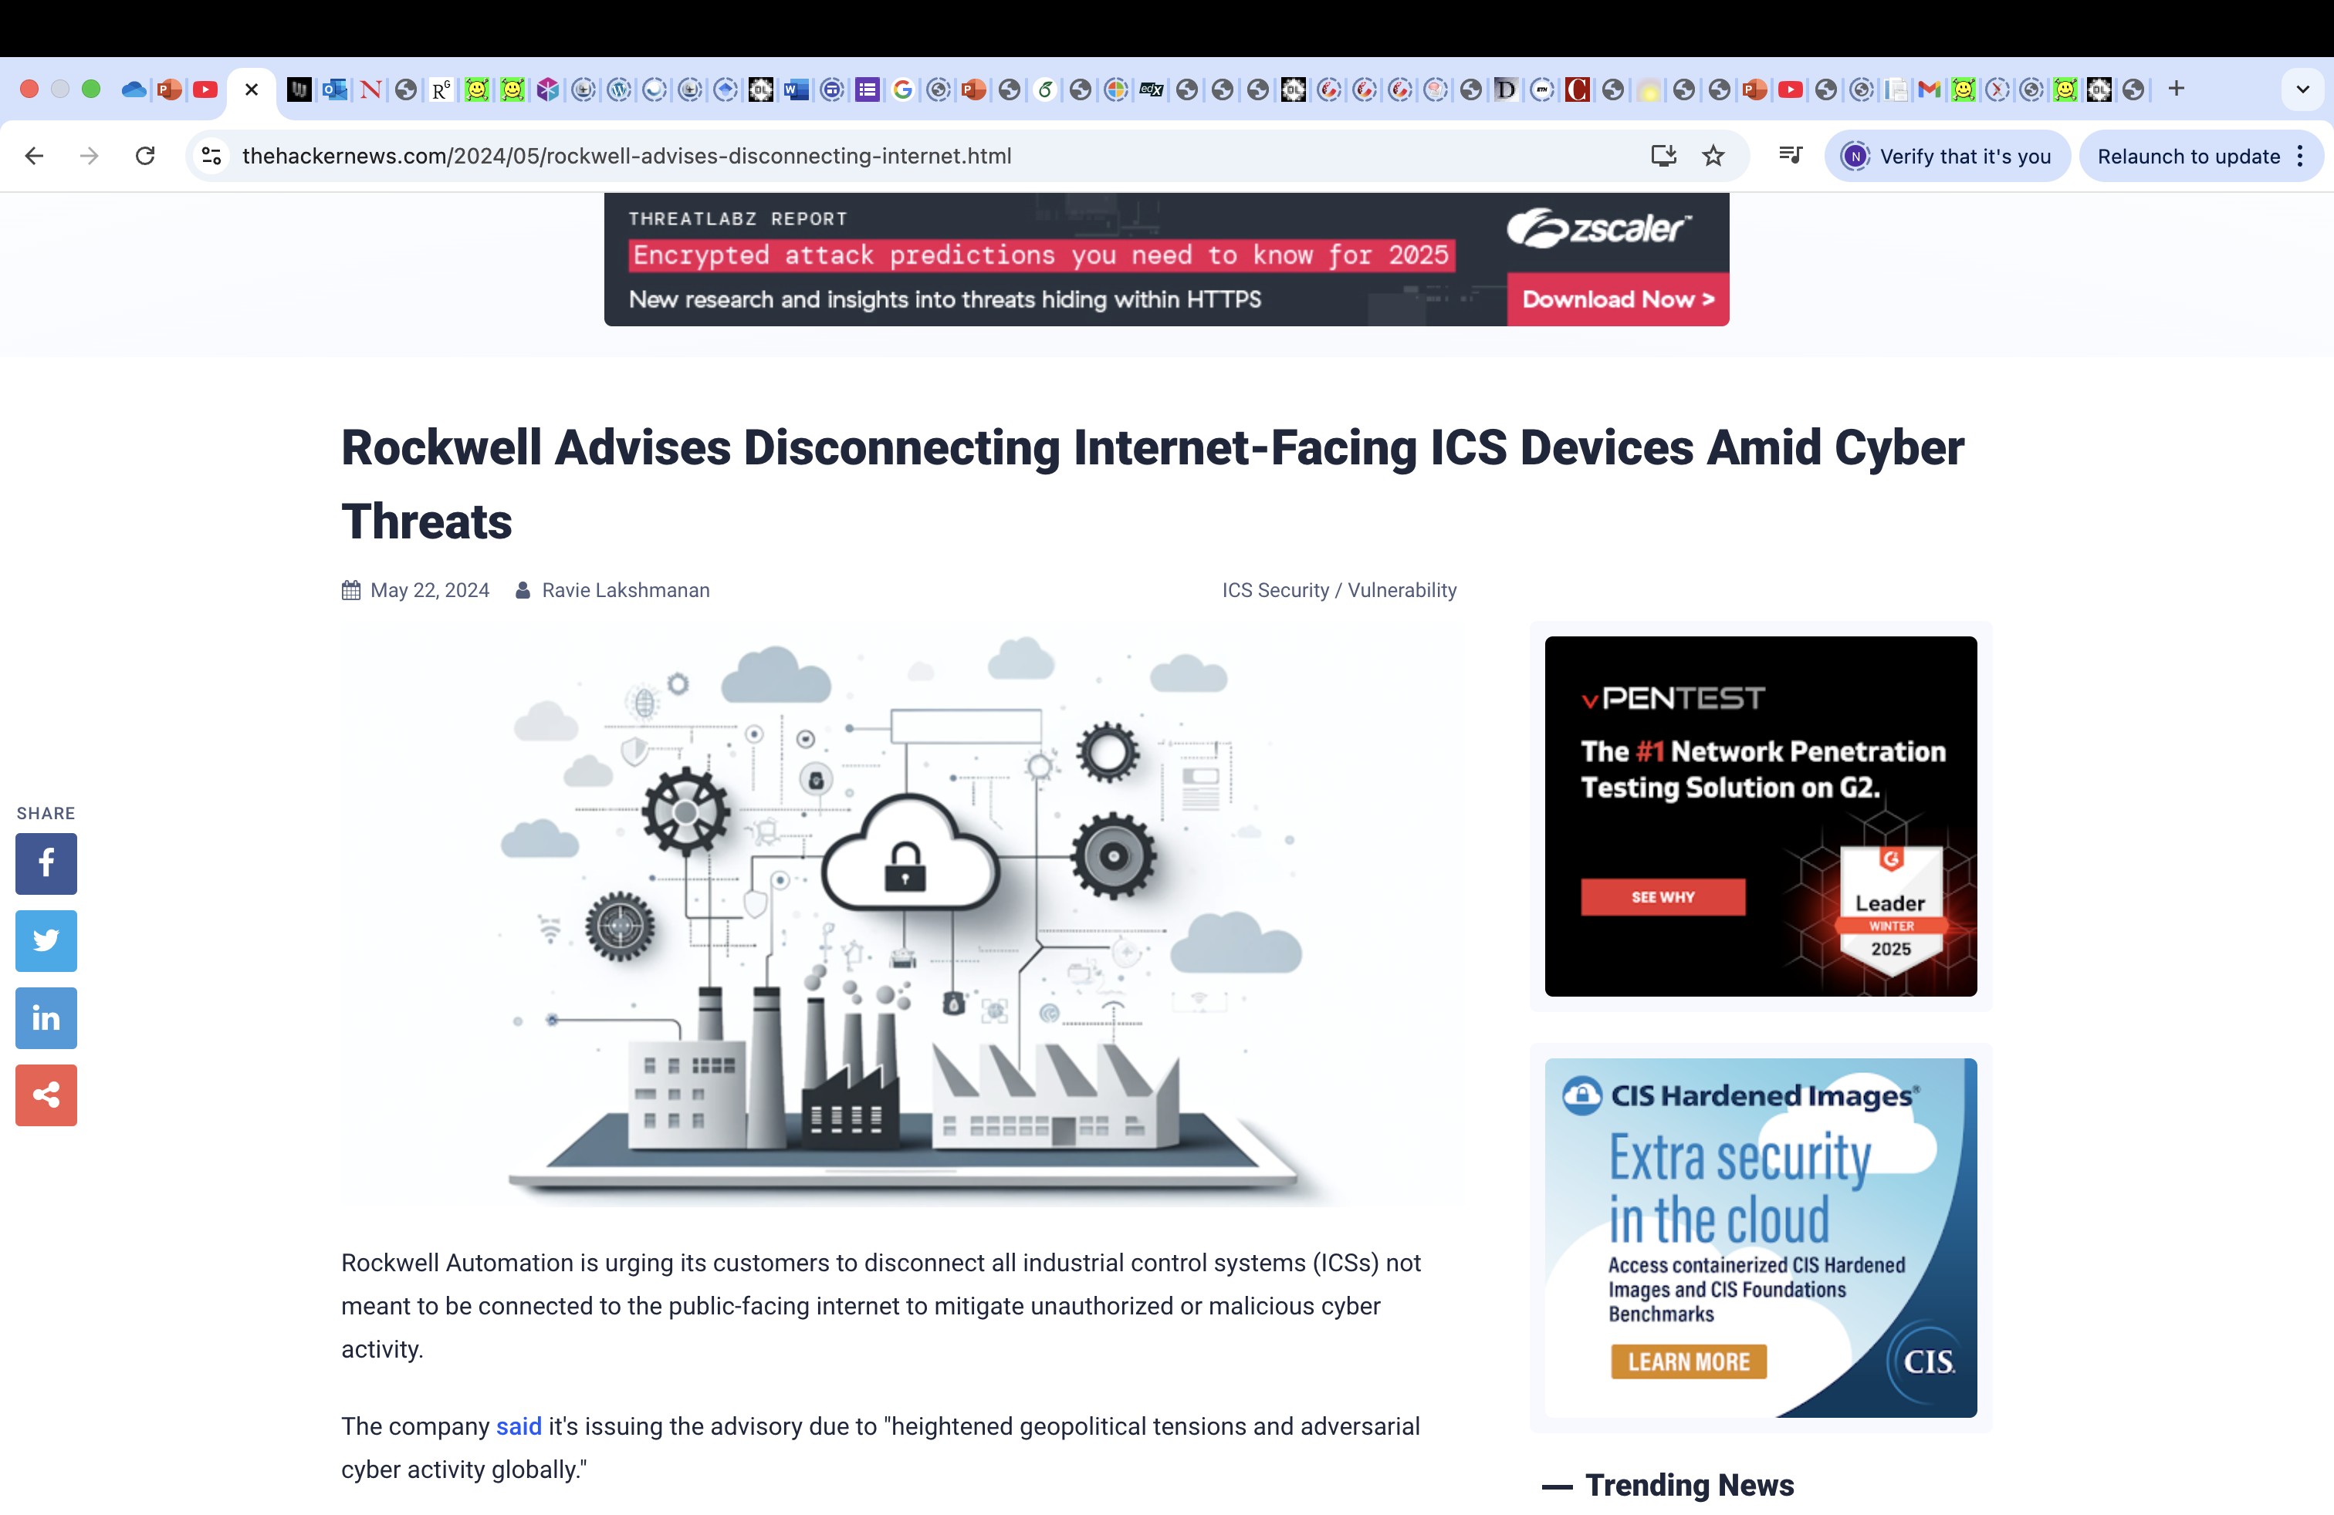

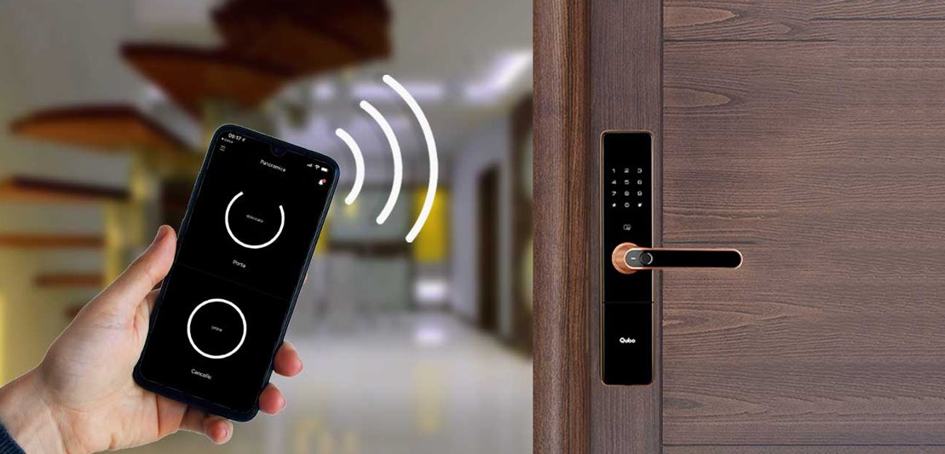
Motivation
Embedded devices are ubiquitous
Numerous security issues
‘Smart’ home devices used as weapons in website attack
[1] https://www.wired.com/story/infusion-pump-hack-dose-increase/
[2] https://thehackernews.com/2024/05/rockwell-advises-disconnecting-internet.html
[3] https://www.bbc.com/news/business-37776964

Slide 3



Remote Attestation
Goal: Verify the integrity of software running on a remote device.
Verifier
Prover
Challenge
Authentic Report
Measure software state
(e.g. hash of binary)
Verify report
Measurement Database
Trust Anchor
Notes:
Key limitation of binary attestation schemes is that they do not address runtime attacks.

Slide 4


Runtime Attacks
Control-Flow Attack
Non-Control-Data Attack
A
Corrupt condition variable
A
corrupt
code pointer
If-else
B
C
B
C
D
E
D
E
D
X
inject malicious code
F
F
Notes:
Let us now understand what kinds of runtime attacks are possible on the syringe pump application.
In general, we can categorise the runtime attacks into two type – code modification attack and control-flow hijacking attack.
These attacks are best represented by a control-flow graph. Here, the nodes represent the basic blocks (a code sequence that runs in straight line, which a single entry and single exit point) and edges represent the control-flow transitions.
The control-flow graph depicts the valid execution paths that a program may follow at runtime.
If the program contains a memory vulnerability such as buffer overflow then the attacker can inject malicious code into the program’s address space and corrupt a code pointer such as return address and redirect the execution to the injected malicious code.
The attackers have moved to control-flow hijacking attacks such as return-oriented programming where they build gadget chains out of existing code to run arbitrary malicious and turing complete computations.
The attacker can also change data variables such as condition of if-else statement to divert the control-flow of the program.
Fortunately, today’s modern systems and embedded systems support static attestation and data execution prevention. Static attestation ensures the integrity of the program binary before execution and data execution prevention ensures that attacker cannot execute any code from data memory. These defenses prevent code modification and code injection attacks. Control-flow attestation is a defense against control-flow hijacking attacks and it is also useful for overall reasoning about the program runtime integrity.

Slide 5
Control-Flow Attestation
CFA is a technique to attest the
execution of a program running on a remote device
in order to detect
control-flow hijacking attacks
Notes:
One of the ways to build trust in the device is by verifying its integrity. We want to verify the runtime integrity of the software program running on the device as it executes the given command.
Control-flow attestation is one such technique, which enables fine-grained measurement of the execution of the program by interfacing with a root of trust. It produces a proof of execution which can be verified by a trusted verifier to ensure that the device performed the operation correctly.

Slide 6
Contributions
Problem Statement: Prior CFA techniques incur high runtime overheads on whole-program attestation and are not secure in non-bare-metal settings.
Notes:
CFA is increasingly becoming a popular technique, and my work is on improving CFA.
I have improved the scope of CFA and scaled it to attestation of whole programs. The key idea of this work is the use of Ball Larus profiling for path measurements.
With the use of Ball Larus profiling and other novel ideas, I reduced the performance overhead of CFA by two orders of magnitude compared to prior works. This work was published in CCS 2023.
I have enabled CFA of userspace application in a non-bare-metal setting, i.e. when the program runs atop an untrusted privileged software such as operating system or hypervisor. With novel use of commodity ARM
hardware feature – PAN, I secure the CFA mechanism and its artifacts from the untrusted operating system. I will be mainly discussing BLAST in this talk and present only some ideas from SULFUR in the interest of time. I'd be happy to talk about the details after the talk. This work is currently under submission, and if you're interested, I'd be happy to share the paper.

Slide 7
Contributions
Thesis Statement: We can scale CFA to whole programs and apply it in non-bare-metal settings by the novel use of hardware and software-based isolation techniques.
New Capability Enabled | Key Idea
BLAST: Whole Program Scalability [CCS'23] | Buffer Locally/Ball Larus Path Profiling
SULFUR: Non-bare-metal Setting [ACSAC'25] | ARM Privileged Access Never
Notes:
CFA is increasingly becoming a popular technique, and my work is on improving CFA.
I have improved the scope of CFA and scaled it to attestation of whole programs. The key idea of this work is the use of Ball Larus profiling for path measurements.
With the use of Ball Larus profiling and other novel ideas, I reduced the performance overhead of CFA by two orders of magnitude compared to prior works. This work was published in CCS 2023.
I have enabled CFA of userspace application in a non-bare-metal setting, i.e. when the program runs atop an untrusted privileged software such as operating system or hypervisor. With novel use of commodity ARM
hardware feature – PAN, I secure the CFA mechanism and its artifacts from the untrusted operating system. I will be mainly discussing BLAST in this talk and present only some ideas from SULFUR in the interest of time. I'd be happy to talk about the details after the talk. This work is currently under submission, and if you're interested, I'd be happy to share the paper.

Slide 8
Trusted Hardware
ARM Trustzone
TEE capabilities used by CFA:
1. Secure Storage
2. Digital Signatures
REE TEE
EL0
Normal App
Trusted App
EL1
REE OS
TEE OS
EL3
Secure Monitor
Notes:
We assume that the prover's device has a trusted hardware such as ARM Trustzone, which is widely available in embedded devices.
ARM trustzone separates the device’s hardware domain into secure and non-secure environments called TEE and REE. TEE stands for trusted execution environment and REE stands for rich execution environment.
It provides isolation between the two worlds, ensuring that the non-secure world cannot access the hardware elements, memory, software, interrupts, peripherals belonging to the secure world.
The secure monitor, which executes at the highest privileged level, enables the transition between the two environments.
We leverage two key capabilities of Trustzone. First, the TEE provides secure storage which cannot be accessed by any software in REE. Second, TEE generates digital signatures with the private key stored securely in the trustzone.

Slide 9

Threat Model and Assumptions
Attacker can provide malicious inputs to P's public interfaces.
Data Execution Prevention is enabled.
TEE attests the P's binary at load time.
Pure data-only attacks and physical attacks are out of scope.
Bare-Metal Setting
REE TEE
Trusted Apps
P
TEE OS
Secure Monitor

Slide 10



Running Example – Remote Patient Monitoring
Peter
Dr. Victor
Inject 1 ml Medicine
Command
Response
Remote Operator
Syringe Pump Device
Notes:
For my talk, I will consider a remote patient monitoring application where such vulnerabilities can compromise the device and threaten the safety and health of patients.
On the left, we have a patient named Peter, who is using an embedded syringe pump device. The device can be given remote commands by a trusted operator, viz. Victor.
For example, Victor can give a command ‘inject 1 ml of medicine’ and in response the syringe pump device must execute the command and send a response acknowledging the execution of the command.

Slide 11
Strawman Approach I: Record Execution
Record Program Execution
REE TEE
I
Basic Block
Switch to TEE
BB1
Secure
Memory
BB1
Entry
asm_instr,
. . .
Exit
T F
BB3
BB2
BB2
I
T F
Instrument
BB1
BB5
BB4
BB5
BB2
Entry
asm_instr,
. . .
smc #0
Exit
BB5
BB6
BB6
BB6
Notes:
Slide 12: REE/TEE -- too soon. It was mentioned in very brief in the previos slide, and now you're using it extensively. Did you mention the features of the TEE that make it the right place to record these measurements? I don't recollect, or even if you did, it went too fast. You need to spend some time discussing what the TEE is and why it is the right place to record things.
Slide 12: You're talking about basic blocks -- can you briefly introduce this term when you first introduce the control-flow graph?

Slide 12

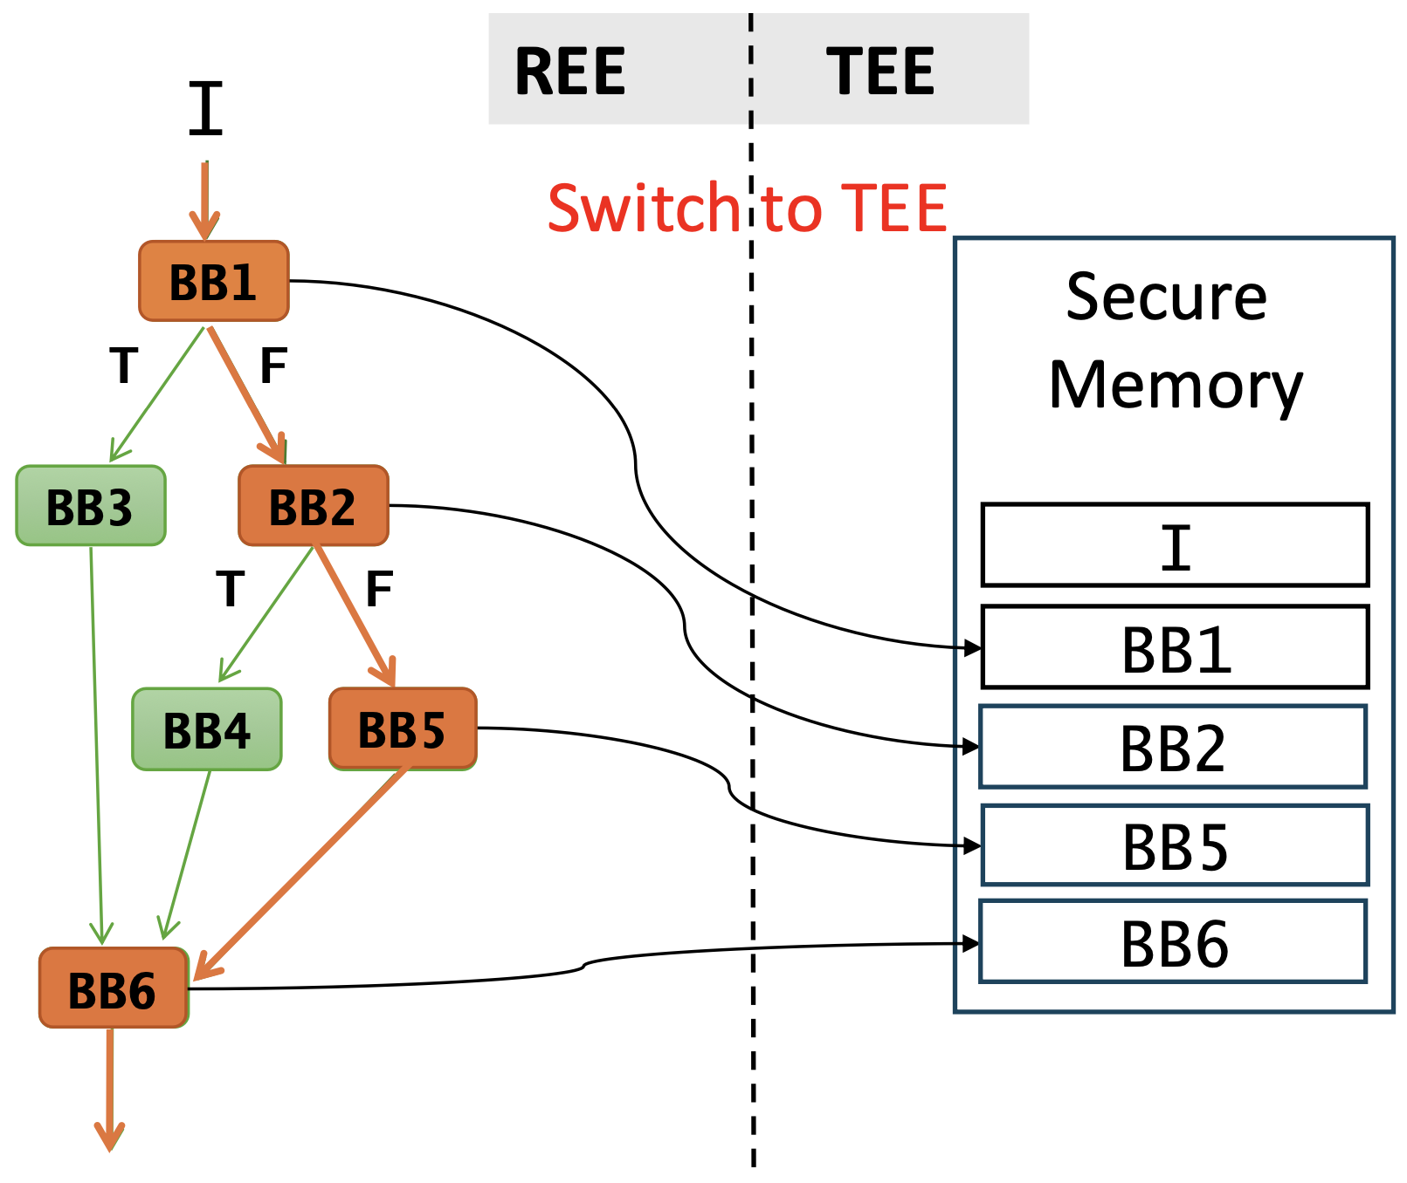

Strawman Approach I: Verification
Remote Operator
I
PROVER
I
Detect Control-Flow Hijack
CFA report
VERIFIER
Measurement DB
Can we do better?
CFLAT: Control-Flow Attestation for Embedded Systems Software, CCS 2016
Notes:
The goal of CFA is to monitor the functionality of a program P as it executes on a remote computing platform, and processes inputs, e.g., I as shown in the figure. The computing platform on which P runs must be equipped with a TEE, and P typically executes within the REE of that platform. Before P starts executing, the TEE performs static binary attestation of P that allows the verifier V to ensure that the binary has not been replaced. CFA Measurement. P is instrumented so that it records the control-flow path taken by the program. As P executes on I, the instrumentation in it tracks the path followed and stores this information—the CFA measurement—in the TEE. Upon request, the prover platform sends the recorded CFA measurements to V, which can use it for verification and audit. Most prior methods for CFA require V to have access to a measurement database, which consists of the attestation measurements (e.g., hashes, branch history or path numbers) obtained by running P on several inputs in a benign environment. V simply matches the measurement obtained from the prover platform against this database to determine whether the path taken corresponds to the input I that was provided to the prover.

Slide 13
Strawman Approach II: Record Execution
Record Program Execution
REE TEE
I
Basic Block
Switch to TEE
BB1
Secure
Memory
BB1
Entry
asm_instr,
. . .
Exit
T F
BB3
BB2
BB2
I
T F
Instrument
False
BB5
BB4
BB5
False
Entry
asm_instr,
. . .
smc #0
Exit
Return Addr
BB6
BB6
Notes:
Slide 12: REE/TEE -- too soon. It was mentioned in very brief in the previos slide, and now you're using it extensively. Did you mention the features of the TEE that make it the right place to record these measurements? I don't recollect, or even if you did, it went too fast. You need to spend some time discussing what the TEE is and why it is the right place to record things.
Slide 12: You're talking about basic blocks -- can you briefly introduce this term when you first introduce the control-flow graph?

Slide 14
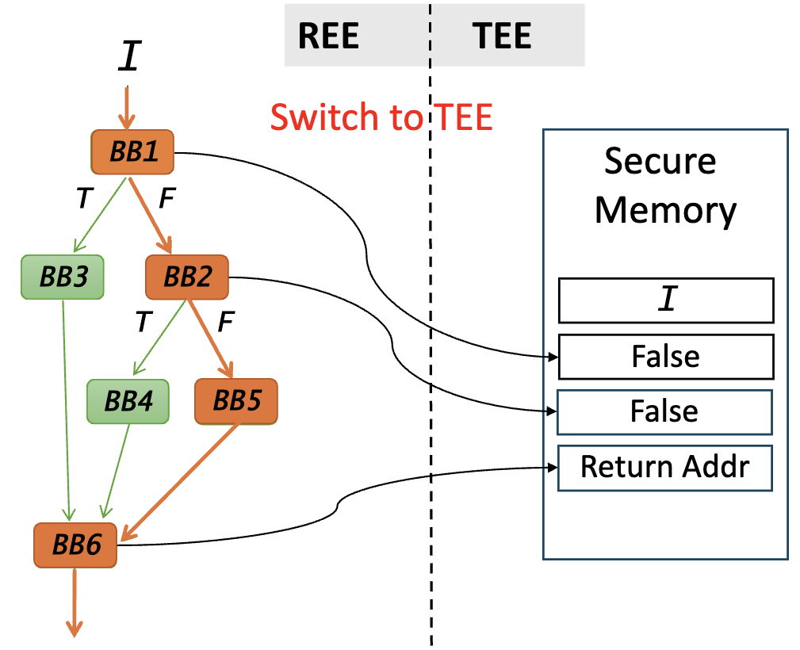
Strawman Approach II
Remote Operator
I
PROVER
I
Detect Control-Flow Hijack
CFA report
VERIFIER
Abstract Execution Engine
#Instrumentation
#REE-TEE Switches
Can we do better?
OAT: Attesting operation integrity of embedded devices, IEEE S&P 2020
Notes:
The goal of CFA is to monitor the functionality of a program P as it executes on a remote computing platform, and processes inputs, e.g., I as shown in the figure. The computing platform on which P runs must be equipped with a TEE, and P typically executes within the REE of that platform. Before P starts executing, the TEE performs static binary attestation of P that allows the verifier V to ensure that the binary has not been replaced. CFA Measurement. P is instrumented so that it records the control-flow path taken by the program. As P executes on I, the instrumentation in it tracks the path followed and stores this information—the CFA measurement—in the TEE. Upon request, the prover platform sends the recorded CFA measurements to V, which can use it for verification and audit. Most prior methods for CFA require V to have access to a measurement database, which consists of the attestation measurements (e.g., hashes, branch history or path numbers) obtained by running P on several inputs in a benign environment. V simply matches the measurement obtained from the prover platform against this database to determine whether the path taken corresponds to the input I that was provided to the prover.

Slide 15
Evaluation of Prior CFA methods
Embench-IoT | Total REE-TEE domain Switches Encountered at Runtime
Program | Strawman Approach I (CFLAT) | Strawman Approach II (OAT)
aha-mont64 | 857,844,016 | 392,967,008
crc32 | 871,930,016 | 348,840,008
cubic | 2,030,022 | 860,013
edn | 1,106,118,020 | 372,621,011
huffbench | 984,236,016 | 496,903,008
matmul-int | 1,201,018,222 | 406,825,691
minver | 277,500,079 | 115,440,042
nbody | 17,279,126 | 6,329,070
nettle-aes | 227,449,298 | 78,858,777
nettle-sha256 | 223,250,050 | 34,200,025
Refer paper for complete table.
Notes:
Slide 16: This is again a slide that's ideal for a security seminar or your thesis defense. For a job talk, give the TLDR. FOr example, Slide 17 is ideal -- you're taking ONE example and getting into detail. Perhaps show Slide 16 quickly, and then say you're going to focus on Slide 17 and move on to the actual practical implications of the overheads (which you actually do -- 11 hours, and 2 hours).

Slide 16
Effect of TEE switches on Runtime
Embench-IoT | Total REE-TEE domain Switches Encountered at Runtime
Program | Strawman Approach I (CFLAT) | Strawman Approach II (OAT)
nettle-sha256 | 223,250,050 | 34,200,025
1 REE- TEE domain switch takes
~ 190 μsecs on Raspberry Pi
X 190 μsecs
X 190 μsecs
Baseline Execution Time | Time with CFLAT | Time with OAT
12 seconds
> 11 hours
~ 2 hours
CFLAT and OAT impose over 1000x and 500x overhead respectively on all benchmarks due to high number of REE-TEE domain switches.

Slide 17
Key Takeaway
Prior CFA approaches are
extremely slow
and attests only parts of the program
Notes:
Slide 18: UNNECESSARY. Say that given this large number of switches, prior techniques are FORCED to only attest portions of the program. Use this to pivot to the key problem highlighted in Slide 19.

Slide 18

Blast: Whole Program Control-Flow Attestation Accelerates and Scales CFA to whole program attestation Accepted at ACM CCS 2023
Notes:
Sulfur aims to ensure that the CFA measurement collected when theuser-space application executes on an input is an accurate evidenceof its execution even in the presence of an attacker that aims tocompromise the REE OS.

Slide 19
Key Insight 1: Buffer Locally
REE TEE
Log head
Data
(Log Reg)
Accumulate Path Measurement
BB1
CFA_{Log}
BB1
BB3
BB2
BB2
BB5
Secure Storage
BB6
BB4
BB5
Flush to TEE
CFA_{Log} size is configurable
Log head is stored in a dedicated register, Log Reg
Code
BB6
P 's Address Space
Notes:
Slide 20-22: Have an attractive title: "Key Insight 1: Buffer Locally"
We thus adopt a buffering strategy to reduce the number of TEE domain switches.
We create a log in the process's data region.
When the program is executed, we record the path measurements in this log. For instance, in CFLAT-like instrumentation, we'll record basic block IDs in this log instead of recording them in the TEE.
When the log is full, it is flushed to the TEE.
The log is protected from malicious access by the application by adding SFI checks at all the store instructions.

Slide 20
Challenge: Isolation of CFA_{Log}
Data
BB1
Log head
CFA_{Log}
BB1
(Log Reg)
BB2
BB3
BB2
BB3
BB4
BB5
store val, addr
Code
BB6
Rewrite the CFA_{Log}
P 's Address Space
Notes:
Slide 22: Then have a slide saying "Challenge: Isolation", and then show what the program can do. You very quickly moved over the SFI part. THIS IS ONE OF THE KEY CONTRIBUTIONS AND IT DIDN'T EVEN COME ACROSS CLEARLY. Show what SFI is. Show the code. Describe the insights behind SFI in low-level detail. Even security people are not familiar with SFI. YOu need to describe this in detail.

Slide 21
Protect CFA_{Log} with Software Fault Isolation
SFI check example
and x9, addr, mask cmp x9, log_start_addr
Data
Log head
(Log Reg)
Address within CFA_{Log}?
NO
CFA_{Log}
BB1
YES
BB2
ABORT
store val, addr
Code
Rewrite the CFA_{Log}
P 's Address Space
Efficient software-based fault isolation, SIGOPS, 1993
Notes:
There was an odd transition here from Slide 22-27, when you had to skip over several slides.

Slide 22
Key Insight 2: Ball Larus Profiling
BB1
Path | Encoding
BB1→ BB2 → BB5 → BB6 | 0
BB1→ BB3 → BB6 | 1
BB1→ BB2 → BB4 → BB6 | 2
BB3
BB2
BB4
BB5
BB6
Efficient path profiling, IEEE Symposium on Microarchitecture, 1996
Notes:
I realized that recording program paths is an old problem that has extensively been studied in the profiling literature and the prior works on CFA were not using it.
My key insight was to use these old tricks in the CFA setting. Ball Larus path profiling technique compute a unique integer path number for each acyclic path in a procedure. If there are N acyclic paths, then each path gets an ID in the range [0-N-1].

Slide 23
Ball Larus Profiling Instrumentation
For every Procedure
BL Reg
R = 0
Entry BB (BB1)
CFG edges (e.g. BB1->BB3)
BB1
Entry
R = 0
asm_instr, . . .
Exit
Entry
R = R + c;
Exit
R+=1
BB3
BB2
R+=2
*c is an integer
BB4
BB5
Exit BB (e.g. BB6)
Entry
asm_instr, . . .
store R, LogAddr
Exit
BL Reg is a dedicated register.
BB6
Efficient path profiling, IEEE Symposium on Microarchitecture, 1996
Notes:
To compute this path encoding, Ball Larus profiling algorithm selectively instruments the CFG edges.
The Ball Larus path number is calculated in a register called BL register, which is initialised to 0 in the entry basic block.
Some of the edges are instrumented with register arithmetic operations. For instance, instrumentation on edge BB1 to BB3 adds value 1 to R and instrumentation on edge BB2 to BB4 adds value 2 to R.
Finally, in the exit basic block, we store the accumulated path value in the CFA-log.
The path encoding is calculated and recorded in the log on loop headers, calls, and return instructions.

Slide 24
Path Measurement
REE
BL Reg
R = 0
Data
Path | Encoding
BB1→ BB2 → BB5 → BB6 | 0
BB1
BB1
R+=1
R
CFA_{Log}
0
BB3
BB2
BB2
R+=2
BB4
BB5
BB5
Code
BB6
BB6
P 's Address Space
Efficient path profiling, IEEE Symposium on Microarchitecture, 1996
Notes:
Let us now look at path measurement using Ball Larus path profiling.
When the program starts executing, value of R is set to 0 in entry basic block. The right-most path has no other instrumentation and value 0 is recorded in the log in the exit basic block.

Slide 25
Path Measurement
REE
BL Reg
R = 0
Data
Path | Encoding
BB1→ BB2 → BB5 → BB6 | 0
BB1→ BB3 → BB6 | 1
BB1
BB1
R+=1
R
CFA_{Log}
1
BB3
BB3
BB2
R+=2
BB4
BB5
Code
BB6
BB6
P's Address Space
Efficient path profiling, IEEE Symposium on Microarchitecture, 1996
Notes:
When left most path is taken, value of R is updated by instrumentation on edge BB1 to BB3, incrementing it by 1. finally value 1 is recored in the log, which is encoding for this path.

Slide 26
Path Measurement
REE
BL Reg
R = 0
Data
Path | Encoding
BB1→ BB2 → BB5 → BB6 | 0
BB1→ BB3 → BB6 | 1
BB1→ BB2 → BB4 → BB6 | 2
BB1
BB1
R+=1
R
CFA_{Log}
2
BB3
BB2
BB2
R+=2
BB4
BB5
BB4
Code
BB6
BLAST also records call /jump and return addresses in CFA_{Log}
BB6
P's Address Space
Efficient path profiling, IEEE Symposium on Microarchitecture, 1996
Notes:
And same is the case for the third path.

Slide 27
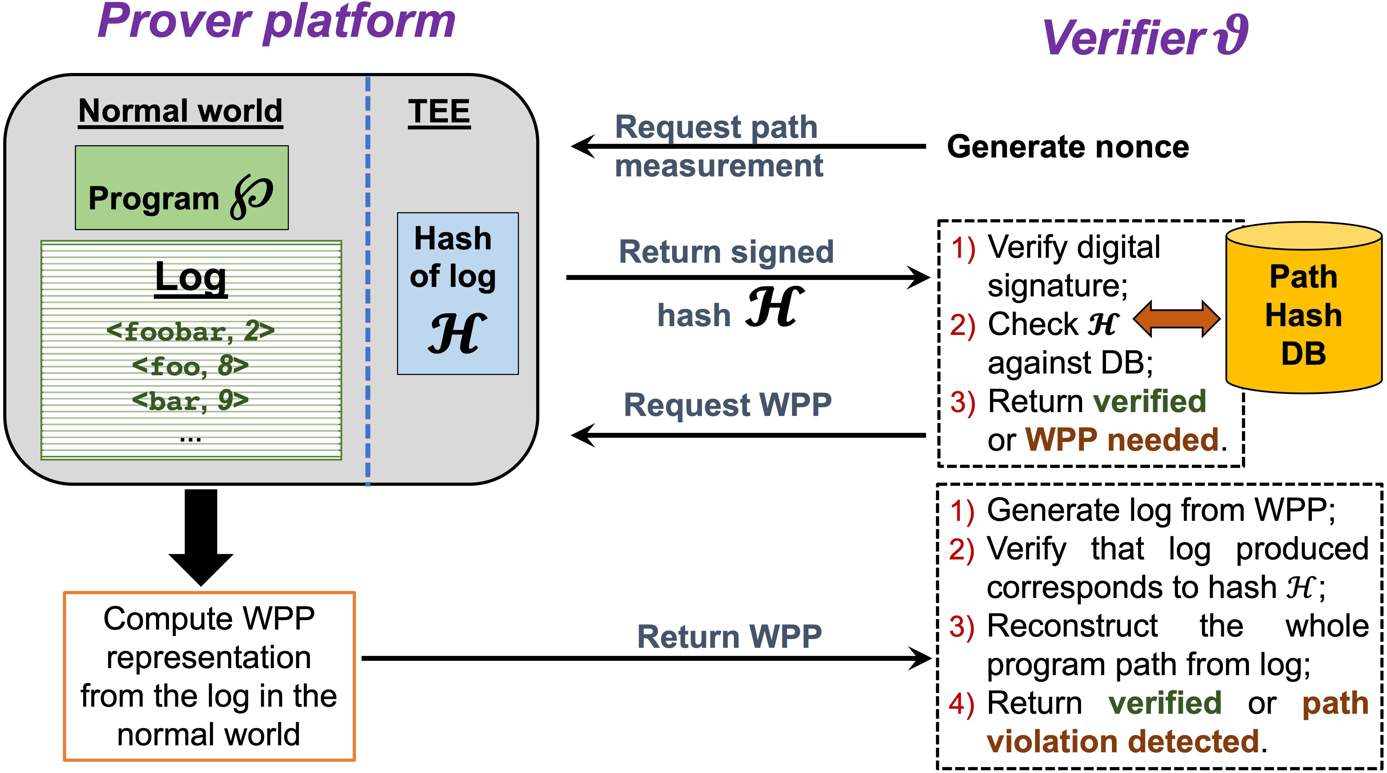
Workflow for Verification
Prover's Device Platform
Verifier
Whole Program Paths, PLDI, 1999

Slide 28
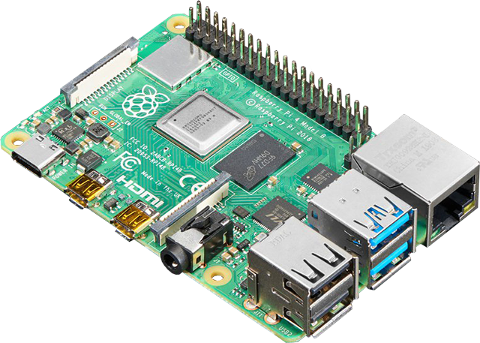


Experimental Setup
Hardware: Raspberry Pi 3
Benchmark: Embench-IoT
Compiler: LLVM 11
Notes:
We ran our experiments on Raspberry Pi 3 and evaluated the performance of our approach on Embench-IoT benchmarks, which are instrumented and compiled with LLVM.

Slide 29
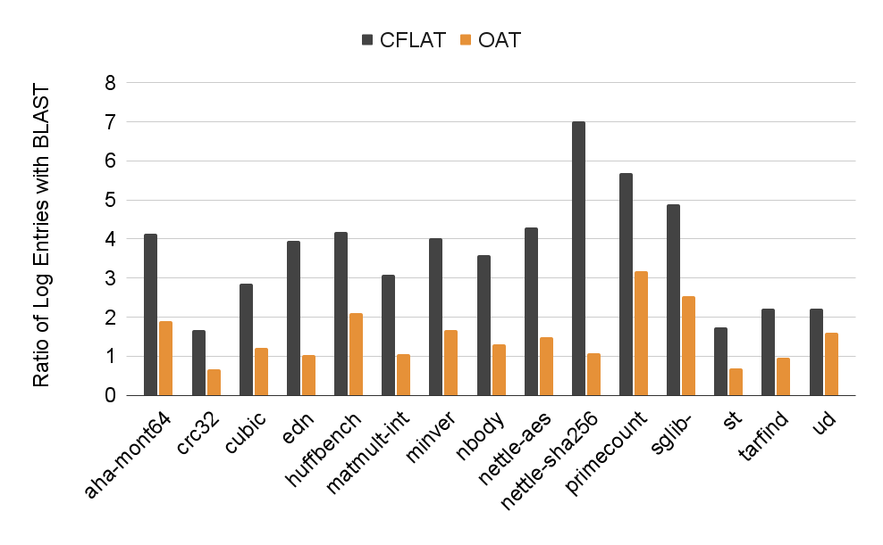
Effectiveness of Ball Larus Profiling
BLAST
crc32 with inlining
BLAST: 348,670,006
OAT: 348,840,008
Notes:
Ball Larus profiling reduces the number of log entries. Compared to CFLAT, BLAST record 7X less log entries for nettle-SHA256 benchmark and 3X less than OAT for primecount.
For crc32 benchmark, BLAST record more log entries because it records direct calls while OAT does not.
We inline small functions upto a call-depth of 5 to further reduce log entries.

Slide 30
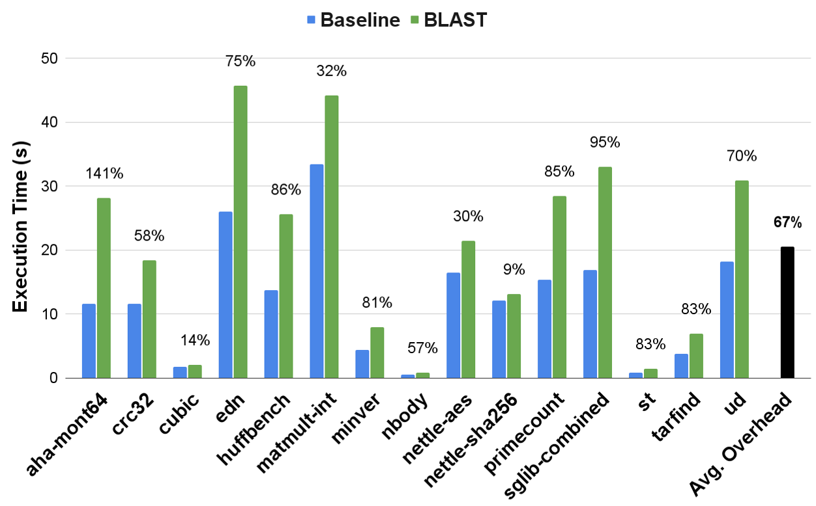
Performance of BLAST
Notes:
You also need to say that although 67% seems high, it's actually MUCH LOWER than other work, and that Blast has become the work that others have started building upon -- cite ENOLA as an example.

Slide 31
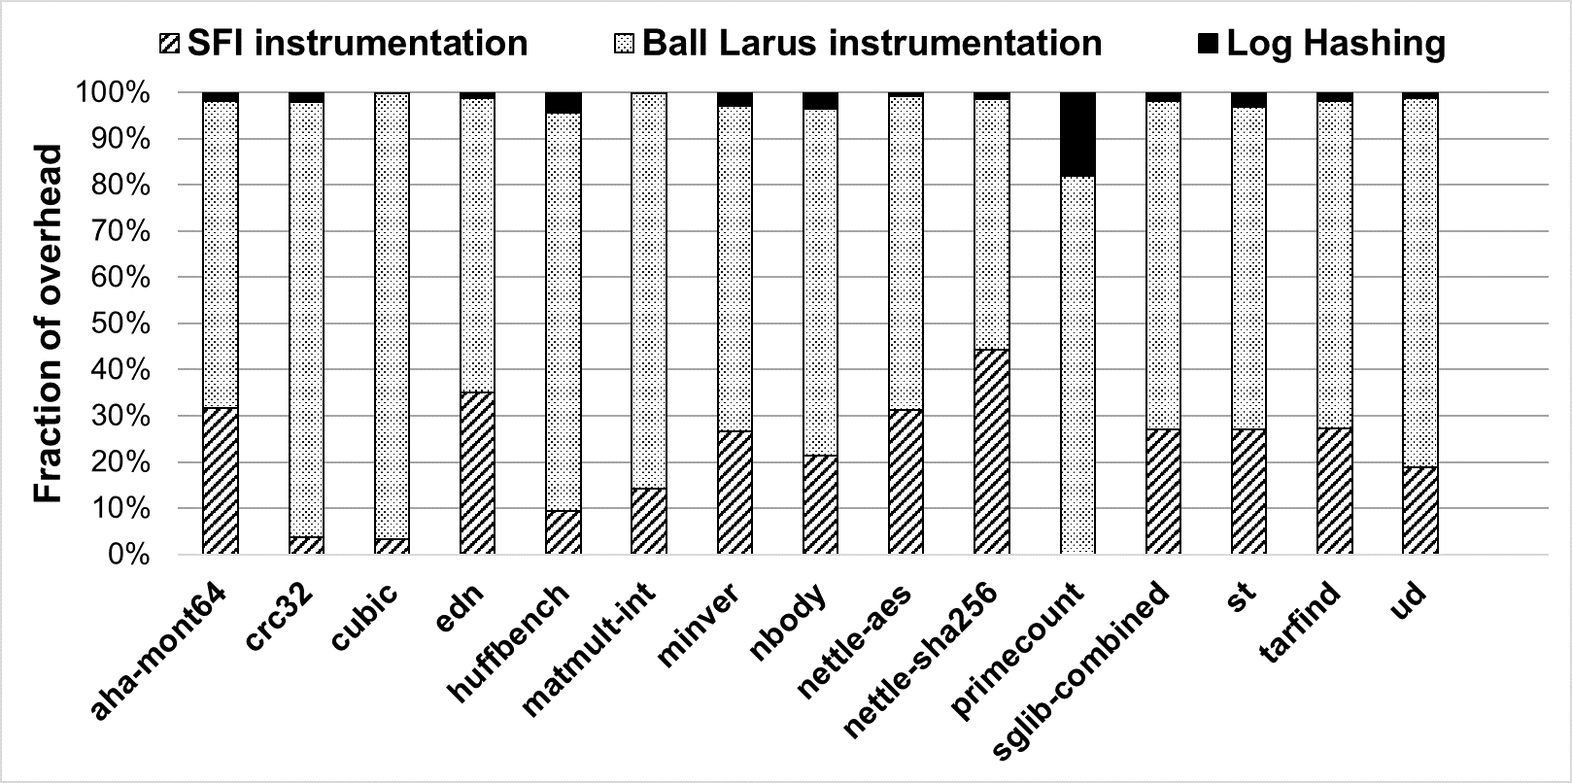
Runtime Overhead Breakdown
Notes:
Three factors contribute to the runtime overhead of Blast-
instrumented binaries—Ball-Larus instrumentation, SFI instrumen-
tation, and the log commit operation.
Our results indicate that the log
commit operation, which proceeds in parallel to P, contributes
negligibly to the overhead of most benchmarks, except in the case
of primecount (the overhead manifests as waiting time in P). The
bulk of the overhead is due to Ball-Larus instrumentation, which is
uniformly more than the overhead due to SFI instrumentation.

Slide 32
Summary
Identified performance bottlenecks: frequent TEE domain switch and sub-optimal path measurement
Buffered measurements locally in REE to reduce TEE switches.
Adapted Ball Larus Path Profiling for CFA measurements.
Conclusion: BLAST enables whole program attestation with ~67% overhead -- two orders of magnitude faster than prior methods.

Slide 33
Research Gap
Bare-Metal Setting
Non-Bare-Metal Setting
REE TEE
REE TEE
Trusted Apps
App
Trusted Apps
App
TEE OS
REE OS
TEE OS
Secure Monitor
Secure Monitor
Bare-metal CFA assumes full trust in TEE only.
Non-bare-metal CFA trusts REE OS (this is risky).
Notes:
Most prior CFA methods operate under the assumption of a bare metal setting, where the program P being attested runs directly on the hardware in privileged mode.
P interfaces with hardware via interrupt service routines (ISRs) and CFA approaches attest the execution of the main program P. Because only one application runs in this setting, attesting P suffices to ensure execution integrity, and the TCB is typically the TEE, consisting of a secure boot mechanism.
**In this setting, the TEE also write-protects the program's binary so that it cannot be replaced or tampered with at runtime.
In the few instances when CFA has been applied in nonbare-metal settings [6, 7, 14], the focus has been on scale and performance. These methods have extended CFA to efficiently attest complex user-space applications. However, these methods fundamentally trust the underlying OS, which is therefore part of the TCB.

Slide 34

The Risk of Trusting the REE OS in CFA
If REE OS is Compromised, CFA cannot be trusted.
Write-Protect the App Binary
Secure Communication with TEE
msr SCTRL_EL1, x0 // Reset WXN bit
App
SVC
REE OS
SMC
TEE
Integrity of State During Interrupts
Integrity of CFA_{Log}
App
SVC
REE OS
Save
App's State
App
REE OS
SMC
TEE
Restore
Kernel Stack
CFA_{Log}
CFA_{Log}
CFA_{Log}
Notes:
In non-bare-metal settings, CFA relies critically on the underlying REE OS to be trustworthy, failing which CFA cannot be trusted to robustly record the execution of a user-space program P. An attack on the OS completely defeat the prior CFA techniques. Such an attacker can subvert CFA stealthily by corrupting the user and system states. A vulnerable OS can be compromised and subvert assumptions required by CFA.
Specifically, the key foundational assumptions made by prior works can be compromised. Then talk about R1, R2, R3, R4.

Slide 35


Key Takeaway: CFA Needs Extra Protection
CFA is not secure if the REE OS is compromised.
Extra Protections are essential for CFA in non-bare-metal settings.
Notes:
Consequently, CFA mechanisms in P cannot be considered robust in the presence of a system-level adversary that compromises the REE OS, thereby violating the above assumptions. Additional protections are required to ensure that the CFA measurements are recorded securely and accurately reflects P’s true control-flow execution. To ensure trustworthy attestation in non-bare-metal settings, extra protections are essential so CFA measurements remain accurate and tamper-proof.

Slide 36
Sulfur: Non-Bare-Metal User-Space CFA Trusting the REE OS is fraught with risks, Sulfur raises the bar. Accepted at ACSAC 2025
Notes:
Sulfur aims to ensure that the CFA measurement collected when theuser-space application executes on an input is an accurate evidenceof its execution even in the presence of an attacker that aims tocompromise the REE OS.

Slide 37
Sulfur: Core Assumptions and Scope
Sulfur inherits all the standard assumptions from prior CFA approaches, e.g.,
The program is instrumented for CFA.
Program's image is attested before execution.
Sulfur also requires the prover platform to be equipped with a TEE.
Note: We rule out data-only attacks.
Notes:
I have not mentioned all the assumptions.

Slide 38
SulfurOS: A Secure Middle Ground for CFA
Non-Bare-Metal Setting
REE TEE
Sulfur introduces SulfurOS + Sulfur Monitor to protect CFA even if REE OS is attacked.
TCB: TEE (including the Sulfur Monitor).
App
Trusted Apps
SulfurOS
TEE OS
Attests
Sulfur Monitor
Notes:
Unlike prior works that either assume a bare-metal setting or a fully-trusted REE OS, Sulfur targets a practical middle ground—it operates in non-bare-metal settings with SulfurOS—an REE OS that is specifically co-developed to ensure that CFA artifacts cannot be compromised by SysAdv.
Sulfur’s TCB consists of Sulfur monitor and the components running in the ARM secure world. The TEE measures and boots SulfurOS in the REE.

Slide 39
Sulfur's Design: Two Layers of Defense
CFA-Centric Protections
Secures CFA artifacts
System Integrity Guardrails
Protects REE OS and System State

Slide 40
Guardrails: Protecting REE OS & System State Redirect sensitive operations to TEE for verification
SulfurOS
Sulfur Monitor
SMC
Redirect security-sensitive operations to Sulfur Monitor.
Enforce security policies (e.g. WXN) and page table integrity.
Harden Kernel with PACBTI-based CFI.
PAC: Pointer Authentication Code, BTI: Branch Target Identification
Example: Sulfur replaces direct system register writes with SMC to enforce integrity.
msr SCTRL_EL1, x0
...
smc #0
...
Notes:
System integrity guardrails aim to protect both the integrity of the OS and the critical state of the system from SysAdv. Guardrails inserted at security-sensitive locations in the SulfurOS kernel invoke the TEE. These invocations are akin to paravirtualization [32]—they invoke Sulfur monitor via an ARM secure monitor call (SMC), which in turn invokes a trusted agent in the secure world. This trusted agent ensures that key system configurations are not tampered (e.g., that WXN remains enabled), prevents any compromise of SulfurOS and application code integrity, and mediates all changes to SulfurOS page tables. This approach is inspired by Knox [27, 37], and ensures the integrity of SulfurOS system state and code throughout the lifetime of the system, thus enabling other defenses to operate reliably. SulfurOS is hardened against control hijacking by enabling PACBTI-based CFI [36] within the kernel. PACBTI-based CFI is now deployed in most commodity compilers.
SulfurOS’s design remains flexible and could integrate more advanced CFI mechanisms for stronger integrity guarantees

Slide 41
CFA-Centric Protections: Secure CFA Artifacts
S-Vault (In-Process Secure Region)
Non-Bare-Metal Setting
REE TEE
CFA_{Log}
App’s Execution Context
TEE Args
App
Trusted Apps
SulfurOS
TEE OS
Dedicated memory region for CFA artifacts
S-Vault ensures CFA data remains tamper-proof even if OS is compromised
Sulfur Monitor
Notes:
Sulfur’s CFA-centric protections are a novel set of mechanisms that focus on securing user-space CFA artifacts using hardware support.
The centerpiece of these protections is a dedicated memory region called S-Vault in the address space of the program P being traced by CFA.
SVault serves as a storage space for three CFA artifacts: 1 as a cache of CFA measurements, i.e., CFALog, 2 to store P’s context during entry/exit to the SulfurOS kernel, and 3 to hold arguments during TEE invocations to store CFALog. Although S-Vault resides in user-level, Sulfur protects it from SysAdv using PAN.

Slide 42
Key Insight: ARM PAN for Memory Isolation
Without PAN
With PAN Enabled
Program P
Program P
EL0
EL0
LDR/
STR
LDTR/
STTR
LDR/
STR
LDTR/
STTR
EL1
EL1
OS
OS
PAN = 0
PAN = 1
PAN: Privileged Access Never
Notes:
PAN [29] is a security feature introduced in ARMv8.1- A that prevents privileged OS code (executing at EL1) from accessing user-space memory (EL0) using standard load/store instructions (i.e., LDR/STR). With PAN enabled, user-space memory access from the OS results in a fault. To access user memory intentionally, the OS must use PAN-aware instructions, called unprivileged load (LDTR) and store (STTR) instructions, which are checked against EL0 page permissions, even when executed in privileged mode. PAN is enabled by setting the PAN bit in the SCTLR EL1 system control register.

Slide 43
S-Vault: Protected User-Space Region
Program P
SulfurOS uses LDTR/STTR for user memory access.
SFI checks prevent writes to S-Vault.
EL0
S-Vault
SFI Protected
SFI check:
and x3, addr, #0x7ffffffffffff000
cmp x3, =S-Vault_addr
b.e abort
sttr reg, [addr]
LDR/
STR
LDTR/
STTR
EL1
SulfurOS
PAN = 1
Key Takeaway: S-Vault ensures CFA artifacts remain inaccessible to the SulfurOS.
Notes:
SulfurOS is designed to only use LDR/STR instructions for all kernel memory accesses. This ensures that user-space memory, including S-Vault, remains inaccessible to SulfurOS. However, there are situations in which SulfurOS does legitimately need to access user-space memory regions, for example, to read/write data from user-space for I/O. In fact, OS kernels have dedicated user-access functions, e.g., get user, put user, copy from user, copy to user, strncpy from user, that are used for this purpose. Such functions in SulfurOS use LDTR/STTR instructions, suitably protected using SFI, to access user-space application buffers. User-access functions in SulfurOS that have the LDTR/STTR instructions must not be allowed to modify S-Vault. To ensure this, SulfurOS incorporates SFI checks on STTR instructions within these functions. The snippet below shows SFI checks inserted before a STTR instruction in copy to user, with the maskbased checks ensuring that the store does not target the memory region allocated to S-Vault. The above SFI instrumentation is secure only if arbitrary control transfers are restricted in SulfurOS. In particular, control-hijacks in SulfurOS must not be able to bypass the SFI checks before STTR. We ensure this by enforcing PACBTI-based CFI in SulfurOS. Protecting S-Vault from unauthorized access within the CFA-traced program P is also crucial. We add SFI checks in P to prevent unauthorized accesses to S-Vault

Slide 44
Protecting App’s Context with Gates
SulfurOS
App
Entry Gate
Kernel
Exit Gate
App
Gates save/restore register state in S-Vault.
Implemented at syscall entry/exit, interrupts, context switches.
PACBTI ensures gates execute securely.
Entry_gate: // Save register state to S-Vault
ldr x19, =S-Vault_addr
sttr x0, [x19, #8 * 0]
sttr x1, [x19, #8 * 1]
...
sttr x30, [x19, #8 * 30]
Exit_gate: // Restore register state from S-Vault
ldr x19, =S-Vault_addr
ldtr x0, [x19, #8 * 0]
ldtr x1, [x19, #8 * 1]
...
ldtr x30, [x19, #8 * 30]
Notes:
Key takeaway: Context integrity guaranteed even under OS compromise
To protect P’s context (i.e., register state), SulfurOS implements entry and exit gates at each entry point and exit point into the kernel (Figure 4). Gates are implemented at system call entry/exit points, interrupt handlers, and context-switch code. In addition to storing P’s context on the kernel stack (as normally happens in an OS), the entry gate stores a copy of P’s context in S-Vault, and the exit gate restores P’s context from S-Vault before returning control to the user-space.
Design of SulfurOS Gates. Since S-Vault is in P’s address space, the entry and exit gates must use LDTR/STTR instructions to access S-Vault. SulfurOS gates are the only places in SulfurOS (aside from user-access functions such as copy to user) that contain LDTR/STTR instructions that allow the SulfurOS to write to user-space memory. PAN and SFI ensure that S-Vault is inaccessible from SulfurOS besides the gates and user-access functions.
Normally, accesses to user-space memory via LDTR/STTR instructions must be SFI-protected to ensure that they do not target arbitrary locations within P’s address space. However, the process context is a data structure of definite size. By ensuring that S-Vault is always allocated at a fixed virtual address in P, the gates hard-code the address of S-Vault and thereby avoid the additional cost of an SFI-check. Control returns from the SulfurOS to P via exit gates, which use LDTR instructions to read the saved process context from SVault and restore P’s register state. PACBTI-enabled CFI in SulfurOS. PACBTI prevents control-flow hijacks that could allow an attacker to re-enter a gate or jump midway e.g., directly to ERET. Since our implementation of entry/exit gates contains no BTI landing pads, PACBTI ensures they execute exactly once, from start to end, and only through valid control paths. This guarantees that context is reliably saved/restored using gates and that the SVault remains protected from tampering via misuse of gates.

Slide 45
Experimental Setup
AArch64 Trustzone-based Prover Platform with PAN, PACBTI
SulfurOS: Modified Linux REE OS
OPTEE + Sulfur Monitor for TEE services.
Prototype built on Blast CFA instrumentation.
Notes:
Our prototype targets an AArch64 TrustZone-based prover platform equipped with PAN/PXN/PACBTI. The REE (normal world) of this platform runs SulfurOS, which is built as a general-purpose OS by modifying Linux-6.7.0. It can execute arbitrary user-space processes, only some of which may be instrumented for CFA. For the TEE, our prototype uses OP-TEE [40], which runs OP-TEE OS as the TEE OS, and ARM Trusted Firmware [41] as the secure monitor running at EL3. We implement Sulfur monitor as a security service in the secure monitor, running at EL3.
For CFA instrumentation of benchmark programs, we use the version of Blast described in the original CCS’23 paper [3], ensuring consistency with the evaluation presented in that work.

Slide 46
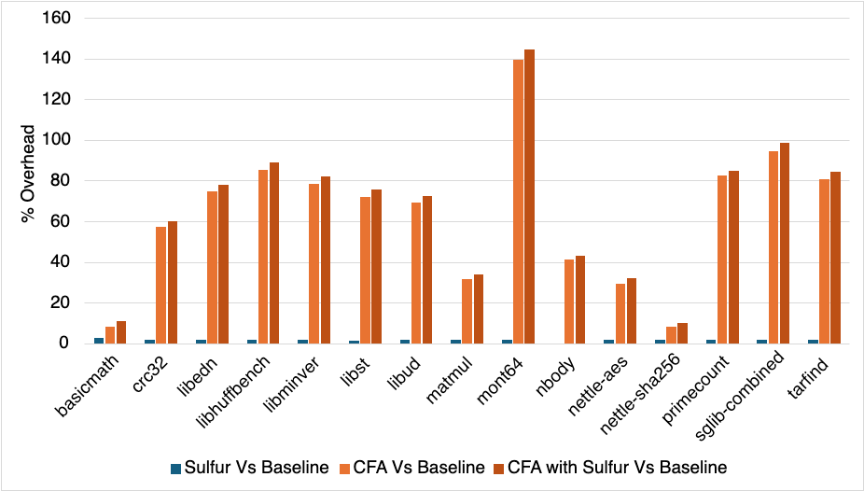
Evaluation: Embedded Benchmarks
Avg +1.67% for Sulfur alone
Avg +1.94% on top of Blast with Sulfur
Notes:
Sulfur’s protections are lightweight: ~1.7% average overhead by itself, and ~1.94% when layered on top of CFA—tiny compared to CFA’s ~63.5% cost.
Sulfur vs Baseline (avg): 1.67% (median 1.69%). Max: 2.91% on basicmath; Min: 0% on nbody.
CFA vs Baseline (avg): 63.50%; CFA+Sulfur (avg): 66.66%.
Incremental Sulfur over CFA (avg): 3.17% (median 3.28%); peak: +5.02% on mont64. Across diverse embedded benchmarks, Sulfur’s overhead is about 1.7% by itself. The heavy lifting cost is CFA at ~63.5%. When we add Sulfur on top of CFA, the increment is still small—~3.2% on average.

Slide 47
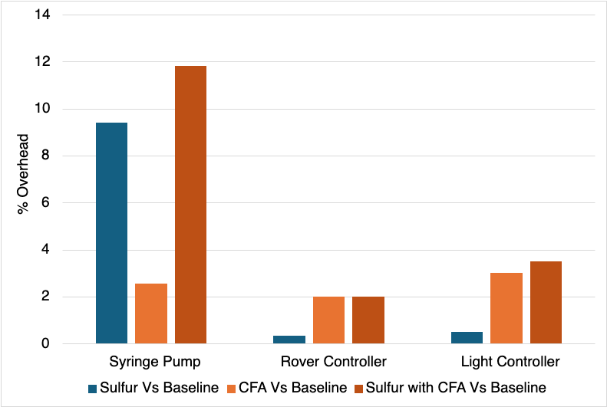
Evaluation: Embedded Applications
Near‑zero to moderate added cost; worst case stays <10% on top of Blast.
Notes:
On real apps, Sulfur is negligible on two workloads and moderate on one: +0.33% (Rover), +0.5% (Light), and +9.39% (Syringe Pump); combined with CFA it stays below ~10%.
In real applications, Sulfur’s added cost is near‑zero for Rover, low for Light, and moderate for Syringe Pump, but even there the total with CFA stays under 10%.

Slide 48
Summary
Robust CFA in non-bare-metal settings.
Protects CFA artifacts and execution state of the system/OS.
Lightweight via hardware features (PAN/PACBTI).
Conclusion: Sulfur delivers robust CFA in non‑bare‑metal settings with low overhead.
Notes:
Together, these two sets of defenses enable Sulfur to offer robust user-space CFA measurements. They isolate and protect P’ execution state and its CFA measurements, ensuring that any deviation in P’s control flow, whether due to attacks in P or SulfurOS, either cannot modify or leave a detectable attack trail in CFA measurements. Sulfur’s use of hardware features (PAN/PXN/PACBTI) allows the defenses to be lightweight. Copilot: To wrap up, here’s the bottom line: Sulfur delivers robust Control-Flow Attestation in non-bare-metal settings, even when the REE OS is compromised.
We achieve this through two layers of defense:
System Integrity Guardrails that protect the OS and system state.
CFA-Centric Protections like S-Vault, which secures CFA artifacts and application context.
What’s equally important is that these protections are lightweight. Sulfur adds only about 1.7% overhead by itself, and even when combined with CFA, the extra cost is just ~3% on average for benchmarks and stays under 12% total for real applications.

Slide 49
Conclusion
Scales CFA to whole programs and applies it to non-bare-metal setting by the novel use of hardware and software-based isolation techniques
Metric | Contributions
Scalability | Whole Programs
Performance Overhead | Two order of magnitude faster
Log Size | Compact WPPs
Applicability | Non-bare-metal setting

Slide 50


Open Problems
Attestation of OS services:
Current CFA approaches do not ensure that the operation has been pursued to completion within the OS and hardware.
Challenges – code constraints, different contexts, verification, scope of attestation.
Explore combination of techniques such as Control-Flow Integrity and hardware features to create lightweight control-flow attestation.
App A
App B
System Call
Operating System
Peripherals
Notes:
I have identified open problems based on my research works in attestation so far, which I think are worth exploring. I will be happy to collaborate, if you're interested. And I 'll be happy to explore some other research directions as well. I have listed the problems from least speculative to most speculative.
The first problem is attestation of OS services and peripherals to generate an end-to-end proof of execution. e.g. syringe pump--- ( we don't attest whether the operation has been performed to completion in the OS or not).
This is an open problem and has not been explored by any prior works.
Now, there can be some challenges in attesting the integrity of an OS execution. First, OS instrumentation itself may pose some contraints as
it may contain architecture specific code and contraint on the changes we can make. Second, the OS switches context frequently and runs in different context, we'll have to record the context separately for every process. Third, Verification is also challenging because of the sheer complexity of the OS – a single 1 MB write to disk from app results in approx. 400,000 control-flow events.. Finally, it is also difficult to specify what do we want to attest, what is an operation and there can be multiple definition. For. E.g., we may be interested in ensuring that peripherals registers were written correctly , e.g., the bolus amount. In case of files, we may be interested in ensuring that the file content written on disk have not been modified by OS. We'll have to narrow down the problem, define the scope, and build technique for attestation of it's services. I would like to explore hybrid techniques which combine CFI with CFA in order to build lightweight CFA. For example, when CFI is enabled, we may have to record less information to verify the program execution.
3. applying CFI to kernel – XFI: software guards for system address space

Slide 51
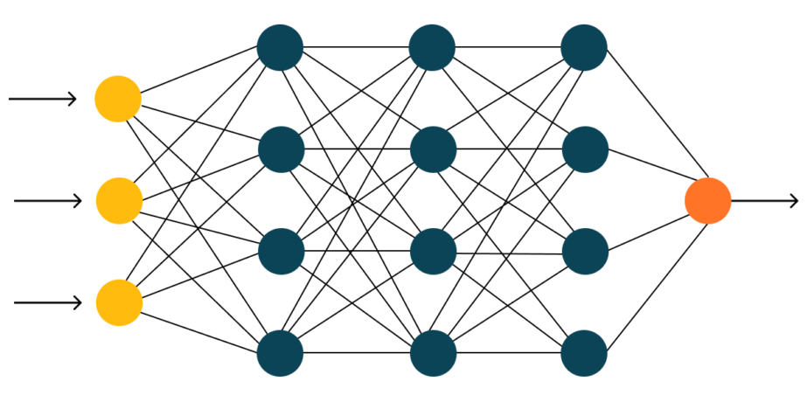
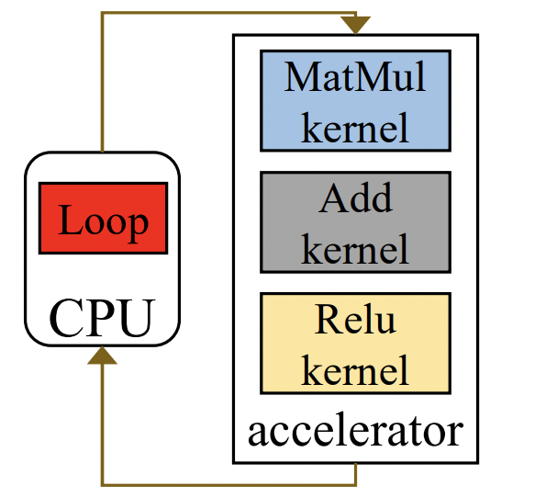
Open Problems
Proof of Inference:
ML models are increasingly deployed in cloud and edge environments where adversaries may try to tamper with execution.
Attacker can inject malicious code in ML pipeline/ alter control-flow (e.g. in Tensorflow).
Adapt notion of 'attestation' to reason about integrity of ML inference.
ML Model
Input
Output
System overview of DNN computation^{[2]}
[1] Image Source: qtravel.ai;
[2] Cocktailer, OSDI'23
Notes:
Lastly, we can apply the notion of attestation in ML domain to build proof of inference. This is interesting because
(1) ML models are increasingly deployed in cloud and edge environments where adversaries may try to tamper with execution. For e.g., Attackers could inject malicious code into the ML pipeline
(2) Similar to normal programs, execution of ML model also include control-flows, which is mainly used to distributed the ML training and inference on multiple CPUs and GPUs. The control-flow logic is executed In the CPU and data operation are sent to GPU which run parallely. Attacker can alter control flow to (introduce hidden backdoors) to compromise execution, For e.g., it may not include some data for inference. Control-flow Attestation can help to verify that the execution of a model follows the predefined graph of operations (e.g., in TensorFlow/PyTorch)
Data-flow attestation can help to track the flow of model parameters and verify that weights have not been maliciously altered.

Slide 52



Acknowledgements
Prof. Vinod Ganapathy
Indian Institute of Science
CSSL
Computer System Security Laboratory
Friends & Family

Slide 53
Thank you

Slide 54
Backup slides

Slide 55
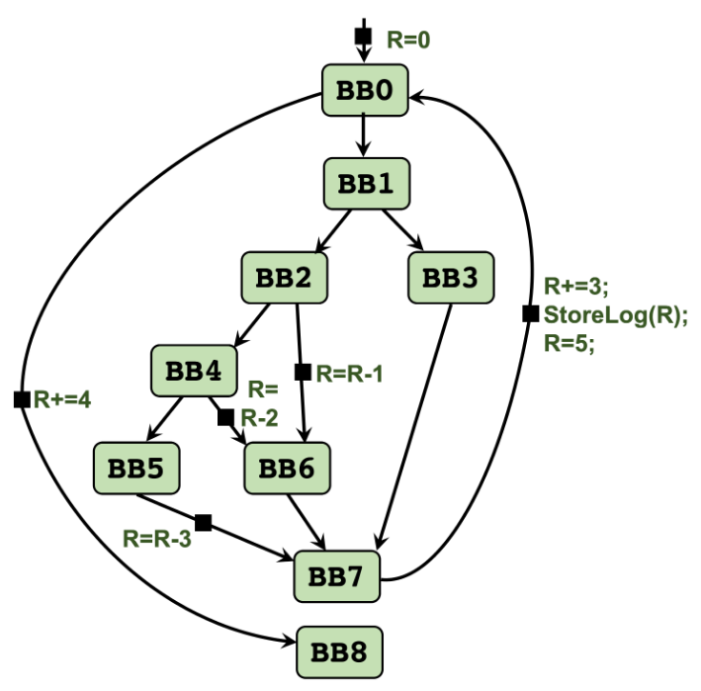
Ball Larus Profiling: Handling Loops
Path | Encoding
BB0 -> BB1->BB2->BB4->BB5->BB7 | 0
BB0->BB1->BB2->BB4->BB6->BB7 | 1
BB0->BB1->BB2->BB6->BB7 | 2
BB0->BB1->BB3->BB7 | 3
BB0->BB8 | 4
BB7->BB0->BB1->BB2->BB4->BB5->BB7 | 5
BB7->BB0->BB1->BB2->BB4->BB6->BB7 | 6
BB7->BB0->BB1->BB2->BB6->BB7 | 7
BB7->BB0->BB1->BB3->BB7 | 8
BB7->BB0->BB8 | 9

Slide 56
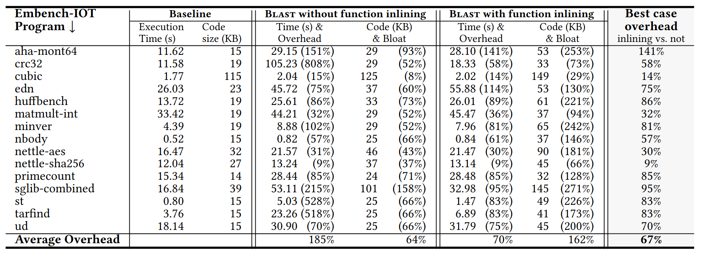
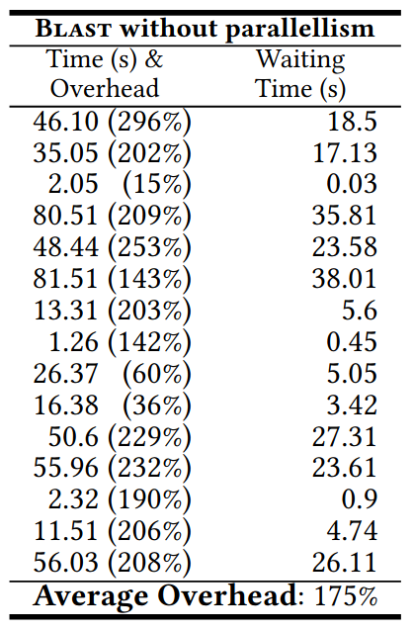
Performance Analysis of BLAST
(a) Log Commit happens in parallel with P's execution on a different CPU core.
(b) Log Commit is interleaved with P's execution.

Slide 57
WPP Representation
Repeated sequences of control-flow events are compressed into
context-free grammar rules.
Log Entries | Identifier
<foobar, 2> | a
<foo, 8> | b
<bar, 9> | c
<foobar, 5> | d
<foo, 8> | b
<bar, 9> | c
Execution Trace: abcdbc
WPP:
S -> aCdC
C -> bc
Ref: Whole program paths, ACM SIGPLAN Symposium on Programming Language Design and Implementation, 1999

Slide 58
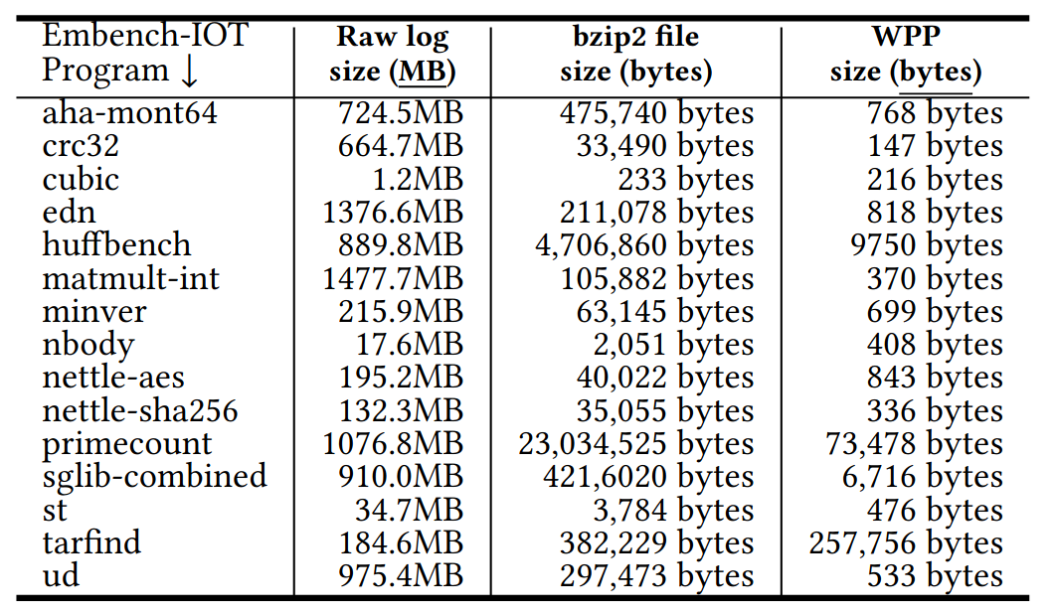
Effectiveness of WPP Representation

Slide 59
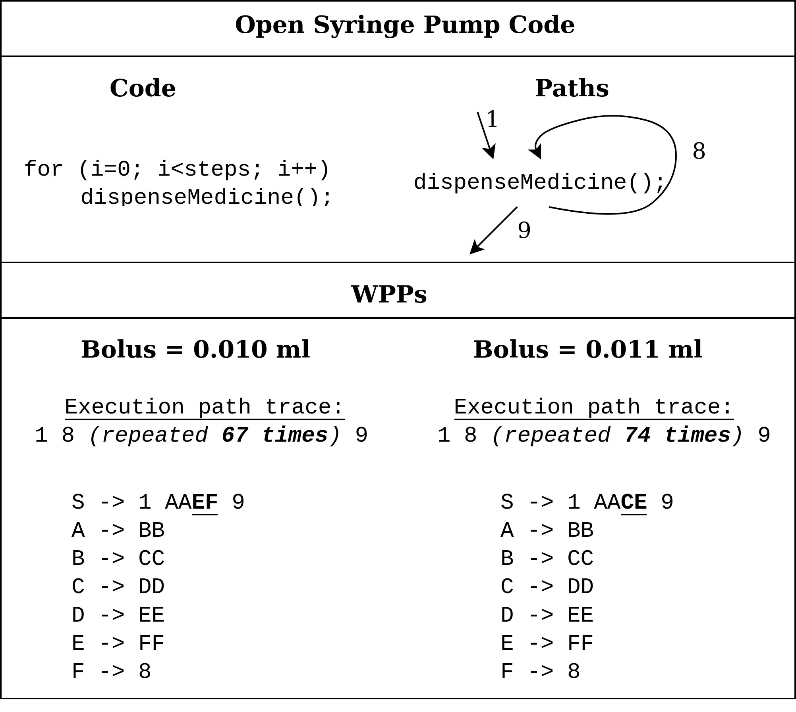
Case Study - Syringe Pump

Slide 60
Qualitative Security Analysis
Attacker modifies BL Reg suitably to record desired path value
The BL Reg is reserved.
The indirect jump and call addresses are logged.
Attacker corrupts the Log
Tries to use program's store instruction to write in Log
Prevented by SFI checks on all store instructions
Tries to use BLAST instrumentation to write in Log
The Log Reg is reserved, and it is only incremented by instrumentation.
It can only append to Log. But the execution trace is always recorded!

Slide 61
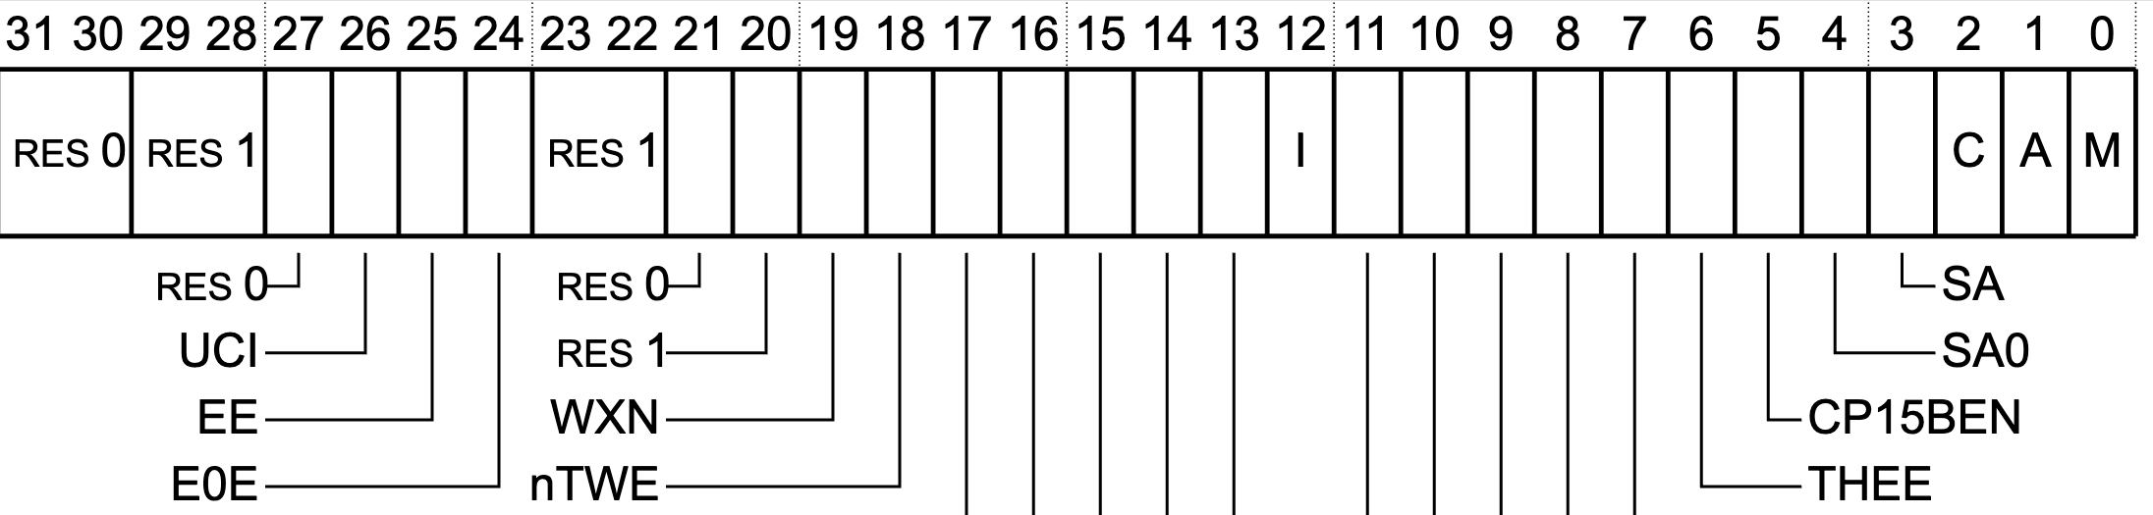
Attack Example: Code Modification
REE
Reset WXN bit in SCTRL_EL1 Register
Program P
…..
Store BLReg, Log
CALL Reg
…..
User
Kernel
System Config
System Registers
Operating system
Notes:
Slide 38 is TOO BUSY for a job talk. There is too much going on here. I don't know which box to focus on. Can you just show the relevant code, and introduce things as and when you talk about them? Not all the boxes here are necessary to understand what is going on. CAN YOU CONVEY THE CRUX OF THE PROBLEM WITHOUT GOING INTO ALL THE DETAILS? I FEEL THE AUDIENCE MEMBER WILL GET LOST INTO THE DETAILS HERE AND COMPLETELY LOSE TRACK OF THE BIG PICTURE, I.E., THAT THE PRESENCE OF AN UNTRUSTED OS COMPLETELY DEFEATS CFA.
This phrase "The untrusted OS COMPLETELY DEFEATS PRIOR CFA TECHNIQUES, INCLUDING BLAST" MUST be there in your talk to show that NOTHING works once you bring an OS into the picture.

Slide 62
Interrupt-based Attack
CFA-instrumented Program P
REE TEE
Control Data
Code
CFA_{Log}
CFA Trusted App
Mov R, Addr
Call Addr
0x8d46
BL Num
Record
R value 0x8d46
CALL R
TEE OS
User
Interrupt
Resume
Kernel
System Config
Modify
Context
Memory Mgmt
TEE
Driver
Secure Monitor
OS
R = 0x9045
System Registers
Page Tables
Notes:
Slide 39. TOO much detail. Too many attacks. You give one attack in detail. And then mention what else is possible. You don't need to describe everything in detail in a job talk.

Slide 63
Key Insight 3: SULFUR Gates
Program P
S-Vault
1
4
Save
context
Restore
context
Entry Gate
2
3
Exit Gate
SULFUR OS
PAN = 1

Slide 64
Key Insight 3: Protecting Context
Entry Gate
//Save Process Context to Userspace Log
sttr x0, addr //stores the value of register x0
….
Program P
Is it secure?
Code
Context
Rewrite x0 with modified value
Entry / Exit Gates
LDTR/STTR
LDR/STR
Re-enter the entry gate
EL1
Context
Modifies x0
OS
PAN = 1
Notes:
Slide 45: Do NOT INTRODUCE CLOG and other details. Just talk about ONE log, i.e., the log presented in the first portion of the talk. Not TWO logs.
Slide 45: Entry and exit gates are important. Talk about them abstractly as writing to the log. No need to get into details of CLOG, CFALOG and so on. Talk about Gate design. That gets into one technical detail, but explain the design of these gates. Show the code, show the attack possible, and show your clever defense! Show how everything comes together in the solution here! CONVEY INTUITIONS, NOT DETAILS.

Slide 65
Key Insight 3: Protecting Context
Program P
Non-Rentrant Entry Gate
If (kernel_mode is 0):
Save Process Context to Userspace Log
If (kernel_mode is 0):
Set kernel_mode to 1
else:
Call Monitor // Re-entry Detected!
else:
Call Monitor // Incorrect Exit Detected!
Code
Kernel_mode = 1
Kernel_mode = 0
Context
x0
Entry / Exit Gates
LDTR/STTR
LDR/STR
Exit Gate
Set Kernel_mode to 0
Restore Process Context from Userspace Log
Return to user
Jump to Line 2 in Entry Gate
EL1
OS
Modifies x0
PAN = 1
Notes:
Slide 45: Do NOT INTRODUCE CLOG and other details. Just talk about ONE log, i.e., the log presented in the first portion of the talk. Not TWO logs.
Slide 45: Entry and exit gates are important. Talk about them abstractly as writing to the log. No need to get into details of CLOG, CFALOG and so on. Talk about Gate design. That gets into one technical detail, but explain the design of these gates. Show the code, show the attack possible, and show your clever defense! Show how everything comes together in the solution here! CONVEY INTUITIONS, NOT DETAILS.

Slide 66
Summary
Whole Program CFA
Non-bare-metal CFA
BLAST addresses performance bottlenecks
SULFUR protects the integrity of
Frequent TEE Domain Switches
Sub-optimal Path Measurement
CFA artifacts (instrumentation, CFA_{Log}, TEE calls)
Process State
Buffer Locally
Ball Larus Profiling
Configuration Protection
PAN and SFI Isolated Region
Entry/ Exit Gates
Avg. 67% Runtime Overhead
Low Runtime Overhead

