Slide 1

Techniques and Tools for Secure Web Browser Extension Development
Rezwana Karim
Computer Science, Rutgers University
Committee: Prof. Vinod Ganapathy(Chair), Prof. Ulrich Kremer, Prof. Santosh Nagarkatte, Prof. Long Lu(Stony Brook University)
PhD Defense Talk

Slide 2






Platforms with extensibility
Rezwana Karim

Slide 3
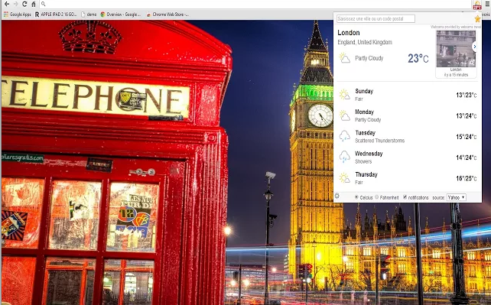
Web browser extension
Rezwana Karim

Slide 4










Extensions are everywhere
Weather Watcher
Gmail Manager
Google Toolbar
Search by Image
Video Download
Helper
Evernote Web Clipper
Strict Workflow
Invisible Hand
Honey
ESPNCricinfo
Pic2Pixlr
Greasemoneky
Click and Clean
Firebug
Instapaper
Pocket
Unfriend Notify for Facebook
Social fixer
Adblock
HTTPS everywhere
LastPass
Rezwana Karim

Slide 5








Extensions are everywhere
Sensitive resources
Weather Watcher
Gmail Manager
Google Toolbar
Search by Image
Video Download
Helper
Evernote Web Clipper
Strict Workflow
Invisible Hand
Honey
File system
Network
Cookies
History
Password
Preference
Camera
OS
Different from Web applications
ESPNCricinfo
Pic2Pixlr
Greasemoneky
Click and Clean
Firebug
Instapaper
Pocket
Unfriend Notify for Facebook
Social fixer
Adblock
HTTPS everywhere
LastPass
Rezwana Karim

Slide 6









Extension ecosystem
Feature-rich platform
Increased download
Privileged API
Rezwana Karim

Slide 7
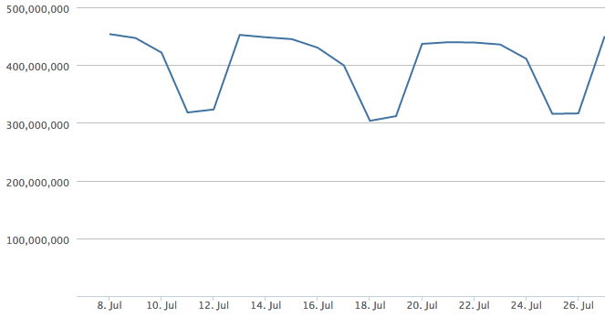


Popularity of browser extensions
Firefox extensions in use
> 53, 000 (February, 2013)
>10 million users for Adblock plus
> 14, 000 (July, 2015)
>19 million users for Adblock plus
https://addons.mozilla.org/en-US/statistics/
Rezwana Karim

Slide 8
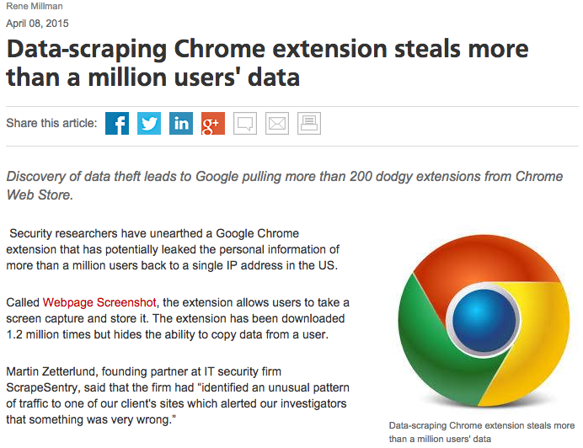
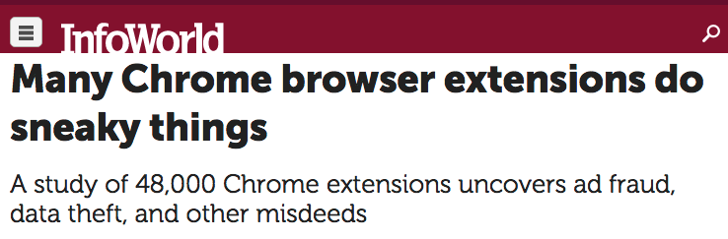

Slide 9






Vulnerable extensions jeopardize platform security
www.evil.com
Insecure Programming Practice | ➔ | Exploitable vulnerability
[Barth et al., NDSS‘10] [bhandhakavi et al., Usenix Security‘10]
Rezwana Karim

Slide 10


Safeguard platform from vulnerable third party extensions
Rezwana Karim

Slide 11
Legacy extension architecture
Extension Code
(Web Script + Extension Script)
Access sensitive resource
Interact with
Web pages
Sensitive resources
Web page
File system
Network
Cookies
History
Password
Preference
Camera
OS
Extension Script: JavaScript code executing within the secure world
Web Script: JavaScript code executing on the insecure web page world
Rezwana Karim

Slide 12
Modern extension: Layered defense architecture
Isolation
Privilege Separation
Principle of Least Authority (POLA)
Insecure World
Secure World
Extension
Script
Extension Code
(Web Script + Extension Script)
Web
Script
Access sensitive resource
Interact with
Web pages
Manifest
Web page
Sensitive resources
Rezwana Karim

Slide 13


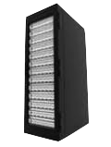

Defense-in-depth strategy
Developer’s expertise effect extension security
Main
[Karim et al., ECOOP‘12]
File
Network
Rezwana Karim

Slide 14
Research questions
How can we simplify secure extension development?
How to detect security principle violations in browser extensions?
How to transform a legacy vulnerable extension into a secure extension that adheres to the security principles?
Analyzing the interactions with sensitive resources in extension code

Slide 15
Extension Security: Solution spectrum
1) VEX [Usenix Sec ‘09]
Key Idea: Static taint analysis
2) Security Signature [CGO ’14]
Key Idea: Information flow and API usage
1) SABRE[ACSAC ‘09], Secure extensibility[Usenix Sec ‘10]
Key Idea: Taint tracking
2) Sentinel[DIMVA‘13], IBEX[S&P ‘11]
Key Idea: Runtime policy enforcement
1) Beacon [ECOOP‘12]
2) Morpheus [ECOOP ‘14]
Morpheus [ECOOP ‘14]
Rezwana Karim

Slide 16

Module Interaction
Main
Capability: Privilege to access sensitive resources
var file = require(“file”);
file.readFile (“zipCodeFile”);
. . .
var fileSystemPtr = accessToFileSystem();
exports.readFile = function readFile(fileName){
//read the content of fileName
. . .
// return the content
. . .
};
File

Slide 17
Research questions
How can we simplify secure extension development?
How to detect security principle violations in browser extensions?
How to transform a legacy vulnerable extension into a secure extension that adheres to the security principles?
Rezwana Karim

Slide 18


Key Idea: Detect capability leaks
Capability leaks through module interface leads to vulnerability
Main
File
Network
Rezwana Karim

Slide 19
Capability flow analysis
Static analysis of JavaScript(JS) modules
Points-to analysis
Information flow
Taint: capability
Source : privileged resource access
Sink: ‘exports’ interface
Call graph based
Context and flow insensitive
Rezwana Karim

Slide 20
Capability flow in object hierarchy
var a = {
x : object,
y : {
p : fileSystemPtr,
z : object
}
}
a
x
y
p
z

Slide 21
Capability flow using Datalog
var a ={
x : object,
y:{
p: fileSystemPtr,
z: object
}
}
ptsTo(v_{a}, h_{a})
isTainted(h_{a}, file)
a
heapPtsTo(h_{a}, y, h_{y})
isTainted(h_{y}, file)
ptsTo(v_{y}, h_{y})
ptsTo(v_{x}, h_{x})
x
y
heapPtsTo(h_{a}, x, h_{x})
store(v_{y}, p, v_{p})
heapPtsTo(h_{y}, z, h_{z})
heapPtsTo(h_{y}, p, h_{p})
p
z
ptsTo(v_{p}, h_{p})
ptsTo(v_{z}, h_{z})
isTainted(h_{p}, file)
Rezwana Karim
[Gatekeeper, Guarnieri et al., Usenix Security’09]

Slide 22


Beacon: Capability flow analysis tool
Rules for JS to Datalog translation
Points-to
rules
Heap allocation
Call graph generator
SSA analyzer
Inference engine
SSA
format
Initial facts
Capability
analysis
report
Taint
inference rules
Imported module
summaries
2.8k lines of Java, Datalog
Tools Used : WALA, DES
Rezwana Karim

Slide 23
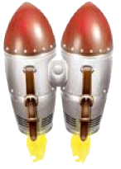
Evaluation
Jetpack: Mozilla’s new browser extension framework
Over 600 Jetpack modules
Modules from 359 Jetpack extensions
68k lines of JavaScript code
Rezwana Karim

Slide 24
Capability leak
36 leaks in over 600 modules
12 in vendor code
Modules | Capability | Leak Mechanism | Essential
tabs/utils | Active tab, browser window and tab container | Function return | yes
window-utils | Browser window | Function return | yes
xhr | Reference to the XMLHttpRequest object | Property of this object | no
xpcom | Entire XPCOM utility module | Exported property | no
Effect all extensions developed on top of it
Rezwana Karim

Slide 25
Capability leaks: developer code
24 leaks in 359 extensions
Not required for functionality
Extension | Capability | Count
Bookmarks Deiconizer | Sensitive resource service module | 1
Browser Sign In | Window, document | 2
Customizable Shortcut | Preference, DOM, window | 3
Firefox Share | Preference, window, database, observer database, stream, network | 10
Most Recent Tab | Preference, window | 2
Open Web Apps | Preference, window, database, observer | 4
Recall Monkey | IOService, favIcon | 2
Rezwana Karim

Slide 26
Accuracy: Capability leak
No False Positive
May miss some leaks
Dynamic features
Iterator, generator
Unsupported JS constructs
for..each, yield, case statement over a variable
Unmodeled JS constructs
eval, with
Latent bugs
Rezwana Karim

Slide 27
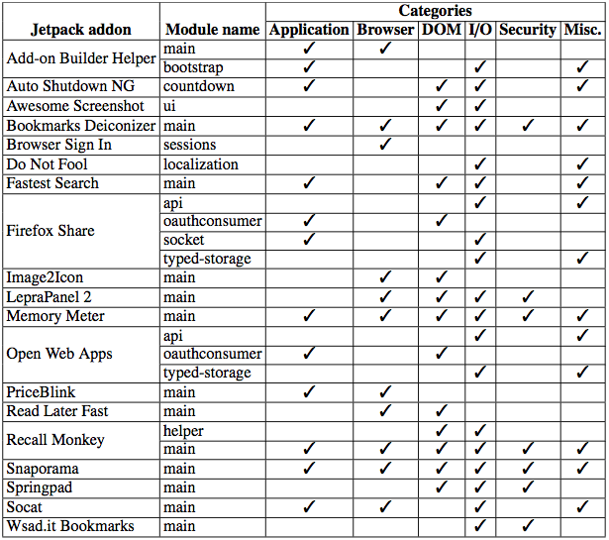
Violation of privilege separation
26 modules in 19 extensions

Slide 28
Violation of POLA
Beacon generates 18 warnings, 7 false positive
Vendor module | Privilege | Severity
file | Directory service | Moderate
hidden-frame | Timer | None
tab-browser | Errors | None
content/content-proxy | Chrome | Critical
content/loader | File | Moderate
content/worker | Chrome | Critical
keyboard/utils | Chrome | Critical
clipboard | Errors | None
widget | Chrome | Critical
windows | XPCOM, apiUtils | Critical
Mozilla acknowledged and removed these violations
https://github.com/mozilla/addon-sdk/pull/291
Rezwana Karim

Slide 29
Research questions
How can we simplify secure extension development?
How to detect security principle violations in browser extensions?
How to transform a legacy vulnerable extension into a secure extension that adheres to the security principles?
Rezwana Karim

Slide 30
Legacy to modern transformation
~10000 popular legacy extensions
Legacy
Morpheus
Modern
Design Challenges
Privilege Separation
POLA
Preserve UI
Time consuming, labor-intensive
Deep and clear understanding of differences between two programming models
Rezwana Karim

Slide 31
Challenge 1: Privilege Separation
Secure/Insecure partition
Partition monolithic code into isolated JavaScript modules
Increase the minimum number of modules to be compromised
Rezwana Karim

Slide 32
Secure/Insecure world partition
Static dataflow analysis to identify object’s context
Rewrite property access with accessor
Opaque identifiers for shared objects
Emulating synchronous communication over asynchronous channel
Insecure
contentDocument
Asynchronous communication
gBrowser.contentDocument
Secure
gBrowser
.getProperty(‘contentDocument’)
Legacy
Modern
Rezwana Karim

Slide 33
Partition into multiple modules
(Legacy)
DisplayWeather
Main
Weather
Network
File
Sensitive resources
Rezwana Karim

Slide 34
Challenge 2: Conformance to POLA
Only required modules are imported
No capability leak across module interface
Encapsulate privileged object
Exposes only accessor methods; returns
Primitive values
An instance of a module
Generate Manifest
Rezwana Karim

Slide 35
Transforming legacy code
Sensitive resource invoke
Rewrite with ‘require’
o := object(ξ)
o is sensitive OR o is in content
Rewrite with ‘getProperty’/ ’setProperty’
Property access
Node n in AST
Expression
ξ
o := object(ξ)
o is sensitive OR o is in content
Rewrite with ‘invoke’
Method invoke
Object Literal
Rewrite with ‘require’
Extract User module
Global access
Rewrite with ‘GlobalGET’ / ‘GlobalSET’
Rezwana Karim

Slide 36
Core module usage
Identify sensitive resource usage
Replace with core module
main.js
var data = fileSystemPtr.read(‘zip.txt’);
require(‘file’).module.
invoke(‘read’, ‘zip.txt’);
file module
var file = fileSystemsPtr;
var _module_ = {
invoke: function(methodName, args){. . .
//switch case },
. . .}
exports.module = _module_;
Rezwana Karim

Slide 37
Extracting user module
Identifies and groups related functionality into a single module
main.js
function readZipCodeFromFile(location){...}
var Weather = { ...
getWeatherData:function(zipcode){
...
return Weather.requestDataFromServe(zipcode);
},
requestDataFromServer: function(zipcode){...},
}
function showWeather(){
...
var temperature = Weather.getWeatherData(zipcode);
...
}
var Weather = require(‘user/Weather’).module;
GlobalSET(’Weather’, Weather);
Weather.invoke(
‘getWeatherData’, zipcode);
Rezwana Karim

Slide 38
Extracted Weather module
Weather module
var _module_ = {
...
getWeatherData: function(zipcode){
return GlobalGET(’Weather’).invoke (’requestDataFromServer’, zipcode);
},
requestDataFromServer: function(sendData){ ...
}
}
exports.module = _module_;
Rezwana Karim

Slide 39
Preserve UI
Analyzes legacy extension’s XUL overlay file, resource URI, CSS, icons
Generates JS code to dynamically modify the browser’s UI
var sb = document.
getElemenById(‘sb’);
sb[“onclick”]=function(){
alert(‘Hi’);
}
<statusbar id=‘sb’
onclick=‘alert(“Hi”)’>
...
</statusbar>
Legacy XUL code
Generated JS code

Slide 40


Policy checker
Yes
m = ‘file’
p = ‘read’
α[‘file-path’] allowed?
No
Yes
m = ‘network’
p = ‘open’
α[‘url’] allowed?
CHECK
Module: m
Property: p ArgList: α
No
. . .
. . .
Yes
(m, p, α) is sink
violating source(m’, p’, α’) already accessed?
No
Rezwana Karim

Slide 41
Module level privilege computation
Let, P(m) : the set of privileges that can be accessed by a module m
m → x : module m has direct access to sensitive resource x
m_{i} → m_{j} : module m_{i} imports module m_{j}
m^{u} : user module in an extension,
m^{c} : core module in an extension
Core module User module
Module privilege is fixed at runtime
P(m) :=
{ P(x) | m → x }
P(m) :=
{ P(m^{c}) | m→m^{c}}
U
{ P(m^{c}) | m→m^{c}}
Rezwana Karim

Slide 42



Security analysis of transformed DisplayWeather extension
Limit vulnerability effect only to compromised module
Increases the minimum number of modules to be comprised
Main
file
network
password.txt
Weather
file
password
network
Login Manager
Network
File
Policy Checker
Rezwana Karim

Slide 43
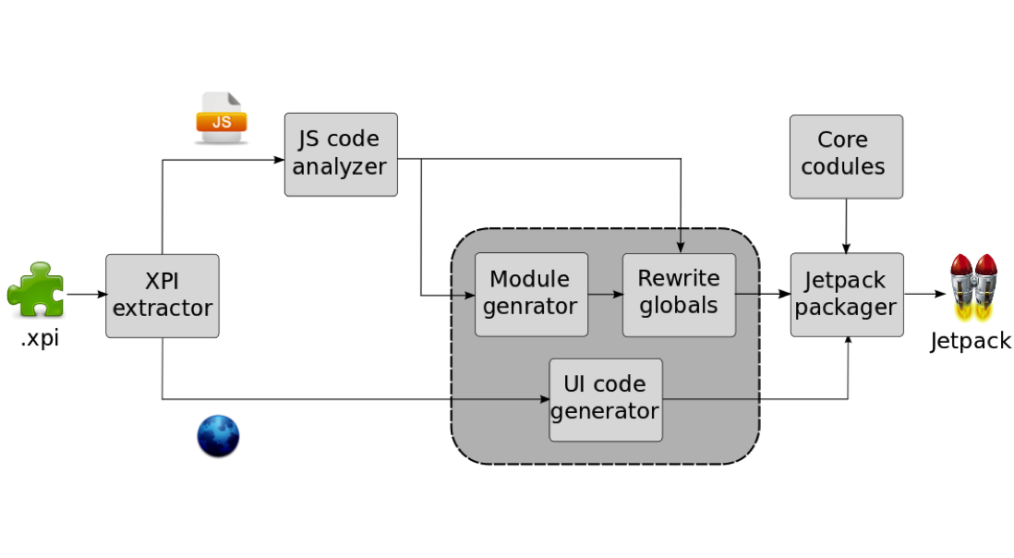
Morpheus: Implementation
2.9k lines of JavaScript
10.5k lines implementing 100 core modules
Rezwana Karim

Slide 44
Evaluation
Dataset
Extensions developed using JavaScript, HTML, XUL, CSS
52 Legacy extensions: 50 real-world, 2 synthetic
Correctness of transformation
Manually exercised advertised functionality
All transformed (Jetpack) extensions retains advertised functionality
Rezwana Karim

Slide 45

Evaluation: Conformation to POLA
Capability leaks lead to POLA violation
Used Beacon to verify that no module leak reference to privileged objects
Main
File
Network
[Karim et al., ECOOP‘12]
Rezwana Karim

Slide 46
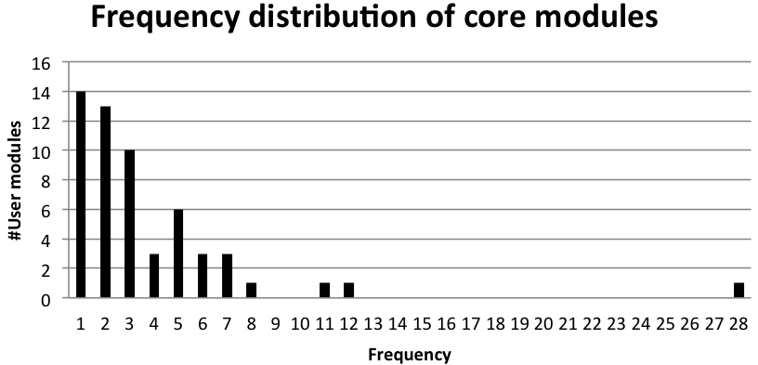
Evaluation: Effectiveness of user module extraction
Privilege separation in user modules
#Core modules
Rezwana Karim

Slide 47
Modules accessing multiple categories of core modules
Categories
I : Application
II: Browser
III: DOM
IV: I/O
V: Security
VI: Misc.

Slide 48
Runtime policy checking
Policy | Generic | # extensions
Contact only specified remote server | No | 3
Access only files in profile directory as advertised | No | 1
Cannot access preference branch other than its own | Yes | 2
Cannot contact server if the extension has already accessed file system | Yes | 1
Cannot contact server if the extension has already accessed LoginManager | Yes | 1
Cannot contact server if the extension has access browsing history | Yes | 1
Cannot contact server if the extension has access browser cache | Yes | 2
Rezwana Karim

Slide 49
Limitations
Plethora of privileged APIs
Extensions with binary component
Performance slowdown due to repeated context switches
Might require Developer assistance
Encoding extension-specific policy
Rewriting special cases like comparison against HTMLDocument
Rezwana Karim

Slide 50
Summary
Extension security depends on developer expertise and meticulous effort
How to detect security principle violations in Web browser extensions?
Beacon[ECOOP ’12]: a system for capability flow analysis
How to transform a vulnerable extension into a secure extension that adheres to these principles?
Morpheus[ECOOP ’14]: automate transformation toolchain
Results acknowledged by Mozillahttps://github.com/mozilla/addon-sdk/pull/291
Rezwana Karim

Slide 51



Web technology in app development
42% app developers already using
Most popular technology in emerging markets
– Vision Mobile, Q3,2014
50% apps by 2016 - Gartner
Rezwana Karim

Slide 52
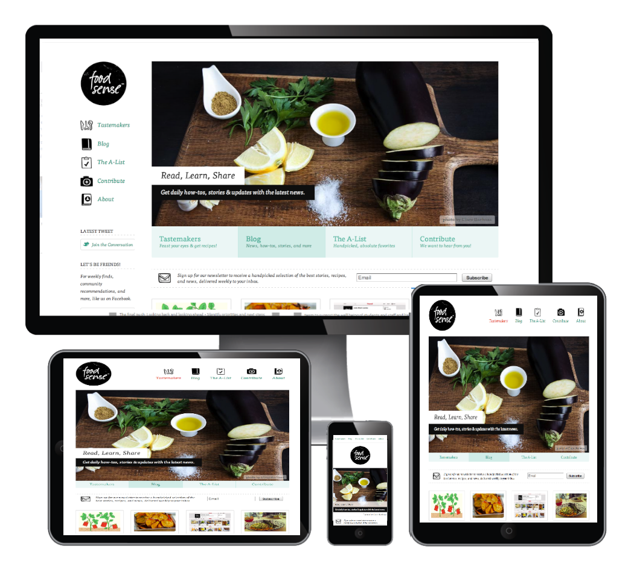

My research
Simplify app development
Security
Cross-platform app UI
Beacon
[ECOOP’12]
Morpheus
[ECOOP’14]
WebC
[FSE’13]
DECOR
[FSE’15]
Rezwana Karim

Slide 53
Other contributions
Simplifying Programming for the Web [ISEC 2015] Best Paper Award
Fast, Memory-efficient Regular Expression Matching with NFA-OBDDs [Computer Network Journal]
Improving NFA-based Signature Matching using Ordered Binary Decision Diagrams [RAID2010]
Rezwana Karim

Slide 54
Future direction
Simplify app development
Porting app across platforms
Security
Cross-platform app UI
App security in IoT
Context-sensitive UI
in IoT
Rezwana Karim

Slide 55
Acknowledgements
Dissertation advisor
Vinod Ganapathy
PhD Committee members
Ulrich Kremer, Santosh Nagarkatte, Liviu Iftode, Long Lu
Co-authors
Nishant Sinha (IBM Research)
Chung-chieh Shan (Indiana University)
Mohan Dhawan (IBM Research)
Liu Yang (HP)
Randy Smith (Sandia National Lab)
Discolab members
Steve smaldone, Pravin Shankar, Lu Han, Shakeel Butt, Amruta Gokhale, Nader Boushehrinejadmoradi, Daeyoung Kim, Hai Nguyen, Daehan Kawk, Ruilin Liu and several other past and present members
Friends and Family
Rezwana Karim

Slide 56
Thank you
rkarim@cs.rutgers.edu
http://paul.rutgers.edu/~rkarim

Slide 57
Backup slides (Beacon)

Slide 58
Proof of concept example: Customize-shortcut
const {Cc, Ci} = require("chrome");
let Preferences = {
branches: {},
.. .
getBranch: function (name) {
let branch = Cc["@mozilla.org/preferences-service;1"]
.getService(Ci.nsIPrefService).getBranch(name);
…
return this. branches [name] = branch;
}, ...
};
exports. Preferences = Preferences;

Slide 59
Datalog relations: capability flow analysis
Points-to analysis | Relation | Description
Heap Mapping | ptsTo(V, H) | Variable points-to relation
 | heapPtsTo(H1, F, H2) | Heap objects points-to relation
Object Manipulation | assign(V1, V2) | Variable assignment
 | store(V1, F, V2) | Field store
 | load(V1, V2, F) | Field Load
Taint Inference | Relation | Description
Capability flow | isTainted(H, P) | Heap object taint value P
Rezwana Karim

Slide 60
JavaScript statement processing
Statement | Example Code | Generated Facts
ASSIGN | v₁ = v₂ | assign(v₁, v₂)
OBJECT LITERAL | v = {} | ptsTo(v, h_{fresh})
STORE | v₁.f = v₂ | store(v₁, f, v₂)
LOAD | v₁ = v₂.f | load(v₁, v₂, f)
Rezwana Karim
[Gatekeeper, Guarnieri et al., Usenix Security’09]

Slide 61
Inference rules
Basic Rules
ptsTo(V₁, H) | :- | ptsTo(V₂, H), assign(V₁, V₂ )
ptsTo(V₂, H₂) | :- | load(V₂, V₁, F), ptsTo(V₁, H₁), heapPtsTo(H₁ , F, H₂ )
heapPtsTo(H1, F, H2) | :- | store(V₁, F, V₂), ptsTo(V1, H1), ptsTo(V₂, H₂)
Taint Propagation
isTainted(H1, P) | :- | heapPtsTo(H1, F, H2 ), isTainted(H2, P)
Rezwana Karim

Slide 62
Capability leak
Capability leaks lead to security principle violation
Multiple ways
Direct references to privileged resources
Functions returning references to privileged resources
var fileSystemPtr = accessToFileSystem();
exports.fileSystemPtr = fileSystemPtr;
exports.getFileSystem = function(){
return fileSystemPtr;
}
File
Rezwana Karim

Slide 63
Backup slides (Morpheus)

Slide 64
Module template
. . .
getProperty: function() {
var propertyName = arguments[0];
var violated = policyChecker.check(<core_module_name>, propertyName);
if(violated) return {};
var ref = table.getReference(this.id);
switch(propertyName) {
case ’< depends on the core module >’:
var retval = ref[propertyName];
var newref = <new_core_module_instance> ; table.setReference(newref.id, retval);
return newref;
... /* more case statements */
default:
return null;
}
} . . .

Slide 65
Security properties
Limit vulnerability effect only to compromised module
Increases the minimum number of modules to be comprised
 | Provider | Property
P1 |  | Isolated Jetpack modules
P2 | Jetpack | The set of privileges a module depends on imported (i) user modules (ii) core modules and (iii) direct access to sensitive resource
P3 |  | Module privilege is fixed at runtime
P4 |  | Modules lie in chrome space and separated by process from Web page content
Rezwana Karim

Slide 66
Security properties(cont’d)
 | Provider | Property
P5 |  | Only core module can directly access a sensitive resource
P6 |  | Each core module is limited to encapsulates reference to only one sensitive resource
P7 | Morpheus | Core modules can not import any user module
P8 |  | Each module exports only an opaque identifier and accessor methods
P9 |  | Reference to the sensitive objects are stored within a designated module
P10 | Policy checker | Access to a particular sensitive resource by a core module is mediated by security policy
Rezwana Karim

