Slide 1
Self-service Cloud Computing
Shakeel Butt
Department of Computer Science
Rutgers University

Slide 2
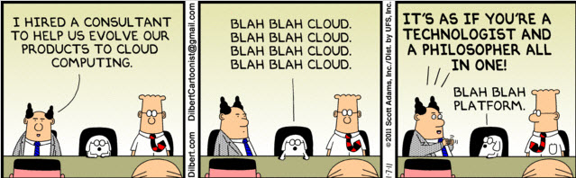
By 2015, 90% of government agencies and large companies will use the cloud [Gartner, “Market Trends: Application Development Software, Worldwide, 2012-2016,” 2012]
Many new companies & services rely exclusively on the cloud, e.g., Instagram, MIT/Harvard EdX [NYTimes, “Active in Cloud, Amazon Reshapes Computing,” Aug 28, 2012]
Notes:
Cloud computing is the new buzz word and many organizations are joining the bandwagon of CC. There is a report that 90% of the government agencies and large companies will use the cloud by 2015 and there are new startup that rely exclusively on the cloud. The reason being the economic benefit of CC, that is no acquisition or maintenance cost, elasticity and are affordable.
Economic benefit
No acquisition or maintenance cost
Elasticity
Affordable
--- NVIDIA Try GRID story

Slide 3
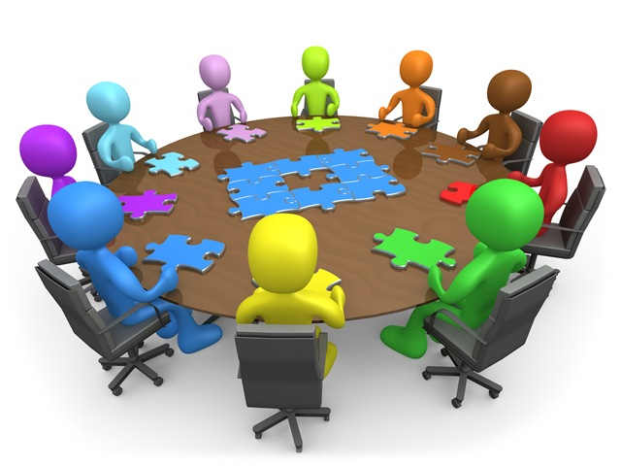
Embracing the cloud
Lets do Cloud
Notes:
In today’s talk,I am gonna talk about the challenges faced by organizations in adopting CC, particularly security challenges and later I will present how we overcome these challenges with our proposed system.

Slide 4
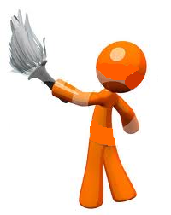

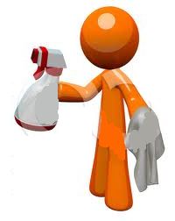

Embracing the cloud
Trust me with your code & data
You have to trust us as well
Client
Cloud Provider
Cloud operators
Problem #1
Client’s data and computation is vulnerable to attacks by malicious cloud operators
Cloud Security Alliance (CSA) termed this threat as
‘malicious insider working for Cloud Provider’
Notes:
Clear reference
Cloud security alliance has termed this kind of threat as ‘malicious insider working for cloud provider’
Biggest hurdle in adopting CC
--- Add CMU SEI CERT internal attackers numbers

Slide 5
Embracing the cloud
I need customized malware detection and VM rollback
For now just have checkpointing …
Client
Cloud Provider
Client
Cloud Provider
Problem #2
Clients must rely on provider to deploy customized services
Notes:
Now lets come to the second problem. In today’s cloud offerings, the provider provides some basic and primitive services to the customers. Now if the customer wants some customized services e.g. host based security tools or network based security tools. He has to rely on the provider to provide such services… more concrete example
The reason of these two problems Is the way current cloud platform are designed.

Slide 6


Virtualized physical platforms
Management VM (dom0)
Work VM
Work VM
Work VM
Hypervisor
Hardware
Examples: Amazon EC2, Microsoft Azure, OpenStack, RackSpace Hosting
Notes:
There is hypervisor over hardware and then there is management VM and other worker VM. This MVM is privileged and has access to all the client’s work VMs

Slide 7


Why do these problems arise?
Management VM
Client’s VM
Hypervisor
Hardware
Notes:
The problem here is that the management VM is too powerful while the client VM is too weak.
- Malicious admin can misuse the power of management VM
- Weak client’s VM doesn’t have enough priv for new services

Slide 8
My thesis
It is possible to improve security, privacy and control that cloud clients have by modifying the hypervisor’s privilege model

Slide 9
SSC: Self-service cloud computing
Management VM
Client’s VM
SSC Hypervisor
Hardware

Slide 10

Mutual trust
Management VM
Client’s VM
Mutually
Trusted
VM
SSC Hypervisor
Hardware
Notes:
The problem here is that the management VM is too powerful while the client VM is too weak.
- Malicious admin can misuse the power of management VM
- Weak client’s VM doesn’t have enough priv for new services

Slide 11
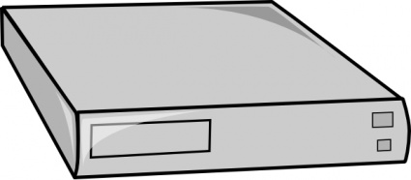
SSC Control Plane
SSC
Hypervisor
Cloud Infrastructure
Notes:
-------
STOP & re-iterate what you are gonna tell

Slide 12
Contributions
Self-service Cloud Computing [CCS’12]
  SSC hypervisor
  Mutual trust
  Six services
On the Control Plane of a Self-service Cloud Platform [SoCC’14]
  SSC Control Plane
  Five Network-based services

Slide 13
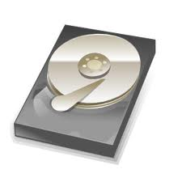
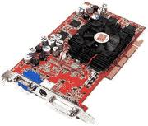
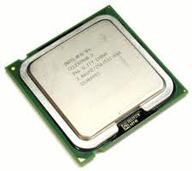
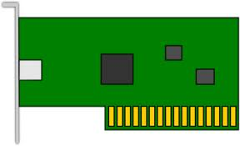

Duties of the management VM
Manages and multiplexes hardware resources
Manages client virtual machines
Management VM (Dom0)
Notes:
Now lets dissect this management VM and see why it really needs such privileges and power. This VM manages and multiplexes hardware resources and it also manages the client’s virtual machines
BTW this management VM is also known as Dom0 in XEN terminology
Arrangement of the boxes

Slide 14
Main technique used by SSC
Disaggregate the management VM
Per-Client
Mgmt. VM
(Udom0)
Manages client’s VMs
Allows clients to deploy new services
Solves problem #2
Manages hardware
No access to clients VMs
System-wide Mgmt.
VM (Sdom0)
Solves problem #1

Slide 15
SSC platform
Client’s meta-domain
SDom0
Work VM
UDom0
Work VM
SSC Hypervisor
Hardware
Trusted Computing Base
Notes:
-- for each client there is an instance of Udom0

Slide 16
Client’s Meta-Domain
UDom0
Checkpoint
service VM
Work VM
Checkpoint
Storage
Storage
service VM
Work VM
UDom0
Rootkit detection
Rootkit detection
service VM
Work VM
SSC Hypervisor
Hardware
Notes:
Two reasons for such design
1. Keep client VM small -> less susceptible
2. Can use mini-OS

Slide 17
SSC hypervisor
Client’s meta-domain
SDom0
UDom0
Service VM
Work VM
SSC Hypervisor
Hardware

Slide 18
Traditional privilege model
Privileged operation
Hypervisor
Is request from Management VM?
YES
NO
ALLOW
DENY

Slide 19
SSC’s privilege model
Privileged operation
Self-service hypervisor
Is the request from client’s Udom0?
YES
NO
ALLOW
Does requestor have privilege (e.g., client’s service VM)
YES
NO
ALLOW
DENY
Notes:
Examples of privileged operations

Slide 20
Bootstrapping Client’s Trust
Client requires
  Correct UDom0 image created
  Secure communication channel with UDom0
SSC requires
  Trusted Platform Module (TPM) hardware
  Trusted Domain Builder
Notes:
Exaplane/describe problem statement
Second contribution
How can client’s trust be established on his management VM or Udom0.
To satisfy these requirements, SSC needs two components. First it need TPM in the hardware and second a domain builder which will be part of TCB of the system. Explain DB

Slide 21
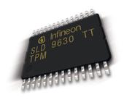
Trusted Platform Module (TPM)
Application
[BIOS, BootLoader, OS, App]
OS
Boot Loader
TPM
BIOS
TPM_Extend(Code)
TPM_Quote(BIOS, BootLoader, OS, App)
Notes:
Add TPM_Extend operation as well

Slide 22
SSC hypervisor
SDom0
UDom0
Domain Builder
SSC Hypervisor
Hardware
Equipped with a Trusted Platform Module (TPM) chip
Trusted Computing Base
Notes:
Only Domain builder has access to TPM

Slide 23
UDom0 Creation Protocol
Domain Builder
UDom0.img , Enc_{TPM}(KEY)
Domain Builder
Create
UDom0
Install (KEY)
KEY
TPM_Quote
Domain Builder
Secure Communication channel using (KEY)
UDom0
Client’s trust established
Notes:
Say this is simplified version

Slide 24
Conflicting interest
NO
data leaks or corruption
NO
illegal activities or botnet hosting
Client
Cloud Provider
SSC puts clients in control of their VMs
Sdom0 cannot inspect these VMs
Malicious clients can misuse privilege
Notes:
Third contribution

Slide 25

Mutually trusted services (MTS)
SDom0
MutuallyTrusted Service VM
UDom0
SSC Hypervisor
Hardware
Notes:
MTSD is a piece of code that is mutually agree upon and trusted by client and provider. MTSD runs in the client meta-domain and has enough privileges to inspect client VMs. Client can not effect the execution of MTSD other than that it is just like other service domains. So, MTSDs are used that client is not misbehaving…
Trustworthy metering
Have extra slide for limitations, new apps, future work

Slide 26
Developing MTS
Clients review MTSD code base
Restrict I/O channels of MTSD
Using third party attester (code verifiers)
Notes:
Title

Slide 27
SSC hypervisor
Client’s meta-domain
Domain Builder
Mutually
Trusted
Service VM
SDom0
UDom0
Service
VM
Work
VM
SSC hypervisor
Notes:
Stop and list/speak about three contributions
- CCS’12
- Work in progress

Slide 28

Traditional Cloud Control Plane
Node
Controller
Node
Controller
Cloud
Controller
Customer
Node
Controller
Cloud Infrastructure

Slide 29
Why new Control Plane for SSC
New capabilities provided by SSC
  Privileged access
  I/O interception
Low level management abstraction
  i.e. Udom0

Slide 30
New Capabilities provided by SSC
SDom0
Storage VM
Work VM
Disk
Security
VM
Work VM
Monitoring

Slide 31
Management abstraction
Udom0
Udom0
Complicates management
Malicious user

Slide 32
SSC Control Plane
VM specifications
Dashboard VM

Slide 33
VM specifications
Relationship among VMs
  Grant_privilege (VM₁, VM₂)
  Set_backend(VM₁, VM₂, [storage|network])
  Combination of above
Examples
  Grant_privilege(RootkitVM, WorkVM)
  Set_backend(Snort-VM, WorkVM, network)

Slide 34
Dashboard-VM
Web
Server
App
Server
App
firewall
NACL
Dashboard
VM
acts as Client
Consolidated
View
Cloud Infrastructure

Slide 35
SSC Control Plane
Cloud
Controller
VM placement
Udom0
Dashboard
VM
VM specs.
Udom0
Cloud Infrastructure
Notes:
Explain controllers in SSC

Slide 36
Evaluation
Goals
  Services
  Overhead of SSC
Dell PowerEdge R610
  24 GB RAM, 8 cores
All VMs (dom0, Sdom0, Udom0, SD)
  2 vcpus, 2 GB RAM
Notes:
We implemented SSC in XEN hypervisor
- Overhead over vanilla XEN

Slide 37
Case studies: Service VMs
Storage services
  Encryption storage, Integrity checking
Network services
  NACL, IDS/IPS, VMWall, Network Metering
Security services
  Memory Introspection, Syscall monitor
Checkpointing service
Memory deduplication

Slide 38
Storage encryption service VM
Dom0
Storage VM
Work VM
SDom0
Work VM
Encryption/
Decryption
Encryption /
Decryption
Disk
Disk
  Set_backend(EncVM, WorkVM, disk)
Platform | Unencrypted (MB/s) | Encrypted (MB/s)
Xen-legacy | 81.72 | 71.90
Self-service | 75.88 (7.1%) | 70.64 (1.5%)
Notes:
In vanilla XEN, Dom0 provides disk accesses to the work VMs. If we want encrypted disk transparent to work VMs,
We measured the throughput of disk accesses

Slide 39
Memory Introspection VM
Dom0
Work VM
Security
VM
Work VM
Security
daemon
  Grant_privilege(SecVM, WorkVM)
Platform | VM boot time (sec)
Xen-legacy | 6.471
Self-service | 6.487 (0%)
Notes:
Whenever work VM tries to execute a page, page fault is raised and handled by this MI tool which check if the hash of the page is good known hash.

Slide 40
VMWall – application firewall
Dom0
SDom0
VMWall
Work
VM
Work
VM
Memory
Introspection
VMWall
Daemon
Memory
Introspection
  Grant_privilege(VMWall, WorkVM)
  Set_backend(VMWall, WorkVM, net)
Platform | TCP connection setup (μsec)
Xen-legacy | 1014±6
Self-service | 1688±31 (66%)
Notes:
In vanilla XEN, Dom0 provides disk accesses to the work VMs. If we want encrypted disk transparent to work VMs,
We measured the throughput of disk accesses

Slide 41
Future work
VM placement
MTS verification
Real world deployment

Slide 42
Conclusion
Self-Service Cloud (SSC) computing
  protects client’s integrity and confidentiality
  provides flexible control to clients
Mutual trust
SSC Control Plane
Service VMs
Questions?
shakeelb@cs.rutgers.edu

Slide 44
Self-service model assurances
Protects client’s integrity and confidentiality
Flexibility to implement new services
BUT NO
  Vulnerabilities in client’s VM
  Availability or Denial of Service
  Protection against hardware attacks
  Protection against side channel attacks
Notes:
Goals/non-goals – provide/no provide
Protects from malicious/curious operators

Slide 45

VM Allocation
Cloud
Controller
VM placement
  Grant_privilege
  (SecVM,VM)
Dashboard
VM
Sdom0
Cloud Provider’s Infrastructure

Slide 46
VM Allocation
Sdom0
Udom0
Security VM
Client’s VM
Dashboard
VM
Self-service hypervisor
Hardware
Create Client controller (Udom0)
Create Security-VM and Work-VM
Notes:
Also talk about de-allocation

Slide 47
Examples specs
Rootkit detector
  Grant_privilege(RootkitVM, WorkVM)
NIDS
  Set_backend(Snort-VM, WorkVM, network)
VMWall
  Privilege_over (VMWall-VM, WorkVM)
  Set_backend(VMWall-VM, WorkVM, network)

Slide 48
VM migration in SSC
client
Management
VM
client
Management
VM
Service VM
Client’s VM
Service VM
Client’s VM
Self-service hypervisor
Self-service hypervisor
Hardware
Hardware
Notes:
- Concurrent VM migration

Slide 49
VM migration
client
Management
VM
Service VM
Client’s VM
Cloud
Controller
Self-service hypervisor
Hardware
VM migrate
client
Management
VM
Dashboard
VM
Service VM
Client’s VM
Self-service hypervisor
Hardware
Notes:
- Concurrent VM migration

Slide 50
VM Migration internals
Migrate(VM)
Iterative Push (VM)
Stop-and-copy(VM)
Resume destination(VM)
Done

Slide 51
Concurrent VM Migration
Migrate(VM₁)
Migrate(VM₂)
Iterative Push (VM₁)
Iterative Push (VM₂)
SYNC
Stop-and-copy(VM₂)
SYNC
Stop-and-copy(VM₁)
Resume destination(VM₁)
SYNC
Resume destination(VM₂)
Done
Done

Slide 52
Cloud infrastructure
Cloud
Controller
Sdom0
Udom0
Customer

Slide 53
SSC usage model
client
Management
VM
Service VM
Client’s VM
Physical
Machine
Self-service hypervisor
Hardware
Physical
Machine
Cloud Provider’s Infrastructure

Slide 54
Client’s VMs on multiple machines
client
Management
VM
client
Management
VM
Service VM
Client’s VM
Service VM
Client’s VM
Self-service hypervisor
Physical
Machine
Self-service hypervisor
Hardware
Hardware
Physical
Machine
Cloud Provider’s Infrastructure

Slide 55
Provider’s infrastructure exposure
Physical
Machine
Physical
Machine
Physical
Machine
Cloud Provider’s Infrastructure

Slide 56
VM specifications
Relationship among VMs
  Grant_privilege (VM₁, VM₂)
  Set_backend(VM₁, VM₂, [storage|network])
  Combination of above
Co-location dependencies (for Cloud Controller)
Ordering (for Dashboard-VM)
  Allocation, Deallocation, Migration

Slide 57
Cloud Management Platform
Node Controller
Cloud
Controller
Node Controller
Cloud Provider’s Infrastructure

Slide 58
