Slide 1
Complete Memory-Safety with SoftBoundCETS
Slides courtesy of
Prof. Santosh Nagarakatte

Slide 2
Project goal: Make C/C++ safe and secure
Why? Lack of memory safety is the root cause of serious bugs and security vulnerabilities

Slide 3




Security Vulnerabilities due to Lack of Memory Safety
Adobe Acrobat – buffer overflow
CVE-2013-1376- Severity: 10.0 (High)
January 30, 2014
Oracle MySQL – buffer overflow CVE-2014-0001 - Severity: 7.5 (High)
January 31, 2014
Firefox – use-after-free vulnerability CVE-2014-1486 - Severity: 10.0 (High)
February 6, 2014
Google Chrome– use-after-free vulnerability CVE-2013-6649 - Severity: 7.5 (High)
January 28, 2014
DHS/NIST National Vulnerability Database:
Last three months: 92 buffer overflow and 23 use-after-free disclosures
Last three years: 1135 buffer overflows and 425 use-after-free disclosures
Notes:
Comprehensive

Slide 4
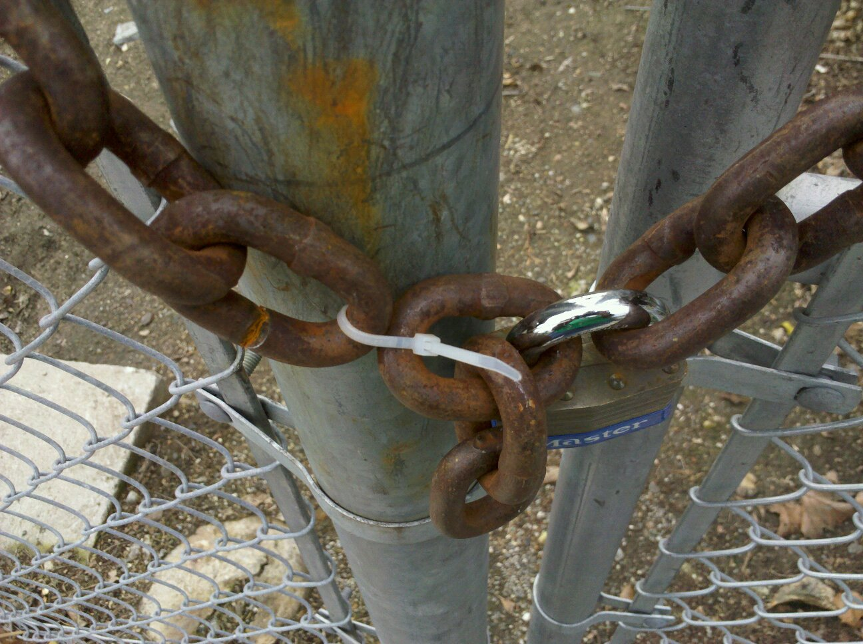
Lack of memory safety
Photo Credit: Roger Halbheer
Notes:
Add a slide here why memory safety?

Slide 5
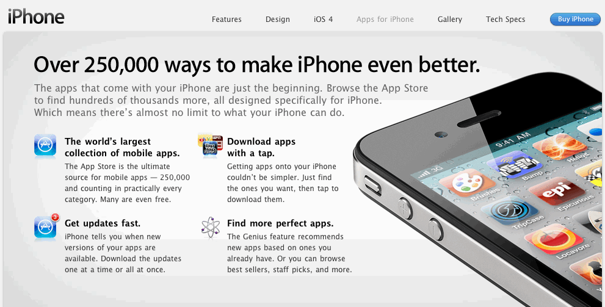
Nobody Writes New C Code, Right?
More than a million new C-based applications!
Over last few years, publically available. Evidence?
Notes:
Mention android

Slide 6
Background on Enforcing Memory Safety

Slide 7
Bounds Violation Example
memory
struct BankAccount {
char acctID[3]; int balance;
} b;
b.balance = 0;
char* ptr = &(b.acctID);
…
…
char* p = ptr;
…
…
do {
char ch = readchar();
*p = ch;
p++;
} while(ch);
memory
registers
acctID
reg
10
11
12
a
b
p
0x12
0x13
0x10
0x17
0x11
c
13
17
bal
0
10000
id
0x10
ptr
38
0x10
Notes:
Let illustrate a spatial violation example with a simple banking application which our famous bank uses.
It represents the account with a character array account ID and balance field. The account is laid out in memory as shown .
The program variable live in registers and memory. The banking application initializes the balance field to zero.
Creates a pointer to the id field. ID pointer lies in memory and is not register allocated. Later it copies to the id pointer to p
P is register allocated. Then p is used to input the accountId. As long as the user inputs 3 characters, everything is fine.
If user inputs more than 3 characters either by accident or because the user is malicious, the user can overwrite the balance field. Moreover, he can overwrite arbitrary regions of memory. If our bank uses this application, our bank is bound to incur huge losses. Our bank would like prevent it

Slide 8
Dangling Pointer Example
memory
registers
struct BankAcct *p, *q, *r;
…
q = malloc(sizeof(BankAcct));
…
r = q;
…
free(q);
…
p = malloc(10*sizeof(BankAcct));
….
*r = …..
memory
p
r
r
q
Notes:
done

Slide 9
What is Void * C?
int foo (void * c);

Slide 10
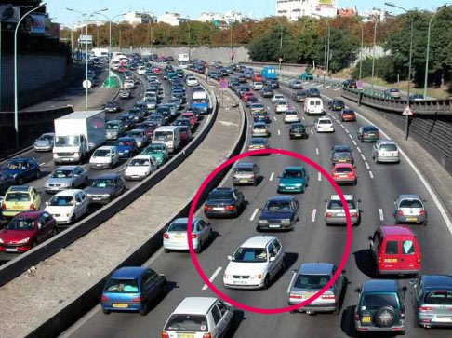
Abstractions Not Enforced!
Notes:
Lack of enforced abstractions, provides abstractions and does not ensure that the abstractions are preserved.

Slide 11
Pointer Based Checking
memory
memory
registers
id
reg
10
11
12
Ccured, MSCC, P&F, SafeC
Maintain metadata with pointers
Each pointer has a “view of memory it can access”
p
meta
13
17
bal
0
Fat
pointer
meta
Pointer based metadata for both registers and memory
38
ptr

Slide 12
Pointer Based Checking: Spatial Safety
memory
struct BankAccount {
char acctID[3]; int balance;
} b;
b.balance = 0;
char* ptr = &(b.acctID);
…
…
char* p = ptr;
…
do {
char ch = readchar();
*p = ch;
p++;
} while(ch);
memory
registers
base
id
reg
10
11
12
a
b
p
0x12
0x13
0x10
0x17
0x11
c
bound
13
17
bal
0
id
bound
bound
base
base
38
ptr

Slide 13
SoftBound Base/Bound Storage
Registers
For memory: hash table
Tagged, open hashing
Fast hash function (bitmask)
Nine x86 instructions
Shift, mask, multiply, add, three loads, cmp, branch
Alternative: shadow space
No collisions ➔ eliminates tag
Reduce memory footprint
Five x86 instructions
Shift, mask, add, two loads
Hash Table
tag
base
bound
Shadow
Space
base
bound
Notes:
Now that we have seen, that SoftBound metadata is on the side, lets see how we can organize it.
We can organize the metadata as a simple hash table.
….
Another alternative to the hash table would be to size the hash table sufficiently large, so that we can ensure there are no collisions, we can such an organization shadow space. This eliminates the tag field and tag checking.

Slide 14
Pointer Dereference Checks
All pointer dereferences are checked
if (p < p_base) abort();
if (p + size > p_bound) abort();
value = *p;
Five x86 instructions (cmp, br, add, cmp, br)
Bounds check elimination not focus
Intra-procedural dominator based
Previous techniques would help a lot
Notes:
Whenever a pointer is dereferenced, it is checked. Here pointer p is dereferenced. As with every pointer, p has its base and bound.
Dereference check essentially checks if pointer p is less than the base or is greater than the bound , then it aborts the program.
We use the size of dereference which is atmost the size of the machine word, to prevent a pointer to a character from reading an integer
This is essentially five x86 instructions

Slide 15
Pointer Creation
Heap Objects
Stack and Global Objects
p = malloc(size);
p_base = p;
p_bound = p + size;
int array[100];
p = &array;
p_base = p;
p_bound = p + sizeof(array);
Notes:
Pointer can be created in two ways. Heap objects are created using malloc If the returned pointer is non null, then we set the base to be the pointer and bound to be pointer plus the size.
With global and stack objects, the size of the object is known statically. Base and bound is set appropriately

Slide 16
Base/Bound Metadata Propagation
Pointer assignments and casts
Just propagate pointer base and bound
Loading/storing a pointer from memory
Loads/stores base and bound from metadata space
Pointer arguments to a function
Bounds passed as extra arguments (in registers)
int f(char* p) {…}
int _f(char* p, void* p_base, void* p_bound) {…}
Notes:
On pointer assignments, casts. The base and bound is propogated without any modification
On a load or a store of a pointer, the base and bound is loaded or stored from the disjoint metadata space

Slide 17
Pointers to Structure Fields
struct {
char acctID[3]; int balance;
} *ptr;
char* id = &(ptr->acctID);
option #1
Entire Structure
option #2
Shrink to Field Only
id_base = ptr_base;
id_bound = ptr_bound;
id_base = &(ptr->acctID);
id_bound = &(ptr->acctID) + 3;
Programmer intent ambiguous;
optional shrinking of bounds
Notes:
What should we do when we create a pointer to a structure field. Similar to the bank account example. We are creating a pointer to the accountID. Should the bounds be that of the entire structure or should it be bounds of the field.
Programmer intent is generally ambiguous and provides optional shrinking of bounds

Slide 18
Pointer Based Checking: Temporal Safety
struct foo *q, *r;
struct bar *p;
…
q = malloc(sizeof(struct foo));
…
r = q;
…
free(q);
…
p = malloc(sizeof(struct bar));
….
*r = …..
memory
reg
memory
ID#2
p
r
r
unique identifier with pointers
ID#1
ID#1
Valid IDs:
#1
Valid IDs:
#2
Valid IDs:
q
Maintain the set of valid identifiers

Slide 19
Pointer Based Checking: Lock & Key
memory
Split identifier
Lock & Key
Invariant: valid if
memory[lock] == ptr.key
Allocation
memory[lock] = key
Check: exception if
memory[lock] != key
Deallocation
memory[lock] = 0
memory
lock
0xF8
key
ID#1
#42
q
0xF8
#0
#42

Slide 20
Disjoint Metadata
memory
memory
registers
id
reg
10
11
12
a
Memory layout changed ➔ library compatibility lost
Arbitrary type casts ➔ comprehensiveness lost
b
p
c
13
17
bal
0
metadata
Meta data
meta
38
ptr
metadata

Slide 21
Real World ‘C’ with Disjoint Metadata
Key issue: type casts
Disallow casts??
Insight: casts can only manufacture pointers but not metadata
struct foo{
int* arr;
size_t b;
} ;
struct bar{
size_t x;
size_t y;
};
memory
arr
p
meta
struct foo *p;
struct bar *q;
...
q = (struct bar *) p;
…
*q = …
b
b

Slide 22
Accesses to Disjoint Metadata Space
int *p;
int **q;
…
p_meta = load_meta(q);
p = *q;
Metadata accesses using address of the pointer than what pointer points to

Slide 23
How Do We Organize the Metadata Space?
Shadow entire virtual address space
Allocate entries on demand
32 bytes metadata for every word
12 x86 instructions
(6 loads/stores, 2 adds, 2 shift, mov and mask)
Translation using a trie, a page table like structure
address
trie root
r
+
+
base
bound
key
lock

Slide 24
Performance Design Choice
Design choice: Metadata only with pointers
Programs primarily manipulate data
Metadata propagation on only pointer operations
Type casts between pointers is allowed
Casting an integer to a pointer is disallowed
Pointer obtains NULL/Invalid metadata
Dereferencing such a pointer would raise exception
Disjoint metadata accesses are expensive
Metadata with non-pointers➔ Performance overhead

Slide 25
Pointer Metadata Allocation/Propagation
Memory allocation
Memory deallocation
p = malloc(size);
check_double_frees();
p_base = p;
p_bound = p + size;
free(p);
*(p_lock) = INVALID_KEY;
deallocate_lock(p_lock);
p_key = allocate_key():
p_lock = allocate_lock();
p = q + 10;
p_base = q_base;
p_bound = q_bound;
p_key = q_key;
p_lock = q_lock;
Pointer arithmetic/copies

Slide 26
Summary: Pointer Based Disjoint Metadata
memory
disjoint metadata
Bounds Check
Easy once you have “base” & “bound”
memory
Meta data
base
bound
lock
key
0x10
0x11
0x12
p
0x13
0x15
0xF8
#42
Temporal Check
Check if
key = mem[lock]
0x13
0x14
0x15
0x16
0x17
id
0
bal
Disjoint shadow space
Memory layout intact
Protects metadata
Allocated on-demand
But, hurts locality
0x38
q
0x15
0x17
0xF8
#42
0xF8
#42
Notes:
need to mention about arbitrary casts and its implication on cast somewhere

Slide 27
Where to Perform Pointer-Based Checking?
Compiler instrumentation
provides best
of both
Source-to-source translation
Pointers are readily available
Added code confuses the optimizer
Compiler instrumentation
Pointers need to be optimized
Can operate on optimized code
Binary instrumentation
Pointer identification is hard
Extra code translates into overhead
Hardware injection
Pointers identifications is hard
Streamlined injection necessary
Hardware
injection
can streamline
the extra code
added

Slide 28
SoftBoundCETS Compiler Instrumentation
Goal: reduce performance overheads
How to identify pointers?
How to propagate metadata across function calls?
How to perform instrumentation?
Approach: perform instrumentation over LLVM IR

Slide 29
Background on LLVM IR – C Code
struct node_t {
size_t value;
struct node_t* next;
};
typedef struct node_t node;
int main(){
node* fptr = malloc(sizeof(node));
node* ptr = fptr;
fptr -> value = 0;
fptr -> next = NULL;
for (i= 0; i < 128 ; i++){
node* new_ptr = malloc(sizeof(node));
new_ptr->value = I;
new_ptr->next = ptr;
ptr = new_ptr;
}
fptr->next = ptr;
}
Pointer store
Pointer store
Notes:
Just a pedantic example to illustrate how we use pointer information

Slide 30
Background on LLVM IR
Explicitly typed
%node_t = type {i64, node_t*};
define i32 @main(i32 %argc, i8** argv){
entry:
%call = call i8* malloc(i64 16)
%0 = bitcast i8* %cal to %node_t*
%value = gep %node_t* %0, i32 0, i32 0
store i64 0, i64* %value
%next = gep %node_t* %0, i32 0, i32 1
store %node_t* null, %node_t** next
br label %for.cond
for.cond:
%ptr.0 = phi %node_t* [%0, %entry], [%1, %for.inc]
%i.0 = phi i64 [0, %entry], [%inc, %for.inc]
%cmp = icmp ult i64 %i.0, 128
br i1 %cmp, label %for.body, label %for.end
Pointer arithmetic using gep
IR is in SSA
phi nodes merge values from predecessors

Slide 31
How Do We Instrument IR Code?
Introduce calls to C functions
Checks, metadata accesses all written in C code
SoftBoundCETS Instrumentation Algorithm
Operates in three passes
First pass introduces temporaries for metadata
Second pass populates the phi nodes
Third pass introduces calls to check handlers
Simple linear passes over the code, enabled us extract an implementation from the proofs

Slide 32
Exploring the Hardware/Software Continuum
Watchdog
High
Hardware Modifications
SoftBound
None
None
High
Runtime Overhead
Compiler does pointer identification and metadata propagation and hardware accelerates checks

Slide 33
Hardware vs Software Implementation
Task | Watchdog [ISCA 2012] | SoftBoundCETS [PLDI 2009, ISMM 2010]
Pointer detection | Conservative | Accurate with compiler
Op Insertion | Micro-op injection | Compiler inserted instructions
Metadata Propagation | Copy elimination using register renaming | Standard dataflow analysis
Checks | + fast checks (implicit) - no check optimization | - Instruction overhead + Check optimization
Metadata Loads/Stores | + Fast lookups | - Instruction overhead
Notes:
Add ISCA 2012/PLDI 2009

Slide 34
Hardware vs Software Implementation
Task | Watchdog [ISCA 2012] | SoftBoundCETS [PLDI 2009, ISMM 2010]
Pointer detection | Conservative | Accurate with compiler
Op Insertion | Micro-op injection | Compiler inserted instructions
Metadata Propagation | Copy elimination using register renaming | Standard dataflow analysis
Checks | + fast checks (implicit) - no check optimization | - Instruction overhead + Check optimization
Metadata Loads/Stores | + Fast lookups | - Instruction overhead
Notes:
Add ISCA 2012/PLDI 2009

Slide 35
Hardware vs Software Implementation
Task | Watchdog [ISCA 2012] | SoftBoundCETS [PLDI 2009, ISMM 2010]
Pointer detection | Conservative | Accurate with compiler
Op Insertion | Micro-op injection | Compiler inserted instructions
Metadata Propagation | Copy elimination using register renaming | Standard dataflow analysis
Checks | + fast checks (implicit) - no check optimization | - Instruction overhead + Check optimization
Metadata Loads/Stores | + Fast lookups | - Instruction overhead
Notes:
Add ISCA 2012/PLDI 2009

Slide 36
Hardware vs Software Implementation
Compiler can do these tasks efficiently
Task | Watchdog [ISCA 2012] | SoftBoundCETS [PLDI 2009, ISMM 2010]
Pointer detection | Conservative | Accurate with compiler
Op Insertion | Micro-op injection | Compiler inserted instructions
Metadata Propagation | Copy elimination using register renaming | Standard dataflow analysis
Checks | + fast checks (implicit) - no check optimization | - Instruction overhead + Check optimization
Metadata Loads/Stores | + Fast lookups | - Instruction overhead
Hardware can accelerate checks & metadata accesses
Notes:
Add ISCA 2012/PLDI 2009

Slide 37
Hardware Support
Hardware acceleration with new instructions for compiler based pointer checking
Instructions added to the ISA
Bounds check & use-after-free check instructions
Metadata load/store instructions
Pack four words of metadata into a single wide register
Single wide load/store → eliminates port pressure
Avoid implicit registers for the new instructions
Reduces spills/restores due to register pressure

Slide 38
Spatial (Bound) Check Instruction
int p;
…
p = *q;
if( q < q_base ||
q + sizeof(int) >= q_bound){
abort();
}
Schk.size imm(r1), ymm0
Supports all addressing modes
Size of the access encoded
Operates only on registers
Executes as one micro-op
Latency is not critical
5 instructions for the spatial check

Slide 39
Temporal (Use-After-Free) Check Instruction
int p;
…
p = *q;
if( q_key!= *q_lock){
abort();
}
Tchk ymm0
Performs a memory access
Executes as two micro-ops
Latency is not critical
3 instructions for the temporal check

Slide 40
Metadata Load/Store Instructions
int *p, **q;
…
p = *q;
..
*q = p
p_metadata = table_lookup(q);
Metaload %ymm0, imm(%rax)
table_lookup(q) = p_metadata
Metastore imm(%rax), %ymm0
Performs a wide load/store
Executes as two micro-ops
– address computation
-- wide load/store uop
Shadow space for the metadata
14 instructions for the metadata load
16 instructions for the metadata store

Slide 41
See Papers For ….
Compiler transformation to use wide metadata
Metadata organization
Check elimination effectiveness
Effectiveness in detecting errors
Narrow mode instructions
Comparison of related work

Slide 42
Evaluation

Slide 43
Three questions
Effective in detecting errors?
Compatible with existing C code?
Reasonable overheads?

Slide 44
Memory Safety Violation Detection
Effective in detecting errors?
NIST Juliet Suite – 50K memory safety errors
Synthetic attacks [Wilander et al]
Bugbench [Lu05]: overflows from real applications
Found unknown new bugs
H.264, Parser, Twolf , Em3d, Go, Nullhttpd, Wu-ftpd, ..
Benchmark | SoftBoundCETS | Mudflap | Valgrind
Go | Yes | No | No
Compress | Yes | Yes | Yes
Polymorph | Yes | Yes | No
Gzip | Yes | Yes | Yes

Slide 45
Source Compatibility Experiments
Compatible with existing C code?
Approximately one million lines of code total
35 benchmarks from Spec, Olden
BugBench, GNU core utils, Tar, Flex, …
Multithreaded HTTP Server with CGI support
FTP server
Separate compilation supported
Creation of safe libraries possible
Notes:
why bounds checking is hard, hard to typecheck, why is it hard to propagate metadata

Slide 46
Evaluation – Performance Overheads
Average
overhead
of 29%
Timing simulations of wide-issue out-of-order x86 core
Average performance overhead: 29%
Reduces average from 90% with SoftBoundCETS

Slide 47
Remaining Instruction Overhead
Average instruction overhead reduces to 81% (from 180% with SoftBoundCETS)
Spatial checks → better check optimizations can help
Lea instructions → change code generator

Slide 48
Intel MPX
In July 2013, Intel MPX announced ISA specification
Similar hardware/software approach
Pointer-based checking: base and bounds metadata
Disjoint metadata in shadow space
Adds new instructions for bounds checking
Differences
Adds new bounds registers vs reusing existing AVX registers
Changes calling conventions to avoid shadow stack
Backward compatibility features
Interoperability with un-instrumented and instrumented code
Validates metadata by redundantly encoding pointer in metadata
Calling un-instrumented code clears bounds registers
Does not perform use-after-free checking

Slide 49
Conclusion
Safety against buffer overflows & use-after-free errors
Pointer based checking
Bounds and identifier metadata
Disjoint metadata
SoftBoundCETS with hardware instructions
Four new instructions for compiler-based pointer checking
Four new instructions
Packs the metadata in wide registers
High
Leveraging the compiler enables our proposal to use simpler hardware for comprehensive memory safety
Hardware Modifications
None
None
High
Ideal
Runtime Overhead
Notes:
Add conclusion section

Slide 50
Thank You
Try SoftBoundCETS for LLVM-3.4
http://github.com/santoshn/softboundcets-34/

